Slide 2














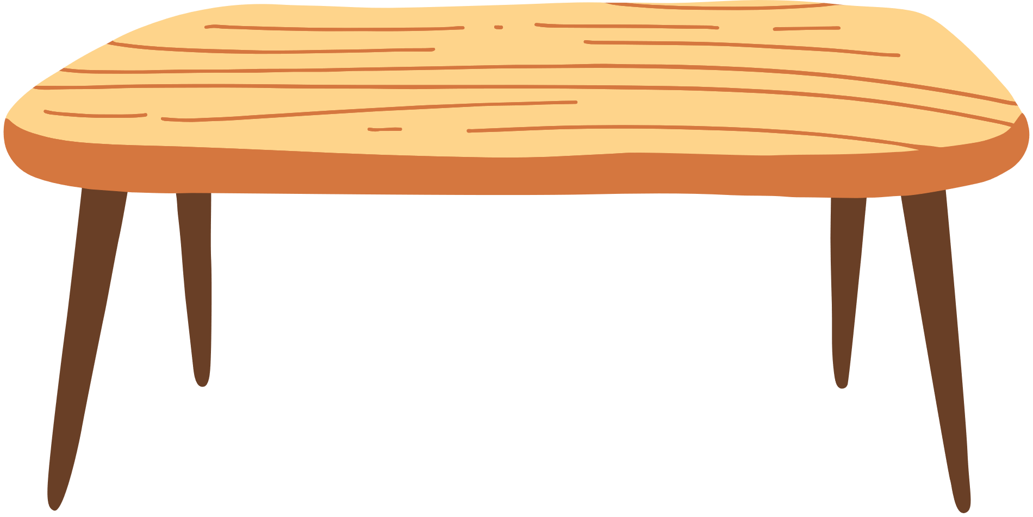
Unit 9
What time is it?
Lesson 6 – Skills time! – Period 2

Slide 3
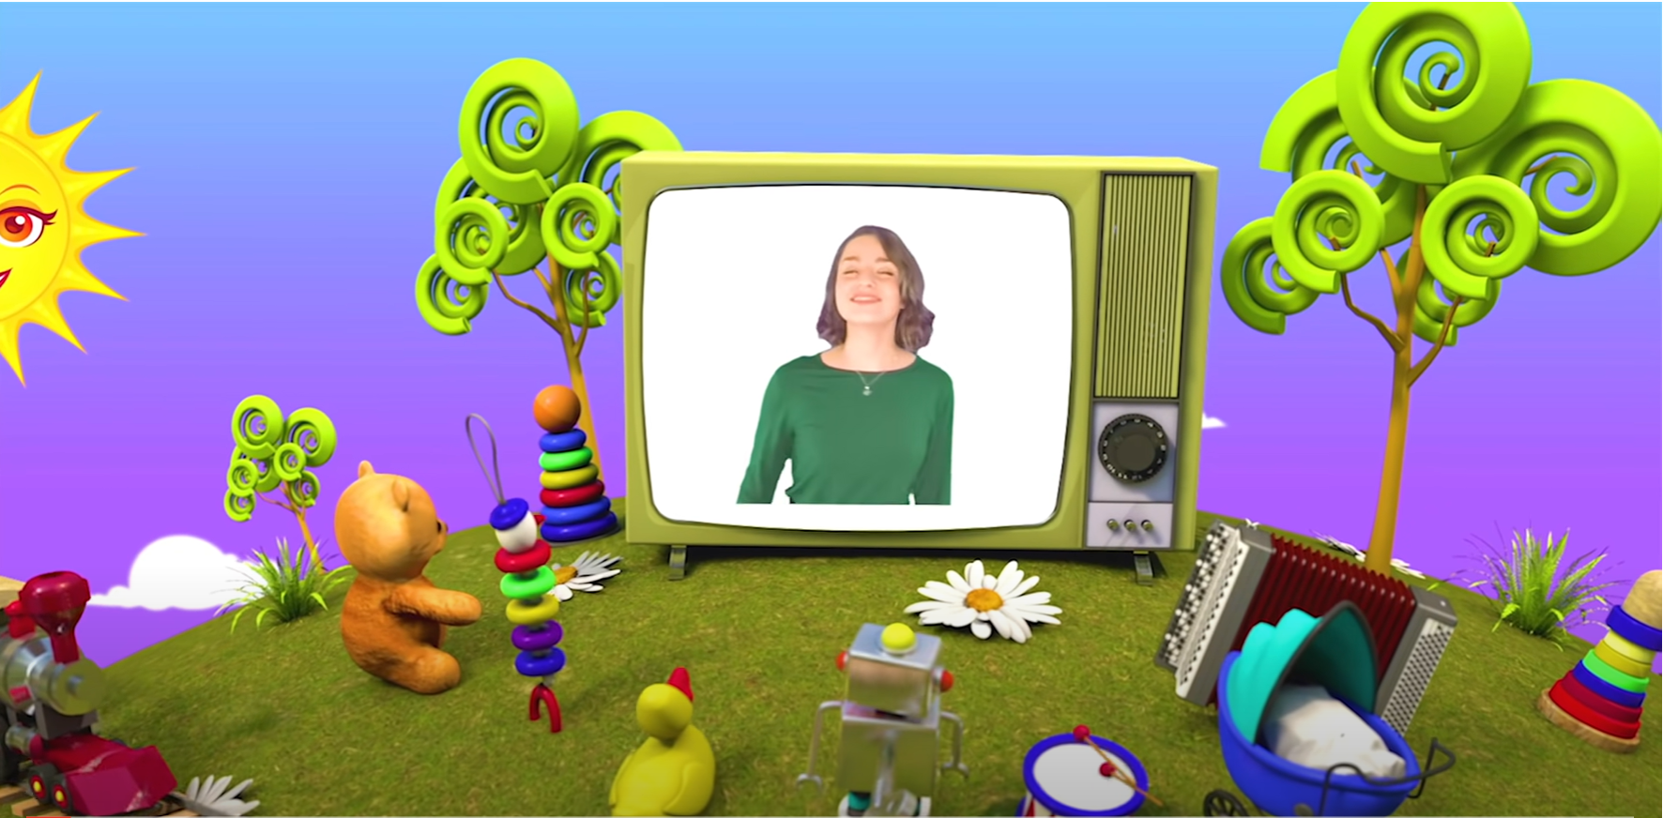

HELLO SONG
Notes:
https://www.youtube.com/watch?v=pqDEwPi7vxg

Slide 4




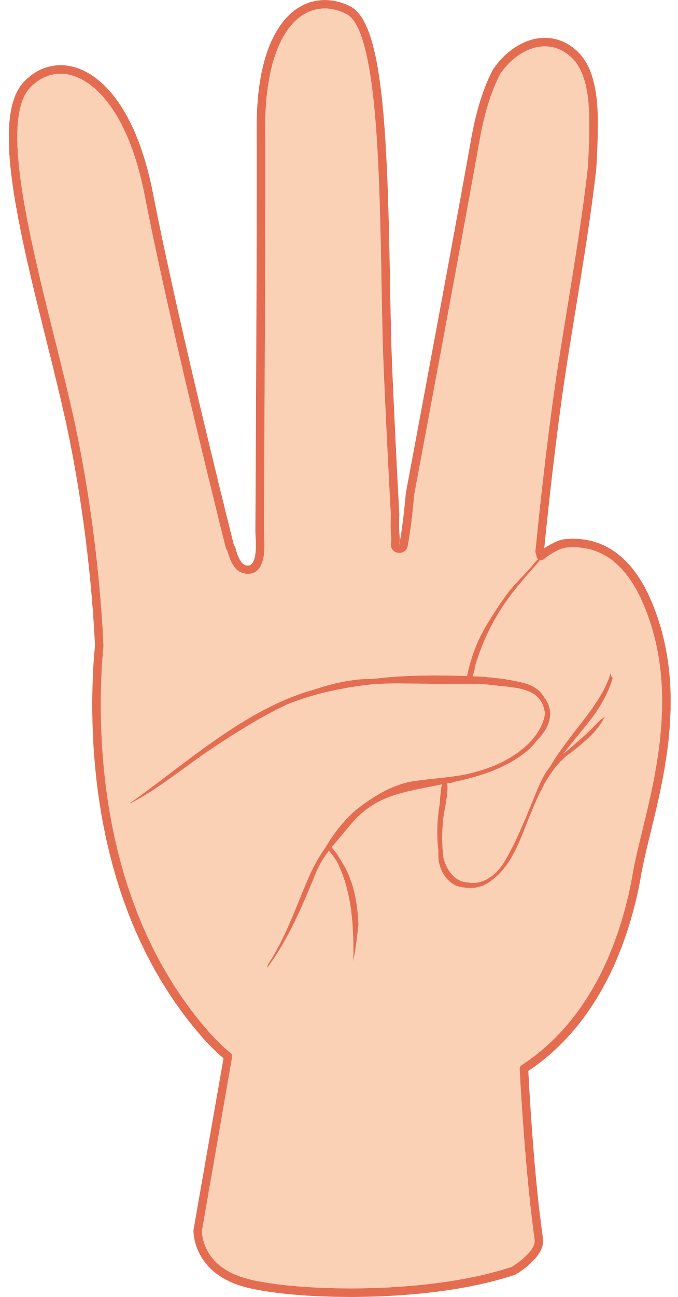


Slide 5


Watch a video
Notes:
* Warmer:
- Sing a song altogether with actions.

Slide 6
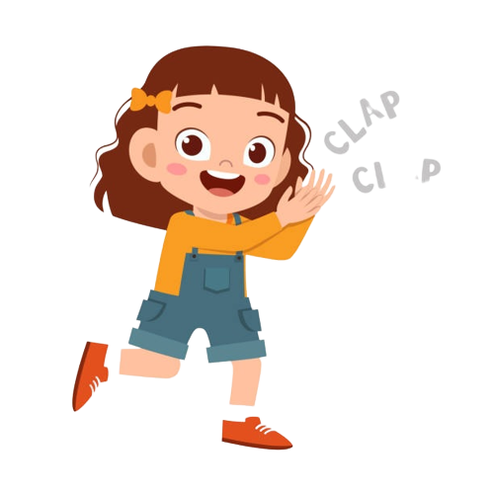
Good job!

Slide 7
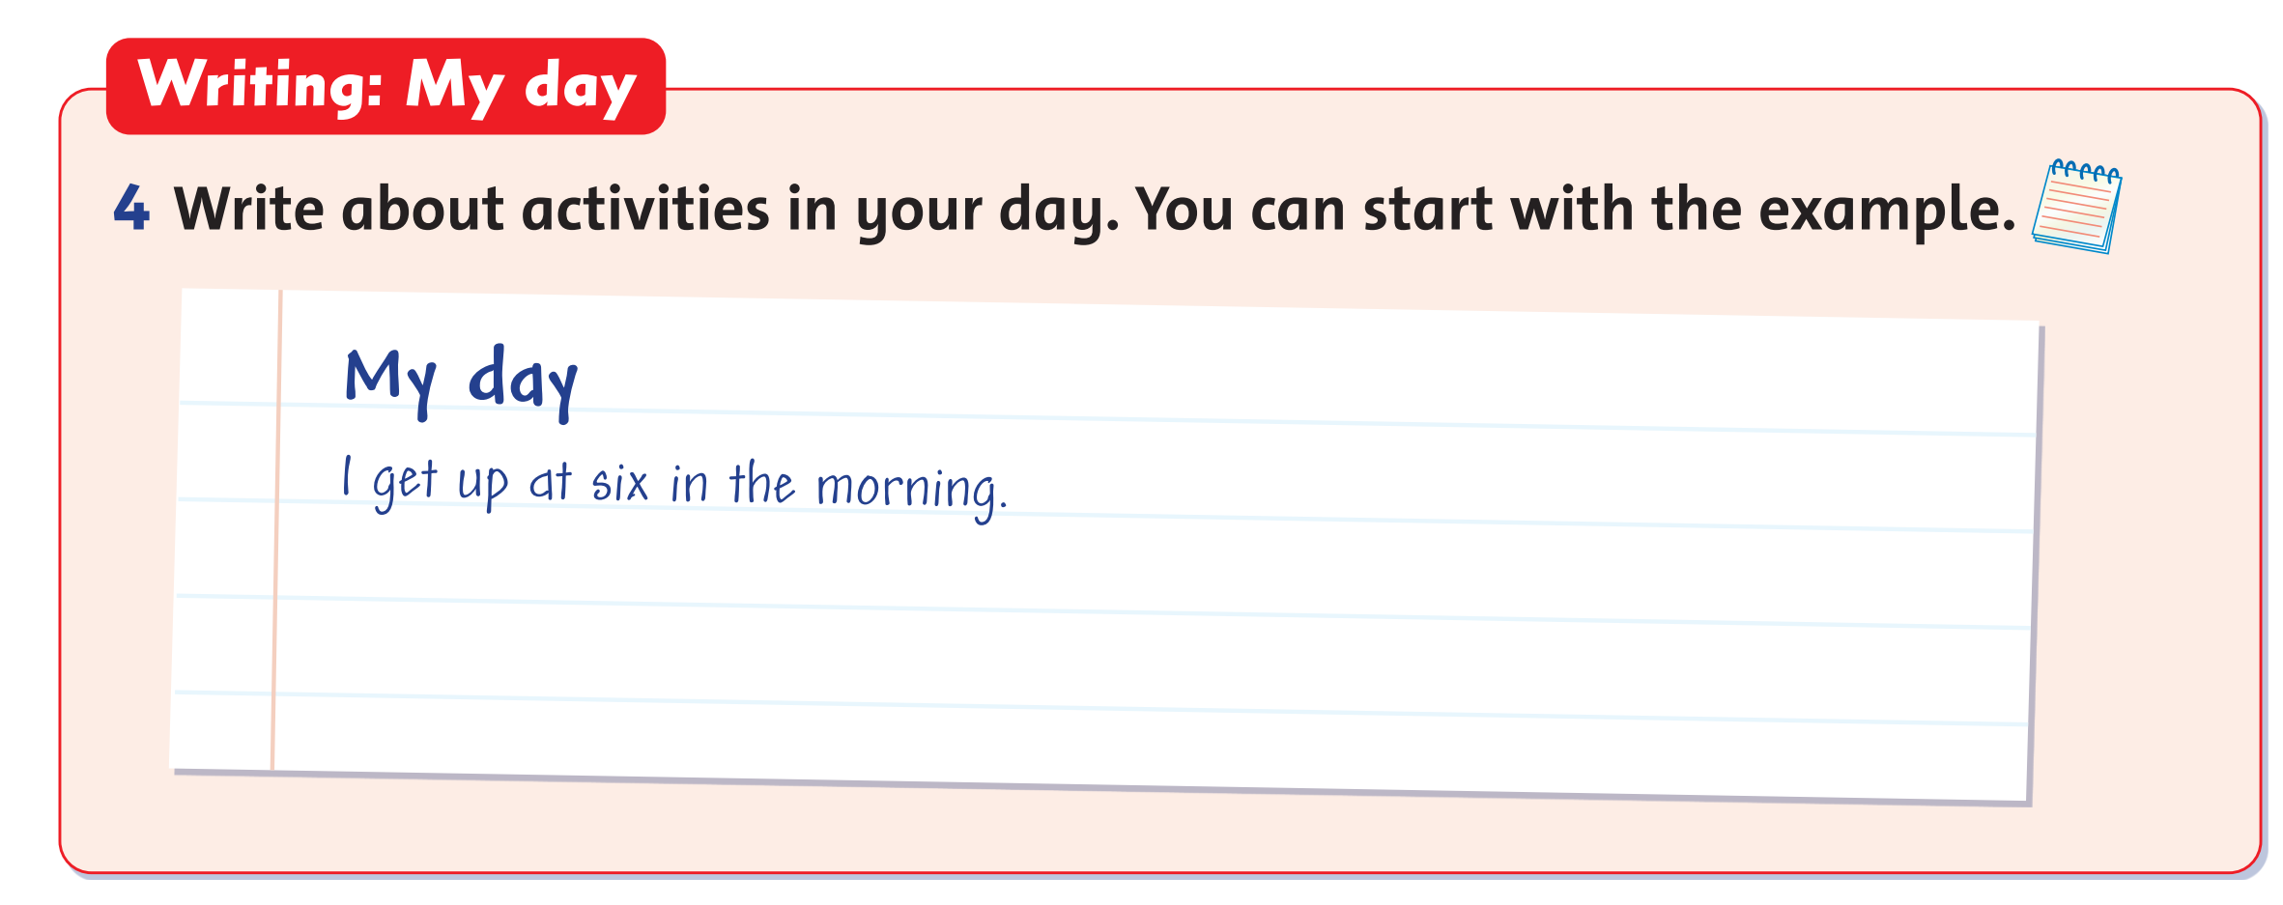
Let’s write! - MY DAY
My day
I get up at six in the morning.
Notes:
* Write about activities in your day. You can start with the example.
Focus on the example text. Ask the children to read it, and ask them if their day is different, and how. Ask them to think about times of the day and activities.
Ask the children to write a similar text about activities in their day in their notebooks.

Slide 8


Let’s write!
MY DAY
Notes:
In 5 minutes, ask children to write their weather report in their notebooks.

Slide 9

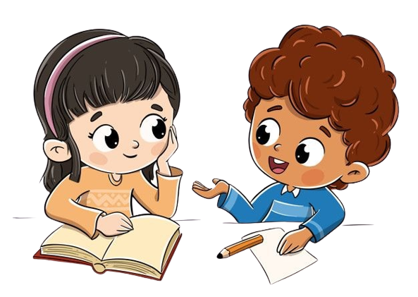
Work in Pairs.
Notes:
Children work in pairs to read their writing to each other.
Invite some volunteer to rea aloud their report in the front.

Slide 10
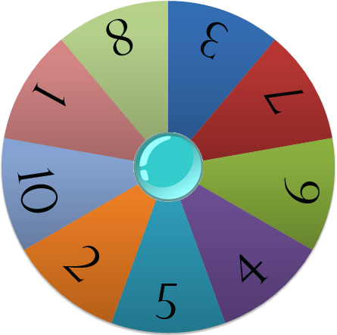
Let’s talk!
Start
Notes:
Number children from number 1 to 10.
Click START to spin the wheel.
The children with that number will talk about their thank-you card in the front.

Slide 11
Good job!

Slide 12




We go to school
by bus at 7 o’clock.
LISTENING PRACTICE
DAILY ROUTINES

Slide 13



Say what Tim does.
Then listen and click the right words.
morning
up
early
on
wake
bed
he
late
in
tired
o´clock
wakes
gets
very
Check the sentence here.
He wakes up very early.

Slide 14
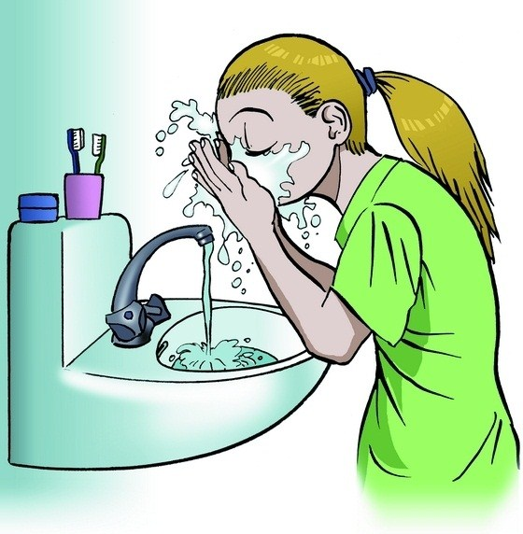

Say what Sue does.
Then listen and click the right words.
hands
she
wash
water
clean
teeth
soap
cleans
face
washes
brush
after
his
her
Check the sentence here.
She washes her face.

Slide 15

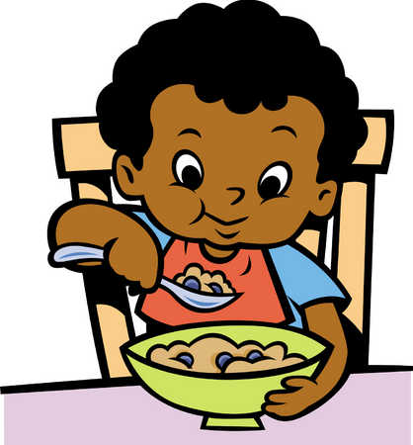
Say what Rob does.
Then listen and click the right words.
breakfast
milk
eat
for
have
he
she
eats
has
coffee
tea
makes
cereals
in
Check the sentence here.
He has cereals for breakfast.

Slide 16

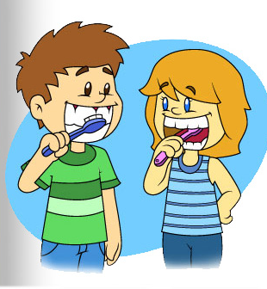
Say what they do.
Then listen and click the right words.
brush
at
before
his
six
her
their
they
wash
teeth
my
tooth
brushes
for
Check the sentence here.
They brush their teeth at six.

Slide 17
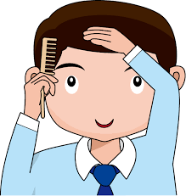
Say what Mike does.
Then listen and click the right words.
combs
her
brushes
hare
has
she
washes
his
always
comb
morning
hair
he
after
Check the sentence here.
He always combs his hair.

Slide 18
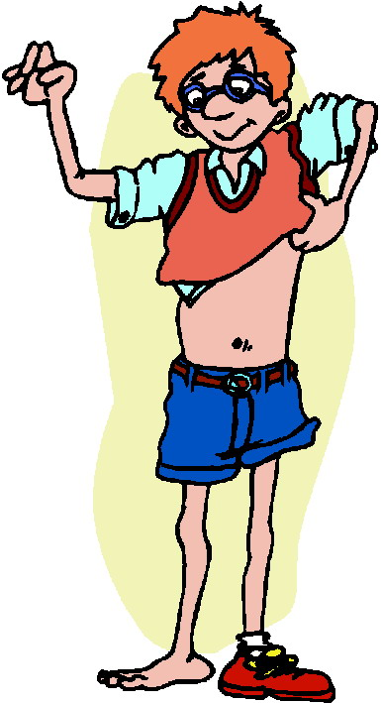
Say what Richard does.
Then listen and click the right words.
the
his
clothes
gets
in
shoe
get
dress
dressed
on
after
he
she
bedroom
Check the sentence here.
He gets dressed in the bedroom.

Slide 19
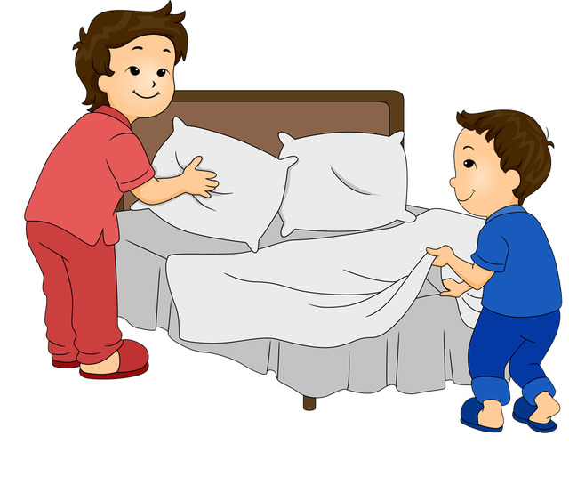
Say what they do.
Then listen and click the right words.
their
they
school
makes
make
before
do
to
after
going
the
does
at
bed
Check the sentence here.
They make the bed before going to school.

Slide 20

Say what they do.
Then listen and click the right words.
walks
school
go
always
for
home
leave
to
they
foot
car
runs
the
on
Check the sentence here.
They always go to school on foot.

Slide 21



Say when his lessons start.
Then listen and click the right words.
starts
o’clock
half
never
nine
lessons
start
to
minutes
past
eight
his
at
quarter
Check the sentence here.
His lessons start at half past eight.

Slide 22
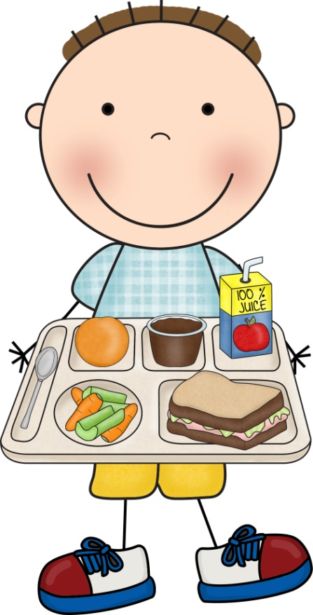
Say what Billy does.
Then listen and click the right words.
has
canteen
eat
in
have
food
the
he
dinner
takes
school
her
for
lunch
Check the sentence here.
He has lunch in the school canteen.

Slide 23
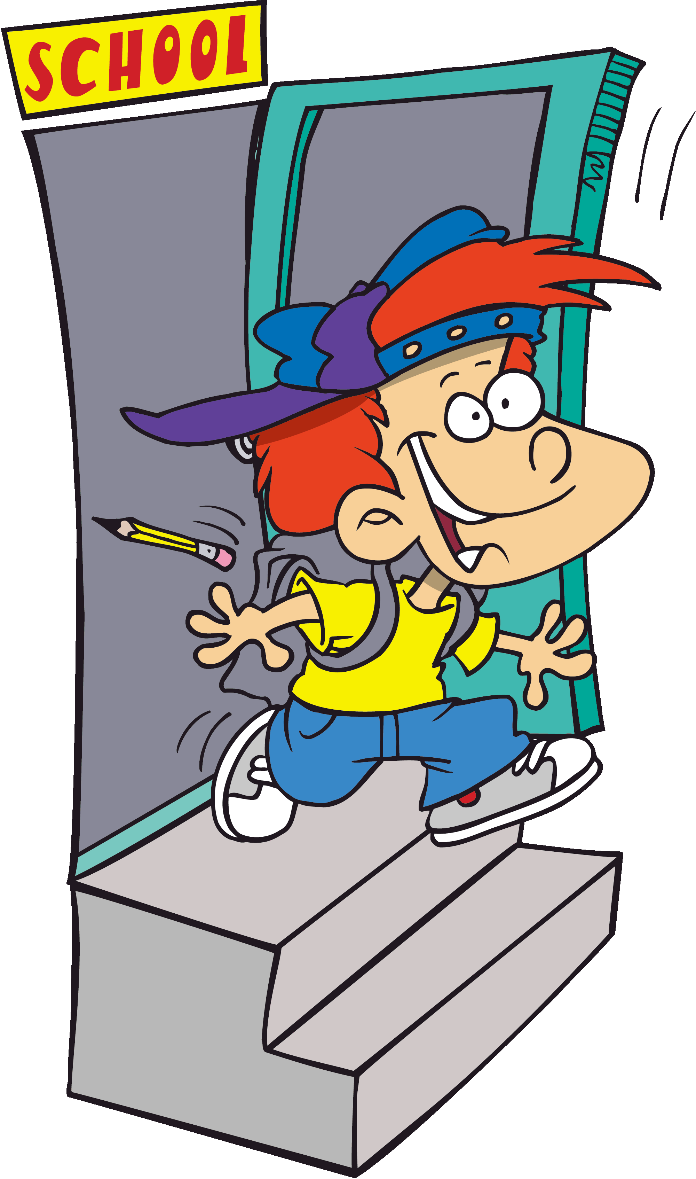
Say what Michael does.
Then listen and click the right words.
and
end
for
to
school
goes
home
go
walks
he
leave
his
leaves
begins
Check the sentence here.
He leaves school and goes home.

Slide 24
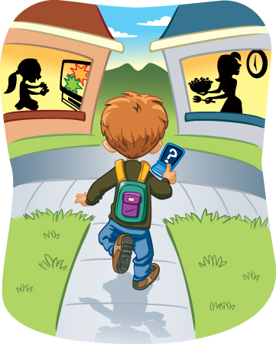

Say what Ryan does.
Then listen and click the right words.
a
to
fifteen
he
half
quarter
arrive
arrives
at
past
three
two
home
o’clock
Check the sentence here.
He arrives home at a quarter past two.

Slide 25

Say what Sarah does.
Then listen and click the right words.
make
does
study
his
her
makes
write
do
never
homework
she
afternoon
books
plays
Check the sentence here.
She does her homework.

Slide 26
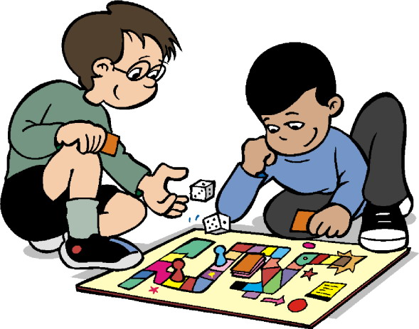
Say what Seth does. Then listen and click the right words.
games
play
board
at
a
with
home
have
plays
his
friend
video
to
he
Check the sentence here.
He plays board games with a friend.

Slide 27
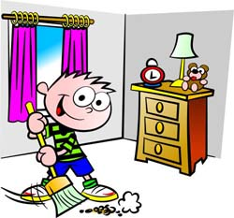
Say what Paul does.
Then listen and click the right words.
he
afternoon
clean
room
washes
never
kitchen
in
does
his
she
the
cleans
broom
Check the sentence here.
He cleans his room in the afternoon.

Slide 28
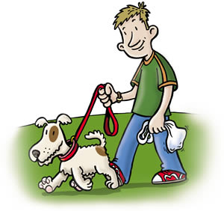
Say what Simon does.
Then listen and click the right words.
the
a
take
her
walk
for
run
park
his
on
in
he
dog
takes
Check the sentence here.
He takes his dog for a walk in the park.

Slide 29
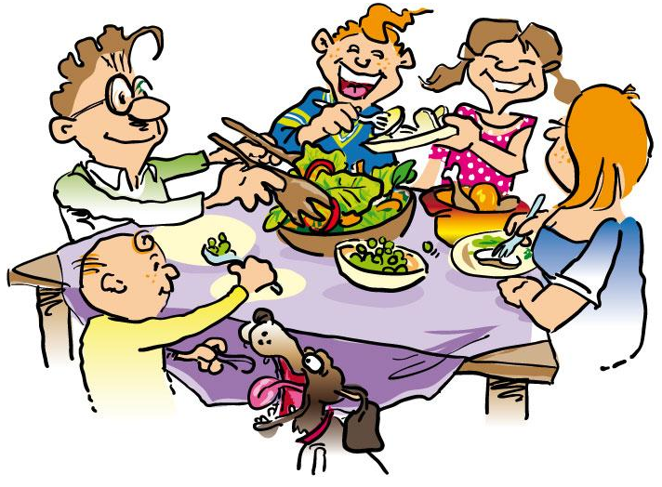
Say what Susie does.
Then listen and click the right words.
eats
lunch
his
at
family
eat
have
with
she
dog
makes
tea
dinner
her
Check the sentence here.
She eats dinner with her family.

Slide 30

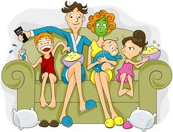
Say what they do.
Then listen and click the right words.
before
they
eat
in
cinema
dinner
TV
family
watches
washes
looks
after
watch
see
Check the sentence here.
They watch TV after dinner.

Slide 31
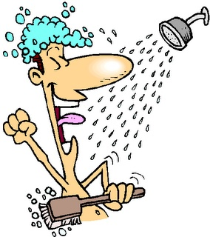
Say what Phil does.
Then listen and click the right words.
bath
a
he
night
have
has
bathroom
takes
take
washes
wash
shower
quick
water
Check the sentence here.
He takes a quick shower.

Slide 32


Say what his father does.
Then listen and click the right words.
a
his
bed
he
reads
read
bedtime
does
her
father
in
time
him
story
Check the sentence here.
His father reads him a bedtime story.

Slide 33


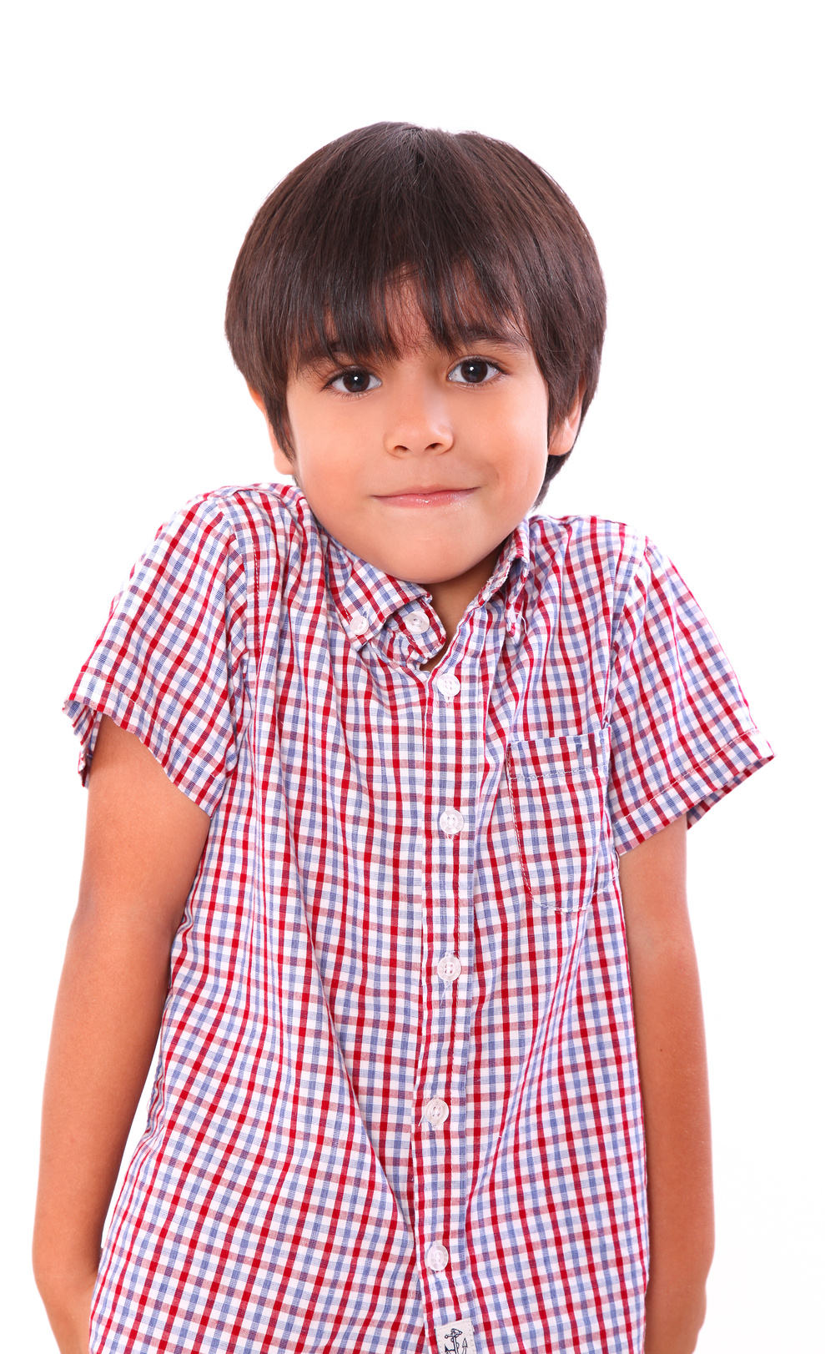
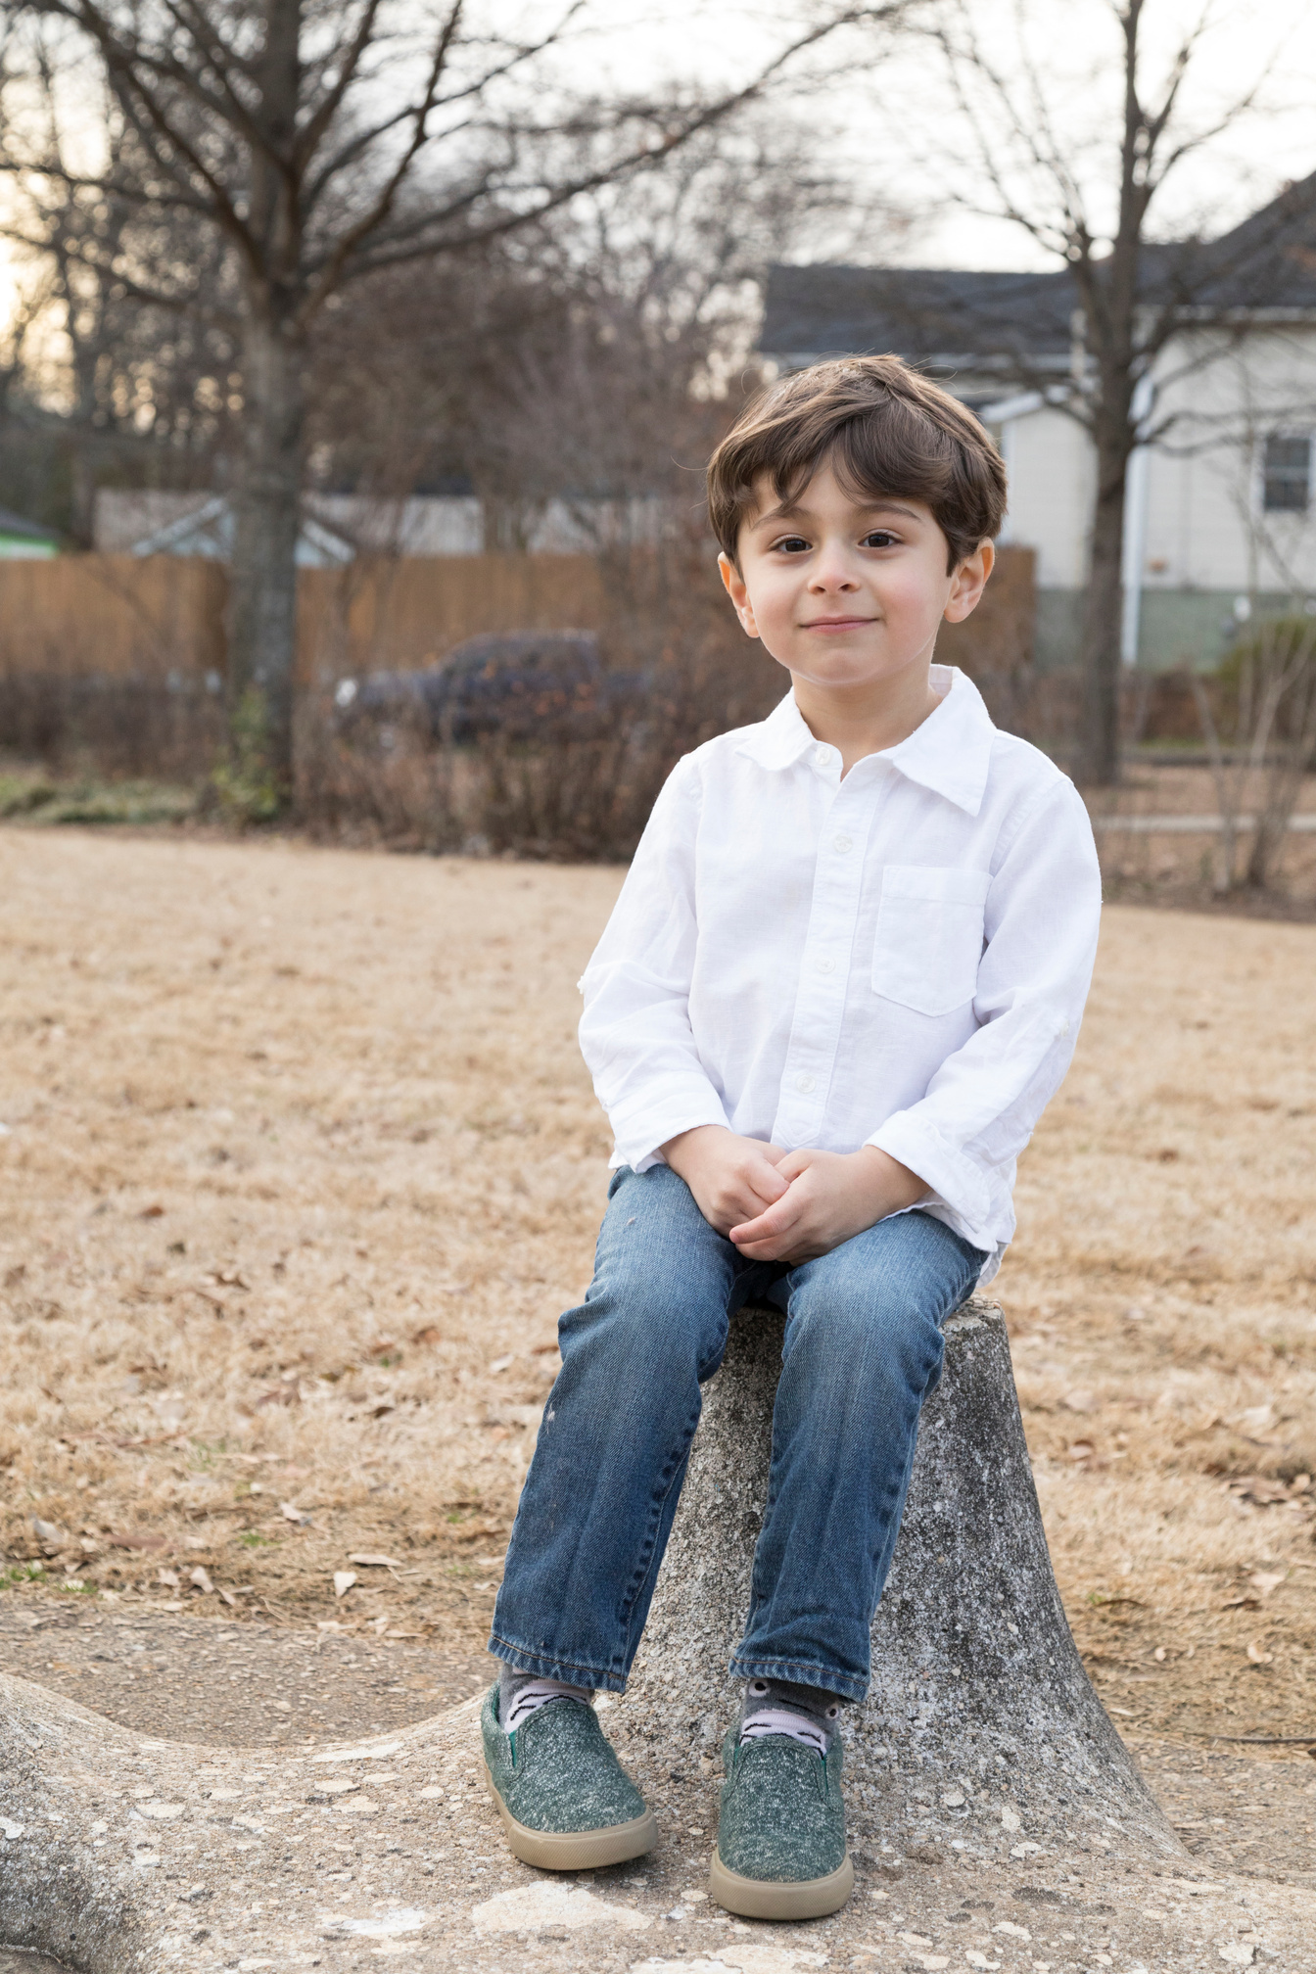
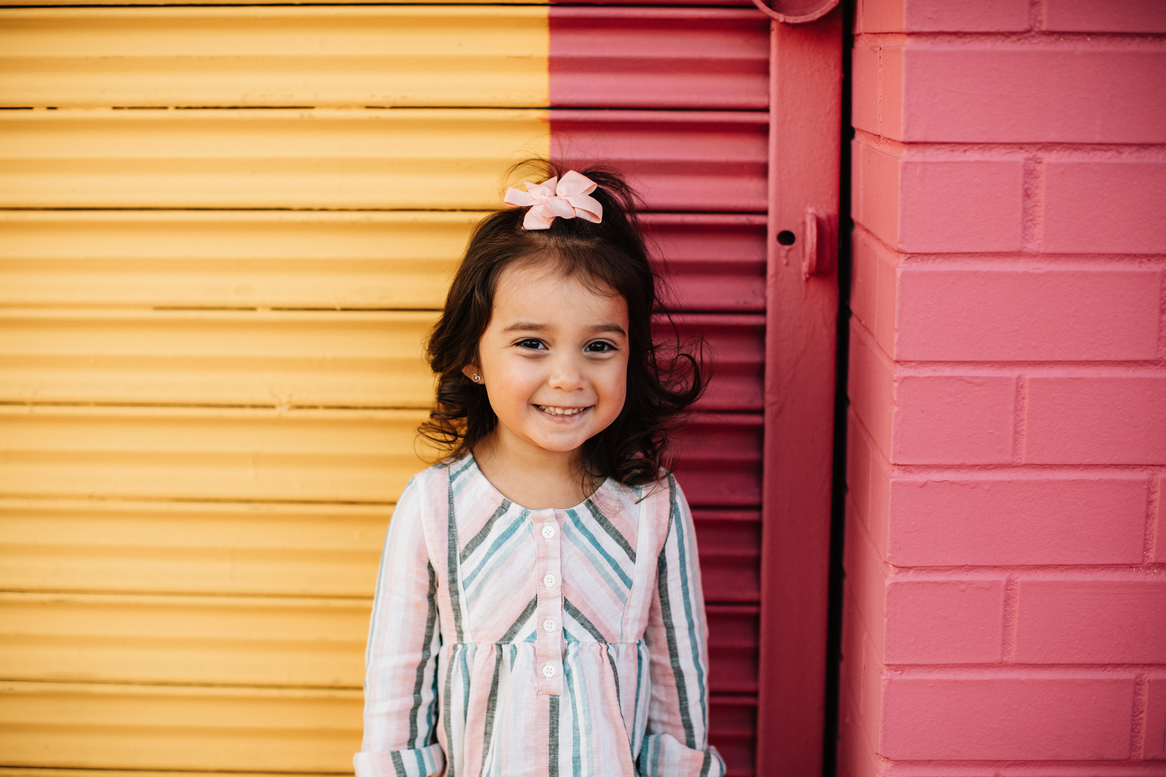
Our Winners!
Peter
Eric
Julie
Notes:
Replace photos and names with your students’ information.

Slide 34


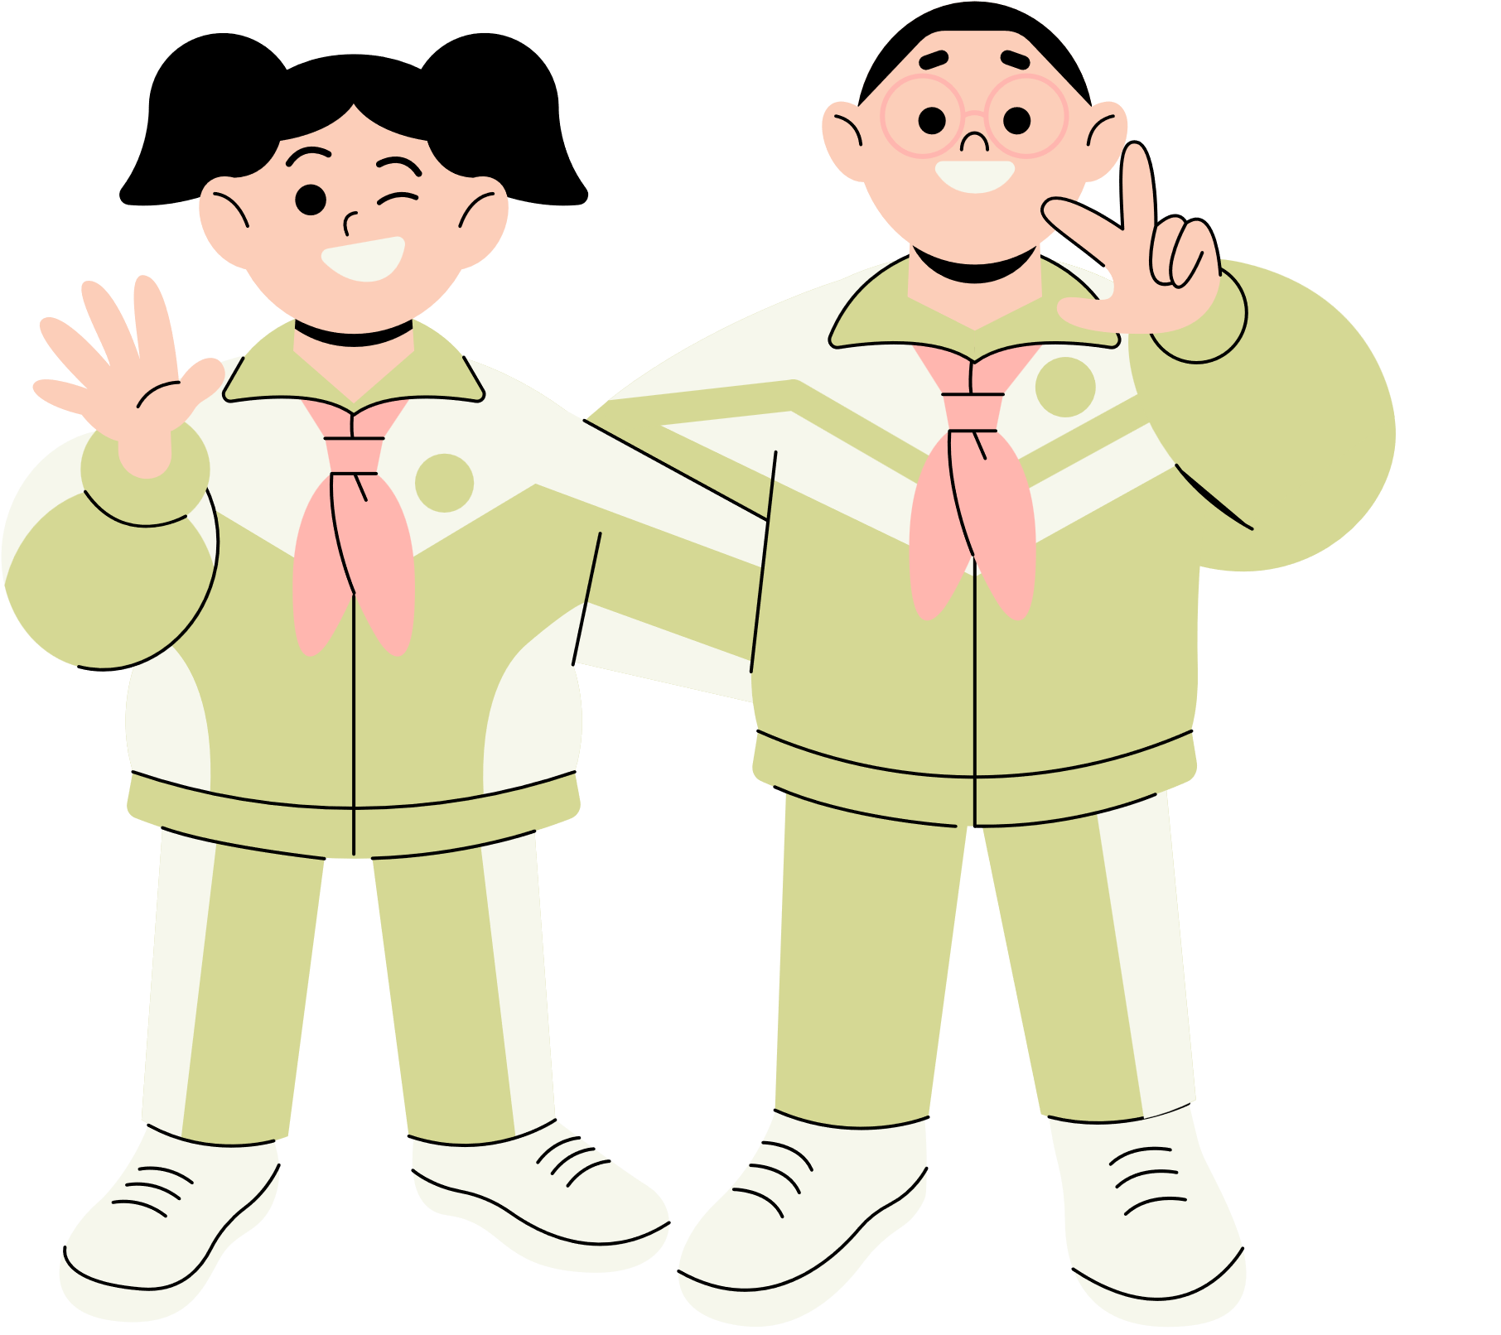





Thank You!
See You Next Time!
Notes:
https://www.youtube.com/watch?v=SRyFiVeNjWs

