Slide 1

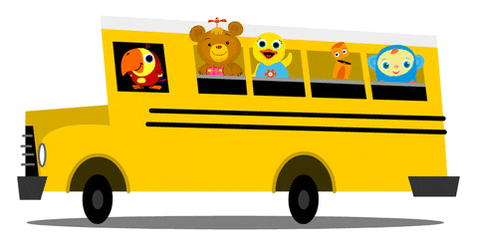
Lesson 1
Unit 4
I go to school by bus.

Slide 2


Slide 3


Slide 4

Listen and point

Slide 5


Slide 6

Listen and repeat

Slide 8
Listen and point

Slide 9
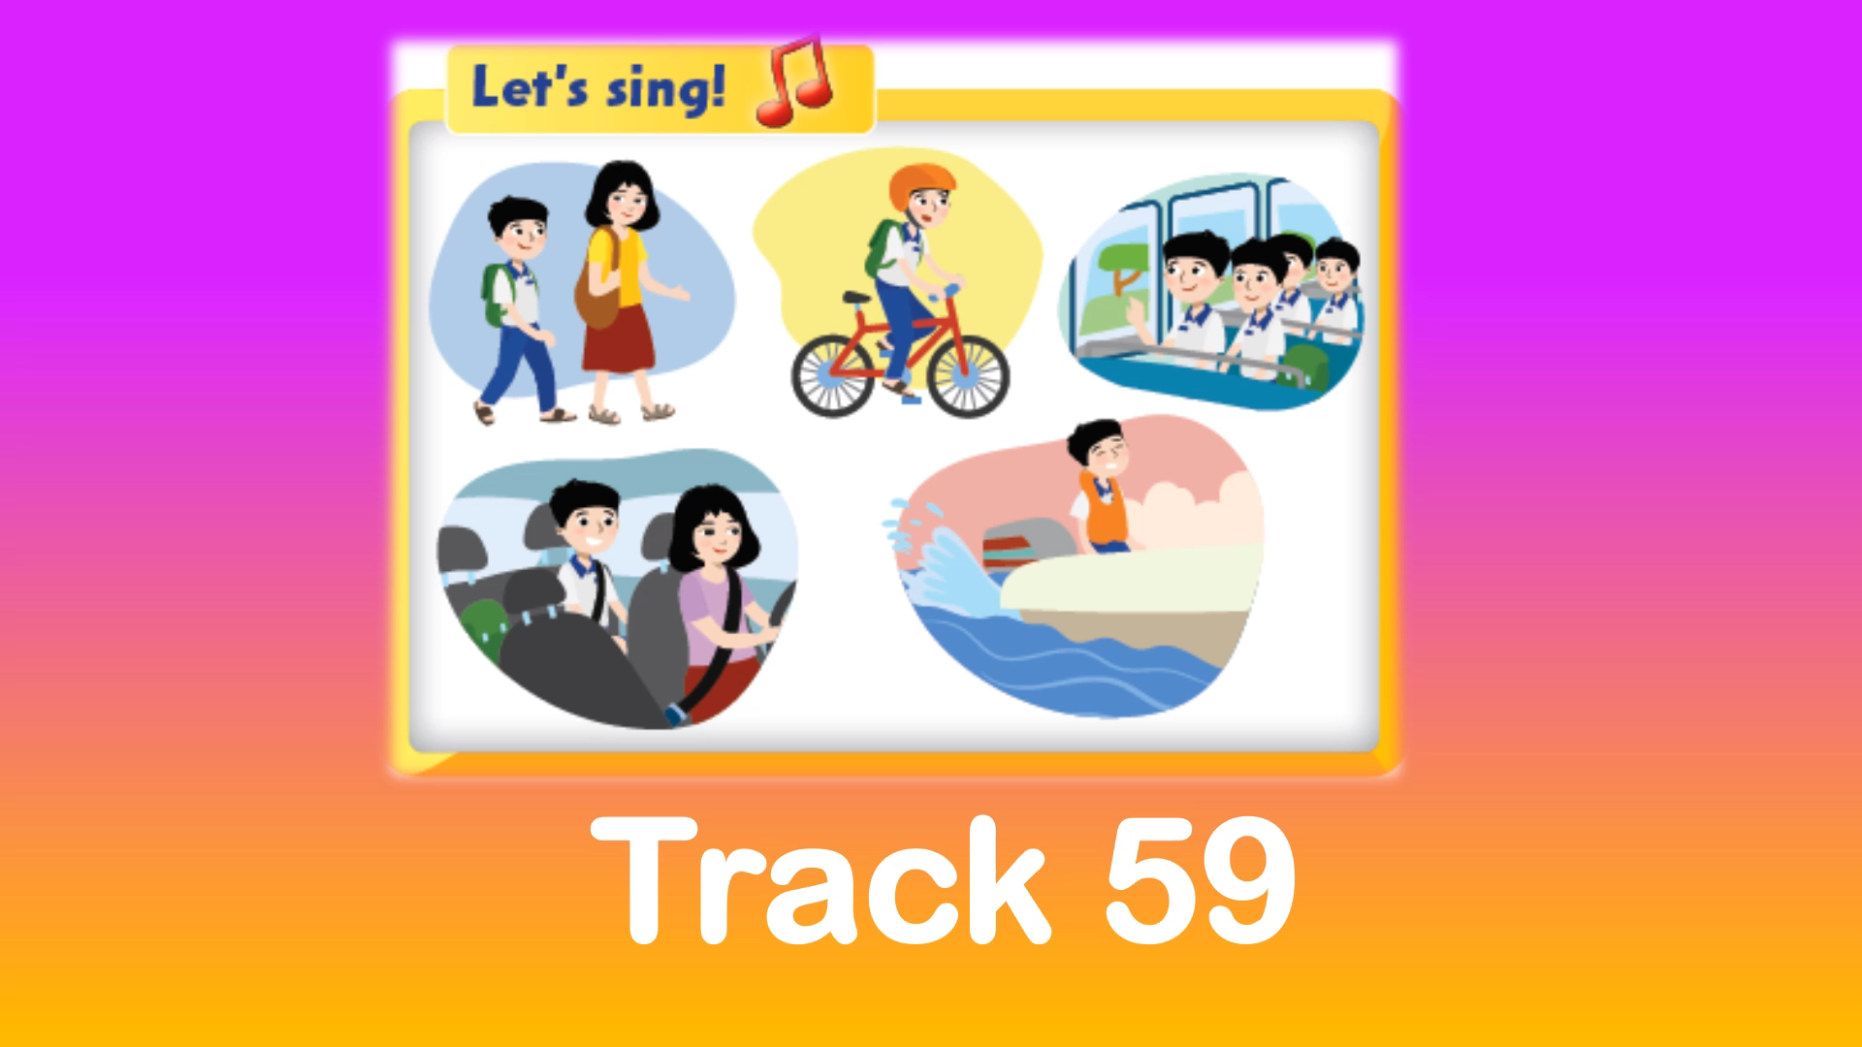

Slide 10
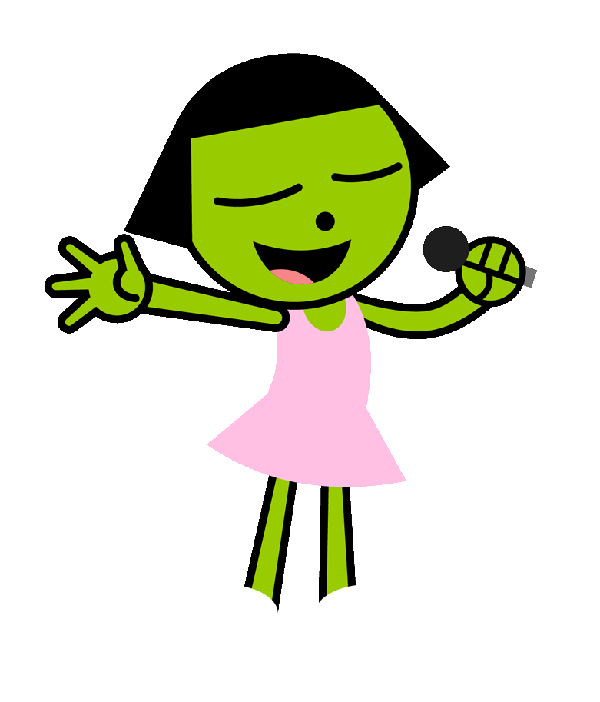
Listen and sing

Slide 12

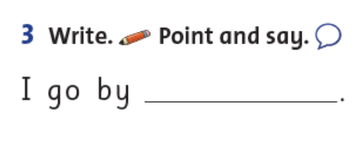
Write.
bike

Slide 13

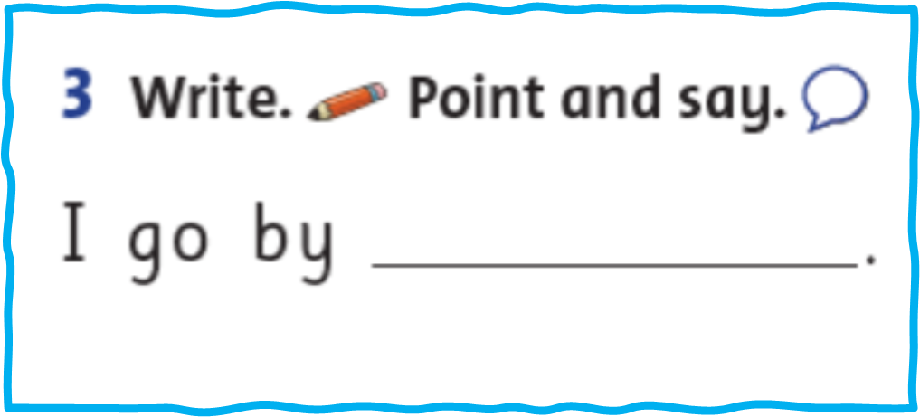
Point and say!

Slide 14

Work in pairs

Slide 15
I go by
motorbike.

Slide 16

It’s play time!

Slide 17
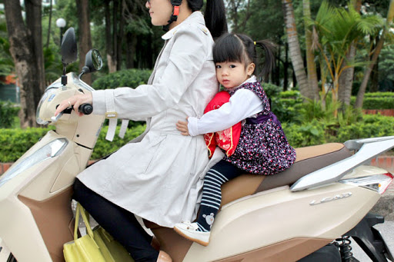

I go to school
by truck.

Slide 18
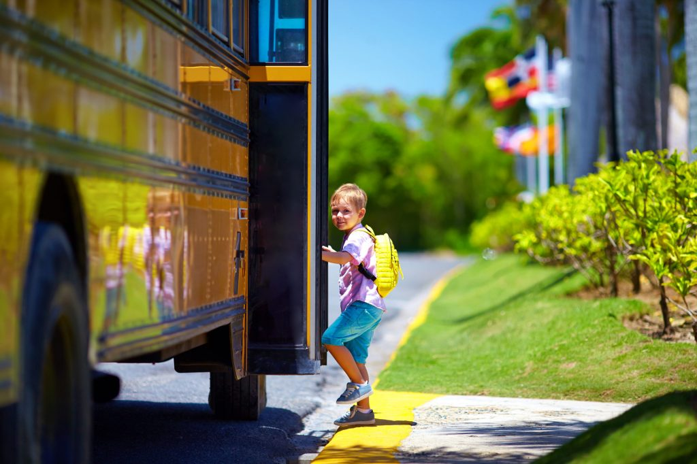
I go to school by bus.

Slide 19
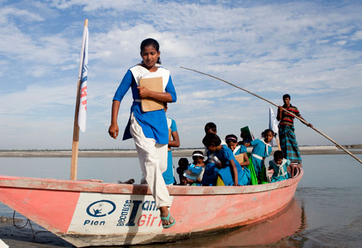
I go to school by boat.

Slide 20
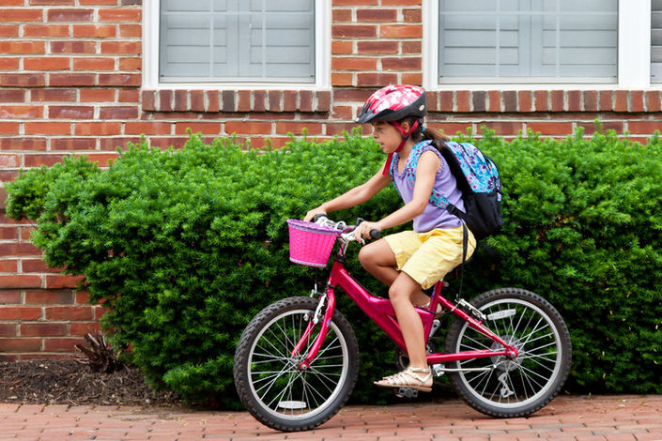
I go to school by bus.

Slide 21
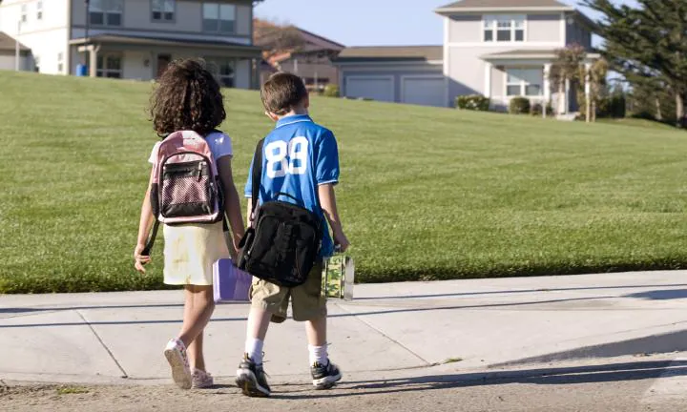
I walk to school.

Slide 22
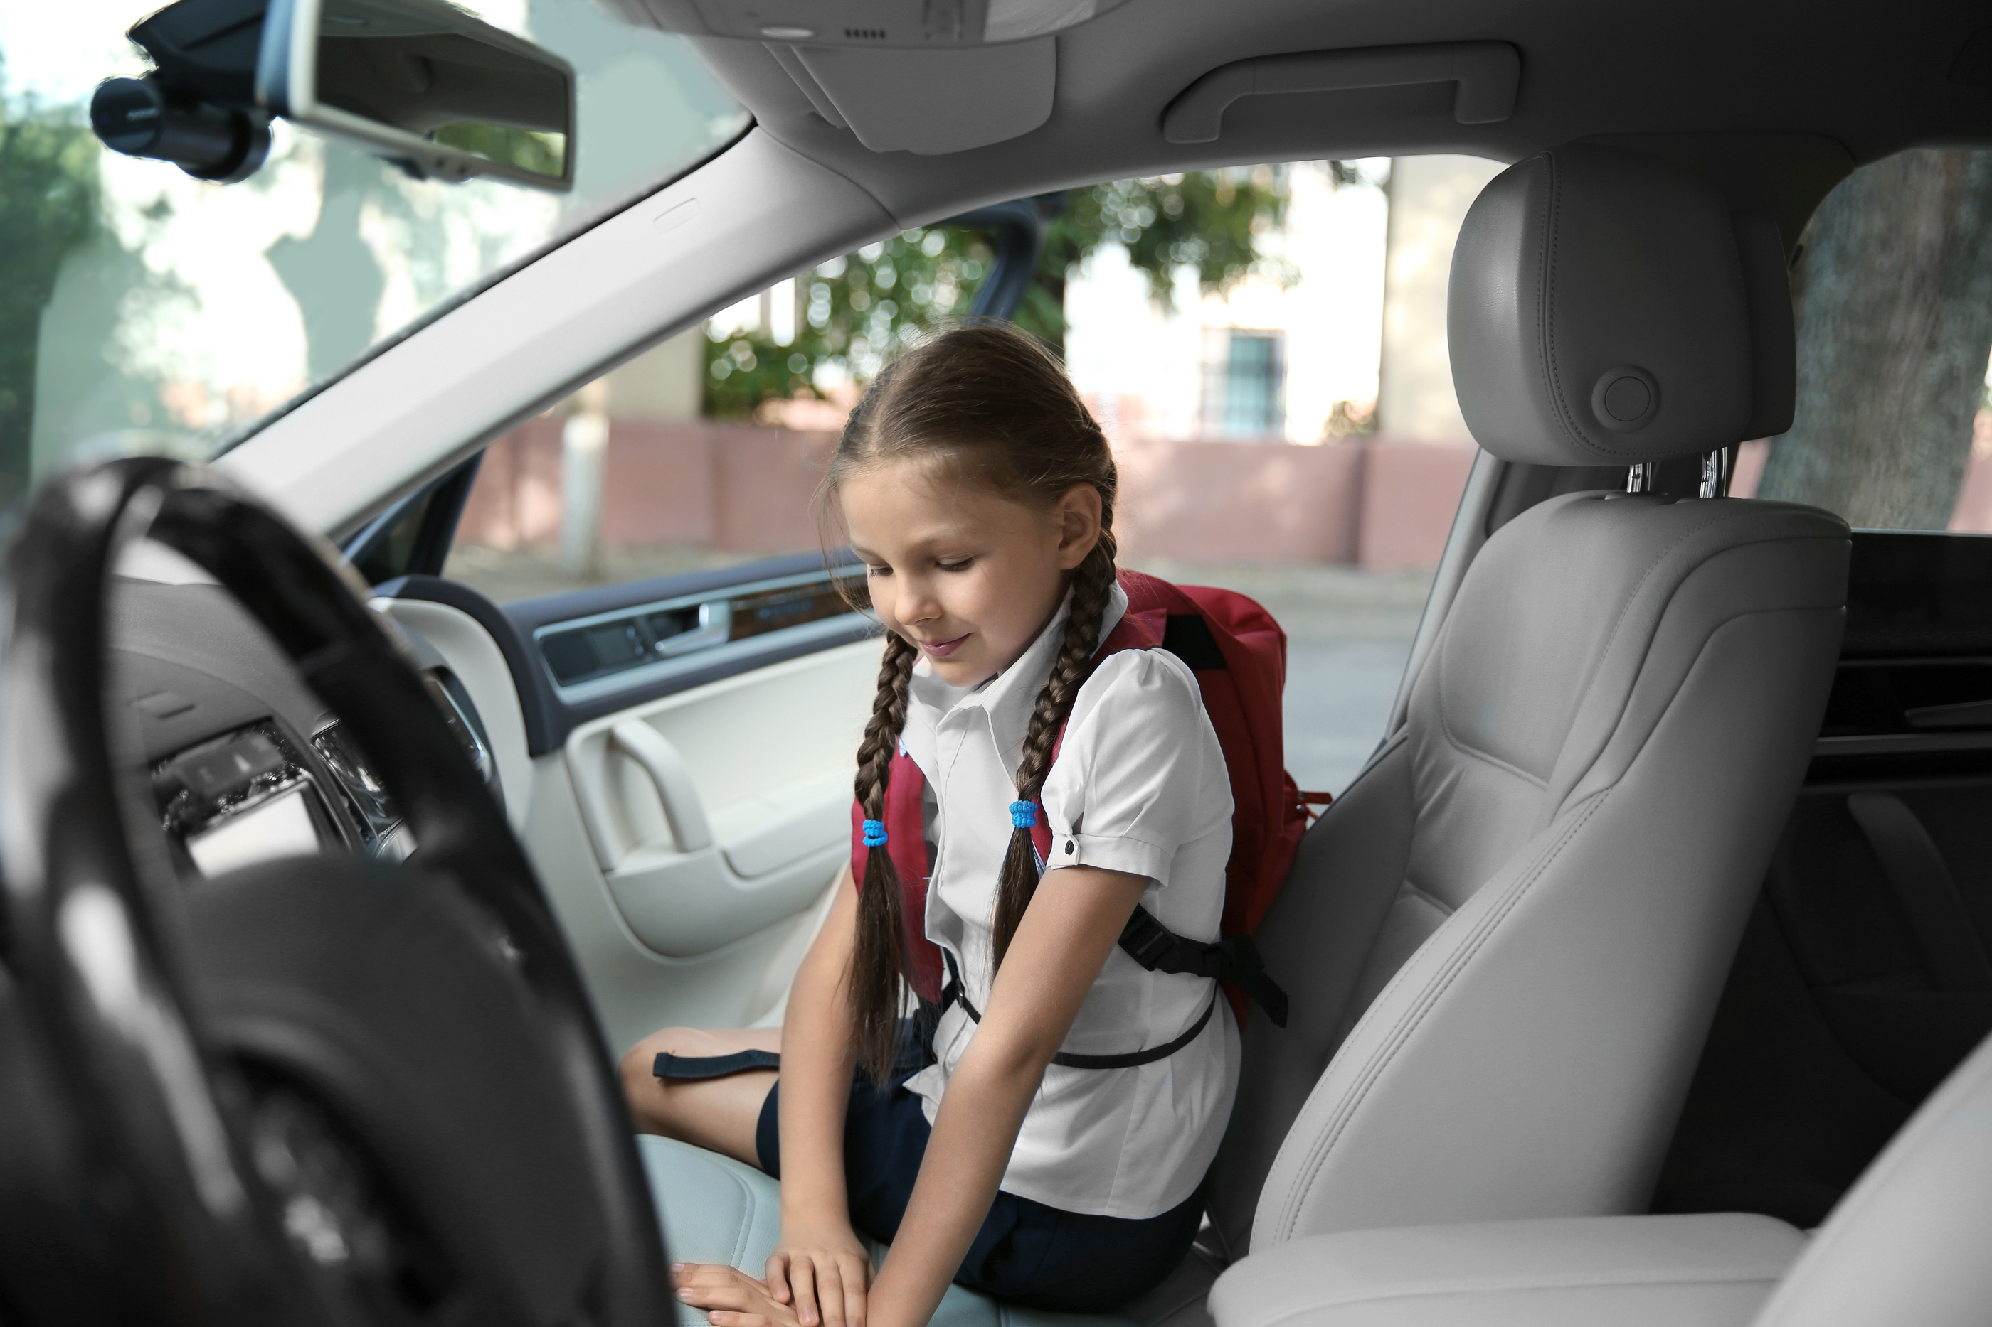
I go to school
by bike.

Slide 23
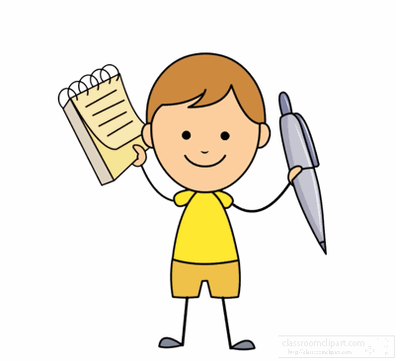
Workbook time!!!

Slide 24
1

Slide 25
Say and count:
I go to school
by................
 | NUMBERS
Walk to school
By car
By motorbike

Slide 26


Slide 27


