Slide 1

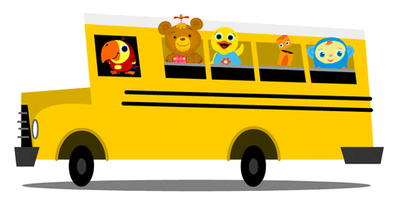
Lesson 1
Unit 4
I go to school by bus.

Slide 2


Slide 3


Slide 4

Listen and point

Slide 5
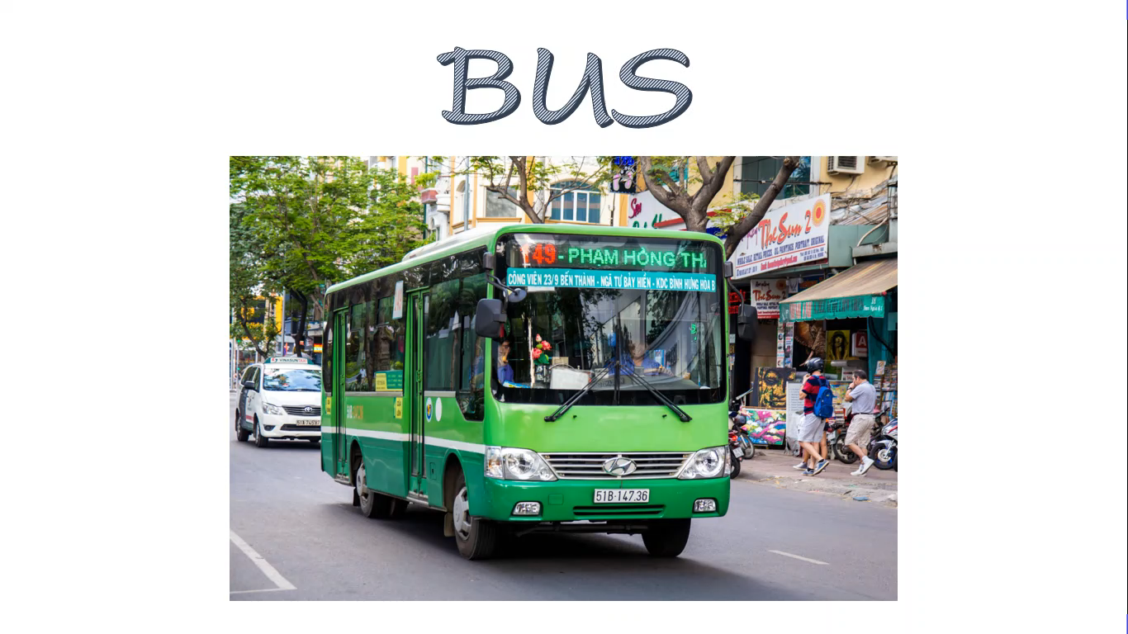

Slide 6

Listen and repeat

Slide 8

Work in pairs

Slide 9
Listen and point

Slide 10


Slide 11

Listen and chant

Slide 13
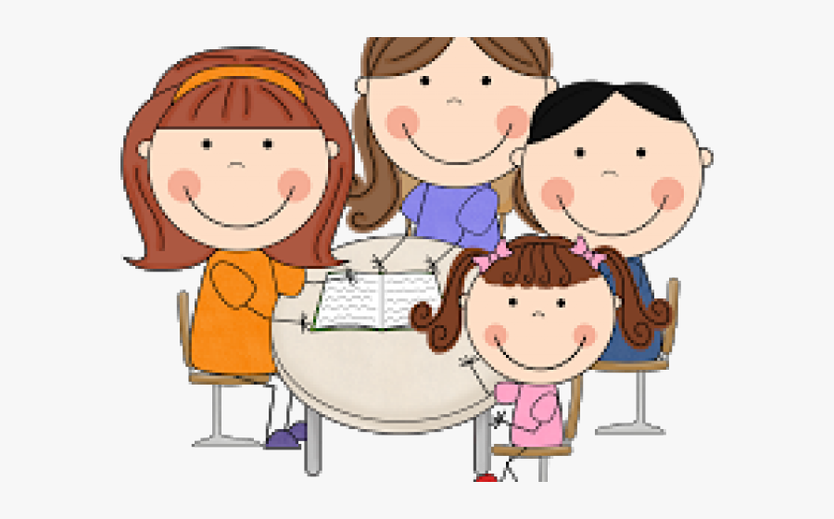
Work in groups

Slide 14

It’s play time!

Slide 15
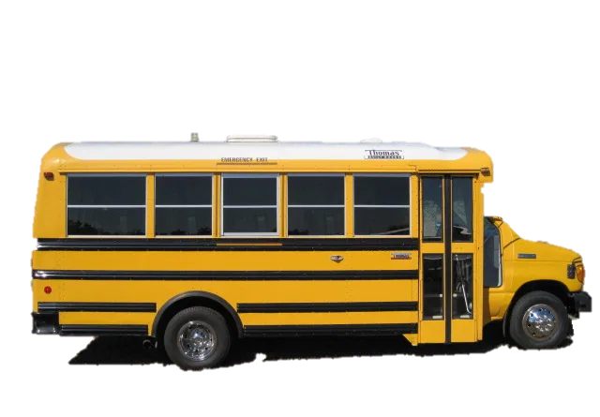
motorbike
bus
bike

Slide 16
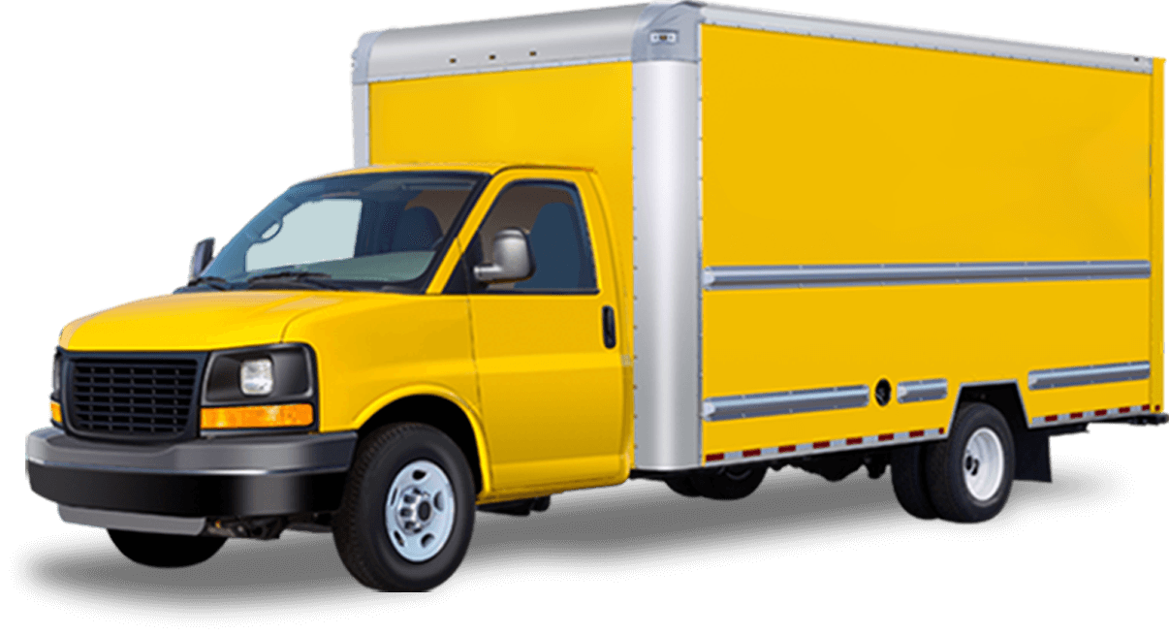
boat
car
truck

Slide 17
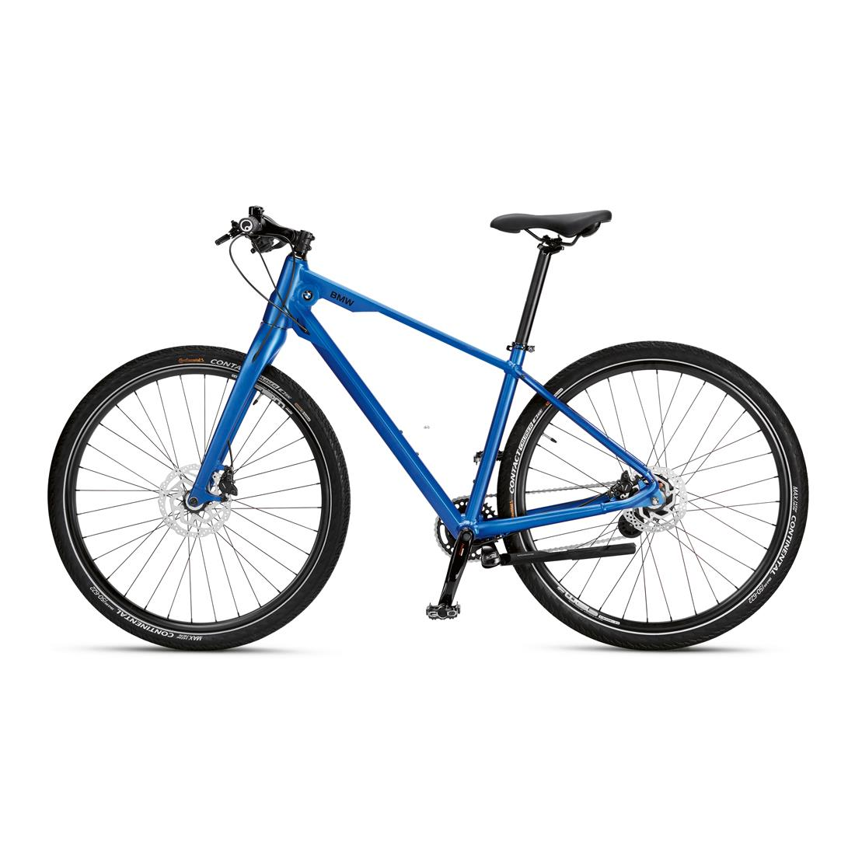
bike
truck
boat

Slide 18
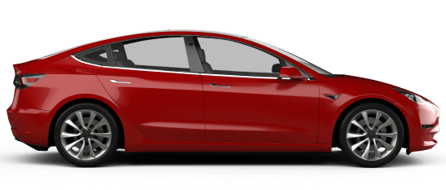
boat
bus
car

Slide 19
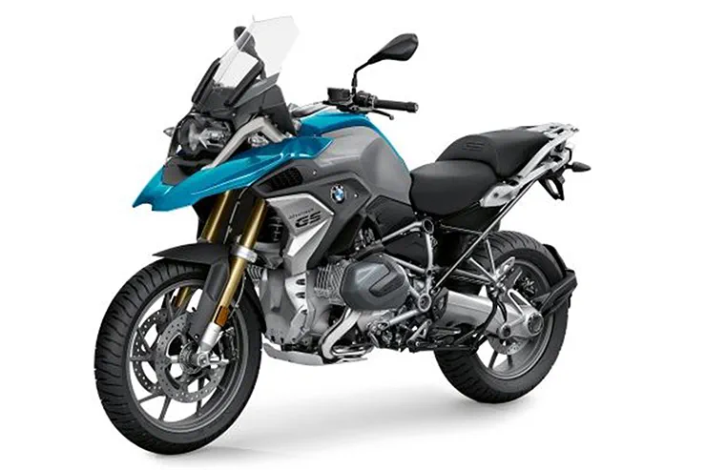
bike
truck
motorbike

Slide 20
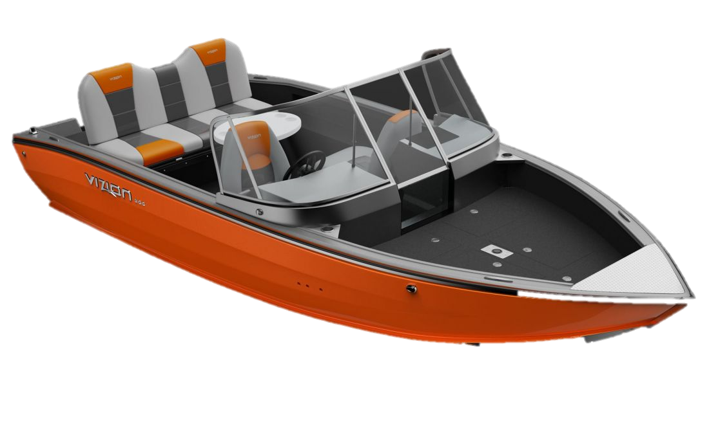
truck
boat
motorbike

Slide 21

Point and say!

Slide 23
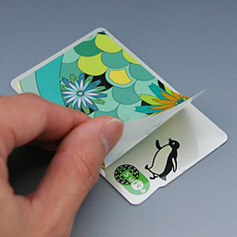
Let’s stick!

Slide 24
truck

Slide 25
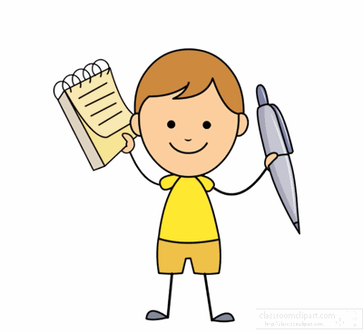
Workbook time!!!

Slide 27


Slide 28


