Slide 1
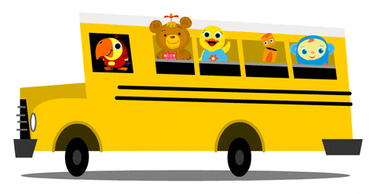
Lesson 1
Unit 4
I go to school by bus.

Slide 4
Listen and point

Slide 6
Listen and repeat

Slide 8
Listen and point

Slide 10
Listen and sing

Slide 12
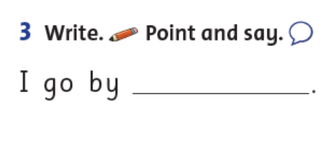
Write.
bike

Slide 13
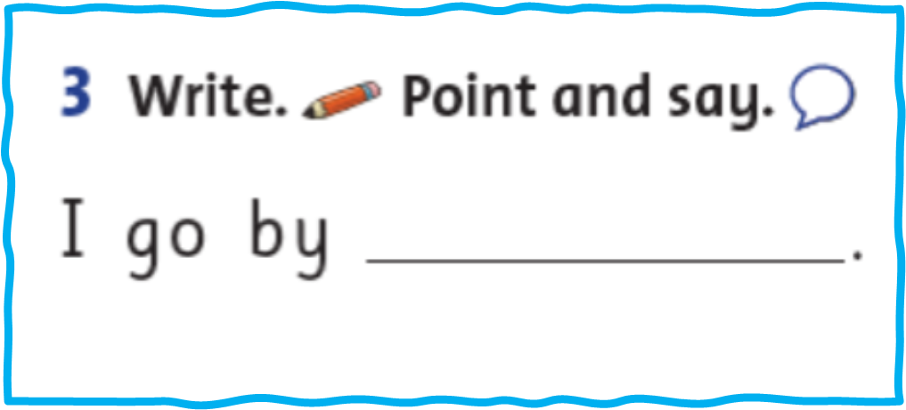
Point and say!

Slide 14
Work in pairs

Slide 15
I go by
motorbike.

Slide 16
It’s play time!

Slide 17
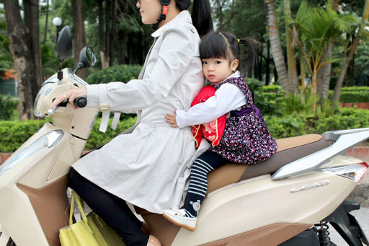
I go to school
by truck.

Slide 18
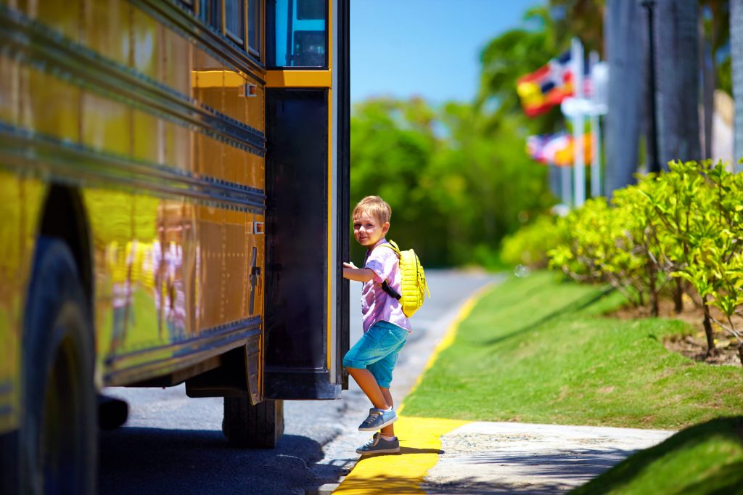
I go to school by bus.

Slide 19
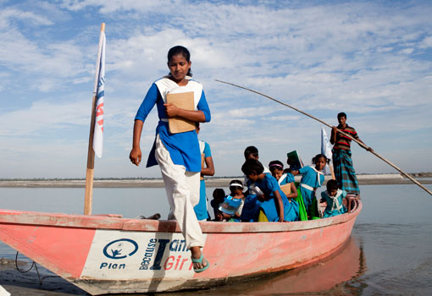
I go to school by boat.

Slide 20
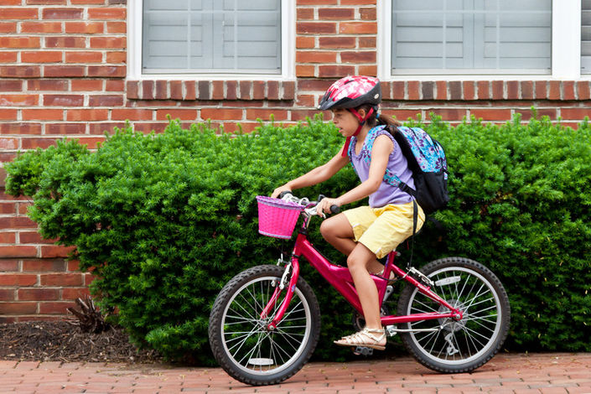
I go to school by bus.

Slide 21
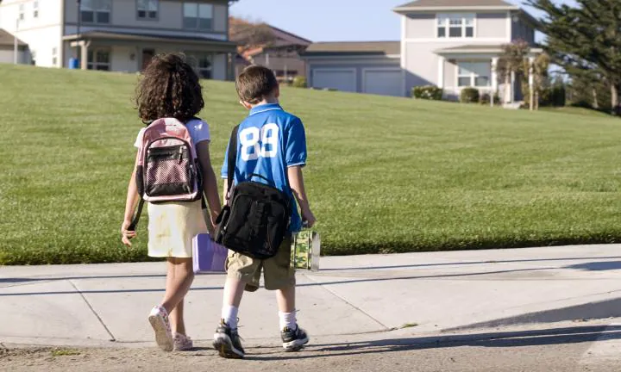
I walk to school.

Slide 22
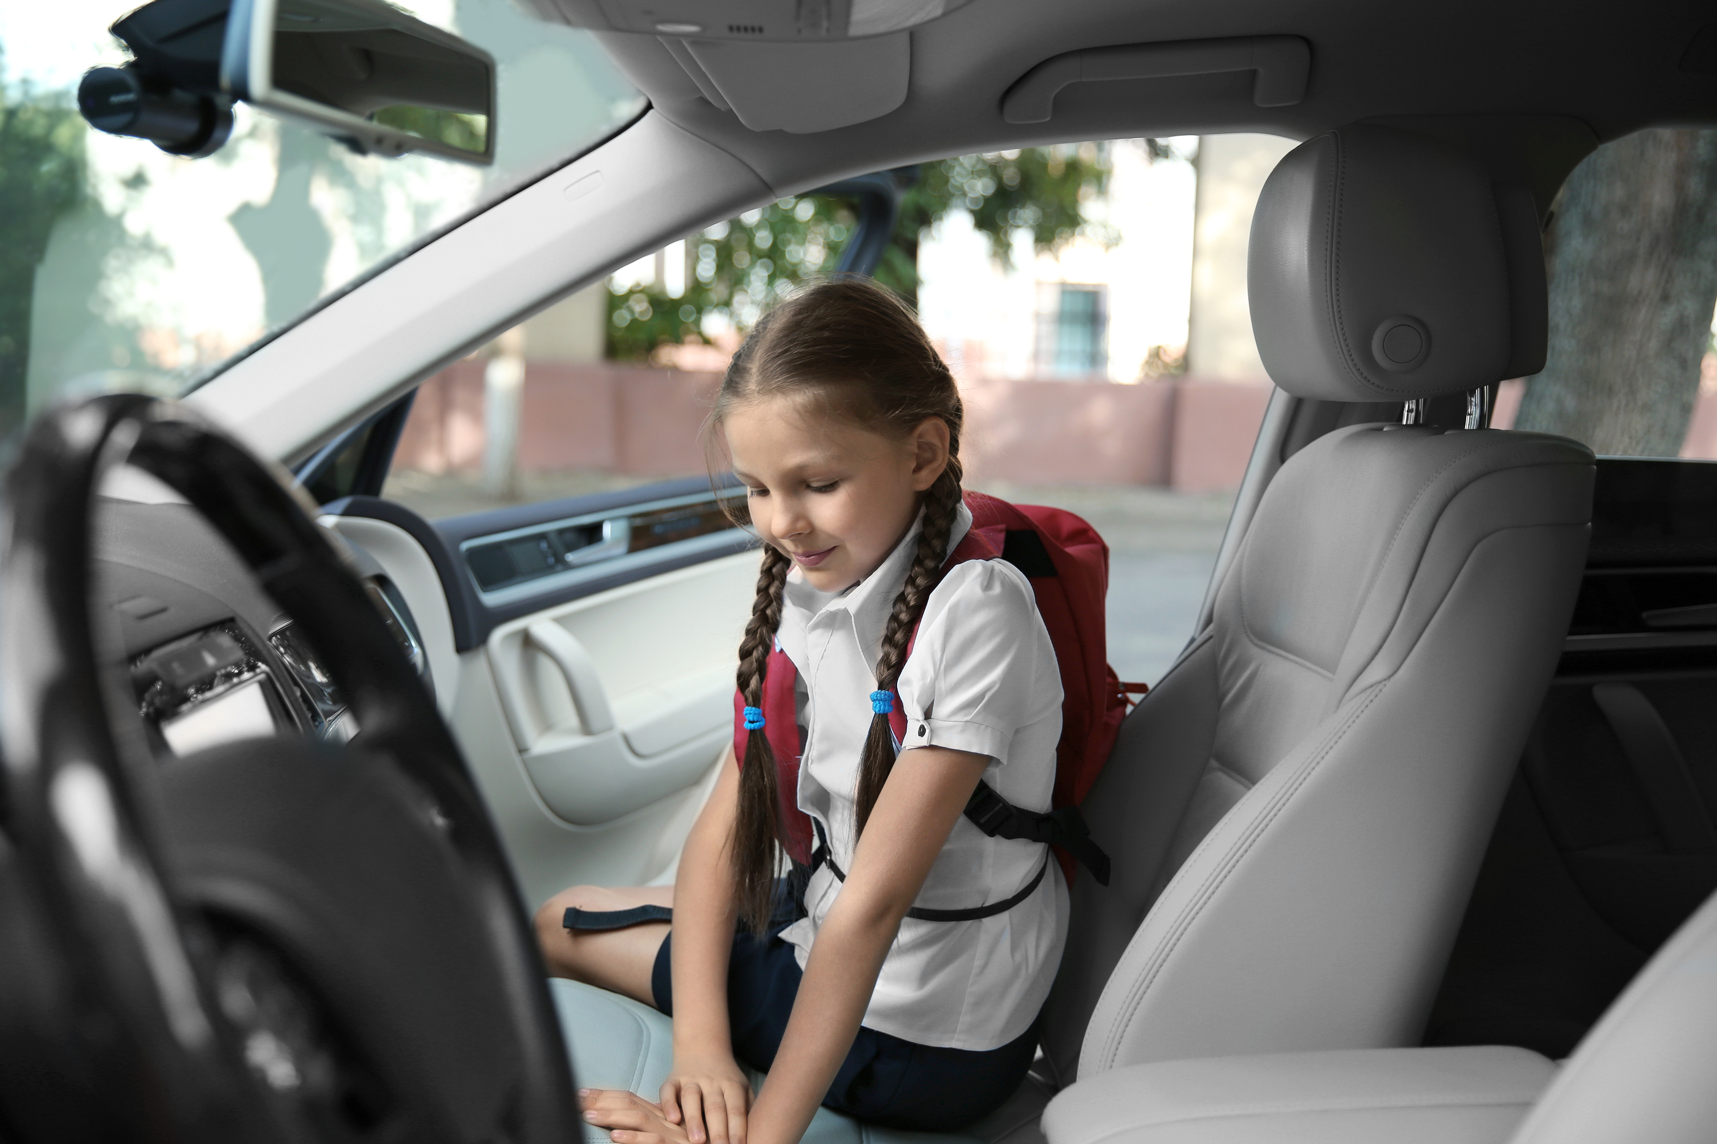
I go to school
by bike.

Slide 23
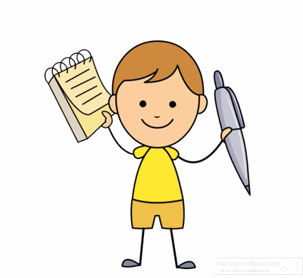
Workbook time!!!

Slide 24
1

Slide 25
Say and count:
I go to school
by................
 | NUMBERS
Walk to school
By car
By motorbike

