Slide 1
I have a new friend.
Unit 6
Lesson Five – Skills Time

Slide 2
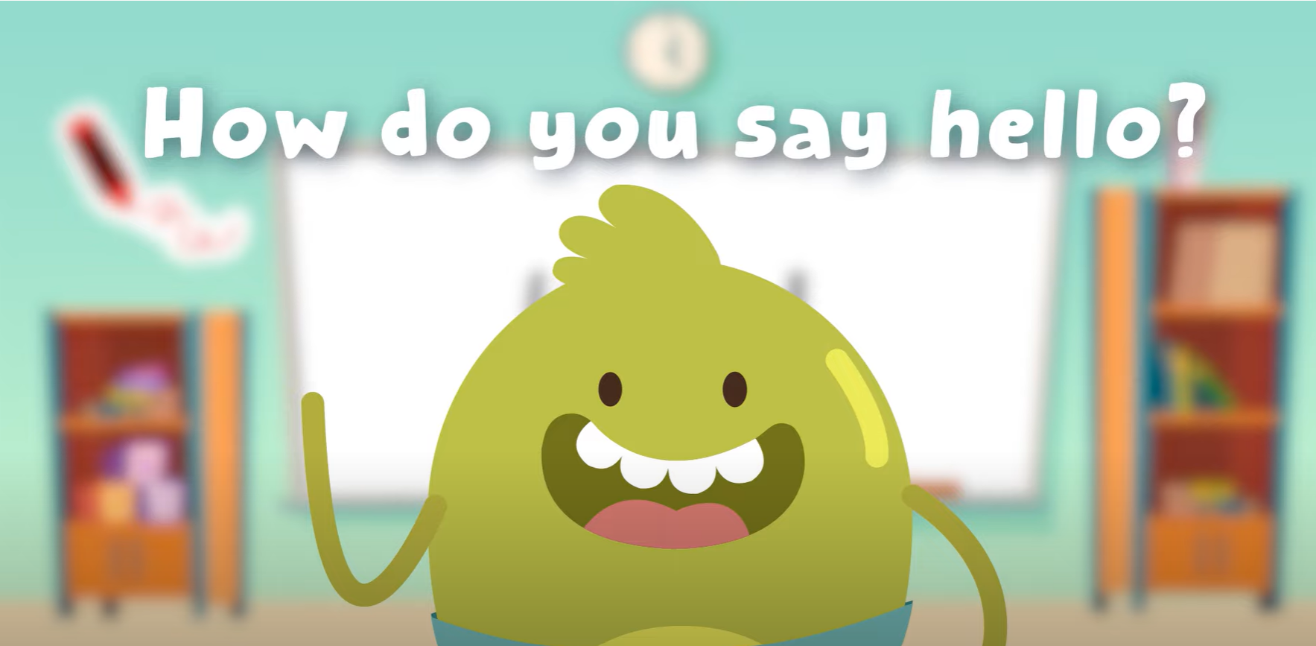
Hello Song

Slide 3
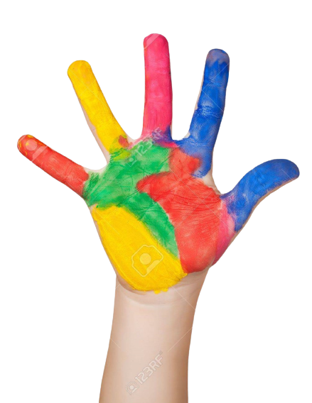
Give me FIVE

Slide 4
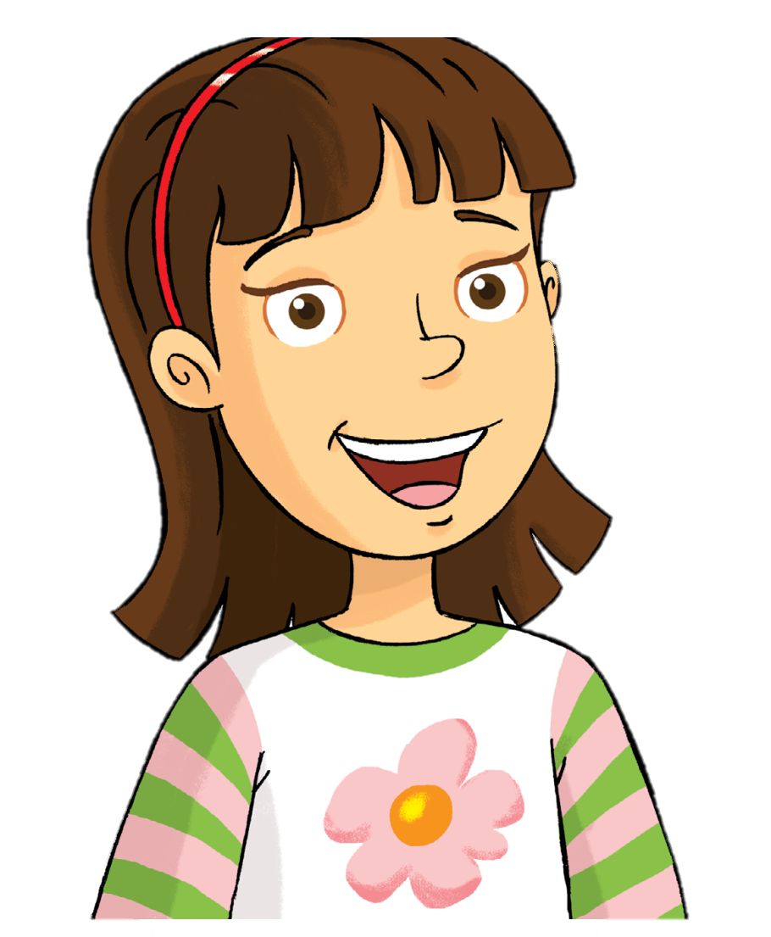
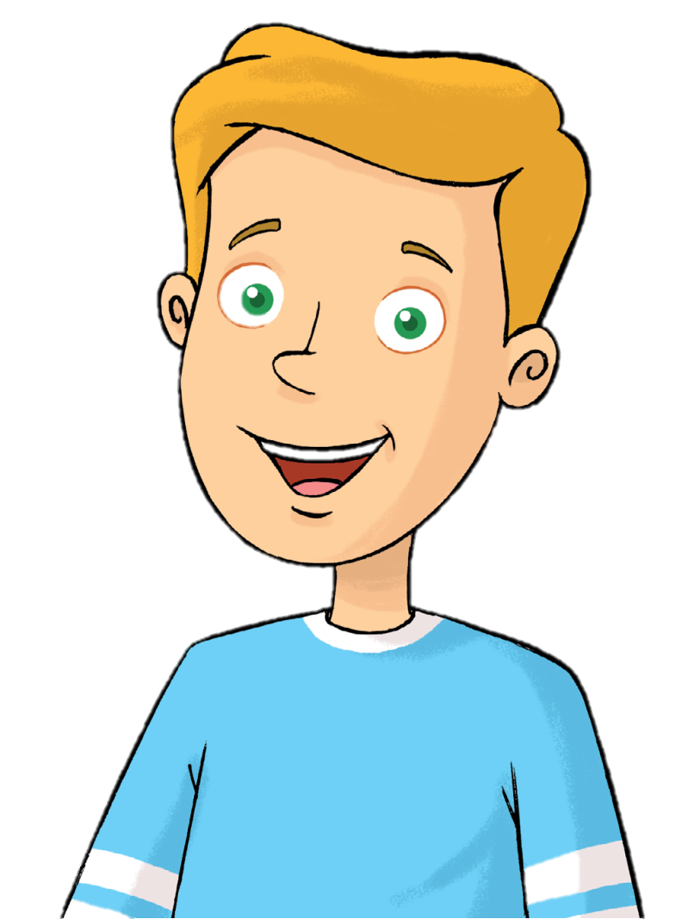
Look and Say
Rosy
Tim

Slide 5
Watch and Answer

Slide 6
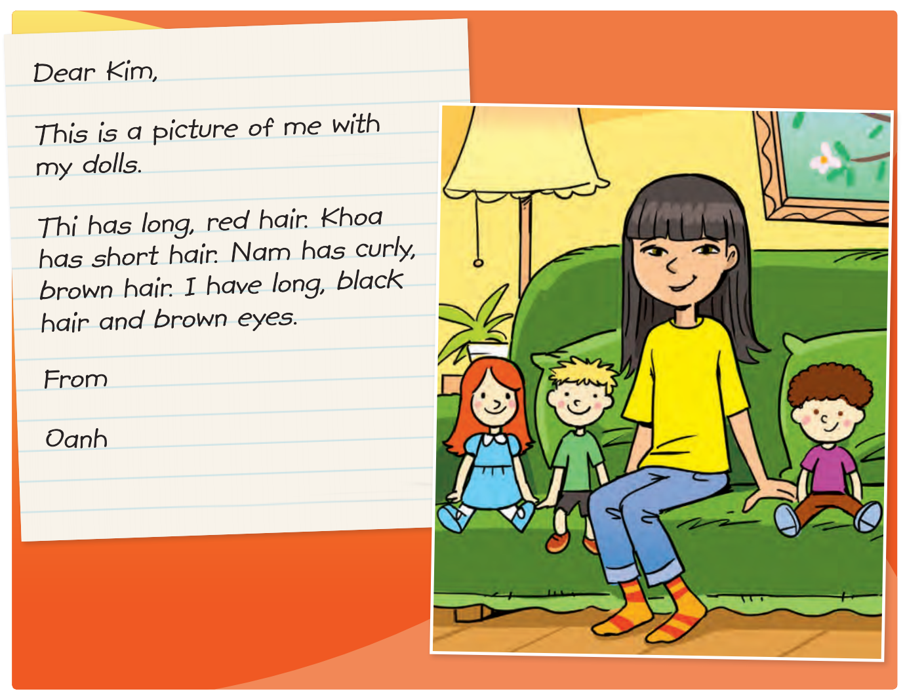
Look and Say
How many dolls can you see?

Slide 7
Listen and Point
48

Slide 8
Listen and Repeat
48

Slide 9
REVIEW READING

Slide 10
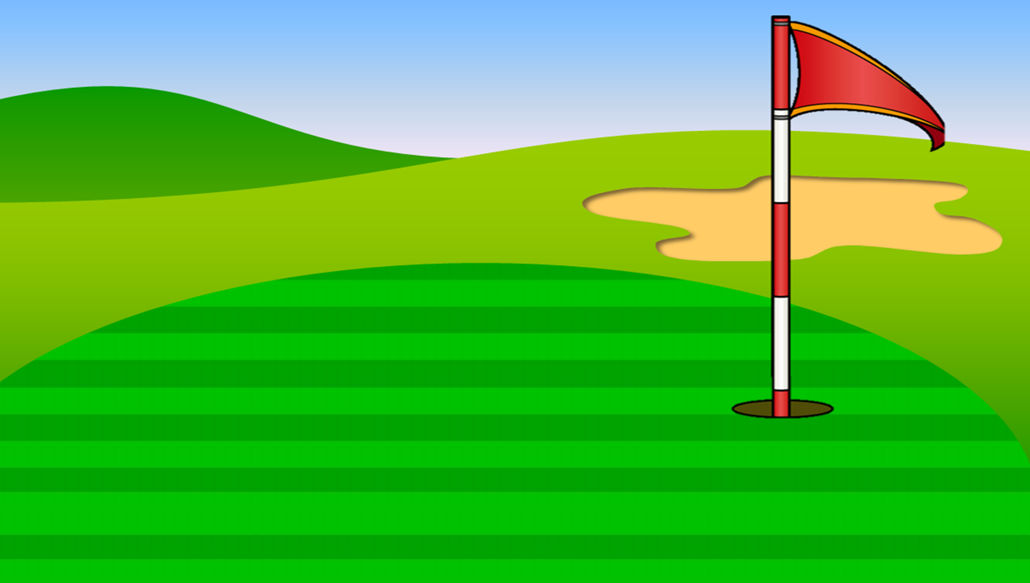
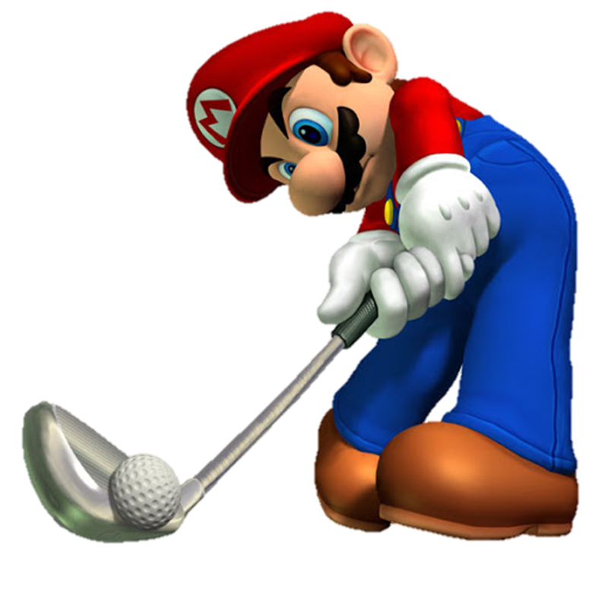
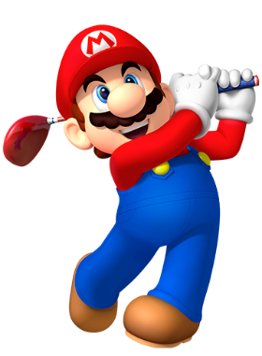

Slide 11
Thi has long,_______ hair.
black
red
blue

Slide 12
________ has long, black hair and brown eyes.
Kim
Oanh
Khoa

Slide 13
Listen and choose
Khoa has_________ hair.
curly
long
straight

Slide 14
Nam has curly, brown hair.
Yes
No

Slide 15
What color are Oanh’s eyes?
brown
black
blue

Slide 16
Who is writing a letter?
Kim
Oanh
Thi

Slide 17
What color is Nam’s hair?
black
green
brown

Slide 18
Good job!

Slide 19
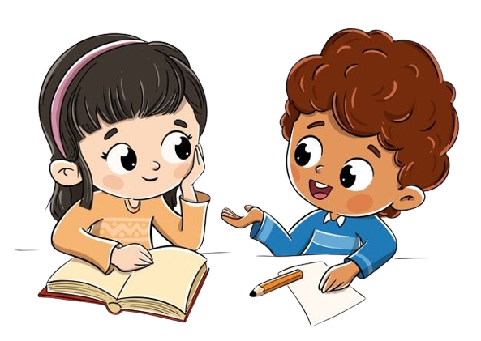
Work in Pairs
Point and Read.

Slide 20
Good job!

Slide 21
Read again and Write the names.
Oanh
Khoa
Thi

Slide 22
Work in Pairs
Do you like doll?
What’s your favorite toy?

Slide 23
Goodbye!

