Slide 1
I have a new friend.
Unit 6
Lesson Three - Song

Slide 2
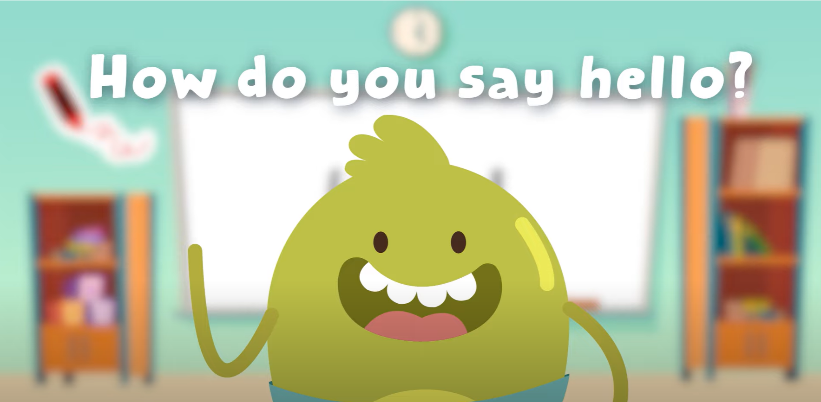
Hello Song

Slide 3
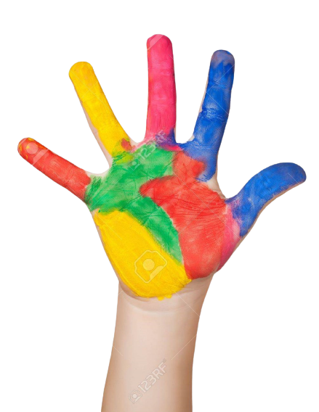
Give me FIVE

Slide 4
Listen and Point

Slide 5
Listen and Repeat

Slide 6
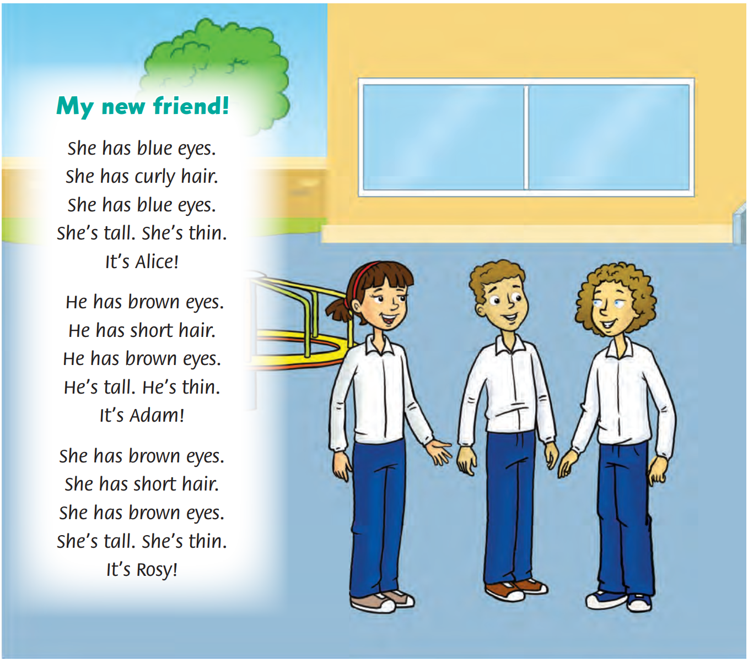
Look and Answer
46

Slide 7
Listen and Point
46

Slide 8
Listen and Repeat

Slide 9
Listen and Sing

Slide 10
Watch and Sing.

Slide 11
Sing in groups.

Slide 12
Good job!

Slide 13
Live on stage

Slide 14
Good job!

Slide 15
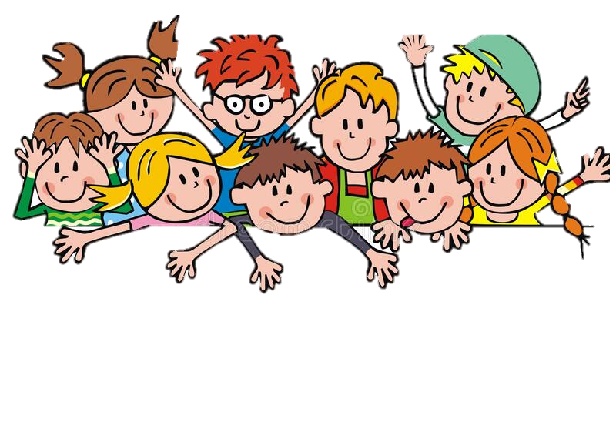
Racing Boat Game

Slide 16
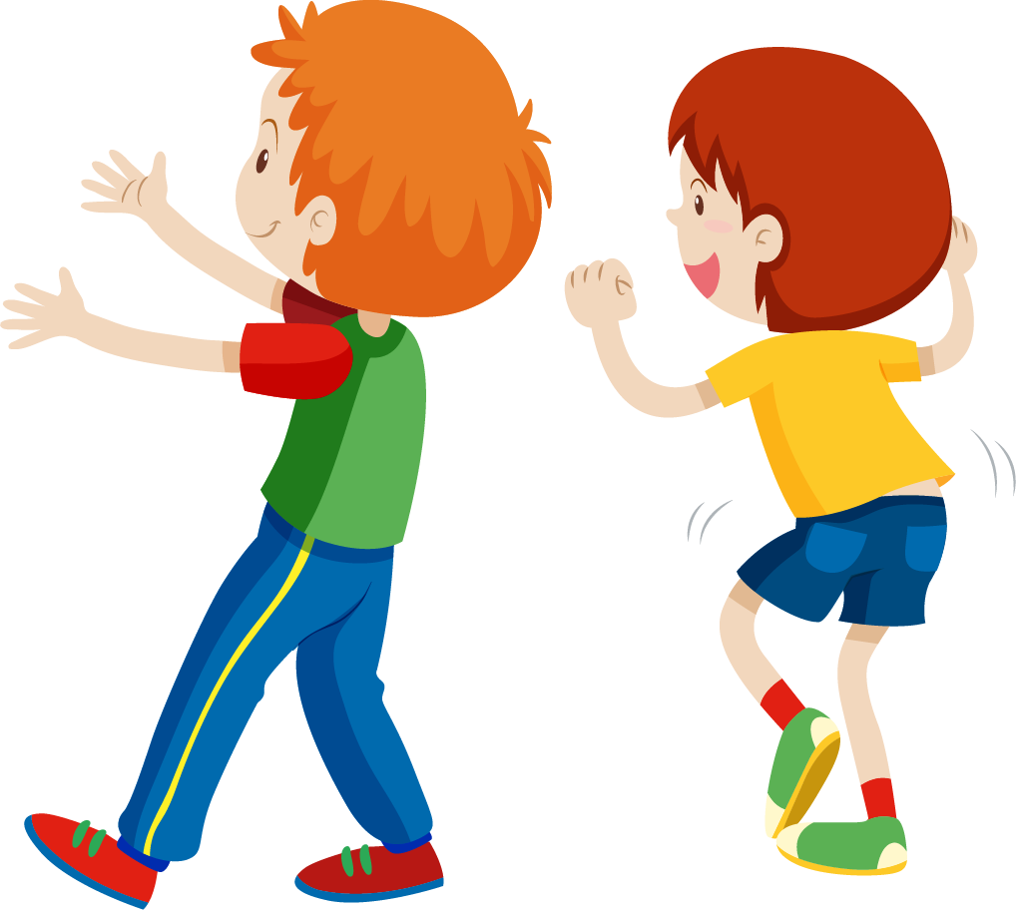

Slide 17
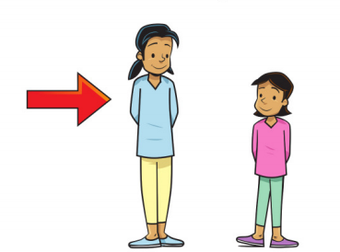
She is ___ .
tall
thin
short
fat

Slide 18
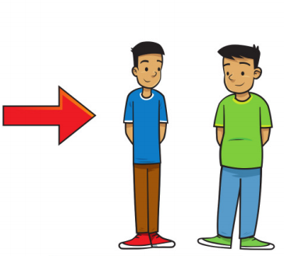
He is ___ .
tall
thin
short
fat

Slide 19
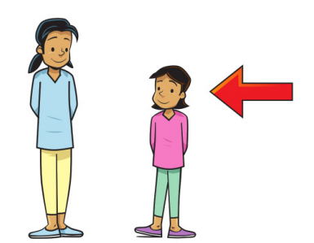
She is ___ .
short
tall
big
fat

Slide 20
She has ___.
short hair
curly hair
long hair
black hair

Slide 21
thin
tall
short
fat

Slide 22
tall
thin
short
fat

Slide 23
short
tall
thin
fat

Slide 24
Unscramble
h – s – t – a – r – g - i
short
shoes
straight
stand

Slide 25
Good job!

Slide 26
Goodbye!

