Slide 1
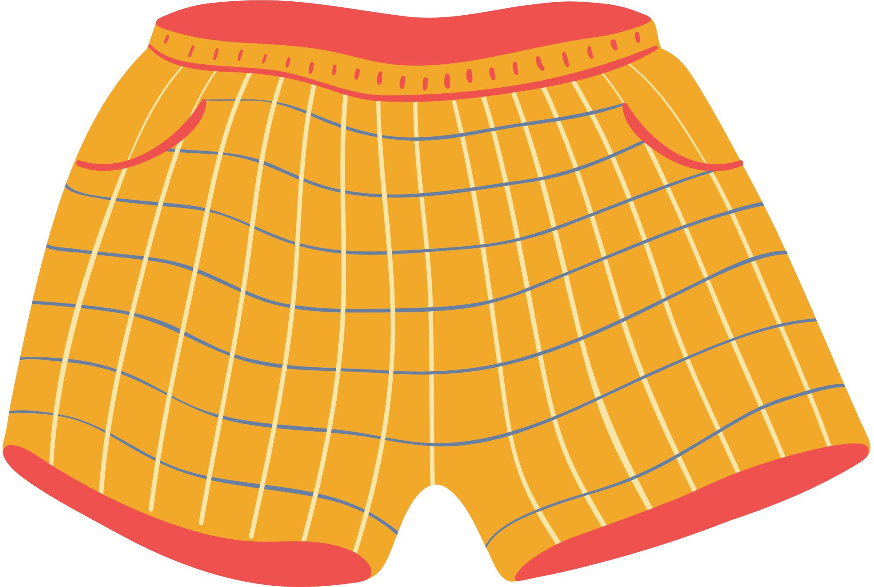
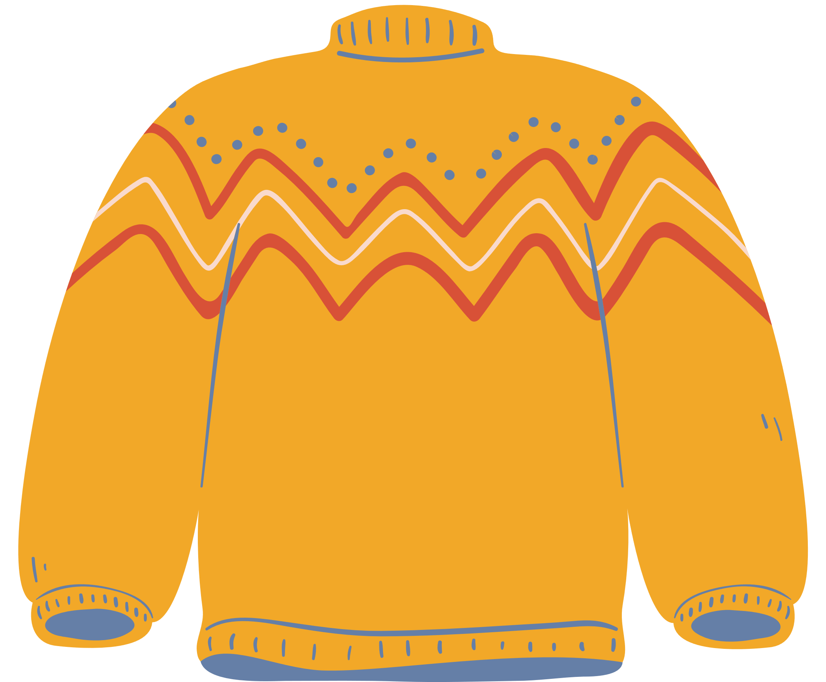
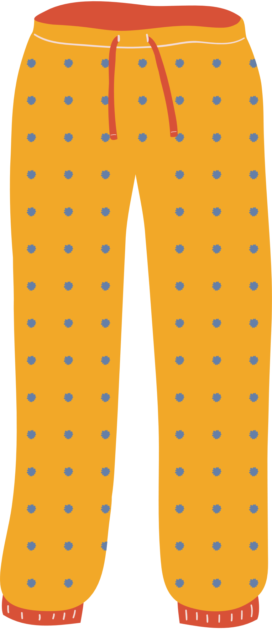
Unit 7
I’M WEARING
A BLUE SKIRT.
Lesson 4

Slide 2
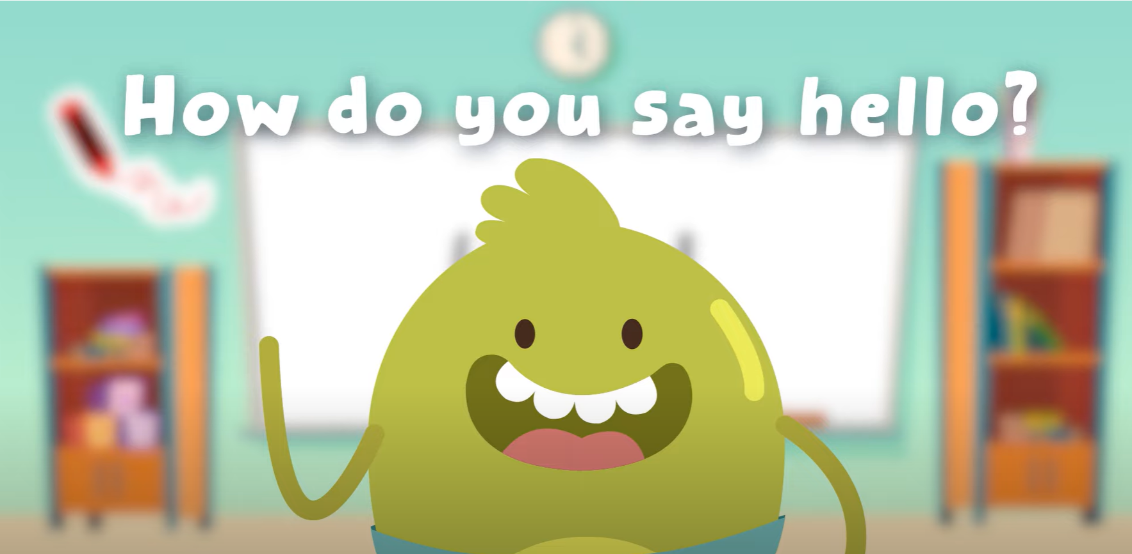
Hello song

Slide 3
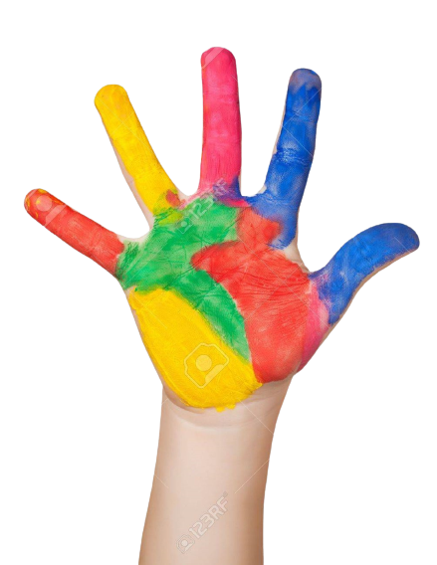
Give Me Five
Notes:
Class Rules

Slide 4
Watch and Sing.

Slide 5
Good job!

Slide 6
Listen and Point

Slide 7
Listen and Repeat

Slide 8
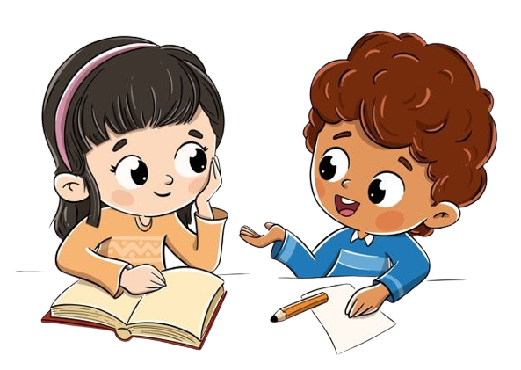
Work in Pairs
Point and Say

Slide 9
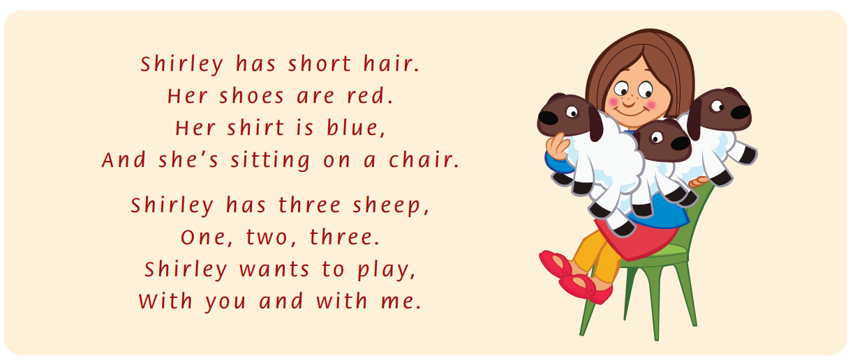
Listen and Point

Slide 10
Listen and Repeat

Slide 11
Listen and Chant

Slide 12
Good job!

Slide 13
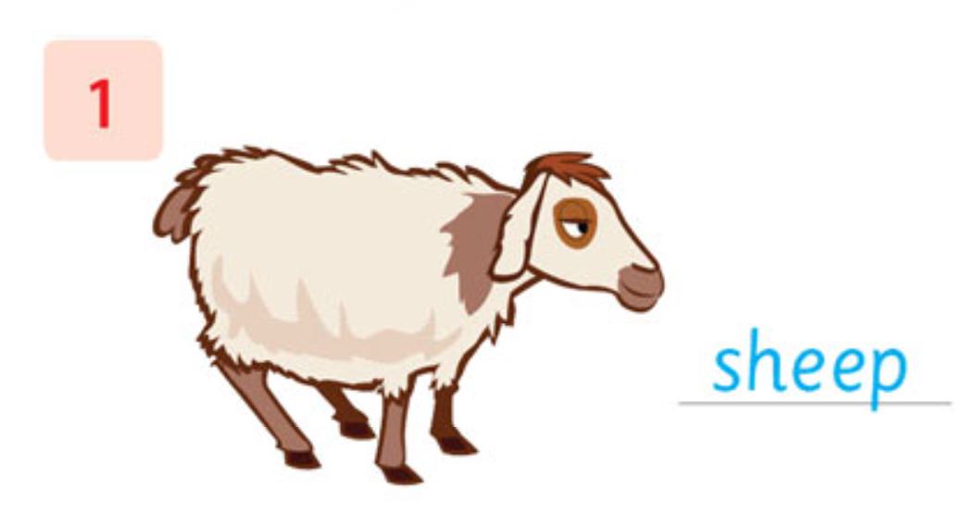
Look, Write and Say
sheep
Notes:
Do number 1 with the whole class as an example.

Slide 14
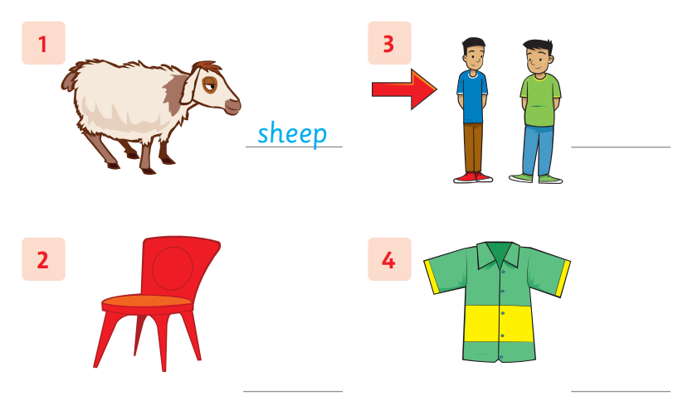
Look, Write and Say
Notes:
Students do the task individually.

Slide 15
Work in Pairs
Peer-check your answers

Slide 16
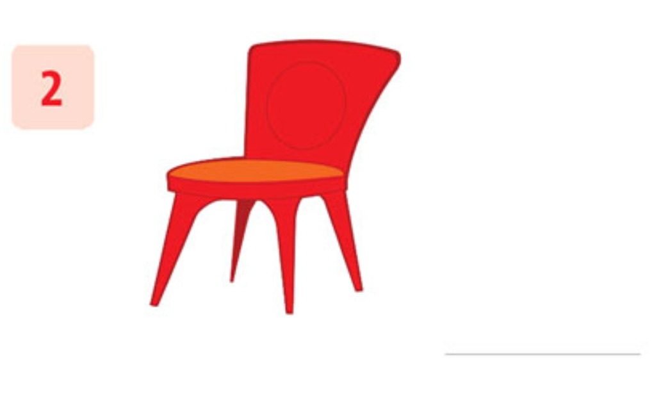
Let’s check!
chair
Notes:
Answers:
1. sheep 2. chair 3. thin 4. shirt

Slide 17
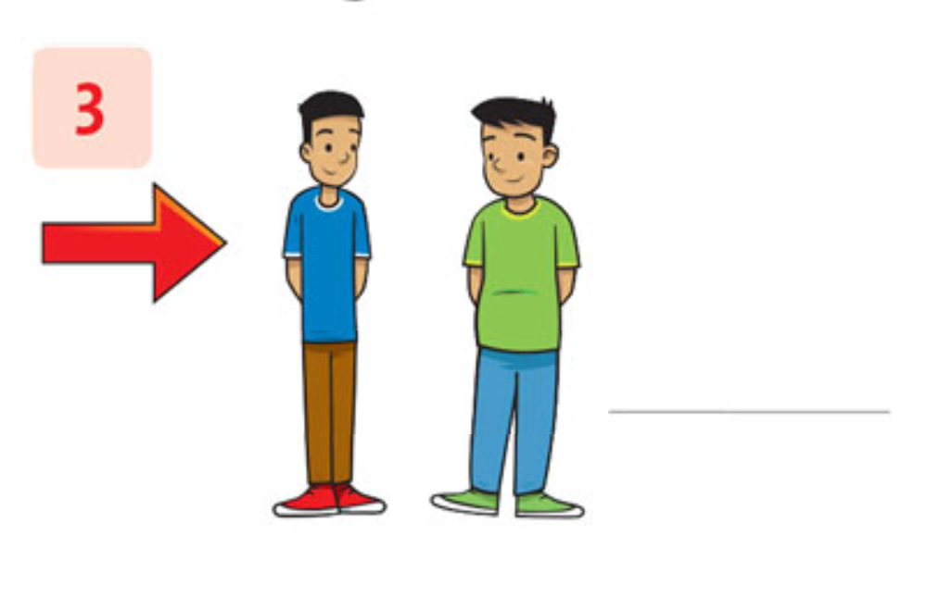
Let’s check!
thin
Notes:
Answers:
1. sheep 2. chair 3. thin 4. shirt

Slide 18
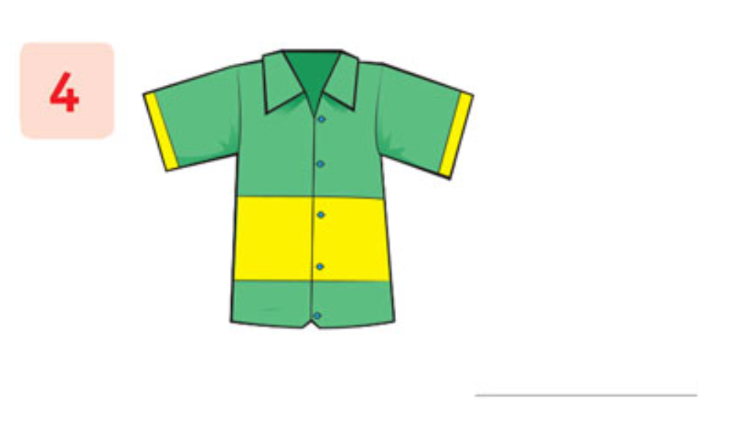
Let’s check!
shirt
Notes:
Answers:
1. sheep 2. chair 3. thin 4. shirt

Slide 19
Good job!

Slide 20
Game
PROBLEM SOLVING!

Slide 21
ODD ONE OUT
ch
Try again!
Correct!
Try again!
Next

Slide 22
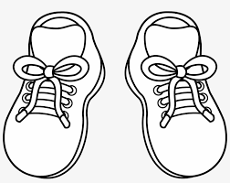
ODD ONE OUT
sh
Try again!
Try again!
Correct!
Next

Slide 23
ODD ONE OUT
th
Try again!
Correct!
Try again!
Next

Slide 24
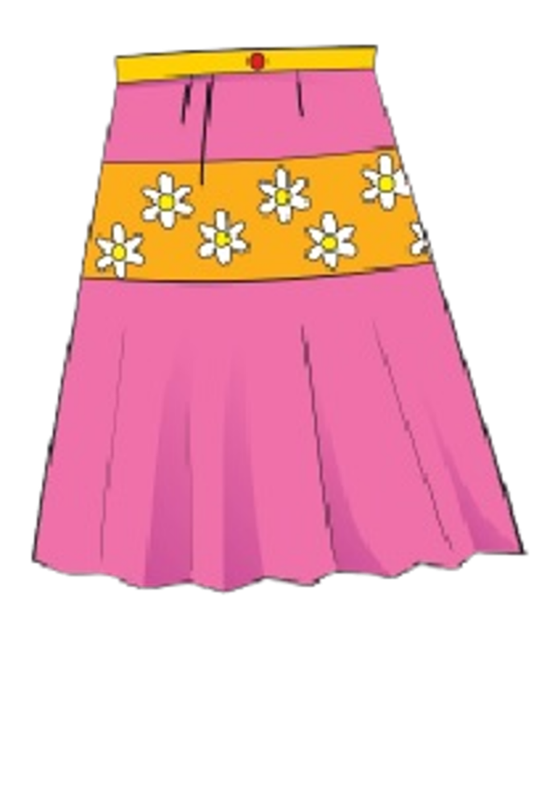
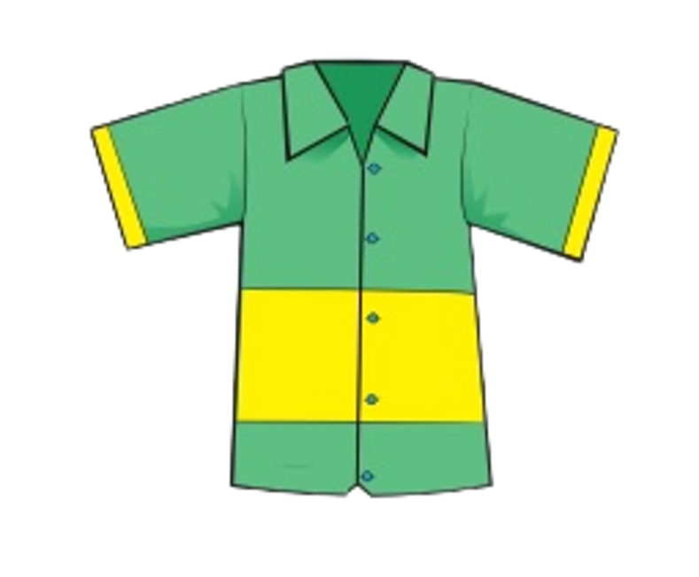
READ AND CHOOSE shoes
Try again!
Correct!
Try again!
Next

Slide 25
LISTEN AND CHOOSE
sh
th
ch
Try again!
Correct!
Try again!
Next

Slide 26
LISTEN AND CHOOSE
ch
sh
th
Try again!
Correct!
Try again!
Next

Slide 27
Good job!

Slide 28
Thank you!

