Slide 1
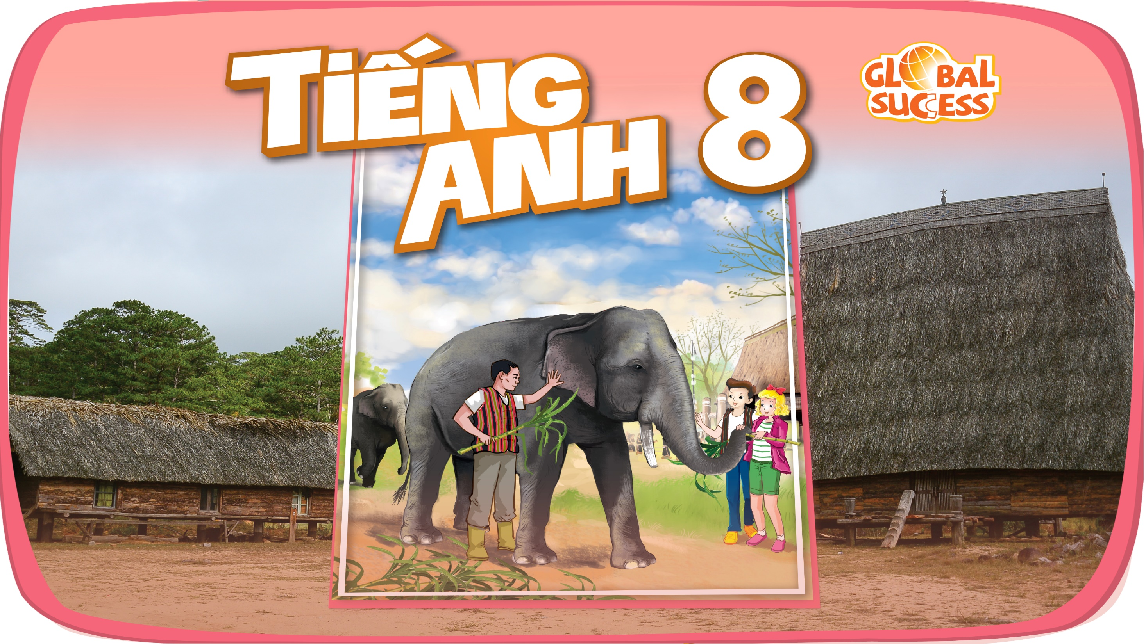

Slide 2

LESSON 1: GETTING STARTED
WARM-UP
Asking questions
PRESENTATION
Vocabulary
Task 1: Listen and read.
Task 2: Read the conversation again and tick T (True) or F (False).
Task 3: Match the phrase with the correct pictures.
Task 4: Complete the sentences with the verbs from the box.
PRACTICE
FURTHER PRACTICE
Task 5: Quiz Time
CONSOLIDATION
Wrap-up
Homework

Slide 3
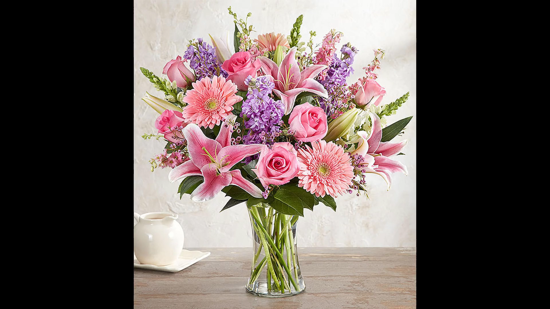
WARM-UP
1. Can you name some festivals in Viet Nam?
2. Do you like Tet holiday?
3. What do you do before Tet holiday?
4. What do you do during Tet holiday?

Slide 4

WARM-UP
Keys:
watermelon, ao dai, lion dance, fireworks, fruits, flowers, lucky money, nuts, banh chung, ca chep, candy, lantern, dried fruits

Slide 5
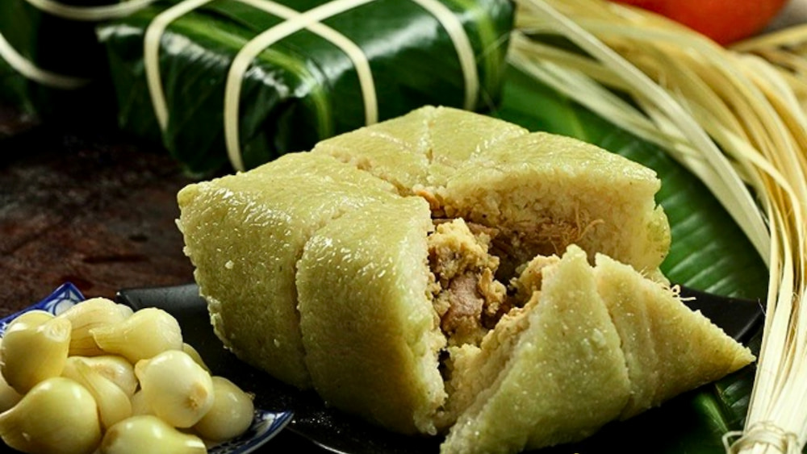
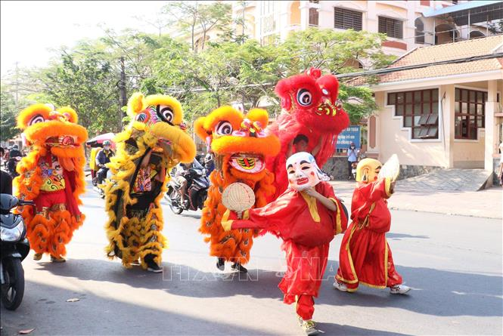
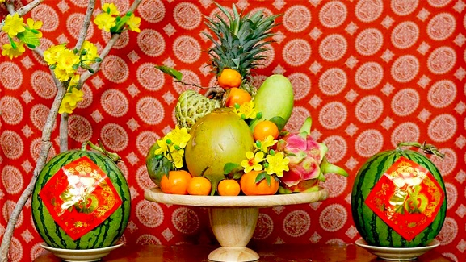
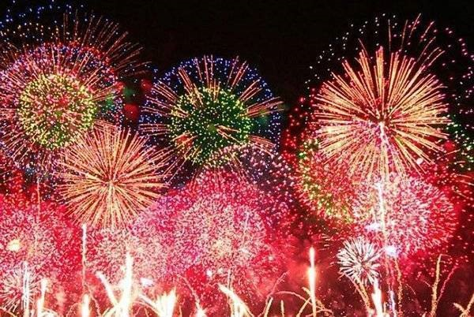
Tet holiday / Lunar New Year
WARM-UP
Answer the questions!
1. What festival are the things in the clip related to?
2. Do you like Tet holiday?
3. What do you do before Tet holiday?
4. What do you do during Tet holiday?

Slide 6
Unit
5
OUR CUSTOMS AND TRADITIONS
LESSON 1: GETTING STARTED
LESSON 1: GETTING STARTED
Tet is coming!

Slide 7
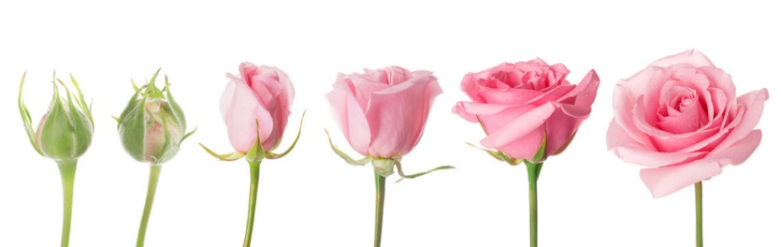
PRESENTATION
1
Listen and read.
a blooming flower
/ə ˈbluːmɪŋ ˈflaʊər/
bông hoa đang nở

Slide 8
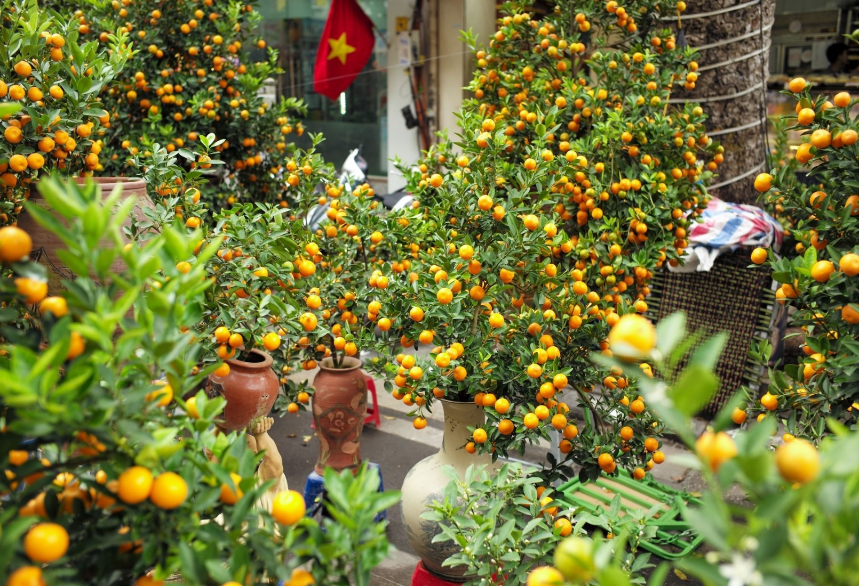
a kumquat tree (n)
/ə ˈkʌmkwɒt tri:/
cây quất, cây tắc

Slide 9
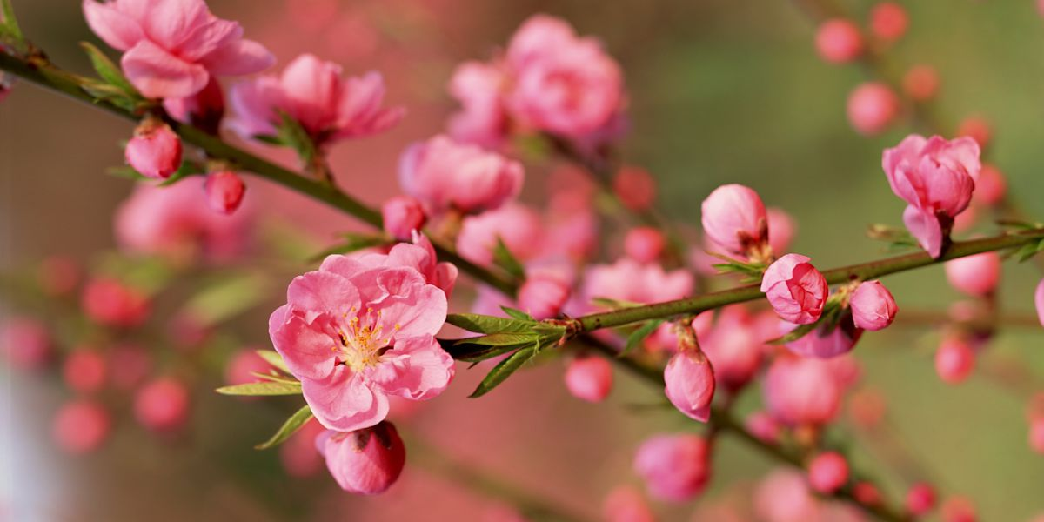
peach blossom (n)
/piːtʃ ˈblɒsəm/
hoa đào

Slide 10
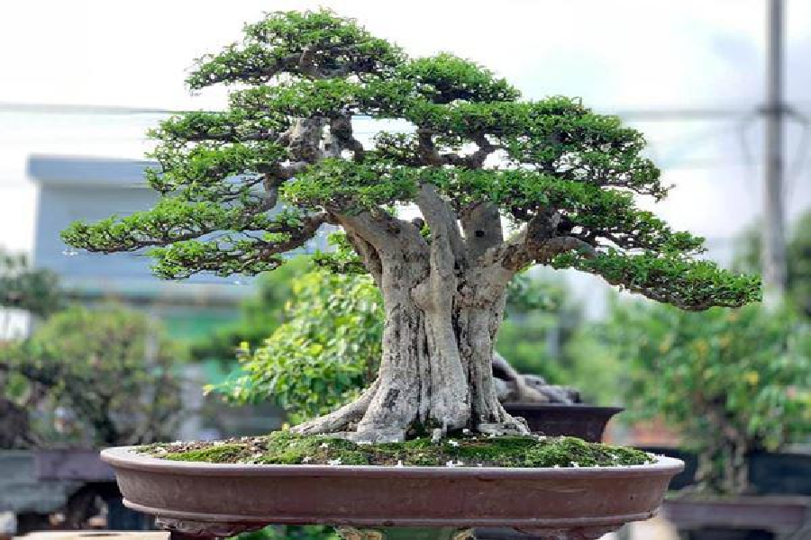
an ornamental tree
/ɔːnəˈmentl triː/
cây cảnh

Slide 11
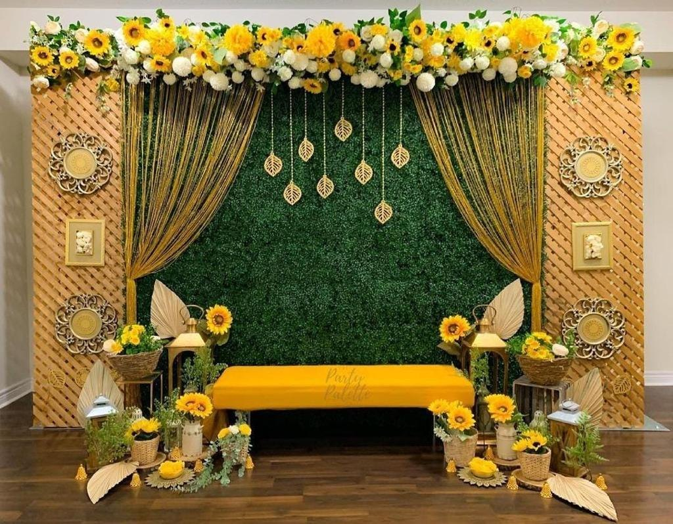
decoration (n)
/ˌdekəˈreɪʃən/
sự trang trí

Slide 12
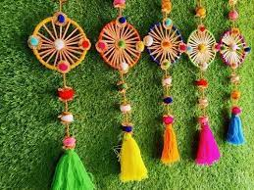
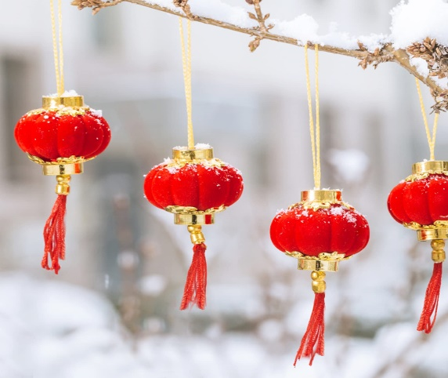
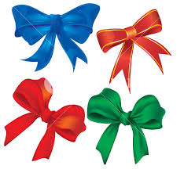
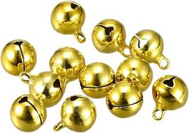
decorative items
/ˈdekərətɪv ˈaɪtəmz/
những đồ vật trang trí

Slide 13
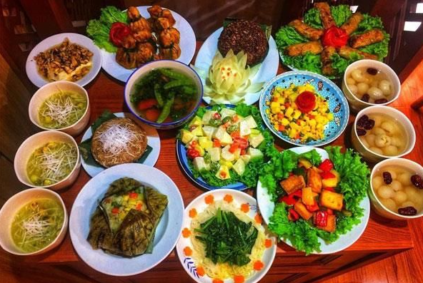
offering (n)
/ˈɒfərɪŋ/
đồ thờ cúng

Slide 14
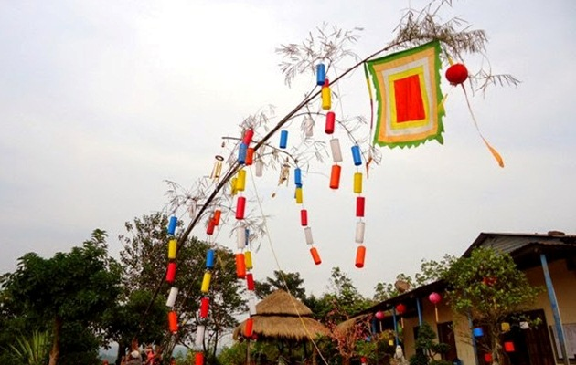
a bamboo pole (n)
/ə bæmˈbuː pəʊl/
cây nêu

Slide 15

chase away (v)
/tʃeɪs əˈweɪ/
xua đuổi

Slide 16
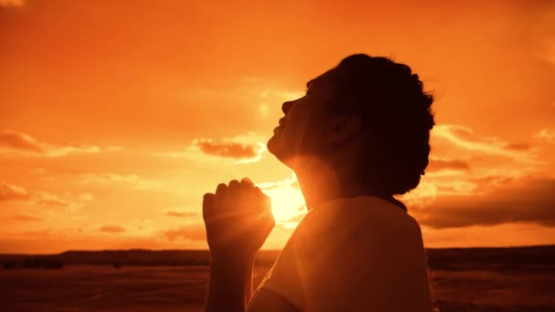
pray for (v.phr)
/preɪ fɔːr /
cầu nguyện cho

Slide 17
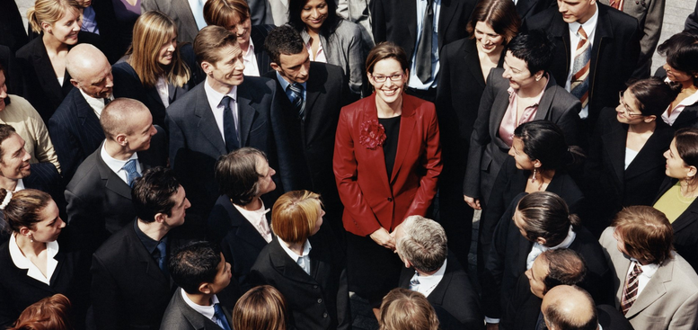
admire (v)
/ədˈmaɪər/
khâm phục, ngưỡng mộ/ nhìn ngắm

Slide 18
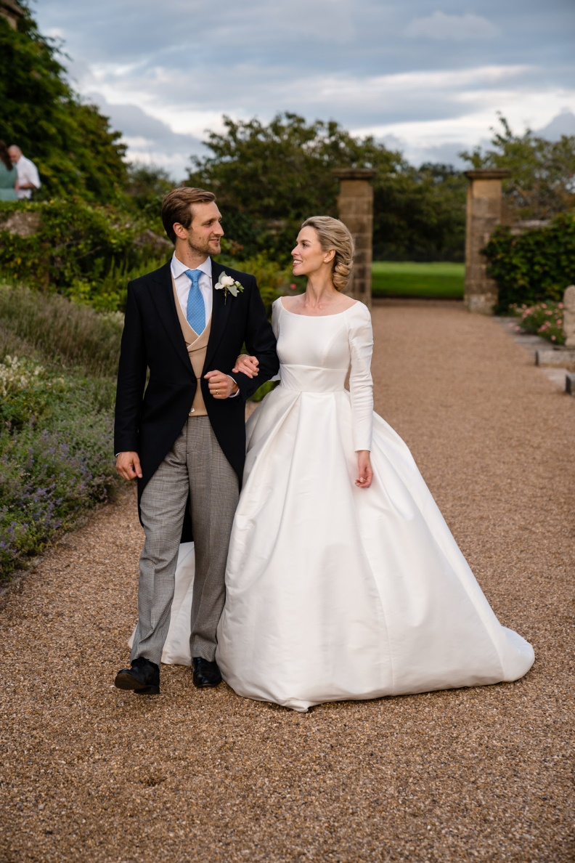
custom (n)
/ˈkʌstəm/
phong tục
Ex: In my country, it's the custom for women
to get married in white.

Slide 19
*New words
1. a blooming flower (n.phr) | bông hoa đang nở | 7. offering (n) | đồ thờ cúng
2. a kumquat tree (n.phr) | cây quất, cây tắc | 8. a bamboo pole (n.phr) | cây nêu
3. peach blossom (n.phr) | hoa đào | 9. chase away (v.phr) | xua đuổi
4. an ornamental tree (n.phr) | cây cảnh | 10. pray for (v.phr) | cầu nguyện cho
5. decoration (n) | sự trang trí | 11. admire (v) | nhìn ngắm
6. decorative items (n.phr) | những đồ vật trang trí | 12. custom (n) | phong tục

Slide 20


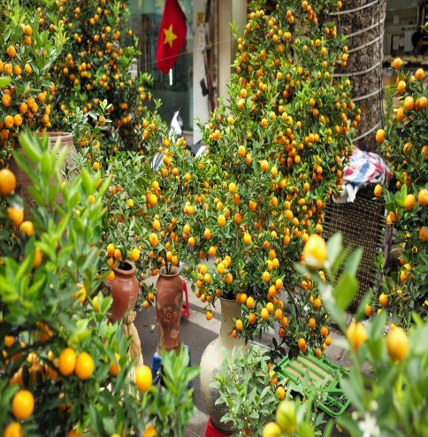

Checking vocabulary
1.
2.
3.
4.
5.
peach
blossom
pray for
chase away
bamboo pole
admire
6.
7.
8.
9.
10.
blooming
flower
ornamental
tree
kumquat
tree
decoration
offering

Slide 21
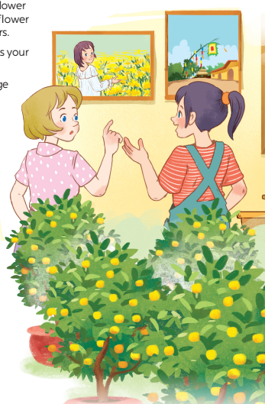
PRACTICE
1
Listen and read.
1. What can you see in each picture?
2. Can you guess the places that the picture show?

Slide 22

1
Listen and read.
Elena: Wow, this girl looks so cute.
Trang: Yeah ... She’s my cousin. She’s at Sa Dec Flower Village. Tet is coming soon, so many
people visit flower villages to take pictures with the blooming flowers.
Elena: Oh, I’m fond of admiring the flowers. Does your family visit places like this too?
Trang: Yes, we do. We usually visit Nhat Tan Village to buy kumquat trees and peach blossoms.
Elena: I see flowers and ornamental trees everywhere these days. What are they for?
Trang: We, Vietnamese, use plants and flowers for decorations and for oﬀerings. They are an important part of our Tet tradition.
Elena: And what’s that tall tree in the photo?
Trang: Well, it’s actually a bamboo pole. People place it in the yard of the communal house. They hang decorative items like small bells and lanterns on it. They want to chase away bad luck and pray for a lucky New Year.
Elena: Interesting! I didn’t know that.

Slide 23
1
Listen and read.
Elena: Wow, this girl looks so cute.
Trang: Yeah ... She’s my cousin. She’s at Sa Dec Flower Village. Tet is coming soon, so many
people visit flower villages to take pictures with the blooming flowers.
Elena: Oh, I’m fond of admiring the flowers. Does your family visit places like this too?
Trang: Yes, we do. We usually visit Nhat Tan Village to buy kumquat trees and peach blossoms.
Elena: I see flowers and ornamental trees everywhere these days. What are they for?
Trang: We, Vietnamese, use plants and flowers for decorations and for oﬀerings. They are an important part of our Tet tradition.
Elena: And what’s that tall tree in the photo?
Trang: Well, it’s actually a bamboo pole. People place it in the yard of the communal house. They hang decorative items like small bells and lanterns on it. They want to chase away bad luck and pray for a lucky New Year.
Elena: Interesting! I didn’t know that.

Slide 24
PRACTICE
2
Read the conversation again and tick T (True) or F (False).
Sentences | T | F
1. Elena and Trang are at Sa Dec Flower Village.
2. Many people visit ﬂower villages to take photos.
3. Trang’s family usually buys kumquat trees and peach blossoms at Nhat Tan Village.
4. Flowers are not part of any Vietnamese traditions.
5. People decorate bamboo poles with small bells and lanterns for New Years.

Slide 25
PRACTICE
2
Read the conversation again and tick T (True) or F (False).
Sentences | T | F
1. Elena and Trang are at Sa Dec Flower Village.
2. Many people visit ﬂower villages to take photos.
3. Trang’s family usually buys kumquat trees and peach blossoms at Nhat Tan Village.
4. Flowers are not part of any Vietnamese traditions.
5. People decorate bamboo poles with small bells and lanterns for New Years.

Slide 26

2
Read the conversation again and tick T (True) or F (False).
Sentences | T | F
1. Elena and Trang are at Sa Dec Flower Village.
1. Trang’s cousin is at Sa Dec Flower Village.
2. Many people visit ﬂower villages to take photos.
Trang: Yeah ... She’s my cousin. She’s at Sa Dec Flower Village.
3. Trang’s family usually buys kumquat trees and peach blossoms at Nhat Tan Village.
Trang: Tet is coming soon, so many people visit flower villages to take pictures with the blooming flowers.
Trang: Yes, we do. We usually visit Nhat Tan Village to buy kumquat trees and peach blossoms.
4. Flowers are not part of any Vietnamese traditions.
4. Plants and flowers are an important part of Tet.
Trang: We, Vietnamese, use plants and flowers for decorations and for oﬀerings. They are an important part of our Tet tradition.
5. People decorate bamboo poles with small bells and lanterns for New Years.
Trang: Well, it’s actually a bamboo pole. People place it in the yard of the communal house. They hang decorative items like small bells and lanterns on it. They want to chase away bad luck and pray for a lucky New Year.

Slide 27
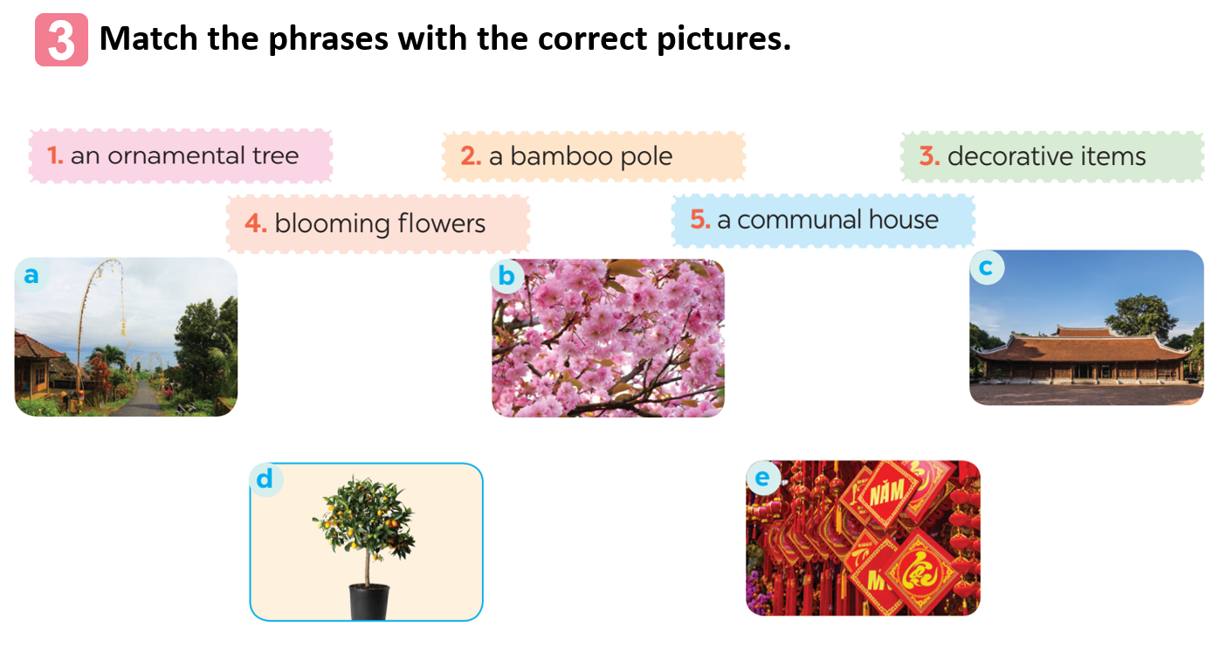
1

Slide 28

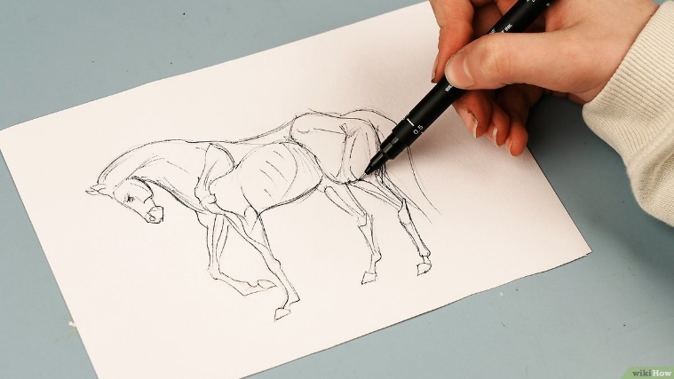
Draw and guess
1

Slide 29
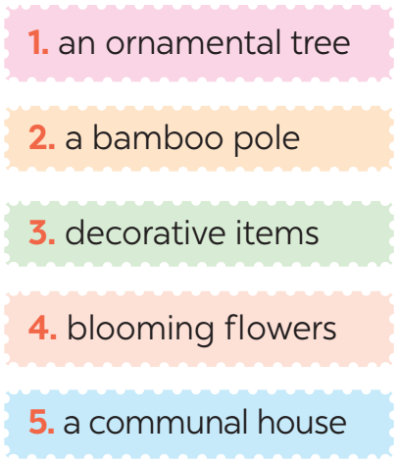
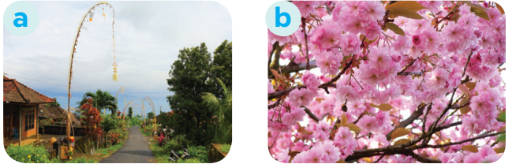
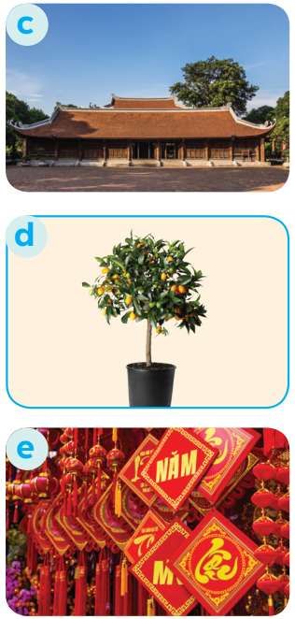
3
Match the phrases with the correct pictures.

Slide 30
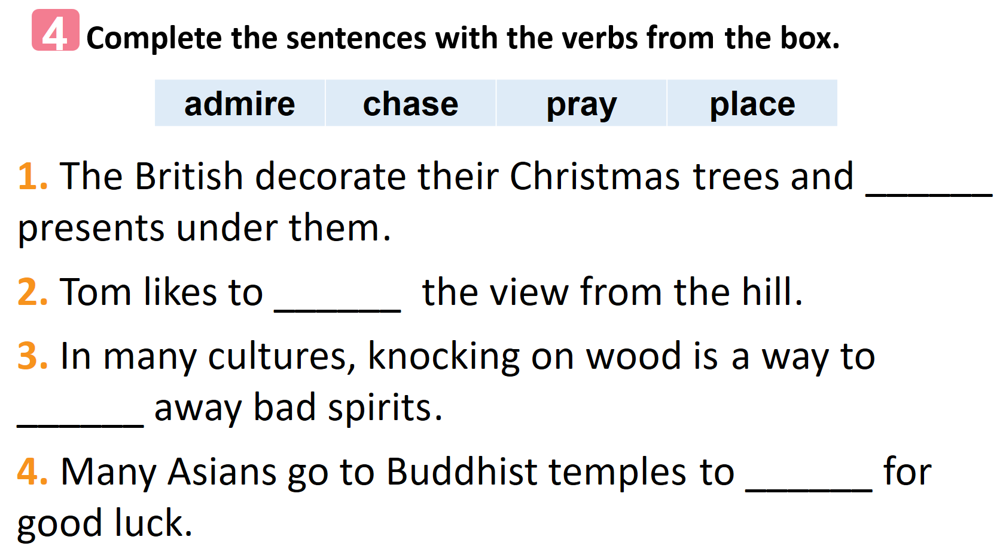
1

Slide 31
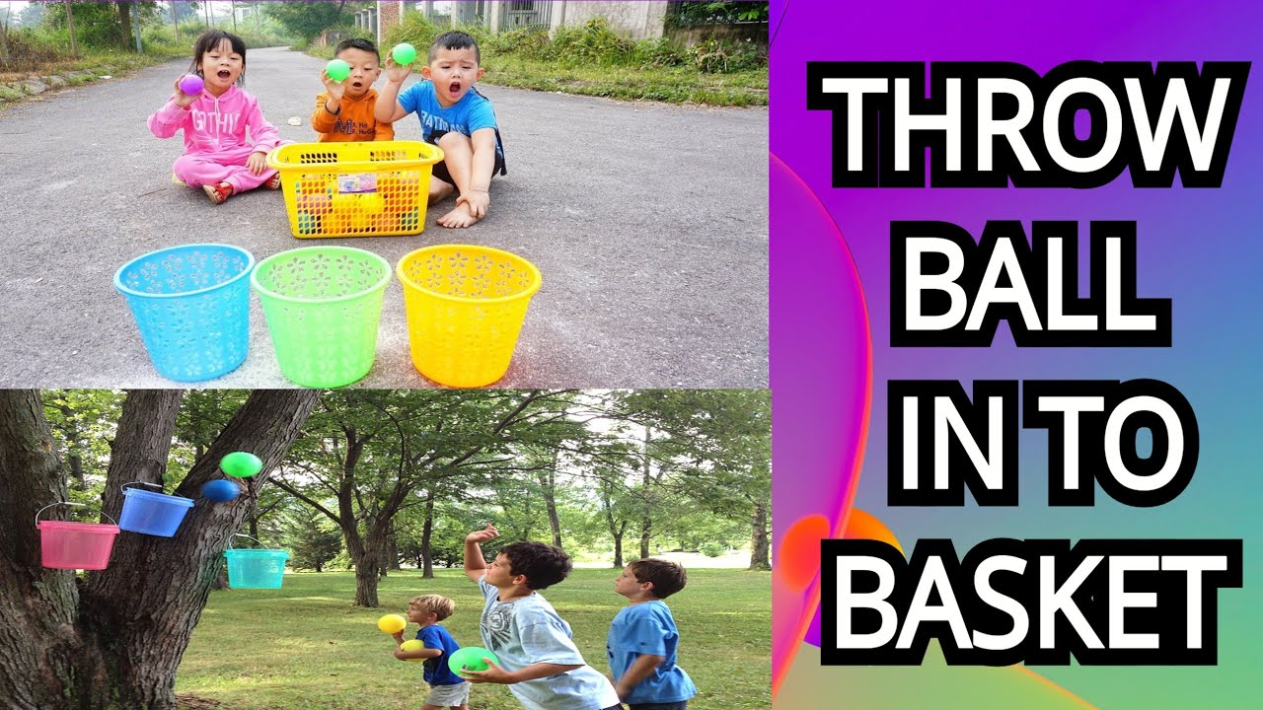
1

Slide 32
4
Complete the sentences with the verbs from the box.
admire | chase | pray | place
1. The British decorate their Christmas trees and ______ presents under them.
2. Tom likes to ______ the view from the hill.
3. In many cultures, knocking on wood is a way to ______ away bad spirits.
4. Many Asians go to Buddhist temples to ______ for good luck.
place
admire
chase
pray

Slide 33

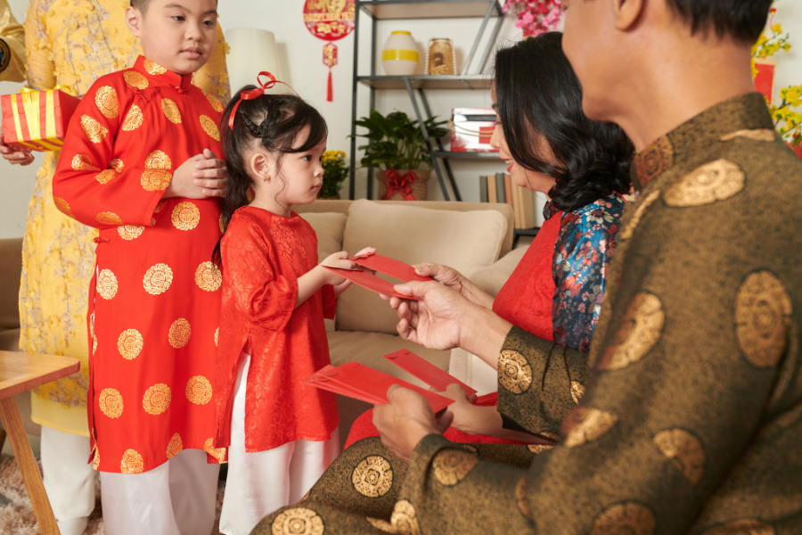
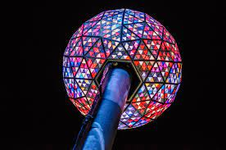
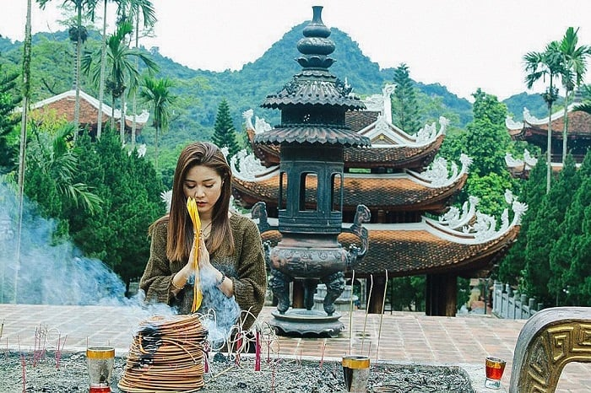
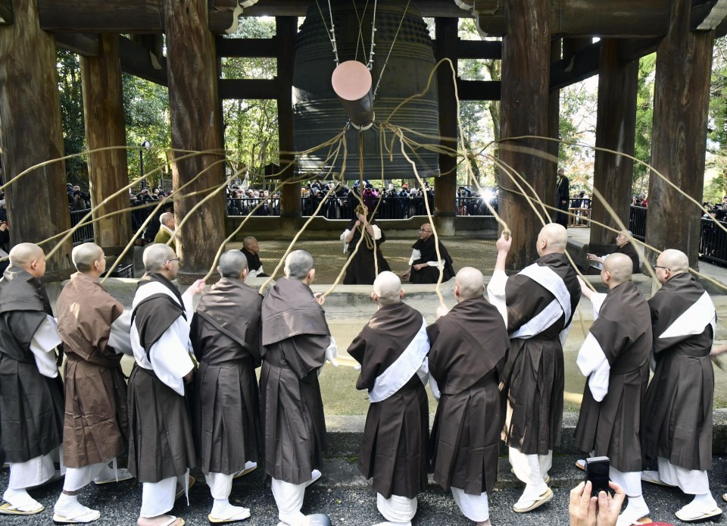
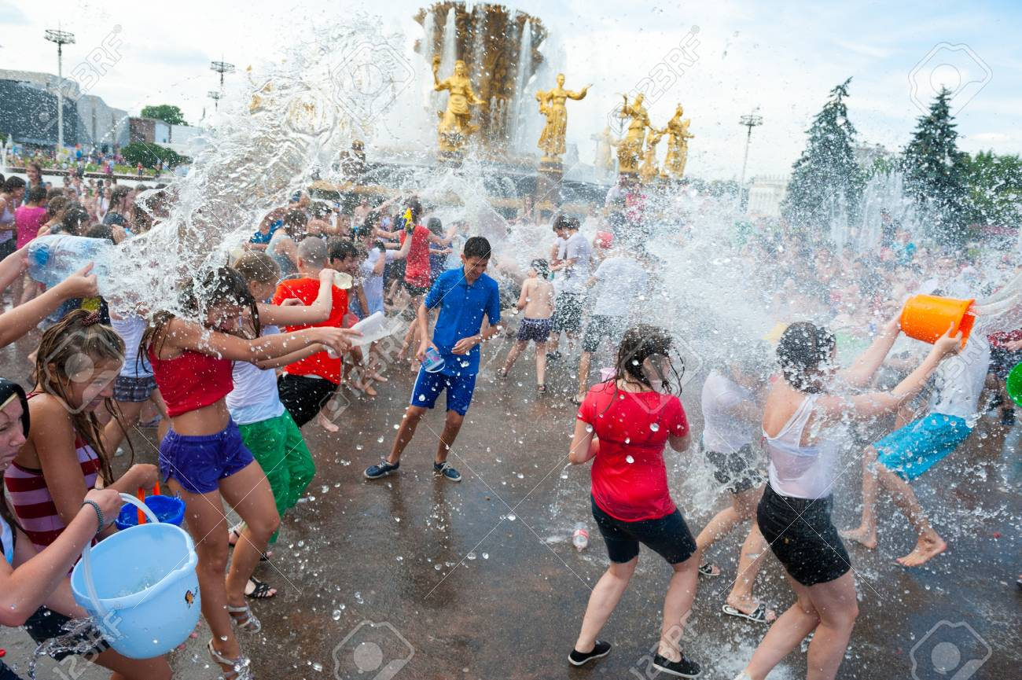
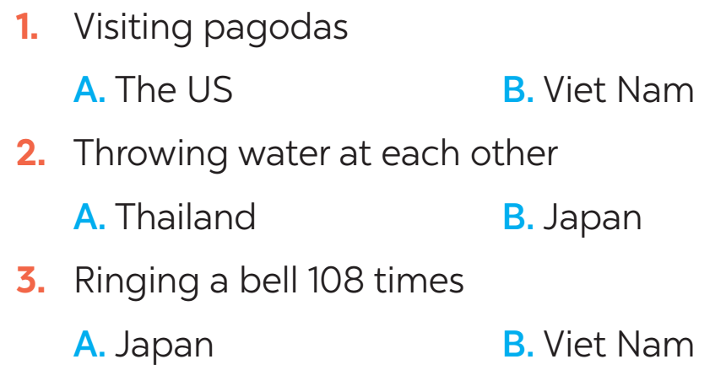
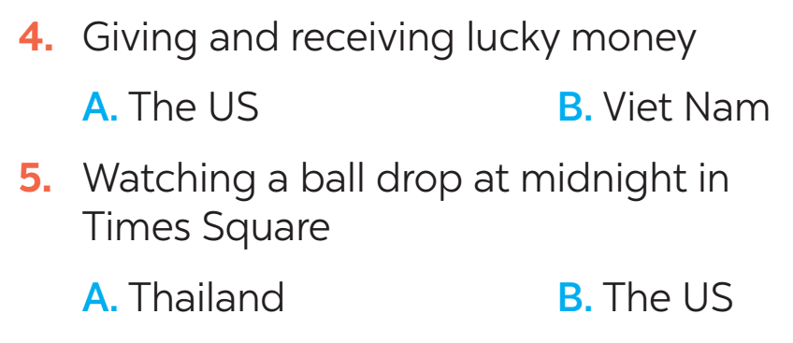
FURTHER PRACTICE
5
New Years around the world.
People around the world celebrate New Years differently. Choose the tradition below.

Slide 34

CONSOLIDATION
1
Wrap-up
What have we learnt in this lesson?
identify the topic of the unit
use lexical items related to Tet holiday

Slide 35

CONSOLIDATION
2
Homework
- Learn the new words by heart.
- Practise talking about Tet Holiday.

Slide 36

Website: hoclieu.vn
Fanpage: facebook.com/www.tienganhglobalsuccess.vn/

