Slide 1


UNIT 5: OUR CUSTOMS AND TRADITIONS
>>> A CLOSER LOOK 2 <<<

Slide 2


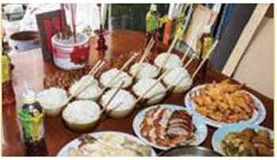
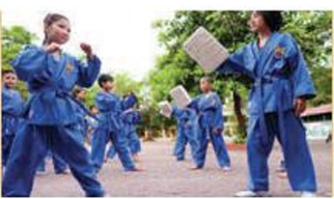
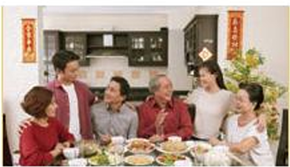
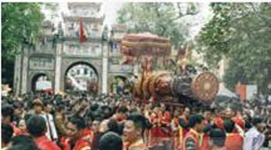
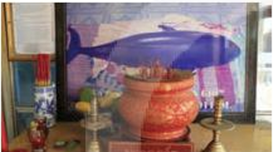
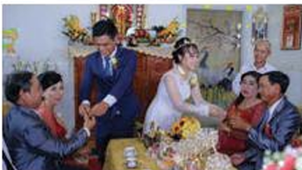
A
B
1.
1.
4
2
5
9
3
8
0
6
1
7
17
11
12
20
14
15
13
16
10
18
19
food offerings
martial arts
2.
2.
festival goers
family reunion
3.
3.
whale worship
wedding ceremony

Slide 3
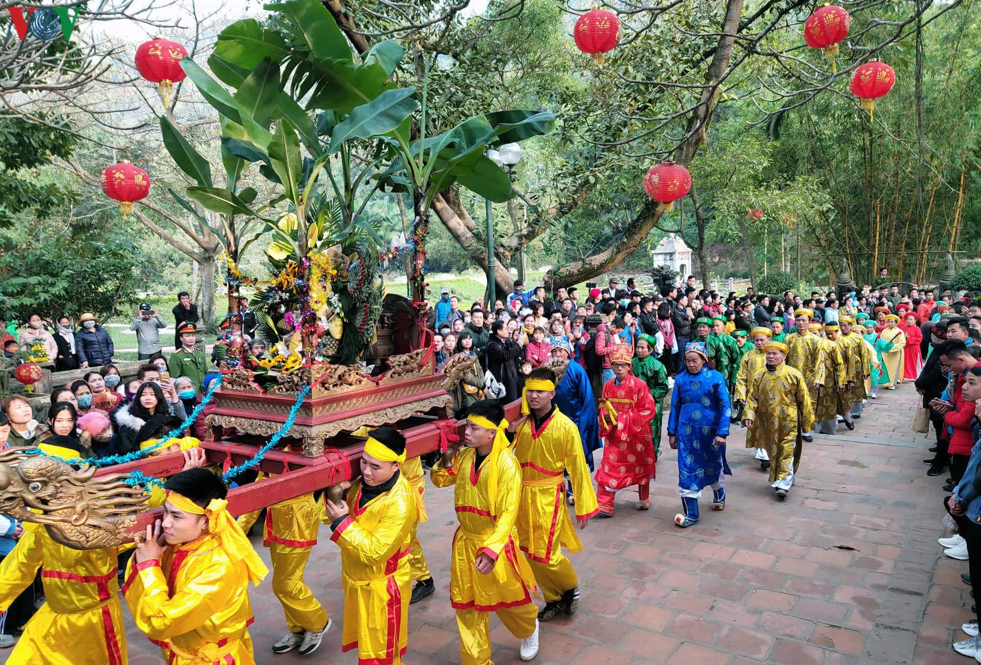
I saw a festival goer at the market.

Slide 4
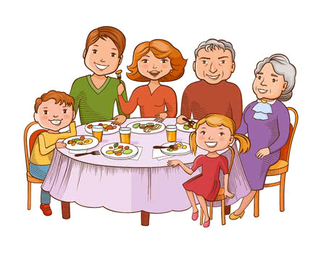
The family reunion was held last week.

Slide 5
a
an
Indefinite Articles
Mạo từ KHÔNG xác định
the
2. Definite Article
Mạo từ xác định

Slide 6
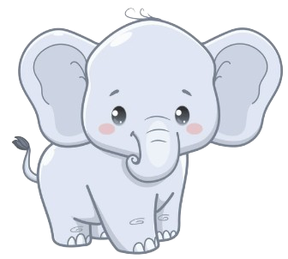
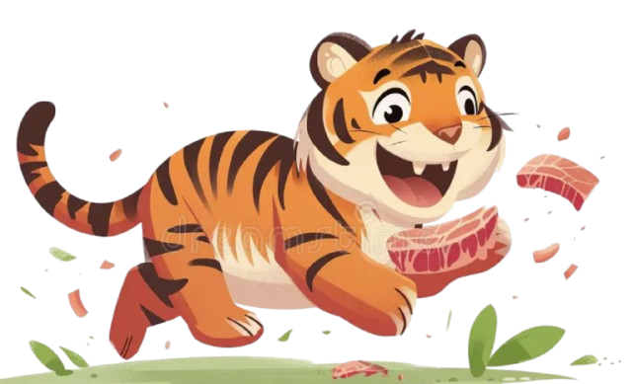
a
an
* I saw___ tiger
and ____ elephant in the zoo.
The
* _____ tiger is eating meat.

Slide 7

Ø
* He goes to school by ____ bike .

Slide 8
GRAMMAR
C
ARTICLES
01
a
02
an
03
the
04
the zero article

Slide 9

REMEMBER
Articles in English include a / an, the and the zero articles
Sometimes, we use nouns without a / an or the. We call this the zero article.

Slide 10
We use the zero article
with uncountable or abstract nouns
EX: Sugar, Salt, Money, Education, …
when making general statements
EX: Students should work hard.
when describing general forms of transport.
EX: by bike, by air, by train, …

Slide 11
when talking about years, months, days.
EX: in 2025, in January, in March, on Monday, ..
when talking about school subjects, sports, and games
EX: study Maths, play football, play chess, …
with the name of meals
EX: have breakfast, have lunch, have dinner

Slide 12
when talking about proper nouns (tên riêng)
EX:
Personal name: Kien, John, …..
Countries: Viet Nam, Thailand, …
Languages: Vietnamese, English, …
Continents: Asia, Africa, …
Individual Mountains: Mount Everest, Mount Fuji, …
Lakes: Hoan Kiem Lake, Xuan Huong Lake, …
Islands: Easter Island, Phu Quoc Island, …
Streets: Nguyen Ai Quoc Street, Dong Khoi street, …

Slide 13
Task 1
Choose the correct option in each sentence below.

Slide 14


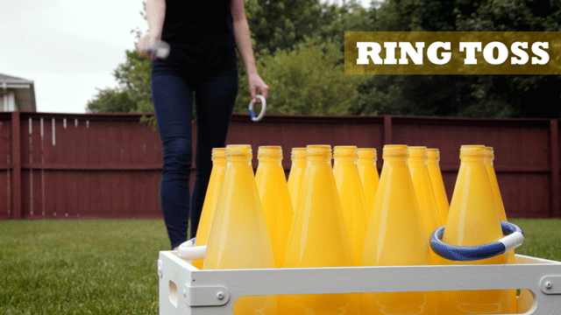
CONE RING TOSS GAME
Cone ring toss game

Slide 15


1. It takes more than a / an hour to drive to Can Tho.
2. It’s a / Ø tradition for children to wake up early on Christmas Day.
3. The Ok Om Bok Festival takes place in the / Ø October.
4. We went to Can Tho by an / Ø air.
5. A: Where’s a / the book?
B: I thought you left it next to the TV.

Slide 16



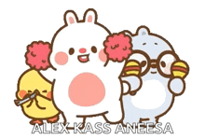




Question BGM
CONE RING TOSS GAME
CLOSE
00
START
TIMER
IS THAT YOUR FINAL ANSWER?
END
$200
YES
NO
1
2
Start
CORRECT ANSWER
END
CONTINUE

Slide 17
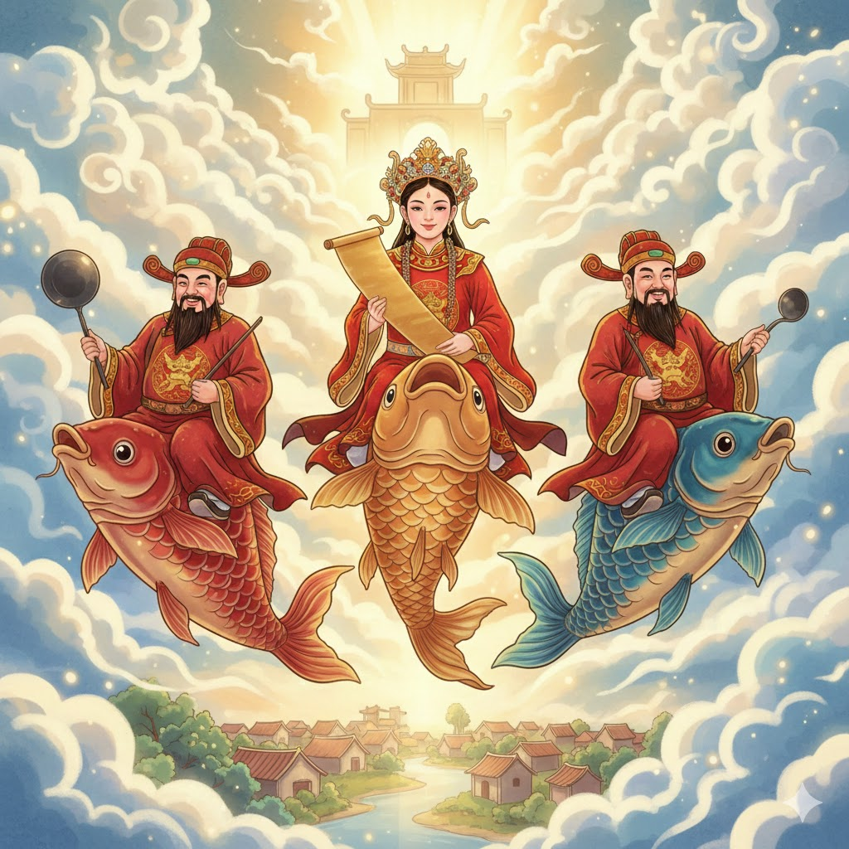
1. Who are they?
→ They are the Kitchen Gods.
2. Which type of fish carries the Kitchen Gods to Heaven?
→ The carp
3. When do the carp carry the Kitchen Gods to Heaven?
On the 23rd day of the
twelfth lunar month.
The Kitchen Gods Worshipping Ceremony

Slide 18
Task 2
Which of the underlined parts in each question is incorrect? Find and correct it.

Slide 19
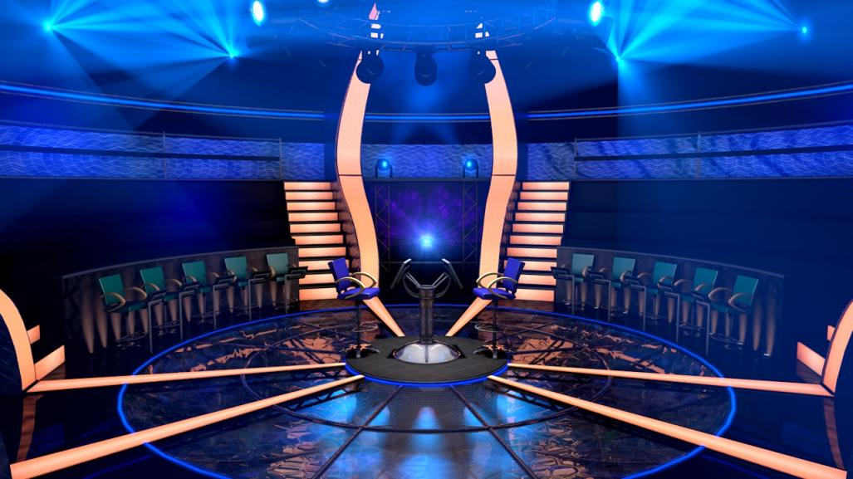



Slide 20
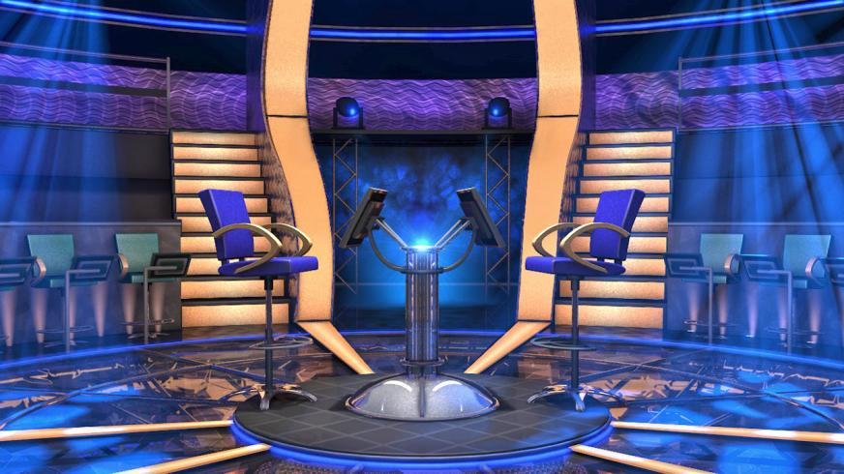
Question BGM
1. The worshipping Kitchen Gods is a long-time
tradition of the Vietnamese.
X
Q Select
$1,000,000
A
B
Q Right
$500,000
$250,000
CLOSE
Q Wrong
$100,000
C
$50,000
00
$25,000
START
TIMER
$16,000
$8,000
IS THAT YOUR FINAL ANSWER?
END
$4,000
$200
$2,000
YES
NO
$1,000
A
a
The
B
$500
$300
1
2
$200
C
$100
the
CORRECT ANSWER
END
CONTINUE
Bắt đầu

Slide 21
Question BGM
2. People organise the worshipping
ceremony at noon so that a Kitchen Gods
can leave for Heaven at 12 o'clock.
Q Select
$1,000,000
A
$500,000
the
Q Right
$250,000
CLOSE
Q Wrong
$100,000
B
C
$50,000
00
$25,000
START
TIMER
$16,000
$8,000
IS THAT YOUR FINAL ANSWER?
END
$4,000
$200
$2,000
YES
NO
$1,000
the
noon
$500
A
B
$300
1
2
$200
a
$100
C
CORRECT ANSWER
END
CONTINUE
Bắt đầu

Slide 22
Question BGM
3. Most families in the Viet Nam prepare
offerings for the Kitchen Gods.
X
Q Select
$1,000,000
A
B
Q Right
$500,000
$250,000
CLOSE
C
Q Wrong
$100,000
$50,000
00
$25,000
START
TIMER
$16,000
$8,000
IS THAT YOUR FINAL ANSWER?
END
$4,000
$200
$2,000
YES
NO
$1,000
Most
the
$500
A
B
$300
1
2
$200
offerings
$100
C
CORRECT ANSWER
END
CONTINUE
Bắt đầu

Slide 23
Question BGM
4. The offerings include a set of flowers and
fruits, a paper clothes, and three carps.
Q Select
$1,000,000
A
B
Q Right
$500,000
X
$250,000
CLOSE
Q Wrong
$100,000
C
$50,000
00
$25,000
START
TIMER
$16,000
$8,000
IS THAT YOUR FINAL ANSWER?
END
$4,000
$200
$2,000
YES
NO
$1,000
The
a
$500
A
B
$300
1
2
$200
a
$100
C
CORRECT ANSWER
END
CONTINUE
Bắt đầu

Slide 24
Question BGM
5. The Vietnamese people believe that
the Kitchen Gods go to Heaven on carps.
X
Q Select
A
$1,000,000
Q Right
$500,000
$250,000
CLOSE
B
C
Q Wrong
$100,000
$50,000
00
$25,000
START
TIMER
$16,000
$8,000
IS THAT YOUR FINAL ANSWER?
END
$4,000
$200
$2,000
YES
NO
$1,000
The
the
$500
A
B
$300
1
2
$200
carps
$100
C
CORRECT ANSWER
END
CONTINUE
Bắt đầu

Slide 25
Task 3
Complete the text with the or Ø (zero article)

Slide 26

WHO IS THE FASTEST?

Slide 27
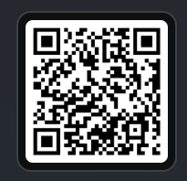
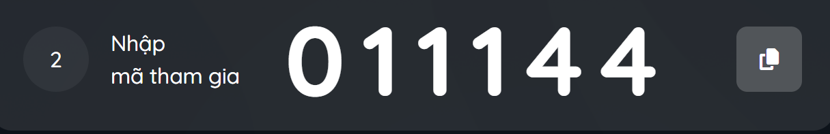

Slide 28
the
A recent study in (1) ____ UK shows that family time traditions are good for (2) ____ teens. These traditions include family members playing card games, watching their favourite TV programmes, or performing (3) ____ karaoke shows at weekends with one another. These activities often lead to lots of laughter and (4) ____ fun conversations. By taking part in such activities, teens strengthen (5) _________ bonds with their family.
∅
∅
∅
the

Slide 29
Task 4
Complete the sentences with a, an, the or Ø (zero article)

Slide 30

a
an
the

Slide 31
Complete sentences with a / an , the or ∅ (zero article)
3
1
5
2
4




✦

Slide 32
1
a
an
the
It is a custom in my family to
have ______ breakfast at home on Sundays.

∅
1
4
2
0
5
3

Slide 33
a
an
the
2
When visiting a family home in some countries, you should bring _____
small gift with you.
a

4
0
1
2
3
5

Slide 34
a
an
the
3
∅
Our village festival is held on the 10th of ___ January.

2
3
0
4
5
1

Slide 35
a
an
the
4
the
Ancient Egyptians worshipped _____ Sun.

4
0
2
3
1
5

Slide 36
a
an
the
5
an
Many people think that hard work is ____
important Vietnamese value.
✦
2
5
1
0
3
4

Slide 37
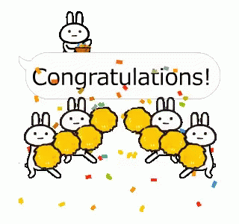

Slide 38
Articles
a dog, a cat,
a table, …
Viet Nam, October, …
a
an
∅
the
an apple,
an hour, ….
The Sun,
The Earth, …

Slide 39
Homework
◻
Review Articles

Prepare next lesson: Lesson 4: Communication
Homework link: https://yourhomework.net/quiz/assignment/1157-1764477910-81662700647143013
Pass: 1234 – Nhập họ và tên + Lớp

Slide 40
THANKS FOR ATTENDING

