Slide 1

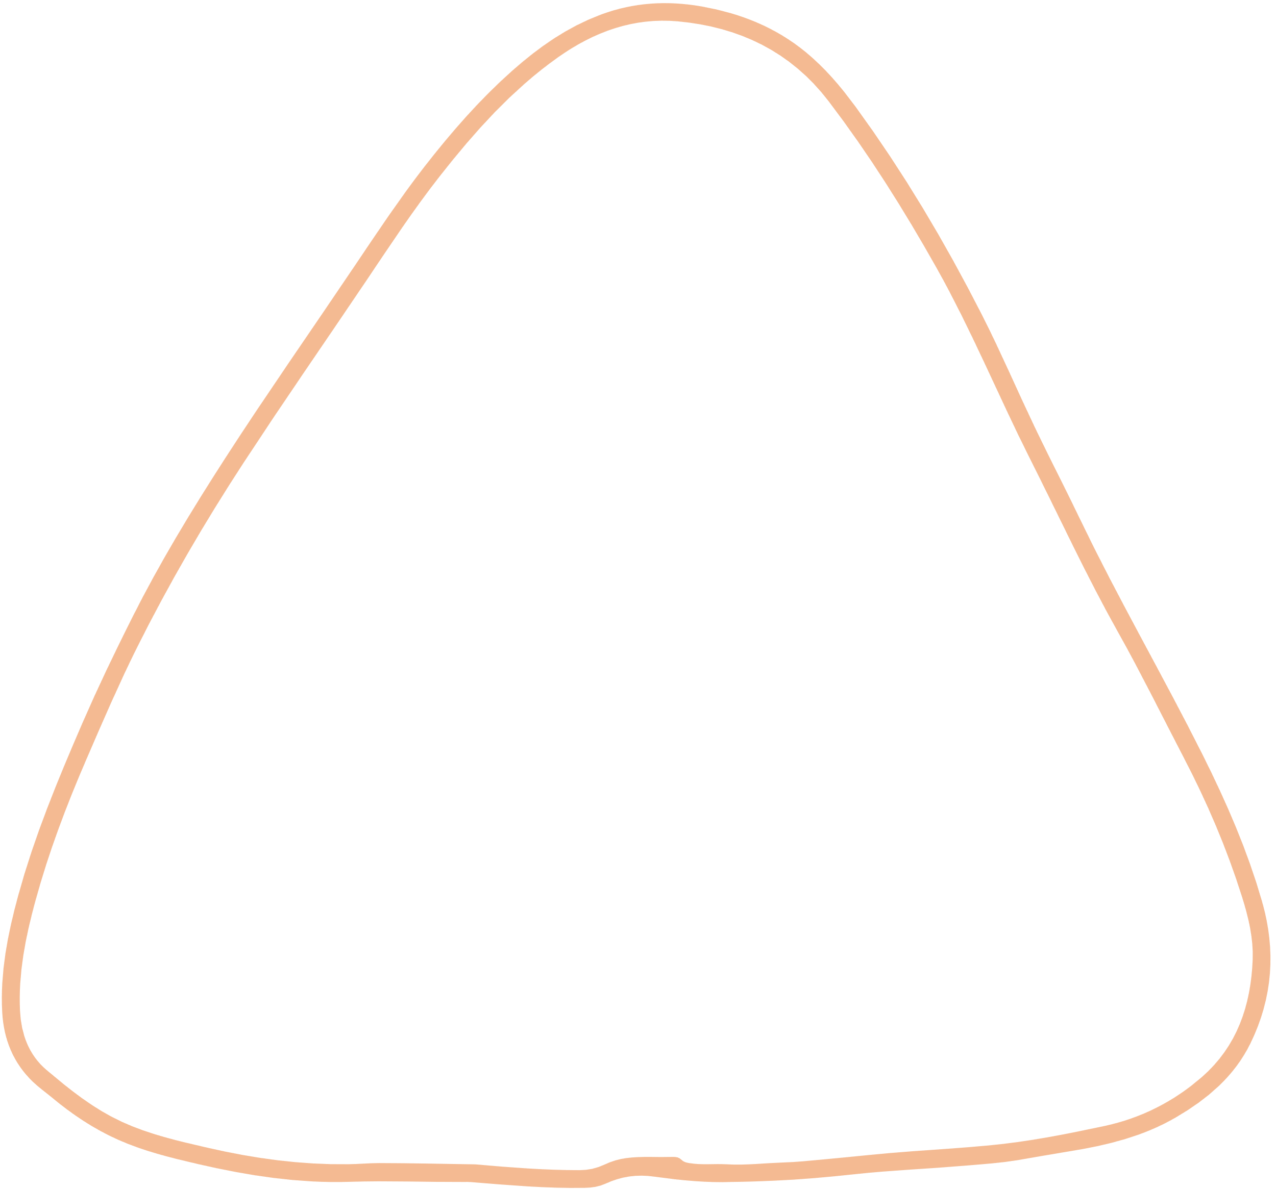



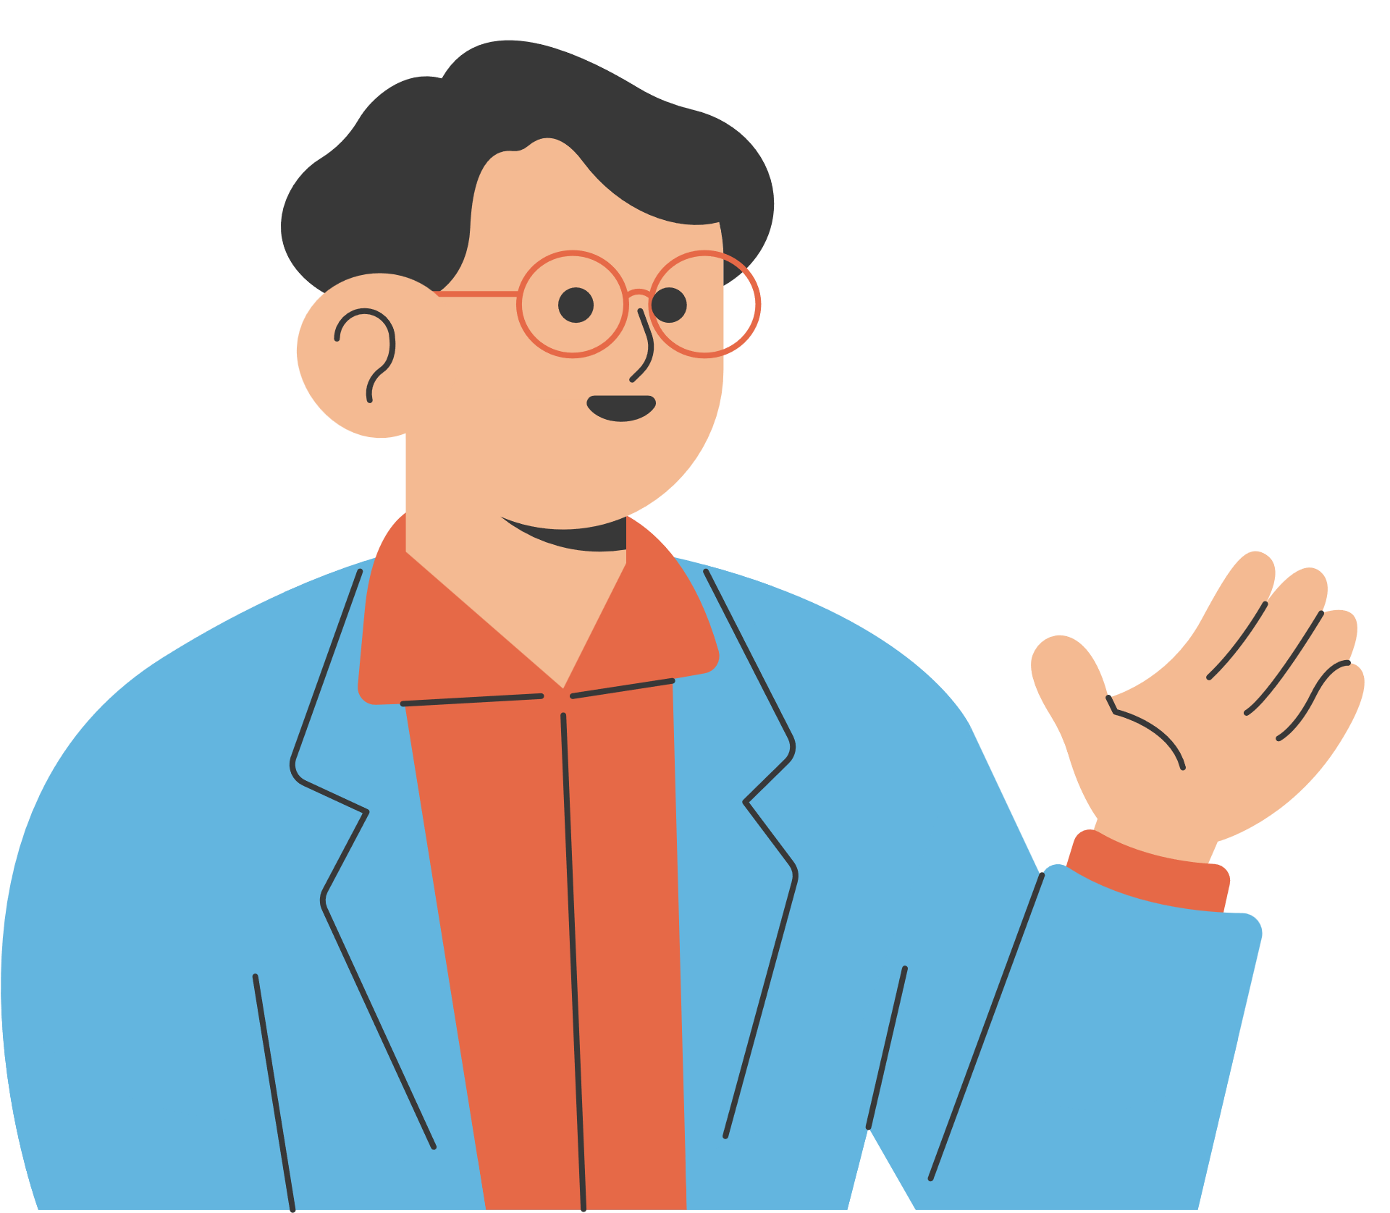


WELCOME TO OUR CLASS!
Teacher: ……..

Slide 2



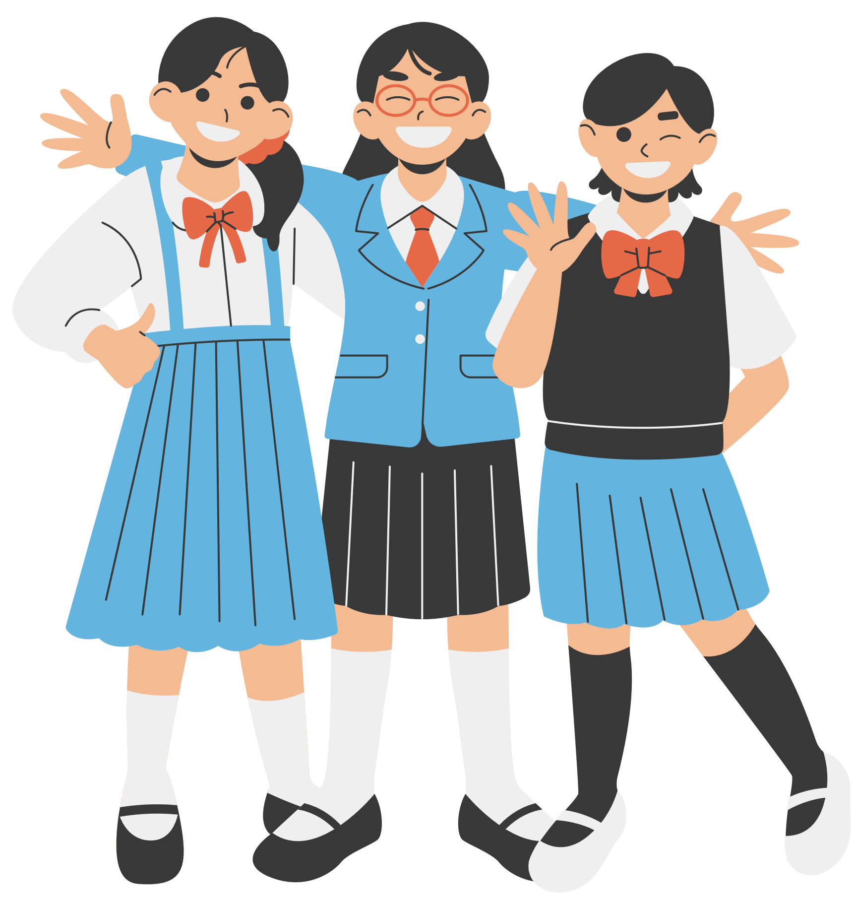


Unit 4:
Ethnic groups of viet nam
Lesson 6: Skills 2

Slide 3







Listening

Slide 4

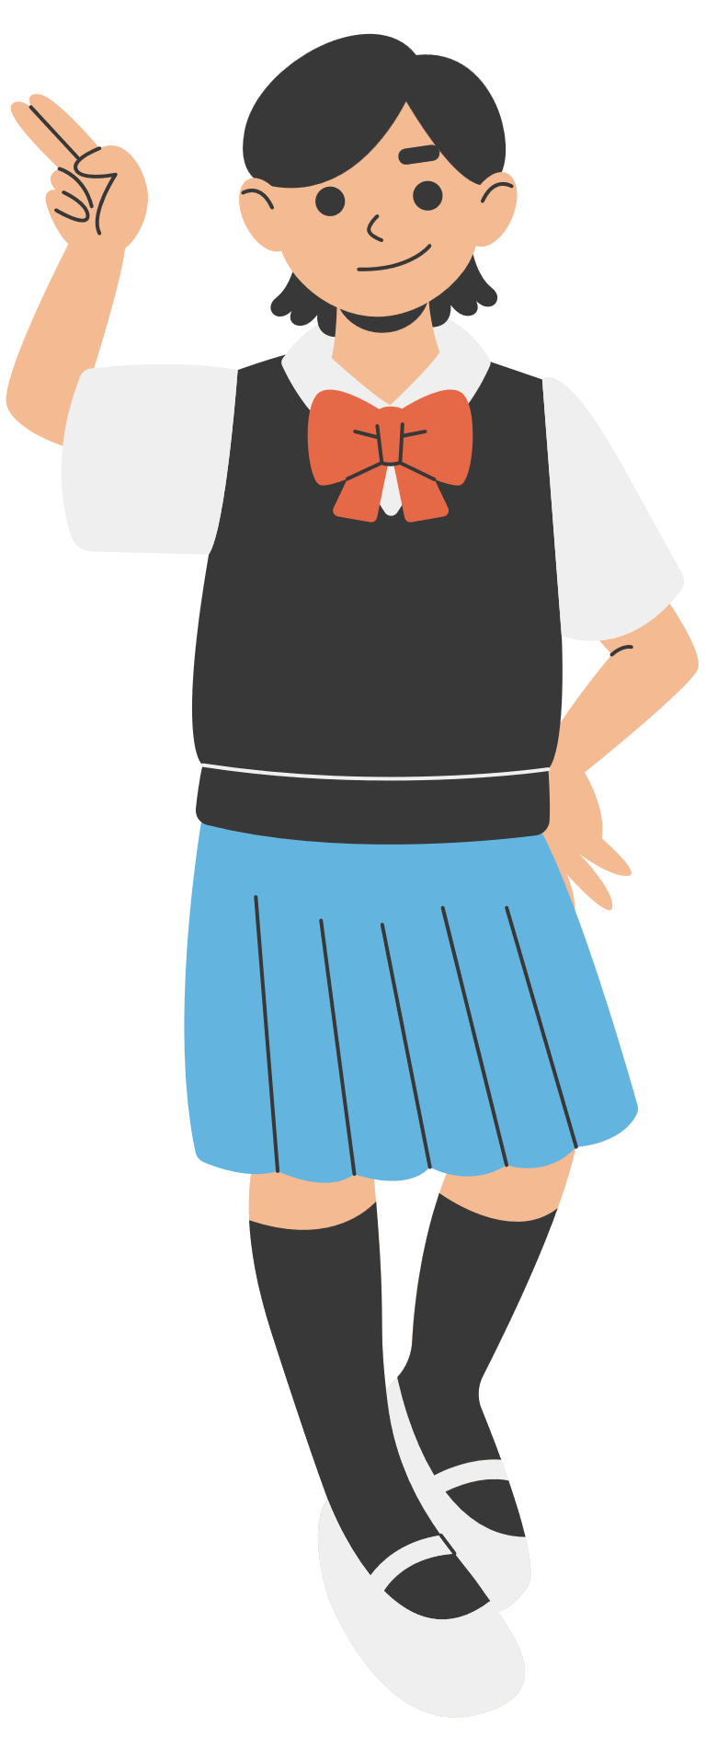



1. Match the phrases with the correct pictures.
1. catching fish
2. weaving clothing
3. growing crops
_______________
_______________
_______________

Slide 5
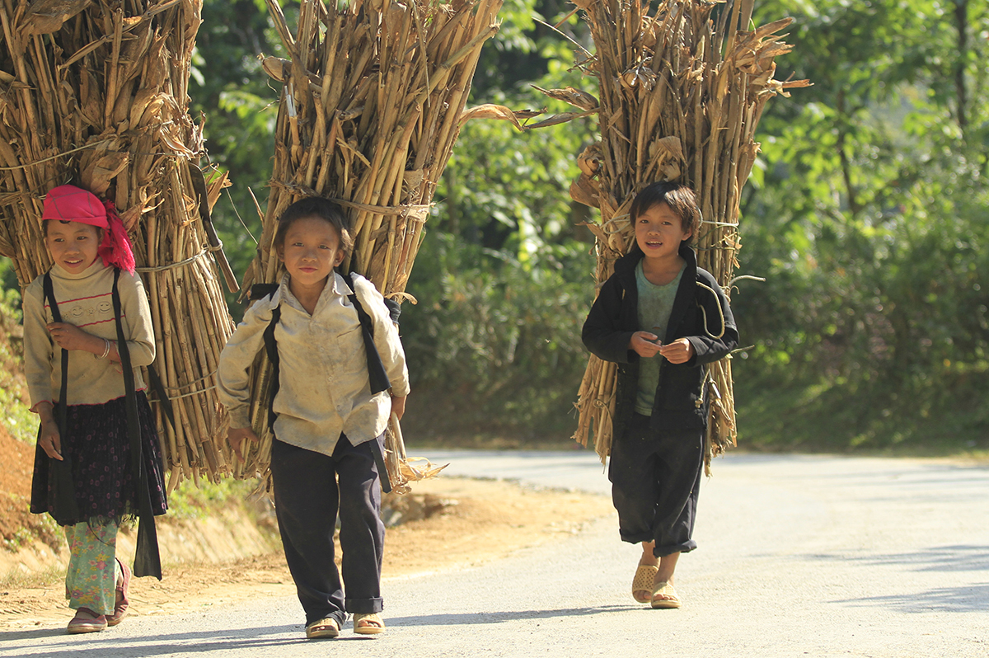
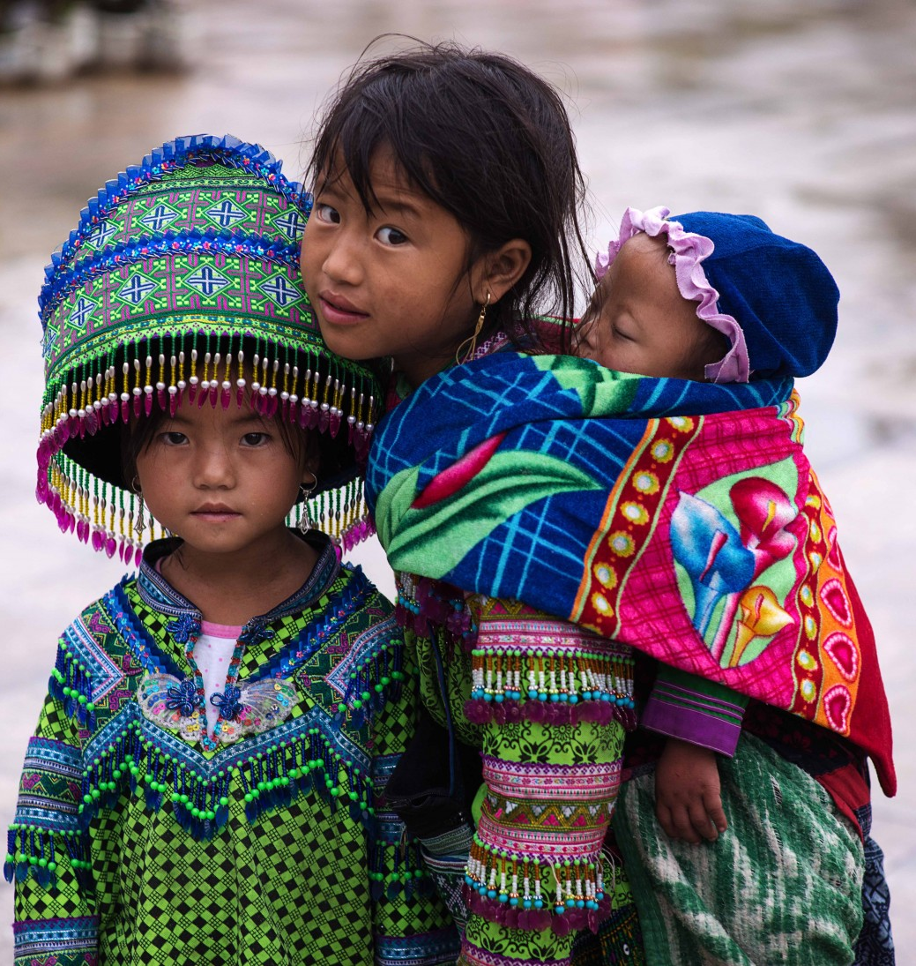
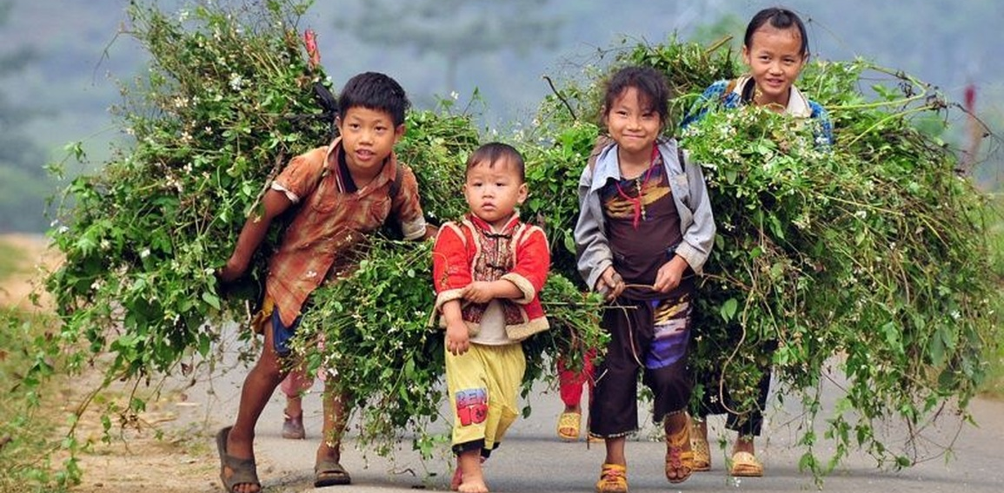

Slide 6

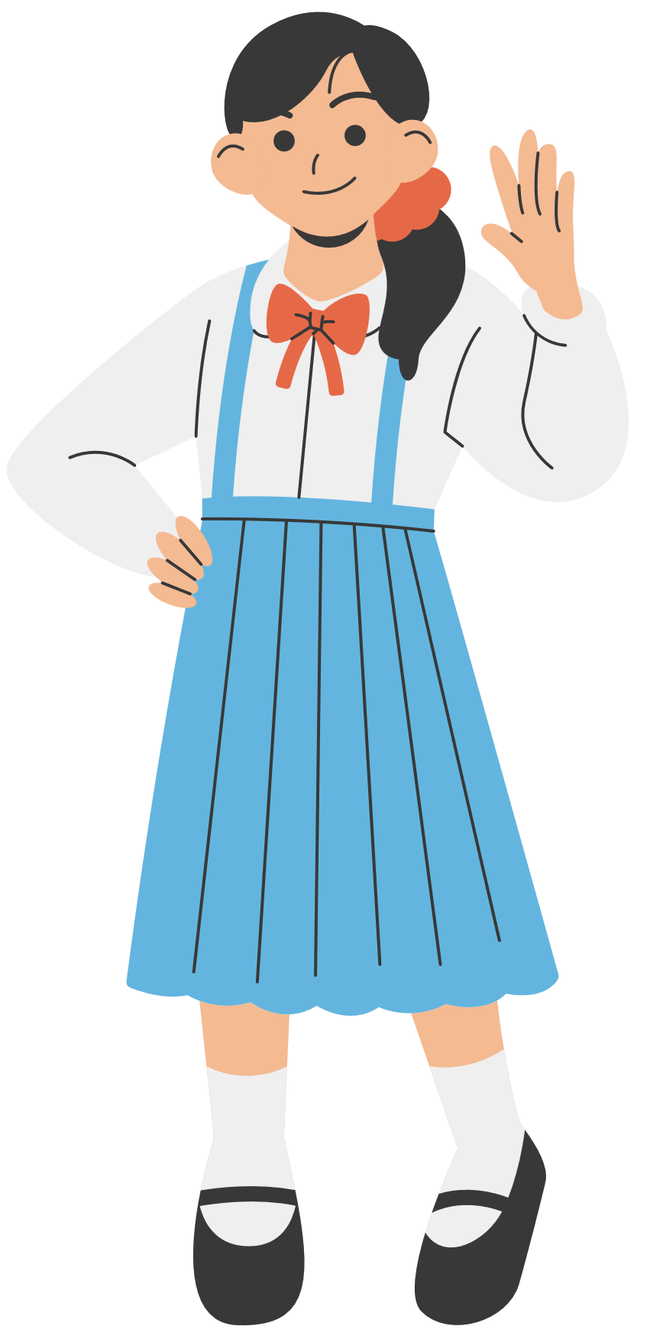

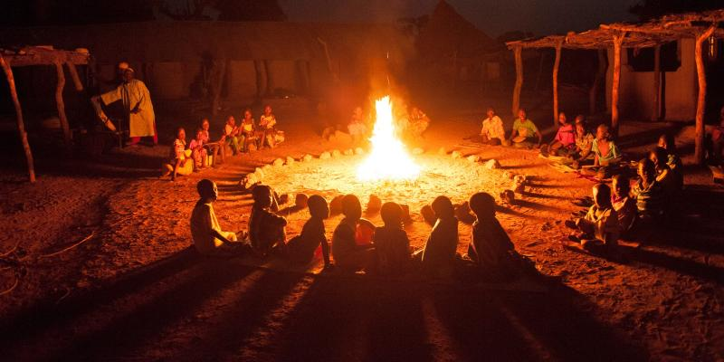

VOCABULARY
gather (v)
/ˈɡæðər/
tụ họp

Slide 7
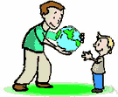
VOCABULARY
pass on (v)
/pɑːs ɒn/
để lại

Slide 8

VOCABULARY
legend (n)
/ˈledʒənd/
truyền thuyết

Slide 9
VOCABULARY
- gather (v) | /ˈɡæðər/ | tụ họp
- pass on (v) | /pɑːs ɒn/ | để lại
- legend (n) | /ˈledʒənd/ | truyền thuyết

Slide 10


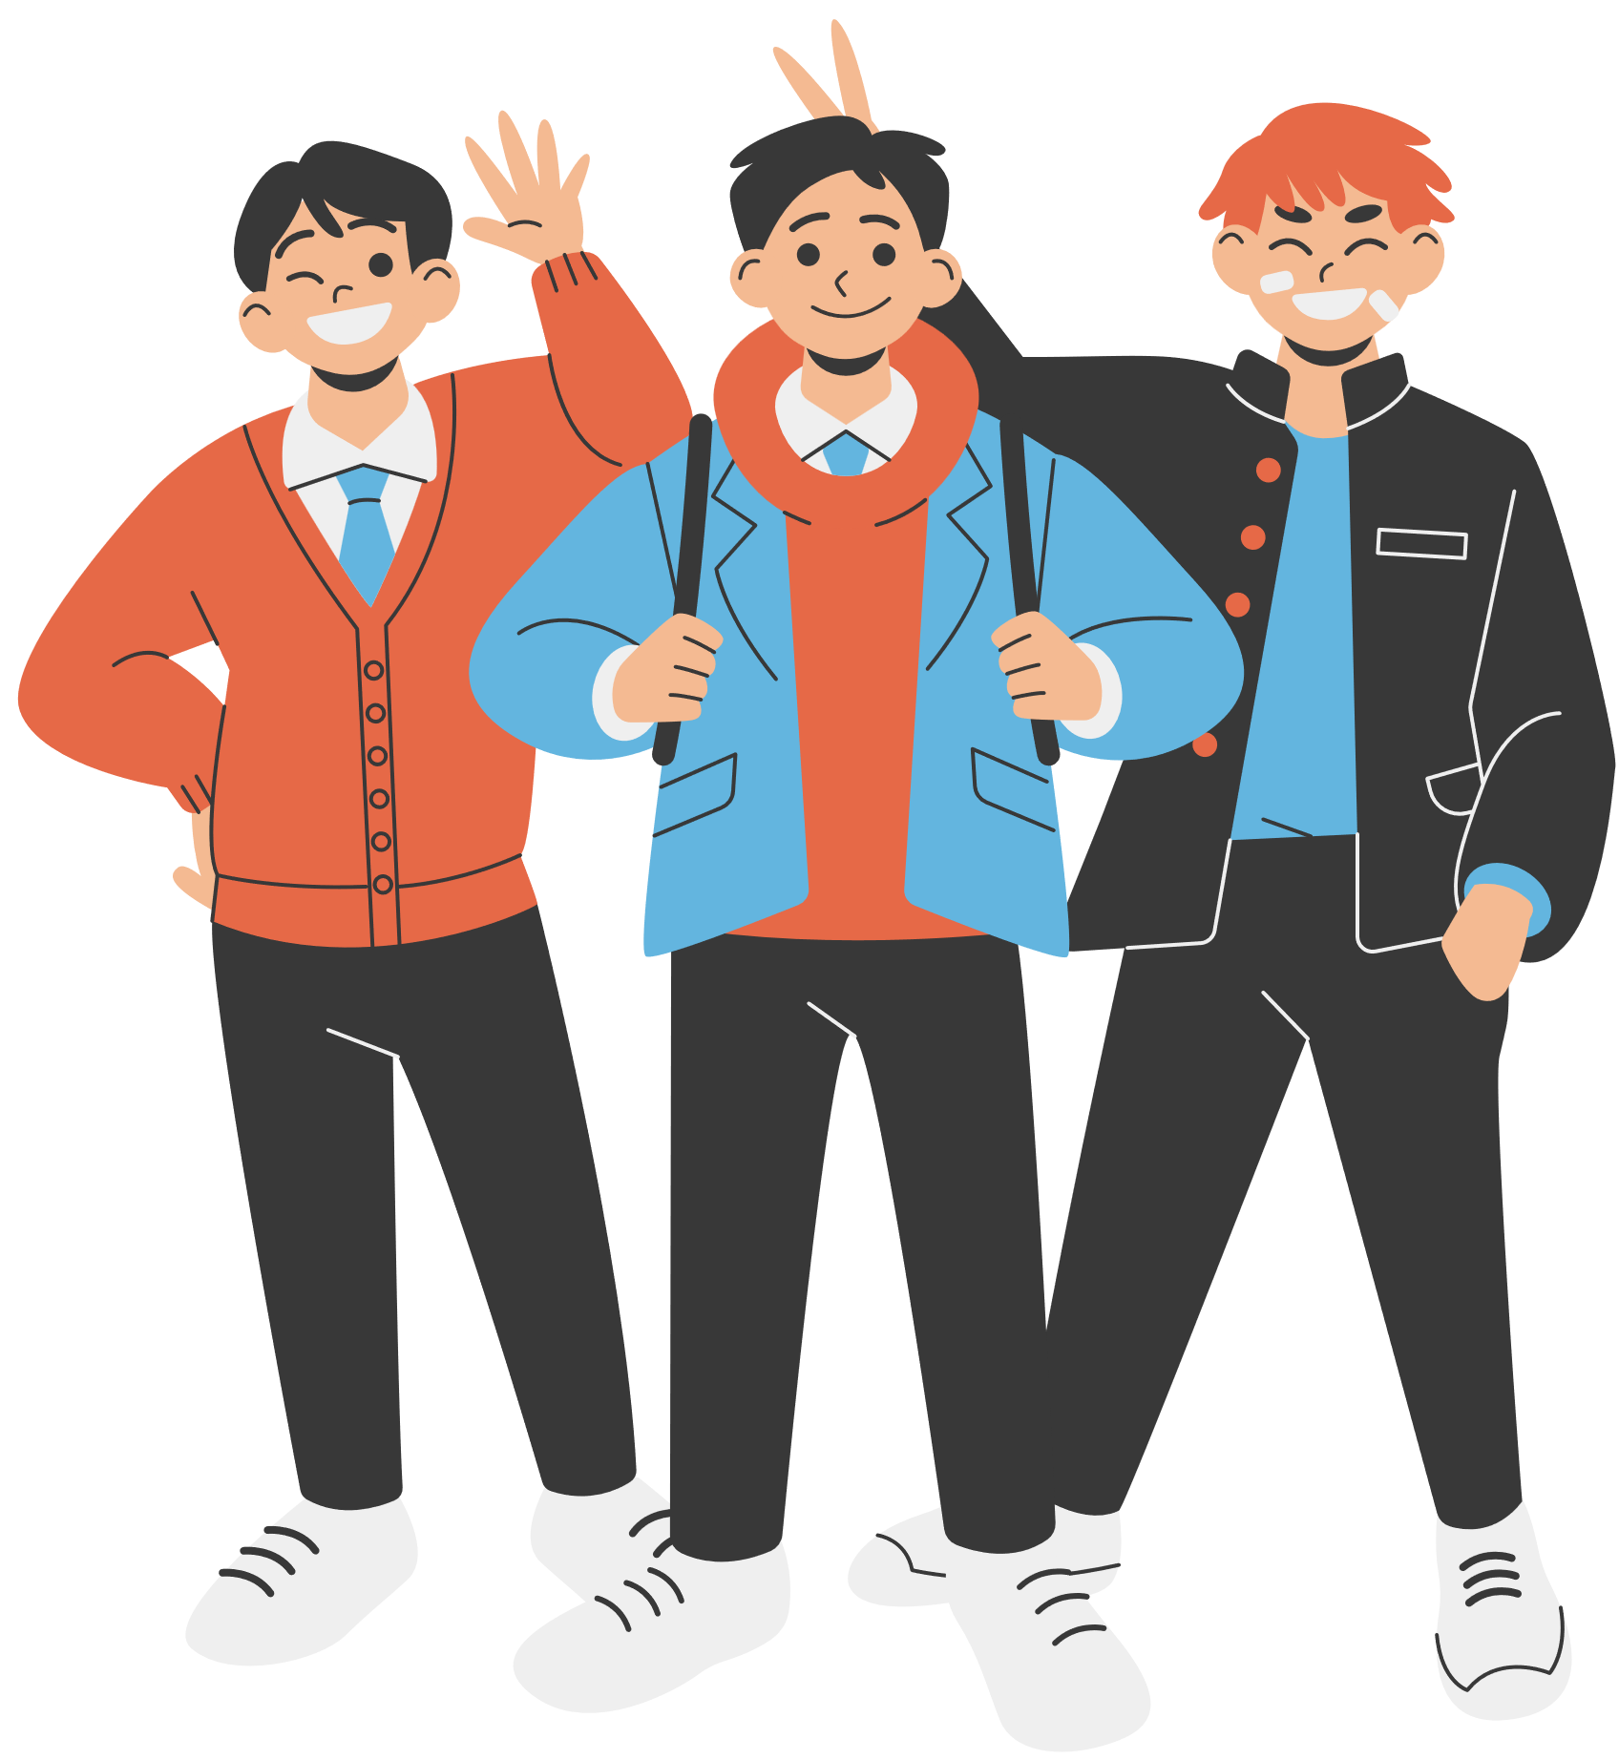


2. Listen and tick ( ) the activities that minority children do to help their families.
1. look after the house
2. weave clothing
3. prepare food
4. build houses
5. grow crops
6. raise livestock

Slide 11

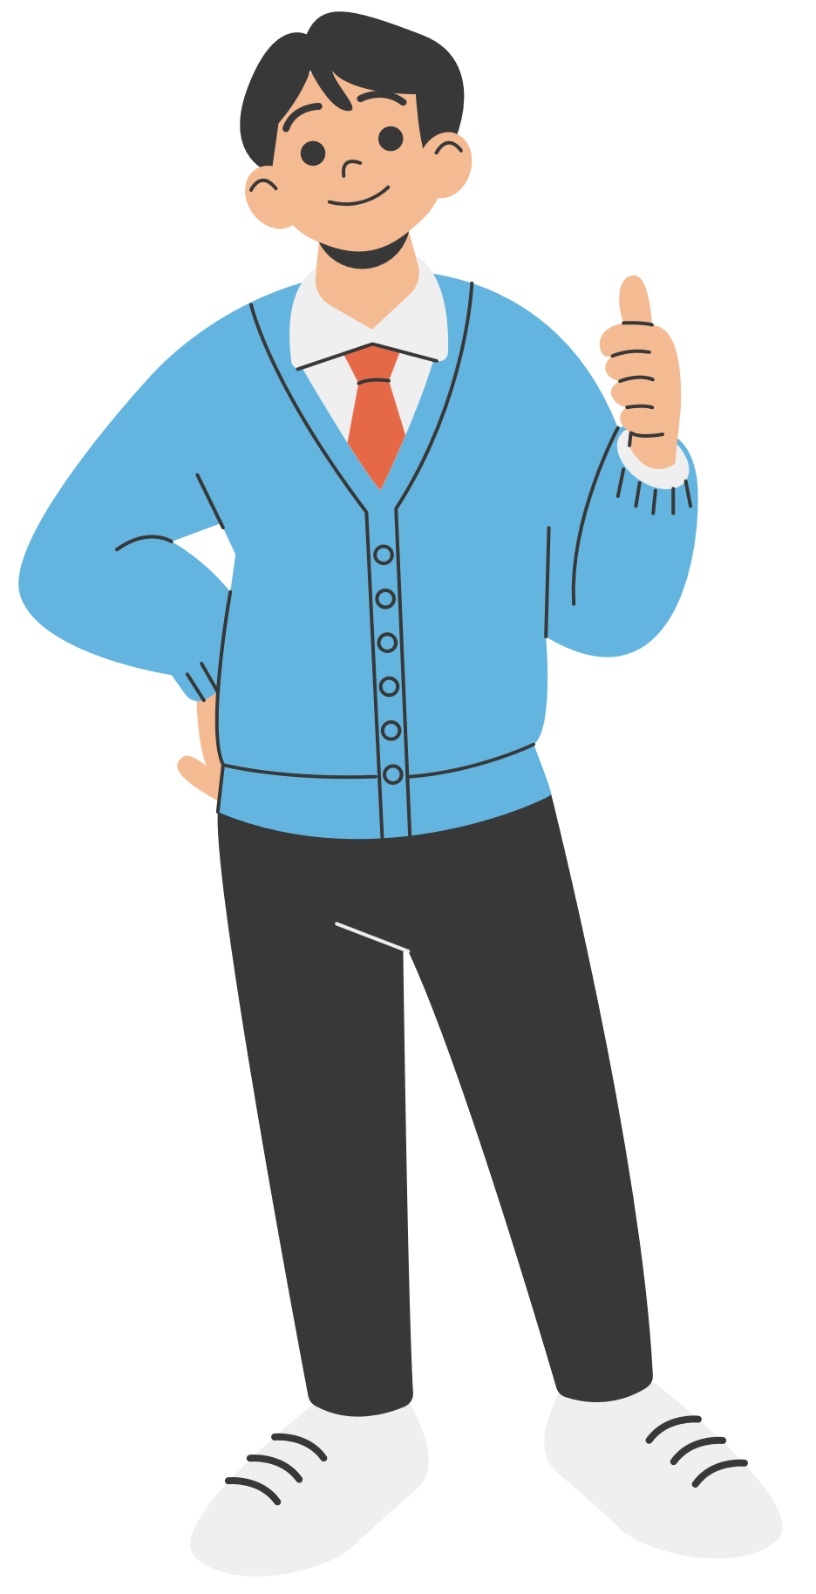

3. Listen again and circle the correct answer A, B, or C.
1. Minority children usually learn to work at ______.
twelve
ten
six
2. Girls ______.
A. weave clothing
B. do the gardening
C. catch fish
3. Boys ______.
A. prepare food
B. raise livestock
C. do housework
4. Children learn traditions through _____
work
music
stories
5. The number of minority children going to school is ______.
A. going up
B. going down
C. staying the same

Slide 12
Writing

Slide 13



4. Note five things you do to help your family.
Example: - cook meals
Example 2
- Tidy up the bed
- Prepare breakfast / dinner
- Clean the room
- Plant vegetables / flowers
- Repair the bike

Slide 14


5. Write a paragraph (80 - 100 words) about the things you do to help your family. Use the ideas in 4.
I help my family by doing housework every day. In the morning, I _______________ (e.g., tidy up my bed, sweep the floor). After school, I _______________ (e.g., help mom prepare dinner, wash the dishes). On weekends, I _______________ (e.g., plant vegetables, dust the furniture). I feel _______________ (e.g., happy, proud) because I can make our house a better place./I think helping at home is a great way of showing love and responsibility.

Slide 15
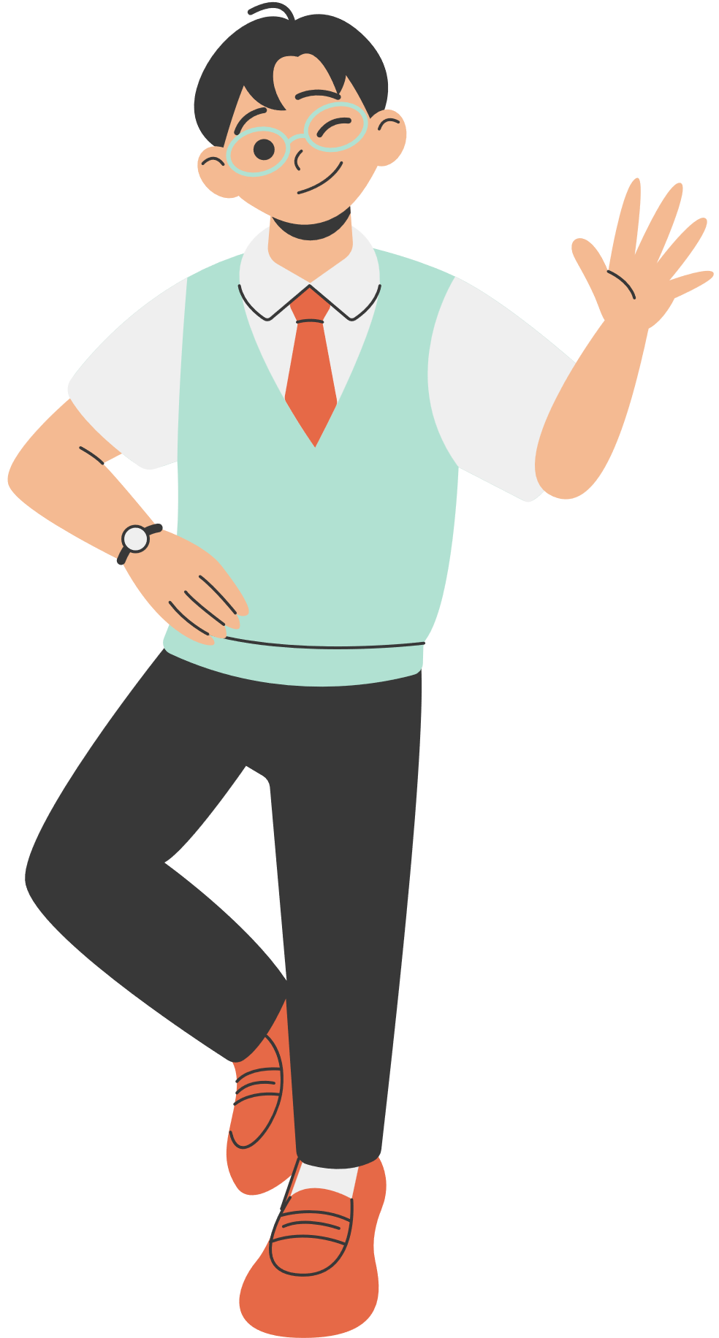


Suggested answer:
I learnt to share housework with other members of the family when I was seven or eight. I always start the day by tidying up my bed. Then I prepare breakfast for me and my brother. I usually help prepare dinner or do the washing afterwards. At the weekend, I usually spend an hour cleaning and tidying up my room and collecting dirty clothes of the whole family for washing. I sometimes do other work like planting vegetables or flowers on the top open floor of our house with my mother, repairing our bikes with my father, or repainting the gate. I think doing housework together connects our family’s members.

Slide 16
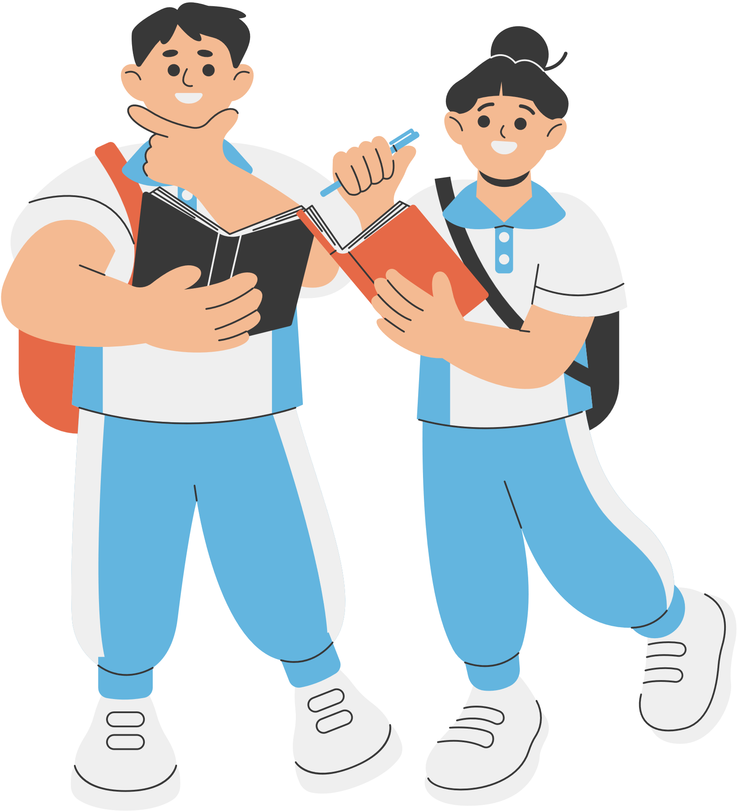


WRAP - UP
learnt new words related the topic of the listening text.
understood more about ethnic children through listening tasks.
written a paragraph about the things you do to help your family.

Slide 17
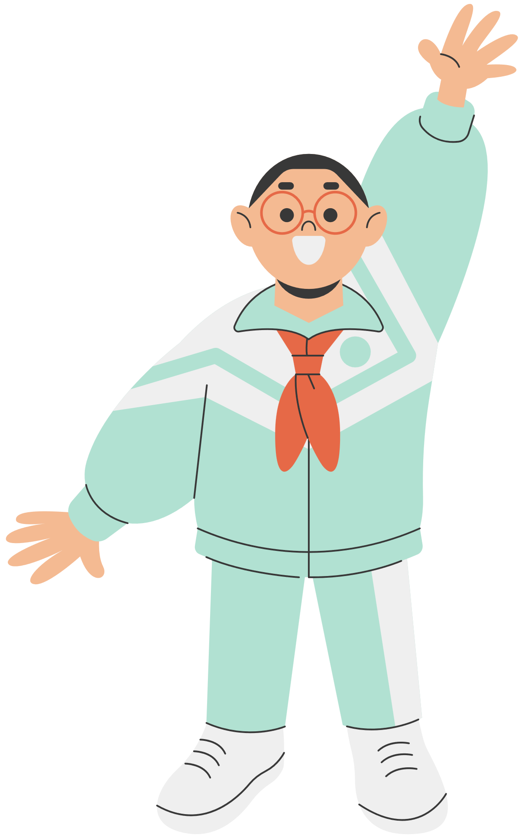

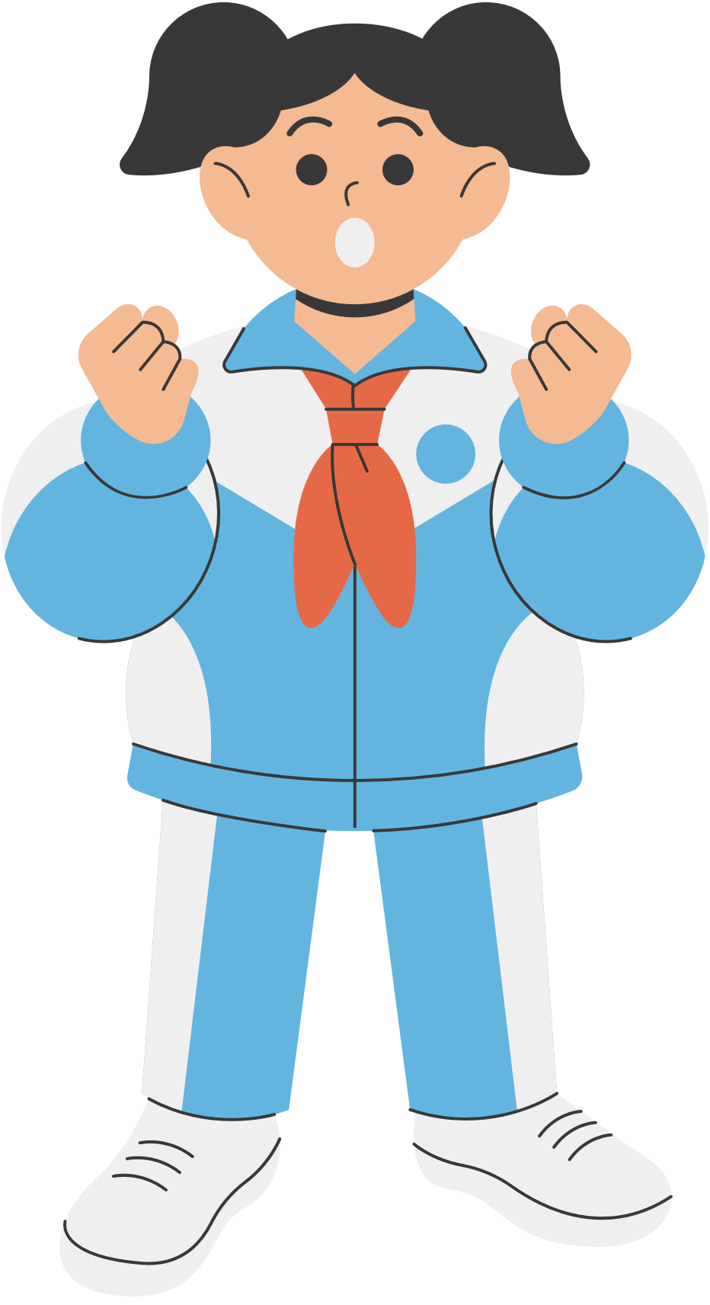
HOMEWORK
Learn by heart vocabulary
Prepare for the next lesson

Slide 18

THANK YOU
SEE YOU IN THE NEXT CLASS!

