Slide 1





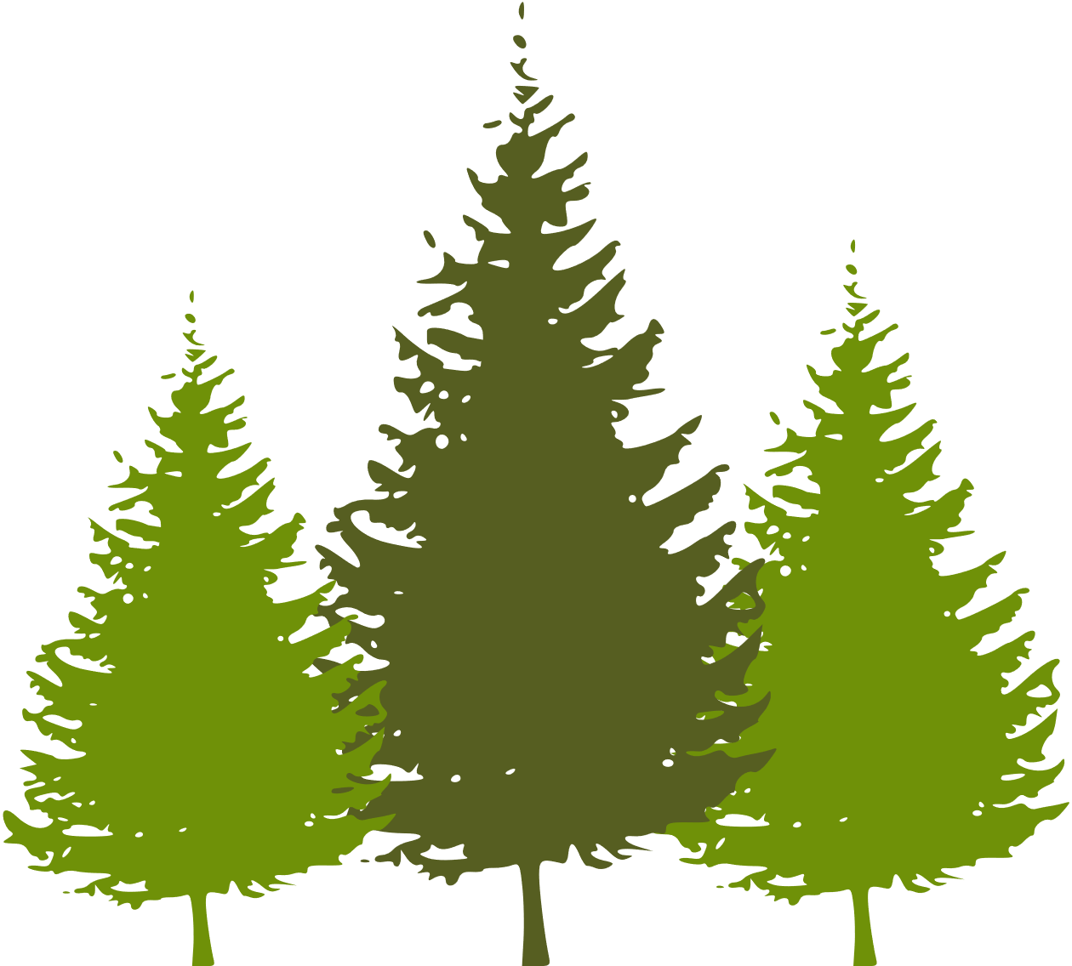



WELCOME TO OUR CLASS
Teacher: ….

Slide 2



NETWORK
The Muong
The Koho
The Giay
The Bru-Van Kieu
Ethnic groups
The Tay
The Bahnar
The Nung
The Yao
The Hmong
The Kinh
The Brau
The Hani

Slide 3


Slide 4
Unit 4:
ETHNIC GROUPS OF VIET NAM
Lesson 1: Getting Started
– I’m from the Tay ethnic group

Slide 5

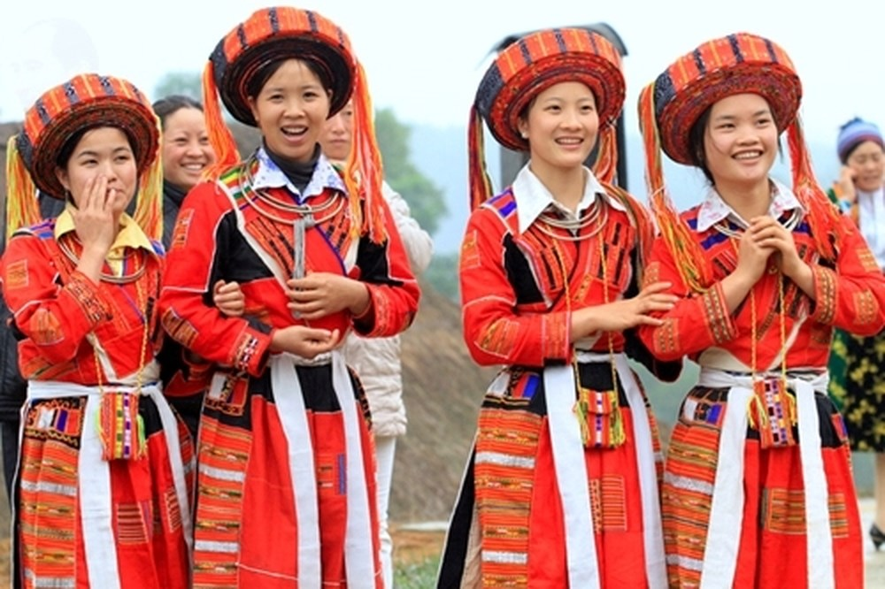


VOCABULARY
ethnic (group) (adj)
/ˈeθnɪk / (/gru:p/)
(nhóm) dân tộc

Slide 6
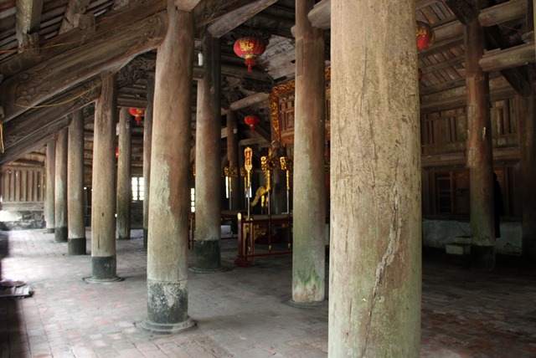
amira Hadid
VOCABULARY
post (n)
/pəʊst/
cột

Slide 7
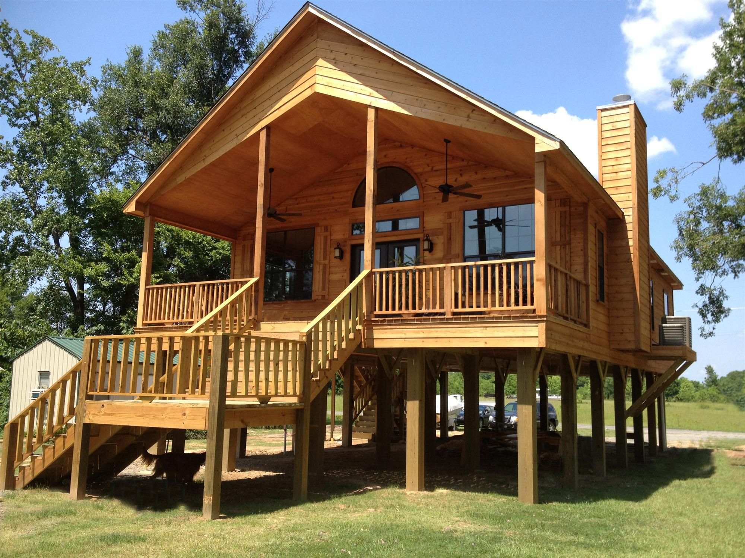
VOCABULARY
stilt house (n)
/stilt haus/
nhà sàn

Slide 8
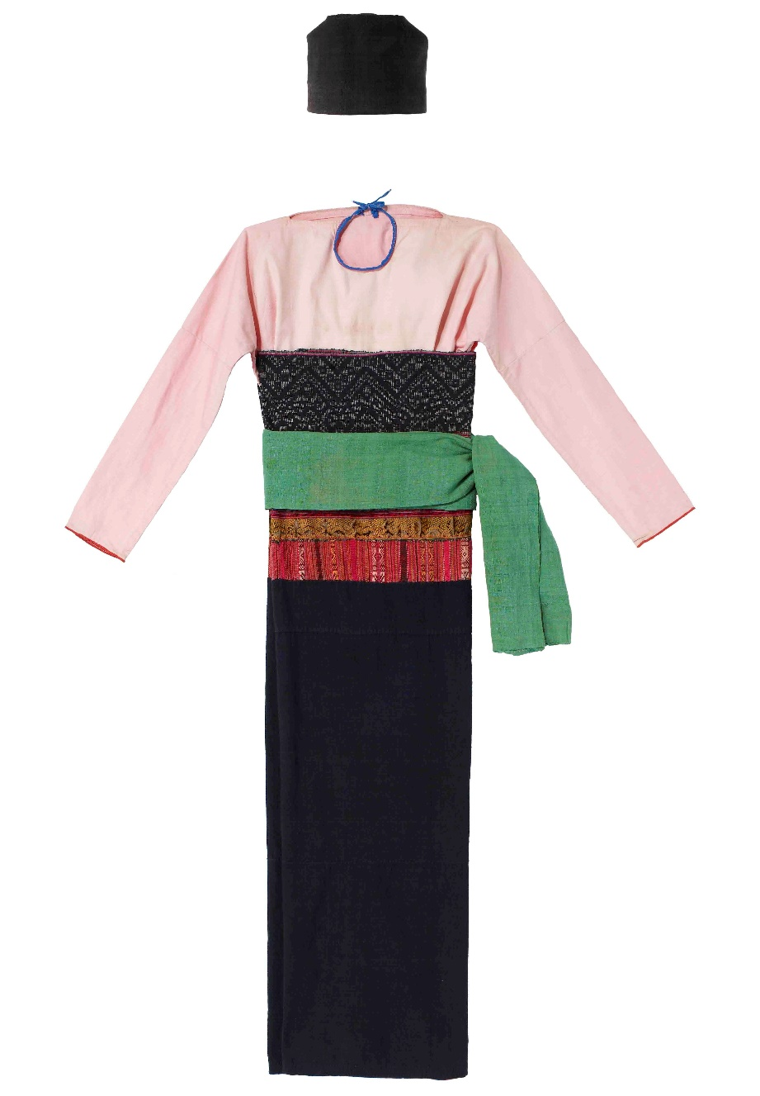
VOCABULARY
costume (n)
/'kɔstju:m/
trang phục

Slide 9
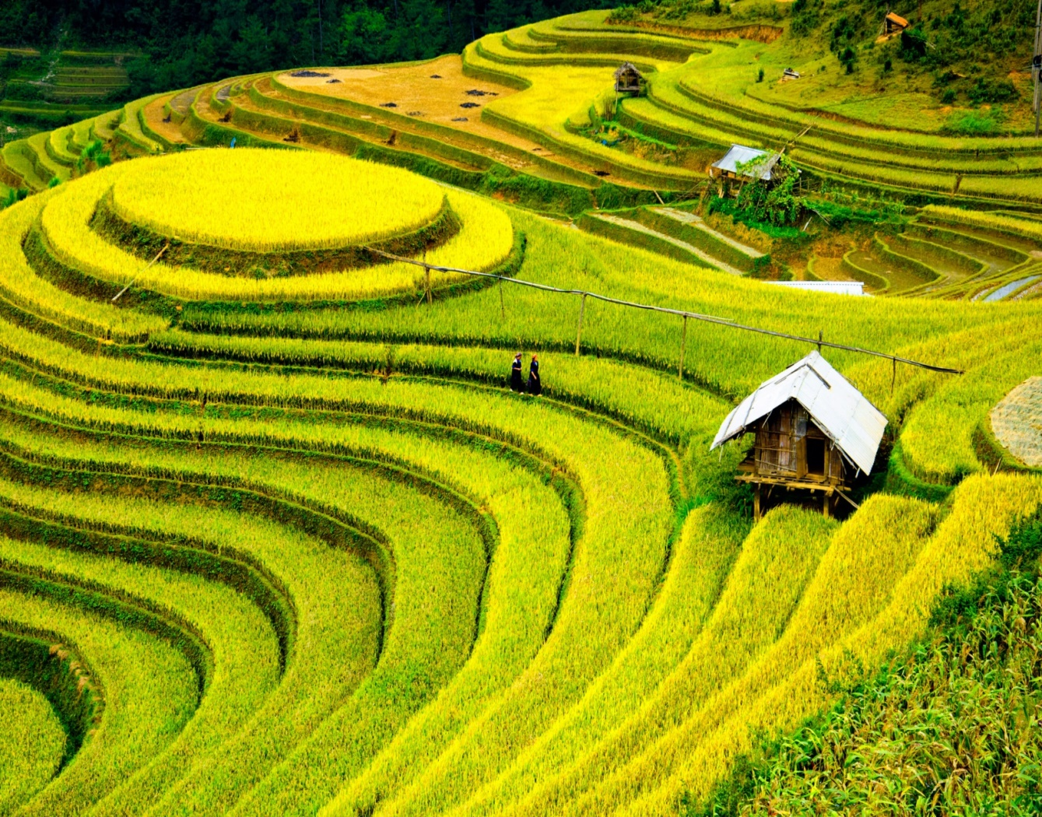
VOCABULARY
terraced field (n)
/ˈterəst fiːld /
ruộng bậc thang

Slide 10
VOCABULARY
- ethnic (group) (adj) | /ˈeθnɪk / (/gru:p/) | (nhóm) dân tộc
- post (n) | /pəʊst/ | cột
- overlook (v) | /ˌəʊ.vəˈlʊk/ | nhìn ra
- stilt house (n) | /stilt haus/ | nhà sàn
- costume (n) | /'kɔstju:m/ | trang phục
- terraced field (n) | /ˈter.əst fiːld / | ruộng bậc thang

Slide 11

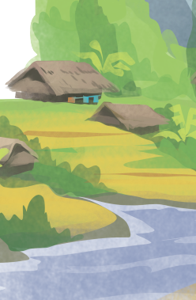
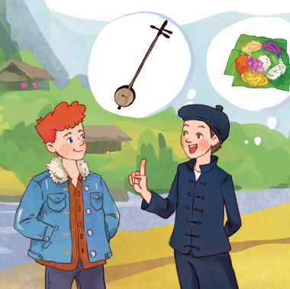
Listen and check

Slide 12
Listen and read
Tom: Hi, I’m Tom. You look new here.
Lai: I am. I’m Lai from Ha Giang.
Tom: Oh, I’ve heard about beautiful Ha Giang. Do you live in the mountains?
Lai: Yes, I do. I’m from the Tay ethnic group. We are the second largest ethnic group in Viet Nam, only after the Kinh.
Tom: Oh … I once saw a bamboo house on high posts in a travel brochure. Do you live in a home like that?
Lai: Yes, we call it a “stilt house”. Our house overlooks terraced fields.
Tom: Awesome. What is life in your village like?
Lai: It’s peaceful. There are 16 houses in my village. We live very close to nature.
Tom: I love it. Can you tell me something about your culture?
Lai: Certainly. We have our own culture. You can see it in our folk dances, musical instruments like the dan tinh, and our special five-colour sticky rice.
Tom: It sounds interesting. I hope to visit Ha Giang one day.

Slide 13
2.Read the conversation again and circle the best answers
What are Tom and Lai talking about?
A. Minority groups in Viet Nam.
B. Ha Giang.
C. Life of the Tay people.
1.
A “stilt house” ______.
A. is a multi-storey home
B. is on high posts
C. always faces a field
2.
Lai mentions ______ of the Tay people.
A. folk dances
B. popular festivals
C. costumes
3.

Slide 14
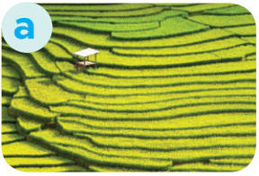
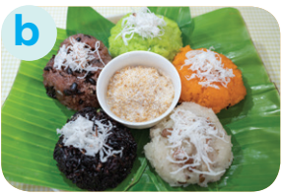
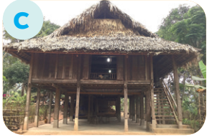

3. Match the pictures with the word and phrases from the conversation
1. stilt house
2. terraced fields
3. bamboo
4. five-colour sticky rice

Slide 15
4. Complete the sentences with the words and phrases from the box
overlooks musical instrument ethnic groups
folk dance traditional
+ noun
folk dance
1. I love mua sap, a popular _________ of the Thai people.
2. Their beautiful stilt house _________ a large rice field.
3. A: What is the name of a popular Tay’s __________________? - B: It’s dan tinh.
4. Every ethnic group has their own __________ culture.
5. Of the 54 ______________ in Viet Nam, the Kinh is the largest
+ verb
overlooks
+ noun
musical instrument
traditional
+ adj
+ noun
ethnic groups

Slide 16
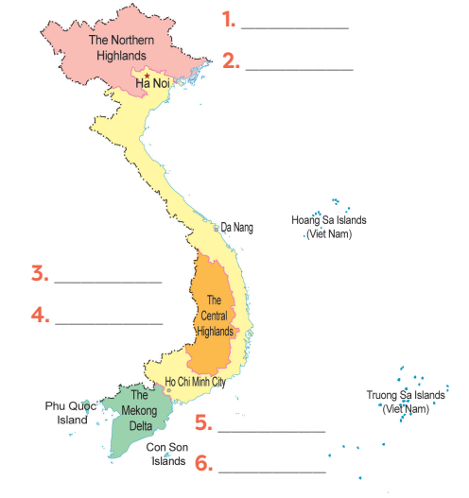
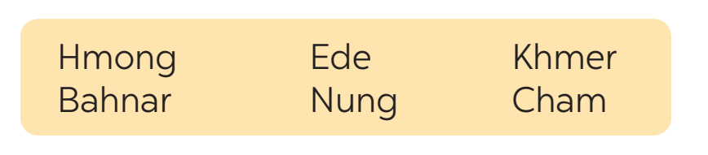

GAME: Where are they?
Hmong
Nung
Ede
Bahnar
Khmer
Cham

Slide 17
THANK YOU

