Slide 1
Welcome to our class!
Teacher: ……………

Slide 2
Unit 3: TEENAGERS
Lesson 6: Skills 2

Slide 3
How do you think about the problem in the video?

Slide 4
1. Which types of pressure below do you think teens face?
parental pressure
pressure from work
pressure from schoolwork
pressure from their clubs

Slide 5
VOCABULARY

Slide 6
VOCABULARY
parental (adj)
/pəˈrentl/
liên quan tới bố mẹ, thuộc bố mẹ

Slide 7
VOCABULARY
peer (n)
/pɪə(r)/
người ngang hàng, bạn đồng lứa

Slide 8
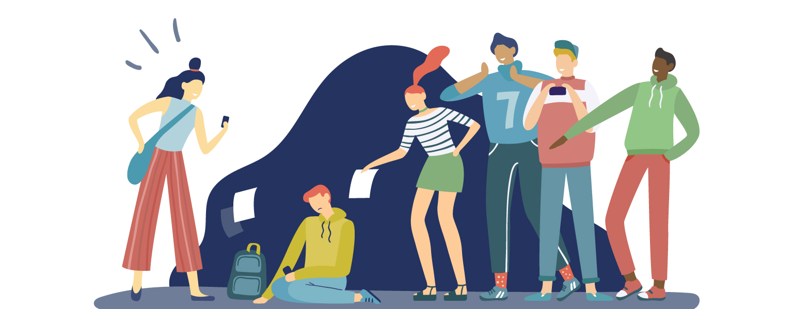
VOCABULARY
bully (v)
/ˈbʊli/
bắt nạt

Slide 9
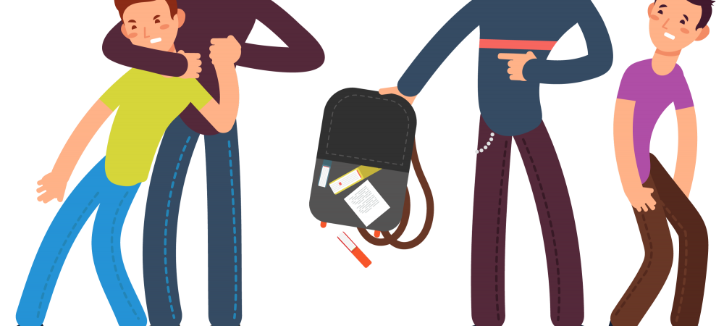
VOCABULARY
bullying (n)
/ˈbʊliɪŋ/
sự bắt nạt

Slide 10
VOCABULARY
- parental (adj) | /pəˈrentl/ | liên quan tới bố mẹ, thuộc bố mẹ
- peer (n) | /pɪə(r)/ | người ngang hàng, bạn đồng lứa
- bully (v) | /ˈbʊli/ | bắt nạt
- bullying (n) | /ˈbʊliɪŋ/ | sự bắt nạt

Slide 11
2. Listen to a conversation and choose the correct answer to each question.
1. How many students are talking?
One.
Two.
Three.
2. What are they discussing?
Their class forum.
Their stress.
Their community activities.

Slide 12
3. Listen to the conversation again and fill each blank with ONE word.
Problems | Solutions
Minh has pressure from his (1)________. | Minh should tell his parents about his interests and (2) __________.
Ann is unhappy about her (3) _____________. | Ann should feel (4)________ about her body.
Mi doesn’t get on with her (5)________. | She should (6) ______ to her mum.
parents
abilities
good
body / weight
talk
sister

Slide 13
4. Match the causes of teen stress with the possible solutions. There may be more than one solution to a problem.
Causes of teen stress
Possible solutions
1. peer pressure
2. too much schoolwork
A. avoiding bullies wherever possible
spending too much
time on social media
B. staying calm and relaxed
C. turning off smartphones
4. bullying
D. talking to teachers

Slide 14
4. Match the causes of teen stress with the possible solutions. There may be more than one solution to a problem.
Possible solutions
Causes of teen stress
B. staying calm and relaxed
1. peer pressure
D. talking to teacher

Slide 15
4. Match the causes of teen stress with the possible solutions. There may be more than one solution to a problem.
Possible solutions
Causes of teen stress
B. staying calm and relaxed
D. talking to teacher
2. too much schoolwork

Slide 16
4. Match the causes of teen stress with the possible solutions. There may be more than one solution to a problem.
Causes of teen stress
Possible solutions
spending too much
time on social media
C. turning off smartphones

Slide 17
4. Match the causes of teen stress with the possible solutions. There may be more than one solution to a problem.
Causes of teen stress
Possible solutions
4. bullying
A. avoiding bullies wherever possible
B. staying calm and relaxed
D. talking to teachers

Slide 18
5. Write a paragraph (80 - 100 words) about the cause(s) of your stress
and offer solutions.

Slide 19
Problem: Trouble Understanding English
Topic sentence: "I feel stressed because of not understand English words in class and here are some ways I deal with my stress.
Solution 1: Firstly, I ask my teacher to explain the words I don’t know. (explain more…)
Solution 2: Secondly, I also practice speaking English with my friends or family. (explain more…)
Solution 3: Lastly / Finally, I read English books or watch English videos to learn new words. (explain more…)
Closing: To sum up / In short, these ideas help me improve my English and feel less worried."

Slide 20
Wrap-up
What have we learned in this lesson?
Tell the whole class about their stress and what they often do to deal with stress.

Slide 21
Thank you!

Slide 22
Resource
Page
Use these design resources
in your Canva Presentation.
Happy designing!
Don't forget to delete this page before presenting.

Slide 23
Resource
Page
Use these design resources
in your Canva Presentation.
Happy designing!
Don't forget to delete this page before presenting.

