Slide 1
WELCOME TO OUR CLASS!
Teacher: ………..

Slide 2
Unit 3: TEENAGERS
Lesson 5: Skills 1

Slide 3
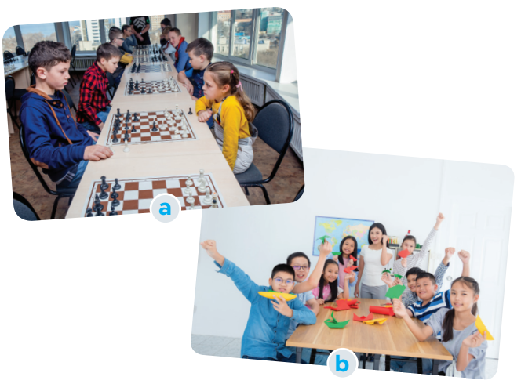
BRAINSTORMING
Look at the picture and say what club it is.
b. Which of your school clubs do you want to join?
Chess club
Arts and crafts club

Slide 4
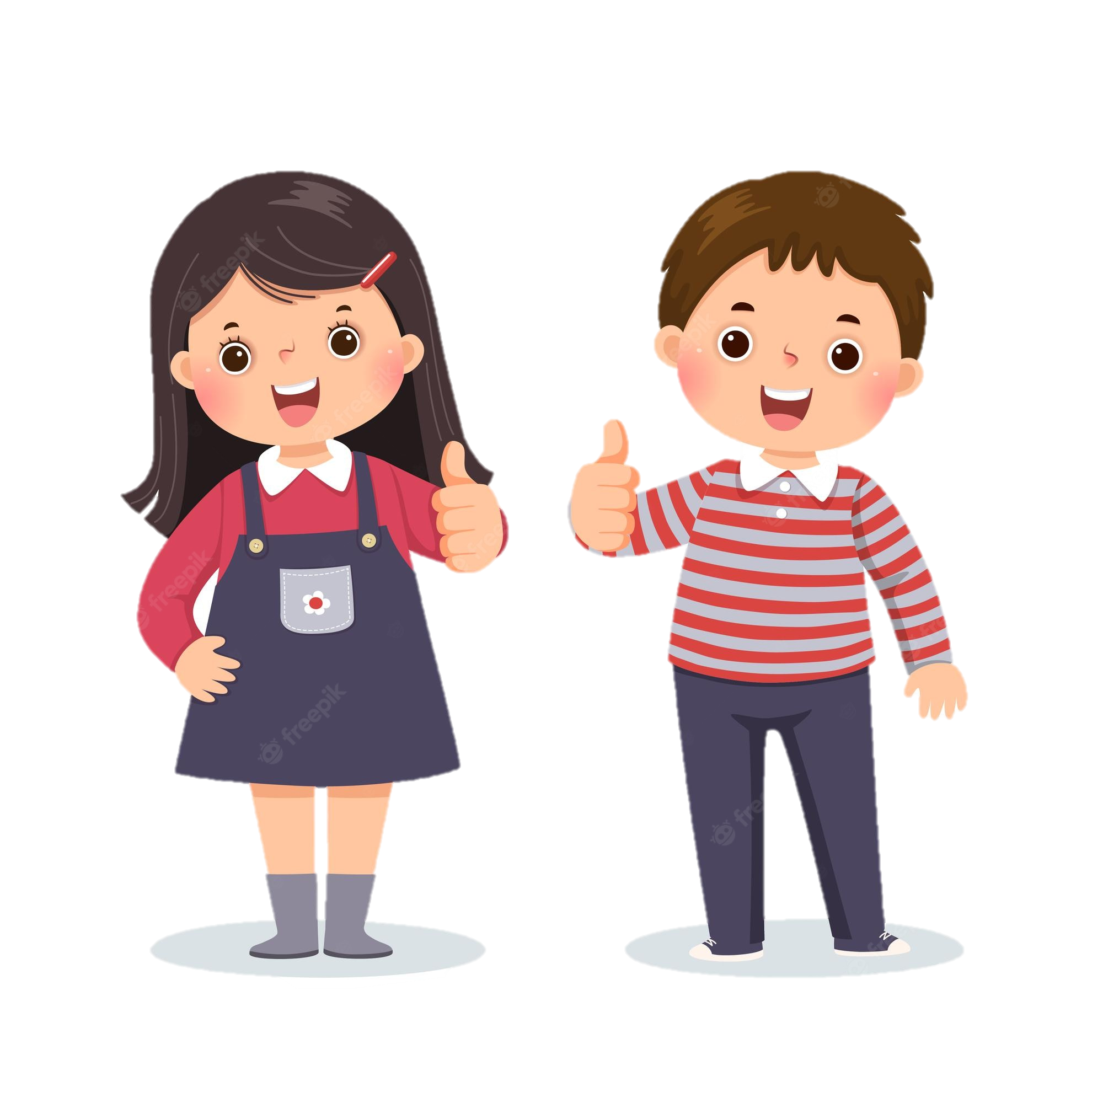
MAI
TOM
SCHOOL CLUB

Slide 5
VOCABULARY

Slide 6
Mai: Tom, so which club do you want to join?
Tom: I’m interested in two clubs: badminton and chess.
Mai: I like badminton, too. It’s relaxing.
Tom: Yes, I play it to keep fit. So let’s join that club together.
Mai: OK. It’s on Tuesdays and Fridays from 5:00 p.m. to 6:30 p.m. It starts 30 minutes after school, so we have enough time to get some snacks beforehand. I know you like chess. Will you join the chess club?
Tom: Well, I started playing it five years ago. My mum first sent me to a chess club because she wanted me to be more focused. Now I find that I can concentrate better. Do you like chess? Let’s join the chess club too.
Mai: Actually, this year there is a new arts and crafts club, and I want to join it. I hear that the members will work together in small community service projects. Members can do art projects and also improve their practical skills and teamwork skills too.
Tom: Awesome, Mai. Who will coach that club?
Mai: Ms Hoa, the art teacher. She will help us connect with the community.

Slide 7
2. Read the conversation and tick T (true) or F (false) for each sentence.
1. The school has badminton, chess, and arts and crafts clubs.
T
F
T
F
2. The badminton club activities are after school.
T
F
3. Tom stayed playing chess when he was five.
4. Members of the arts and crafts club do community activities.
T
F

Slide 8
2. Read the conversation and tick T (true) or F (false) for each sentence.
1. The school has badminton, chess, and arts and crafts clubs.
T
F
Tom: I’m interested in two clubs: badminton and chess.
Mai: Actually, this year there is a new arts and crafts club, and I want to join it.

Slide 9
2. Read the conversation and tick T (true) or F (false) for each sentence.
T
F
2. The badminton club activities are after school.
Mai: OK. It’s on Tuesdays and Fridays from 5:00 p.m. to 6:30 p.m. It starts 30 minutes after school, so we have enough time to get some snacks beforehand.

Slide 10
2. Read the conversation and tick T (true) or F (false) for each sentence.
T
F
3. Tom stayed playing chess when he was five.
Tom: Well, I started playing it five years ago. My mum first sent me to a chess club because she wanted me to be more focused.

Slide 11
2. Read the conversation and tick T (true) or F (false) for each sentence.
4. Members of the arts and crafts club do community activities.
T
F
Mai: … I hear that the members will work together in small community service projects. Members can do art projects and also improve their practical skills and teamwork skills too.

Slide 12
Look at the answers again.
Sentences | T | F
1. The school has badminton, chess, and arts and crafts clubs.
2. The badminton club activities are after school.
3. Tom stayed playing chess when he was five.
4. Members of the arts and crafts club do community activities.
five years ago

Slide 13
3. Read the conversation again and choose the correct answer A, B, or C.
1. Tom and Mai are discussing _________.
A. their leisure time activities
B. their school club activities
C. their likes and dislikes
2. Tom started playing chess because ________.
A. he loved it
B. he wanted to stay focused
C. his mum wanted him to play
3. Playing chess helps Tom________.
A. connect with other members
B. concentrate better
C. do community service
4. The word “it” refers________.
A. chess club B. arts and crafts club C. community service
5. Mai will participate in the arts and crafts club to ________.
A. help the school B. coach her friends C. do art projects

Slide 14
3. Read the conversation again and choose the correct answer A, B, or C.
1. Tom and Mai are discussing _________.
A. their leisure time activities
B. their school club activities
C. their likes and dislikes

Slide 15
3. Read the conversation again and choose the correct answer A, B, or C.
2. Tom started playing chess because ________.
A. he loved it
B. he wanted to stay focused
C. his mum wanted him to play

Slide 16
3. Read the conversation again and choose the correct answer A, B, or C.
3. Playing chess helps Tom________.
A. connect with other members
B. concentrate better
C. do community service

Slide 17
3. Read the conversation again and choose the correct answer A, B, or C.
4. The word “it” refers________.
A. chess club
B. arts and crafts club
C. community service

Slide 18
3. Read the conversation again and choose the correct answer A, B, or C.
5. Mai will participate in the arts and crafts club to ________.
A. help the school
B. coach her friends
C. do art projects

Slide 19
Look at the answers again.
1. Tom and Mai are discussing _________.
A. their leisure time activities
B. their school club activities
C. their likes and dislikes
2. Tom started playing chess because ________.
A. he loved it
B. he wanted to stay focused
C. his mum wanted him to play
3. Playing chess helps Tom________.
A. connect with other members
B. concentrate better
C. do community service
4. The word “it” refers________.
A. chess club B. arts and crafts club C. community service
5. Mai will participate in the arts and crafts club to ________.
A. help the school B. coach her friends C. do art projects

Slide 20
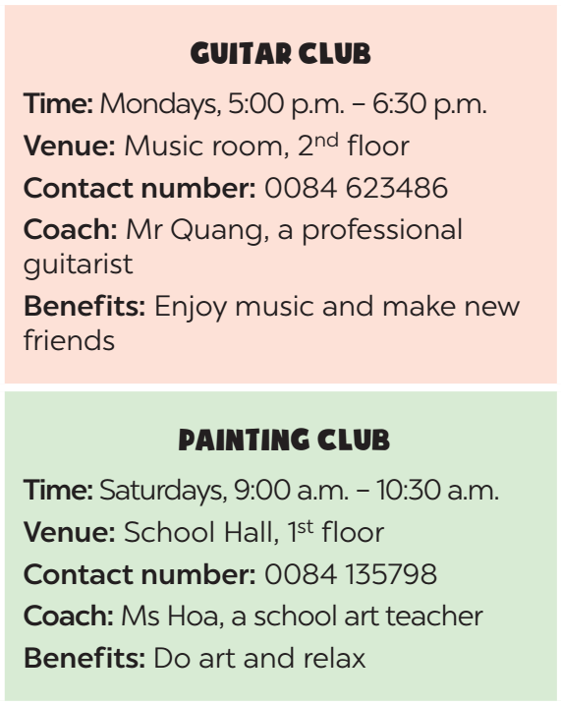
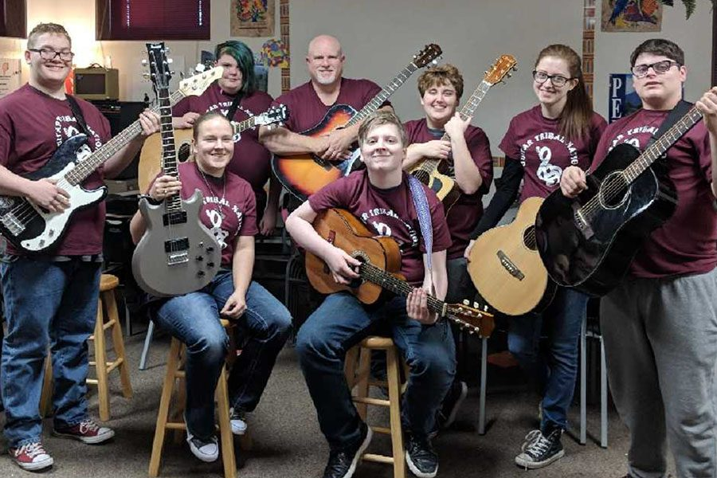
4. Work in groups. Make conversations using the given information.
Guitar club

Slide 21
4. Work in groups. Make conversations using the given information.
What time does the guitar club meet?
It meets on Mondays, from 5:00 p.m. to 6: 30 p.m.
It meets in the music room, on the second floor.
Where does it meet?
Suggested questions:
- What is the contact number of the club?
- Who will coach the club?
- Why do you want to join this club?

Slide 22
4. Work in groups. Make conversations using the given information.
What time does the …..meet?
It meets on ….
It meets in …
Where does it meet?
Suggested questions:
- What is the contact number of the club?
- Who will coach the club?
- Why do you want to join this club?

Slide 23
5. Work in groups. Ask and answer questions about a club at your school. Report the answers to your class.
The music club at my school meets on Tuesdays, from 5:00 p.m. to 6:30p.m. It meets in the music room, on the second floor…
Suggested questions:
- What time does the club meet?
- Where does it meet?
- What is the contact number of the club?
- Who will coach the club?
- Why do you want to join this club?

Slide 24
WRAP –UP
Retell some school clubs they have learned after the lesson and their benefits.

Slide 25
THANK YOU!

Slide 26
RESOURCES

