Slide 1
Welcome to our class!
Teacher:………….

Slide 2
KIM’S GAME
Work in groups of three or four students
Look at the pictures about kinds of pressure on the screen.
They will disappear after 2 seconds, so try to remember all the pictures without writing them down.
After all the pictures disappear, you have 1 minute to write down the kinds of pressure in each picture on your poster.
2 points for each correct answer

Slide 3
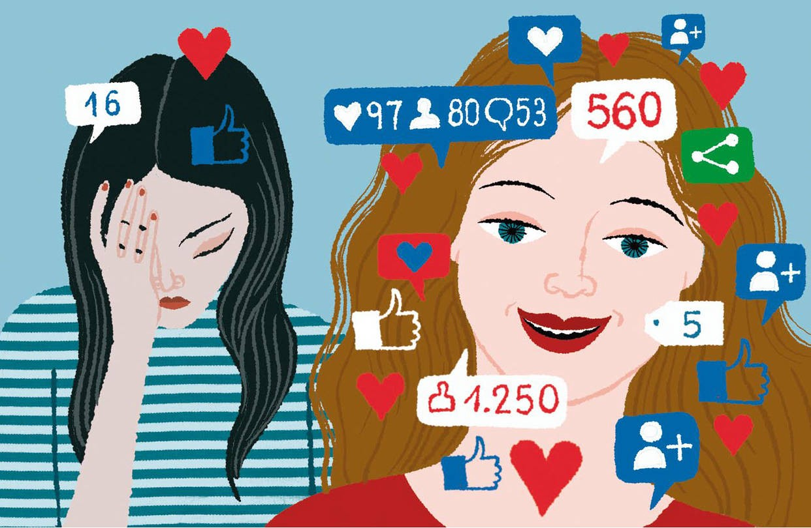
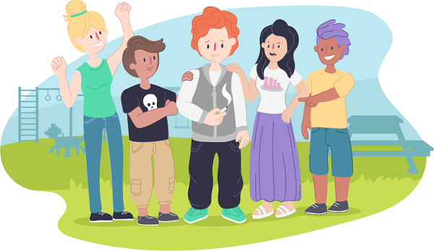
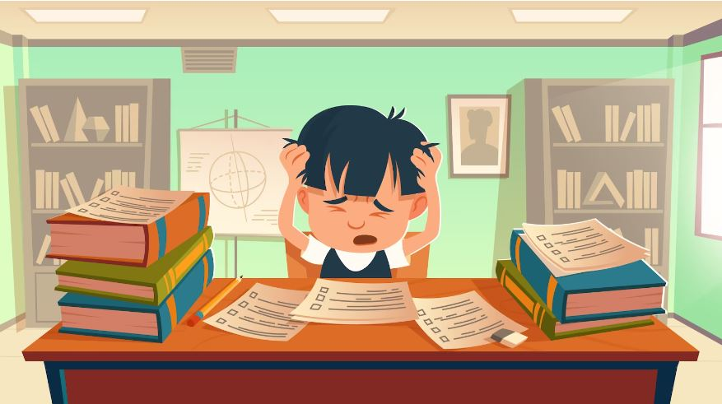
KIM’S GAME

Slide 4
KIM’S GAME
pressure from schoolwork
pressure from parents
pressure from friends
pressure from social media

Slide 5
Unit 3: TEENAGERS
Lesson 7: Looking back and Project

Slide 6
1. Complete the webs with suitable words and phrases.
logging on to an account
activities on social media
browsing websites
uploading pictures
checking notifications

Slide 7
1. Complete the webs with suitable words and phrases.
peer pressure
causes of teen stress
pressure from parents
pressure from schoolwork
bullying

Slide 8
VOCABULARY
2
Fill in each blank with the correct form of the word from the box.
2. Fill in each blank with the correct form of the word from the box.
skill | club | participate | upload | bully | connect
Mike has a busy and active life. He does well at school and (1)________________ in many (2)_________ like basketball and chess clubs. He is also a member of the school community projects, where he (3)___________ with other teens and learns new (4)____________. He has many classes, but he can still manage his schoolwork well. Mike is also an active member of his class forum. He and his friends (5)___________ pictures and videos about their class activities. They also discuss homework, their problems, and how to deal with pressure from parents, friends, and schoolwork. The most common problem they discuss is how to deal with (6)_________________.
participates
clubs
connects
skills
upload
bullies / bullying

Slide 9
3. Use the conjunctions provided to connect the sentences.
1. Mai is the head of the music club. She knows the members very well. SO
2. Lan wanted to go to the party. She couldn’t choose a suitable dress. BUT
3. Tom felt stressed. He tried to finish his homework. HOWEVER
4. He isn’t a member of the chess club. He didn’t join the chess competition. THEREFORE
5. We will have a short holiday. We will feel very stressed. OTHERWISE

Slide 10
3. Use the conjunctions provided to connect the sentences.
1. Mai is the head of the music club. She knows the members very well. SO
2. Lan wanted to go to the party. She couldn’t choose a suitable dress. BUT
Mai is the head of the music club, so she knows the members very well.
Lan wanted to go to the party, but she couldn’t choose a suitable dress.

Slide 11
3. Use the conjunctions provided to connect the sentences.
3. Tom felt stressed. He tried to finish his homework. HOWEVER
4. He isn’t a member of the chess club. He didn’t join the chess competition. THEREFORE
5. We will have a short holiday. We will feel very stressed. OTHERWISE
Tom felt stressed; however, he tried to finish his homework.
He isn’t a member of the chess club; therefore, he didn’t join the chess competition.
We will have a short holiday; otherwise, we will feel very stressed.

Slide 12
4. Complete the sentences below. Then compare your sentences with your partners.
they should do some sports
1. Teens need to have good health, so ______________________________.
2. His parents have high expectations of him, but ______________
3. Teenagers should develop social skills; otherwise ____________ ____________________________________________.
they don’t care
they may
not be able to communicate with peers and other people

Slide 13
4. Complete the sentences below. Then compare your sentences with your partners.
4. We sometimes feel lonely and sad; therefore, ________________ ____________________.
5. He does very well at school; however, ______________________ _____________________________________________.
we need
parents and friends
he doesn’t have
teamwork or communication skills

Slide 15
THANK YOU

