Slide 1
WELCOME TO OUR CLASS!
Teacher: …………

Slide 2
Unit 3: TEENAGERS
Lesson 4: Communication

Slide 3
Everyday English
Making request

Slide 4
Watch a video and complete the sentences.
Could you
1.__________ give me 60$?
2._____________lending me your pink shirt?
3.__________________ lend me your scooter?
Do you mind
I wonder if you could

Slide 5
1. Listen and read the dialogues below. Pay attention to the highlighted sentences.
Student: Can you tell me more about the music club, please?
School club leader: Certainly. It meets on Mondays and Thursdays.
Student: Could you tell me the time it meets?
School club leader: Yes, it’s after school, from 5:00 p.m. to 6:30 p.m.

Slide 6
Making requests | Examples
- Can you…, please? - Could you…(, please)? | - Can you tell me more about the music club, please? - Could you tell me the time it meets?

Slide 7
2. Work in pairs. Make similar conversations, using the cues below.
- Request some advice on how to do your science project.
Example: Could you tell me how to start a science project?

Slide 8
SOCIAL MEDIA POPULAR AMONG TEENS

Slide 9
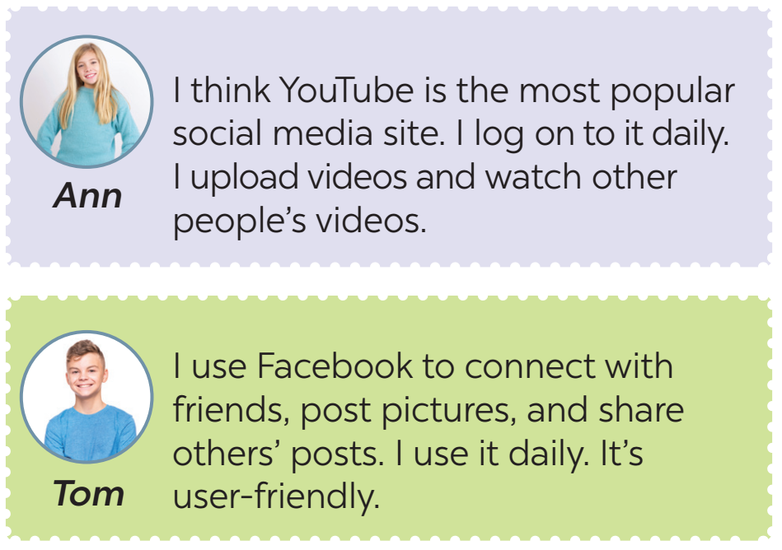
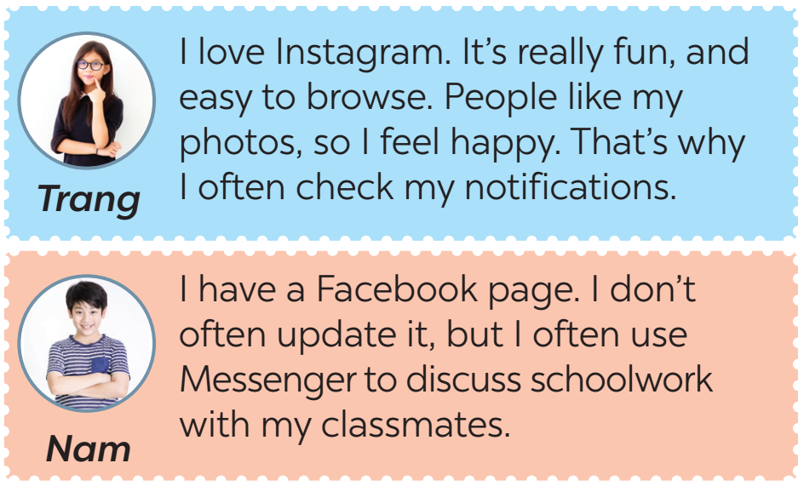
3. Read some posts on a forum about different social media and match the names of the posters with their activities.

Slide 10
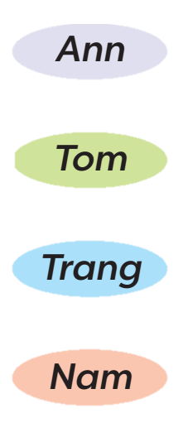
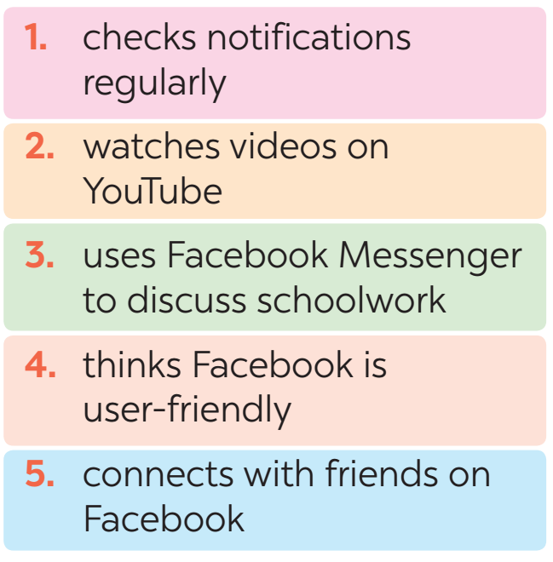
3. Read some posts on a forum about different social media and match the names of the posters with their activities.

Slide 11
4. Work in pairs. Ask and answer questions about what social media the teens in 3 use, why, and how often they use them.
Tom: What social media does Ann use?
Nam: She uses YouTube.
Tom: What does she use it for?
Nam: She uploads her videos and watch other people’s videos.
Tom: How often does she use it?
Nam: Every day.

Slide 12
5. Work in groups. Discuss the following questions:
What social media do you use?
How often do you use it?
What do you use it for?
Report your group’s results to the class.

Slide 13
WRAP -UP
Retell 2 ways of making requests
List some popular social media among teens.

Slide 14
THANK YOU!

Slide 15
THANK YOU FOR LISTENING

Slide 16
FREE RESOURCE PAGE
You can use these gorgeous elements to customize the slides.

Slide 17
FREE RESOURCE PAGE
You can use these gorgeous elements to customize the slides.

