Slide 1
Unit 3:
TEENAGERS
Lesson 3: A Closer Look 2

Slide 2
SIMPLE SENTENCES AND COMPOUND SENTENCES
SIMPLE SENTENCES AND COMPOUND SENTENCES
Eg1: Minh has some problems with his schoolwork.
Eg2: Mark is hard-working; therefore, he usually gets high scores on exams.
s
v
s₁
v₁
s₂
v₂
connector

Slide 3
REMEMBER
A simple sentence is made up of one independent clause.
Example: Minh has some problems with his schoolwork.
A compound sentence is made up of two or more independent clauses, and they are joined by:
A coordinating conjunction: for, and, but, or, so
Example: Mai bought many books, for she likes reading.
A conjunctive adverb: however, therefore, otherwise.
Example: Mark is hard-working; therefore, he usually gets
high scores on exams.

Slide 4
1. Tick the simple sentences
1
We work together on different projects.
2
Teens need good friends and tolerant teachers at school.
3
She plays chess very well, and she won the first prize last year.
4
Sports activities at school help me relax.
5
Teens should learn teamwork, and they should also have communication skills.

Slide 5
2. Write S for simple sentences
and C for compound sentences
S
1
Teenagers are often very active and talkative.
2
He often chats with his friends on Facebook Messenger.
S
She is a smart student, and she is an active member of our club.
3
C
S
4
My friends and I joined a sports competition last year.
He is a club member, but he never participates in any of the activities.
5
C

Slide 6
3. Choose the correct answer A, B or C.
1. Parents should give teens some freedom,______ they should also set limits.
A. for B. so C. but
2. We don’t cheat on exams, ______ it is a wrong thing to do.
A. or B. for C. and
3. Lan wants to join the school music club; ______, she can’t sing or play any instruments.
A. however B. otherwise C. therefore
4. Schoolwork causes teens a lot of pressure, ______ they also feel pressure from their parents.
A. and B. but C. or
5. She wanted to prepare for the exam; ______, she turned off her mobile phone.
A. however B. otherwise C. therefore

Slide 7
Look at the answers again.
1. Parents should give teens some freedom,______ they should also set limits.
A. for B. so C. but
2. We don’t cheat on exams, ______ it is a wrong thing to do.
A. or B. for C. and
3. Lan wants to join the school music club; ______, she can’t sing or play any instruments.
A. however B. otherwise C. therefore
4. Schoolwork causes teens a lot of pressure, ______ they also feel pressure from their parents.
A. and B. but C. or
5. She wanted to prepare for the exam; ______, she turned off her mobile phone.
A. however B. otherwise C. therefore

Slide 8
4. Combine the two sentences to make compound sentences, using the words from the box.
or | therefore | so | but | otherwise
1. Phong has to study harder. He may fail the exam.
___________________________________________________
2. She is very sensitive. Don’t comment on her new hairstyle.
___________________________________________________
Phong has to study harder; otherwise, he may fail the exam.
3. Mi wants to have more friends. She doesn’t connect well with others.
__________________________________________________________
4. Students can work in groups. She can work in pairs.
___________________________________________________
5. My friend likes showing off her new things. She often posts pictures on social media.
___________________________________________________
1
1

Slide 9
4. Combine the two sentences to make compound sentences, using the words from the box.
or | therefore | so | but | otherwise
2. She is very sensitive. Don’t comment on her new hairstyle.
1
She is very sensitive; therefore, don’t comment on her new hairstyle.
1

Slide 10
4. Combine the two sentences to make compound sentences, using the words from the box.
or | therefore | so | but | otherwise
3. Mi wants to have more friends. She doesn’t connect well with others.
1
Mi wants to have more friends, but she doesn’t connect well with others.
1

Slide 11
4. Combine the two sentences to make compound sentences, using the words from the box.
or | therefore | so | but | otherwise
4. Students can work in groups. She can work in pairs.
1
Students can work in groups, or they can work in pairs.
1

Slide 12
4. Combine the two sentences to make compound sentences, using the words from the box.
or | therefore | so | but | otherwise
5. My friend likes showing off her new things. She often posts pictures on social media.
1
My friend likes showing off her new things, so she often posts pictures on social media.
1

Slide 13
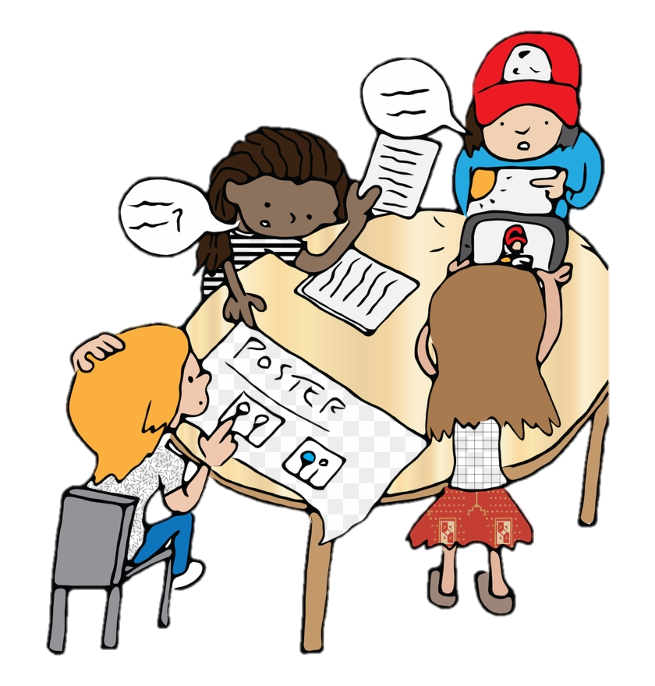
GAME: SENTENCE RACE
Which group has the most sentences?
Work in groups. Each group makes as many compound sentences as possible. The group with the most correct sentence is the winner.

Slide 14
WRAP UP
Say out loud the connectors (coordinating conjunctions and conjunctive adverbs) you have learned in the lesson.
Talk about the meanings of the connectors and how to use commas and semicolons with connectors.

Slide 15
DOES ANYONE HAVE A QUESTION?

Slide 16
THANK YOU!

