Slide 1




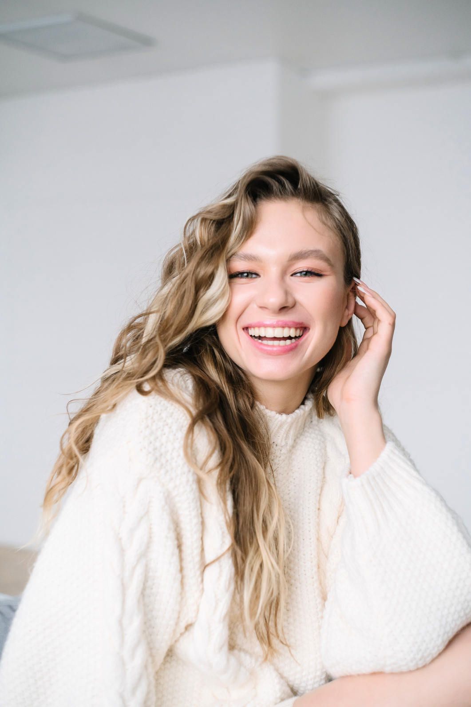




Welcome to our class!
Teacher:…

Slide 2



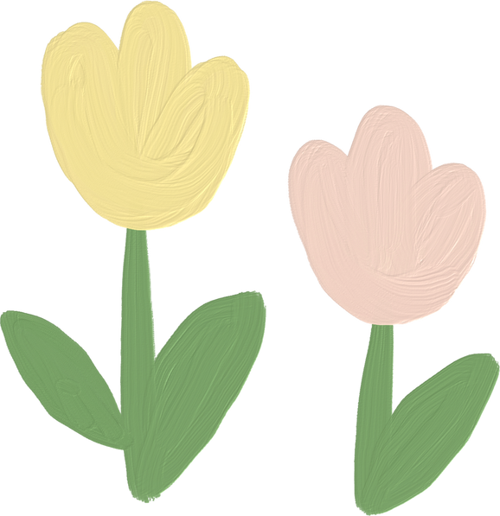
What do you like or dislike about life in the countryside?

Slide 3



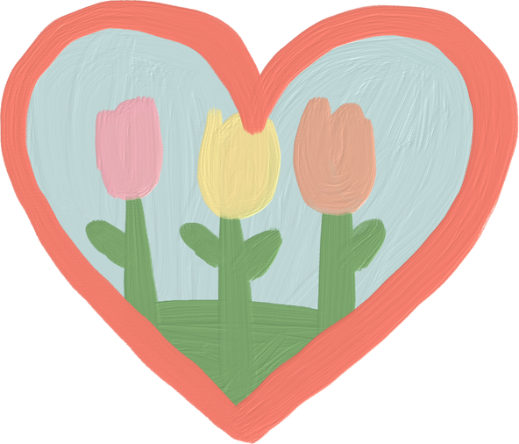
Unit 2: LIFE IN THE COUNTRYSIDE
Lesson 6: Skills 2

Slide 4

LISTENING

Slide 5








2. Listen to three people talking about life in the countryside. Choose the opinion (A-C) that each speaker (1-3) expresses.
Speaker 1
Speaker 2
Speaker 3
A. I don’t like rural life because there are not many good schools and colleges. And entertainment and means of transport are very poor.
B. I like rural life because the people here are close to each other.
C. I want to live in the countryside because there are many things I can’t easily do in the city.

Slide 6

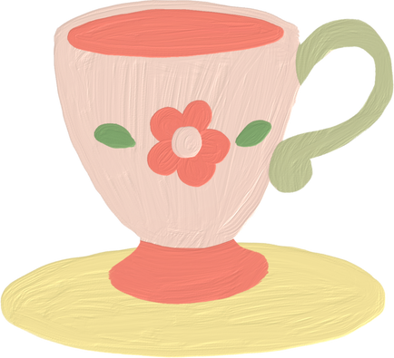
3. Listen again and choose the correct answer A, B, or C.
1. According to speaker 1, there is a great sense of ______ in his village.
A. security B. duty C. community
2. Speaker 1 says that people in his village are very ______.
A. supportive B. unsociable C. well-trained
3. In speaker 2’s opinion, ______ is a big problem in the countryside.
A. the cost of living B. safety C. transportation
4. Speaker 2 says that they should ______ in the countryside.
A. improve the lives of people B. prevent crime C. protect nature
5. According to speaker 3, life in the countryside is peaceful and ______.
A. slow B. simple C. safe

Slide 7
WRITING

Slide 8




4. Work in groups. Discuss and write what you like or dislike about life in the countryside.
LIKE | DISLIKE
– low cost of living – many cheap things | – not many entertainment places, such as theatres, cinemas, etc.
- peacefulness
- natural beauty
– poor means of transport
...
- good sense of community

Slide 9

5. Write a paragraph (80 - 100 words) about what you like or dislike about life in the countryside.
There are some things I like/ dislike about life in the countryside. Firstly, ………………………………………………………….………. Secondly/Additionally …………………………………………….…………………. Finally,…………………………………………………………………………..…………………. To sum up/ Overall / In conclusion …………………………………………..

Slide 10

Suggested answer:
There are some things I like about life in the countryside. One of the main attractions is its peacefulness. This helps people living there feel comfortable and relaxed. Additionally, I enjoy its natural beauty. The countryside often offers picturesque views of rolling hills, rolling meadows, and vast green fields. This can be a great source of inspiration. Finally, I appreciate the strong sense of community in rural areas. Rural people are very tight-knit and always willing to help their neighbours. Overall, these are just some of the many things I enjoy about rural life.

Slide 11
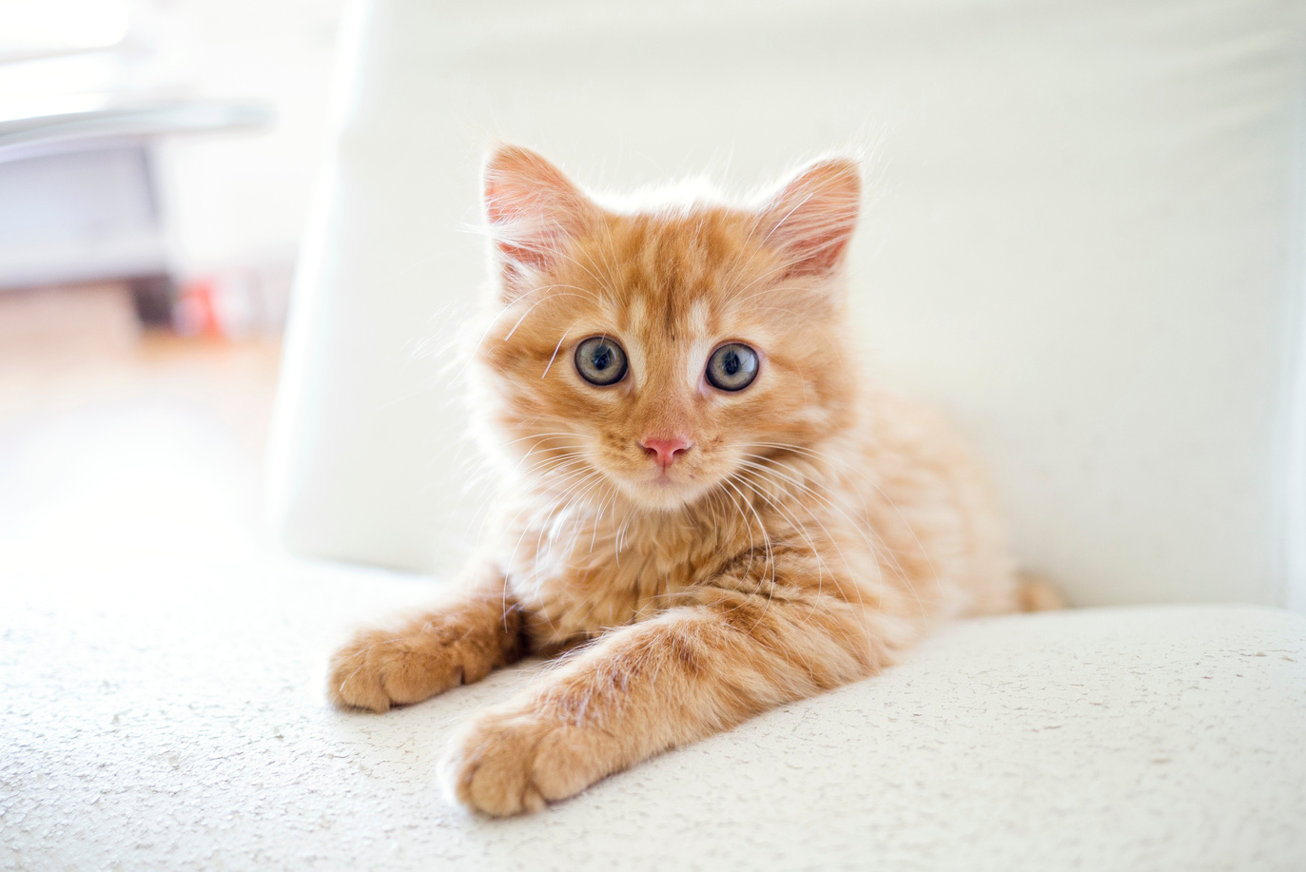

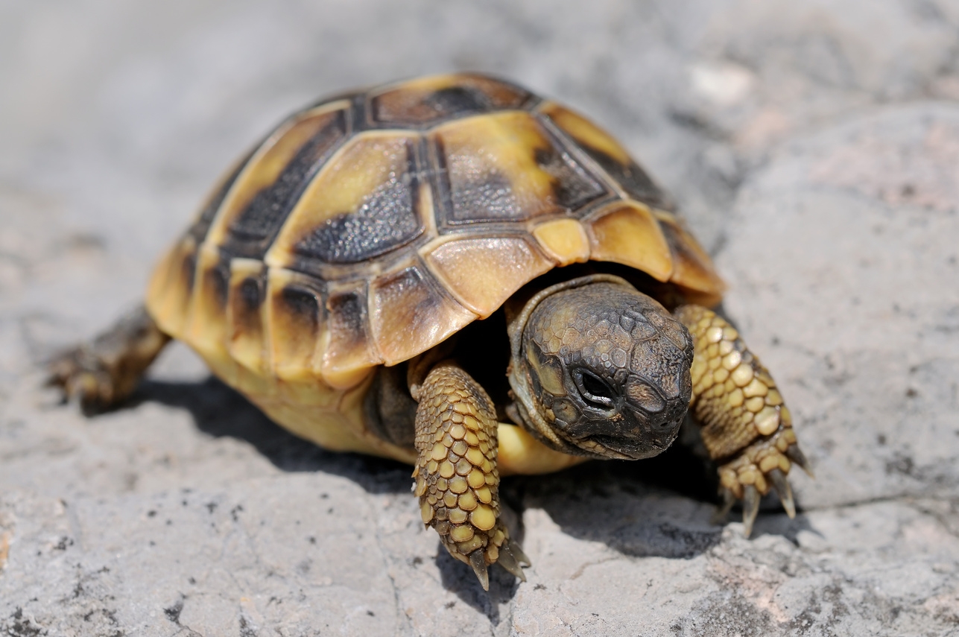

WRAP - UP
What have we learnt in this lesson?
Listen to someone’s opinion about life in the countryside
Write a paragraph about what someone likes or dislikes about life in the countryside

Slide 12

Thank You!

Slide 13


My Favorite Movie

Slide 14
Teacher Resources Page
Use these icons and illustrations in your presentation. Enjoy designing!

