Slide 1
WELCOME TO OUR CLASS
Teacher: …

Slide 3
Unit 2:
LIFE IN THE COUNTRYSIDE
Lesson 1: Getting Started

Slide 4
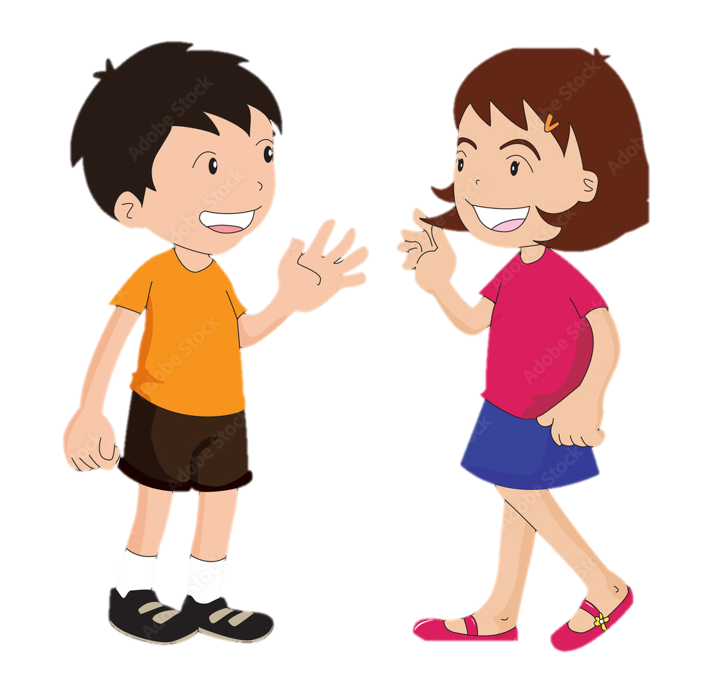
Nick
LAST SUMMER HOLIDAY
Who has just come back from a very enjoyable summer holiday?
Mai

Slide 5
Listen and read
Nick: You look great with a tan, Mai!
Mai: Thank you. I’ve just come back from a very enjoyable summer holiday.
Nick: Really? Where did you stay?
Mai: I stayed at my uncle’s house in a small village in Bac Giang Province.
Nick: What did you do there?
Mai: A lot of things. It was harvest time. The villagers were harvesting rice with a combine harvester. I helped them load the rice onto a truck. Then we unloaded the rice and dried it.
Nick: Sounds great!
Mai: And sometimes I went with the village children to herd the buffaloes and cows. I made friends with them on my first day.
Nick: Were they friendly?
Mai: Yes, they were. They took me to the paddy fields to fly kites. And in the evening, we played traditional games like bamboo dancing and dragon-snake.
Nick: Oh, I envy you!
Mai: Things move more slowly there than in our city, but people seem to have a healthier life.

Slide 6
2. Read the conversation again and choose the correct answer to each question.
1. How does Mai feel about her summer holiday?
A. She likes it. B. She doesn’t like it. C. She thought it was fine.
2. Where did she stay during her summer holiday?
A. At her friend’s house.
B. At her uncle’s house.
C. At her grandparents’ house.
3. During harvest time, people harvest rice by ______.
A. themselves B. using a truck C. using a combine harvester
4. Mai thinks people in the countryside lead ______.
A. a healthy life B. an exciting life C. an interesting life

Slide 7
Check your answer
1. How does Mai feel about her summer holiday?
A. She likes it.
B. She doesn’t like it.
C. She thought it was fine.
Nick: You look great with a tan, Mai!
Mai: Thank you. I’ve just come back from a very enjoyable summer holiday.
Nick: Really? Where did you stay?
Mai: I stayed at my uncle’s house in a small village in Bac Giang Province.
Nick: What did you do there?
Mai: A lot of things. It was harvest time. The villagers were harvesting rice with a combine harvester. I helped them load the rice onto a truck. Then we unloaded the rice and dried it.
Nick: Sounds great!
Mai: And sometimes I went with the village children to herd the buffaloes and cows. I made friends with them on my first day.
Nick: Were they friendly?
Mai: Yes, they were. They took me to the paddy fields to fly kites. And in the evening, we played traditional games like bamboo dancing and dragon-snake.
Nick: Oh, I envy you!
Mai: Things move more slowly there than in our city, but people seem to have a healthier life.

Slide 8
Check your answer
2. Where did she stay during her summer holiday?
A. At her friend’s house.
B. At her uncle’s house.
C. At her grandparents’ house.
Nick: You look great with a tan, Mai!
Mai: Thank you. I’ve just come back from a very enjoyable summer holiday.
Nick: Really? Where did you stay?
Mai: I stayed at my uncle’s house in a small village in Bac Giang Province.
Nick: What did you do there?
Mai: A lot of things. It was harvest time. The villagers were harvesting rice with a combine harvester. I helped them load the rice onto a truck. Then we unloaded the rice and dried it.
Nick: Sounds great!
Mai: And sometimes I went with the village children to herd the buffaloes and cows. I made friends with them on my first day.
Nick: Were they friendly?
Mai: Yes, they were. They took me to the paddy fields to fly kites. And in the evening, we played traditional games like bamboo dancing and dragon-snake.
Nick: Oh, I envy you!
Mai: Things move more slowly there than in our city, but people seem to have a healthier life.

Slide 9
Check your answer
3. During harvest time, people harvest rice by ______.
A. themselves
B. using a truck
C. using a combine harvester
Nick: You look great with a tan, Mai!
Mai: Thank you. I’ve just come back from a very enjoyable summer holiday.
Nick: Really? Where did you stay?
Mai: I stayed at my uncle’s house in a small village in Bac Giang Province.
Nick: What did you do there?
Mai: A lot of things. It was harvest time. The villagers were harvesting rice with a combine harvester. I helped them load the rice onto a truck. Then we unloaded the rice and dried it.
Nick: Sounds great!
Mai: And sometimes I went with the village children to herd the buffaloes and cows. I made friends with them on my first day.
Nick: Were they friendly?
Mai: Yes, they were. They took me to the paddy fields to fly kites. And in the evening, we played traditional games like bamboo dancing and dragon-snake.
Nick: Oh, I envy you!
Mai: Things move more slowly there than in our city, but people seem to have a healthier life.

Slide 10
Check your answer
4. Mai thinks people in the countryside lead ______.
A. a healthy life
B. an exciting life
C. an interesting life
Nick: You look great with a tan, Mai!
Mai: Thank you. I’ve just come back from a very enjoyable summer holiday.
Nick: Really? Where did you stay?
Mai: I stayed at my uncle’s house in a small village in Bac Giang Province.
Nick: What did you do there?
Mai: A lot of things. It was harvest time. The villagers were harvesting rice with a combine harvester. I helped them load the rice onto a truck. Then we unloaded the rice and dried it.
Nick: Sounds great!
Mai: And sometimes I went with the village children to herd the buffaloes and cows. I made friends with them on my first day.
Nick: Were they friendly?
Mai: Yes, they were. They took me to the paddy fields to fly kites. And in the evening, we played traditional games like bamboo dancing and dragon-snake.
Nick: Oh, I envy you!
Mai: Things move more slowly there than in our city, but people seem to have a healthier life.

Slide 11
Look at the answers again
1. How does Mai feel about her summer holiday?
A. She likes it. B. She doesn’t like it. C. She thought it was fine.
2. Where did she stay during her summer holiday?
A. At her friend’s house.
B. At her uncle’s house.
C. At her grandparents’ house.
3. During harvest time, people harvest rice by ______.
A. themselves B. using a truck C. using a combine harvester
4. Mai thinks people in the countryside lead ______.
A. a healthy life B. an exciting life C. an interesting life

Slide 12
3. Complete the sentences with the words and phrases from the box
paddy field
herd
harvest time
load
combine harvester
1. It took them an hour to ___________ all the goods onto the truck.
2. Nowadays, people in my village use a __________________ to harvest their rice and separate the grains from the rest of the plant.
3. Today it is my turn to __________ the cows.
4. A place in which people grow rice is called a _______________.
5. A busy time when people cut and gather their crops is called _____________.

Slide 13
3. Complete the sentences with the words and phrases from the box
paddy field
herd
harvest time
load
combine harvester
1. It took them an hour to ___________ all the goods onto the truck.

Slide 14
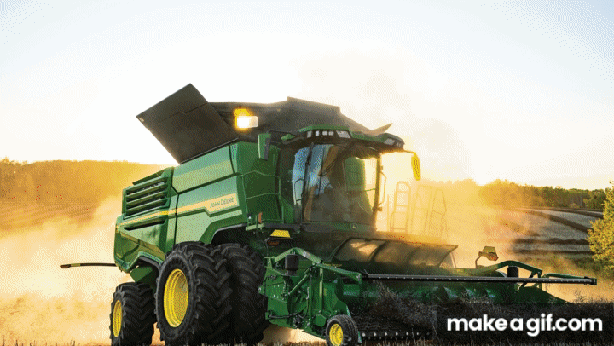
3. Complete the sentences with the words and phrases from the box
paddy field
herd
harvest time
combine harvester
2. Nowadays, people in my village use a __________________
to harvest their rice and separate the grains from the rest of the plant.

Slide 15
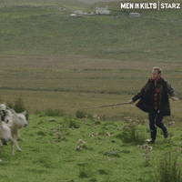
3. Complete the sentences with the words and phrases from the box
paddy field
herd
harvest time
3. Today it is my turn to __________ the cows.

Slide 16
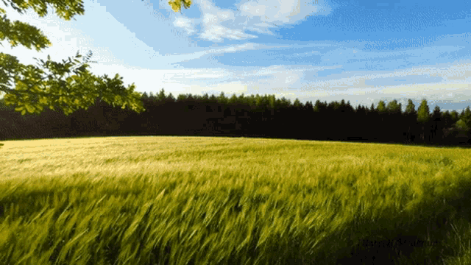
3. Complete the sentences with the words and phrases from the box
paddy field
harvest time
4. A place in which people grow rice is called a ____________.

Slide 17
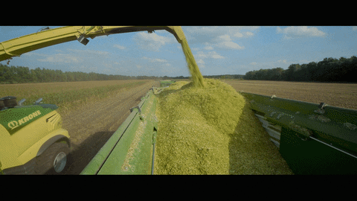
3. Complete the sentences with the words and phrases from the box
harvest time
5. A busy time when people cut and gather their crops is called _____________.

Slide 18
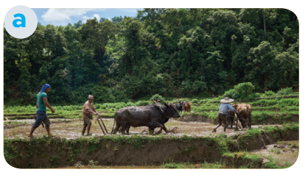
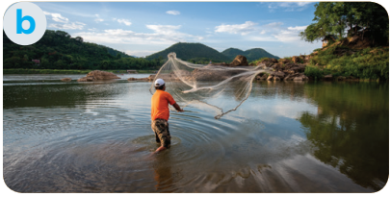
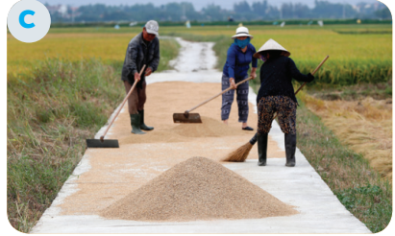
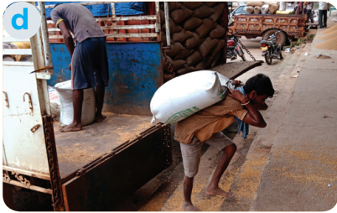
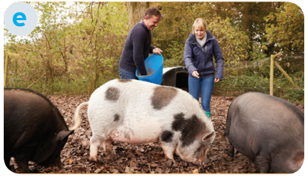
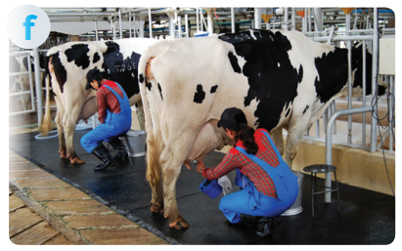
4. Match the activities that people living in the countryside often do with the pictures.
1. unloading rice
2. ploughing fields
3. milking cows
4. feeding pigs
5. catching fish
6. drying rice

Slide 19
WHAT ARE PEOPLE DOING BEHIND THE BINOCULARS?
PLAY

Slide 20
Photo courtesy of Lisa L Wiedmeier (@flickr.com) - granted under creative commons licence - attribution
ploughing fields

Slide 21
Photo courtesy of Lisa L Wiedmeier (@flickr.com) - granted under creative commons licence - attribution
milking cows

Slide 22
Photo courtesy of Lisa L Wiedmeier (@flickr.com) - granted under creative commons licence - attribution
drying rice

Slide 23
Photo courtesy of Lisa L Wiedmeier (@flickr.com) - granted under creative commons licence - attribution
unloading rice

Slide 24
Photo courtesy of Lisa L Wiedmeier (@flickr.com) - granted under creative commons licence - attribution
catching fish

Slide 25
Photo courtesy of Lisa L Wiedmeier (@flickr.com) - granted under creative commons licence - attribution
feeding pigs

Slide 26
Look at the answers again
2. ploughing fields
5. catching fish
6. drying rice
1. unloading rice
4. feeding pigs
3. milking cows

Slide 27
5. Ask and answer about the pictures
What are they doing in picture a?
They are ploughing fields.

Slide 28
Wrap up
What have we learnt in this lesson?
identify the topic of the unit
use lexical items related to life in the countryside
identify the language features that are covered in the unit

Slide 29
Thank
you

