Slide 1


ADVERB | COMPARISON FORM
fluently
happily
early
late
well
badly
far
often

Slide 2




UNIT 2:
LIFE IN THE COUNTRYSIDE
Lesson 4: Communication

Slide 3


Everyday English
Giving and responding to compliments

Slide 4





1. Listen and read the conversations. Pay attention to the highlighted sentences.
Tom: What a beautiful kite you have, Mai!
Mai: Thank you, Tom. My dad made it for me last weekend.
1
Nick: You really have a nice dress, Hoa.
Hoa: I’m glad you like it, Nick. I think its colour really suits me.
2
Giving compliments | Responding to compliments
- What + (a/an) + adj + N + you have! - You really have (a/an) + adj + N. | Thank you. I’m glad you like it.

Slide 5



2. Work in pairs. Make similar conversations to practice giving and responding to compliments, using the cues below.
a bicycle
a shirt
a school bag
Giving compliments | Responding to compliments
- What + (a/an) + adj + N + you have! - You really have (a/an) + adj + N. | Thank you. I’m glad you like it.

Slide 6
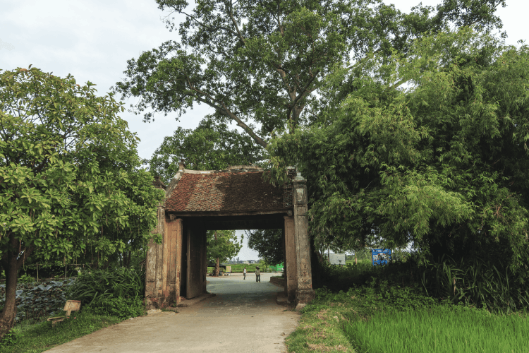
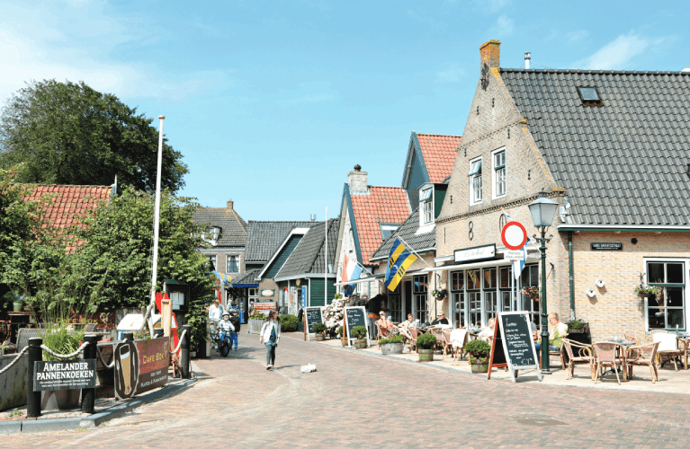
Adverts for beautiful villages

Slide 7
Duong Lam Village
Duong Lam, one of the most ancient villages in Ha Noi, is situated in Son Tay. Visitors can get there from the centre of Ha Noi by car, bus or even by bicycle. It is famous for its ancient pagoda, traditional houses, and temples. Besides these, visitors can observe the locals making specialities, such as keo doi, che lam, etc. and then try them.

Slide 8
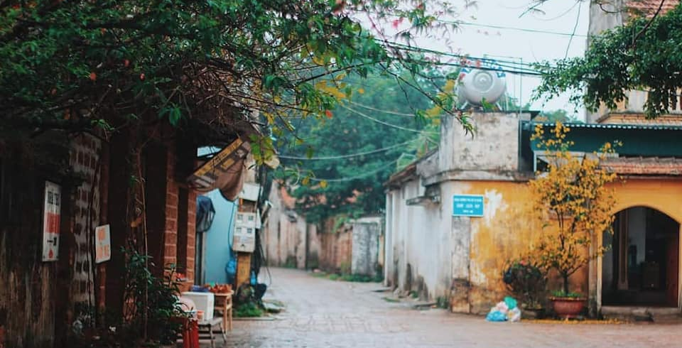
DUONG LAM VILLAGE

Slide 9
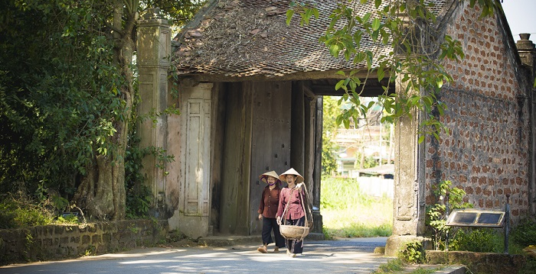

Slide 10
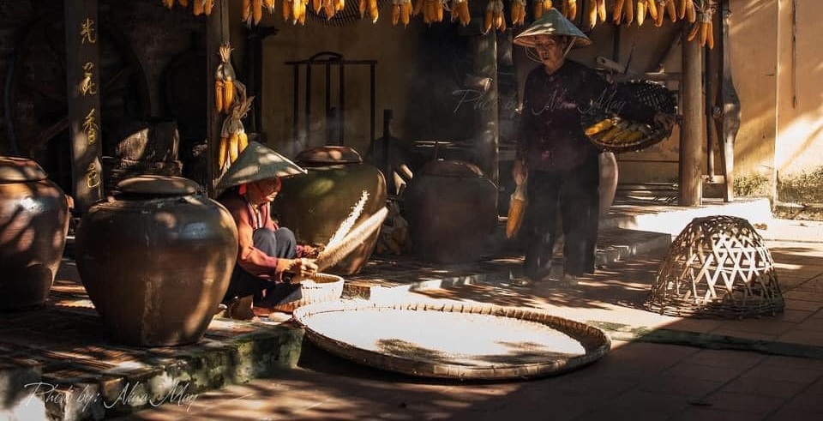

Slide 11
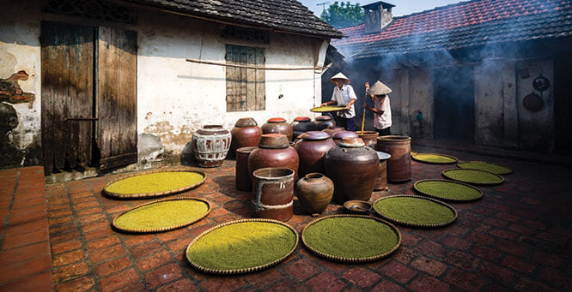

Slide 12
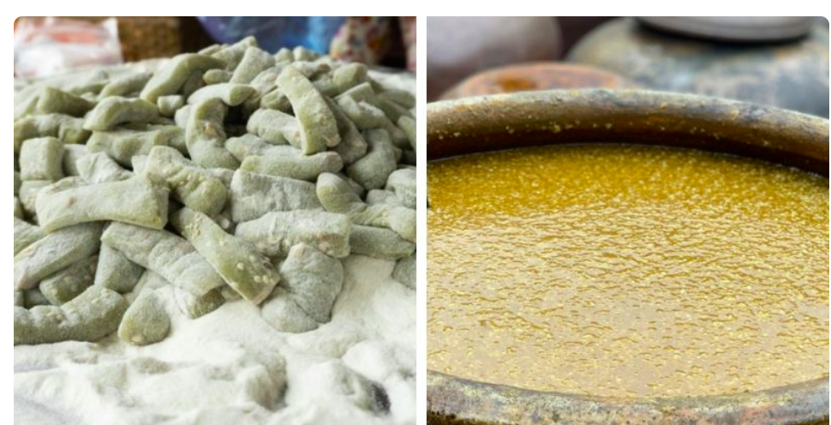

Slide 13
Hollum Village
Hollum is one of the ancient villages on the island of Ameland, the Netherlands. Many visitors come to the village because of its historical and cultural values. It is full of fascinating sights, such as traditional houses, a museum, a church, a lighthouse, etc. Besides sightseeing, visitors can also take part in sports like kite-flying, surfing, etc. Visitors can reach the village by air or ferry.

Slide 14
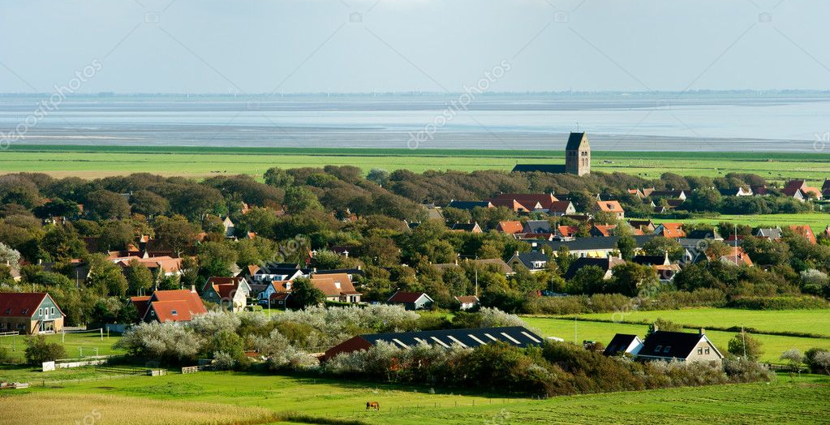
HOLLUM VILLAGE

Slide 15
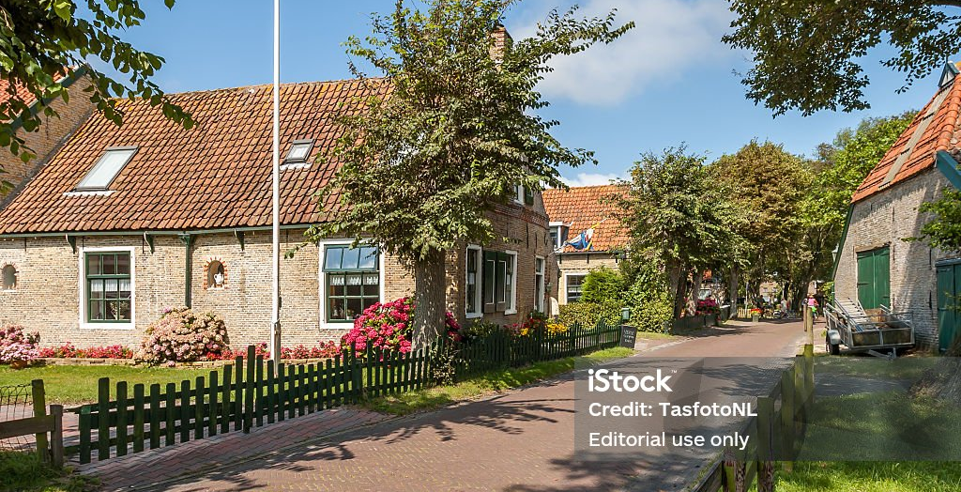

Slide 16
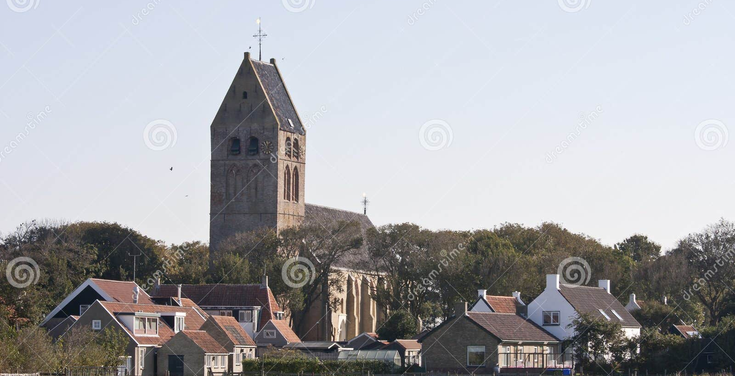

Slide 17
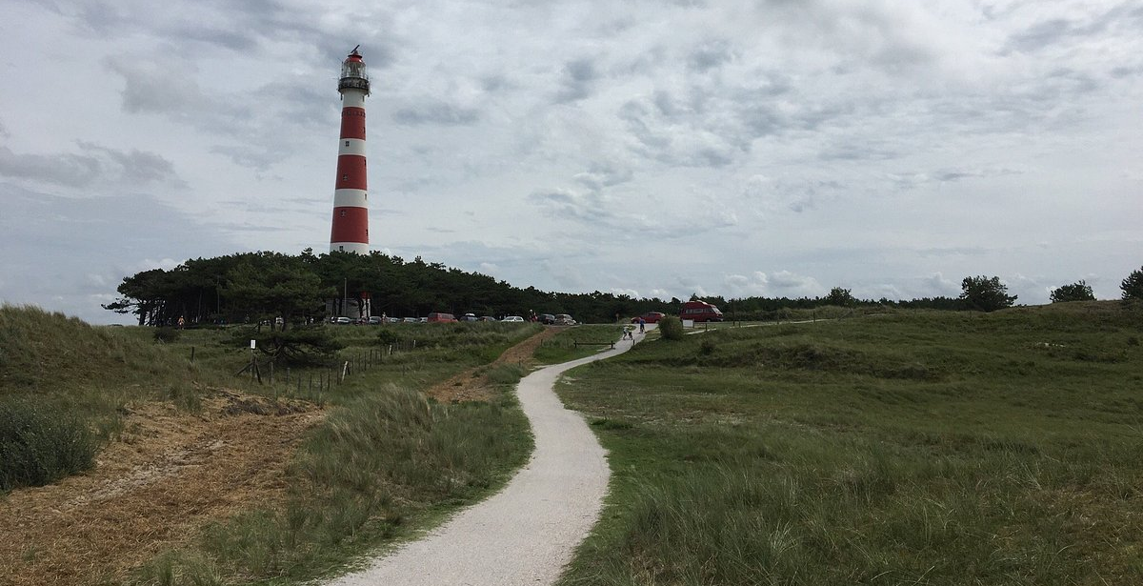

Slide 18

3. Read the adverts for the two beautiful villages. Tick the boxes to show which village the statements describe. Sometimes both boxes need to be ticked.
Statements | Duong Lam | Hollum
1. It’s an ancient village.
2. We can visit an ancient pagoda, traditional houses, and temples in this village.
3. We can get there by plane or ferry.
4. We can go there by car, bus, or bike.
5. It has a lighthouse.

Slide 19



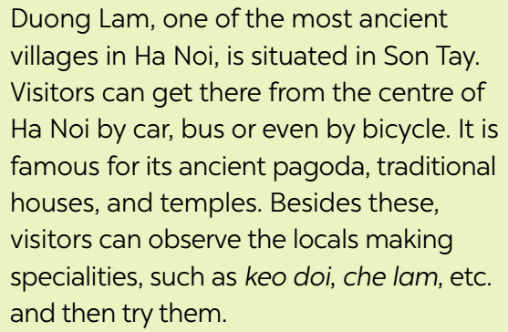
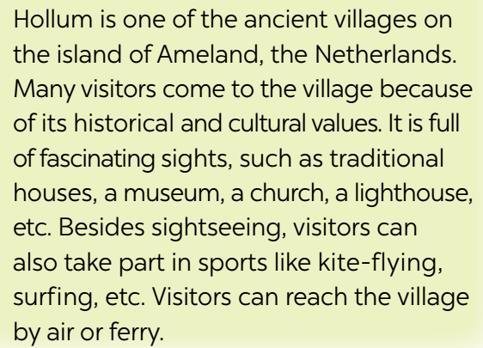
4. Work in groups. Take turns to talk about the similarities and differences between Duong Lam and Hollum.
Duong Lam and Hollum are both ancient villages, …

Slide 20


Suggested answer:
Duong Ham and Hollum are both ancient villages, two of them are famous for their historical attractions. Tourist can visit traditional houses in both Duong Lam and Hollum. However, in Duong Lam, visitors can also observe the locals making specialties, such as keo doi, che lam, etc, and then try them. And in Hollum, besides sightseeing, visitors can also take part in sports like flying kites, surfing, etc. lastly, because Duong Lam is in the rural area of Ha Noi, you can go there by car, bus or even bicycle. Nevertheless, Hollum is on the island of Ameland, so you have to use ferry or plane to go there.

Slide 21




5. Work in pairs. Which village in 3 would you like to visit for a holiday? Explain your choice to your partner.
Duong Lam, of course!
Which village would you like to visit for a holiday?
Why?
Because I love watching the locals making specialties and …

Slide 22

THANK YOU!

