Slide 1
HIDDEN PICTURES

Slide 2
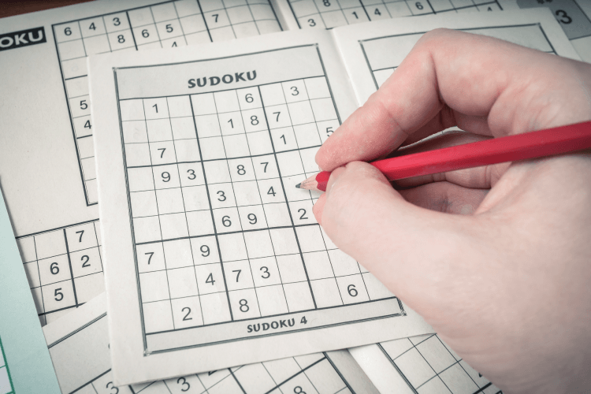
What is it?
doing puzzles
SHOW ALL

Slide 3
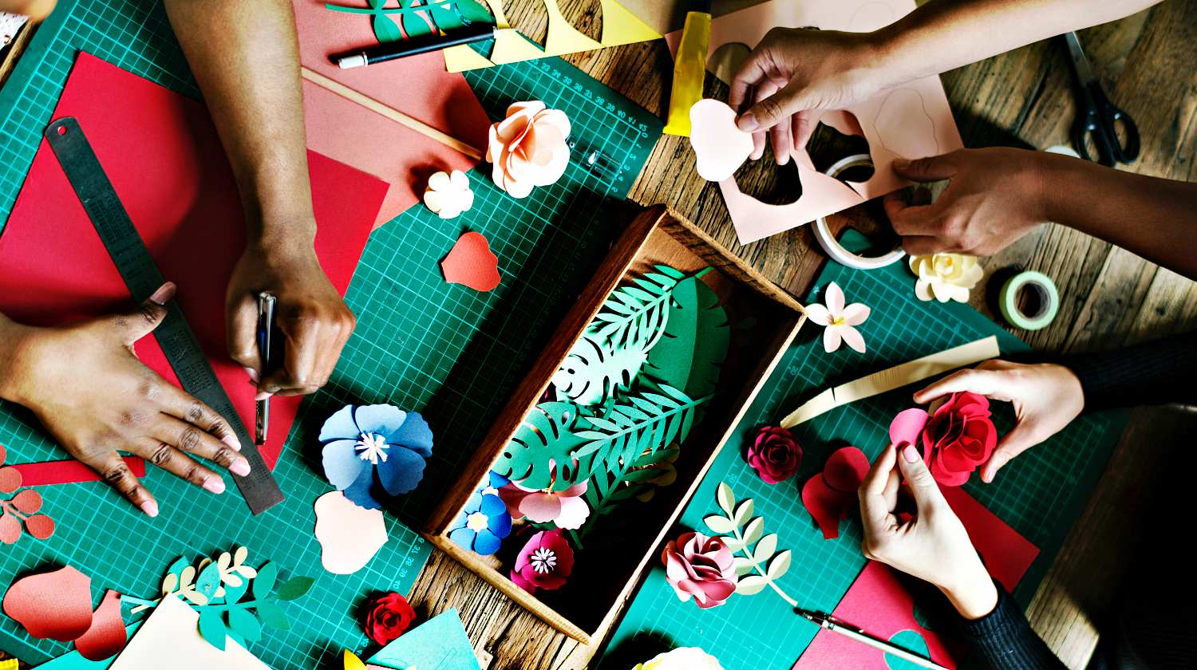
What is it?
doing DIY
SHOW ALL

Slide 4
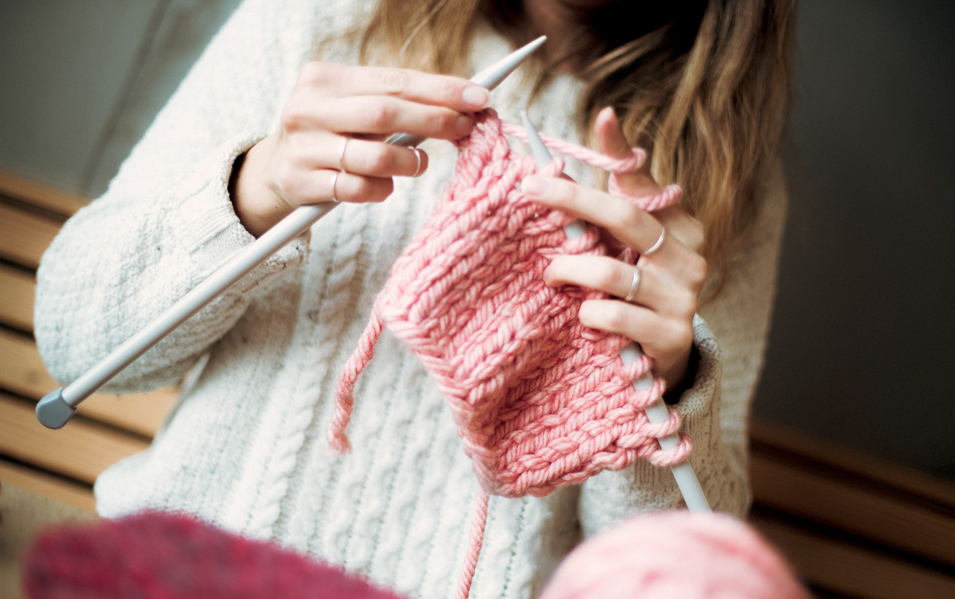
What is it?
knitting
SHOW ALL

Slide 5
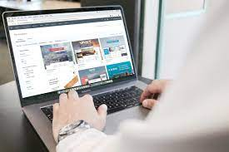
What is it?
surfing the net
SHOW ALL

Slide 6
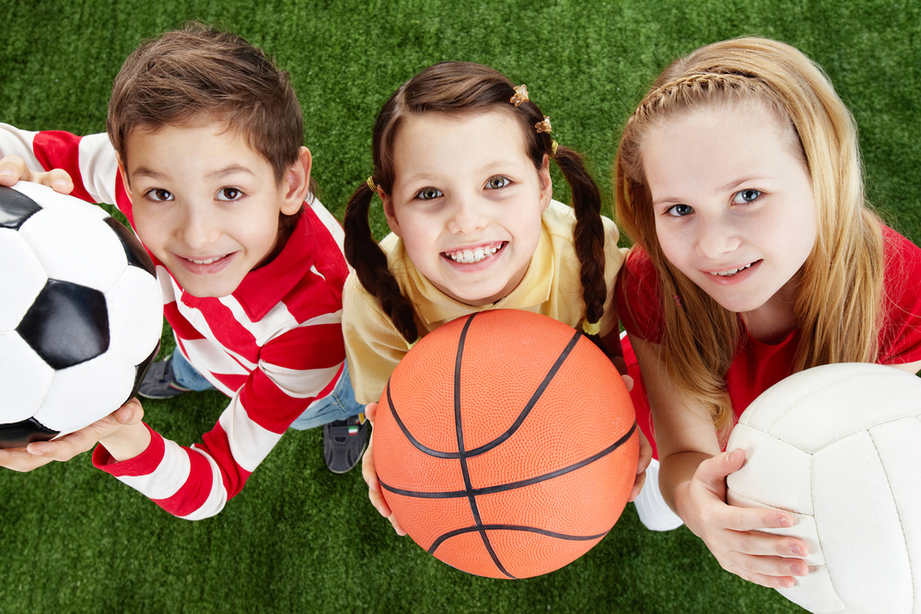
What is it?
playing sport
SHOW ALL

Slide 7
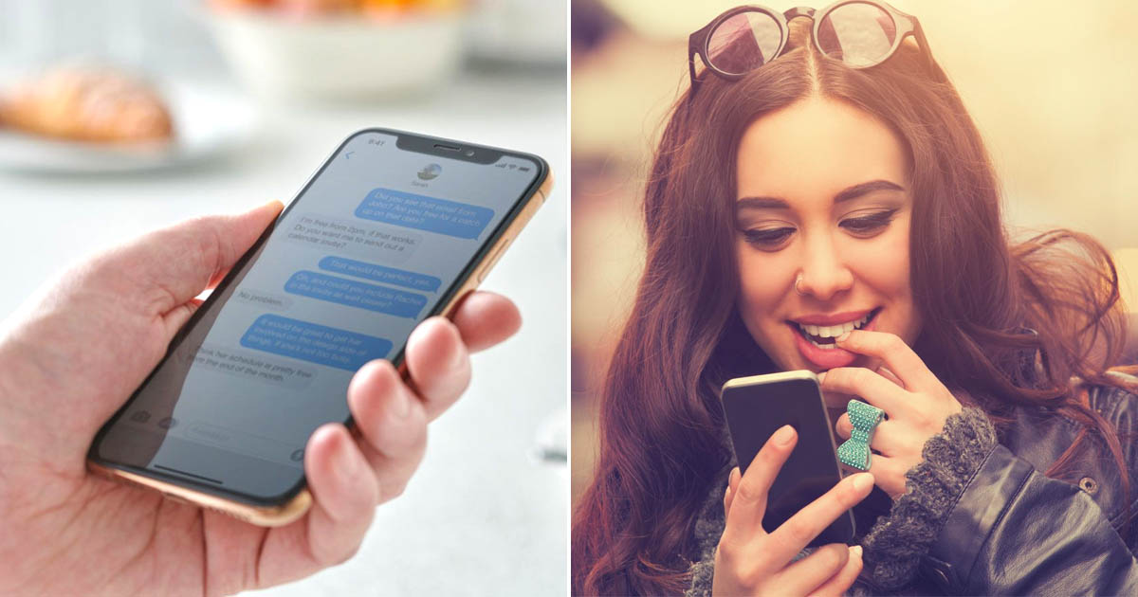
What is it?
messaging friends
SHOW ALL

Slide 8
UNIT 1:
LEISURE TIME
Lesson 7: Looking back and project

Slide 9
VOCABULARY

Slide 10
1. Complete the sentences with appropriate leisure activities.
1. Mai loves ___________ online for about 30 minutes a day. She thinks puzzles are good for the brain.
2. My favourite leisure activity is ________. I can make many things myself, such as paper flowers and bracelets.
doing puzzles
doing DIY
Messaging friends
3. _______________ is a popular way for teens to spend their free time. Many of them send messages to each other every day.
playing sport
4. My brother is fond of ___________ with his friends. On Sundays, he usually plays football, goes swimming, or plays badminton with them.
5. Tom spends one hour on the Internet almost every day. He is keen on ____________.
surfing the net

Slide 11
2. Write complete sentences from the given cues.
1. my cousin / crazy about / play / computer / games.
________________________________________________
2. they / interested / play / badminton / after school?
________________________________________________
3. I / not fond / make models / because / I / not patient.
________________________________________________
My cousin is crazy about playing computer games.
4. - why / you / not into / cook?
_____________________________ - because / often / burn / myself.
_____________________________
5. my friends / keen / do judo / and / they / go / judo club / every Sunday.
_________________________________________________________________

Slide 12
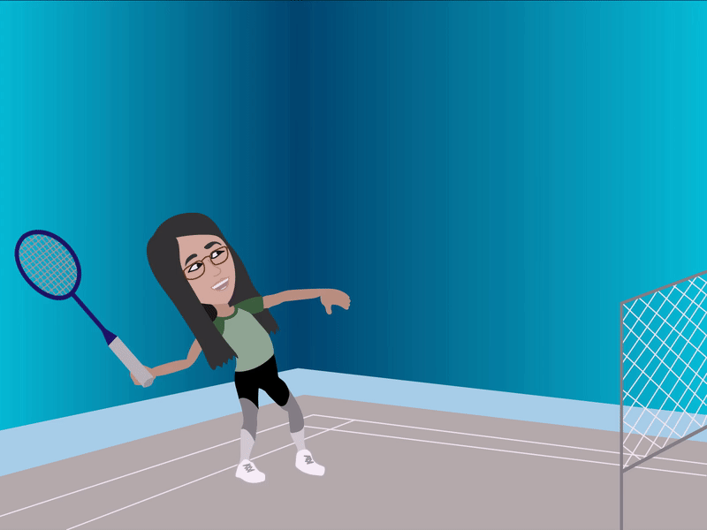
2. they / interested / play / badminton / after school?
Are they interested in playing badminton after school?

Slide 13
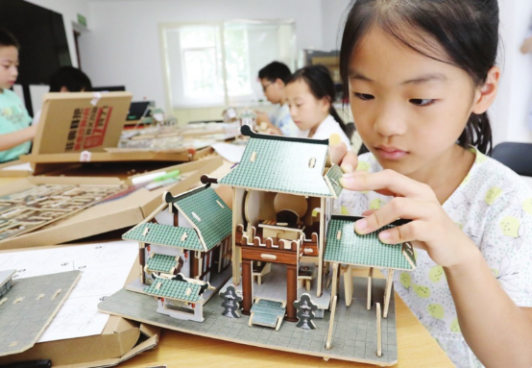
3. I / not fond / make models / because / I / not patient.
I’m not fond of making models because I’m not patient.

Slide 14
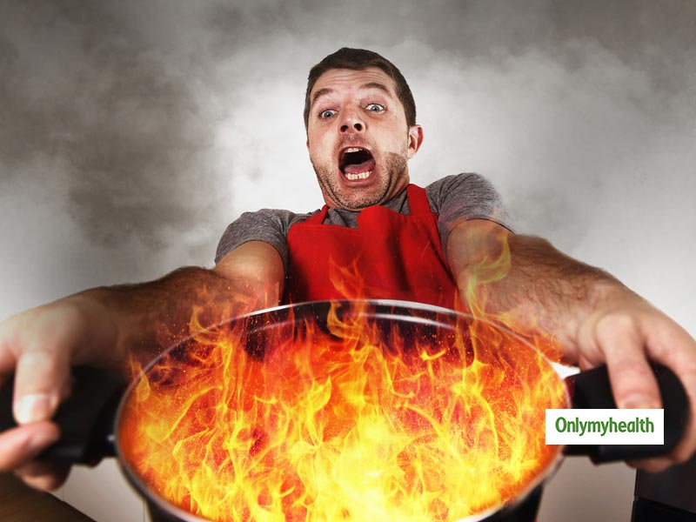
4. - why / you / not into / cook?
- because / often / burn / myself.
Why are you not into cooking?
Because I often burn myself.

Slide 15
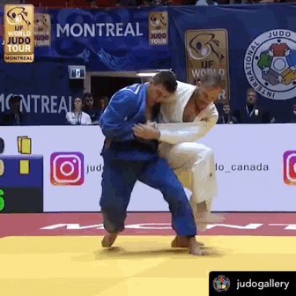
5. my friends / keen / do judo / and / they / go / judo club / every Sunday.
My friends are keen on doing judo, so they go to the judo club every Sunday.

Slide 16
GRAMMAR

Slide 17
Verbs followed by gerunds only:
detest – fancy – dislike – enjoy
Verbs followed by both gerunds and to-infinitives:
love – like – hate – prefer

Slide 18
3. Fill in each blank with the correct form(s) of the verb in brackets.
1. Does Tom enjoy (cycle) _________ in the park with his friends?
2. Some teenagers don’t like (read) ______________ comic books.
3. Mai detests (play) _________ sport because it’s tiring.
4. Trang and Ann love (chat) ______________ with each other in their free time.
5. What do Nam and Mark prefer (do) ___________ at the weekend?
cycling
reading / to read
playing
chatting / to chat
doing / to do

Slide 19
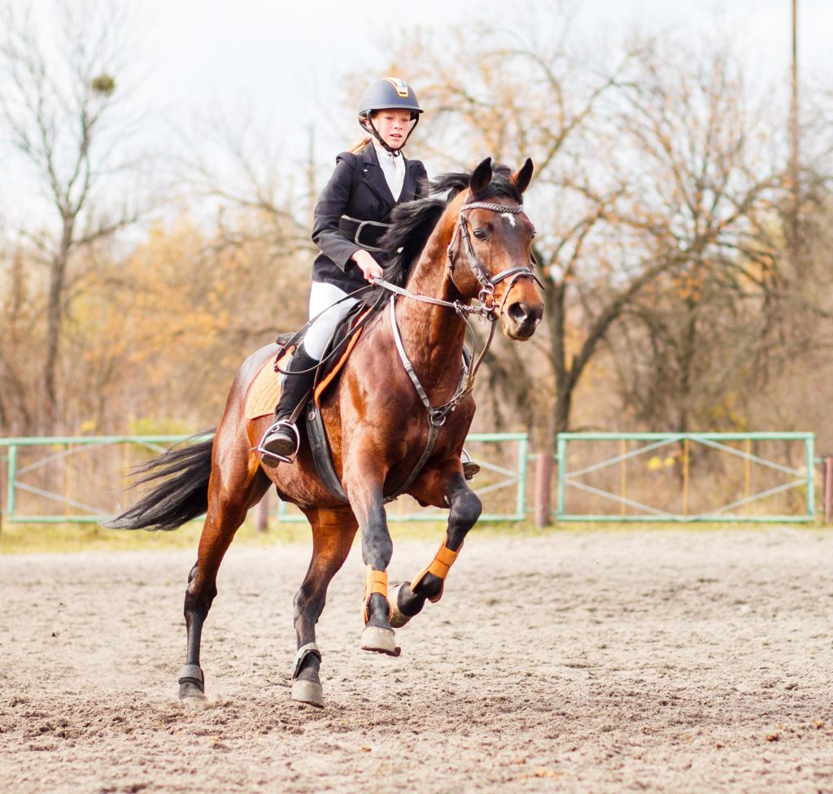
4. Complete the passage. Use the correct form(s) of the verbs in brackets and the pictures. Add more words if necessary.
Ann is my best friend. She usually has free time at the weekend. She adores (1. ride) riding a horse at the riding club. Sometimes, she likes (2. read) _________ or (3. message) ___________. She also loves (4. make) ____________ and (5. knit) ___________. There is one thing she doesn’t like doing in her free time. She dislikes (6. play) _____________.

Slide 20
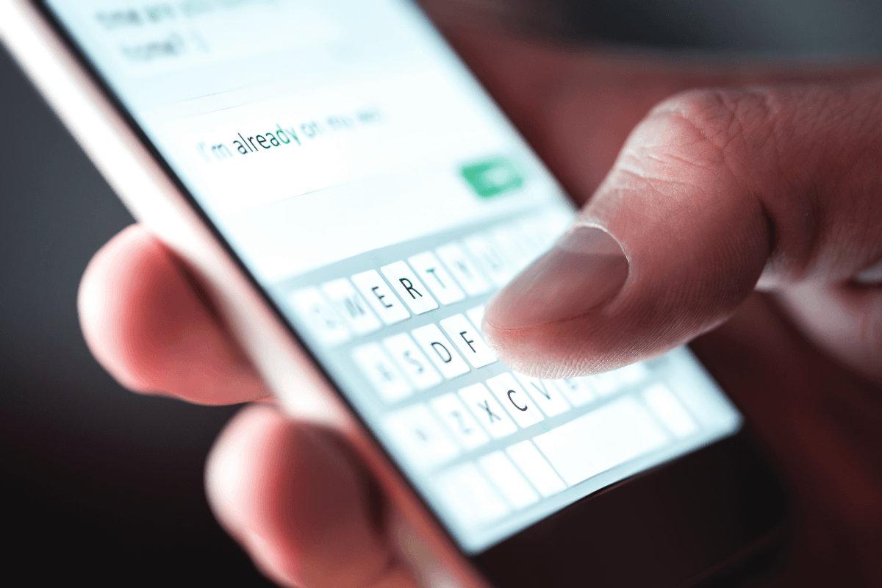
4. Complete the passage. Use the correct form(s) of the verbs in brackets and the pictures. Add more words if necessary.
Sometimes, she likes (2. read) ____________________ or (3. message) _______________________.
reading / to read books
messaging / to message her friends

Slide 21
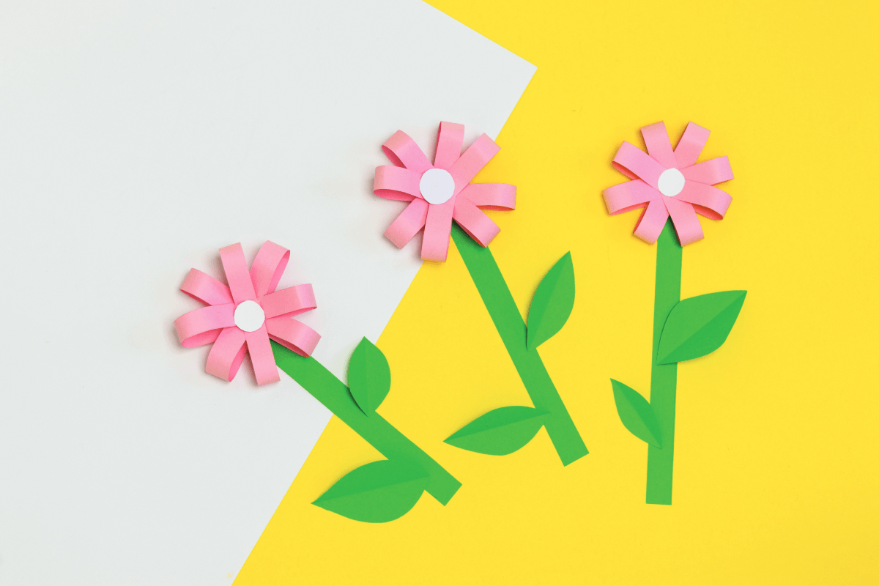
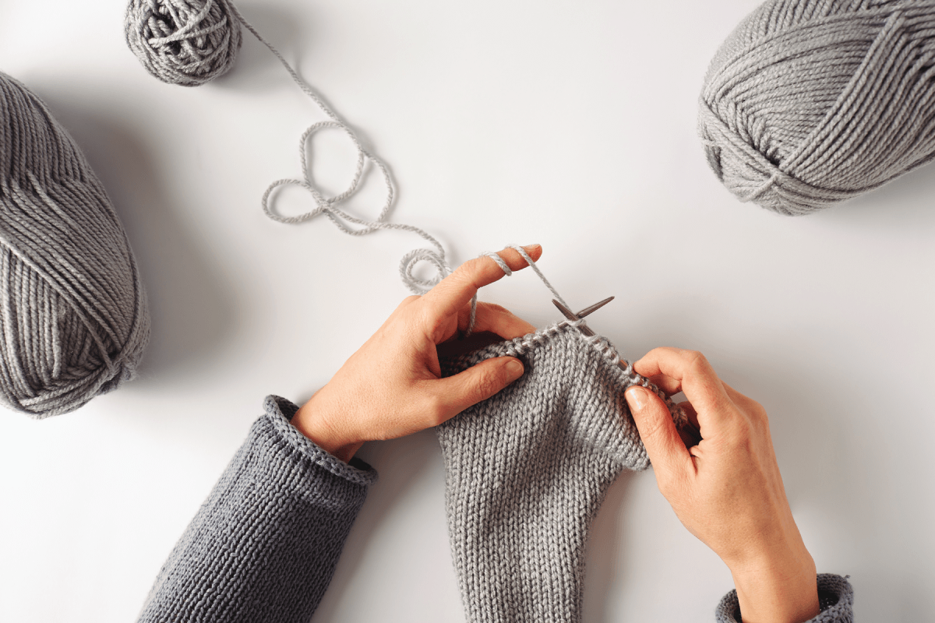
4. Complete the passage. Use the correct form(s) of the verbs in brackets and the pictures. Add more words if necessary.
She also loves (4. make) ________________________ and (5. knit) _____________.
making / to make paper flowers
knitting / to knit

Slide 22
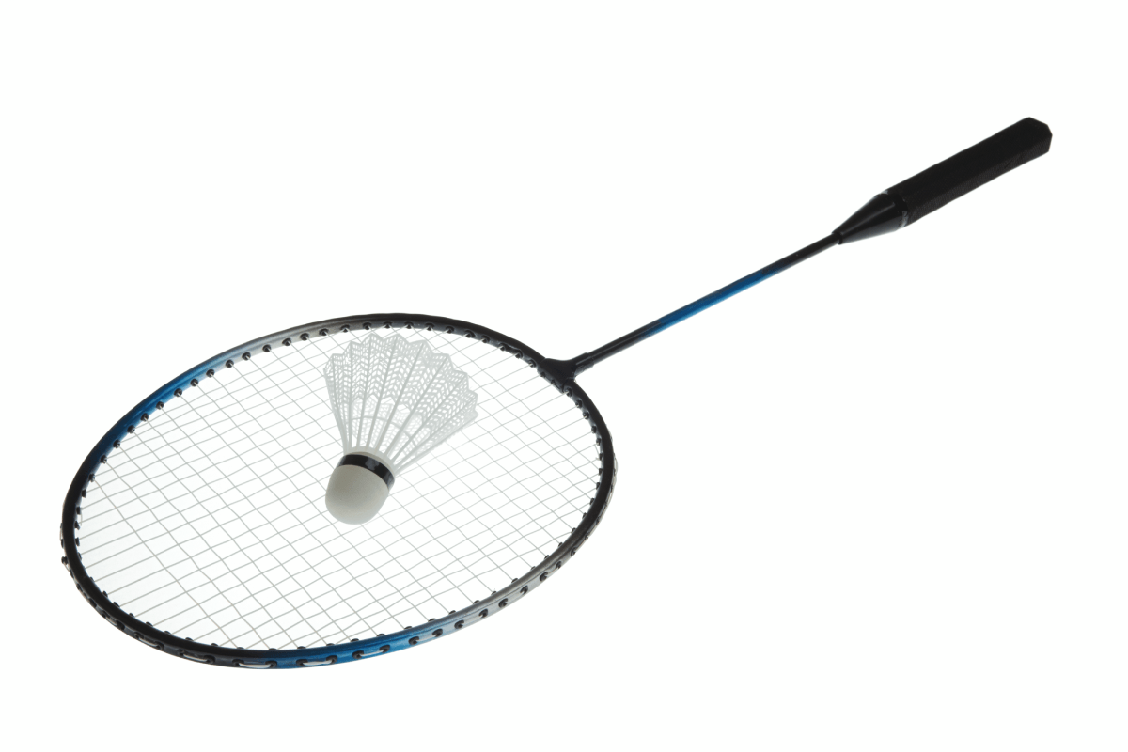
4. Complete the passage. Use the correct form(s) of the verbs in brackets and the pictures. Add more words if necessary.
There is one thing she doesn’t like doing in her free time. She dislikes (6. play) _________________.
playing badminton

Slide 23
PROJECT
PRESENTATION

Slide 24
THANK YOU

