Slide 1
WELCOME TO OUR CLASS
Ms. Lan Phuong
079 287 2996

Slide 2
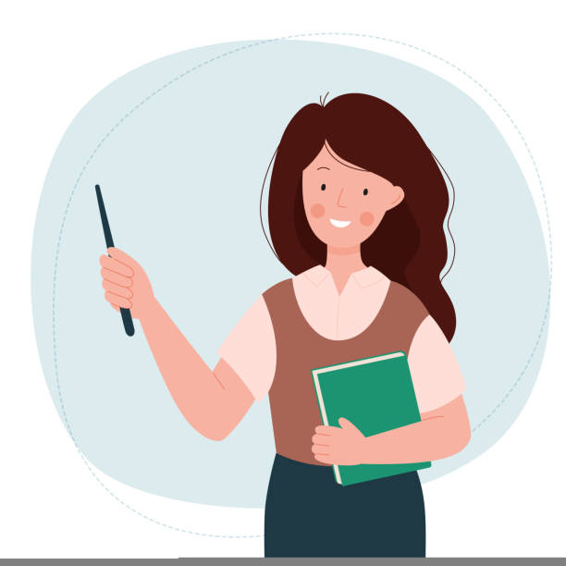
VÀO
RA
NÓI
NHÓM

Slide 4
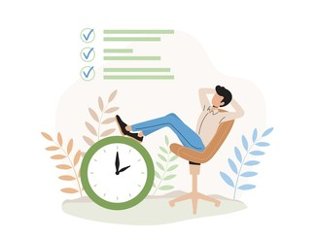
F R E E T I M E
_ _ _ _ _ _ _ _
LEISURE TIME

Slide 5
UNIT 1:
LEISURE TIME
Lesson 1: Getting started

Slide 6
1. Listen and read
I’m keen on doing DIY (do-it-yourself)
Tom: Hi, Trang. Surprised to see you. What brings you here?
Trang: Oh, hello Tom. I'm looking for a knitting kit.
Tom: A knitting kit? I didn't know you like knitting.
Trang: Actually, I'm keen on many DIY activities. In my leisure time, I love knitting, building dollhouses, and making paper flowers.
Tom: I see. So, you like spending time on your own.
Trang: Yeah. What do you do in your free time?
Tom: I'm a bit different. I usually hang out with my friends. We go to the cinema, go cycling, or play sport in the park.
Trang: You love spending free time with other people, don't you?
Tom: That's right. By the way, would you like to go to the cinema with me and Mark this Sunday? There's a new comedy at New World Cinema.
Trang: Yes, I'd love to. Can I ask Mai to join us?
Tom: Sure. Let's meet outside the cinema at 9 a.m.

Slide 7
2. Read the conversation again and complete the sentences.
1
Trang is looking for a ______
2
She likes doing DIY in her ______
3
Tom loves spending his free time with ________
4
Tom and his friends usually _____ together.
5
Tom, Mark, Trang and Mai are going to see a comedy this _______.

Slide 8
Check your answer
Tom: Hi, Trang. Surprised to see you. What brings you here?
Trang: Oh, hello Tom. I’m looking for a knitting kit.
1
Trang is looking for a ______
knitting kit.

Slide 9
Check your answer
Trang: Actually, I’m keen on many DIY activities. In my leisure time, I love knitting, building dollhouses, and making paper flowers.
2
She likes doing DIY in her _____
leisure time.

Slide 10
Check your answer
Trang: You love spending free time with other people, don’t you?
Tom: That’s right.
Tom loves spending his free time with ______.
3
other people.

Slide 11
Check your answer
Tom: I’m a bit different. I usually hang out with my friends.
Tom and his friends usually _______ together.
4
hang out

Slide 12
Check your answer
Tom: That’s right. By the way, would you like to go to the cinema with me and Mark this Sunday? There’s a new comedy at New World Cinema.
Trang: Yes, I’d love to. Can I ask Mai to join us?
Tom, Mark, Trang and Mai are going to see a comedy this ______
5
Sunday.

Slide 13
Look at the answers again.
1
Trang is looking for a knitting kit.
2
She likes doing DIY in her leisure time.
3
Tom loves spending his free time with other people.
4
Tom and his friends usually hang out together.
5
Tom, Mark, Trang and Mai are going to see a comedy this Sunday.

Slide 14
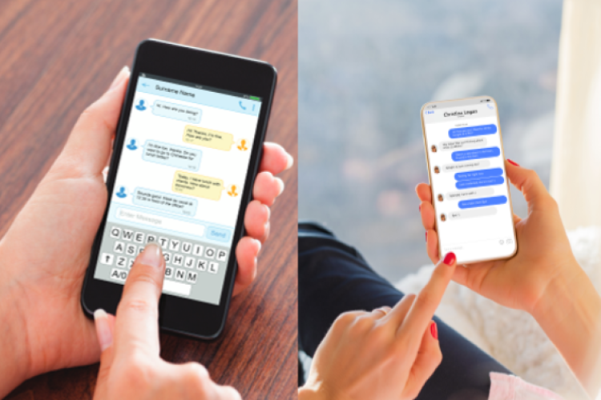
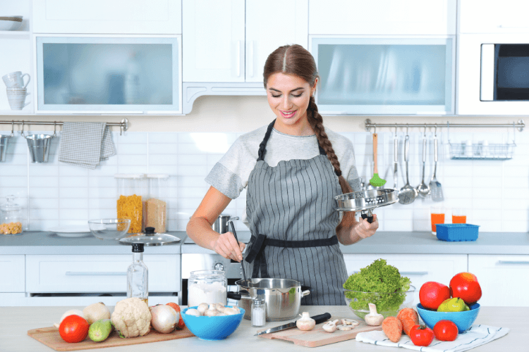
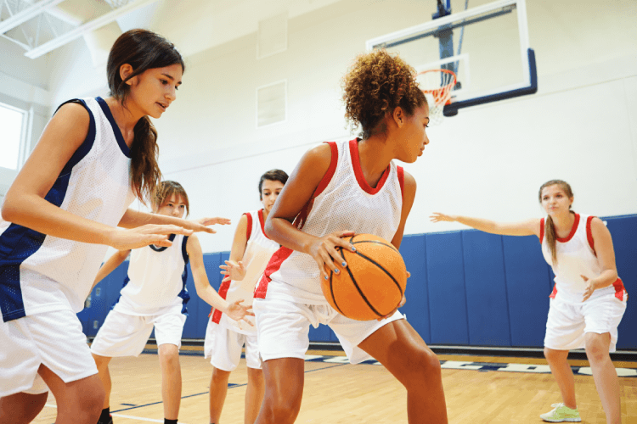
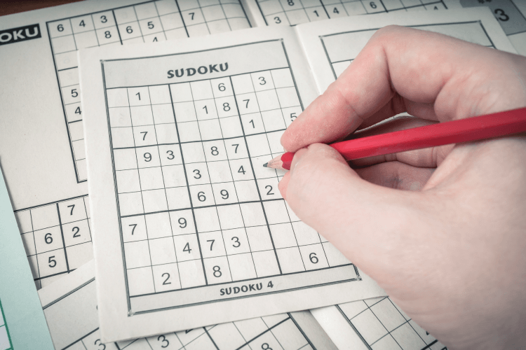
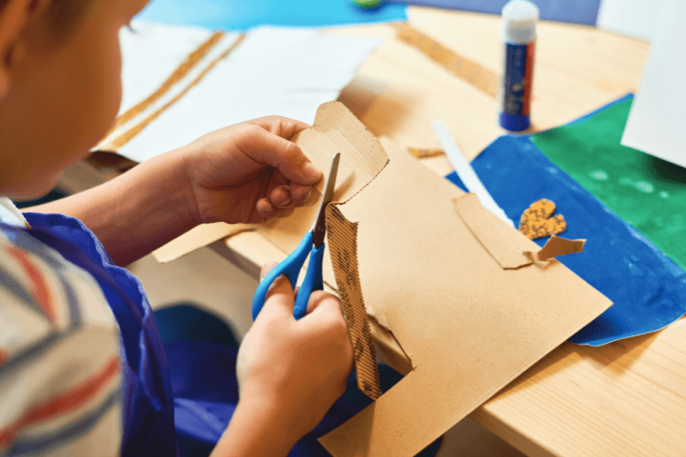
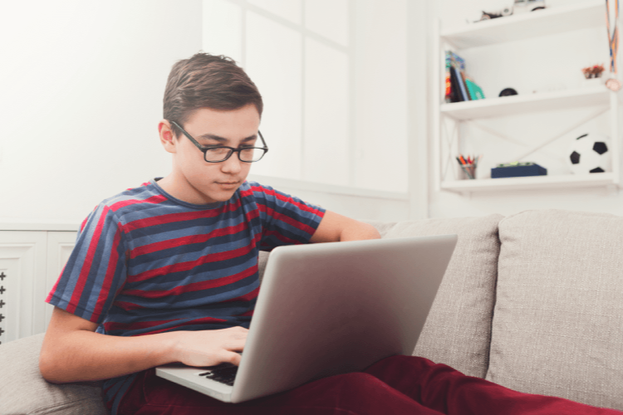
3. Match the activities with the correct pictures.
playing sport
messaging friends
surfing the net
doing DIY
cooking
doing puzzles

Slide 15
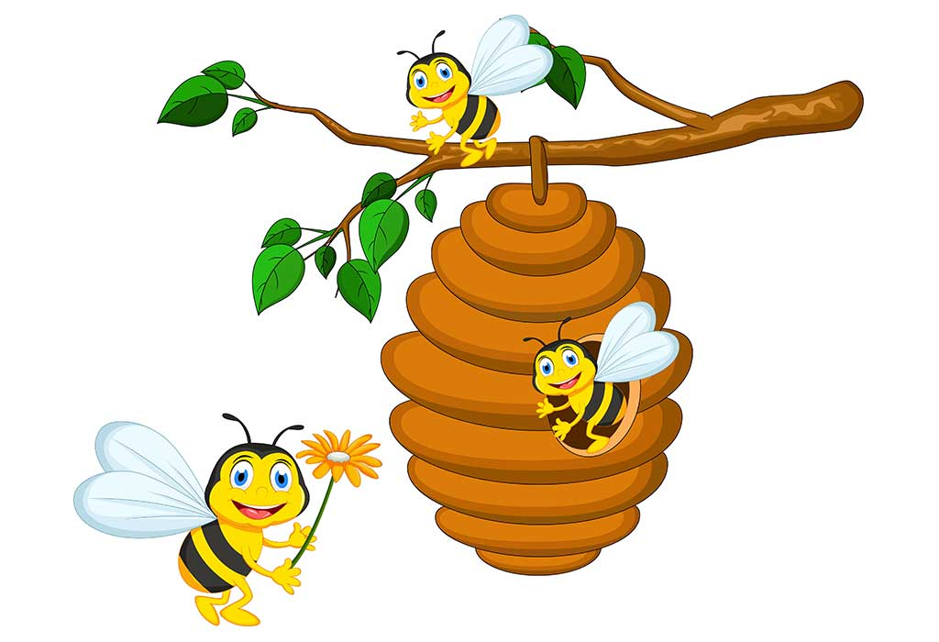
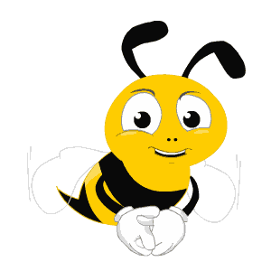
Bee & beehive

Slide 16
cooking

Slide 17
playing sport

Slide 18
surfing the net

Slide 19
messaging friends

Slide 20
doing puzzles

Slide 21
doing DIY

Slide 22
Look at the answers again.
messaging friends
cooking
playing sport
doing puzzles
doing DIY
surfing the net

Slide 23
4. Read the phrases and guess which activities in 3 are described.
doing DIY
messaging friends
doing puzzles
playing sport
surfing the net
cooking
1. improve memory, a mental exercise:
2. save money, increase creativity:
3. improve physical health, make friends:
4. keep in touch, be relaxed:
5. learn something about IT, computer skills:

Slide 24
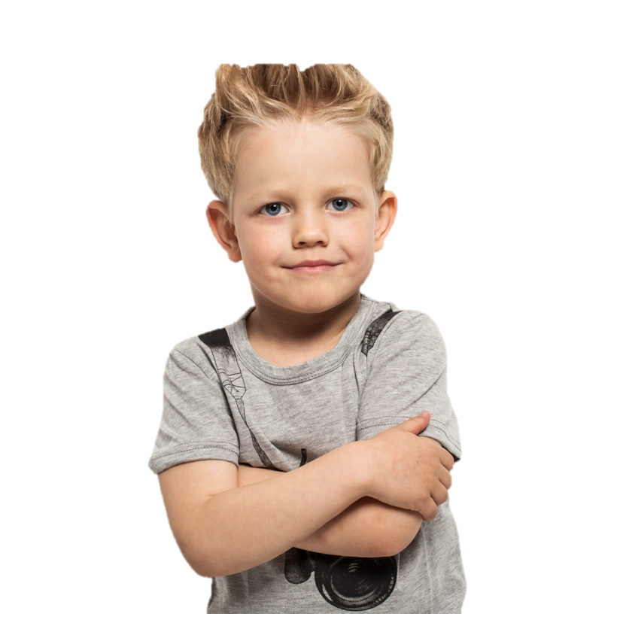
Ask and answer.
If you have some free time this weekend, what will you do?
I will play sport with my friends.

Slide 25
Thank You
HOMEWORK
Learn by heart vocabulary
Prepare: A Closer Look 1

