Slide 2
CHATTING
What do you like doing in your free time?
What do your friends like doing in their free time?
What do young people in Viet Nam often do in their free time?

Slide 3
Unit 1: LEISURE TIME
Lesson 4: Communication

Slide 4
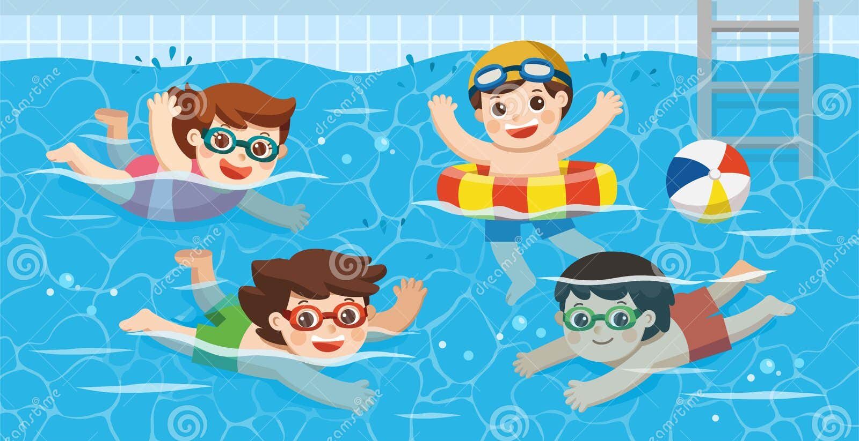
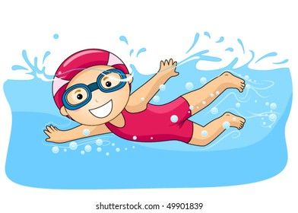
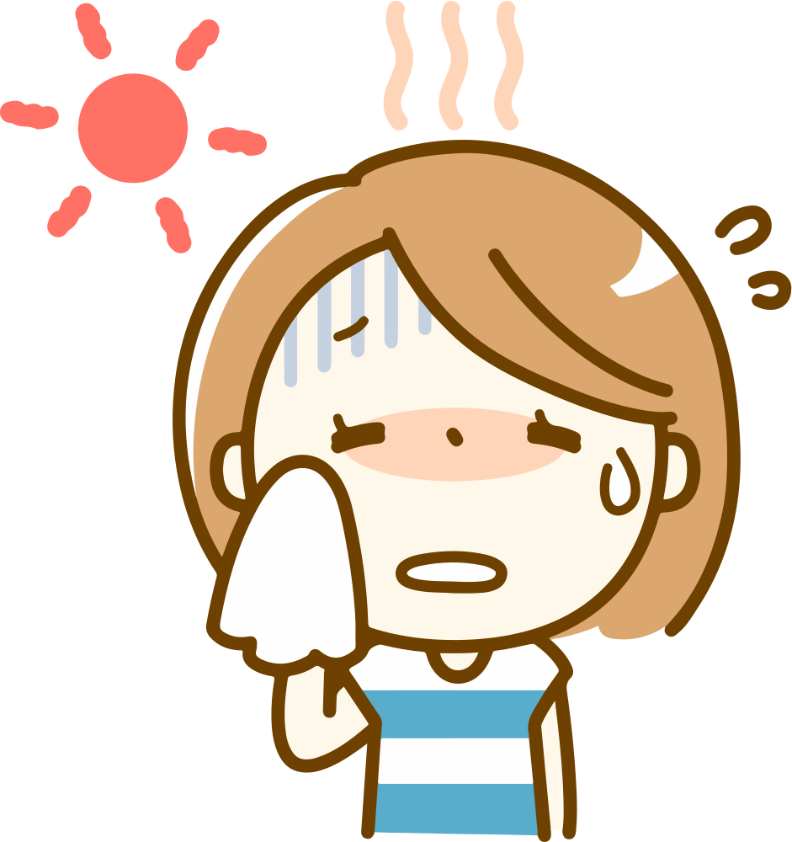
How to INVITE someone to go swimming with you

Slide 5
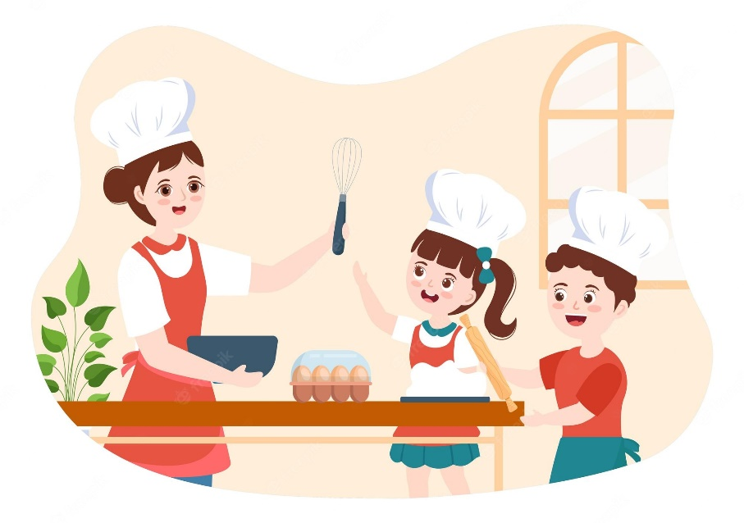
Listen and read the conversations.
Pay attention to the highlighted sentences.
Trang: Would you like to go to the cooking club with me this Sunday?
Ann: I’d love to. Thanks.
Tom: Do you fancy going for a walk?
Mark: That’s great. Thanks.

Slide 6
Making invitation and accepting
Structures | Examples
How to invite | Would you like to..? Do you fancy..?
How to accept invitations | I’d love to. That’s great.

Slide 8
2. Work in pairs. Practice inviting and accepting invitations in the following situations. Remember to use the highlighted language in 1.
You invite your friend to play badminton.
You invite your friend to make paper flowers with you.
You invite your friend to try your home-made pizza.

Slide 9
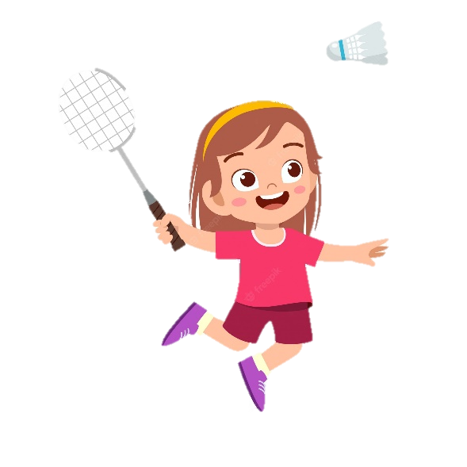
You invite your friend to play badminton.

Slide 10
You invite your friend to make paper flowers with you.

Slide 11
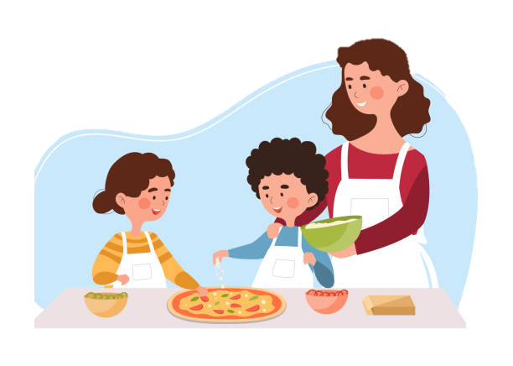
You invite your friend to try your home-made pizza.

Slide 12
TEEN’S LEISURE ACTIVITIES AROUND THE WORLD

Slide 13
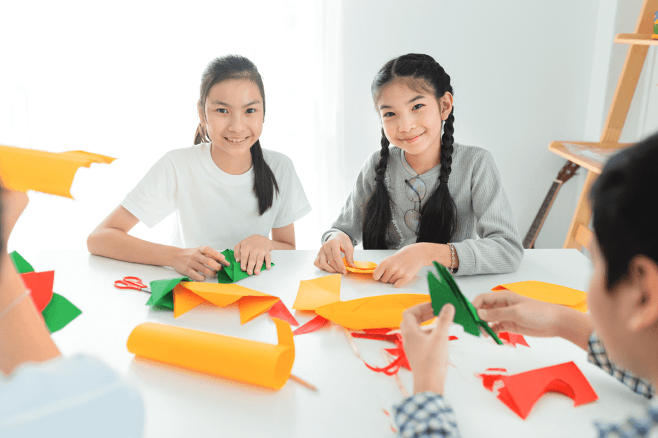
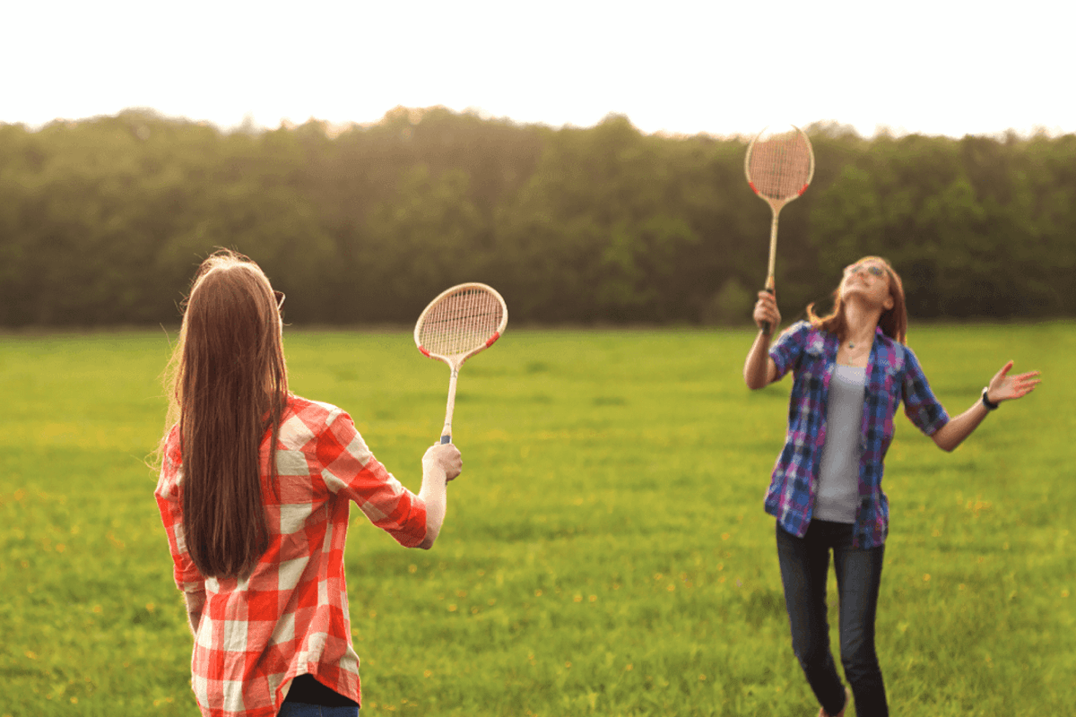
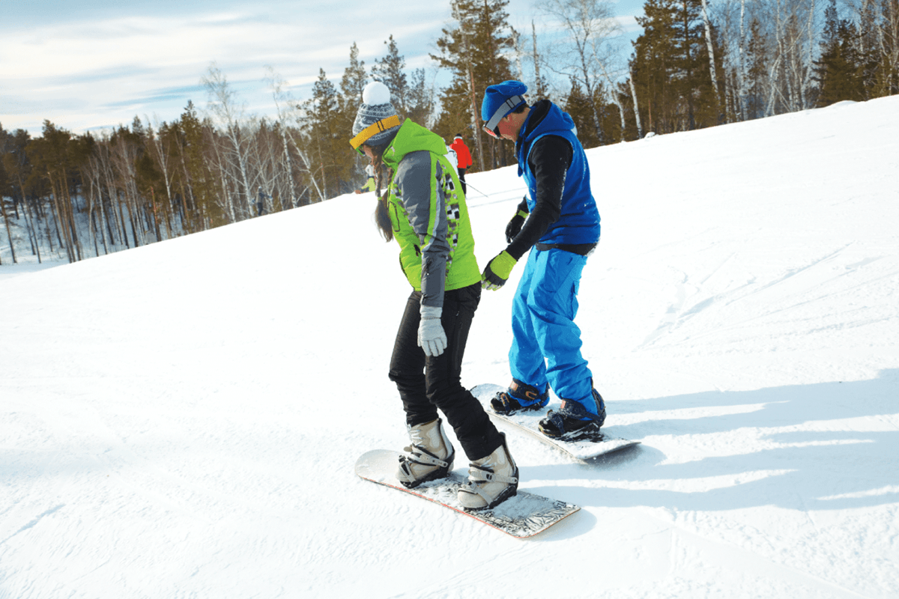
3. Work in pairs. Answer the question.
What is the activity in each picture?
doing origami
playing badminton
snowboarding

Slide 14
3. Work in pairs. Answer the question.
Sakura (Kyoto, Japan): Origami is the art of paper folding. I love doing it on my own in my free time. With just some sheets of paper, I can create almost anything: flowers, birds, or fans. Doing origami helps me to relax.
Eric (St. Gallen, Switzerland): My hometown has some famous ski resorts. I'm into snowboarding and usually go to a nearby ski resort with my parents at weekends. Snowboarding improves my overall health and balance.
Lan (Quang Binh, Viet Nam): I'm keen on playing sport, especially badminton. My best friend lives next door, so we play badminton almost every afternoon. It's an easy sport, and it also improves my muscle strength and helps reduce stress.

Slide 15
4. Read what three teenagers say about their leisure activities. Complete the table with the information from the text.
Name | Country | Leisure activity | Person / People to do the activity with | Benefits of the activity
Sakura | Japan
Eric | Switzerland
Lan | Viet Nam
helps her to relax
doing origami
no one
improves his overall health and balance
snowboarding
parents
- improves her muscle strength
- reduces stress
playing badminton
best friend

Slide 16
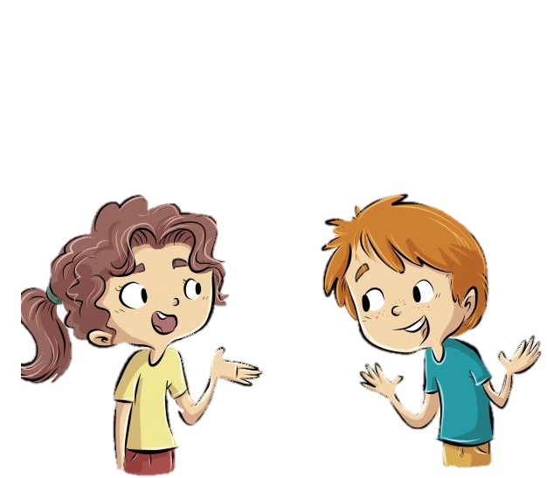
5. Work in groups. Ask and answer the questions.
Which of the activities in 4 do you want to try?.
I would like to try snowboarding.
Because it can improve my overall health and balance.
Why do you want to try it?

Slide 17
THANK YOU!

