Slide 1


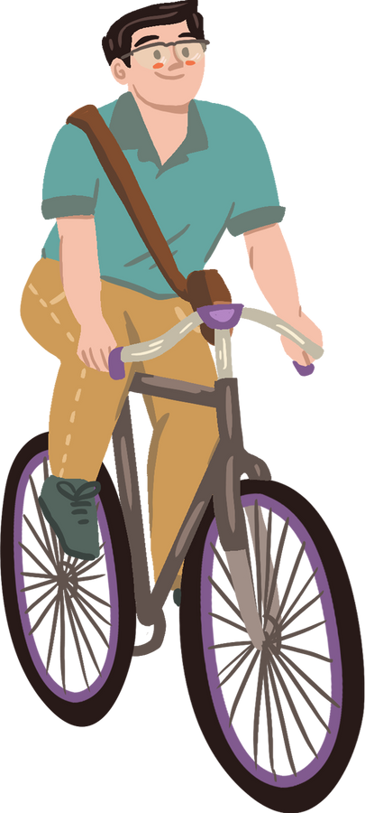
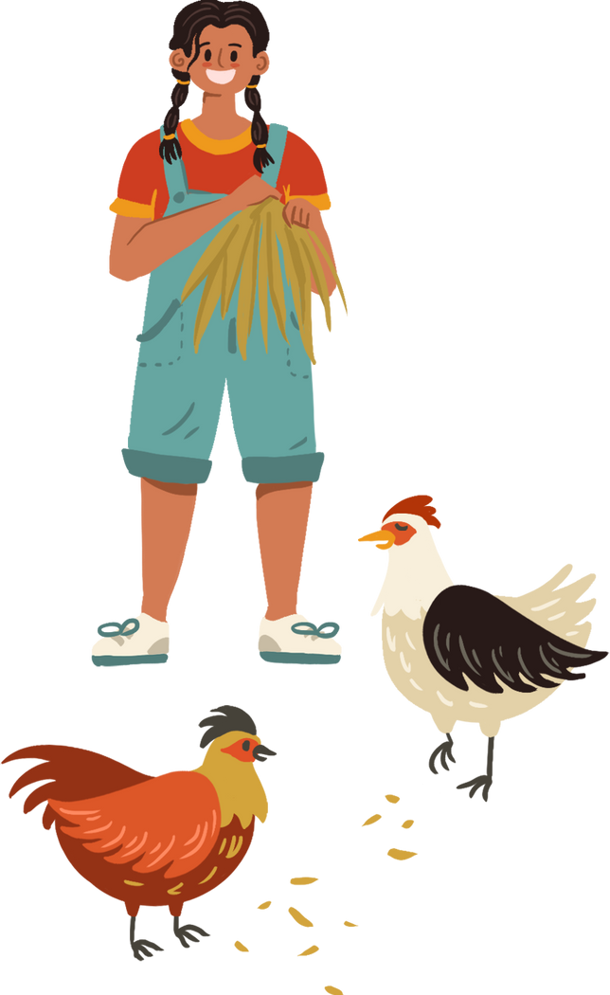




WELCOME TO OUR CLASS

Slide 2


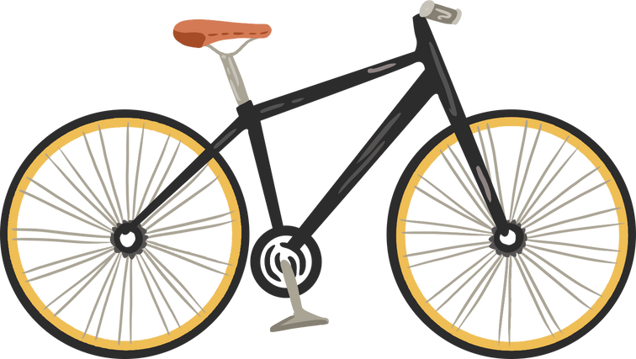
LEISURE TIME
UNIT 1
Lesson 2: A Closer Look 1

Slide 3
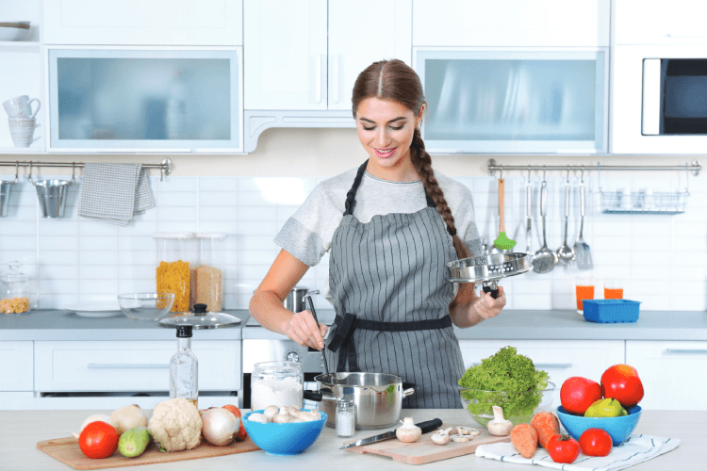

What do you like doing in your leisure time?
I like cooking.

Slide 4
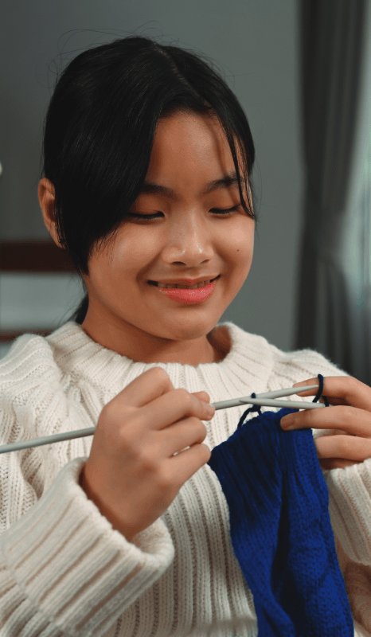

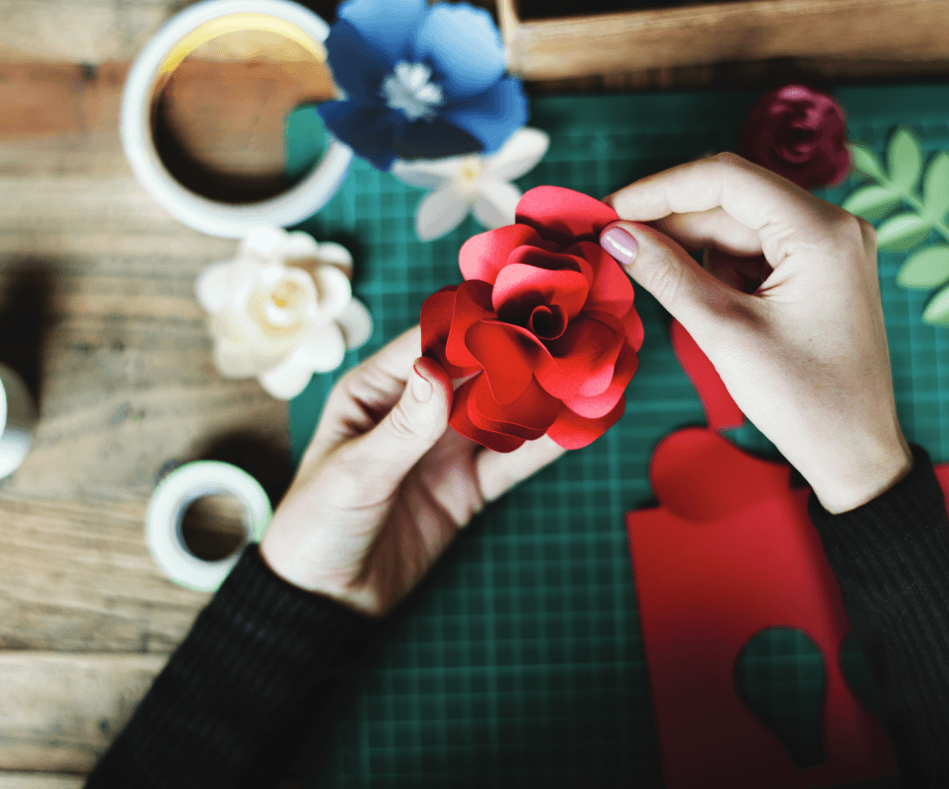

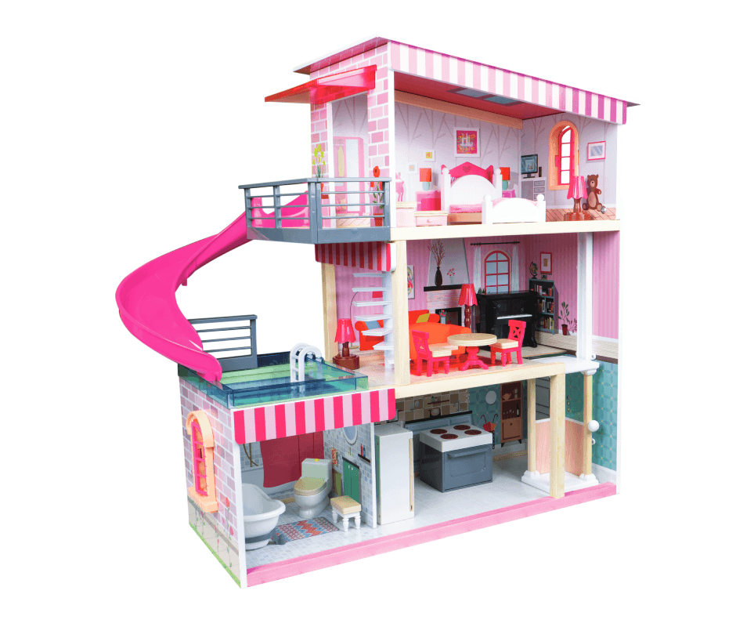

Slide 5
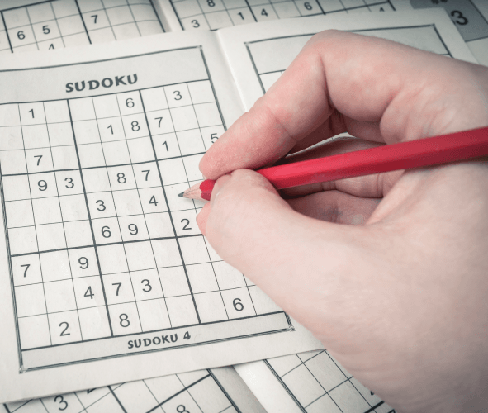
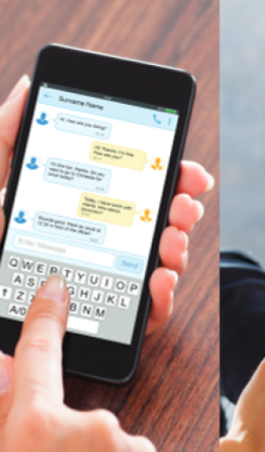

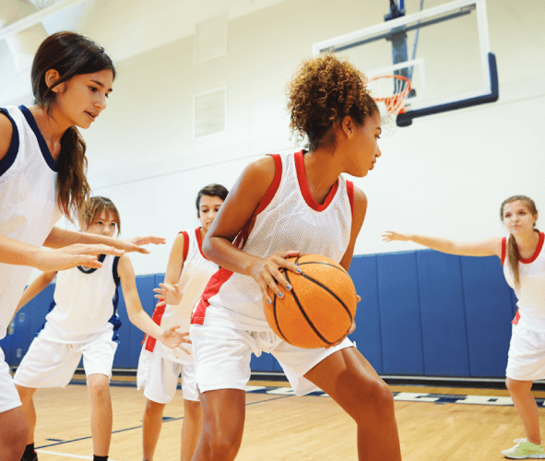
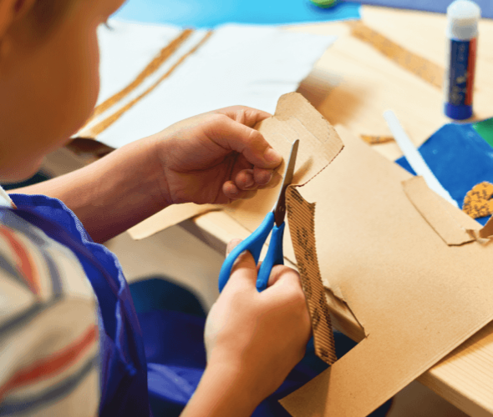

Slide 6

1. Match a word/ phrase in column A with a word in column B to make expressions about likes.
A
B
1. be fond
a. about
2. be keen
b. in
3. be interested
c. on
4. be crazy
d. into
5. be
e. of

Slide 7
be fond of
be keen on
How to express “likes”
be into
be crazy about
be interested in

Slide 8
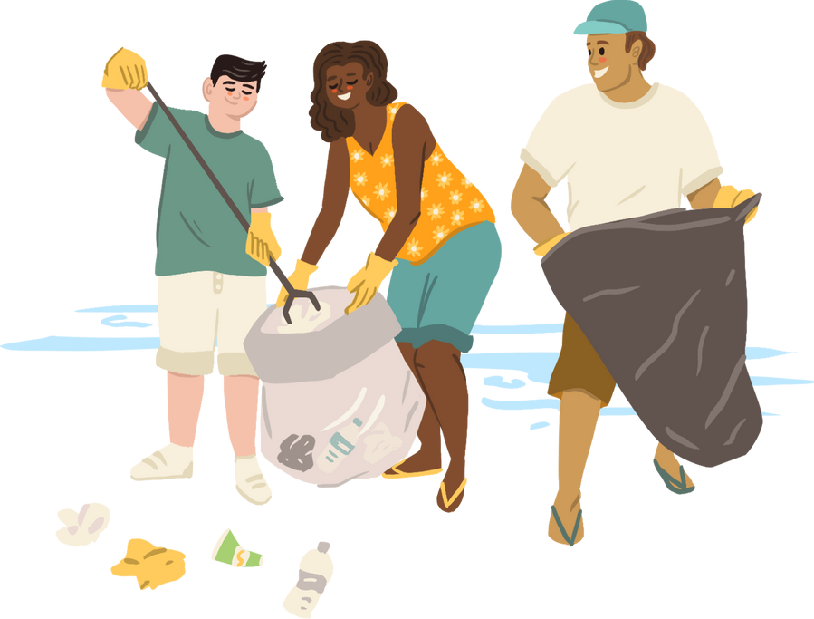
VOCABULARY
New words | Pronunciation | Meaning
1. be interested in | /biː ɪntrəstɪd ɪn/ | hứng thú với
2. be fond of | /biː fɒnd əv/ | thích
3. be keen on | /biː kiːn ɒn/ | quan tâm đến
4. be crazy about | /biː ˈkreɪzi əˈbaʊt/ | say mê
5. be into | /biː ˈɪntuː/ | thích

Slide 9
A
B
1. be fond
a. about
MATCHING GAME
2. be keen
b. in
3. be interested
c. on
4. be crazy
d. into
5. be
e. of

Slide 10
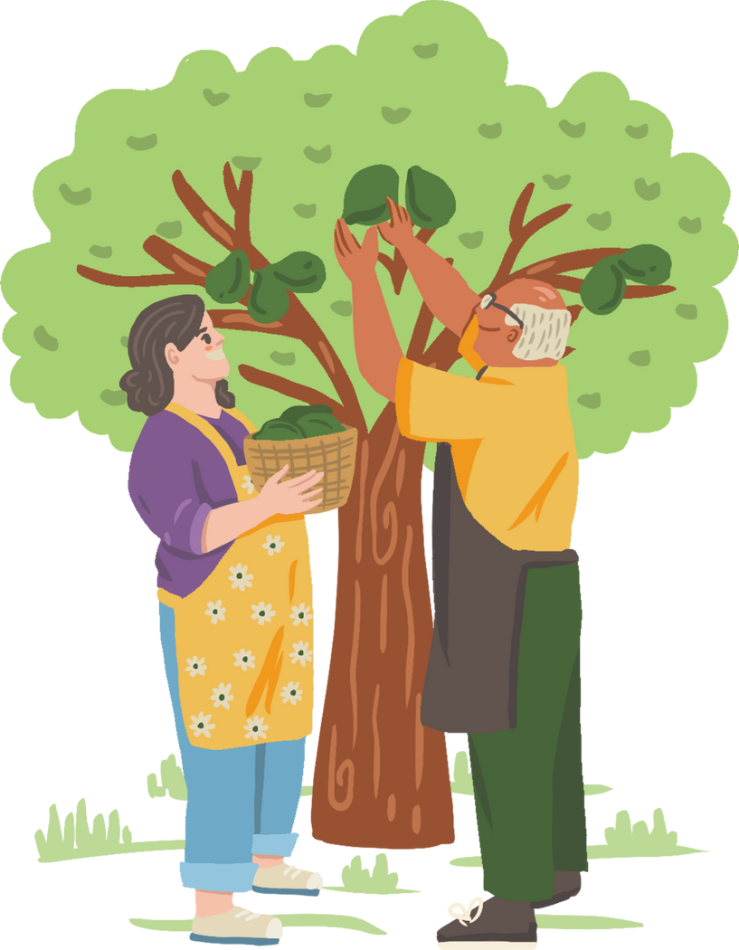
2. Fill in each blank with a correct word from the box.
into fond keen interested about
fond
1. I’m _________ of taking photos. In my free time, I usually go out and take photos of people and things.
2. Mai is ________________ in history. She often goes to museums to see new exhibits and learn about the past.
3. My sister is _________ on cooking. She wants to become a chef in the future.
4. My brother spends lots of time surfing the net, but I’m not _________ it.
5. I’m not crazy _________ doing DIY. I’m never able to finish any DIY projects I start.
interested
keen
into
about

Slide 11
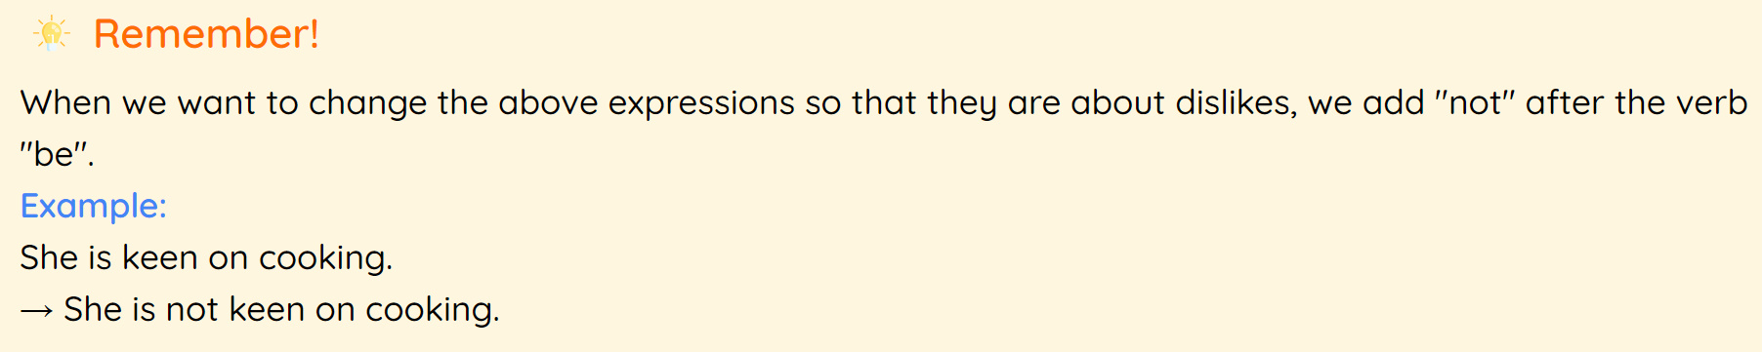
REMEMBER
I’m not crazy about doing DIY. I’m never able to finish any DIY projects I start.

Slide 12
3. Complete the sentences about what you like or dislike doing. Use the word or phrases from the box or your own ideas.
cooking doing DIY surfing the net
playing sport doing puzzles messaging friends
Example: I’m interested in doing DIY.
1. I’m crazy about ______.
2. I’m keen on ______.
3. I’m fond of ______.
4. I’m not interested in ______.
5. I’m not into ______.

Slide 13
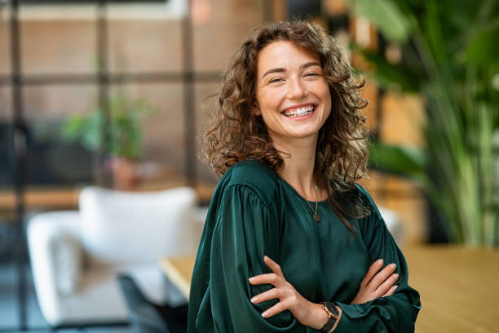
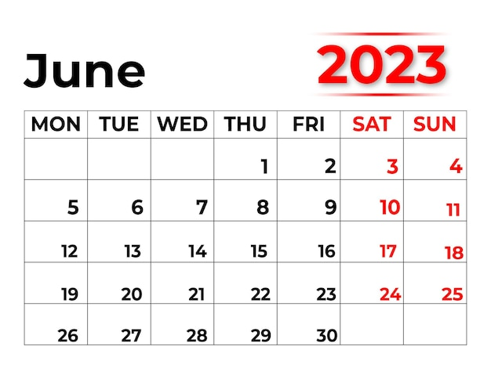

Listen and write
woman
June
/ˈwʊmən/
/dʒuːn/

Slide 14

Watch a video and pay attention to the sound /ʊ/and /u:/

Slide 15
4. Listen and repeat the words. Pay attention to the sound /ʊ/and /u:/. Then put the words into the correct columns.
cook group push June
school would woman move
/ʊ/ | /u:/
cook
group
push
June
would
school
woman
move

Slide 16

5. Listen and practice the sentences. Underline the bold words with /ʊ/ and circle the bold words with /u:/
She likes reading books and swimming in the pool.
When it is cool, we like to play football.
She drew and made puddings in her free time.
My mum loves pumpkin soup and coffee with a little sugar.
My brother is fond of watching the cartoon about a clever wolf.

Slide 17
THANKS
HOMEWORK
Learn by heart vocabulary
Practice the sound /ʊ/and /u:/
Prepare: Unit 1 - A Closer Look 2

