Slide 1
WELCOME TO OUR CLASS!

Slide 2
REVIEW 2
Lesson 2: Skills

Slide 3
READING

Slide 4
1. Read the schedule of the Spring Fair and select the event that each person wants to attend. Write the event names in the table.
PEOPLE | EVENTS
1 Ann wants to take her children out to play folk games.
2 Tom wants to learn about making pottery.
3 Alice wants to see ethnic dance performances.
4 Mai wants to learn more about farm products.
5 Mark wants to see a collection of ethnic people’s daily activities.
1
Childhood Fun
A Pottery Village
2
3
Performances
4
Ethnic Markets
5
Photo Exhibition

Slide 5
2
SPEAKING

Slide 6
2. Work in pairs. Read the list below and tick the main reason(s) for people moving from the countryside to the city. Explain your choice.
1. To look for well-paid jobs.
2. To look for better services.
3. To enjoy crowded and noisy areas.
4. To have better educational opportunities.
5. To experience different types of food and entertainment.

Slide 7
LISTENING

Slide 8
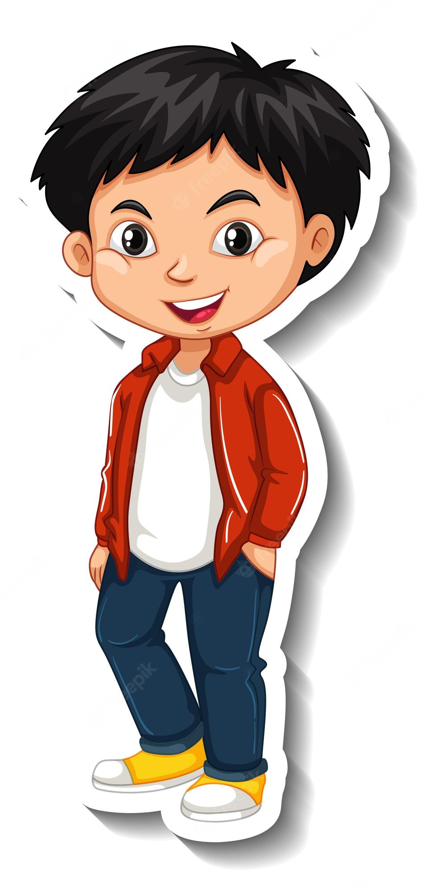
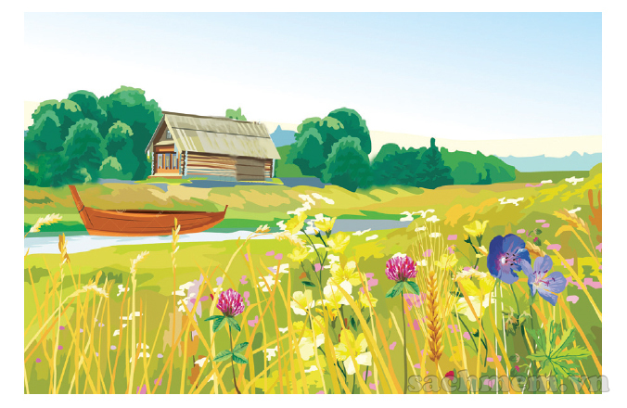
Life in the countryside
PHONG

Slide 9
3. Listen to Phong talking about life in the countryside and complete each sentence with one word.
1. Phong always spends his summer ________ with his grandparents. 2. He likes the _________ games the children play. 3. The villagers sell their home-grown________. 4. They buy food and other _________ things. 5. At the market, the villagers _____ and talk
vacation
traditional
products
necessary
meet

Slide 10
WRITING

Slide 11
4. Write complete sentences from the clues below.
﻿1. Many / Vietnamese families / teach / children / respect / elders.﻿
→ Many Vietnamese families often teach their children to respect the elders.
2. There / many ways / show / respect.
→ ﻿There are many ways to show respect.
3. You / give up / seat / or oﬀer / carry something heavy / elders.
→ ﻿You can give up a seat or offer to carry something heavy for the elders.
﻿4. You / listen / not talk back / elders / speak.﻿
→ You should listen and don’t talk back when the elders speak.
5. At mealtimes / children should not / start / eat / before / elders do.
→ ﻿At mealtimes, children should not start eating before the elders do.

Slide 12
WRAP-UP
In this lesson, you have:
practiced reading for specific information about an event schedule.
practiced talking about the reasons for people moving from the countryside to the city.
practiced listening for specific information about life in the countryside.
practiced writing correct sentences from clues.

Slide 13
HOMEWORK
Do exercises in the workbook.
Prepare for Unit 7 – Getting started

Slide 14
RESOURCE
Page
Use these whiteboard design resources in your Canva Presentation. To access more of these elements, right-click and expand any page into a whiteboard then check out the elements tab. Happy designing!
Delete or hide this page before presenting.

Slide 15
RESOURCE Page
Use these design resources in your Canva Presentation. Happy designing!
Delete or hide this page before presenting.

Slide 16
RESOURCE Page
Use these design resources in your Canva Presentation. Happy designing!
Delete or hide this page before presenting.

