Slide 1
Welcome to our class!

Slide 2
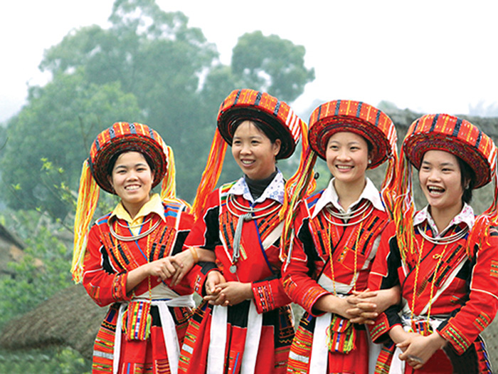
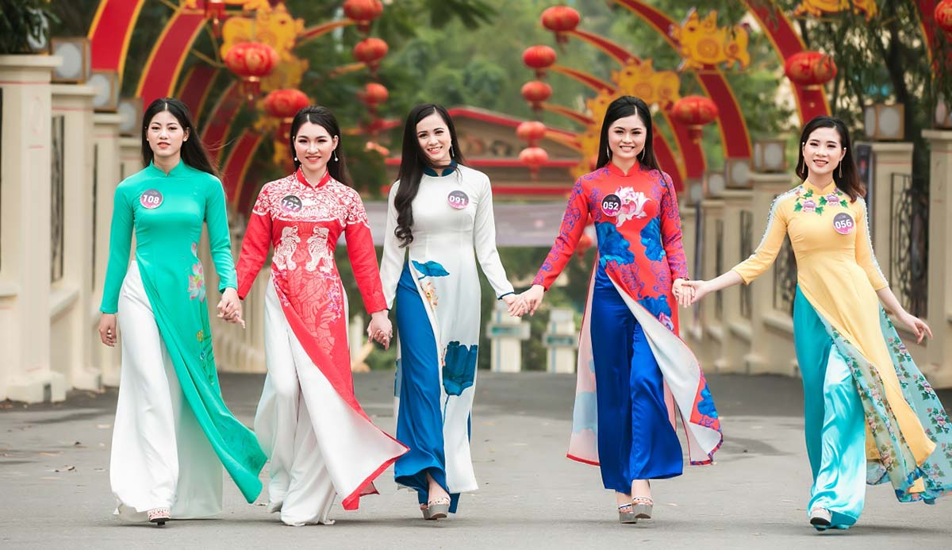
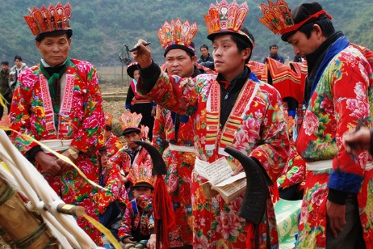
What is the topic?
Ethnic groups of Viet Nam
1
2
3

Slide 3
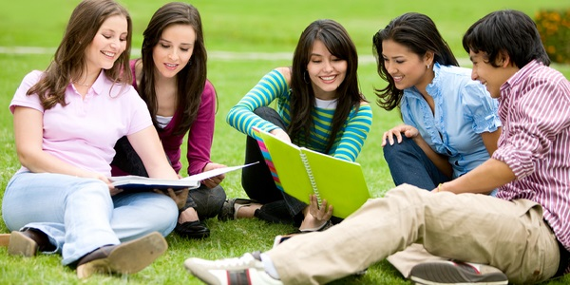
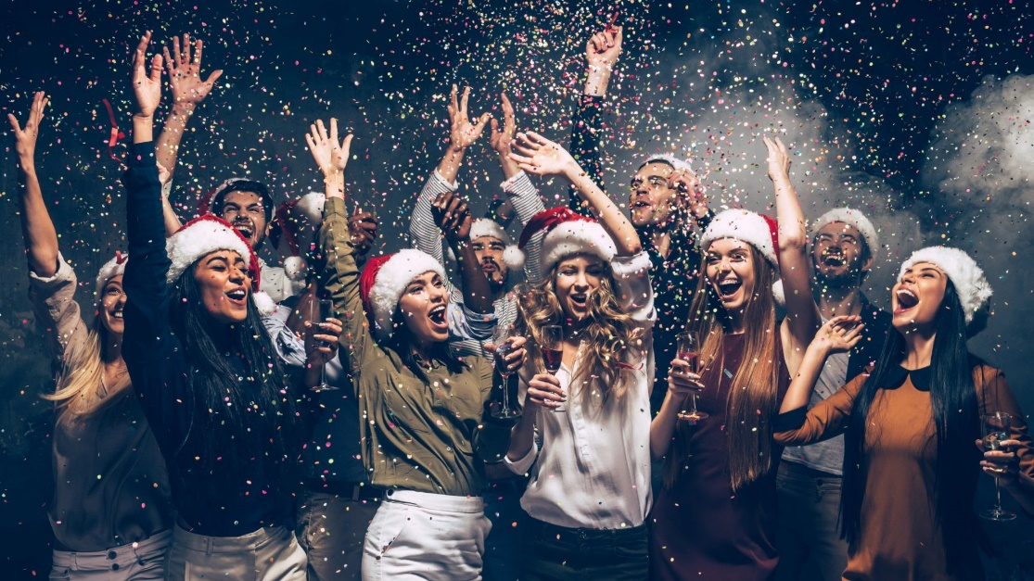
What is the topic?
Lifestyles
1
2
3

Slide 4
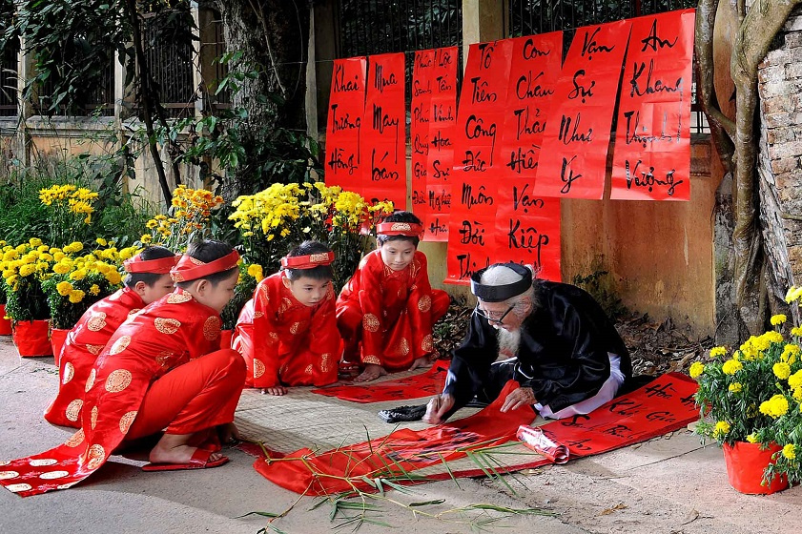
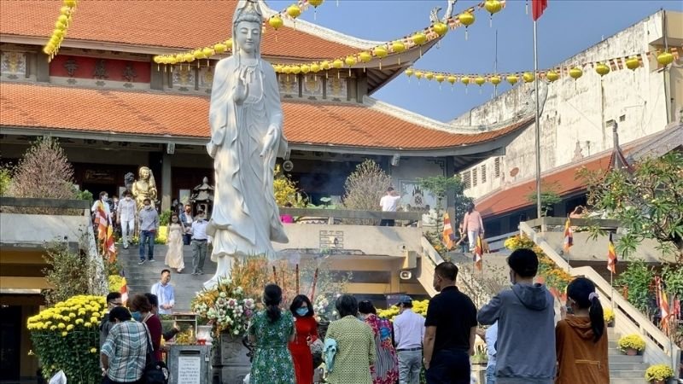
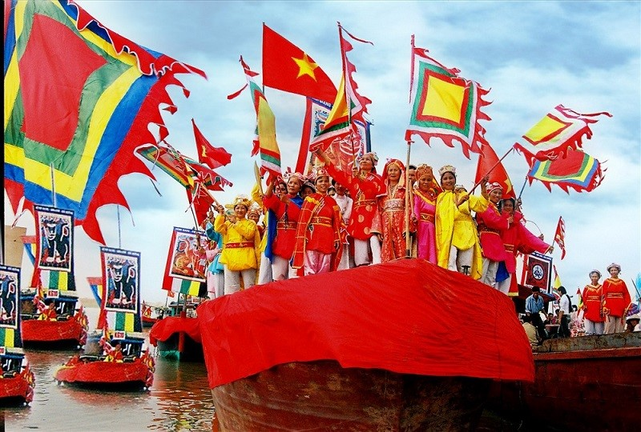
What is the topic?
Our customs and traditions
1
2
3

Slide 5
REVIEW 2
Lesson: Language

Slide 6
1. Circle the word which has the underlined part pronounced differently in each group. Then listen and repeat.
1. A. culture B. community C. circle D. custom
2. A. identify B. thank C. dance D. plan
3. A. bring B. sing C. spring D. longevity
4. A. figure B. danger C. engine D. change
5. A. growth B. globe C. ground D. gender

Slide 7
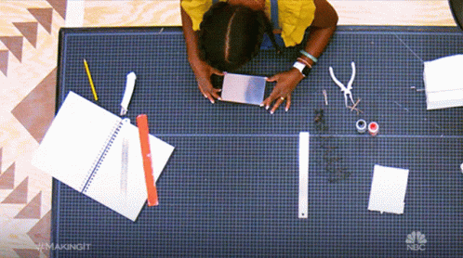
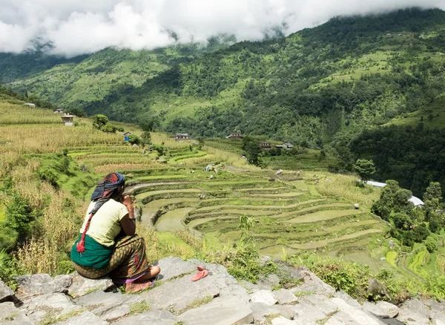
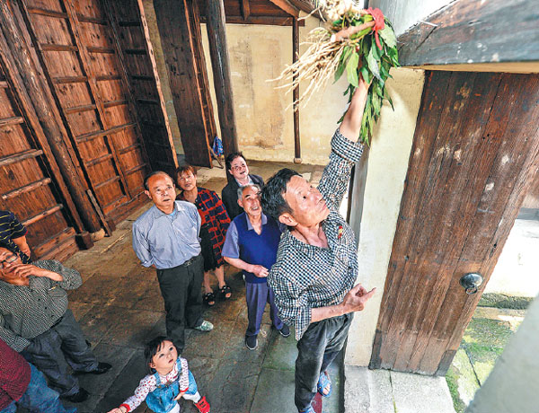
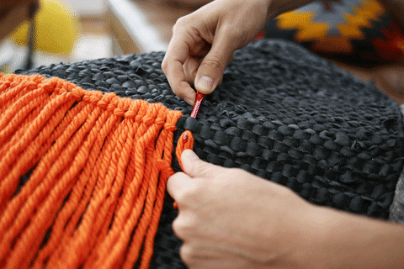
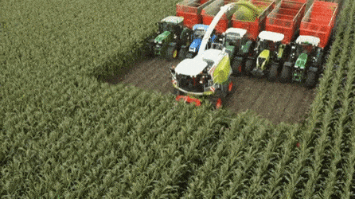
2. Match a verb or verb phrase in A with a noun or noun phrase in B.
A |  | B
1. weave
2. chase away
3. harvest
4. overlook
5. make
a. terraced fields
b. crops
c. crafts
d. clothing
e. bad spirits

Slide 8
3. Complete the sentences with the words and phrases from the box.
habit lifestyle minority group
festivals decorative items
1. Ethnic minority girls wear a lot of beautiful ______________ on special occasions.
2. I love attending local ________ in my area because they are unique.
3. It was a big change in ________ when my family moved from the city to the
countryside.
4. I’d prefer you not to make a ______ of going to bed late.
5. The Bahnar is a large ethnic _____________ in the central highlands.
decorative items
festivals
lifestyle
habit
minority group

Slide 9
4. Choose the correct answer A, B, or C to complete each sentence.
1. Tet is coming. I see ______ flowers and ornamental trees everywhere.
A. a B. the C. Ø
2. Bat Trang Village is famous for ______ traditional craft of pottery making.
A. a B. the C. Ø
3. – Hi, Trang. ______ are things in Hue?
– Everything’s great. The weather’s fantastic, and the food’s delicious.
A. How B. What C. Where
4. ______ street food in Viet Nam is most popular among foreign visitors?
A. How B. What C. Why
5. I’m searching for ______ information about the lifestyle of the Van Kieu in central Viet Nam.
A. some B. many C. an

Slide 10
5. Use the correct forms of the verbs in brackets to complete the sentences.
1. Next year we (build) ________ a house overlooking the lake.
2. Spring is coming, so we (celebrate) ____________ the Ban Flower Festival soon.
3. If you have a chance to travel on a dogsled, you (never forget) ______________ it.
4. If I (be) ____ free to choose a topic, I will give a presentation on Alaska.
5. Unless you try, you (never know) ______________ if you can play football.
will build
will celebrate
will never forget
am
will never know

Slide 11
Wrap-up
In this lesson, you have:
revised words related to ethnic groups, customs and traditions and lifestyles.
revised the sounds /k/, /g/, /n/, /ŋ/, /br/ and /pr/.
revised the use of articles, types of questions, countable and uncountable nouns and simple future tense.

Slide 12
Homework
Do exercises in the workbook.
Prepare for Review 2 - Skills

Slide 13
THANK YOU!

Slide 14
Free Resource Page

Slide 15
Free Resource Page

