Slide 1
WELCOME TO OUR CLASS!

Slide 2
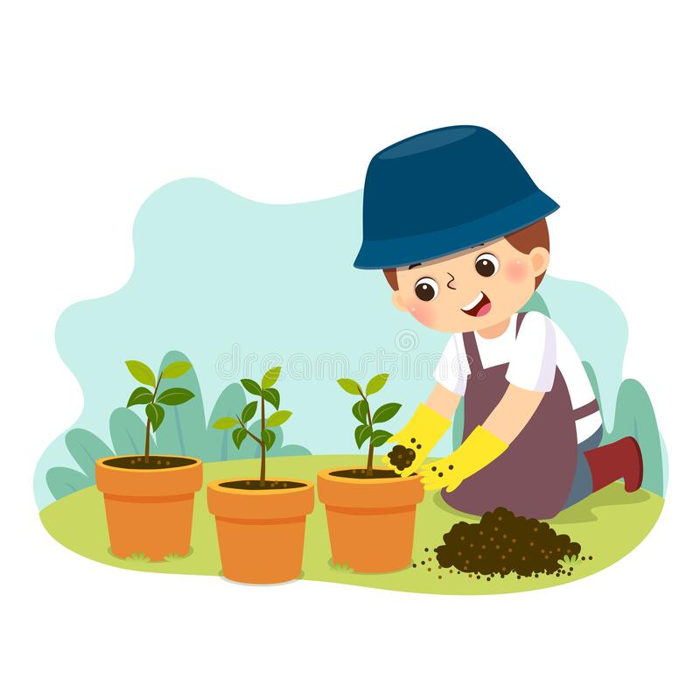
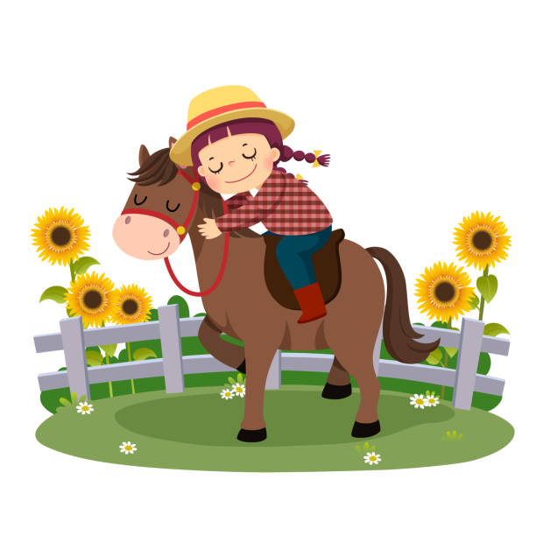
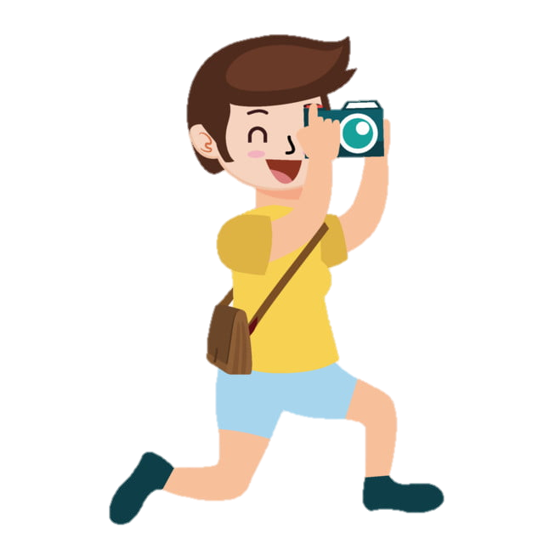
MIMING GAME
GARDENING
HORSE RIDING
TAKING PHOTO

Slide 3
REVIEW 1
Lesson 2: Skills

Slide 4
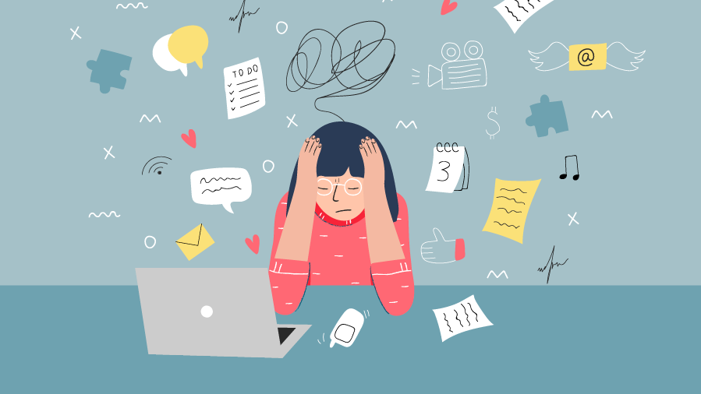
READING
STRESS

Slide 5
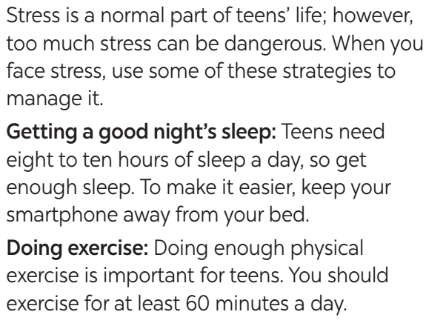
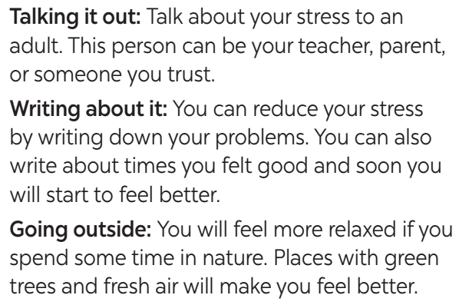
1. Read the passage and choose the correct answers A, B or C.

Slide 6
1. Read the passage and choose the correct answers A, B or C.
1. The passage is about ______.
A. the causes of stress
B. strategies to deal with stress
C. the dangers of stress 2. How many hours of sleep a day do teens need? A. 6 to 8. B. 7 to 9. C. 8 to 10.
3. How much time should teens spend on daily exercise? A. At least an hour. B. Exactly 60 minutes. C. No more than 60 minutes. 4. Teens may talk about their problems to ______. A. a friend in their class B. a young person they like C. someone they trust 5. Teens can feel better when they ______. A. are at home with their parents
B. get closer to nature
C. write to a friend

Slide 7
1. Read the passage and choose the correct answers A, B or C.
1. The passage is about ______.
A. the causes of stress
B. strategies to deal with stress
C. the dangers of stress

Slide 8
1. Read the passage and choose the correct answers A, B or C.
2. How many hours of sleep a day do teens need? A. 6 to 8.
B. 7 to 9.
C. 8 to 10.

Slide 9
1. Read the passage and choose the correct answers A, B or C.
3. How much time should teens spend on daily exercise? A. At least an hour.
B. Exactly 60 minutes.
C. No more than 60 minutes.

Slide 10
1. Read the passage and choose the correct answers A, B or C.
4. Teens may talk about their problems to ______. A. a friend in their class
B. a young person they like
C. someone they trust

Slide 11
1. Read the passage and choose the correct answers A, B or C.
5. Teens can feel better when they ______. A. are at home with their parents
B. get closer to nature
C. write to a friend

Slide 12
Look at the answers again.
1. The passage is about ______.
A. the causes of stress
B. strategies to deal with stress
C. the dangers of stress 2. How many hours of sleep a day do teens need? A. 6 to 8. B. 7 to 9. C. 8 to 10.
3. How much time should teens spend on daily exercise? A. At least an hour. B. Exactly 60 minutes. C. No more than 60 minutes. 4. Teens may talk about their problems to ______. A. a friend in their class B. a young person they like C. someone they trust 5. Teens can feel better when they ______. A. are at home with their parents
B. get closer to nature
C. write to a friend

Slide 13
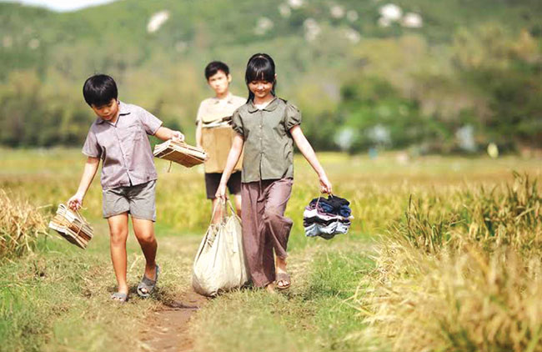
SPEAKING
LIFE IN THE COUNTRYSIDE

Slide 14
SPEAKING
Work in pairs. Interview each other, using the questions below. Take notes of the answers and then report the results to the class.
2. Work in pairs. Interview each other, using the questions below. Take notes of the answers and then report the result to the class.
QUESTIONS
ANSWERS
What are some reasons why people like living in the countryside?
What are some reasons why people dislike living in the countryside?
What are some advantages or disadvantages of living in the city?

Slide 15
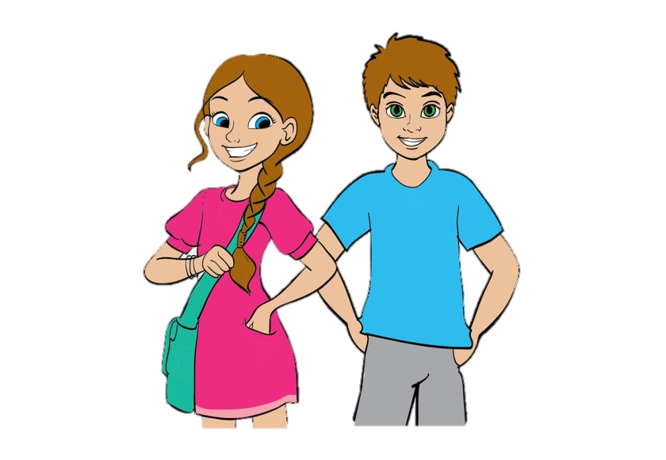
LISTENING
Mai
Tom
LIFE IN THE CITY AND LIFE IN THE COUNTRYSIDE

Slide 16
LISTENING
3. Fill in each blank with one word.
In the city | In the countryside
– There are many (1) ______ for entertainment. – It is more (2) _________ to get around. – There are many means of (3) ______ transport. | – It is peaceful and (4) _________. – Things are simple and lovely. – People are kind and (5) _________.
places
spacious
convenient
hospitable
public

Slide 17
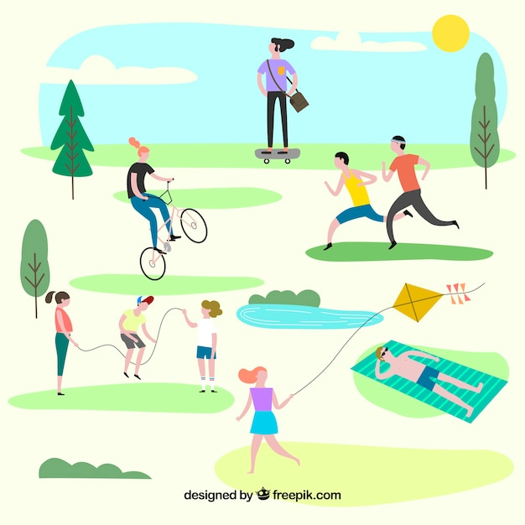
WRITING
LEISURE ACTIVITIES

Slide 18
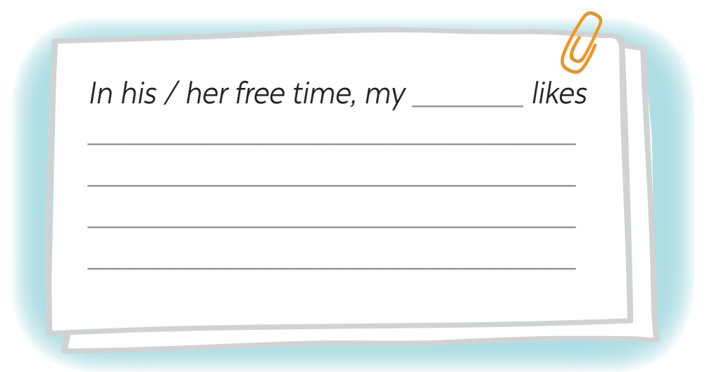
4. Write a paragraph (80-100 words) about the leisure activities one of your family member does.
1. What does he / she like doing in his / her free time? 2. Who does he / she like doing these with? 3. Why does he / she like doing these?

Slide 19
WRAP - UP
What have we learnt in this lesson?
Practice 4 skills using lexical items learnt in Units 1-2-3

Slide 20
THANK YOU

