Slide 1




Teachers to attend our class
Teacher:
Class : 4/1

Slide 2

Warm Up!

Slide 3


Slide 4
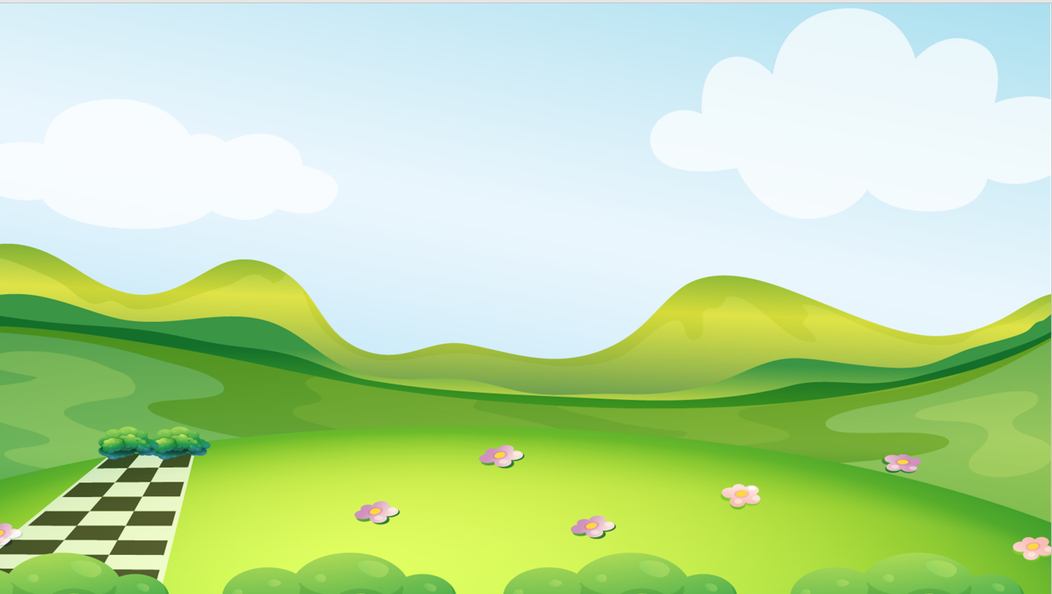

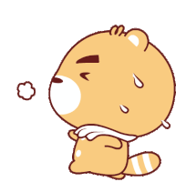
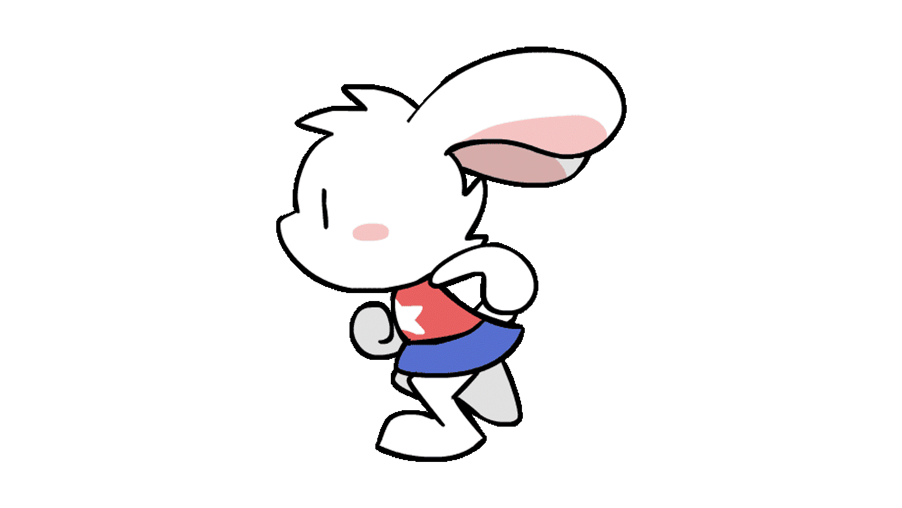


Funny Racing

Slide 5


1
2
3
4
5
6
CHICKEN
Rabbit
Cat
7
8
9
10
11
12
LOST
Notes:
Thanh Yến Trần 0967 255 149 zalo/ FB https://www.facebook.com/thanhyentrananhngutaymy/

Slide 6
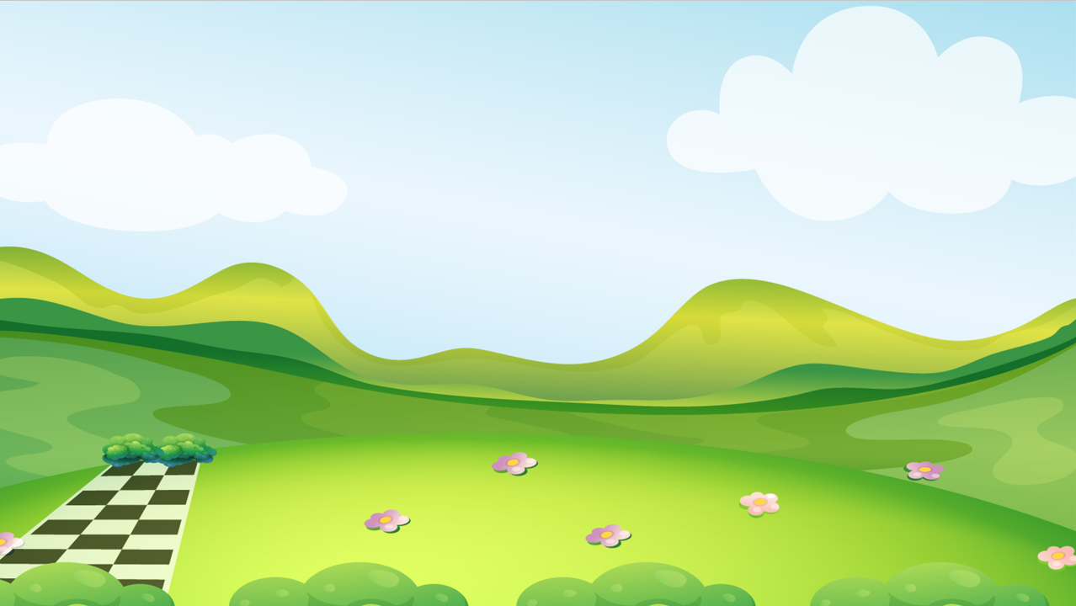
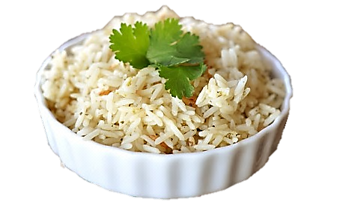


Question 1:
I like ………………
A. rice
C. carrots
B. meat
D. bread

Slide 7
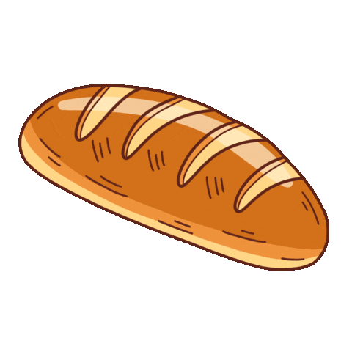
Question 2:
Do you like …………?
Yes, I do.
A. rice
C. carrots
B. meat
D. bread
Notes:
Thanh Yến Trần 0967 255 149 zalo/ FB https://www.facebook.com/thanhyentrananhngutaymy/

Slide 8

Question 3:
Do you like bread?
→ ……,……..
A. Yes, you do.
C. Yes, I do.
B. No, I don’t.
D. No, I do.
Notes:
Thanh Yến Trần 0967 255 149 zalo/ FB https://www.facebook.com/thanhyentrananhngutaymy/

Slide 9
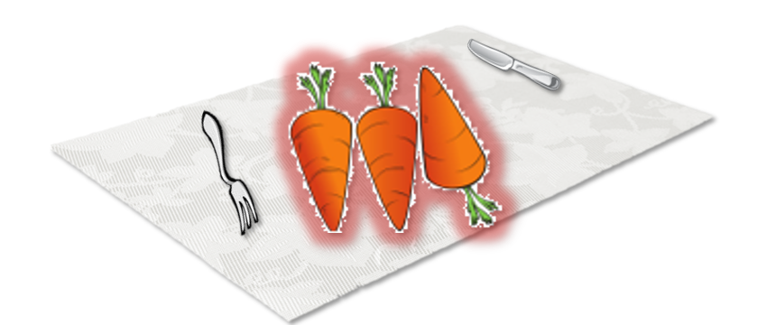
Question 5:
There are some________ on the table.
A. rice
C. bread
B. carrots
D. meat

Slide 10
Question 6:
Arrange these words to full sentence.
Do/ like / you / yogurt/?/
A. Do yogurt like you?
C. Do like yogurt you?
B. You like yogurt do?
D. Do you like yogurt?

Slide 11
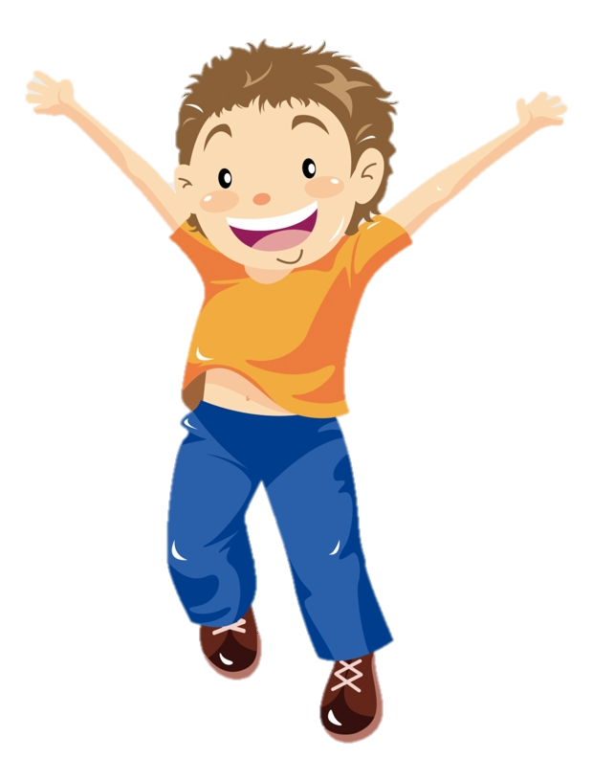

Question 7:
Do you like ………….?
→ Yes, I do.
A. yogurt
C. milk
B. ice cream
D. water

Slide 12
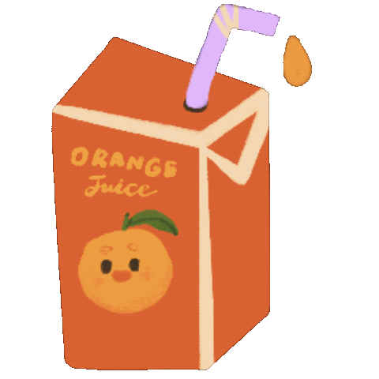
Question 8: I don’t like …….
C. milk
A. juice
B. yogurt
D. milkshake

Slide 13
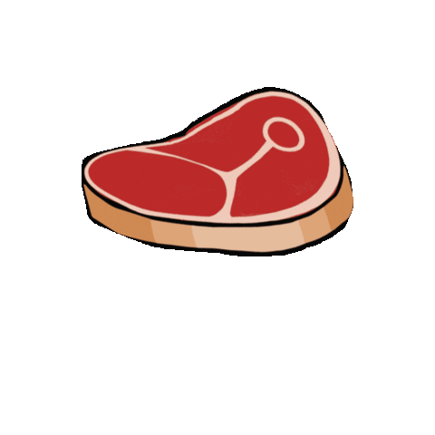
Question 9: I like ….. and ………
A. carrots/rice.
C. meat/rice.
B. rice/meat.
D. bread/ rice

Slide 14
Question 11:
Arrange these words to full sentence.
Does/ like / she / fish/?/
A. Does she fish like?
C. Does fish like she?
B. Does like fish she?
D. Does she like fish?

Slide 15
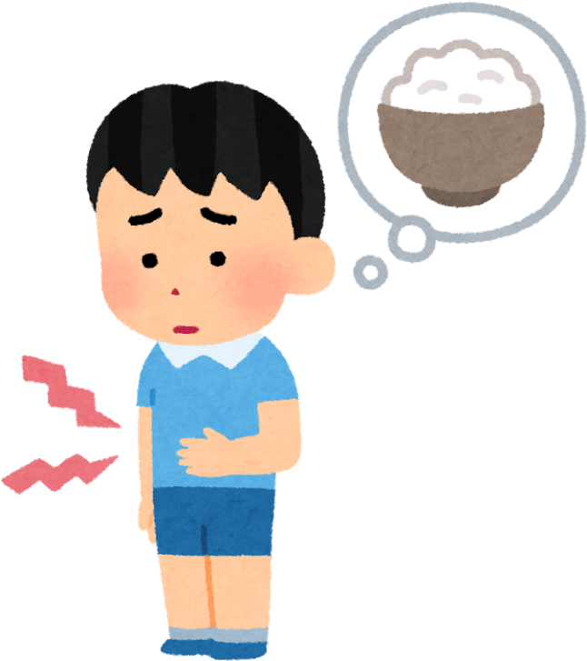
Question 12:
I/hungry/am/.
A. I hungry.
C. I am hungry .
B. am I hungry
D. I hungry am.

Slide 16

Unit 3
WOULD YOU LIKE A BUBBLE TEA?
Lesson 1: Words

Slide 17

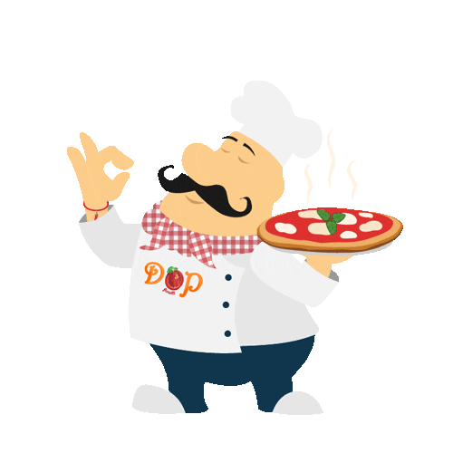
WELCOME TO OUR RESTAURANT
We will go to a restaurant…

Slide 18
New words

Slide 19

…In the menu, we have some dishes here

Slide 20

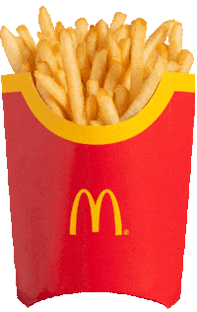
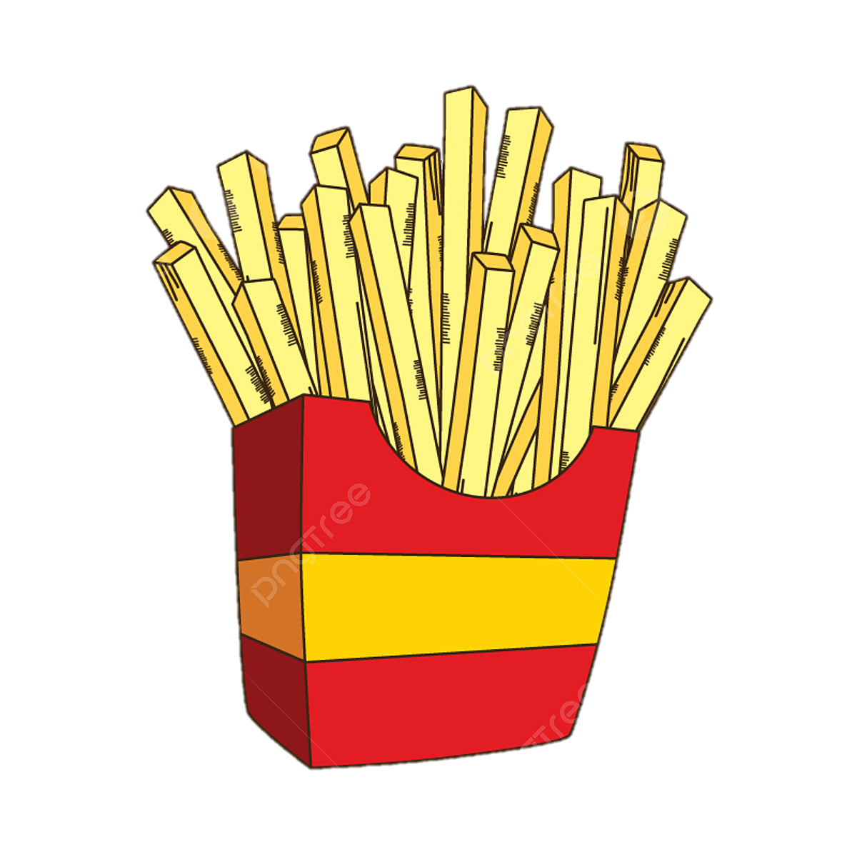

fries
…In the menu, we have some dishes here

Slide 21
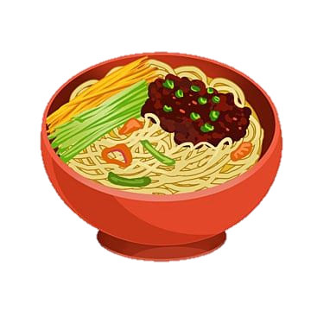
noodles
…In the menu, we have some dishes here

Slide 22
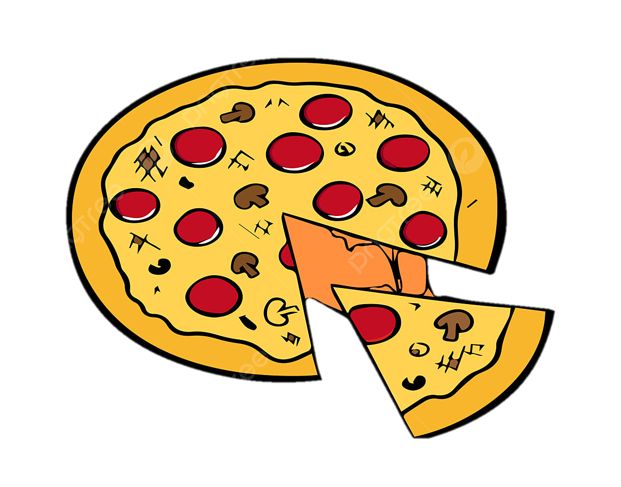
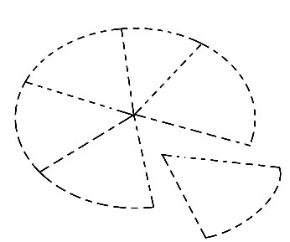
pizza
…What will we have next? – Let’s Guess

Slide 23
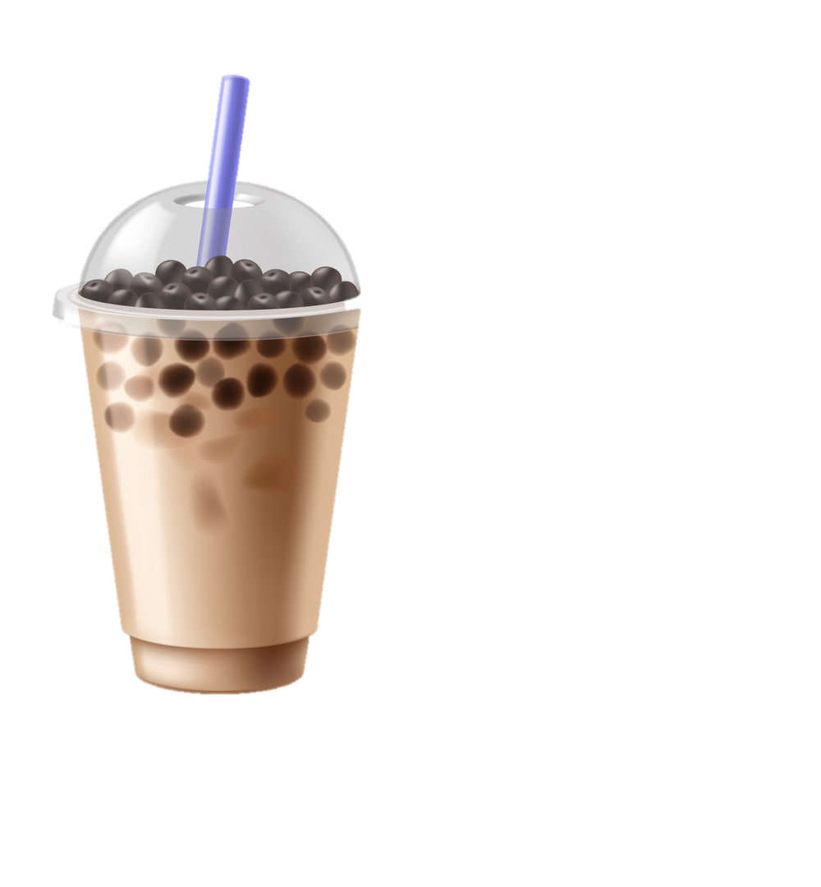
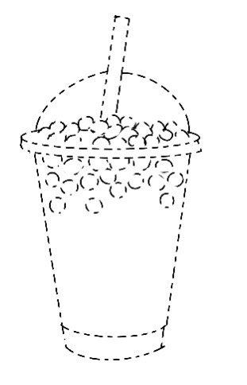
bubble tea
… And let’s gues for drinks what we have…?

Slide 24
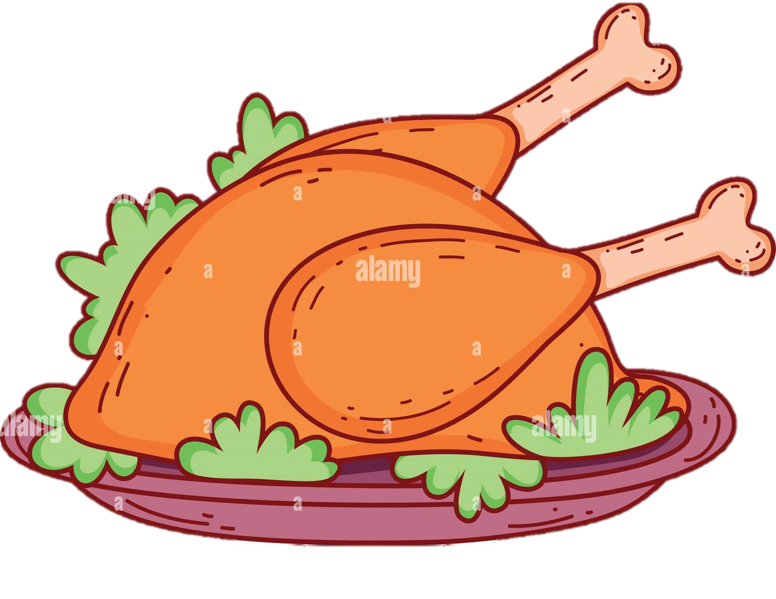
chicken
And the last…

Slide 25
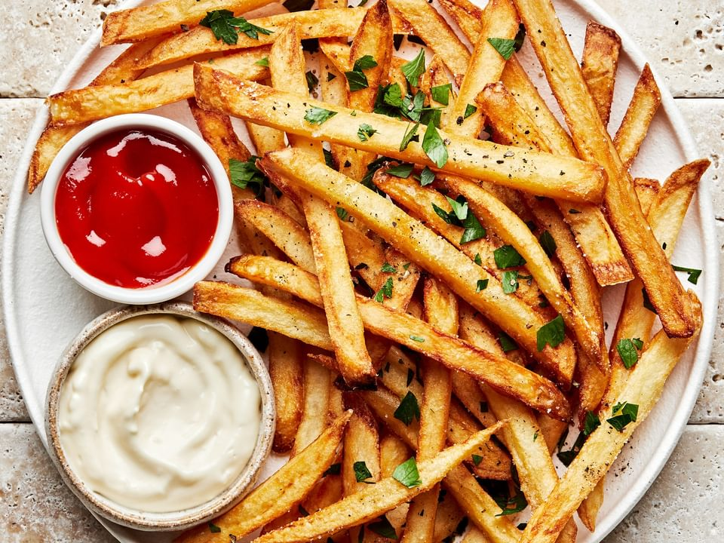
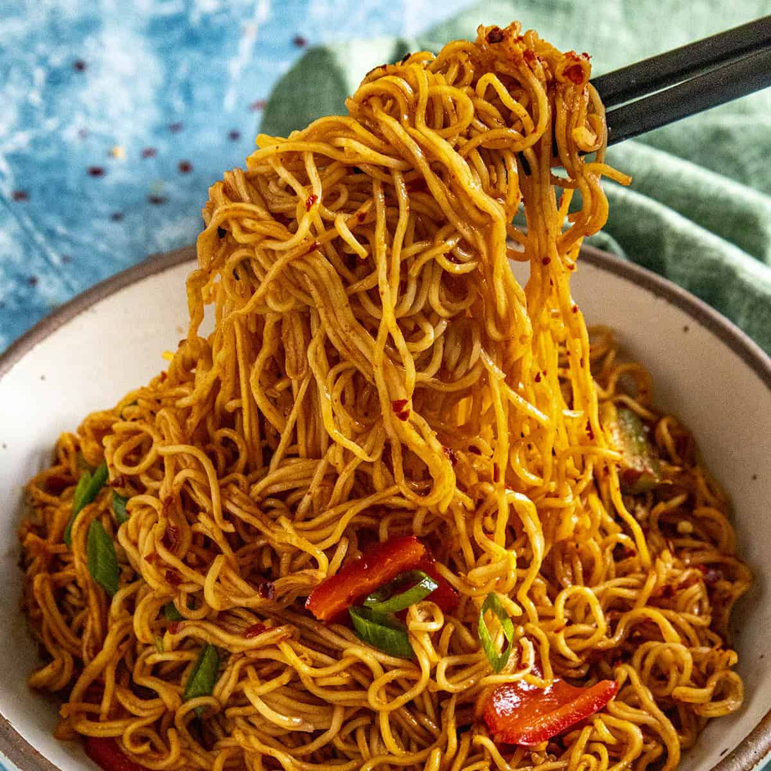
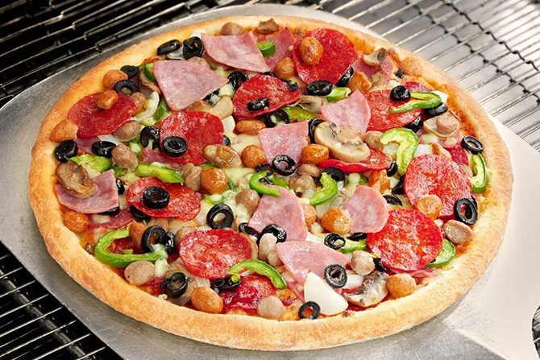
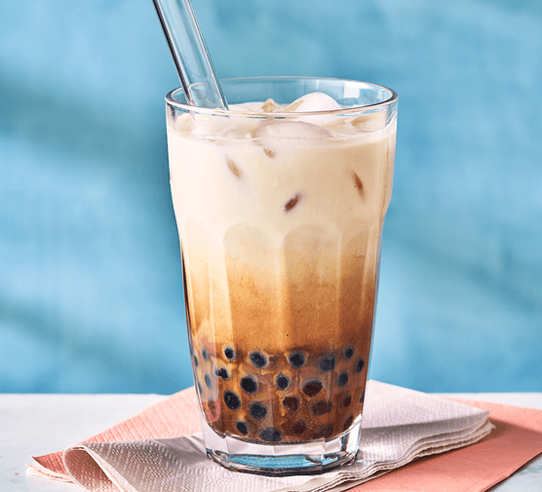
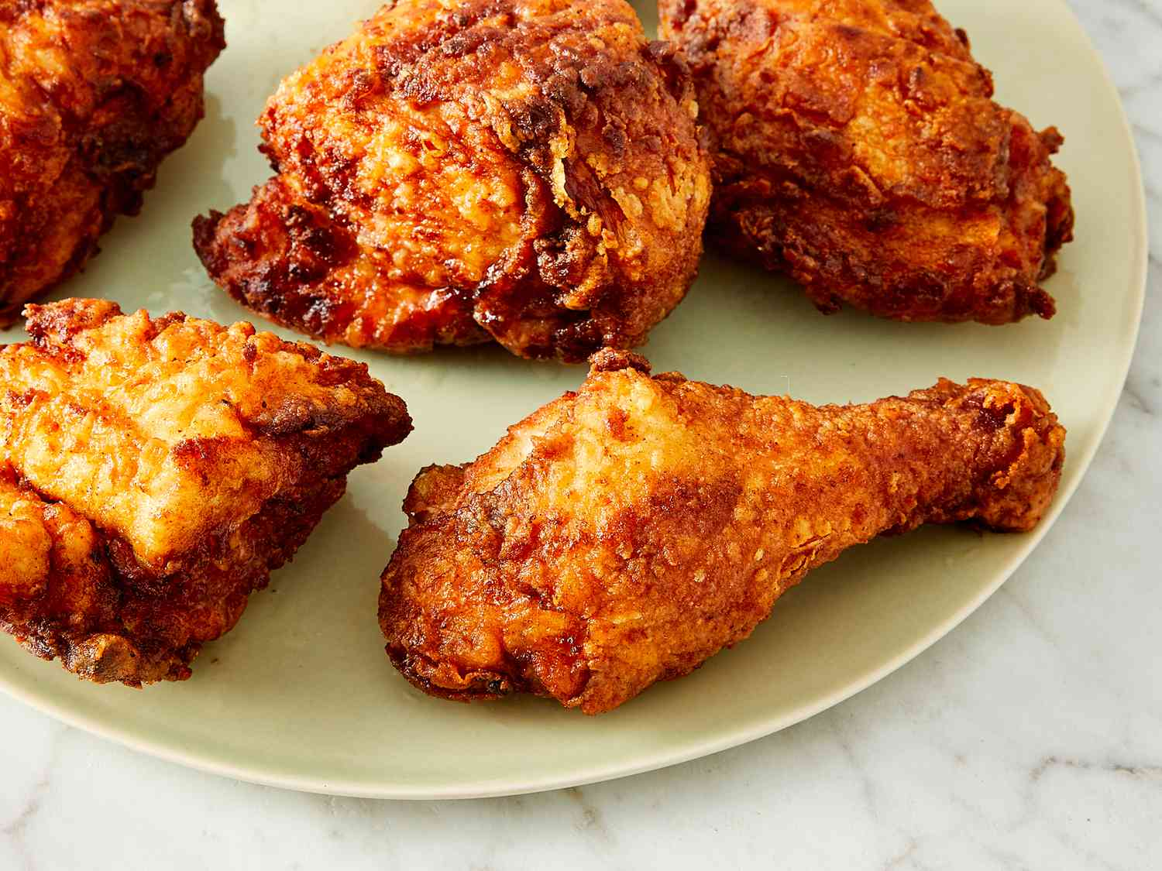
LISTEN AND READ AGAIN
So what do you want to eat and drink?
fries
noodles
pizza
bubble tea
chicken

Slide 26
Listen, point and repeat.
1

Slide 27
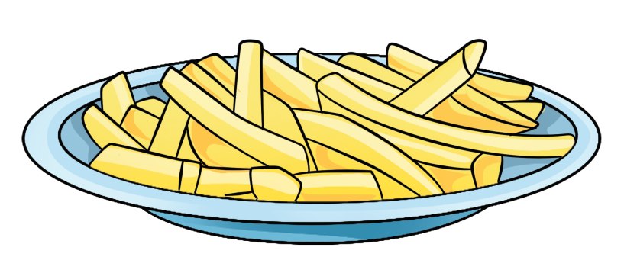
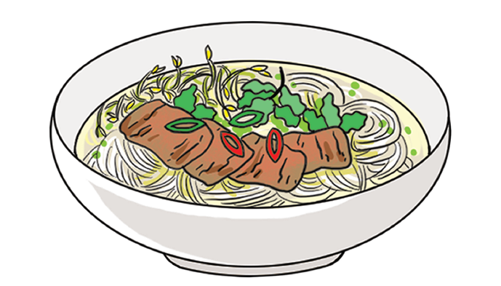
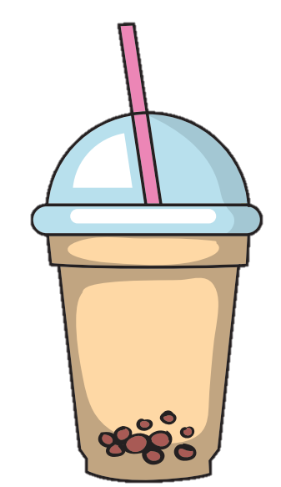



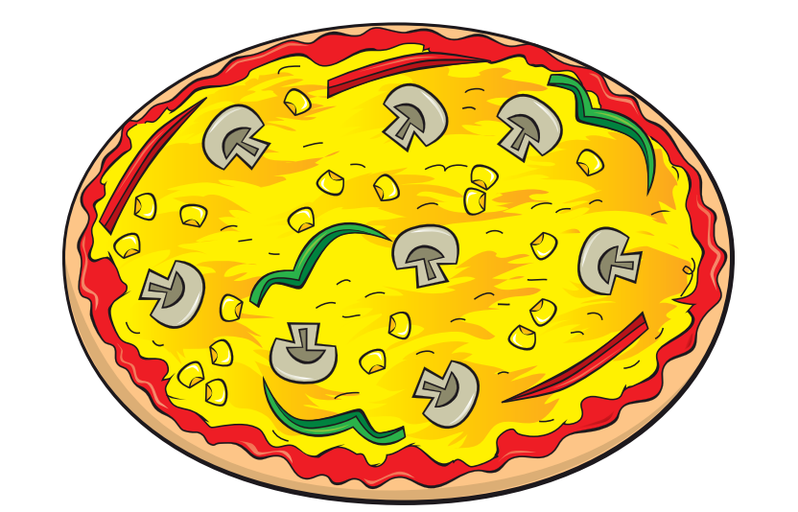
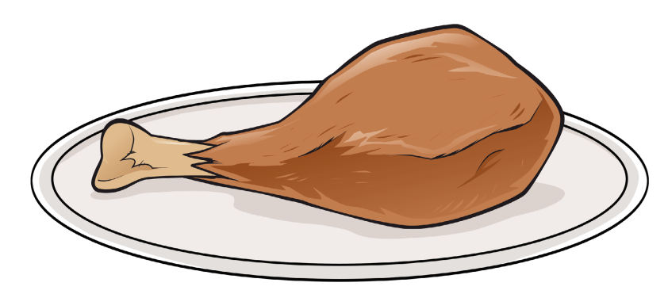




Slide 28

TEAM WORK !!

Slide 29
Review words

Slide 30
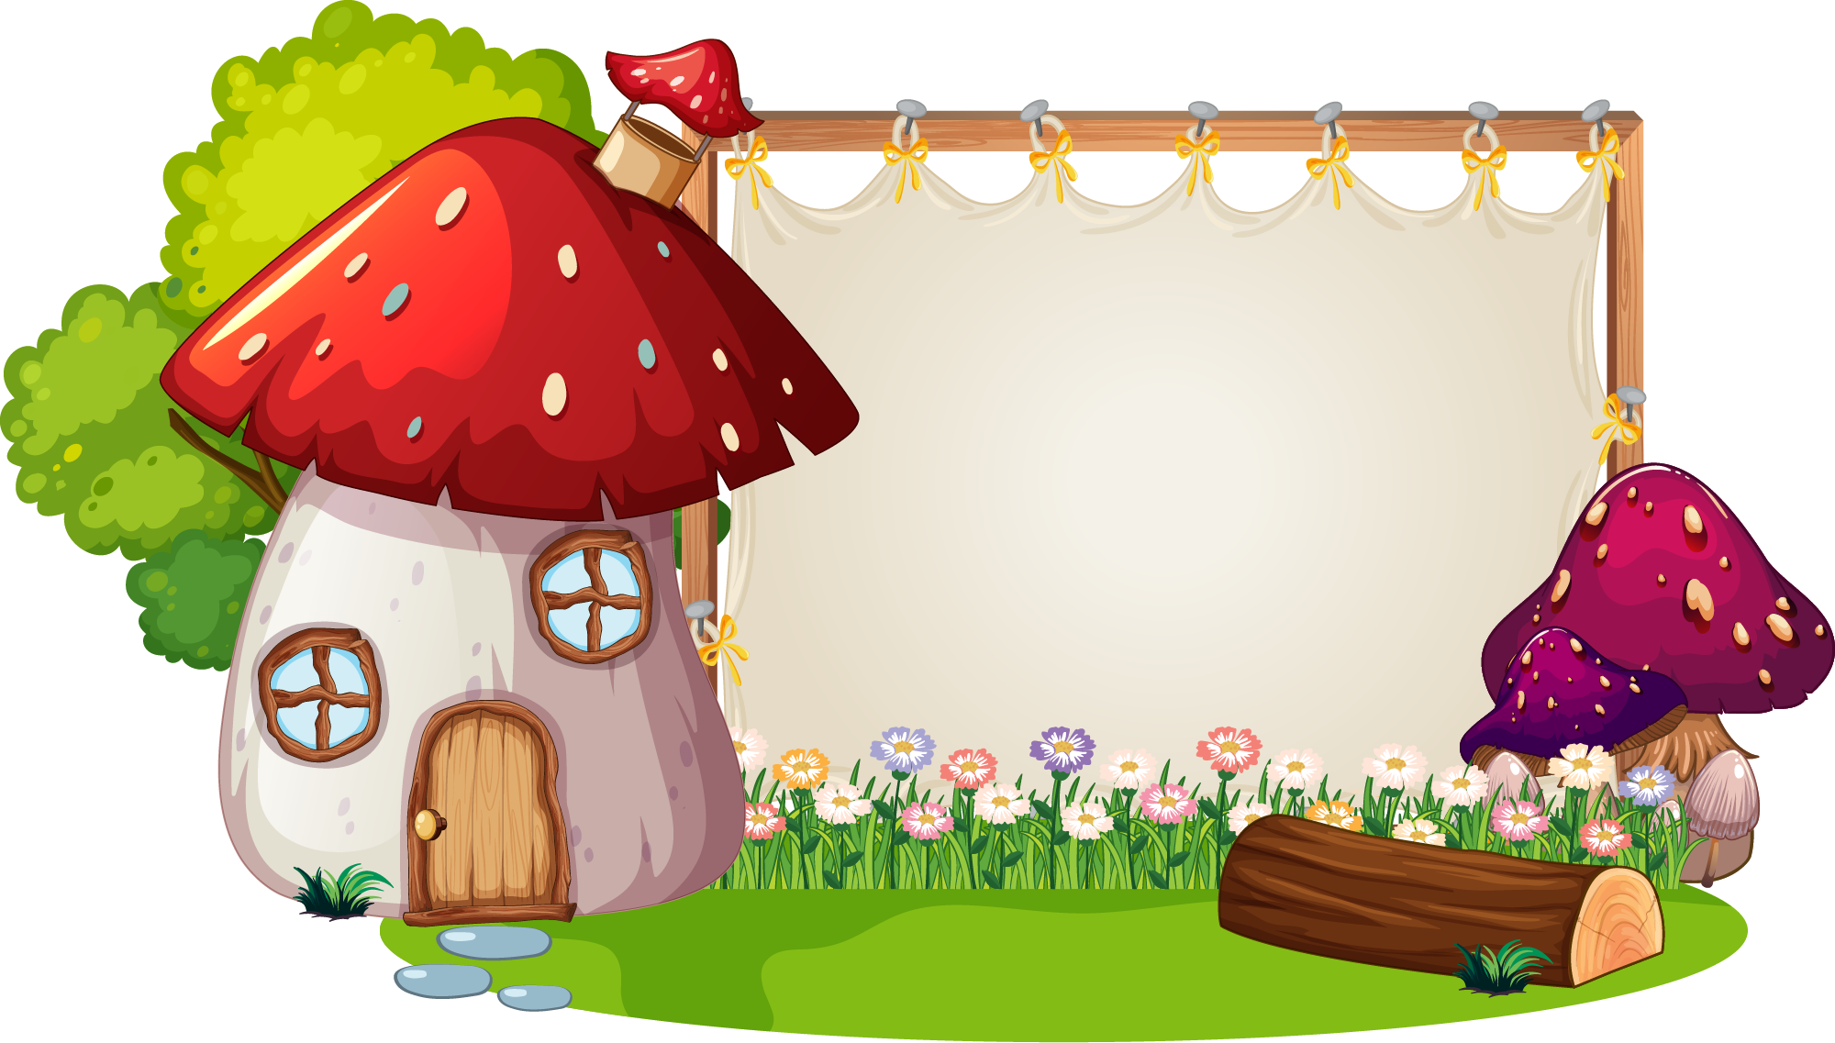
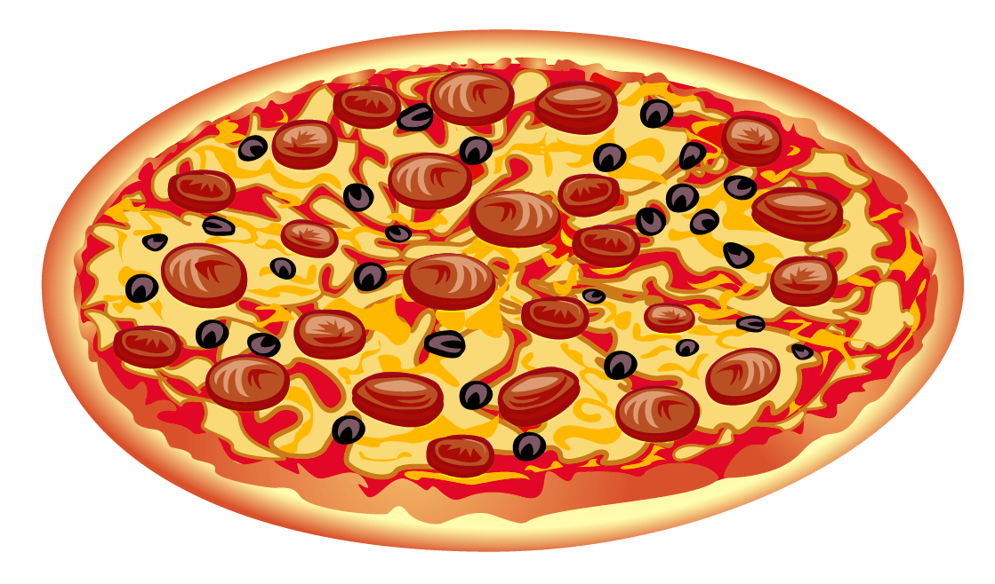

Q1: What's this?
Answer: It's a pizza.

Slide 31
Q2. It's a drink and its taste is sweet.
Answer: bubble tea

Slide 32
Q3. We make this dish from potatoes.
Answer: fries
Notes:
Thanh Yến Trần 0967 255 149 zalo/ FB https://www.facebook.com/thanhyentrananhngutaymy

Slide 33
Q4. A food made from rice and flour. It's long and thin.
Answer: noodles
Notes:
Thanh Yến Trần 0967 255 149 zalo/ FB https://www.facebook.com/thanhyentrananhngutaymy

Slide 34
Q5. Listen the guess the word.
Answer: chicken
Notes:
Thanh Yến Trần 0967 255 149 zalo/ FB https://www.facebook.com/thanhyentrananhngutaymy

Slide 35
Listen and chant.
2

Slide 37
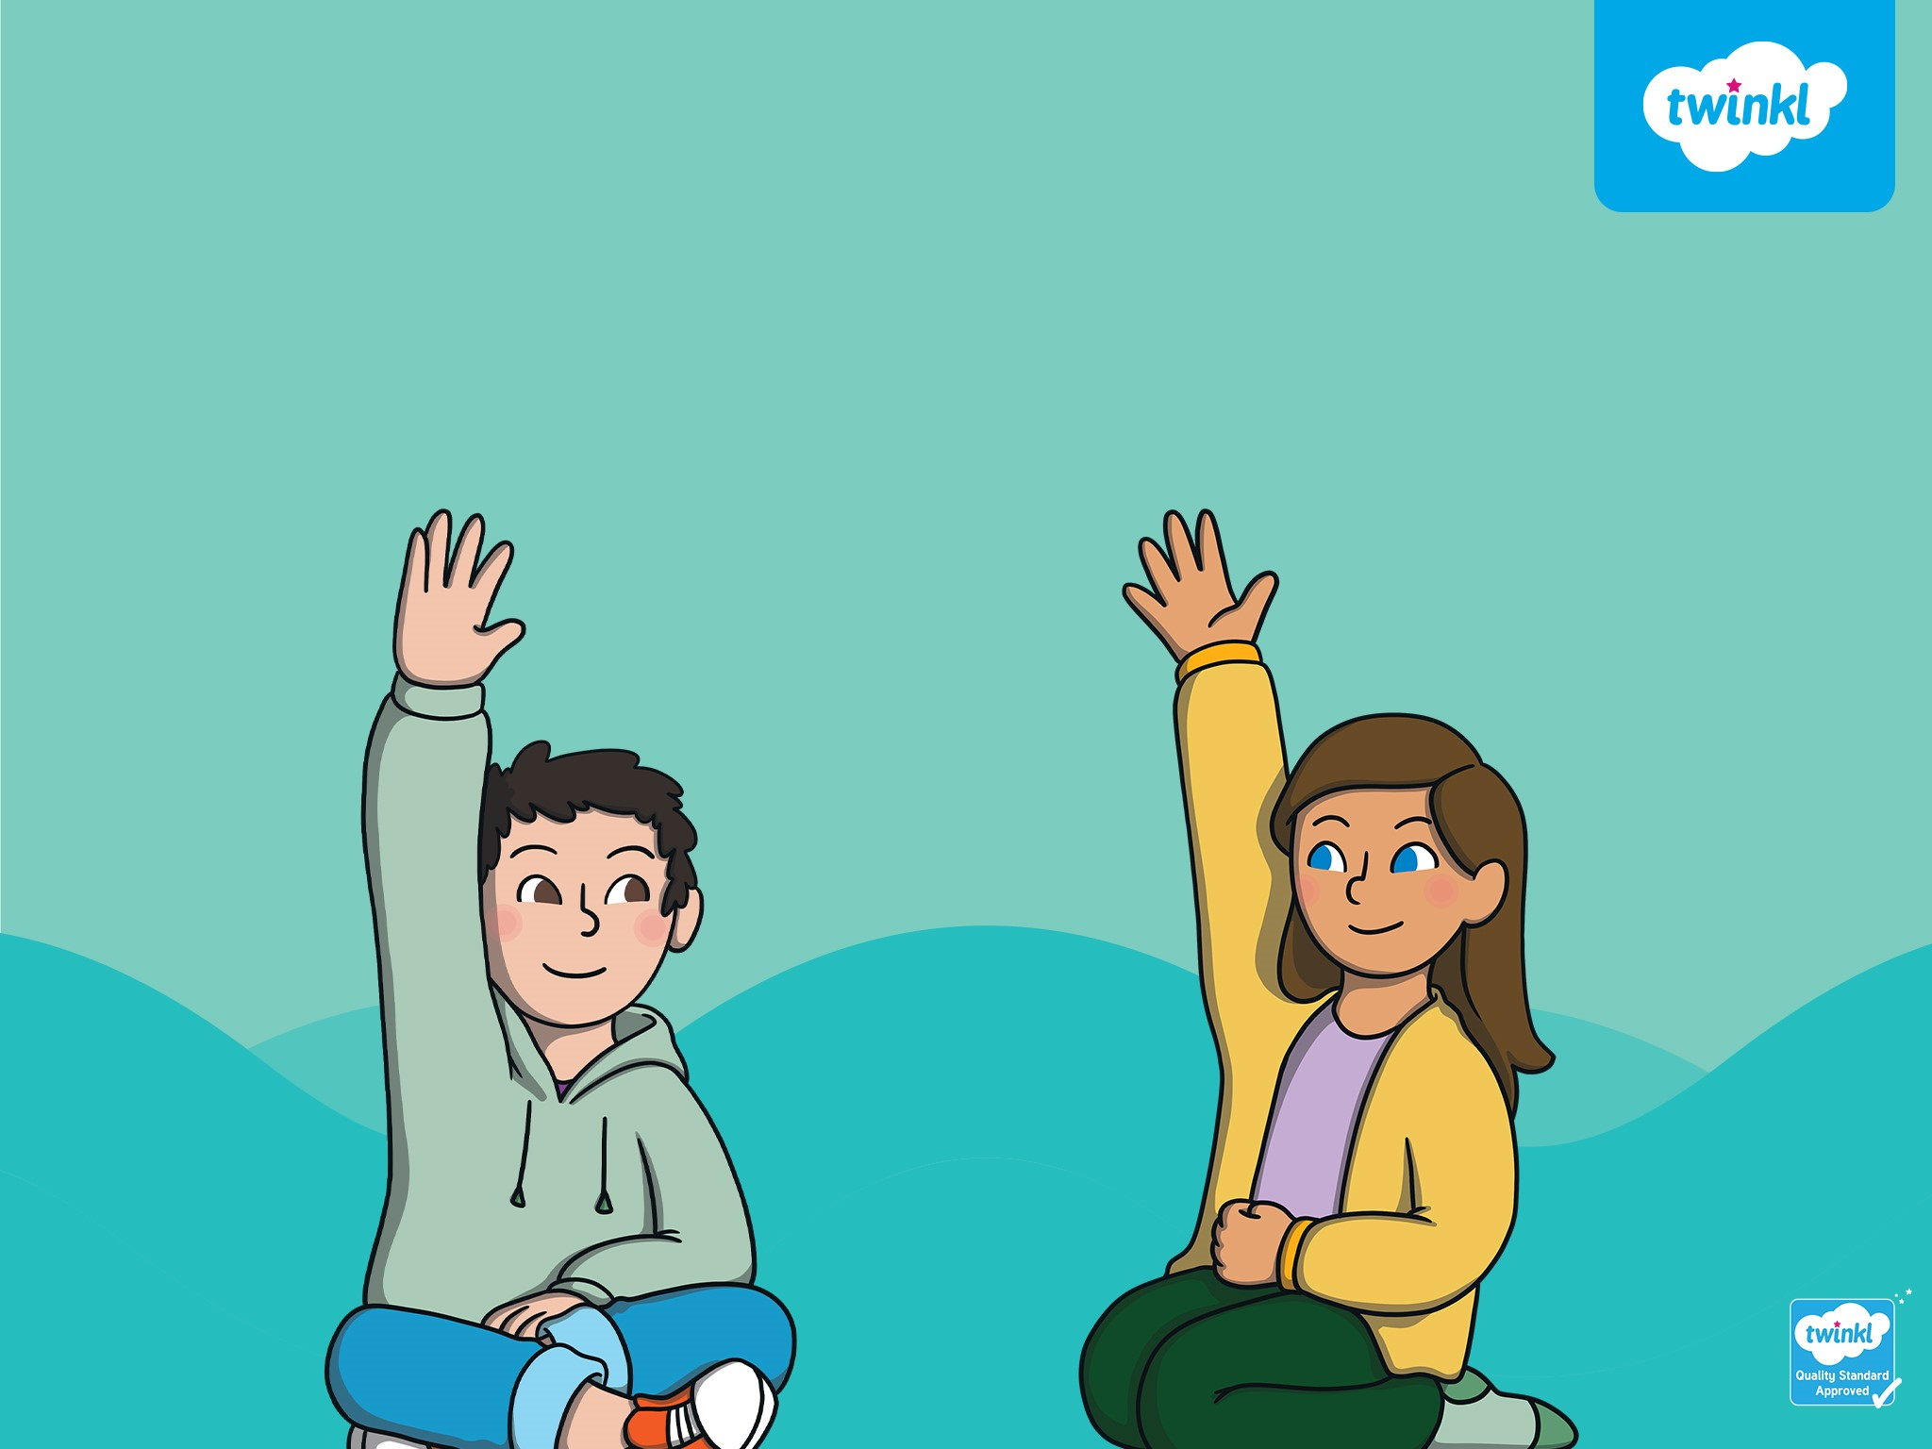
GAMETIME!

Slide 38
Listen and read.
3

Slide 39
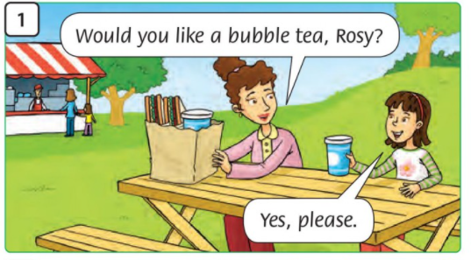
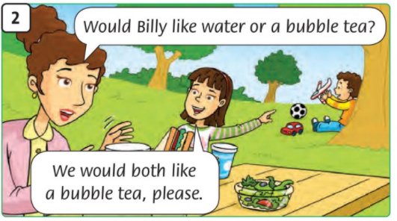
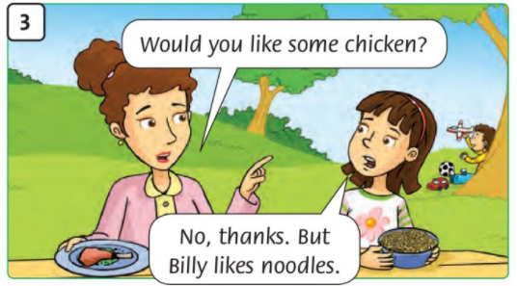
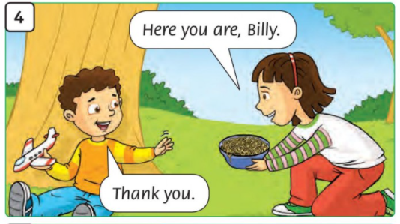
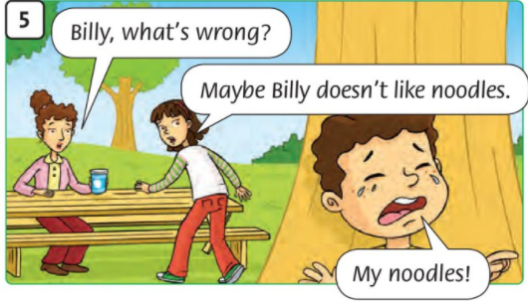
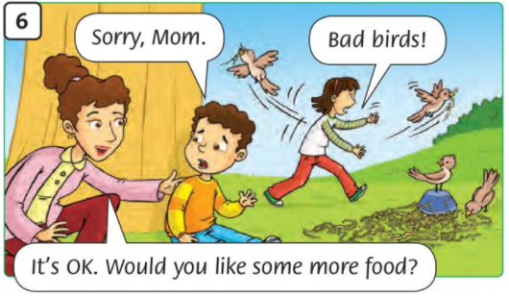

Slide 40
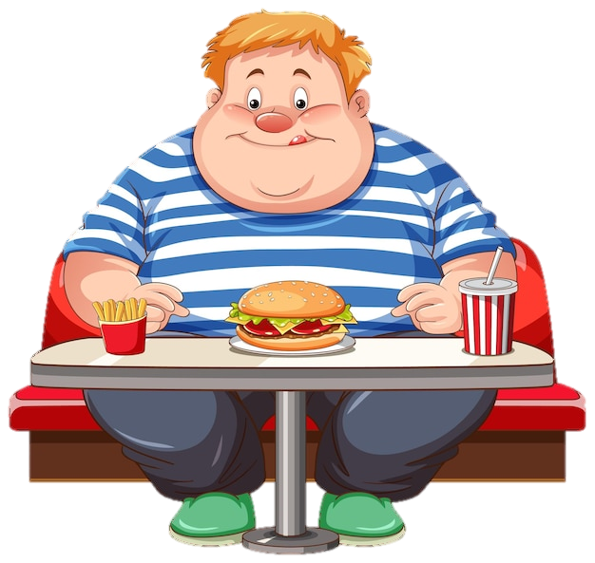
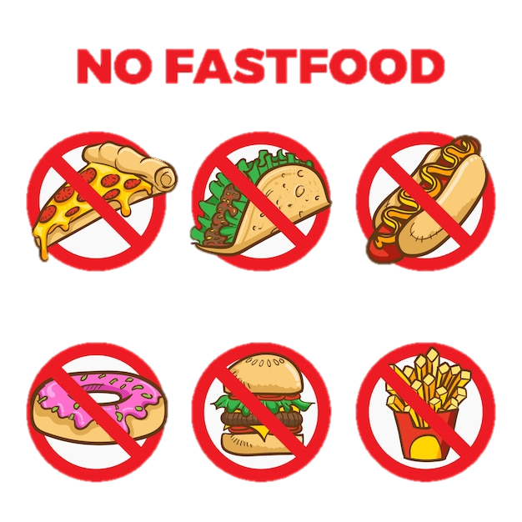
MORAL LESSON

Slide 41
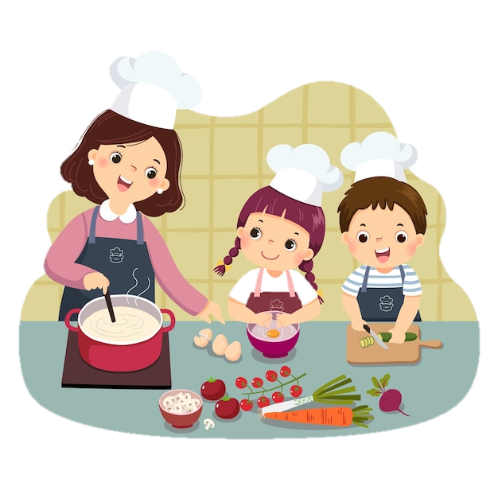

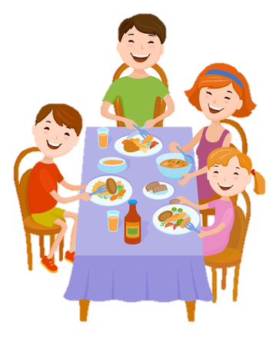
MORAL LESSON

Slide 42
Homework:
- Copy 3 lines the new words.
- Do exercises page 22.
- Prepare next lesson.

Slide 43
Thank you
& goodbye!

