Slide 1
UNIT 1 THIS IS YOUR DOLL.
Thanh Yến Trần 0967 255 149 zalo/ FB https://www.facebook.com/thanhyentrananhngutaymy/
Lesson 3: Song

Slide 2
WARMER

Slide 4
REVIEW

Slide 5
This is _____ ball.
me
my
my
Notes:
Thanh Yến Trần 0967 255 149 zalo/ FB https://www.facebook.com/thanhyentrananhngutaymy/

Slide 6
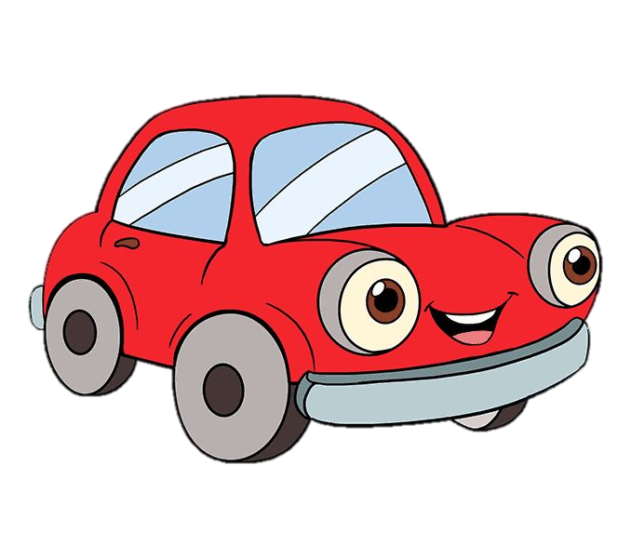
This is my _______
car
cat

Slide 7
I have a desk. ____ desk is big.
My
Your
My

Slide 8
My car ____ blue.
am
is
is

Slide 9
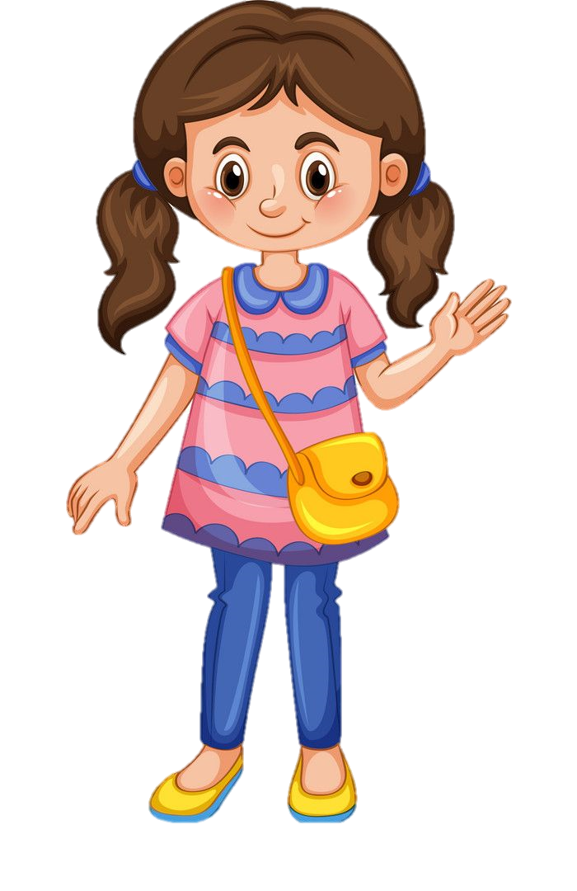
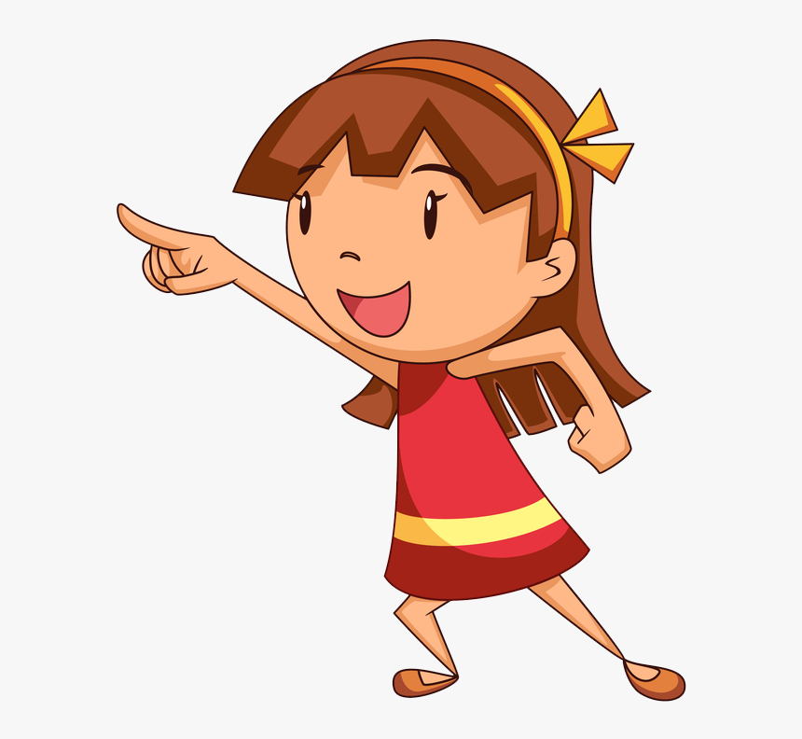
____ chair is red.
My
Your
Your

Slide 10
This is ______.
my bag
your bag
my bag

Slide 11
This is ____ pencil.
you
your
your

Slide 12
01.
Listen and point. Repeat.

Slide 13
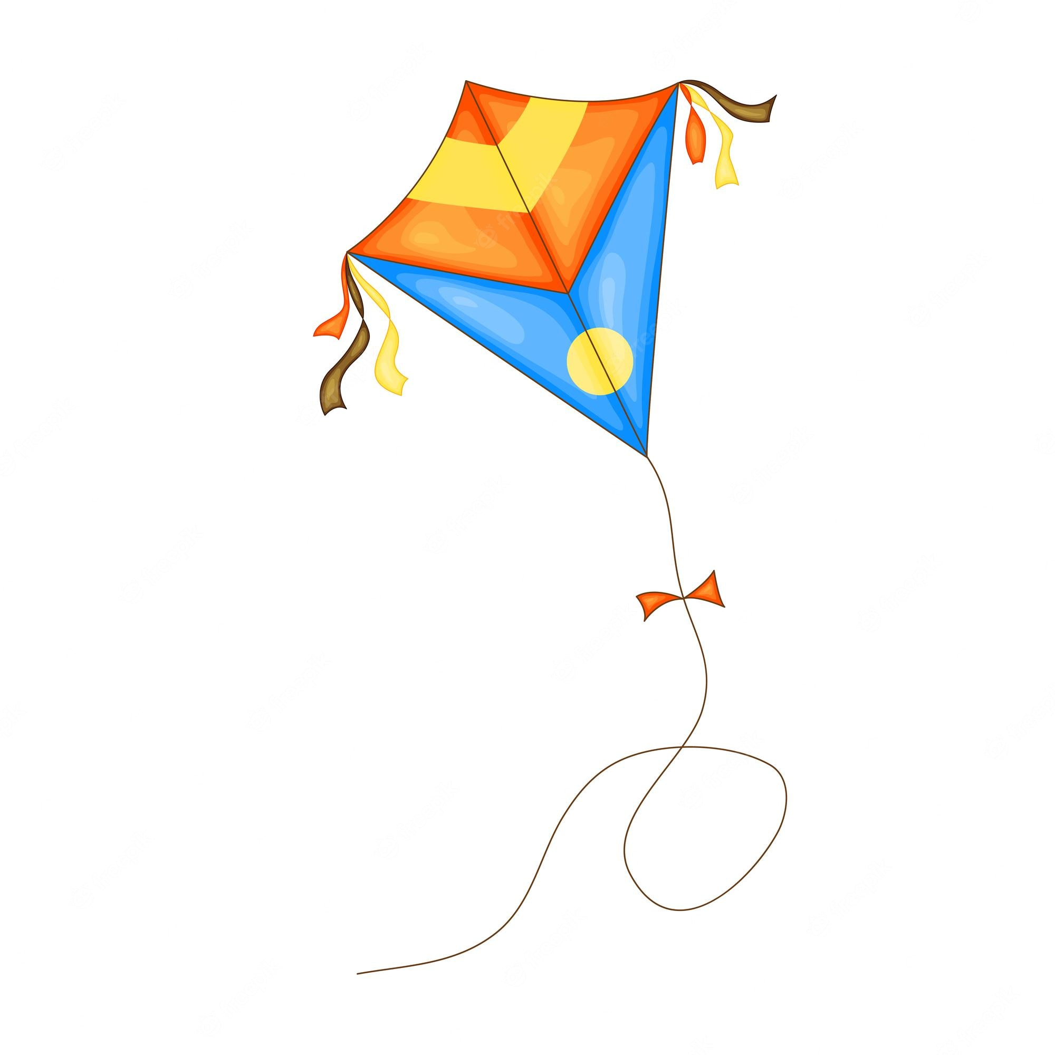
words
kite

Slide 14
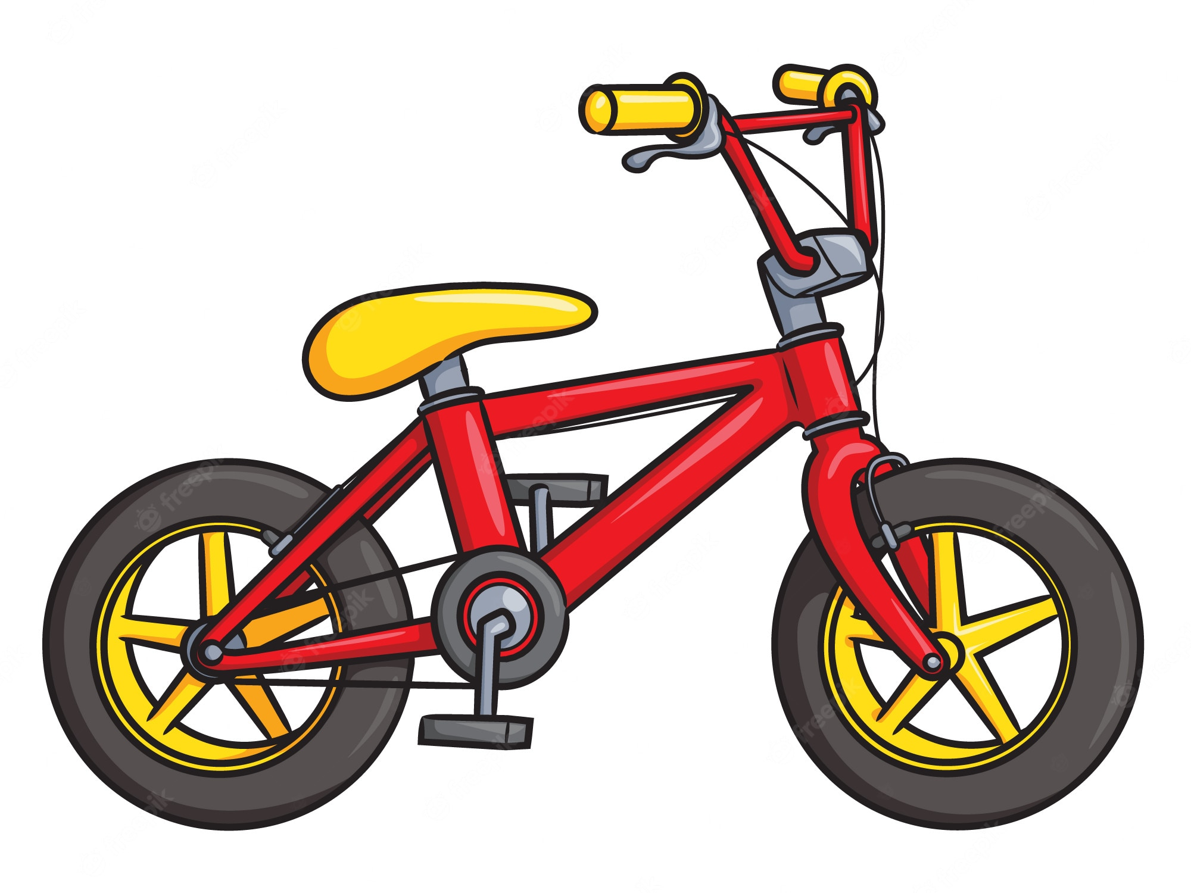
words
bike

Slide 15
words
train

Slide 16
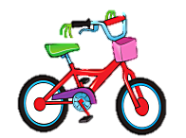
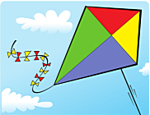
Listen and point
Listen and repeat
Click on the picture to repeat.

Slide 17
GAMETIME!

Slide 18
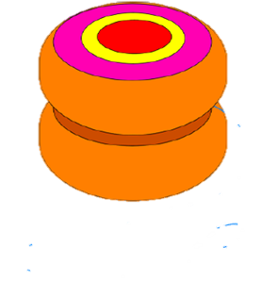

Slide 19
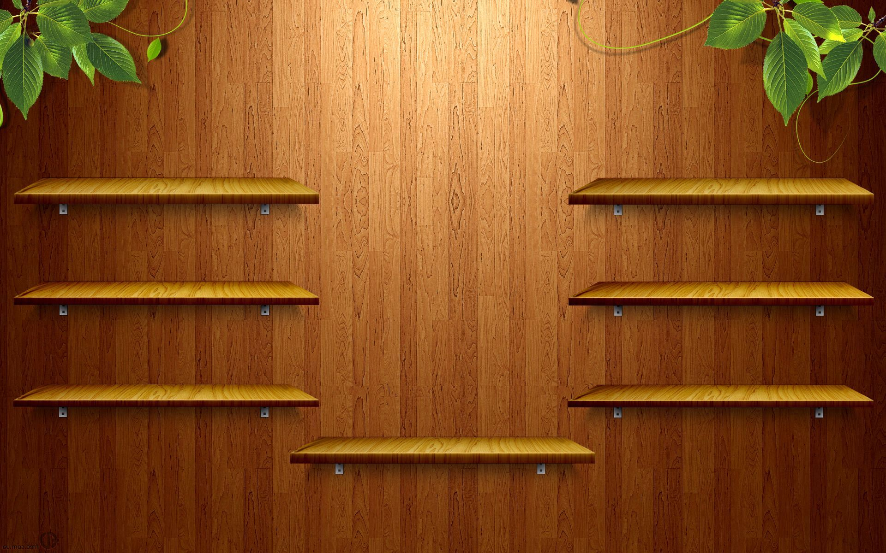
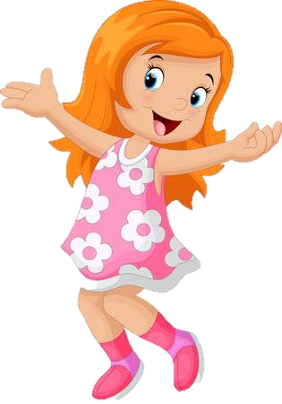
Click on the
ROBOT
GOOD JOB!

Slide 20
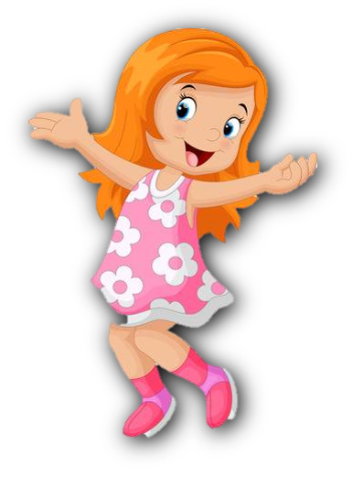
Click on the
CAR
GOOD JOB!

Slide 21
Click on the
TRAIN
GOOD JOB!

Slide 22
Click on the
YO-YO
GOOD JOB!

Slide 23
Click on the
TEDDY BEAR
GOOD JOB!

Slide 24
Click on the
SHIP
GOOD JOB!

Slide 25
Click on the
PLANE
GOOD JOB!

Slide 26
LISTEN AND SING
02.

Slide 27
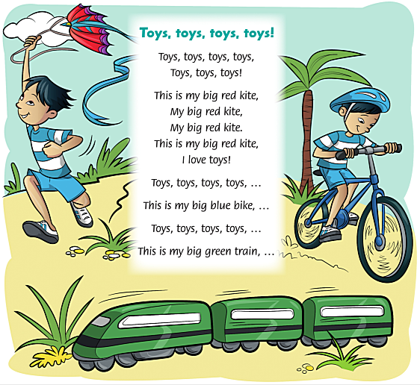

Slide 28
03.
Sing and do

Slide 30
This is my big red kite My big red kite. My big red kite. This is my big red kite I love toys
This is my big blue bike My big blue bike. My big blue bike. This is my big blue bike I love toys
This is my big green train. My big green train. My big green train.
This is my big green train. I love toys

Slide 31
WHOA!!
My students are so talented!

Slide 32
Toys song

Slide 34
Thanks
GOODBYE!

