Slide 2
Unit
7
1
FAMILY LIFE
Unit
VIET NAM AND INTERNATIONAL ORGANISATIONS
LESSON 1
GETTING STARTED
Viet Nam and international organisations

Slide 3
Unit
1
1
FAMILY LIFE
Family Life
Unit
OBJECTIVES
Gain an overview of the topic “Viet Nam and international organisations”
Identify and use words and phrases related to the topic “Viet Nam and international organisations”
Identify and use comparative and superlative adjectives.

Slide 4
LESSON 1
GETTING STARTED
WARM-UP
Trivia: Guess the logo
PRESENTATION
Vocabulary
Task 1: Listen and read.
Task 2: Choose the correct answers.
Task 3: Find words in the texts that mean the following.
Task 4: Complete the sentences.
PRACTICE
CONSOLIDATION
Wrap-up
Homework

Slide 5
LESSON 1
GETTING STARTED
WARM-UP
Trivia: Guess the logo

Slide 6
GUESS THE LOGO!
The United Nations

Slide 7
GUESS THE LOGO!
United Nations
Children’s Fund

Slide 8
GUESS THE LOGO!
United Nations
Development
Programme

Slide 9
GUESS THE LOGO!
World Trade Organization

Slide 10
GUESS THE LOGO!
World Wide Fund
for Nature

Slide 11
GUESS THE LOGO!
The Food and Agriculture Organisation of the United Nations

Slide 12
GUESS THE LOGO!
Association of Southeast Asian Nations

Slide 13
LESSON 1
GETTING STARTED
WARM-UP
Trivia: Guess the logo
PRESENTATION
Vocabulary

Slide 14
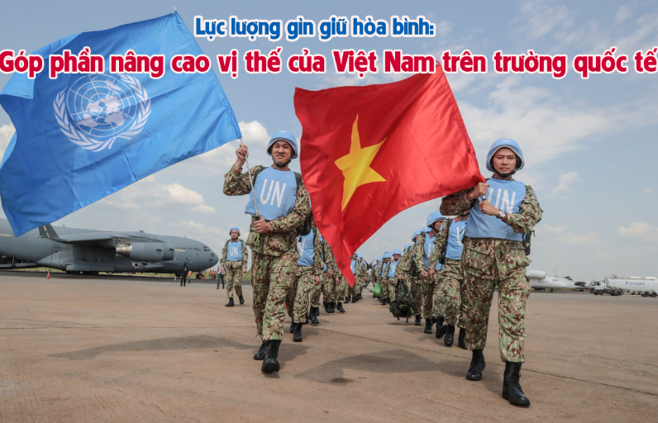
VOCABULARY
peacekeeping (adj)
/ˈpiːskiːpɪŋ/
intended to help stop people fighting and prevent war or violence in a place where this is likely

Slide 15
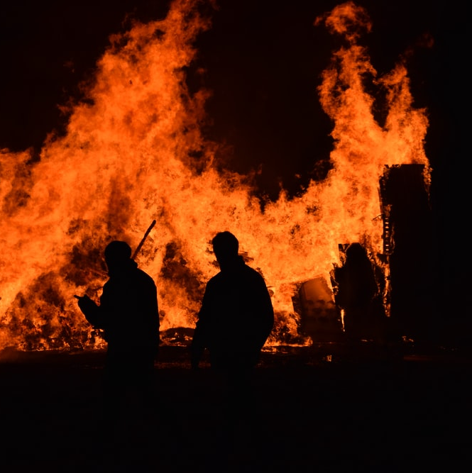
VOCABULARY
harm (n)
/hɑː(r)m/
damage or injury that is caused by a person or an event

Slide 16
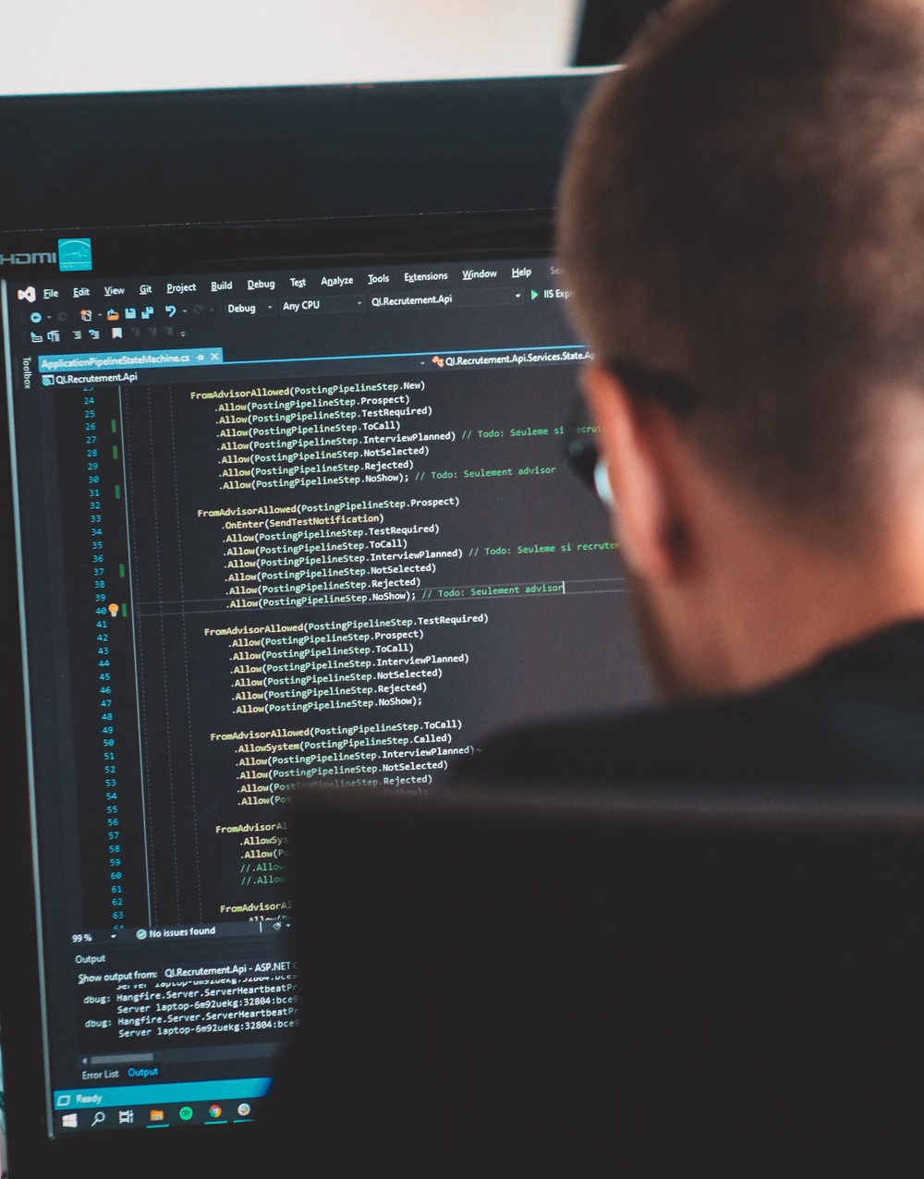
VOCABULARY
expert (adj)
/ˈekspɜːrt/
having or involving great knowledge or skills

Slide 17
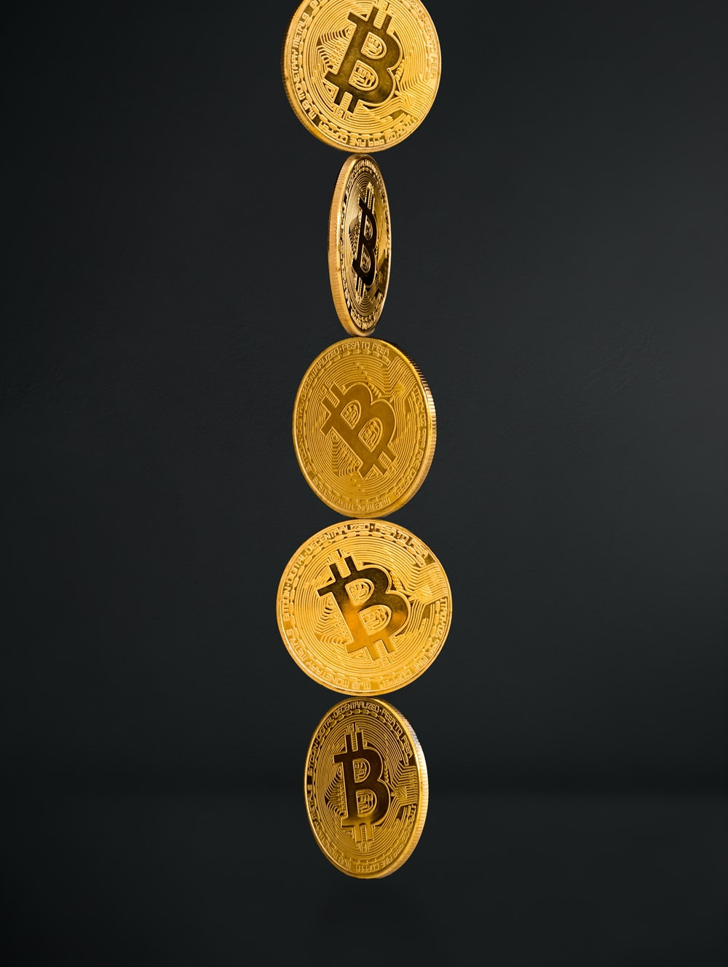
VOCABULARY
investor (n)
/ɪnˈvestə(r)/
a person or an organisation that invests money in something

Slide 18
VOCABULARY
World Peace/Peacekeeping: Hòa bình thế giới/ Giữ gìn hòa bình
Reduce Poverty: Giảm nghèo
Improve People’s Lives: Cải thiện cuộc sống của người dân
Form/Set up/Establish: Thiết lập
Disadvantaged Children: Trẻ em khuyết tật
Safe from Harm: An toàn khỏi nguy hiểm
Technical Support: Hỗ trợ kỹ thuật
Have a Better Life: Có cuộc sống tốt đẹp hơn
Economic Organization: Tổ chức kinh tế
Foreign Investors (->Invest in sth): Nhà đầu tư nước ngoài (-> Đầu tư vào cái gì)
Damage or Injury: Thiệt hại hoặc chấn thương
Aim: Mục tiêu

Slide 19
LESSON 1
GETTING STARTED
WARM-UP
Trivia: Guess the logo
PRESENTATION
Vocabulary
Task 1: Listen and read.
Task 2: Choose the correct answers.
Task 3: Find words in the texts that mean the following.
Task 4: Complete the sentences.
PRACTICE

Slide 20
PRACTICE
1
Listen and read.
Do You Know…?
A. The United Nations (UN) was created in 1945. It is an organisation of most of the world’s countries. Its main goal is world peace. It also works to reduce poverty and improve people’s lives in other ways. Viet Nam joined the organisation in 1977. Since then, our country has become more active and has participated in many UN activities including peacekeeping.
B. UNICEF was formed in 1946. It works in over 190 countries to help improve health and education of children. It particularly aims to support the most disadvantaged children all over the world. UNICEF’s aim in Viet Nam is to protect children and make sure they are healthy, educated and safe from harm.

Slide 21
PRACTICE
1
Listen and read.
Do You Know…?
C. UNDP was formed in 1965 as part of the UN. It provides technical support, expert advice and training to help people in developing countries have a better life. In Viet Nam, UNDP works closely with the government to reduce poverty and improve people’s lives.
D. The WTO was formed in 1995. It is the world’s largest international economic organisation. Viet Nam became a WTO member in 2007. Since then, our economy has achieved a high growth level. Viet Nam has also become more attractive to foreign investors.

Slide 22
PRACTICE
PRACTICE
2
Read the texts again and choose the correct answers.
1. Which organisation was formed in 1945?
A. The UN B. UNICEF C. The WTO
2. Which organisation aims to help improve children’s health and education?
A. UNDP B. UNICEF C. The WTO
3. Which of the following is the largest international economic organisation?
A. The UN B. UNDP C. The WTO

Slide 23
PRACTICE
3
Find words in the texts (A, B, C, or D) that mean the following.
Words | Meanings
 | helping stop people fighting (A)
 | damage or injury (B)
 | having great knowledge (C)
 | people or organisations that invest money (D)
peacekeeping
harm
expert
investors

Slide 24
PRACTICE
4
Complete the sentences with the words and phrases from Task 1.
1. Since joining the UN, Viet Nam has become _____________ and has participated in many UN activities including peacekeeping.
2. UNICEF particularly aims to support _____________________ children all over the world.
3. UNDP helps people in developing countries have a __________ life.
4. The WTO is the world's __________ international economic organisation.
5. Viet Nam has also become ______________ to foreign investors.
more active
the most disadvantaged
better
largest
more attractive

Slide 25
LESSON 1
GETTING STARTED
WARM-UP
Trivia: Guess the logo
PRESENTATION
Vocabulary
Task 1: Listen and read.
Task 2: Choose the correct answers.
Task 3: Find words in the texts that mean the following.
Task 4: Complete the sentences.
PRACTICE
CONSOLIDATION
Wrap-up
Homework

Slide 26
CONSOLIDATION
1
Wrap-up
Some words and phrases related to international organisations
Reading for specific information
Scanning skills

Slide 27
CONSOLIDATION
2
Homework
Do exercises in the workbook
Project preparation

Slide 28
Website: sachmem.vn
Fanpage: facebook.com/sachmem.vn/

