Slide 2
Unit
6
1
Unit
FAMILY LIFE
GENDER EQUALITY
LESSON 5
LISTENING

Slide 3
Unit
1
1
FAMILY LIFE
Family Life
Unit
OBJECTIVES
Listen for specific information in a talk about the first woman in space
Identify and use lexical items related to gender equality

Slide 4
LESSON 5
LISTENING
WARM-UP
Video: A history of women in space
Task 1: Look at the picture and tell your partner what this woman's job is.
PRE-LISTENING
Task 2: Listen and choose the best answer.
Task 3: Listen and give short answers.
WHILE-LISTENING
POST-LISTENING
Task 4: Discussion
CONSOLIDATION
Wrap-up
Homework

Slide 5
LESSON 5
LISTENING
WARM-UP
Video: A history of women in space

Slide 6
VIDEO WATCHING
Write down as many names that you can hear as possible.
After watching: Which names have you already known and which names have you never heard of?
Notes:
https://www.youtube.com/watch?v=HIEach7rmDg

Slide 7
LESSON 5
LISTENING
WARM-UP
Video: A history of women in space
Task 1: Look at the picture and tell your partner what this woman's job is.
PRE-LISTENING

Slide 8
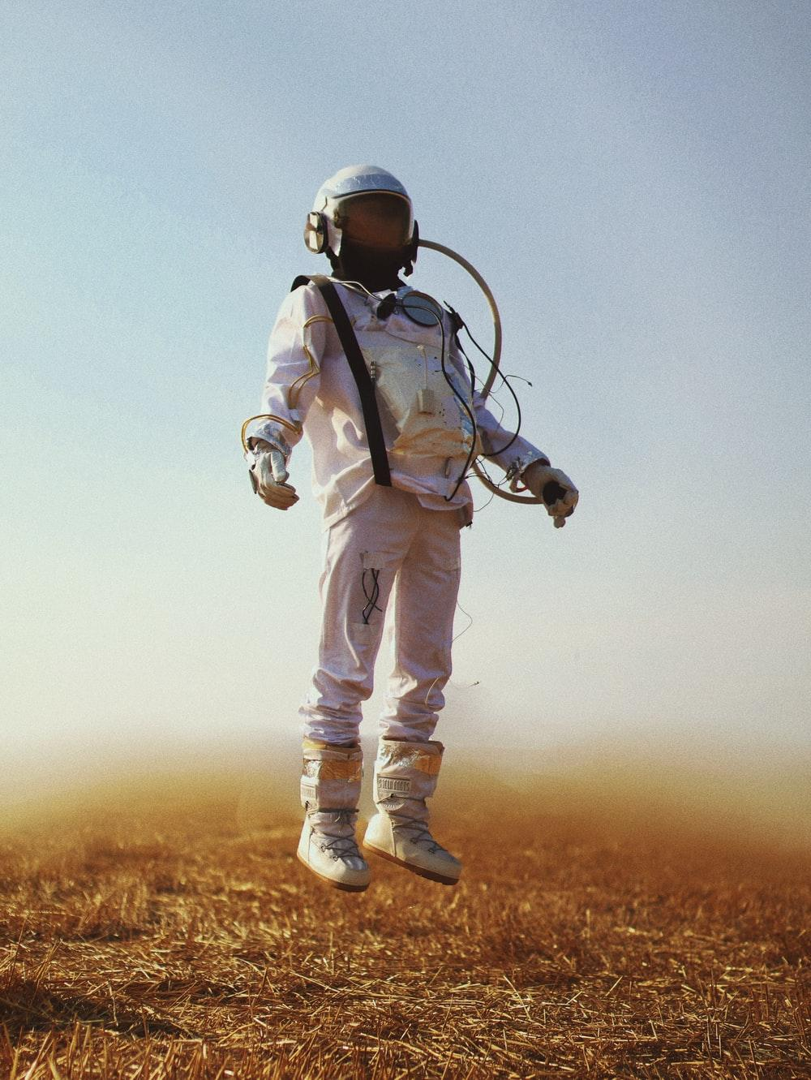
VOCABULARY
cosmonaut (n)
/ˈkɒzmənɔːt/
an astronaut from the former Soviet Union or Russia

Slide 9
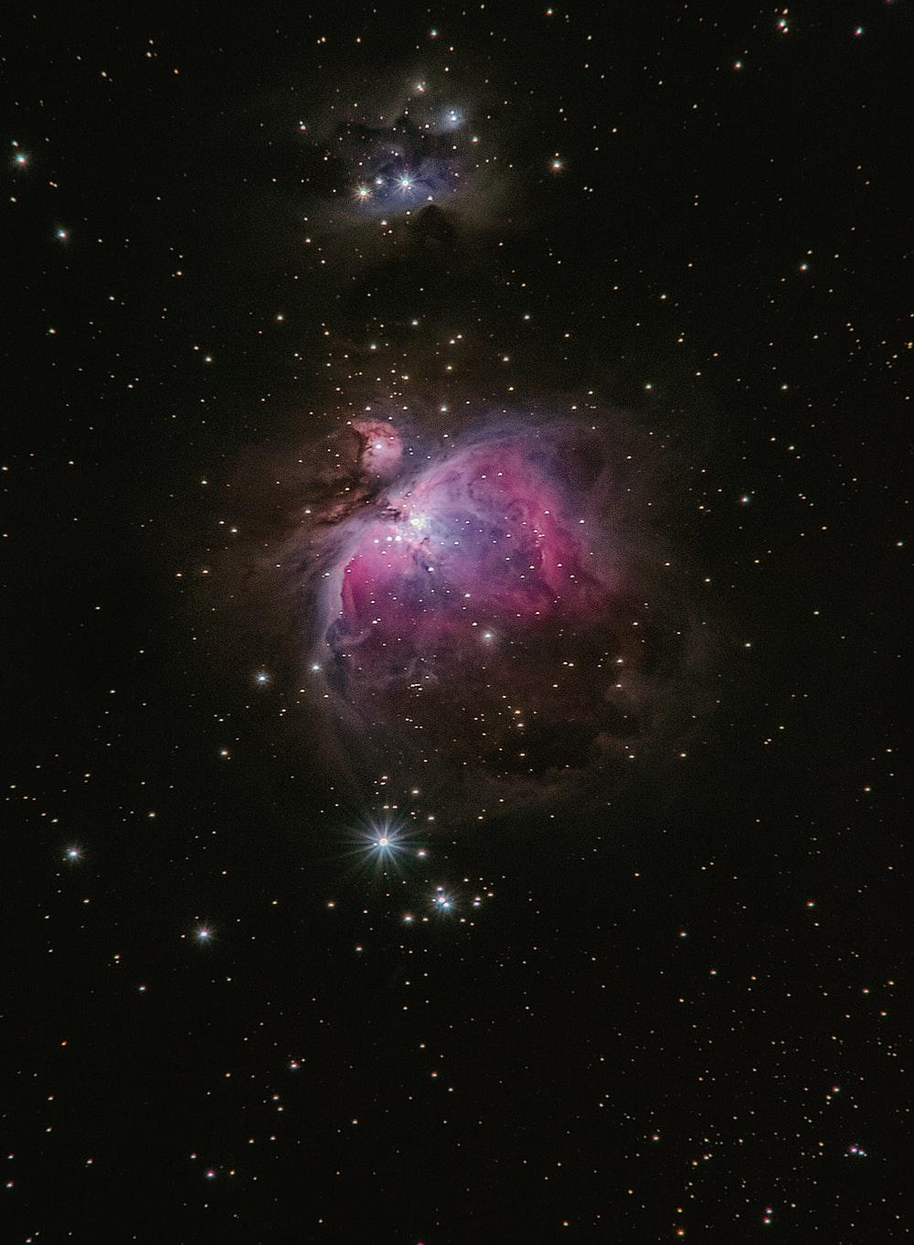
VOCABULARY
space (n)
/speɪs/
the area outside the earth’s atmosphere where all the other planets and stars are

Slide 10
VOCABULARY
parachutist (n)
/ˈpærəʃuːtɪst/
a person who jumps from a plane using a parachute

Slide 11
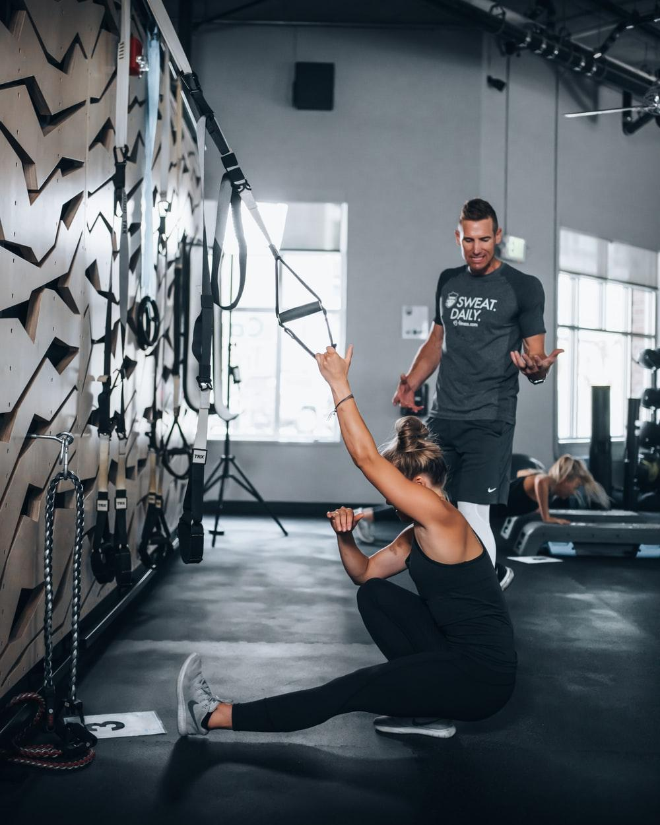
VOCABULARY
instructor (n)
/ɪnˈstrʌktə(r)/
a person whose job is to teach somebody a practical skill or sport

Slide 12
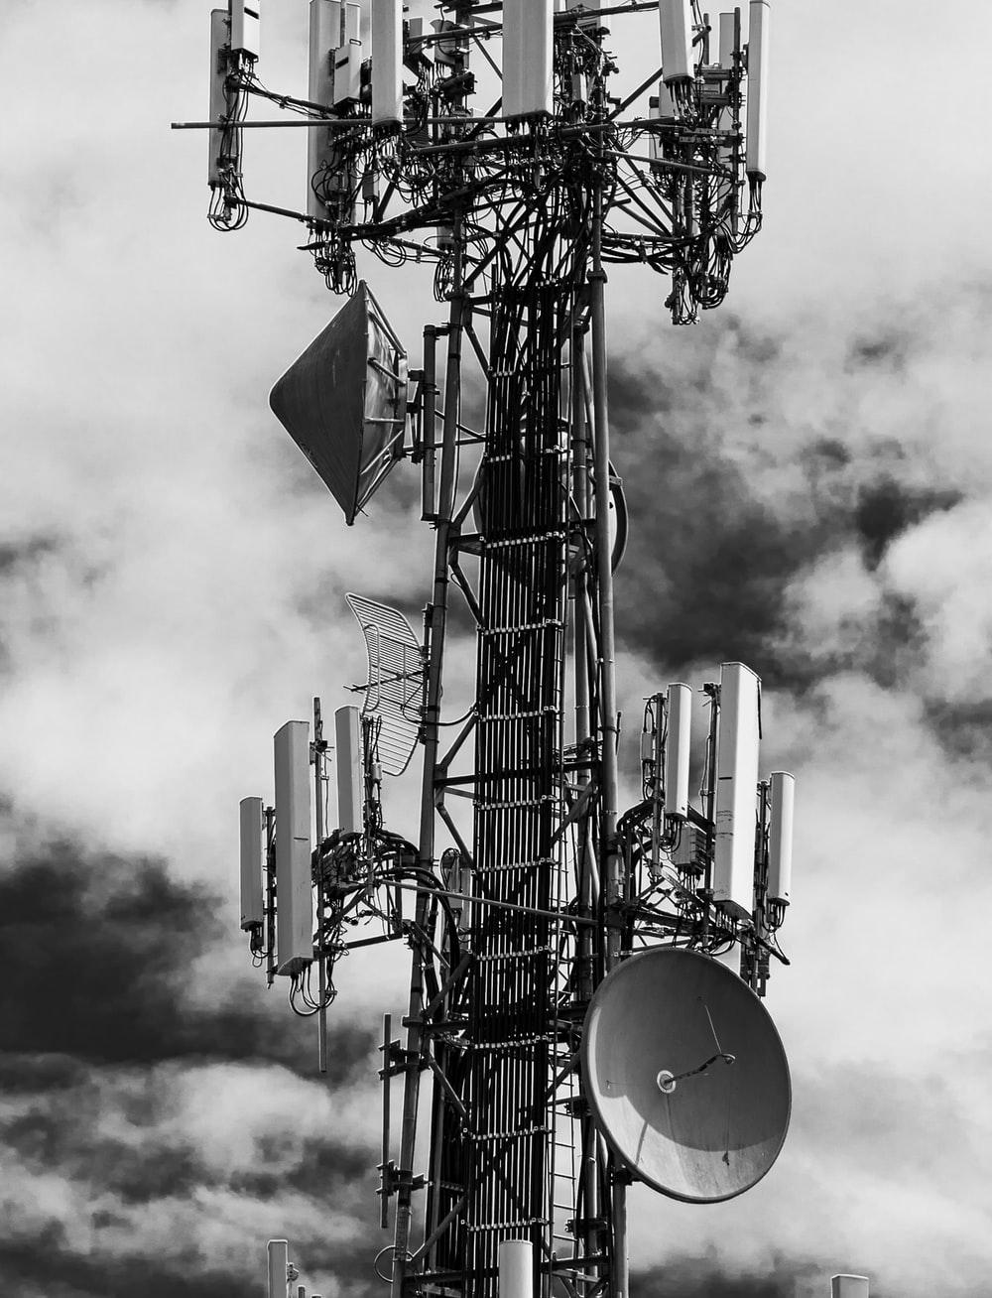
VOCABULARY
technical (adj)
/ˈteknɪkl/
connected with the practical use of machines, methods, etc. in science and industry

Slide 13
PRE-LISTENING
1
Work in pairs. Look at the picture and tell your partner what this woman’s job is.
She’s a cosmonaut.

Slide 14
LESSON 5
LISTENING
WARM-UP
Video: A history of women in space
Task 1: Look at the picture and tell your partner what this woman's job is.
PRE-LISTENING
Task 2: Listen and choose the best answer.
Task 3: Listen and give short answers.
WHILE-LISTENING

Slide 15
WHILE-LISTENING
2
Listen to a talk about Valentina Tereshkova. Choose the best answer to complete each sentence.
1. Valentina Tereshkova joined a local flying club and became a talented parachutist while she was ________________________.
2. Tereshkova and _______ other women were chosen for the Soviet space programme.
3. Tereshkova joined the Soviet Air Force and became _________________ after completing her training and passing an examination.
4. She travelled into space in Vostok 6 and successfully returned to earth on ______________.
5. After the flight, Tereshkova received many awards, and __________________________.
A. working as a factory worker
B. four
A. an Air Force officer
B. 19 June, 1963
B. completed her university degree

Slide 16
WHILE-LISTENING
3
Listen again and give short answers to the following questions.
1. When was Tereshkova born?
1937
2. How old was she when she started working?
16
3. When did she join the Soviet space programme?
1962
4. At what age did she travel into space?
26
5. How many days did she spend in space?
Three days/ 3 days

Slide 17
LESSON 5
LISTENING
WARM-UP
Video: A history of women in space
Task 1: Look at the picture and tell your partner what this woman's job is.
PRE-LISTENING
Task 2: Listen and choose the best answer.
Task 3: Listen and give short answers.
WHILE-LISTENING
POST-LISTENING
Task 4: Discussion

Slide 18
POST-LISTENING
4
Work in groups. Discuss the following questions.
Do you want to be a cosmonaut? Why or why not?

Slide 19
LESSON 5
LISTENING
WARM-UP
Video: A history of women in space
Task 1: Look at the picture and tell your partner what this woman's job is.
PRE-LISTENING
Task 2: Listen and choose the best answer.
Task 3: Listen and give short answers.
WHILE-LISTENING
POST-LISTENING
Task 4: Discussion
CONSOLIDATION
Wrap-up
Homework

Slide 20
CONSOLIDATION
1
Wrap-up
Lexical items about women in space
Listening for specific information

Slide 21
CONSOLIDATION
2
Homework
Do exercises in the workbook.
Prepare for the Project.

Slide 22
Website: sachmem.vn
Fanpage: facebook.com/sachmem.vn/

