Slide 2
Unit
4
1
Unit
FAMILY LIFE
FOR A BETTER COMMUNITY
LESSON 1
GETTING STARTED
Volunteering in the community

Slide 3
WARM-UP
watch a video
list activities they have done

Slide 4
WARM-UP
Clip watching

Slide 5
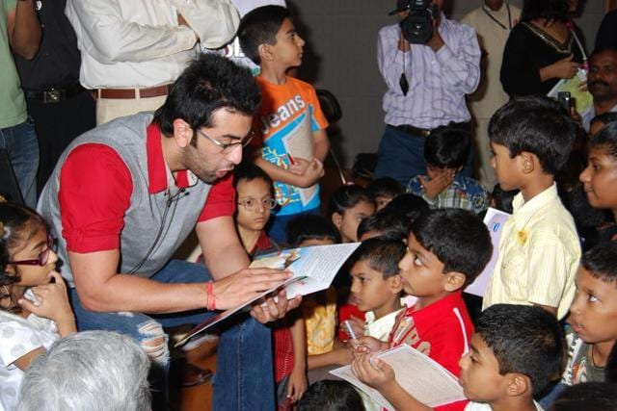
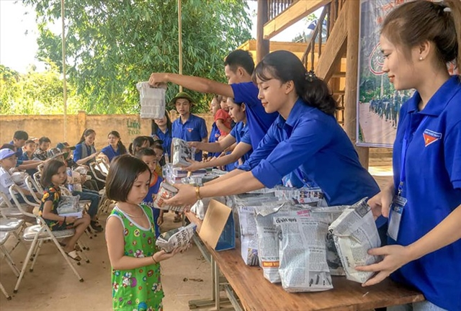
WARM-UP
Clip watching
+ Read books for children in orphanages
+ Visit and play games with them or listen to their problems
+ Work in home of sick and old people
+ Volunteer to work in remote or mountainous areas

Slide 6
PRESENTATION
volunteering activities | hoạt động tình nguyện
boost confidence | tăng cường sự tự tin
by chance | tình cờ
get involved | tham gia vào
excited about | háo hức về
community service development | dịch vụ cộng đồng/phát triển cộng đồng
find sth + adj | thấy cái gì đó ….
benefit (v) (n) | (v) mang lại lợi ích / (n) lợi ích
endless opportunities | cơ hội vô tận
application | đơn xin

Slide 7
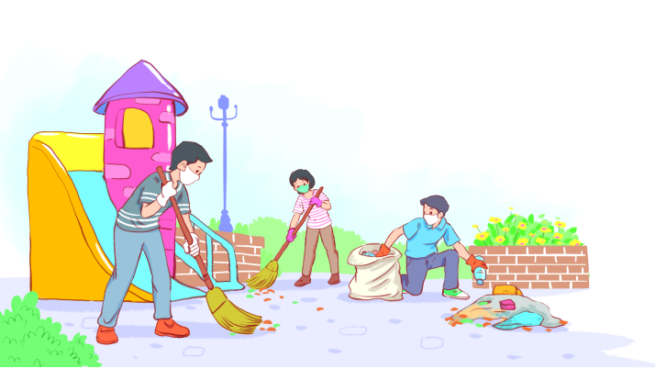
PRACTICE
1
Listen and read.
Volunteering in the community

Slide 8
PRACTICE
1
Listen and read.
Volunteering in the community
Kim: Hi, Tam. I went to your house at 9 a.m., but you weren’t there.
Tam: Oh, when you came, I was working as a volunteer at our local centre for community development.
Kim: Ah, I see. How did you become a volunteer there?
Tam: Just by chance. Last summer, while I was visiting the centre, I saw an advertisement for volunteers. I applied and my application was successful.
Kim: I also want to be a volunteer. I find community work very interesting.
Tam: I agree. Community service not only benefits the local area, but can also boost our confidence and help us learn many useful skills.

Slide 9
PRACTICE
PRACTICE
1
Listen and read.
Volunteering in the community
Kim: What are the regular activities organised by the centre?
Tam: Oh, there are endless opportunities for getting involved. For example, you can join a local environmental group to clean up the park once a week or volunteer at an orphanage.
Kim: Sounds good. How can I apply?
Tam: I’ll email you the form. You just fill it in and send it in.
Kim: Thanks so much. I’m so excited about volunteering at the centre.
Tam: No problem. Good luck. Hope your application is successful and you enjoy the work.

Slide 10
PRACTICE
PRACTICE
2
Read the conversation again and answer the questions.
1. What was Tam doing when Kim went to her house?
She was working as a volunteer at the local centre for community development.
2. What are some regular activities at the centre for community development?
Cleaning up the park or volunteering at the orphanage.
3. How can Kim apply for volunteer work at the centre?
She needs to fill in the form, then send it in.

Slide 11
PRACTICE
3
Find the adjectives with the following suffixes in the conversation and write them below.
suffixes | adjectives
-ed
-ing
-ful
-less
excited
interesting
useful, successful
endless

Slide 12
PRACTICE
4
Find a verb phrase in the conversation to complete each sentence.
1. Oh, when you came, I____________ as a volunteer at our local centre for community development.
2. Last summer, while I was visiting the centre, I_____ an advertisement for volunteers.
was working
saw

Slide 13
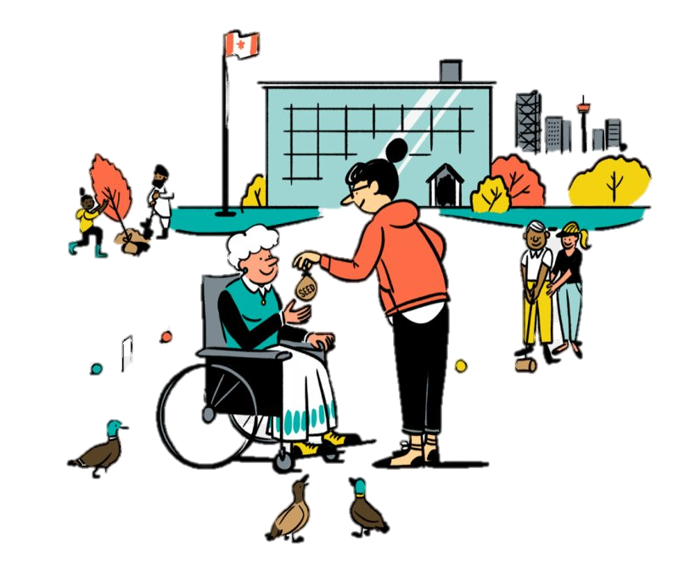
PRODUCTION
SELF-REFLECTION
- Talk about activities you are going to do to make your community a better one for a minute
- Your talk should include:
+ How many activities are you going to talk about?
+ Where do you do those activities?
+ Who do you do with?
+ How often do you do those activities?

Slide 14
CONSOLIDATION
1
Wrap-up
Gain an overview about the topic For a better community
Gain vocabulary to talk about voluntary work

Slide 15
CONSOLIDATION
2
Homework
1. Do exercises in the workbook
2. Prepare for the next lesson
3. Prepare for the Project

Slide 16
Website: sachmem.vn
Fanpage: facebook.com/sachmem.vn/

