Slide 2
Unit
3
1
Unit
FAMILY LIFE
MUSIC
LESSON 4
SPEAKING
Talking about a TV music show

Slide 3
WARM-UP
Video watching
Watch the video and write down the names of the music shows.

Slide 4
WARM-UP
Video watching
America’s Got Talent
Pop Idol
Vietnam’s Got Talent
Perfect Edition (Cover Star)
X Factor

Slide 5
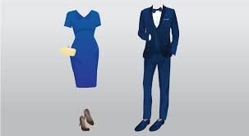
PRESENTATION
dress up (ph.v)
/dres ʌp/
wear clothes that are more formal than those you usually wear
ăn mặc lịch sự

Slide 6
PRESENTATION
runner-up (n)
/ˌrʌnər ˈʌp/
a person or team that finishes second in a race or competition
người đạt giải nhì, á quân

Slide 7
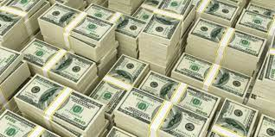
PRESENTATION
cash (n)
/kæʃ/
money in the form of coins or notes
tiền mặt

Slide 8
PRESENTATION
come up with (ph.v)
/kʌm ʌp wɪð/
suggest or think of an idea or plan
nảy ra ý tưởng

Slide 9
PRESENTATION
Form | Pronunciation | Meaning
dress up (ph.v) | /dres ʌp/ | ăn mặc trang trọng (ph.v)
runner-up (n) | /ˌrʌnər ˈʌp/ | người đứng thứ hai (n)
cash (n) | /kæʃ/ | tiền mặt (n)
come up with (ph.v) | /kʌm ʌp wɪð/ | đưa ra (ý kiến, ý tưởng) (ph.v)

Slide 10
PRESENTATION
1
Read about a TV music show and complete the notes below.
Name: I know your face
People who give their scores: _________________________
Number of participants: ________
What participants have to do: ________________________________
How participants win the show: _____________________
6. Prize(s): ________
two main judges and a guest artist
six
dress up and perform as famous international
or local artists in a live show every week
- 3 participants with the highest scores after
5 weeks go to the final night.
- TV audiences vote and decide on the winner
and two runners-up.
cash

Slide 11
PRESENTATION
Extension: Brainstorm some popular TV shows or competitions.
TV shows or competitions
The Voice Kids

Slide 12
1

Slide 13
FREE PRACTICE
PRACTICE
3
Present your show to the whole class. Vote for the best show.
Useful expressions:
We came up with an idea about a TV music show which is …
In our show, … will give them scores
There will be …
In the show, the participants have to …
To win the show, The participants …
The winner will receive …

Slide 14
CONSOLIDATION
1
Wrap-up
Talk about music shows

Slide 15
CONSOLIDATION
2
Homework
Do exercises in the workbook
Search the Internet for some information about music festivals

Slide 16
Website: sachmem.vn
Fanpage: facebook.com/sachmem.vn/

