Slide 1
Unit 1: Family Life
Lesson 8:
Looking Back And Project

Slide 2
Unit
1
1
FAMILY LIFE
Family Life
Unit
OBJECTIVES
1. Knowledge
- review pronouncing the consonant blends /br/, /kr/, /tr/
- review the vocabulary and grammar of Unit 1
- do research on Family Day in Viet Nam or other countries in the world and give a group presentation about it.
2. Core competence
- develop communication skills and creativity;
- develop presentation skills;
- develop critical thinking skills;
- be collaborative and supportive in pair work and team work;
- actively join in class activities.
3. Personal qualities
- be more creative when doing the project;
- develop self-study skills.
- - -

Slide 3
TABLE OF CONTENTS
01
02
03
04
Warm-up
Looking Back
Project
Consolidation

Slide 4
01
Warm-up
List topical words

Slide 5
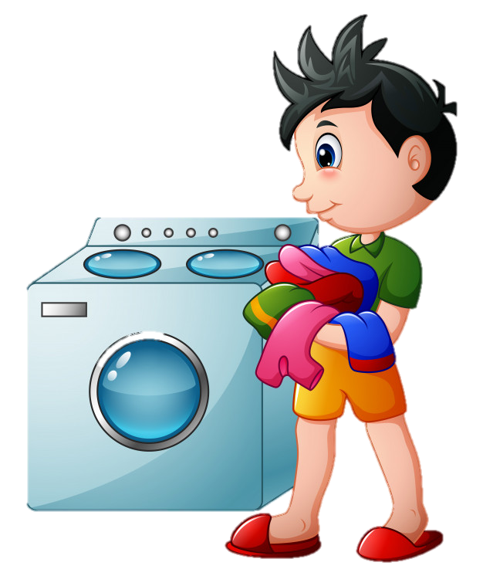
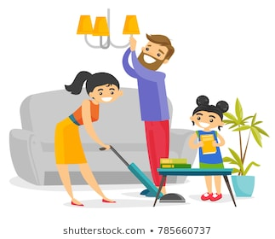
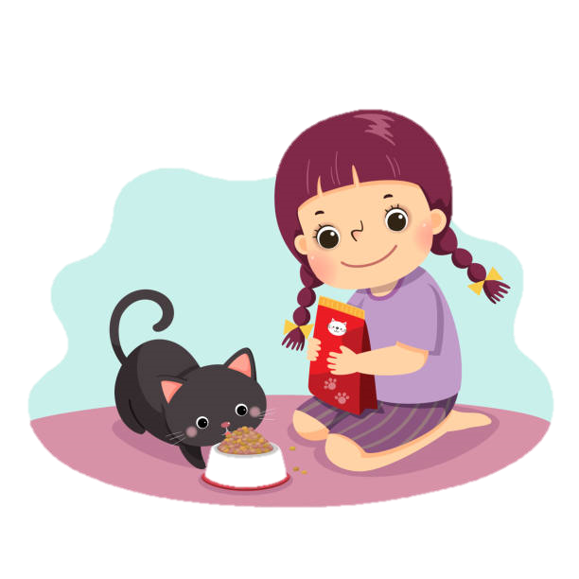
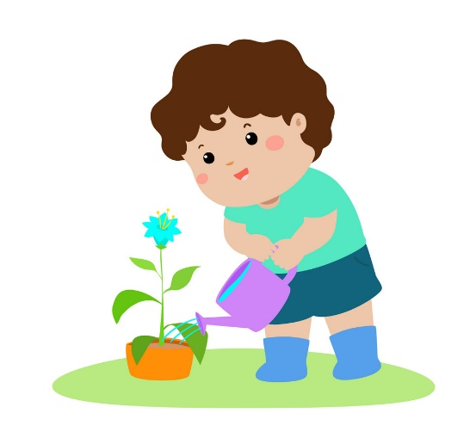
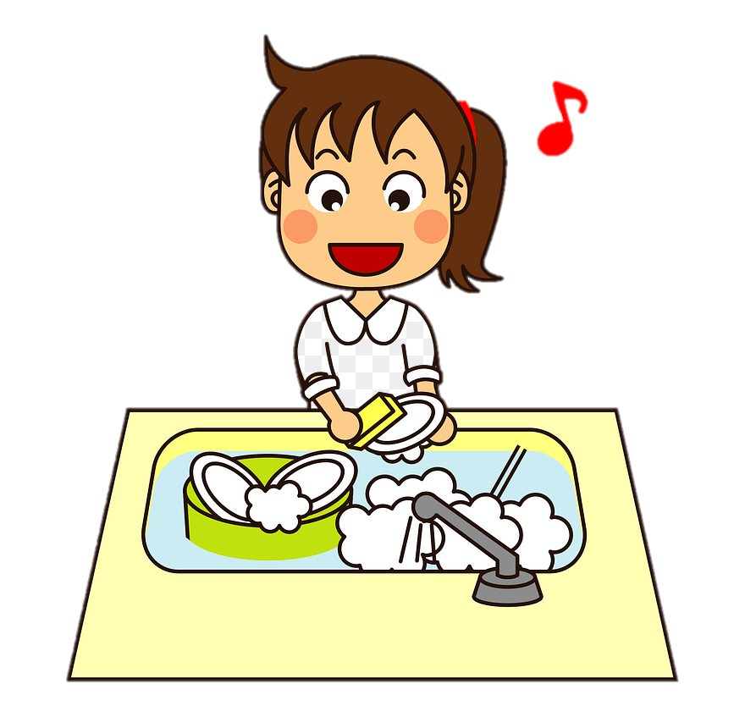
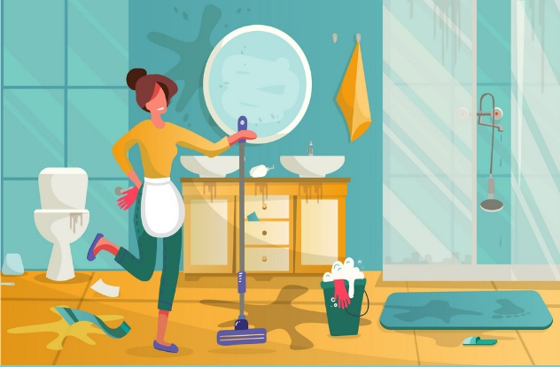
WARM-UP
WRITE DOWN AS MANY WORDS RELATED TO THE TOPIC
‘HOUSEHOLD CHORES’ AS YOU CAN

Slide 6
02
Looking Back

Slide 7
LOOKING BACK
1
PRONUNCIATION
Listen and write /br/, /kr/ or /tr/.
/kr/
/br/
/br/
1. I like ice cream, but my brother likes bread pudding.
2. Tracy crashed her car into a tree and broke her leg.
3. They often have crab soup for breakfast.
/tr/
/kr/
/tr/
/br/
/kr/
/br/

Slide 9
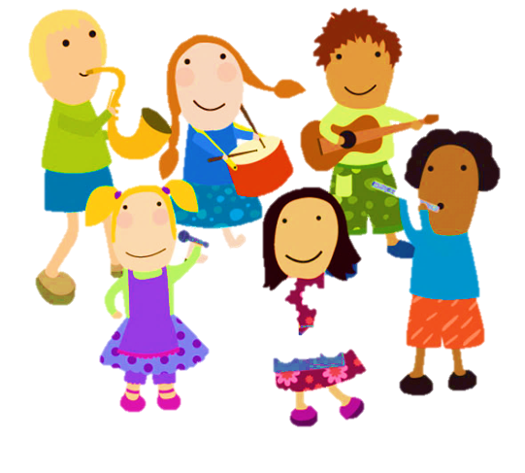

Slide 10
does the cooking
In Thanh’s family, everybody shares the housework. His mother (1) _______________.
does the cooking
does the heavy lifting
laundry
cleaning the house

Slide 11
Thanh really enjoys the food she cooks. Thanh’s father is a strong man, so he (2) __________________.
does the heavy lifting
does the cooking
laundry
does the heavy lifting
does the washing-up

Slide 12
laundry
Thanh helps with the (3) ________. He feels proud that he knows how to run a washing machine.
cleaning the house
does the washing-up
does the cooking
laundry

Slide 13
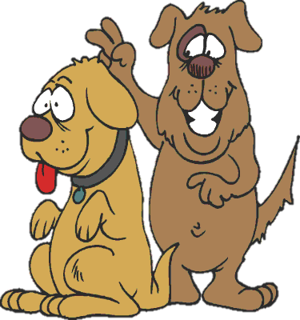
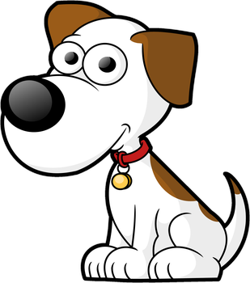
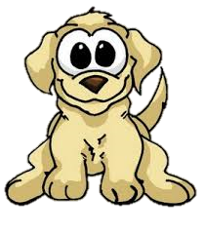
Thanh’s sister helps with (4) _________________. She does it regularly, so their house is never dirty.
cleaning the house
does the heavy lifting
does the cooking
cleaning the house
clean

Slide 14
She also (5) __________________ after each meal.
does the washing-up
clean
does the washing-up
does the cooking
laundry

Slide 15
LOOKING BACK
3
GRAMMAR
There is a mistake in each sentence below. Find the mistake and correct it.
1. I’m writing to you to tell you how much I’m wanting to see you.
2. Jack is away on business, so now I look after his dog.
3. Nam’s often looking untidy.
4. She can’t answer the phone now. She cooks dinner.
5. Excuse me, do you read the newspaper? Could I borrow it?
6. What are your family doing in the evenings?
→ want
→ ’m / am looking
→ (often) looks
→ ’s / is cooking
→ are you reading
→ do / does ... do

Slide 16
03
Project

Slide 17
PROJECT

Slide 18
04
Consolidation

Slide 19
CONSOLIDATION
1
Wrap-up
Revise the consonant blends /br/, /kr/, and /tr/.
Revise words/ phrases related to the topic Household chores.
Revise Present simple and Present continuous.
2
Homework
Exercises in the workbook
prepare for Unit 2 lesson 1

Slide 20
SEE YOU NEXT TIME !!

