Slide 2
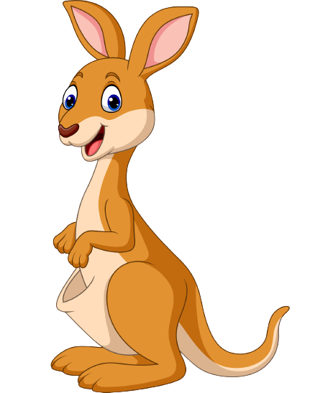
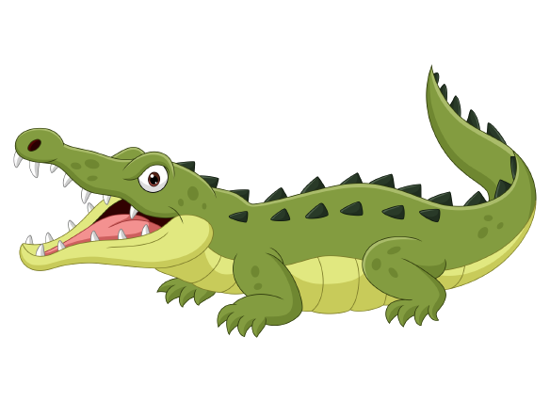
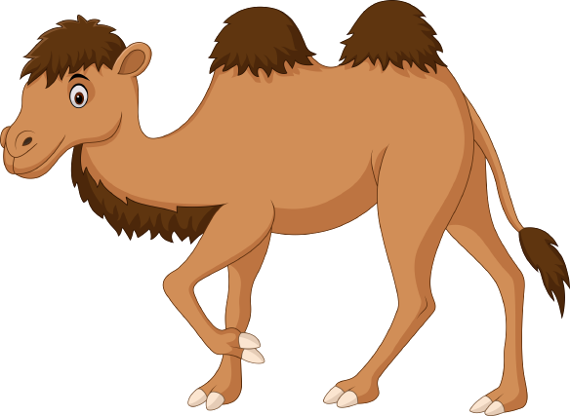
Unit 6
Funny monkeys!
Lesson 6 – Skill Times – Period 2

Slide 3
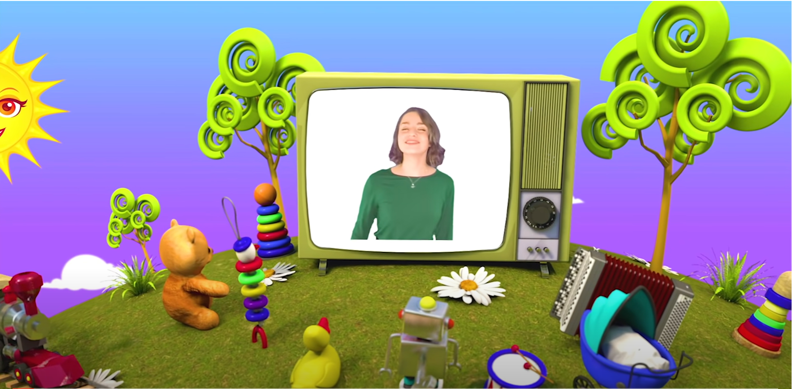
HELLO SONG
Notes:
https://www.youtube.com/watch?v=pqDEwPi7vxg

Slide 5
Game: HOT SEAT
Notes:
The children work in teams.
One member from each team comes to the front, looks at their team miming the action which is on the screen, but he/she cannot see it, then say the sentence/word aloud.
The winner is the one who can guess the correct action first.

Slide 6
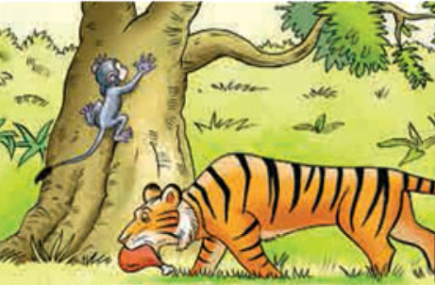
Game: HOT SEAT
Notes:
The children work in teams.
One member from each team comes to the front, looks at their team miming the action which is on the screen, but he/she cannot see it, then say the sentence/word aloud.
The winner is the one who can guess the correct action first.

Slide 7
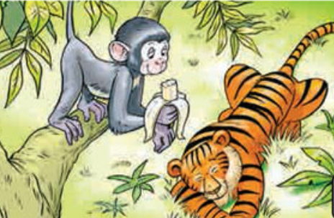
Game: HOT SEAT
Notes:
The children work in teams.
One member from each team comes to the front, looks at their team miming the action which is on the screen, but he/she cannot see it, then say the sentence/word aloud.
The winner is the one who can guess the correct action first.

Slide 8
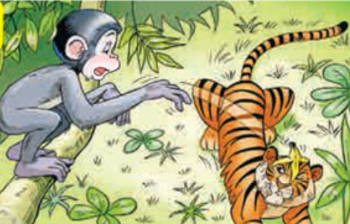
Game: HOT SEAT
Notes:
The children work in teams.
One member from each team comes to the front, looks at their team miming the action which is on the screen, but he/she cannot see it, then say the sentence/word aloud.
The winner is the one who can guess the correct action first.

Slide 9
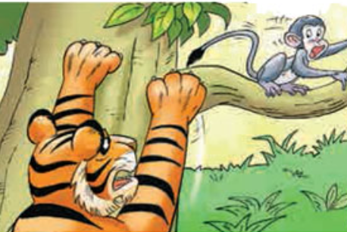
Game: HOT SEAT
Notes:
The children work in teams.
One member from each team comes to the front, looks at their team miming the action which is on the screen, but he/she cannot see it, then say the sentence/word aloud.
The winner is the one who can guess the correct action first.

Slide 10
Good job!

Slide 11
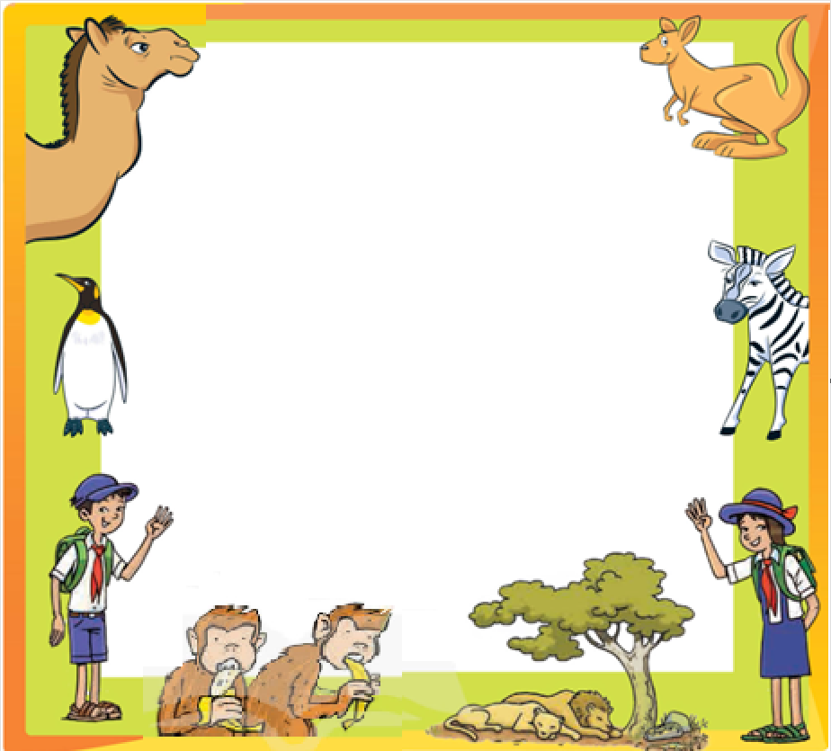
Look, Talk and then Write.
On Wednesday, there is a school trip to the _______ and there are lots of _______ .
zoo
animals

Slide 12
Look, Talk and then Write.
Bring your __________
and a ______________ .
lunchbox
drink

Slide 13
Look, Talk and then Write.
Wear
________ your sun hat.

Slide 14
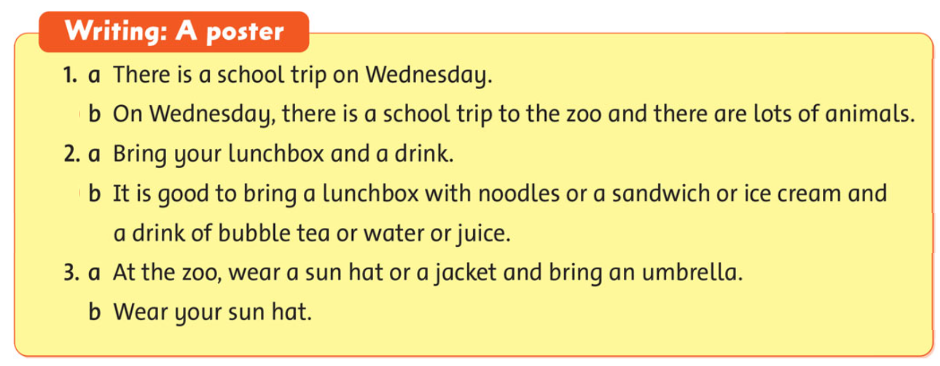
Choose the best sentence.
49
Notes:
* Choose the best sentences for a poster.
Show the box and read it with the class.

Slide 15
Choose the best sentence.
49
✓
1. a. There is a school trip on Wednesday.
b. On Wednesday, there is a school trip to the zoo
and there are lots of animals.
Notes:
Do the first item with the class:
ask one child to read the first option,
then ask another child to read the second option,
and ask the class which is the short, clear sentence.

Slide 16
Choose the best sentence.
49
✓
2. a. Bring your lunchbox and a drink.
b. It is good to bring a lunchbox with noodles or a sandwich or ice cream and a drink of bubble tea or water or juice.
Notes:
Do the first item with the class:
ask one child to read the first option,
then ask another child to read the second option,
and ask the class which is the short, clear sentence.

Slide 17
Choose the best sentence.
49
3. a. At the zoo, wear a sun hat or a jacket
and bring an umbrella.
b. Wear your sun hat.
✓
Notes:
Do the first item with the class:
ask one child to read the first option,
then ask another child to read the second option,
and ask the class which is the short, clear sentence.

Slide 18
Make a poster
about
your school trip.
Where is your school trip?
When is it?
What can you see?
What do you bring?
What do you wear to go?
Notes:
* Lead-in:
Show the pictures in Exercise 1.
Ask children questions about the pictures, e.g. What animals can you see? What is on the tiger’s head? Is the tiger angry? Is the monkey scared? Does the tiger climb the tree? What is the tiger doing?

Slide 19
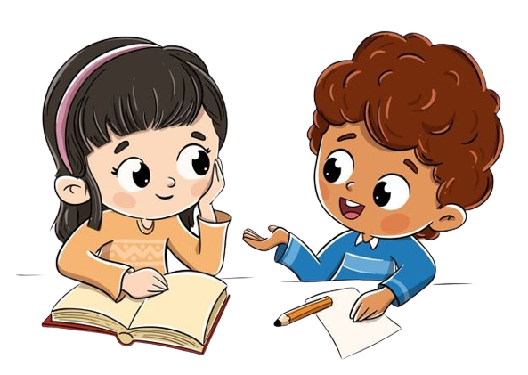
Work in Pairs.
Notes:
Ask two students to work in pairs to talk about their posters.

Slide 20
LIVE ON THE STAGE
Notes:
Invite some volunteers to talk about their school trip in the front.

Slide 21
Good job!

Slide 22
Homework
Do the exercises in Workbook page 49.
Prepare for the next lesson
(Unit 7 - Lesson 1).

Slide 23
Our Winners!
Peter
Eric
Julie
Notes:
Replace photos and names with your students’ information.

Slide 24
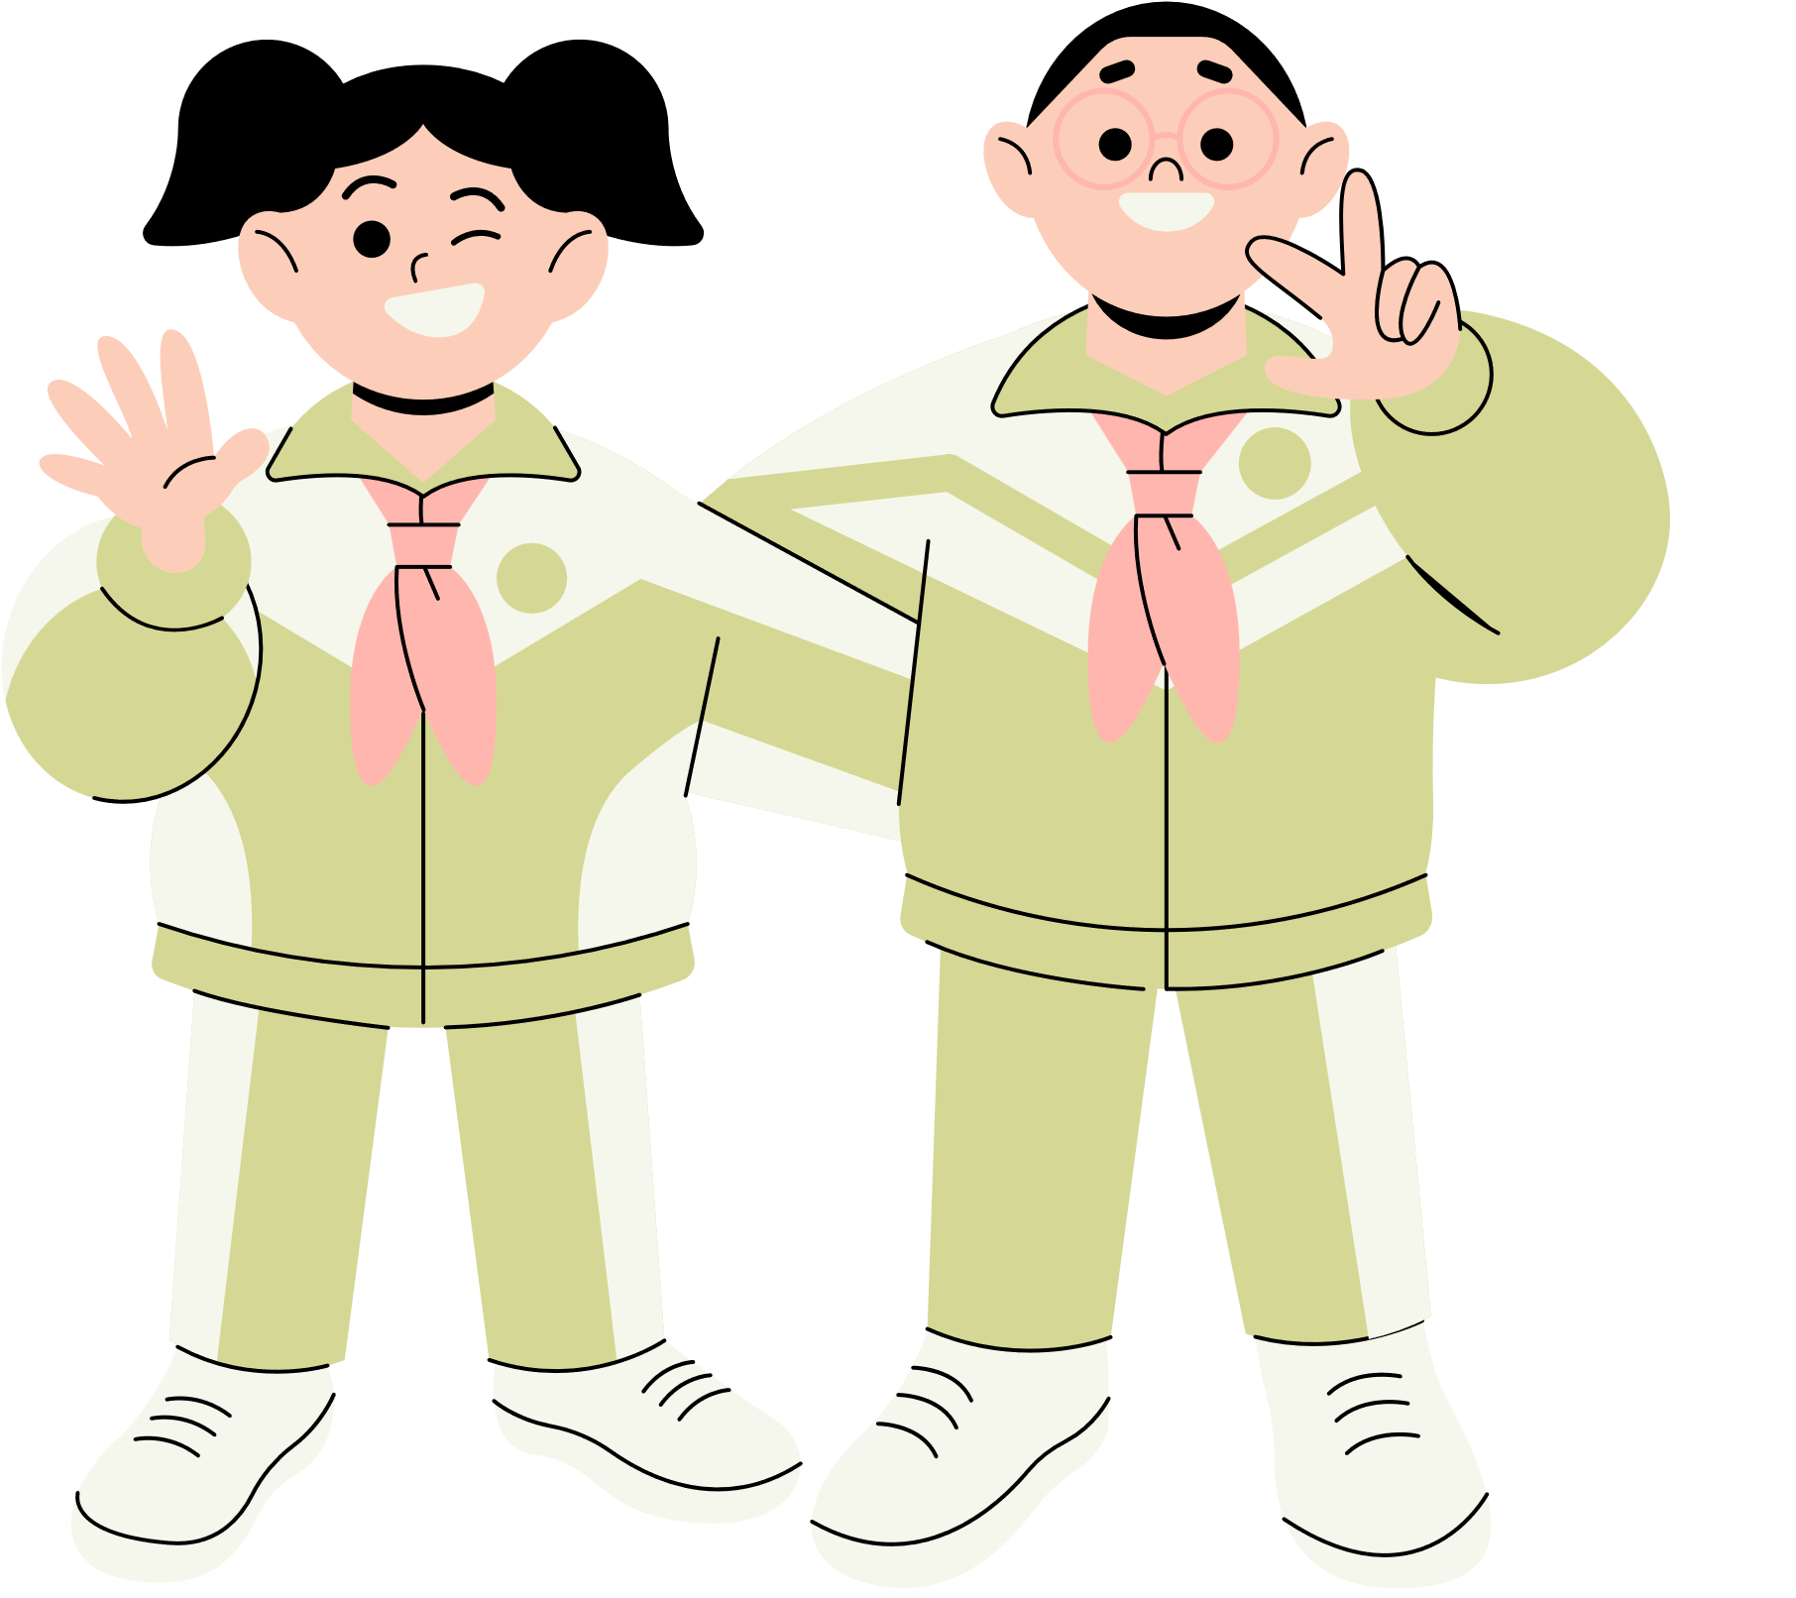
Thank You!
See You Next Time.
Notes:
https://www.youtube.com/watch?v=SRyFiVeNjWs

