Slide 2
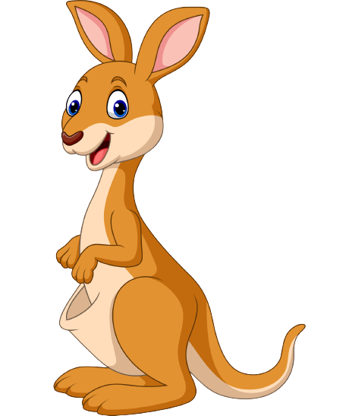
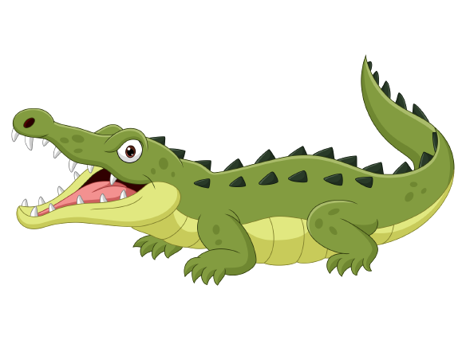
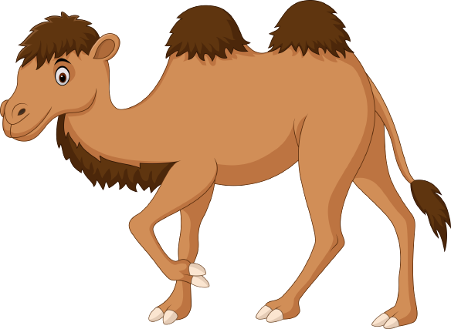
Unit 6
Funny monkeys!
Lesson 6 – Skill Times – Period 1

Slide 3
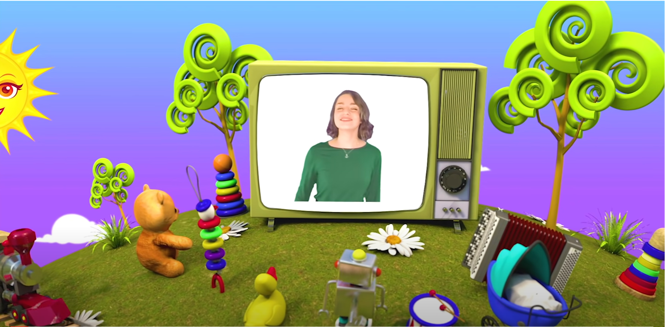
HELLO SONG
Notes:
https://www.youtube.com/watch?v=pqDEwPi7vxg

Slide 4
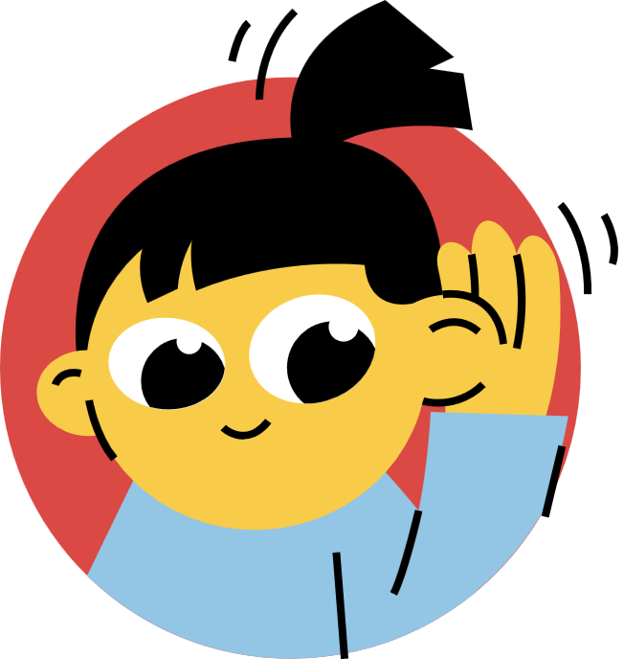
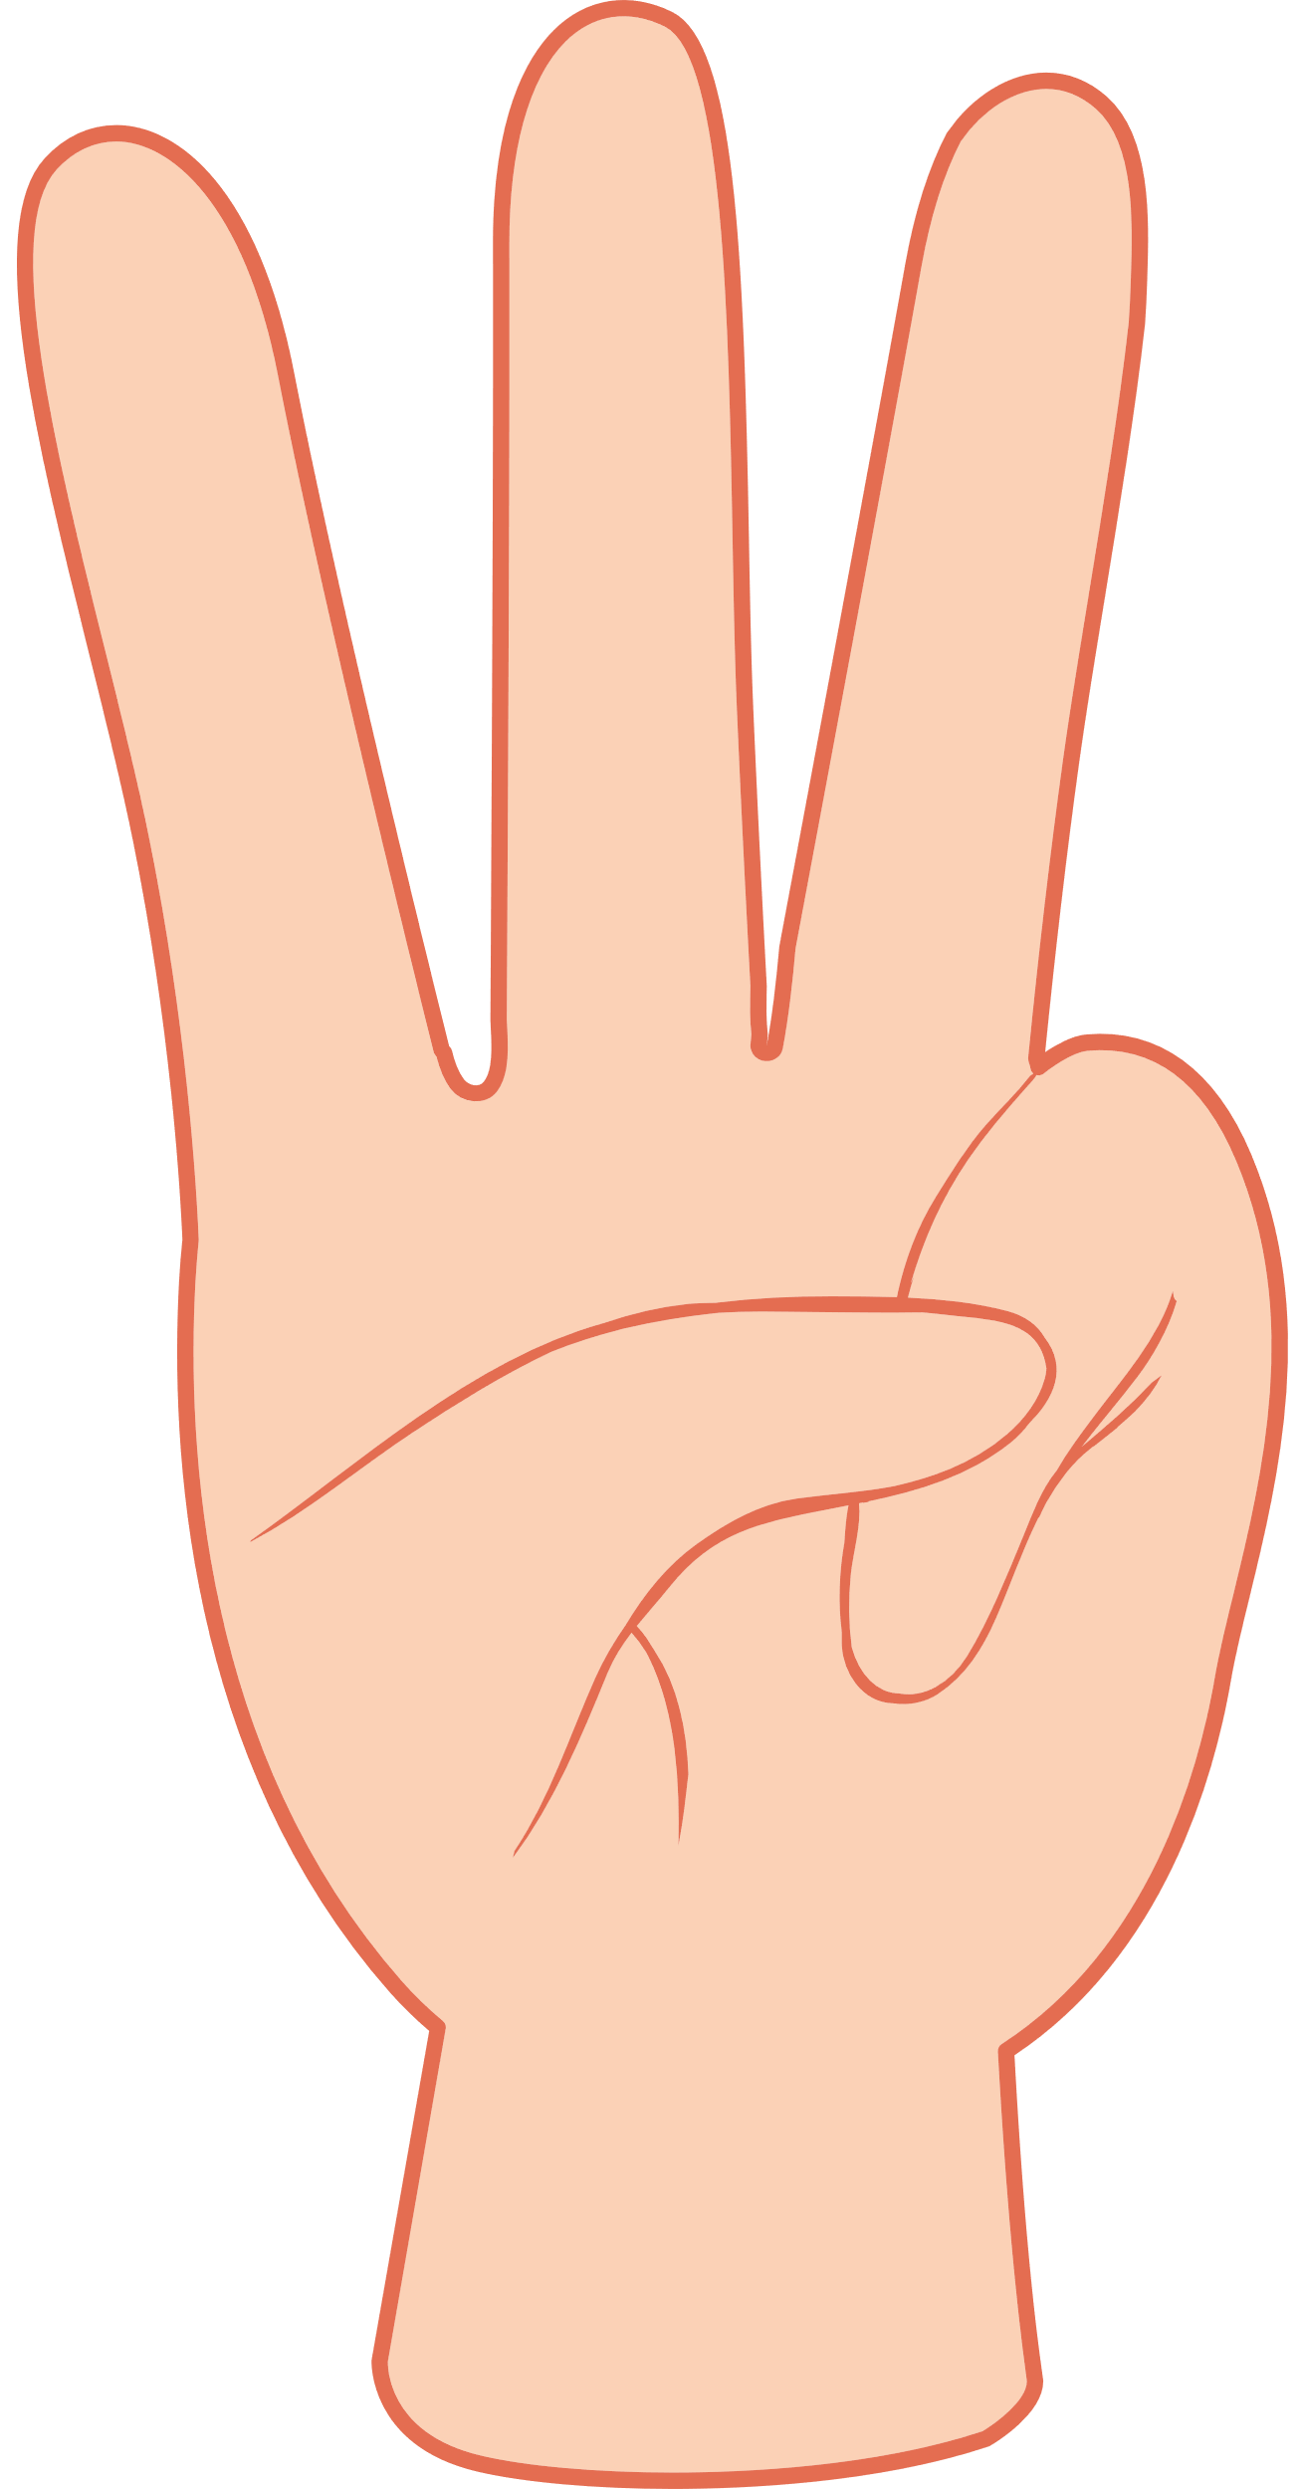

Slide 5
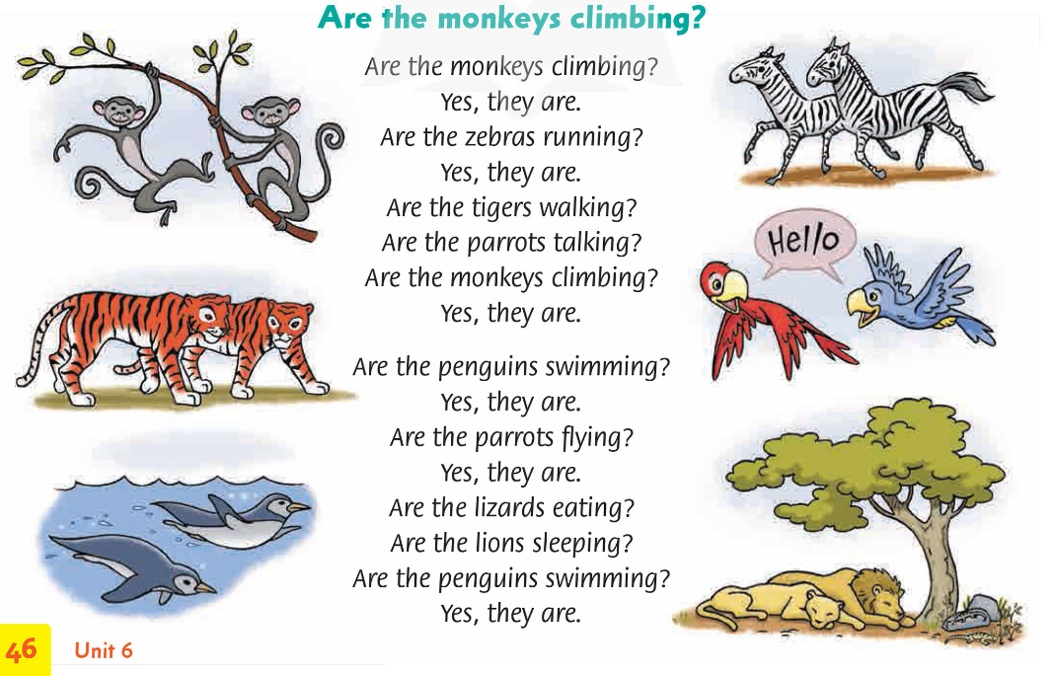
Sing and Do the actions.
Notes:
* Song: “Are the monkeys climbing?”
Ask the children to sing along with actions.
Song Actions
Are the monkeys climbing? – reach up with your hands.
Are the zebras running? – run on the spot.
Are the tigers walking? – move your arms as if walking on four legs.
Are the parrots talking? – make beaks with your fingers to show two birds talking.
Are the penguins swimming? – mime swimming.
Are the parrots flying? – flap your elbows as if flying.
Are the lions sleeping? – mime sleeping.

Slide 6
Good job!

Slide 7
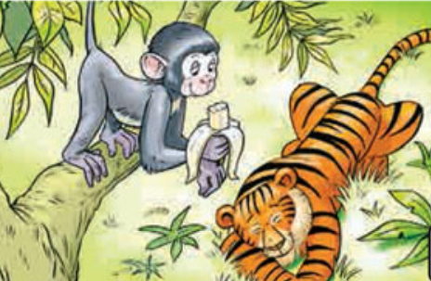
Look and Answer.
Notes:
* Lead-in:
Show the pictures in Exercise 1.
Ask children questions about the pictures, e.g. What animals can you see? What is on the tiger’s head? Is the tiger angry? Is the monkey scared? Does the tiger climb the tree? What is the tiger doing?

Slide 8
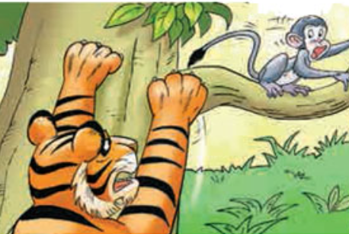
Look and Answer.
Notes:
* Lead-in:
Show the pictures in Exercise 1.
Ask children questions about the pictures, e.g. What animals can you see? What is on the tiger’s head? Is the tiger angry? Is the monkey scared? Does the tiger climb the tree? What is the tiger doing?

Slide 9
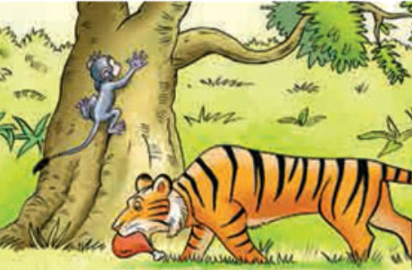
Look and Answer.
Notes:
* Lead-in:
Show the pictures in Exercise 1.
Ask children questions about the pictures, e.g. What animals can you see? What is on the tiger’s head? Is the tiger angry? Is the monkey scared? Does the tiger climb the tree? What is the tiger doing?

Slide 10
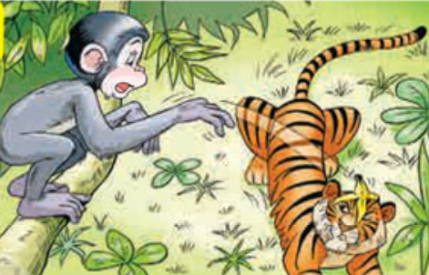
Look and Answer.
Notes:
* Lead-in:
Show the pictures in Exercise 1.
Ask children questions about the pictures, e.g. What animals can you see? What is on the tiger’s head? Is the tiger angry? Is the monkey scared? Does the tiger climb the tree? What is the tiger doing?

Slide 11
Listen and Point.
Notes:
Tell children they are going to hear a recording of a boy talking about the pictures. They have to put the pictures in the order they hear them mentioned.
Play Track 78 for children to point to the correct pictures in order.

Slide 12
Listen again and Write numbers.
49
Notes:
Play the recording again, pausing after each part for children to write the number in the box.
Answers c 1 a 2 d 3 4 b

Slide 13
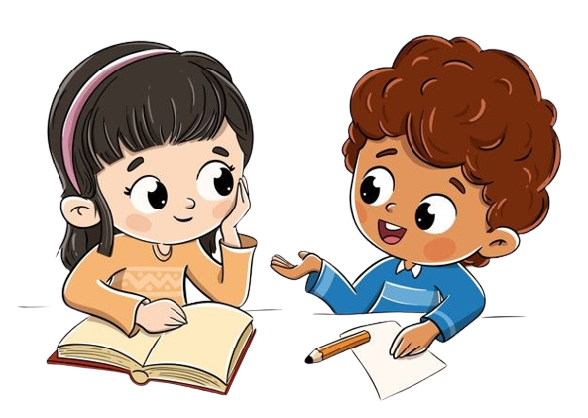
Work in Pairs.
Notes:
Ask two students to work in pairs to peer-check their answers.

Slide 14
Let’s see!
2
4
1
3
Notes:
Answers c 1 a 2 d 3 4 b

Slide 15
Look and Retell the story.

Slide 16
Good job!

Slide 17
Look, Ask and Answer.
_____ the monkey sleeping?
Is
No
____, it isn’t.
Notes:
Ask two children to read the speech bubbles for the class.
Tell children they are going to look at the pictures and ask and answer questions about the monkey and the tiger using the words from the box to help them.
Tell children to follow the order of the pictures.
In pairs, children take turns asking and answering questions (play music while doing the task)

Slide 18
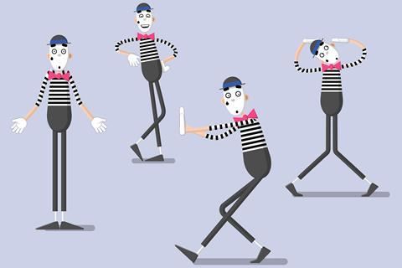
Game: MIMING
Notes:
Mime an activity for your friend to guess.
Read aloud the example speech bubbles.
In pairs, children take turns miming activities, and asking and answering questions.

Slide 19
Good job!

Slide 20
Homework
Do the exercises in Workbook page 49.
Prepare for the next lesson
(Unit 6 - Lesson 6/Part 2).

Slide 21
Our Winners!
Peter
Eric
Julie
Notes:
Replace photos and names with your students’ information.

Slide 22
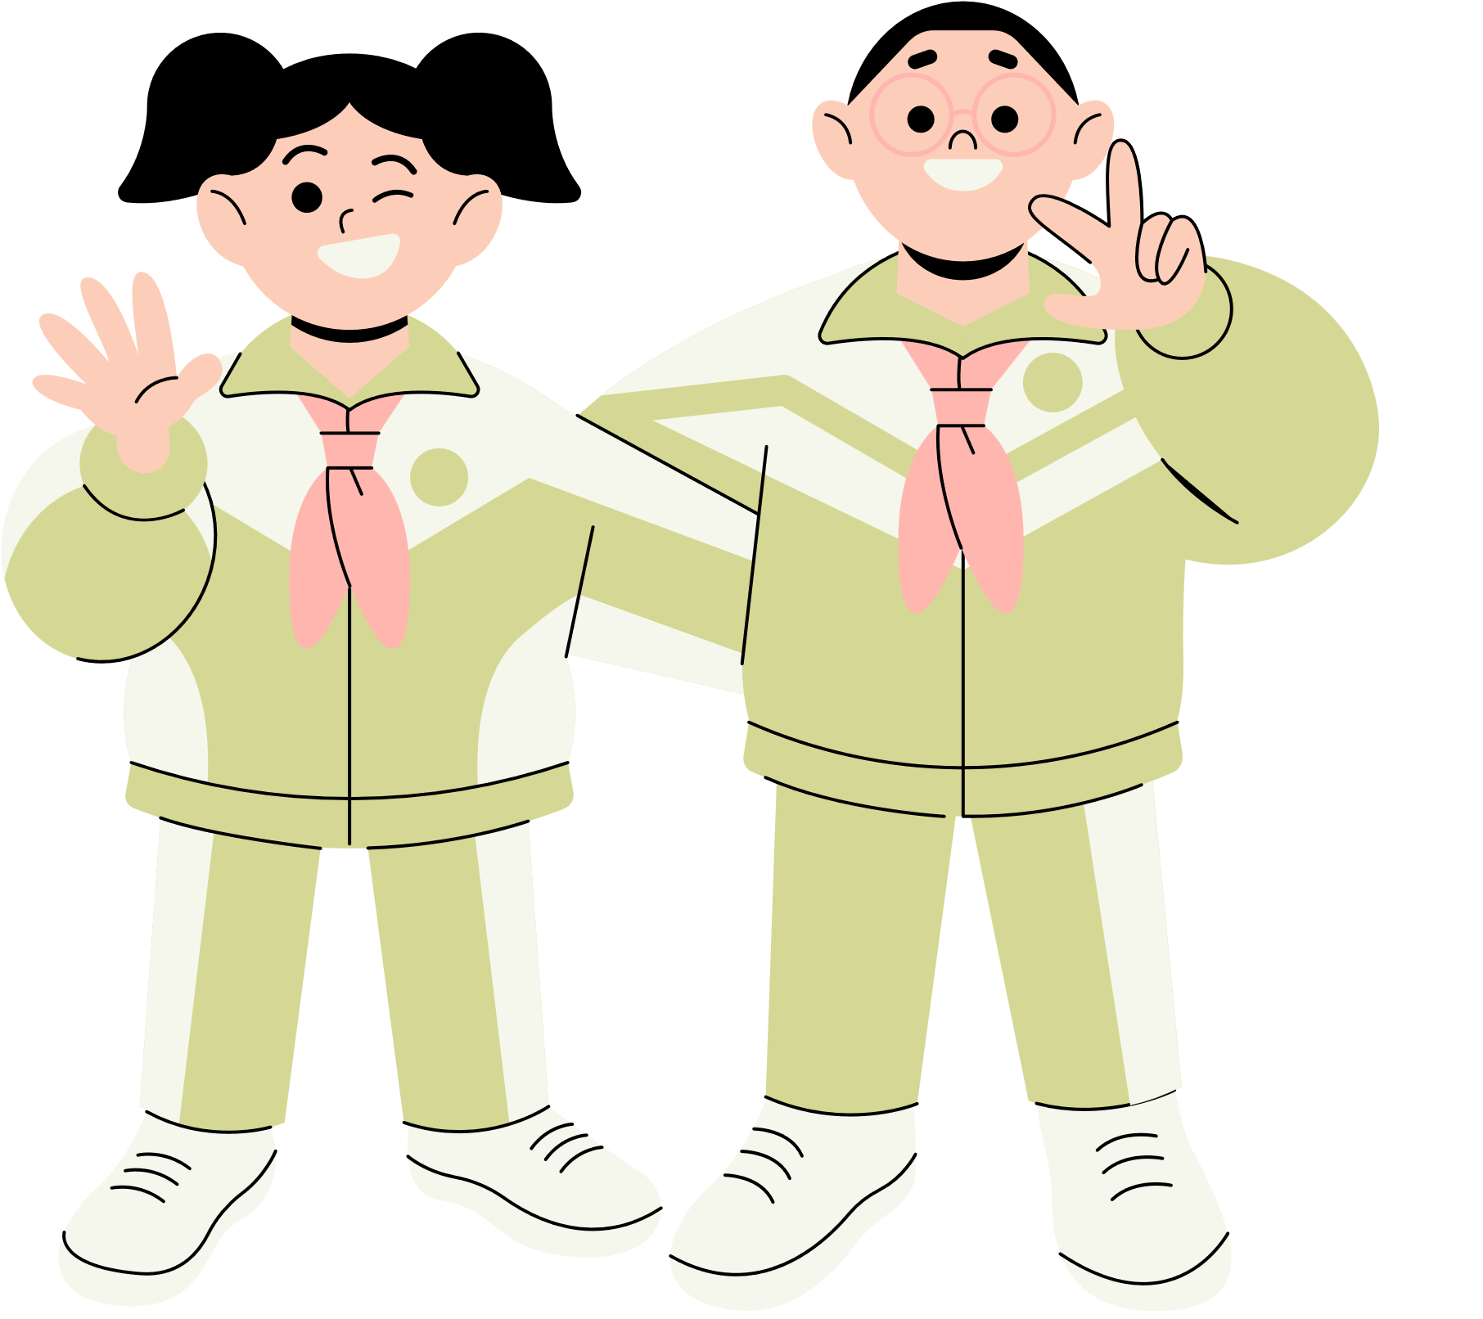
Thank You!
See You Next Time.
Notes:
https://www.youtube.com/watch?v=SRyFiVeNjWs

