Slide 2
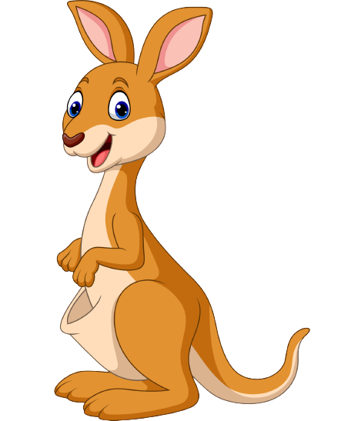
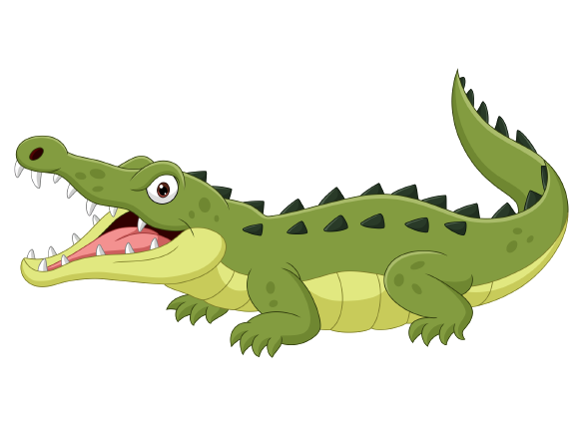
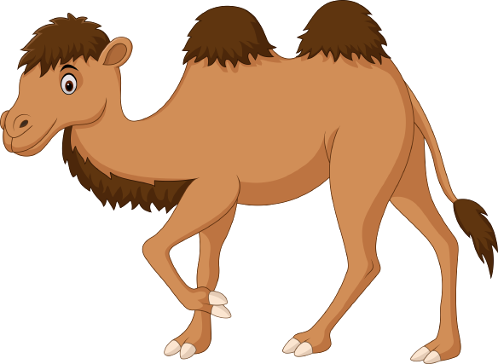
Unit 6
Funny monkeys!
Lesson 5 – Skill Times

Slide 3
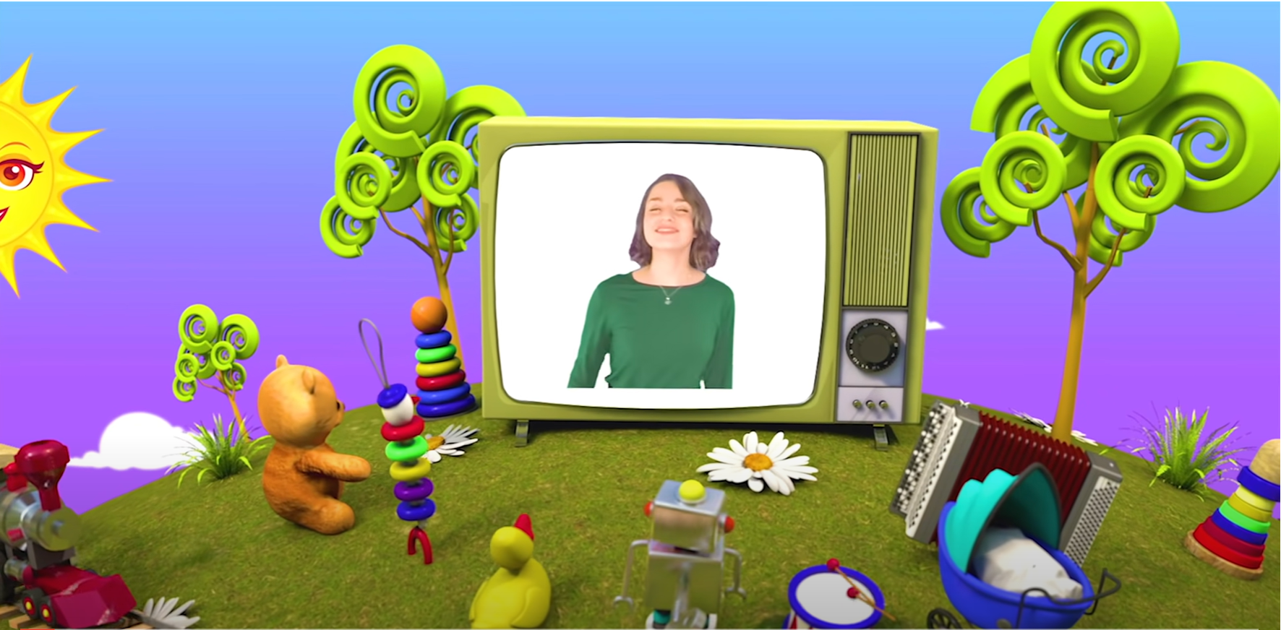
HELLO SONG
Notes:
https://www.youtube.com/watch?v=pqDEwPi7vxg

Slide 5
Game: SIMON SAYS
Notes:
Play Simon says with the verbs in Exercise 1 on page 46.
You can add other verbs.

Slide 6
Good job!
Notes:
Point and Say

Slide 7
Listen and Answer
Which animals can you hear?
Notes:
Tell the children they are going to listen to Are the monkeys climbing? song.
Ask children which animals they remember from the song.
Ask children to open their books to page 46 to check.
Play Track 73 and sing the song.

Slide 8
Look
and
Answer
Notes:
* Look at the picture. Where are the children? What animals do you see?
Ask children to look at the text and the picture. Ask children to say what animals they see, what they are doing, and what the place is.
Answers
They’re at the zoo.
camel, penguin, lizards, monkeys, lions, zebra, kangaroo

Slide 9
Listen and Point
48
Notes:
- Play Track 77. Children listen and follow the text.
- Check the answers to the questions from Exercise 1.

Slide 10
Listen and Repeat
lunchbox
Notes:
Check children’s understanding of lunchbox, a drink, sun hat and zookeeper, miming where possible.

Slide 11
Listen and Repeat
a drink
Notes:
Check children’s understanding of lunchbox, a drink, sun hat and zookeeper, miming where possible.

Slide 12
Listen and Repeat
sun hat
Notes:
Check children’s understanding of lunchbox, a drink, sun hat and zookeeper, miming where possible.

Slide 13
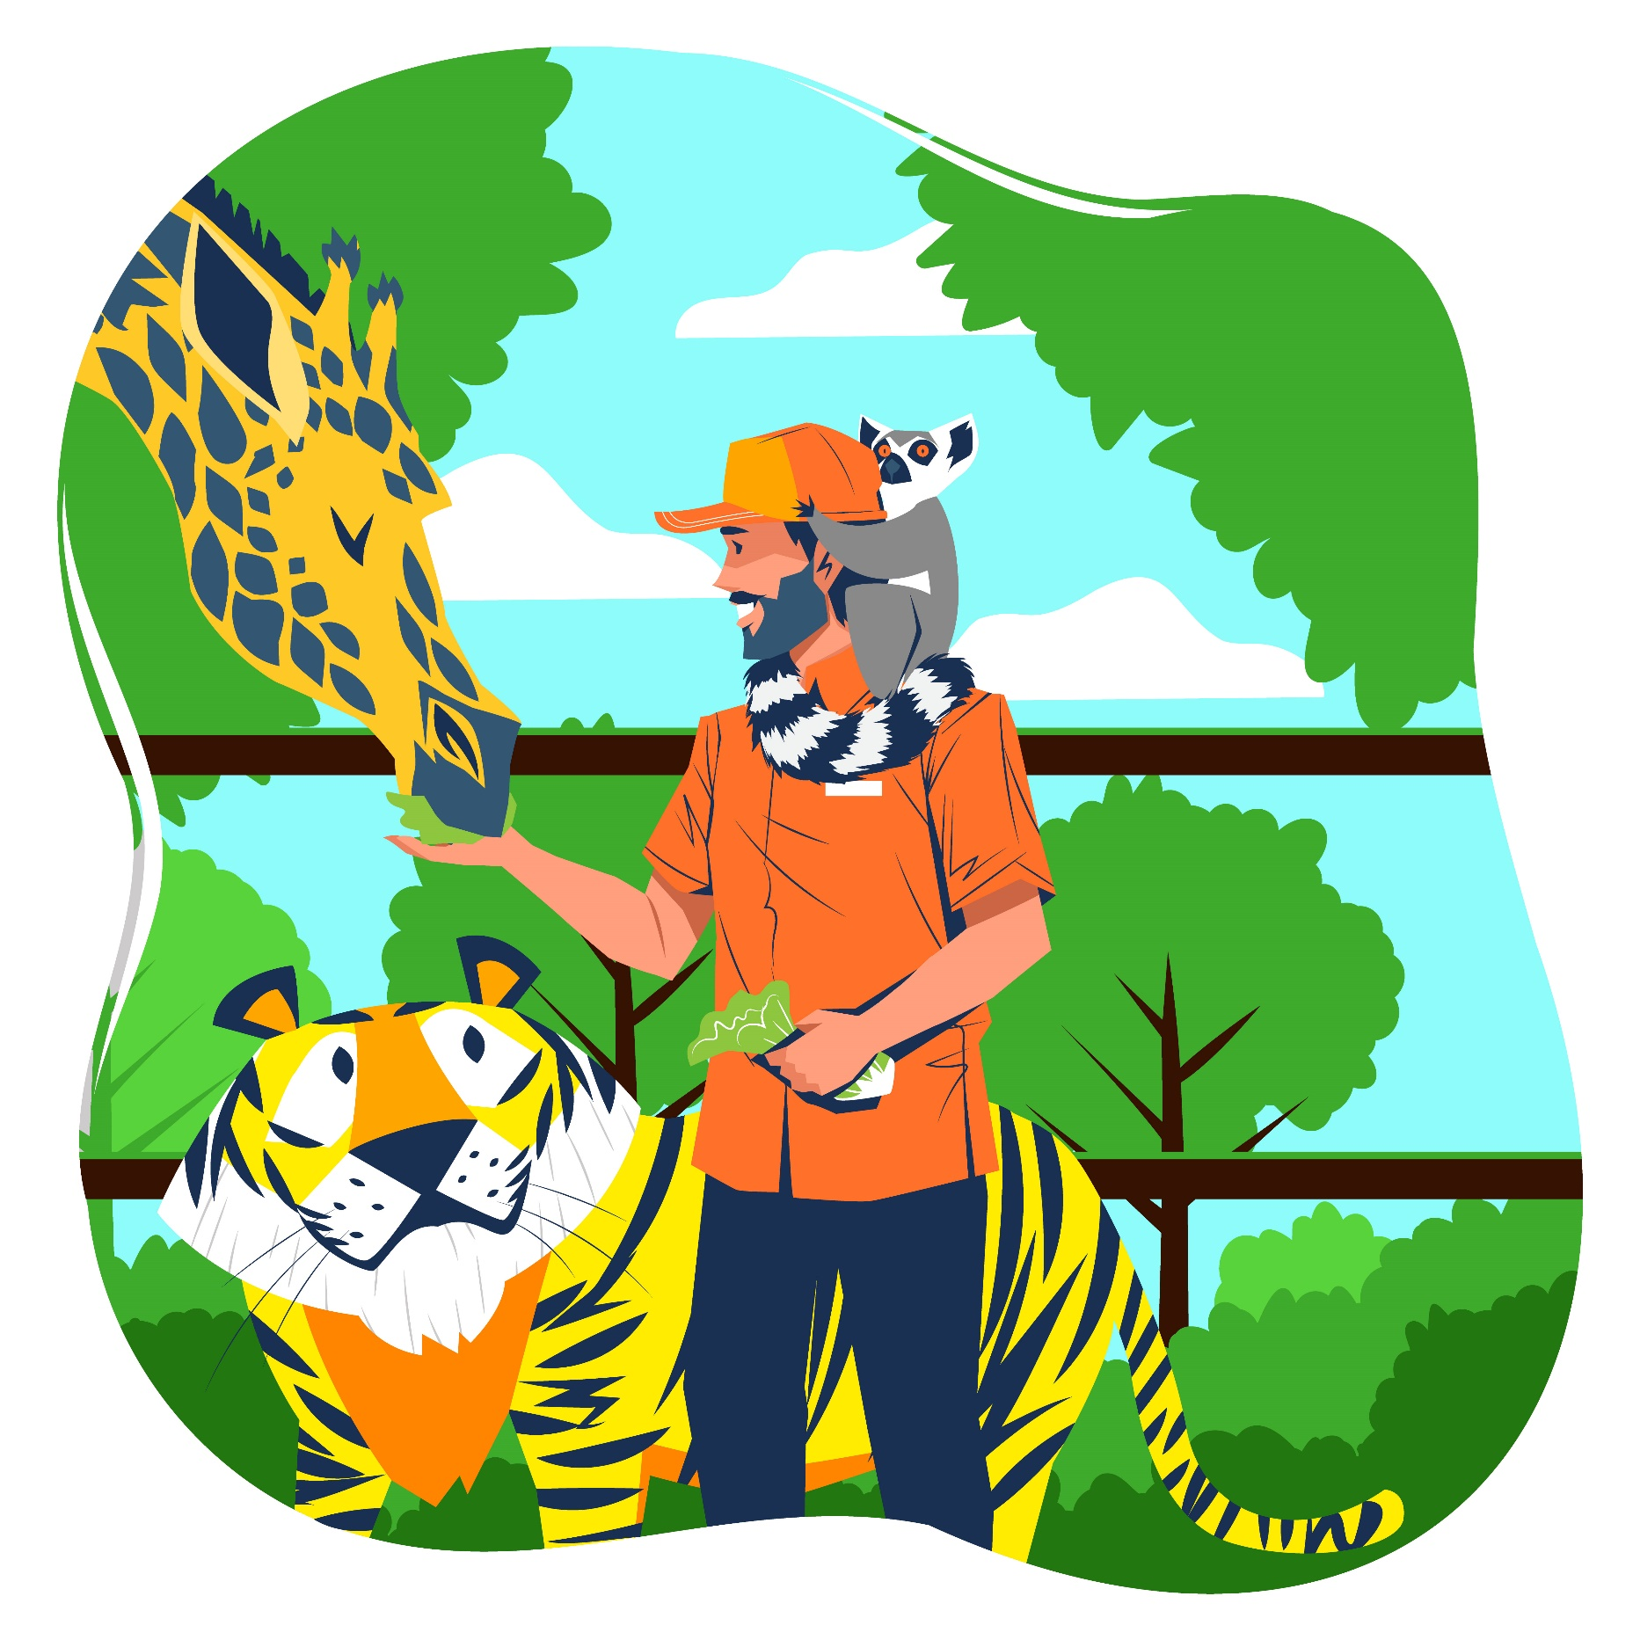
Listen and Repeat
zookeeper
Notes:
Check children’s understanding of lunchbox, a drink, sun hat and zookeeper, miming where possible.

Slide 14
Listen
and
Answer
Notes:
Play the recording a second time and ask children what happens if they touch the water when the crocodiles are swimming; what happens if they open their lunchbox near the monkeys; what happens if they talk near the lizards while the lizards are sleeping; and why they should listen to the zookeeper.

Slide 15
Read again and Write
Wednesday
1. The school trip is on ___________ .
Notes:
Explain that children are going to complete the sentences with words they will find in the text. Show an example.
Ask children to write 1 to 5 in their notebooks.

Slide 16
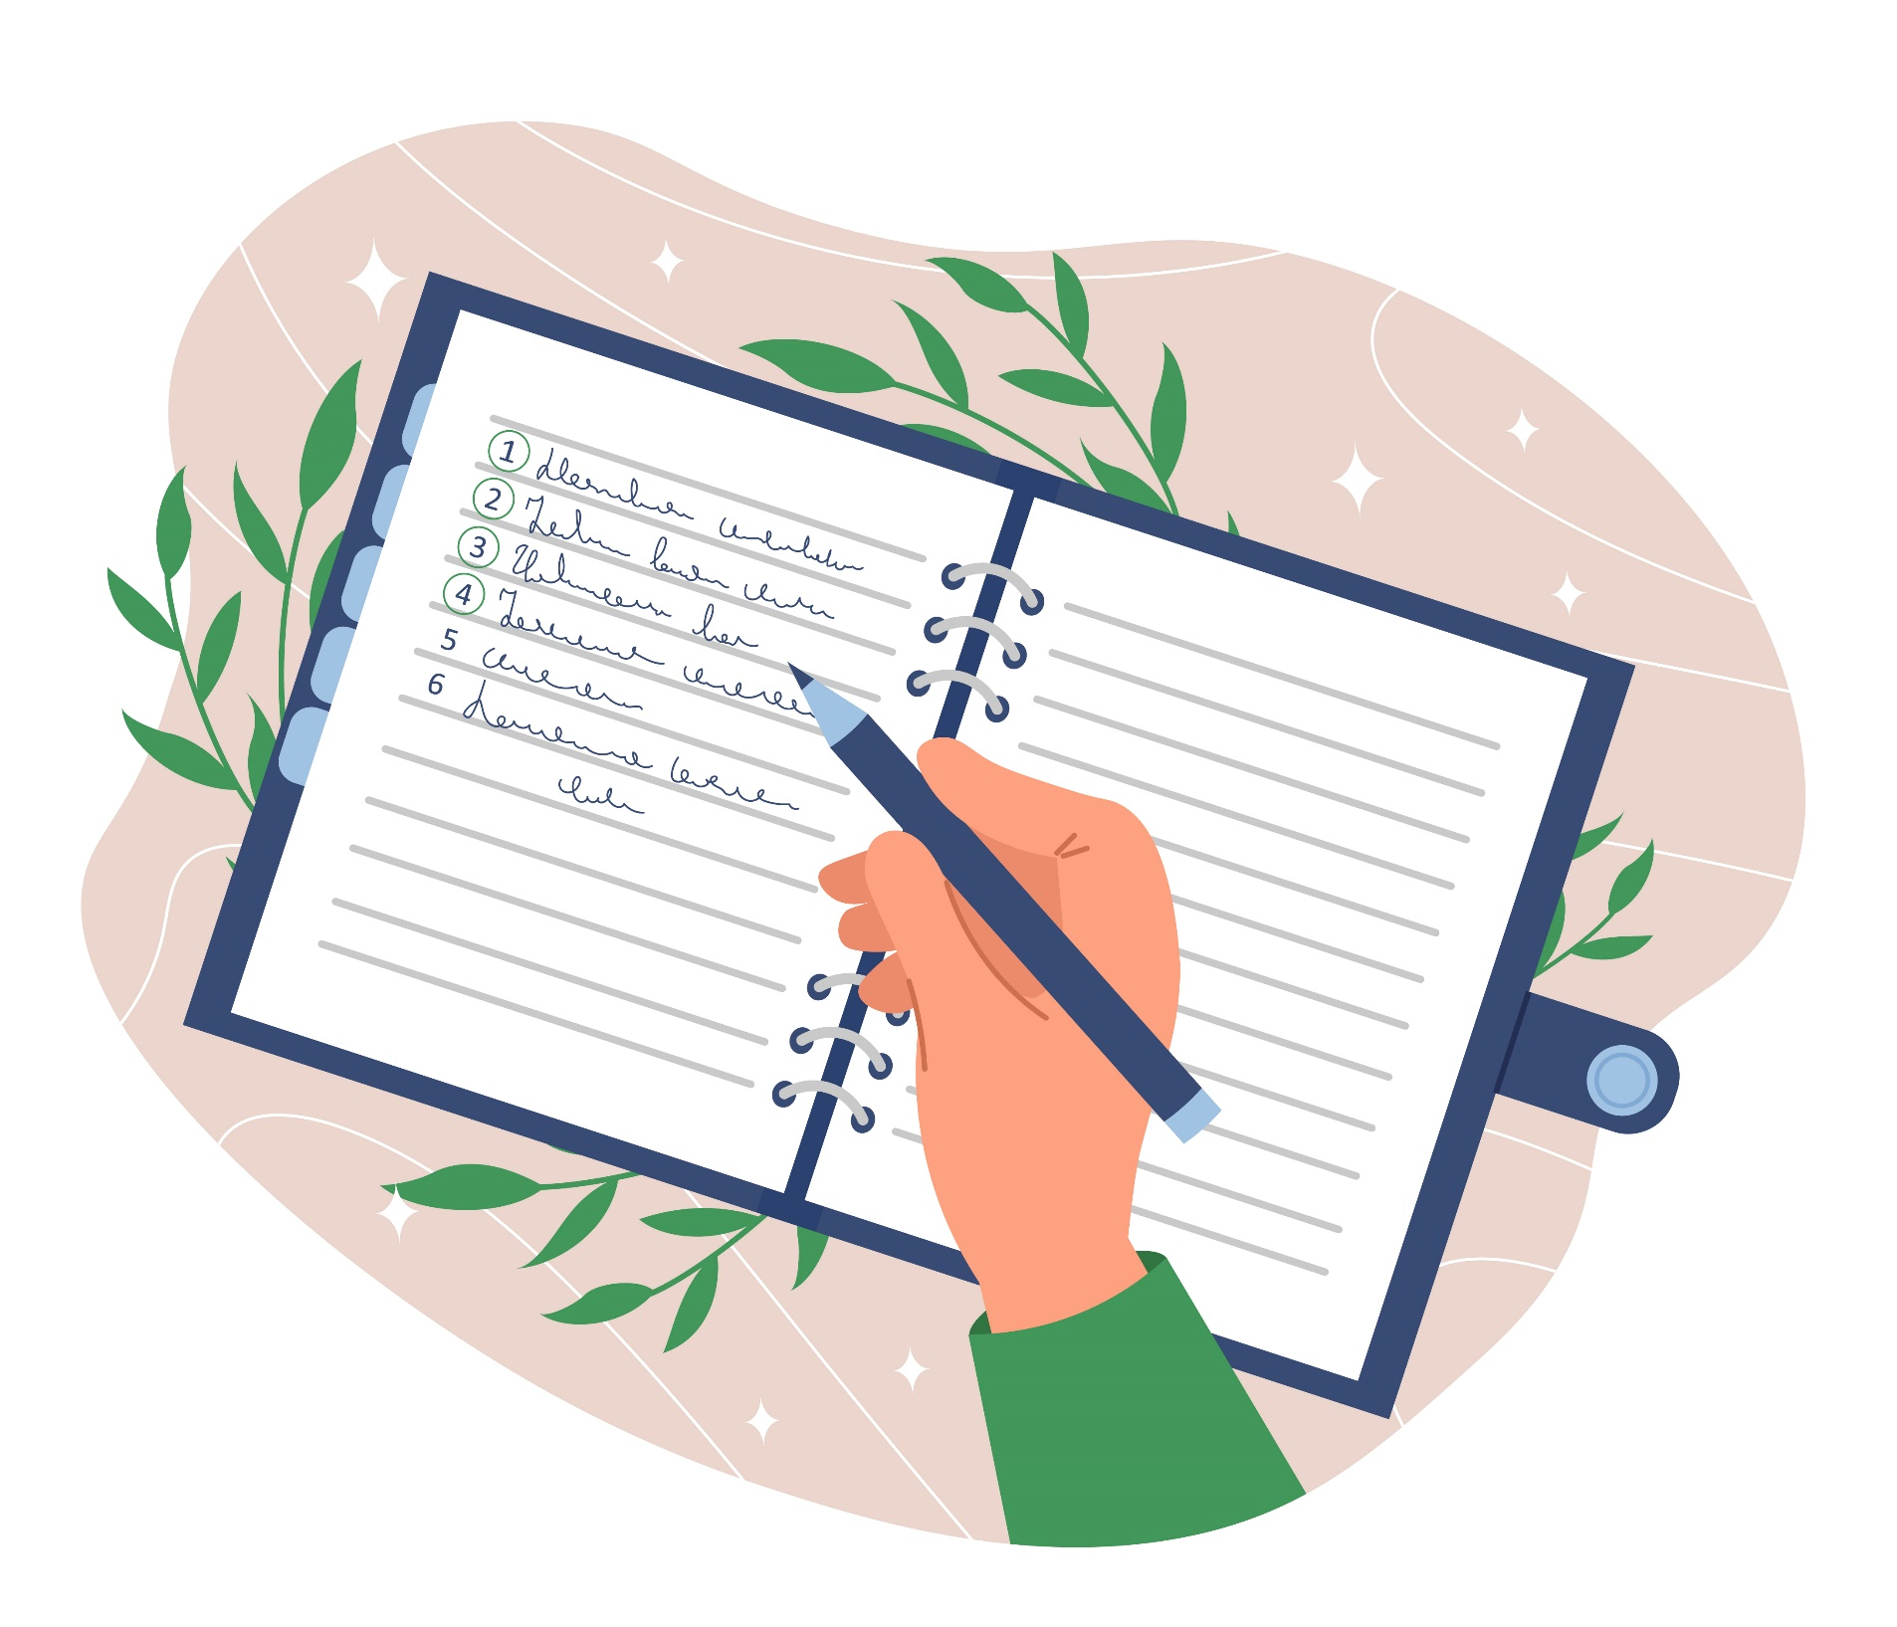
Read again and Write
48
Notes:
Allow time for children to read the text again and write their answers in their notebooks.
Play music for students to do the task.

Slide 17
Let’s see!
zoo
2. The trip is to a _______ .
Notes:
Go through the answers with the class.
Answers
1 Wednesday
2 zoo
3 kangaroos
4 lunchbox and a drink
5 sun hat

Slide 18
Read again and Write
kangaroos
3. There are lizards, _____________ and crocodiles.
Notes:
Go through the answers with the class.
Answers
1 Wednesday
2 zoo
3 kangaroos
4 lunchbox and a drink
5 sun hat

Slide 19
Read again and Write
lunchbox and a drink
4. Bring a ____________________ .
Notes:
Go through the answers with the class.
Answers
1 Wednesday
2 zoo
3 kangaroos
4 lunchbox and a drink
5 sun hat

Slide 20
Read again and Write
sun hat
5. Wear a ____________ .
Notes:
Go through the answers with the class.
Answers
1 Wednesday
2 zoo
3 kangaroos
4 lunchbox and a drink
5 sun hat

Slide 21
Good job!
Notes:
Point and Say

Slide 22
Talk to your friends.
Choose what your favorite school trip is.
Where do you go on school trip?
Why do you like this school trip the best?
Notes:
Have a class discussion about school trips the children have been on.
Ask a few children what their favorite school trip is and why.

Slide 23
Homework
Learn new words by heart.
Do the exercises in Workbook page 48.
Prepare for the next lesson
(Unit 6 - Lesson 6/Part 1).

Slide 24
Our Winners!
Peter
Eric
Julie
Notes:
Replace photos and names with your students’ information.

Slide 25
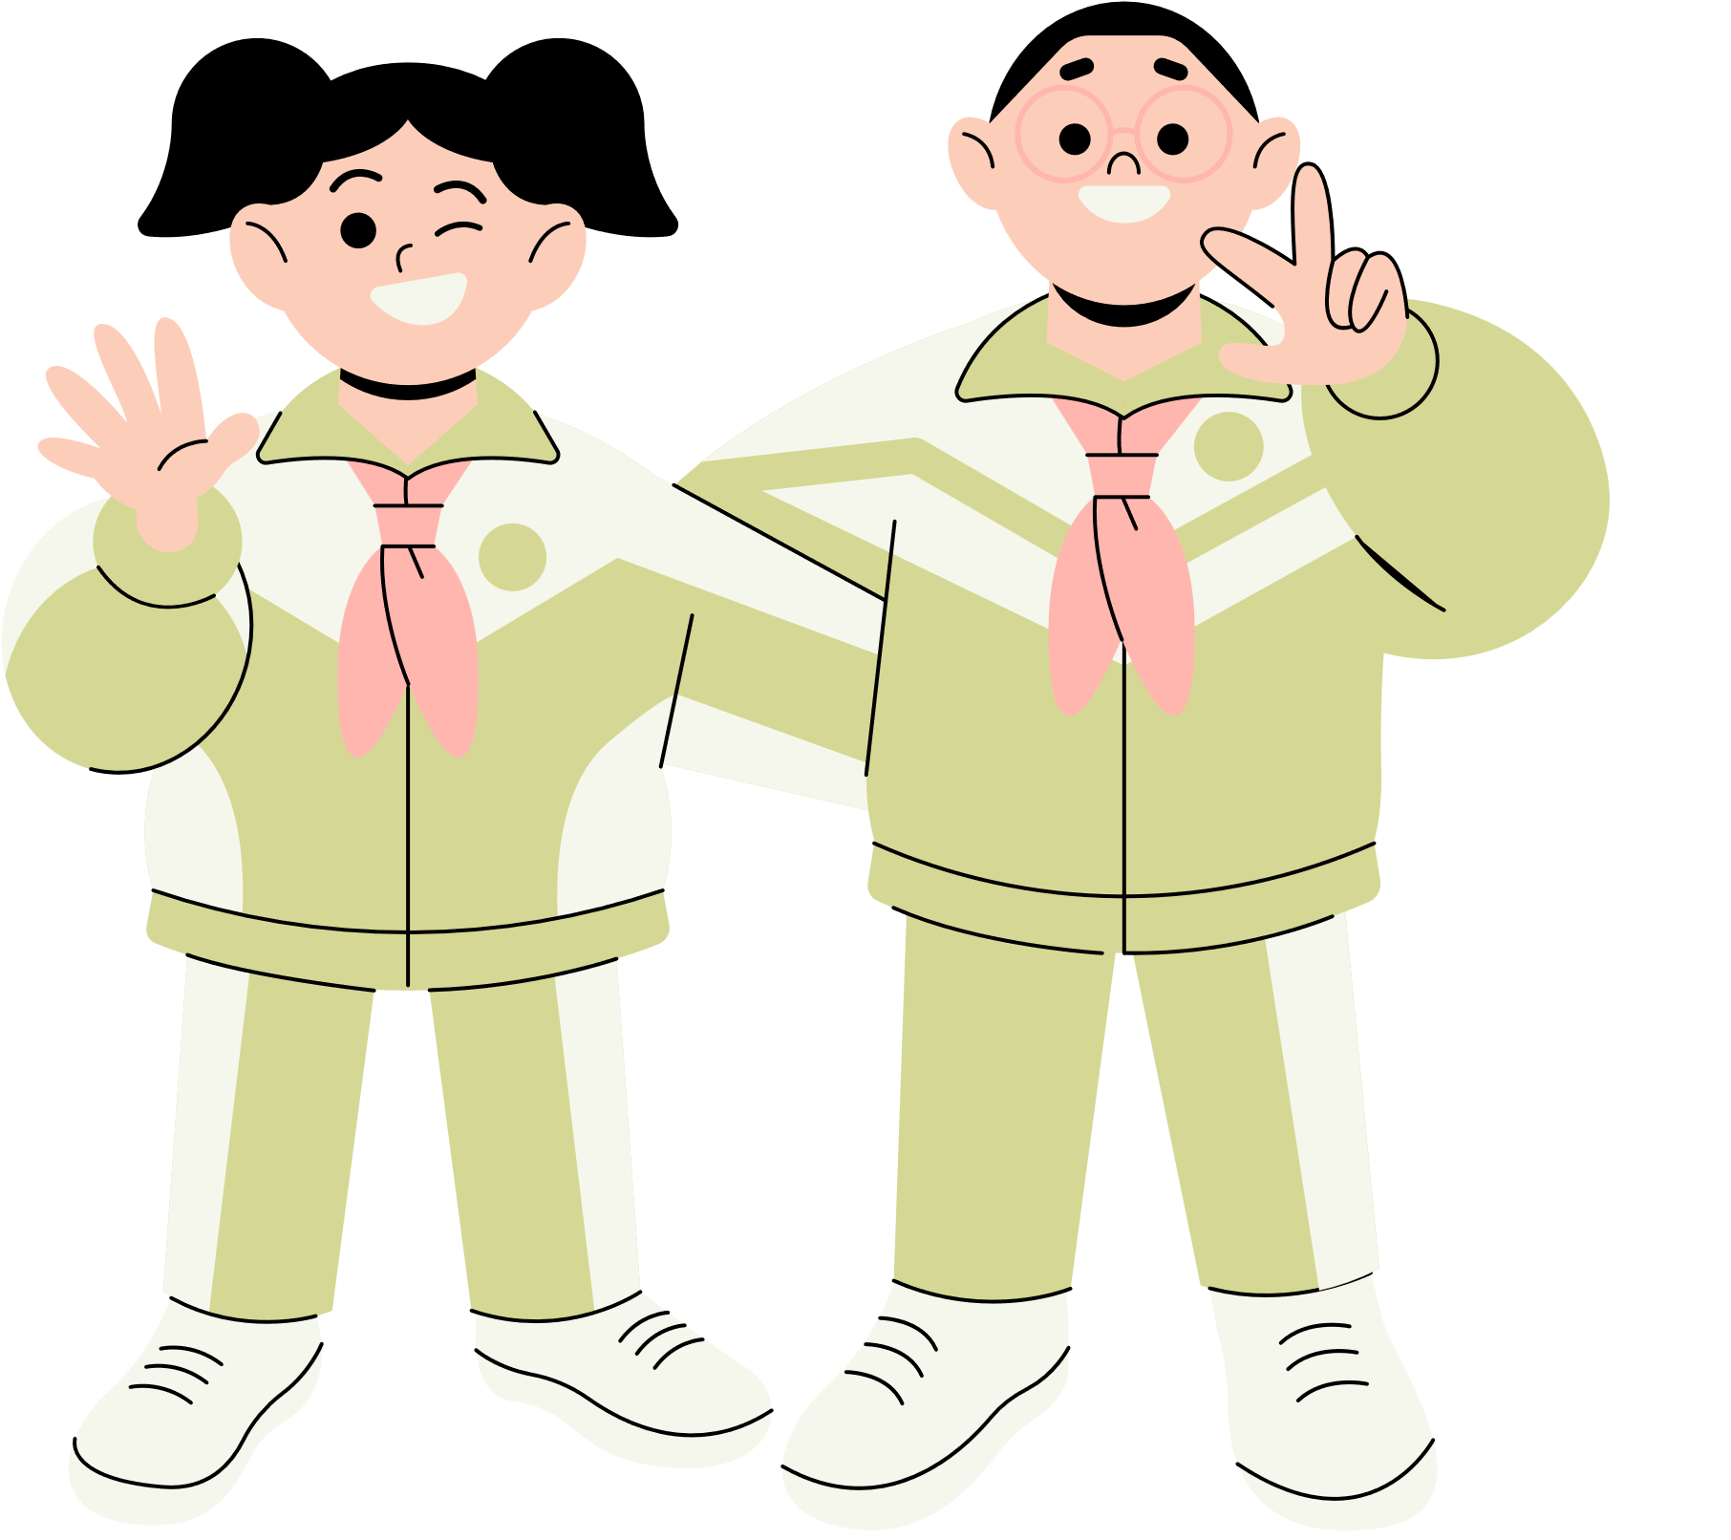
Thank You!
See You Next Time.
Notes:
https://www.youtube.com/watch?v=SRyFiVeNjWs

