Slide 2
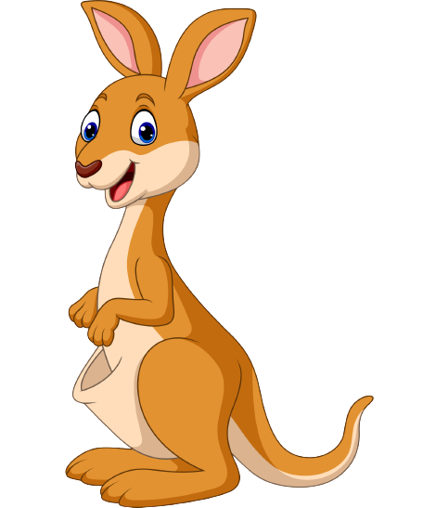
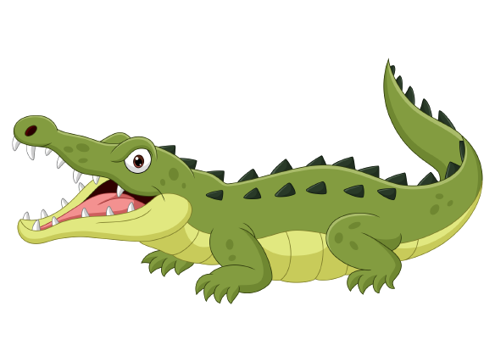
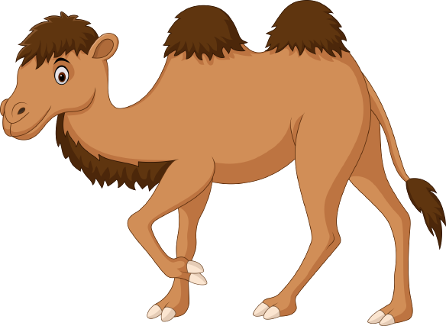
Unit 6
Funny monkeys!
Lesson 4 – Phonics

Slide 3
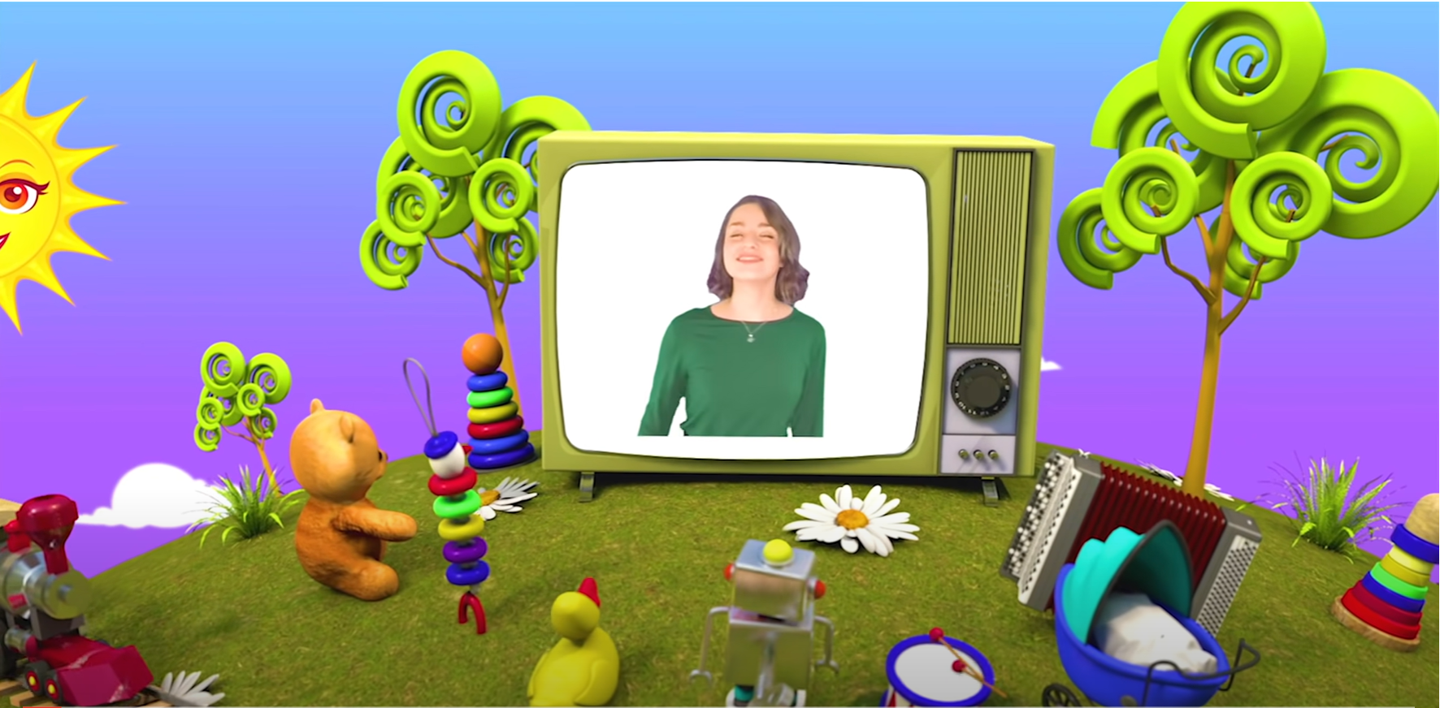
HELLO SONG
Notes:
https://www.youtube.com/watch?v=pqDEwPi7vxg

Slide 5
Let’s say!
Notes:
Ask children which sounds they looked at in their last phonics lesson (/w/ and /ks/).

Slide 6
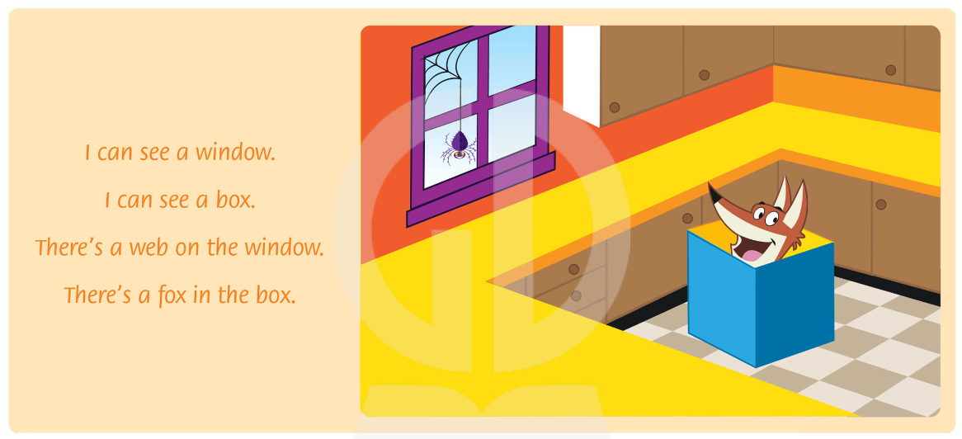
Listen and Chant.
Notes:
Play the chant from page 41 to energize the class and review the sounds from the previous unit.

Slide 7
Good job!

Slide 8
Listen and Repeat.
Y

Slide 9
Listen and Repeat.
Y

Slide 10
Listen and Repeat.
Y

Slide 11
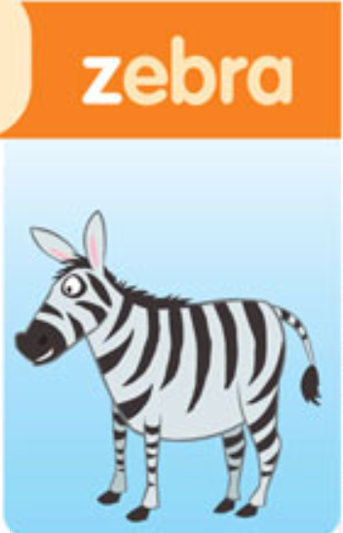
Listen and Repeat.
Z

Slide 12
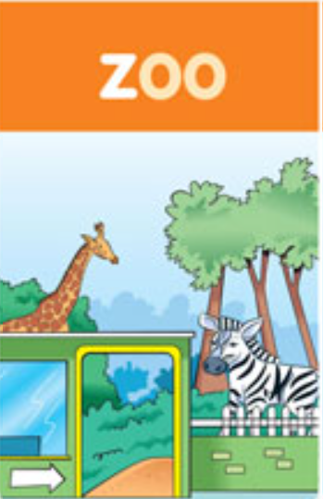
Listen and Repeat.
Z

Slide 13
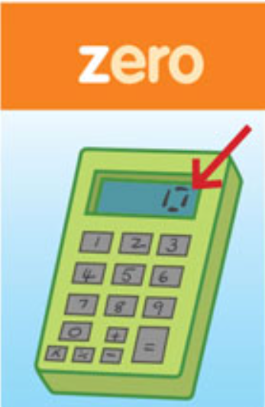
Listen and Repeat.
Z

Slide 14
Listen, Point and Repeat.
47
Notes:
* Listen, point, and repeat. Track 74
Play the first part of the recording. Children listen and point to the pictures.
Play the second part of the recording for children to repeat.
Play the whole recording. Children point and then repeat.

Slide 15
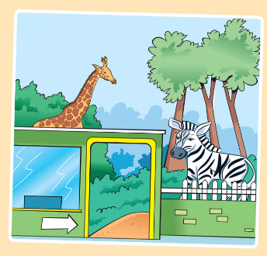
Look and Answer.
What can you see in the picture?

Slide 16
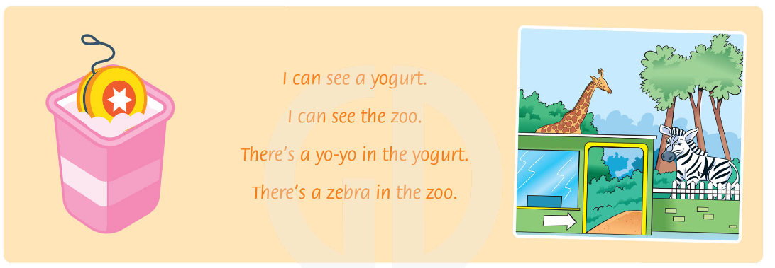
Listen and Chant.
Notes:
Play the recording for children to listen to the chant.
Play the chant again, pausing for children to repeat.
Repeat with children following along.

Slide 17
Read and Find the word with letter y.
I can see a yogurt.
Notes:
Write the first line of the chant on the board.
Invite a child to come to the front, find examples of the letter y, and say the word (yogurt).

Slide 18
Read and Say.
yogurt
zoo
yo-yo
zebra
Notes:
Children read the chant silently and only say the words with y and z out loud.
Children write the y and z words in their notebooks.

Slide 19
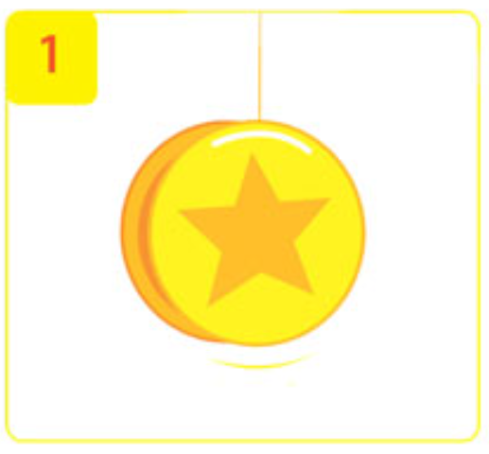
Listen and Complete.
y
_o-_o
y
Notes:
Children look at the first picture.
Play the recording.
Ask What’s the word? (yo-yo). Ask What letter makes the first sound in each syllable?
Draw attention to the example letter y.

Slide 20
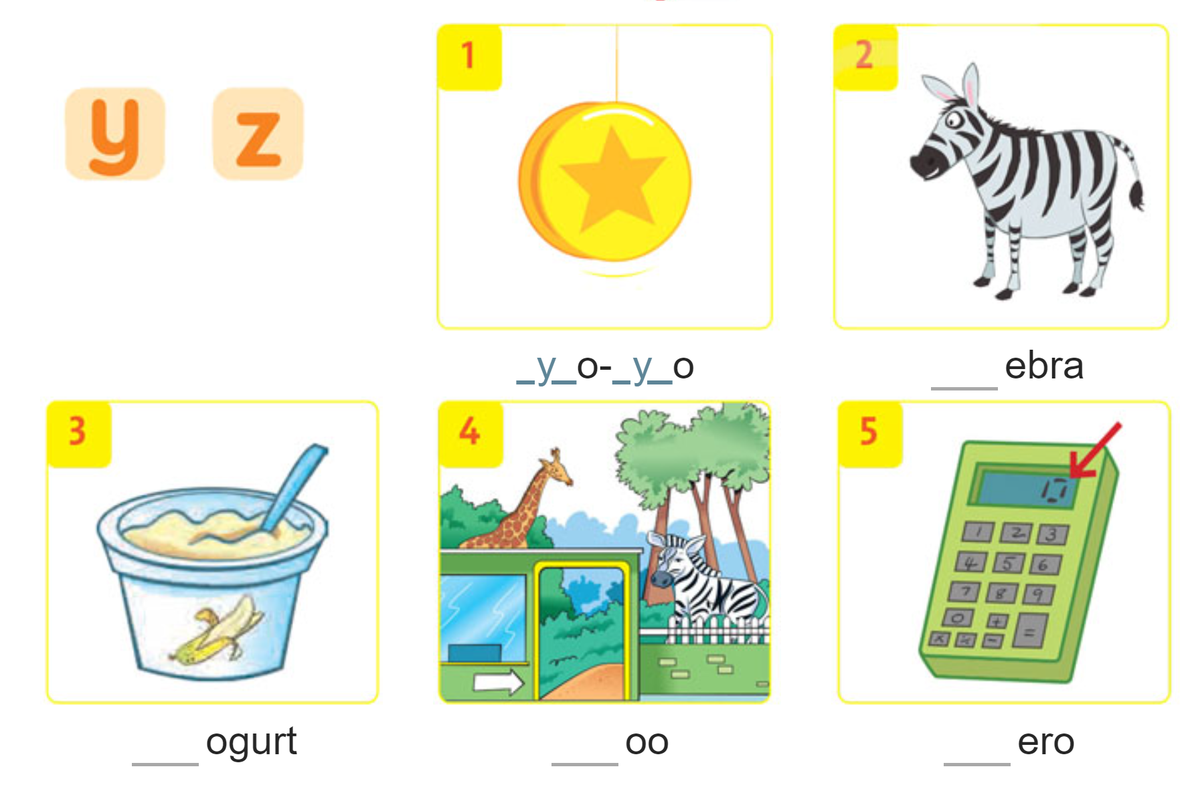
Listen and Complete.
Notes:
Play the rest of the recording for children to write the missing letters with their pencils.
Ask children to say the missing sounds, then the words.

Slide 21
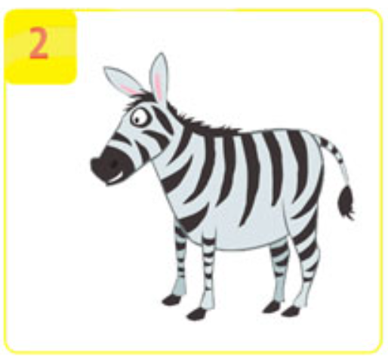
Listen and Complete.
_ebra
z
Notes:
Go over the answers with the class.
Answers
1 y 2 z 3 y 4 z 5 z

Slide 22
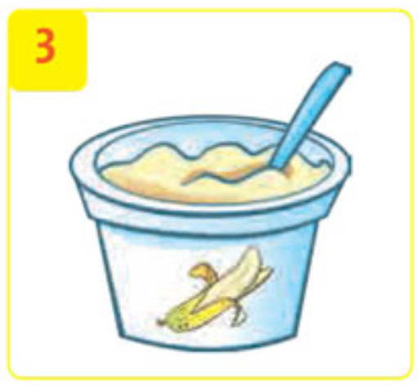
Listen and Complete.
_ogurt
y
Notes:
Go over the answers with the class.
Answers
1 y 2 z 3 y 4 z 5 z

Slide 23
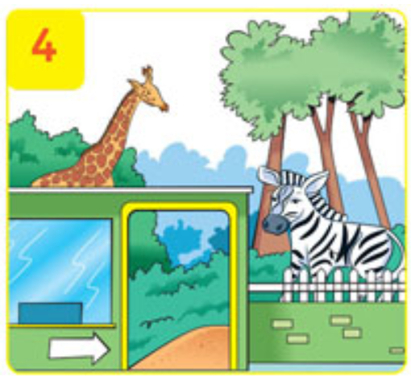
Listen and Complete.
_oo
z
Notes:
Go over the answers with the class.
Answers
1 y 2 z 3 y 4 z 5 z

Slide 24
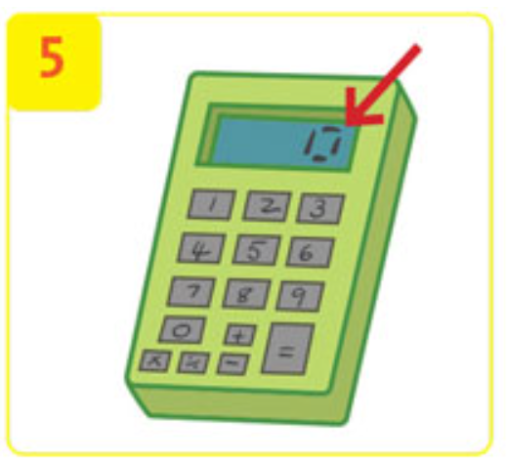
Listen and Complete.
_ero
z
Notes:
Go over the answers with the class.
Answers
1 y 2 z 3 y 4 z 5 z

Slide 25
Good job!

Slide 26
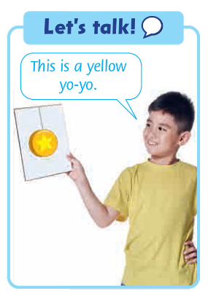
DRAW and TELL
Notes:
Ask children to look at the picture and speech bubble. Say the sentence and ask the class to repeat it chorally.
In pairs, children take turns saying the sentence, using other vocabulary words on the page.

Slide 27
Homework
Do the exercises in Workbook page 47.
Prepare for the next lesson
(Unit 6 - Lesson 5).

Slide 28
Our Winners!
Peter
Eric
Julie
Notes:
Replace photos and names with your students’ information.

Slide 29
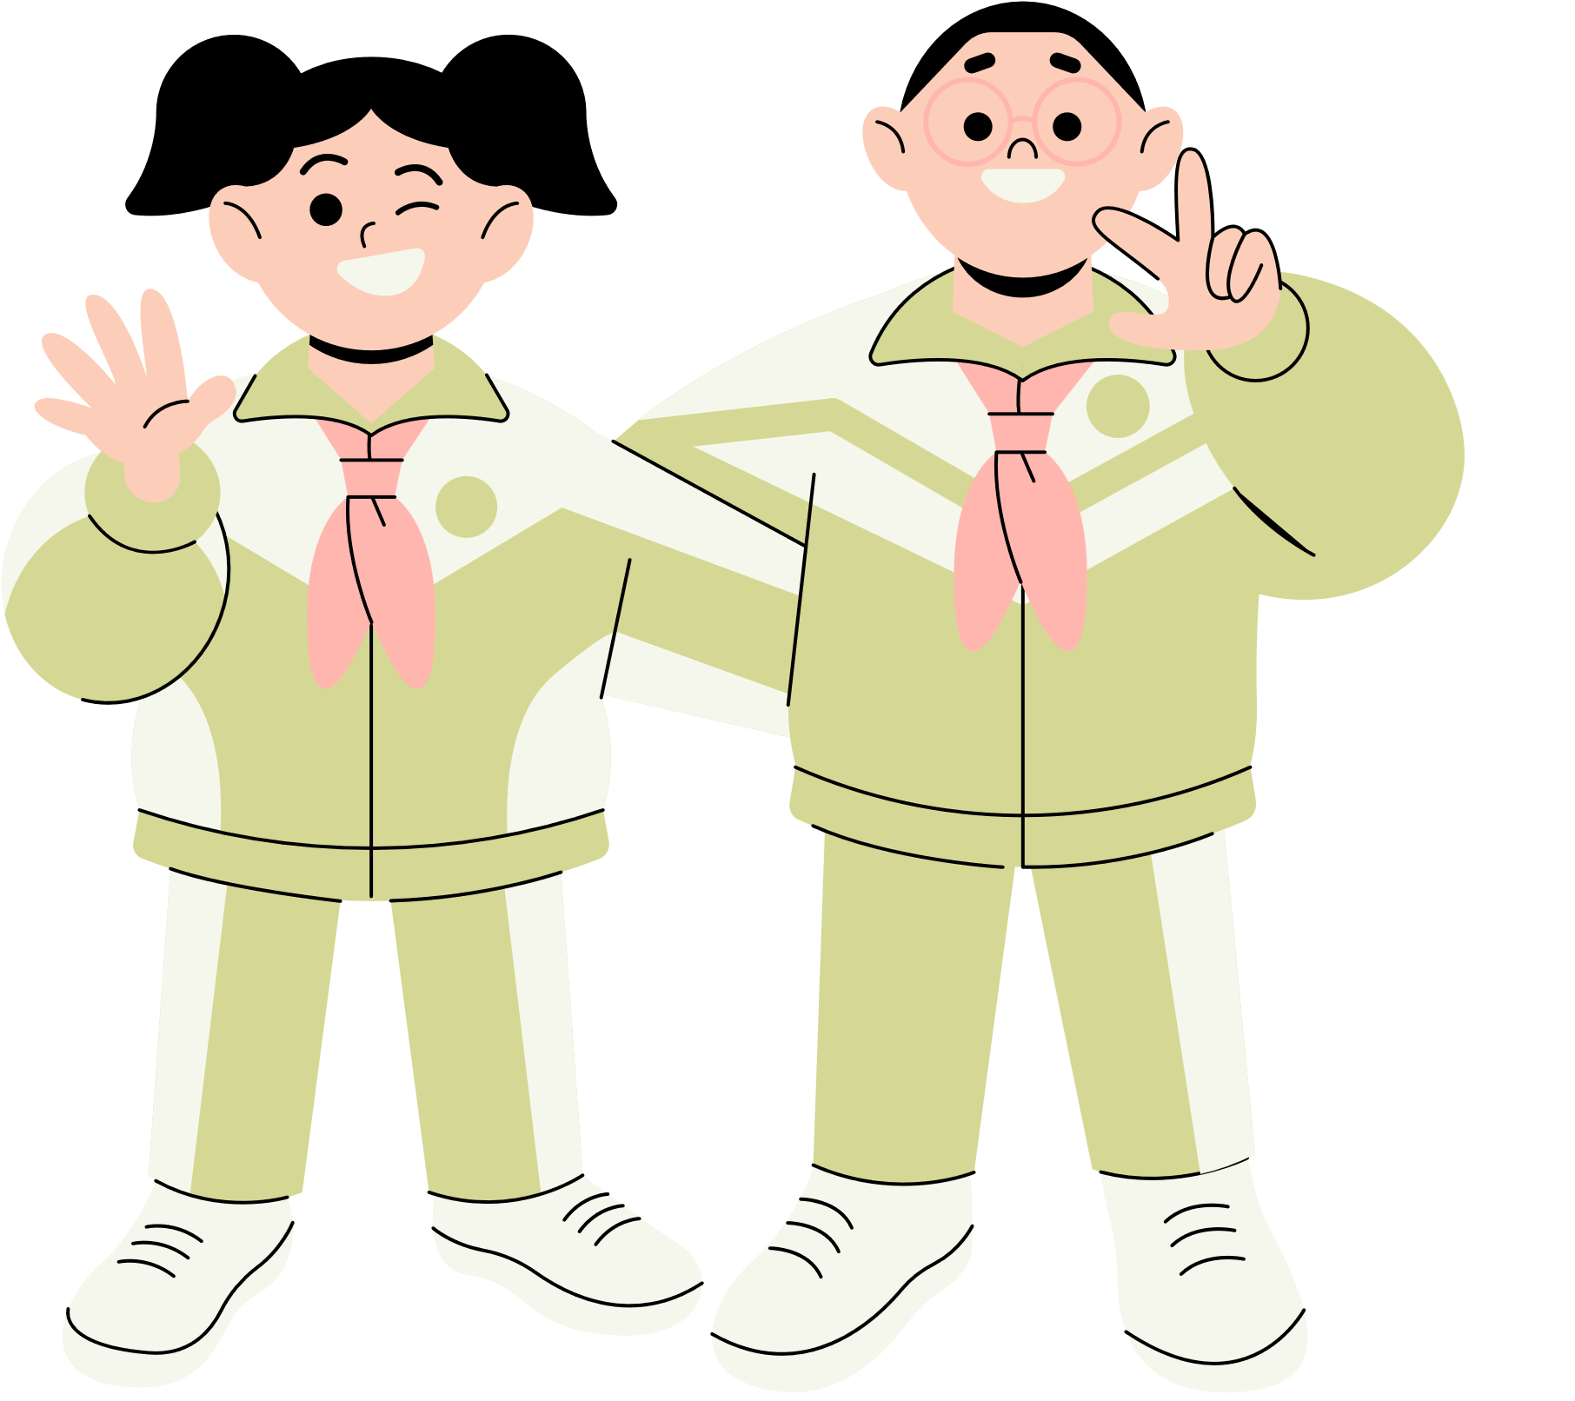
Thank You!
See You Next Time.
Notes:
https://www.youtube.com/watch?v=SRyFiVeNjWs

