Slide 2
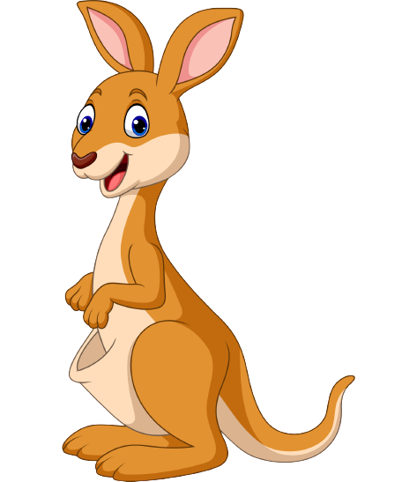
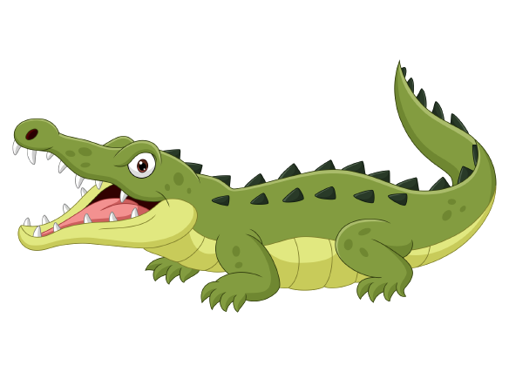
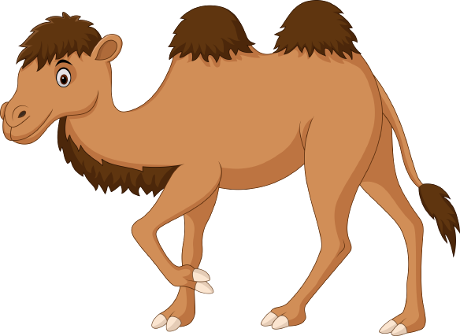
Unit 6
Funny monkeys!
Lesson 3 – Song

Slide 3
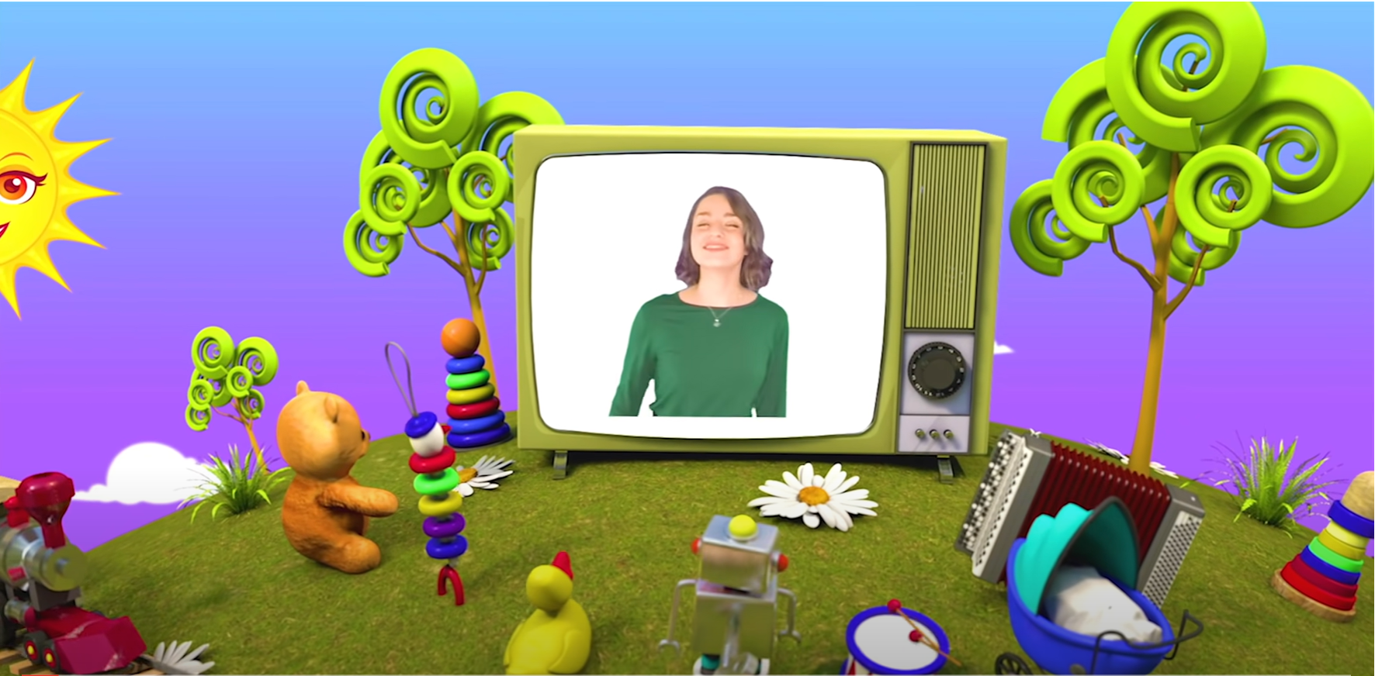
HELLO SONG
Notes:
https://www.youtube.com/watch?v=pqDEwPi7vxg

Slide 5
Game: POINT and SAY
Notes:
Ask a child to think of an animal and say the word.
Ask the child to point to another child, who has to think of and say another word. Continue around the class.
Children can say animals from this unit or previous levels, and they can repeat words, but they can’t say the same word as the person before them.

Slide 6
Good job!

Slide 7
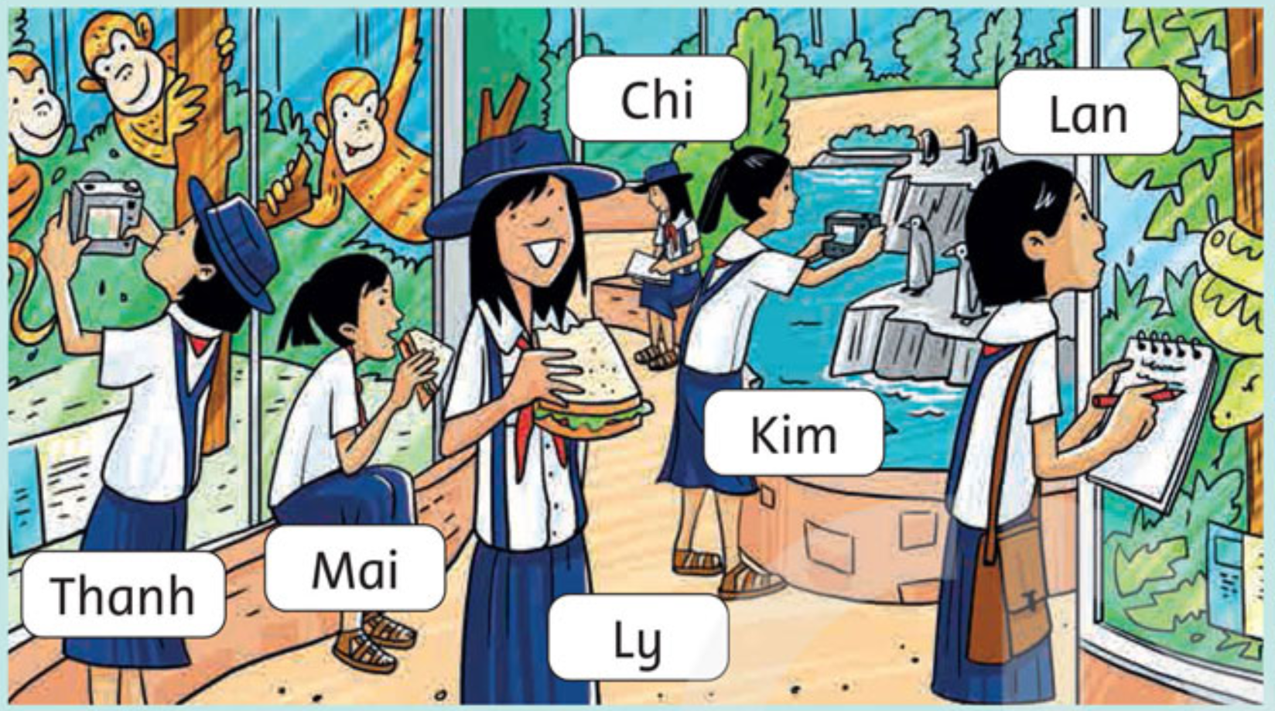
Look and Answer.
Notes:
Ask questions about the picture,
e.g. What animals can you see?
Are the girls with their moms and dads?
How many people are wearing hats / eating a sandwich?
How many penguins can you see?
Are the monkeys swimming?
Are they climbing?

Slide 8
Look and Answer.
What is Chi doing?
She’s writing in a notebook.

Slide 9
Look and Answer.
What are Mai and Ly doing?
They’re eating sandwiches.

Slide 10
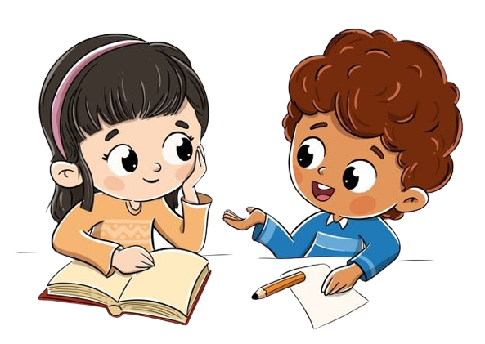
Ask and Answer.
46

Slide 11
Work in Pairs
Notes:
Ask two students to work in pairs, look at the Exercise 3 on page 45, ask and answer questions based on the pictures.

Slide 12
Write about the girls.
Thanh and Kim
Thanh and Kim are taking photos.

Slide 13
Write about the girls.
Mai and Ly
Mai and Ly are eating sandwiches.

Slide 14
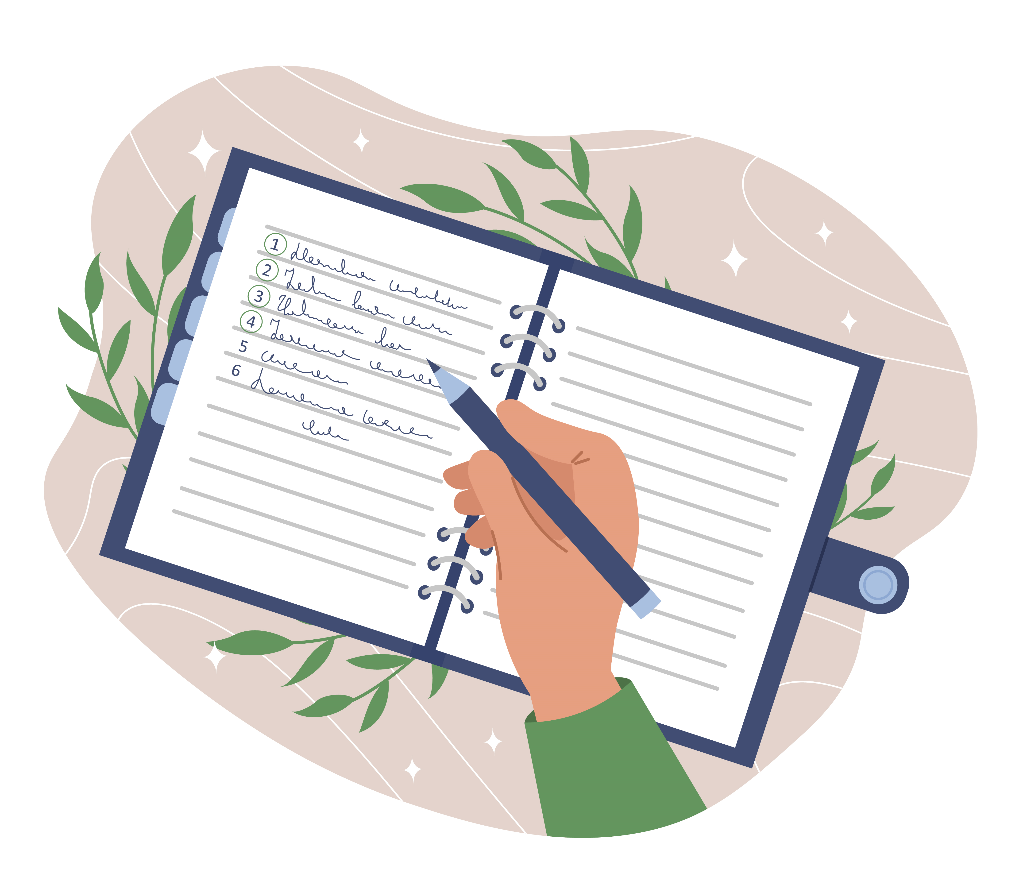
Write about the girls.

Slide 15
Work in Pairs.
Notes:
Ask two students to work in pairs to peer-check their writing.

Slide 16
Write about the girls.
Chi and Lan
Chi and Lan are writing in a notebook.

Slide 17
Good job!

Slide 18
Look and Name the animals.
monkeys
zebras
tigers
parrots
penguins
lions
Notes:
Ask children to look at the pictures and name the animals.

Slide 19
Look and Name the animals.
running
climbing
talking
walking
flying
swimming
sleeping
Notes:
Elicit what each pair of animals is doing (climbing, running, walking, talking, swimming, sleeping).

Slide 20
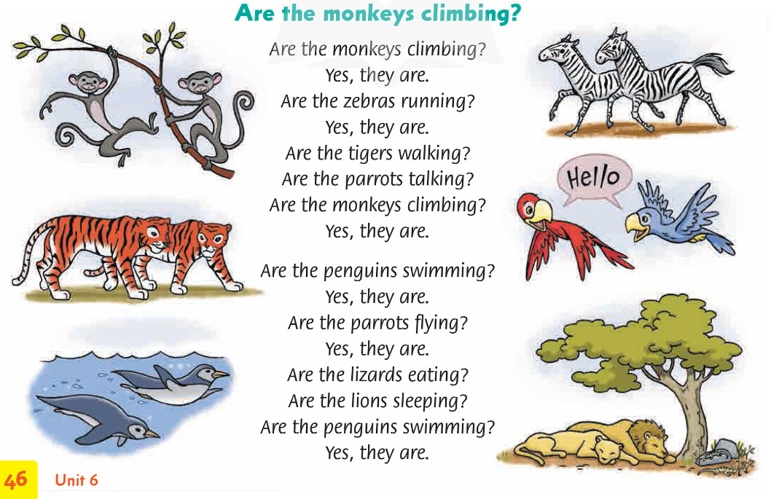
Listen and Point.

Slide 21
Listen and Follow the song.

Slide 22
Listen and Repeat.
Are the monkeys climbing?
Are the monkeys climbing?
Yes, they are.
Are the zebras running?
Yes, they are.

Slide 23
Listen and Repeat.
Are the monkeys climbing?
Are the tigers walking?
Are the parrots talking?
Are the monkeys climbing?
Yes, they are.

Slide 24
Listen and Repeat.
Are the monkeys climbing?
Are the penguins swimming?
Yes, they are.
Are the parrots flying?
Yes, they are.

Slide 25
Listen and Repeat.
Are the monkeys climbing?
Are the lizards eating?
Are the lions sleeping?
Are the penguins swimming?
Yes, they are.

Slide 26
Listen and Sing along.

Slide 27
Practice the actions.
Notes:
Are the monkeys climbing? – reach up with your hands.
Are the zebras running? – run on the spot.
Are the tigers walking? – move your arms as if walking on four legs.
Are the parrots talking? – make beaks with your fingers to show two birds talking.
Are the penguins swimming? – mime swimming.
Are the parrots flying? – flap your elbows as if flying.
Are the lions sleeping? – mime sleeping.

Slide 28
Sing and Do the actions.
Notes:
Are the monkeys climbing? – reach up with your hands.
Are the zebras running? – run on the spot.
Are the tigers walking? – move your arms as if walking on four legs.
Are the parrots talking? – make beaks with your fingers to show two birds talking.
Are the penguins swimming? – mime swimming.
Are the parrots flying? – flap your elbows as if flying.
Are the lions sleeping? – mime sleeping.

Slide 29
Good job!

Slide 30
New version for the song.
Are the _______ ________?
Are the _________ _________?
Yes, they are.
Are the __________ _________?
Yes, they are.
Notes:
* Game: “New version for the song”
Show the song with blanks.
Ask the students to think of new words and use them to fill in the blanks.
Put the students into small groups of four or five and ask them to do the task.
Ask students to practice singing and doing the actions in groups.
Praise students if they have done well.

Slide 31
LIVE ON THE STAGE
Notes:
Invite some groups to come to the front and perform their new version of the song with actions.

Slide 32
Homework
Learn new words by heart.
Do the exercises in Workbook page 46.
Prepare for the next lesson
(Unit 6 - Lesson 4).

Slide 33
Our Winners!
Peter
Eric
Julie
Notes:
Replace photos and names with your students’ information.

Slide 34
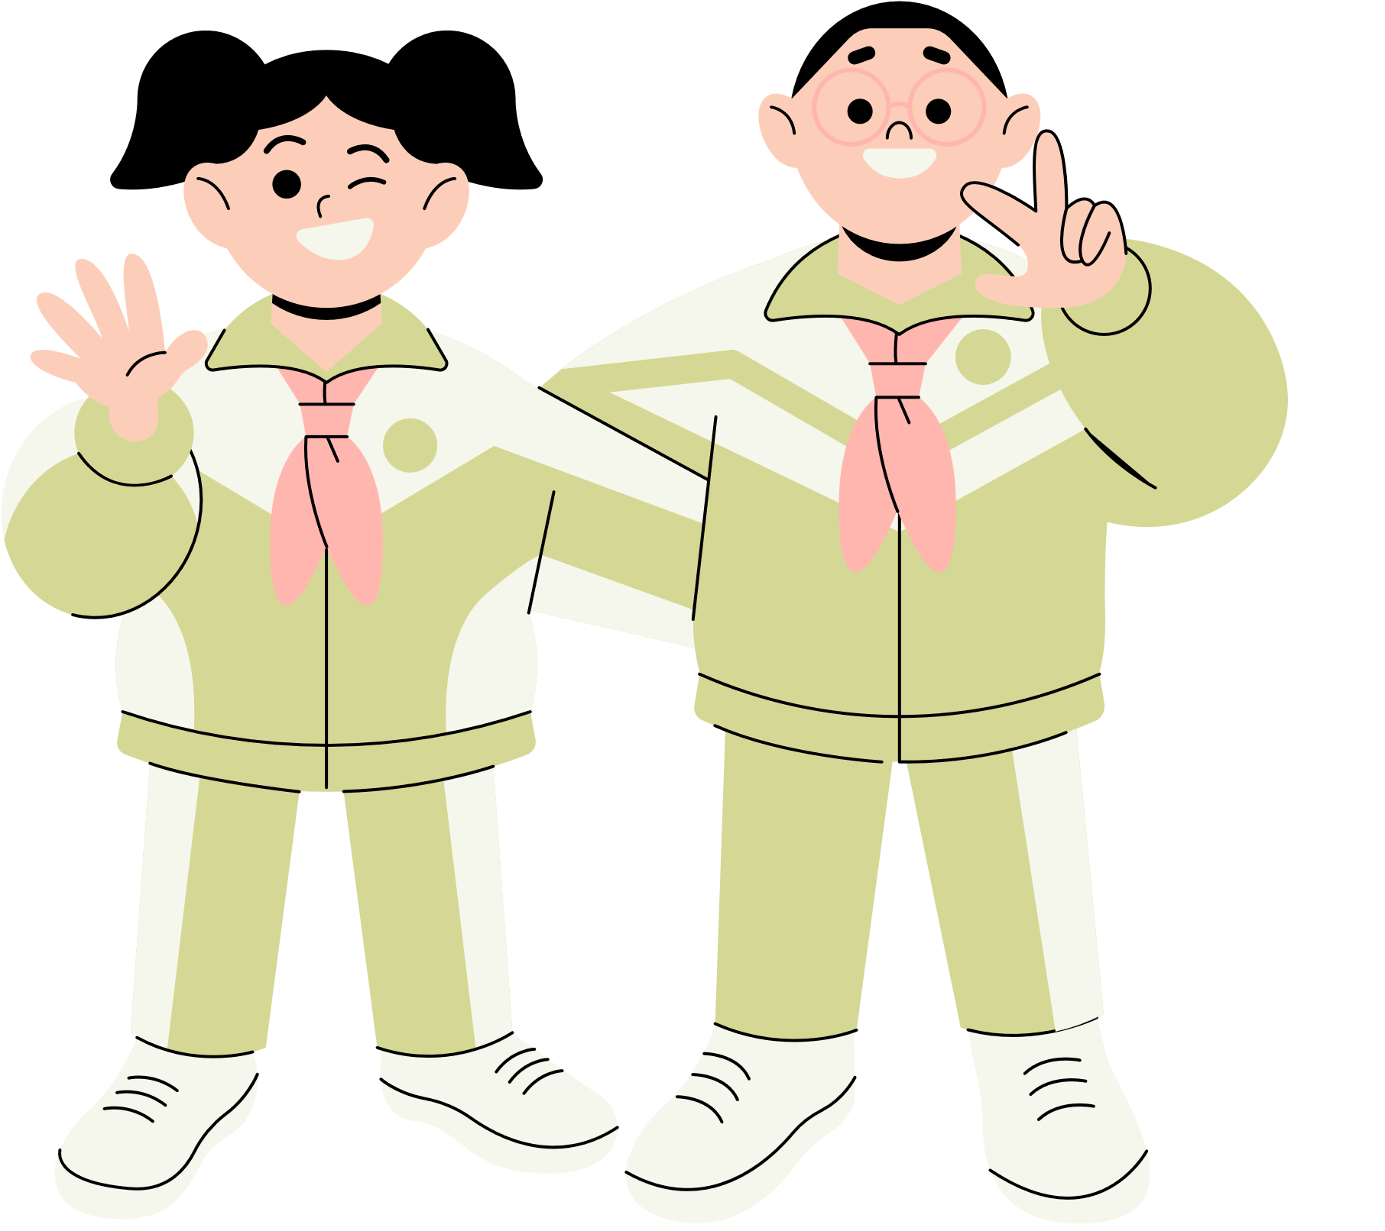
Thank You!
See You Next Time.
Notes:
https://www.youtube.com/watch?v=SRyFiVeNjWs

