Slide 2
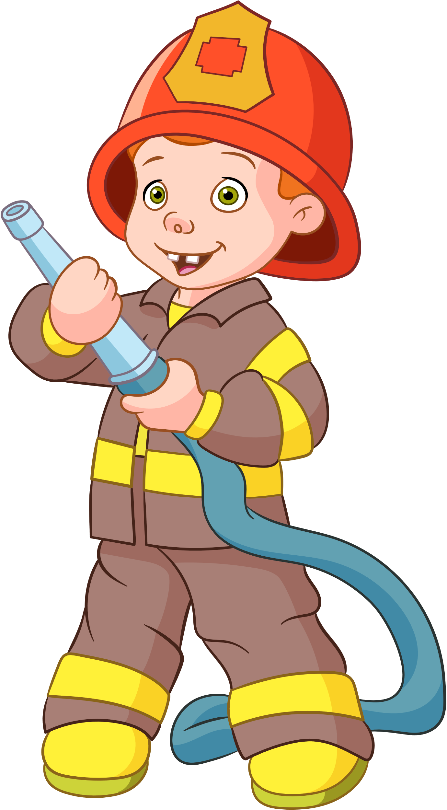
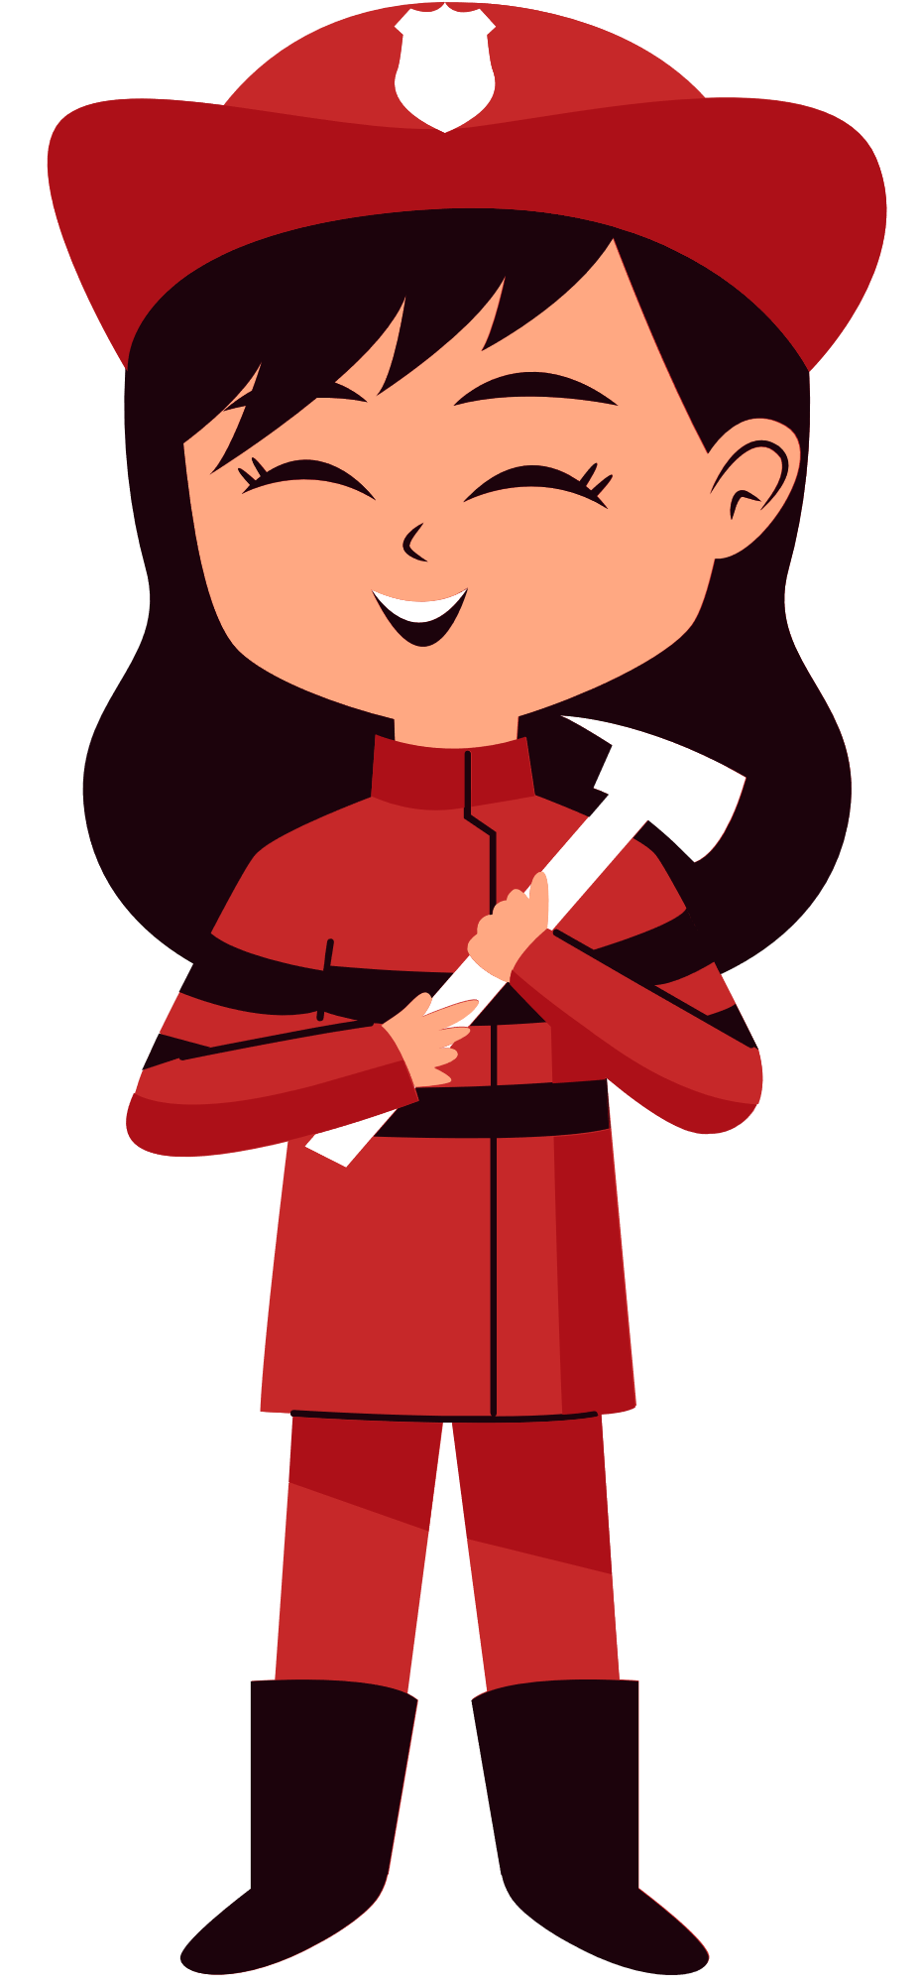
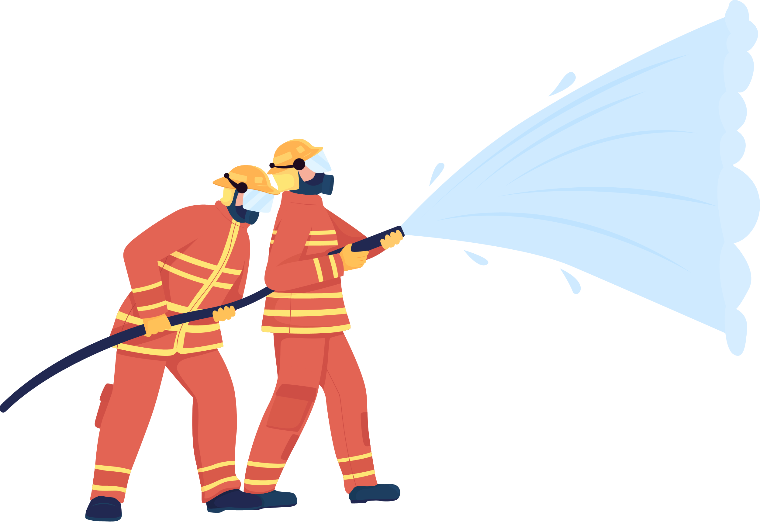
Unit 2
Does he work in a police station?
Lesson 1

Slide 3
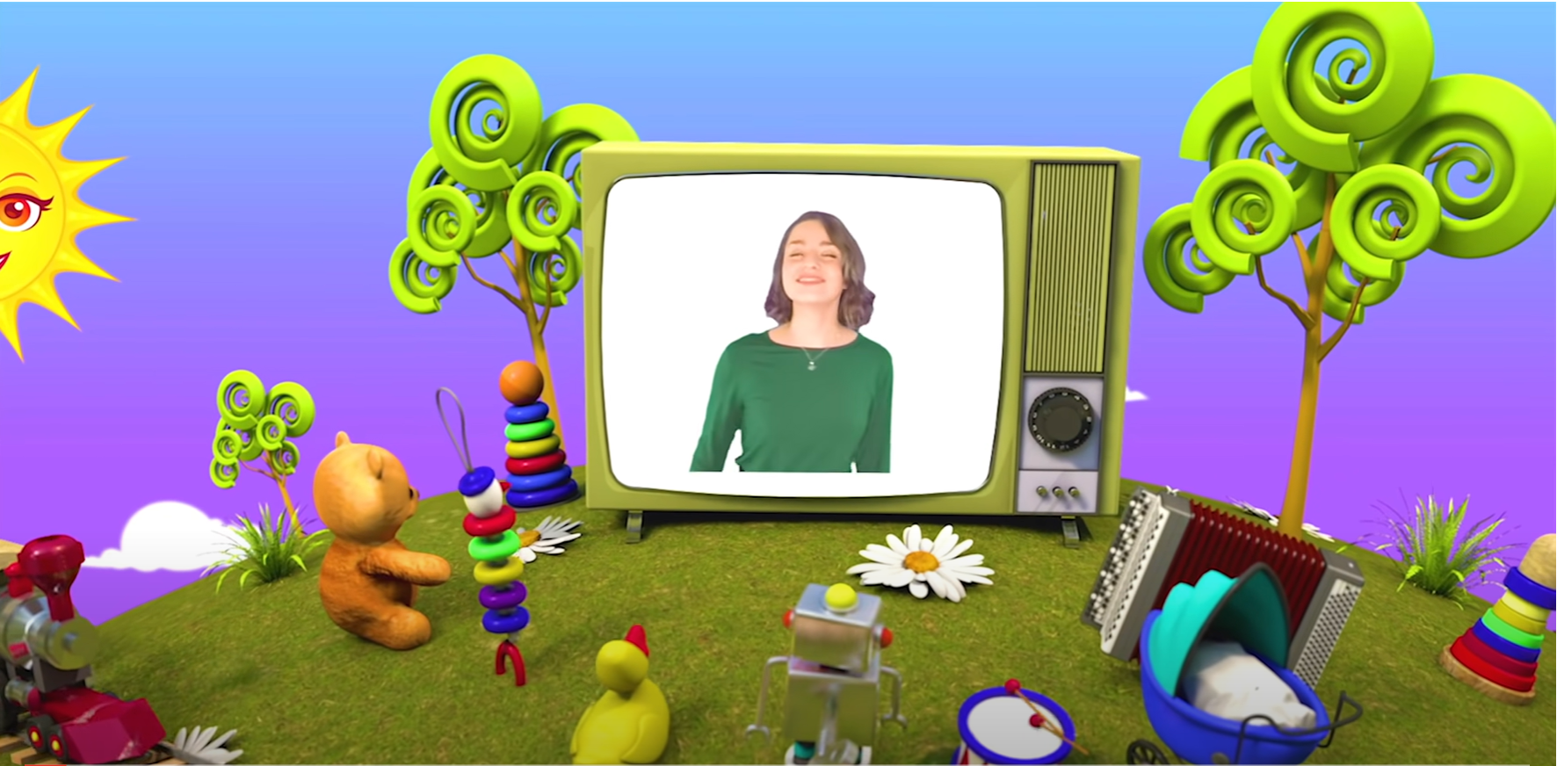
HELLO SONG
Notes:
https://www.youtube.com/watch?v=pqDEwPi7vxg

Slide 4
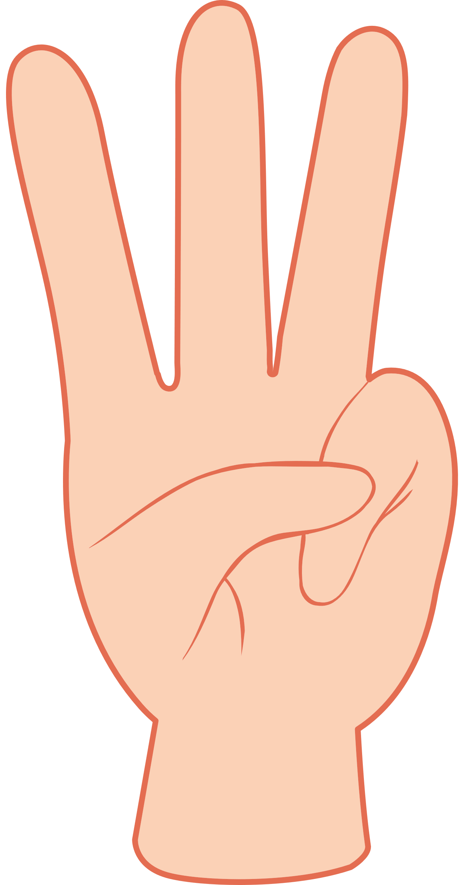

Slide 5
Look and Say
doctor

Slide 6
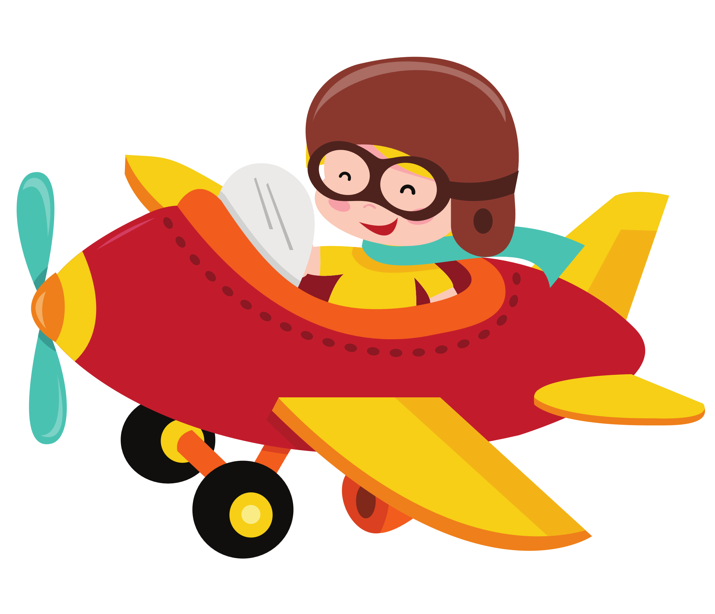
Look and Say
pilot

Slide 7
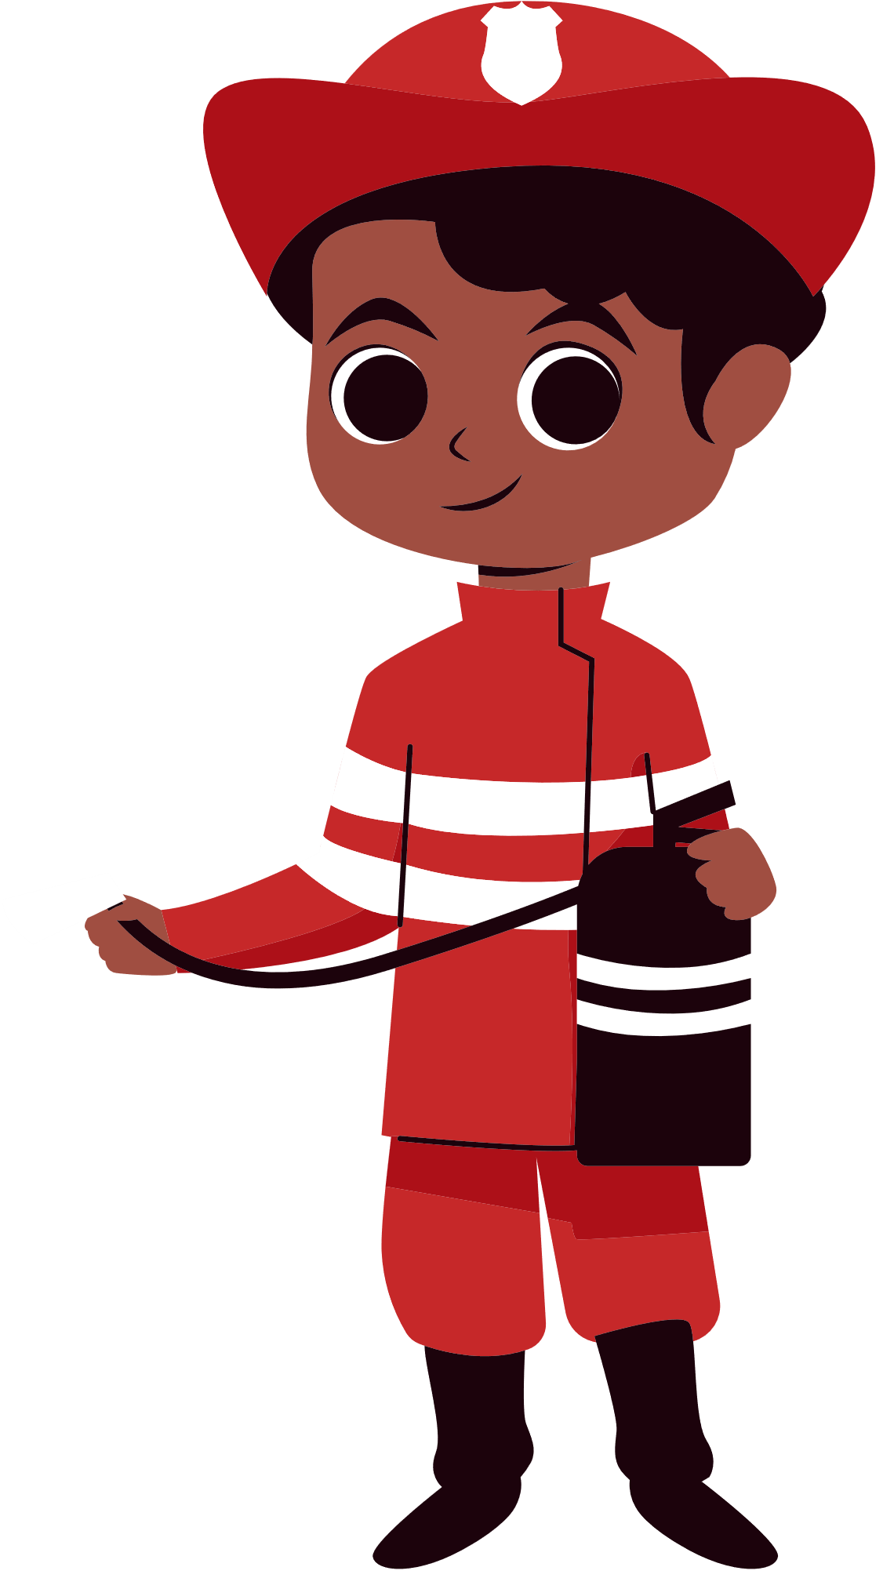
Look and Say
firefighter

Slide 8
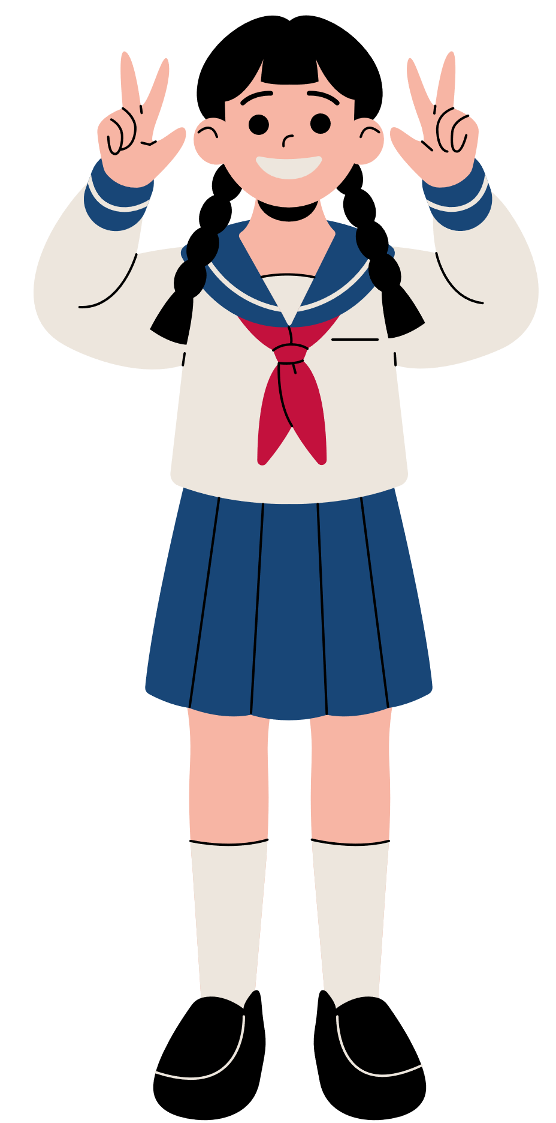
Look and Say
student

Slide 9
Look and Say
teacher

Slide 10
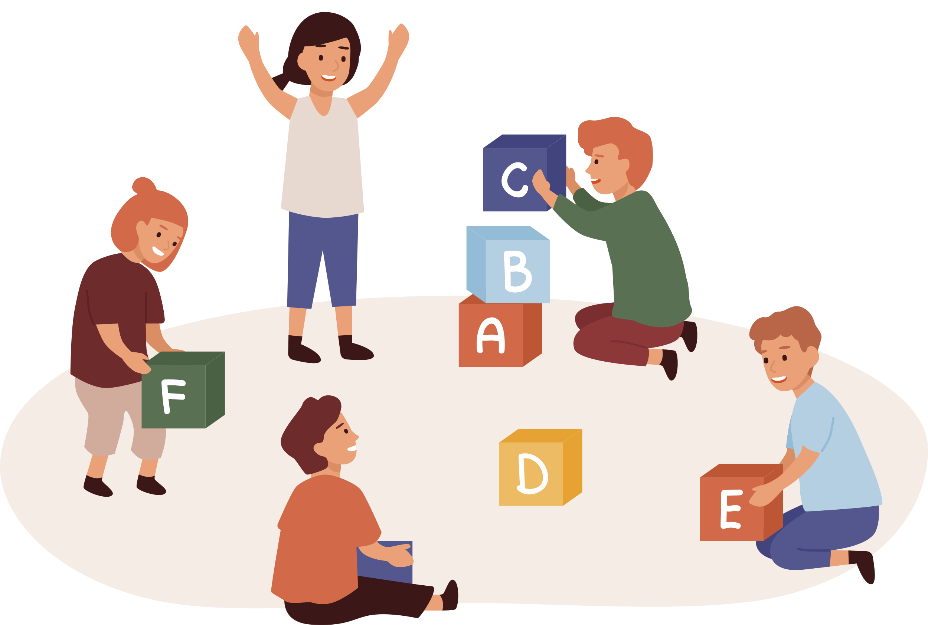
Game: Miming Game
Notes:
* Game: Miming
Sing Can you see … from page 12 to energize the class.
Ask children what they can remember about the story from the previous unit.
Have children look at the story pictures on page 10. Ask Is Billy a doctor? Is Grandma a teacher? Who are the heroes?
Mime an action and ask the children to guess what the job is.

Slide 11
Good job!
Notes:
Point and Say

Slide 12
Look and Listen
hospital

Slide 13
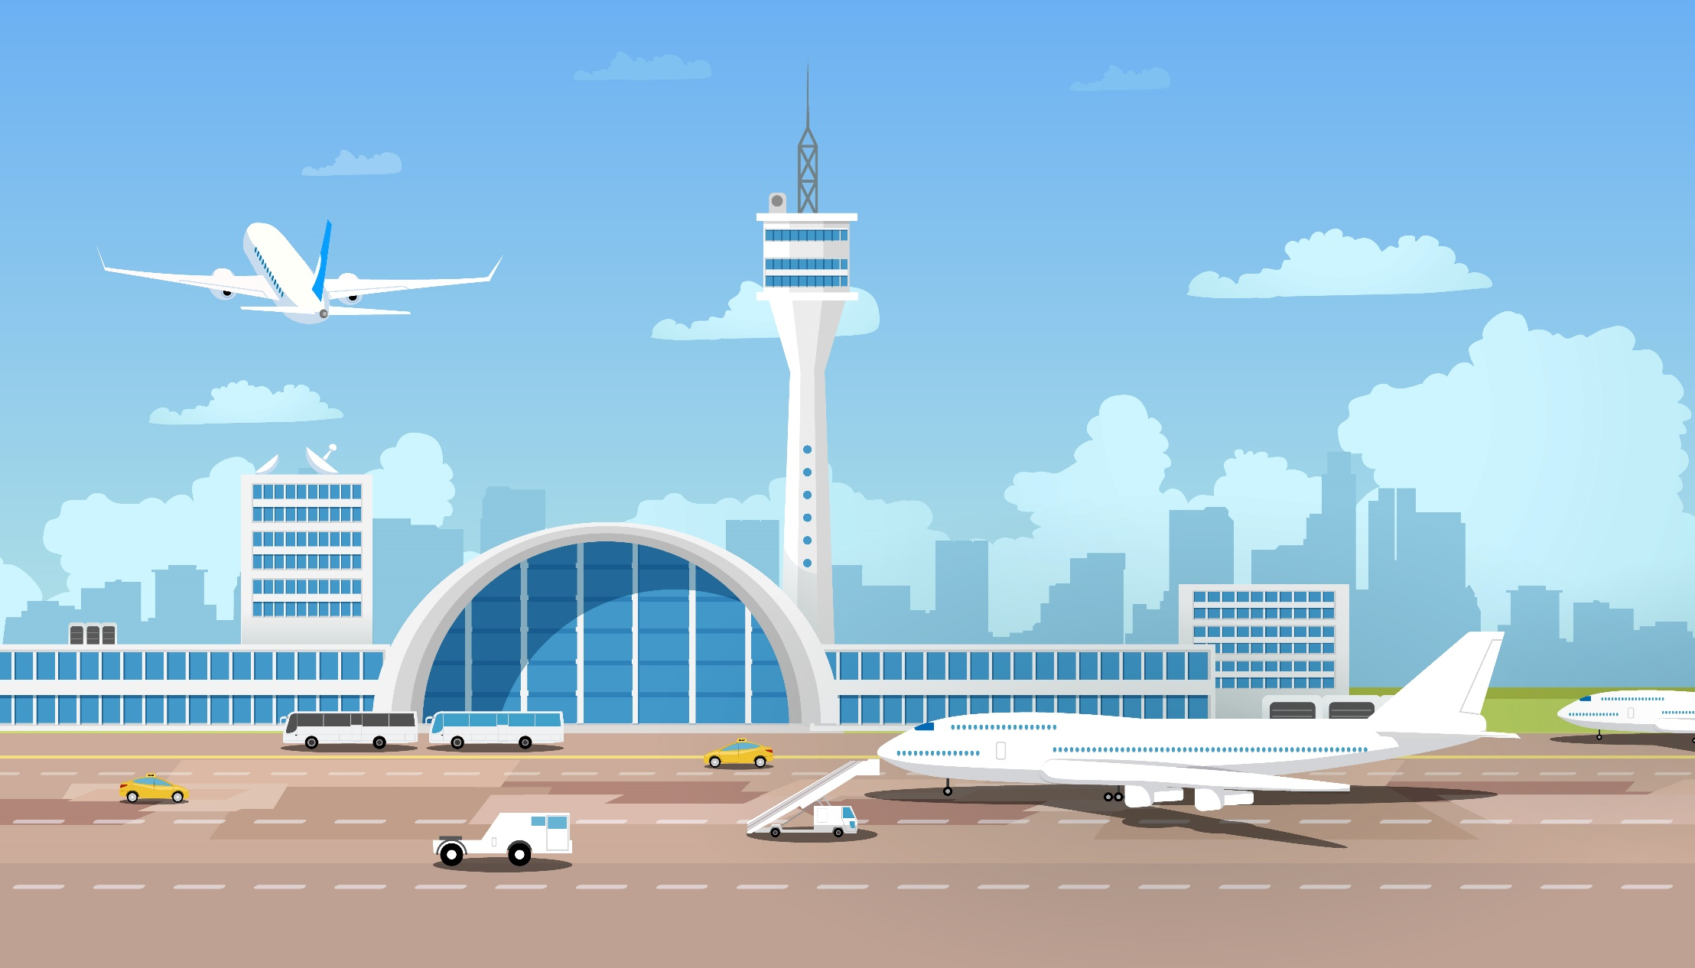
Look and Listen
airport

Slide 14
Look and Listen
police station

Slide 15
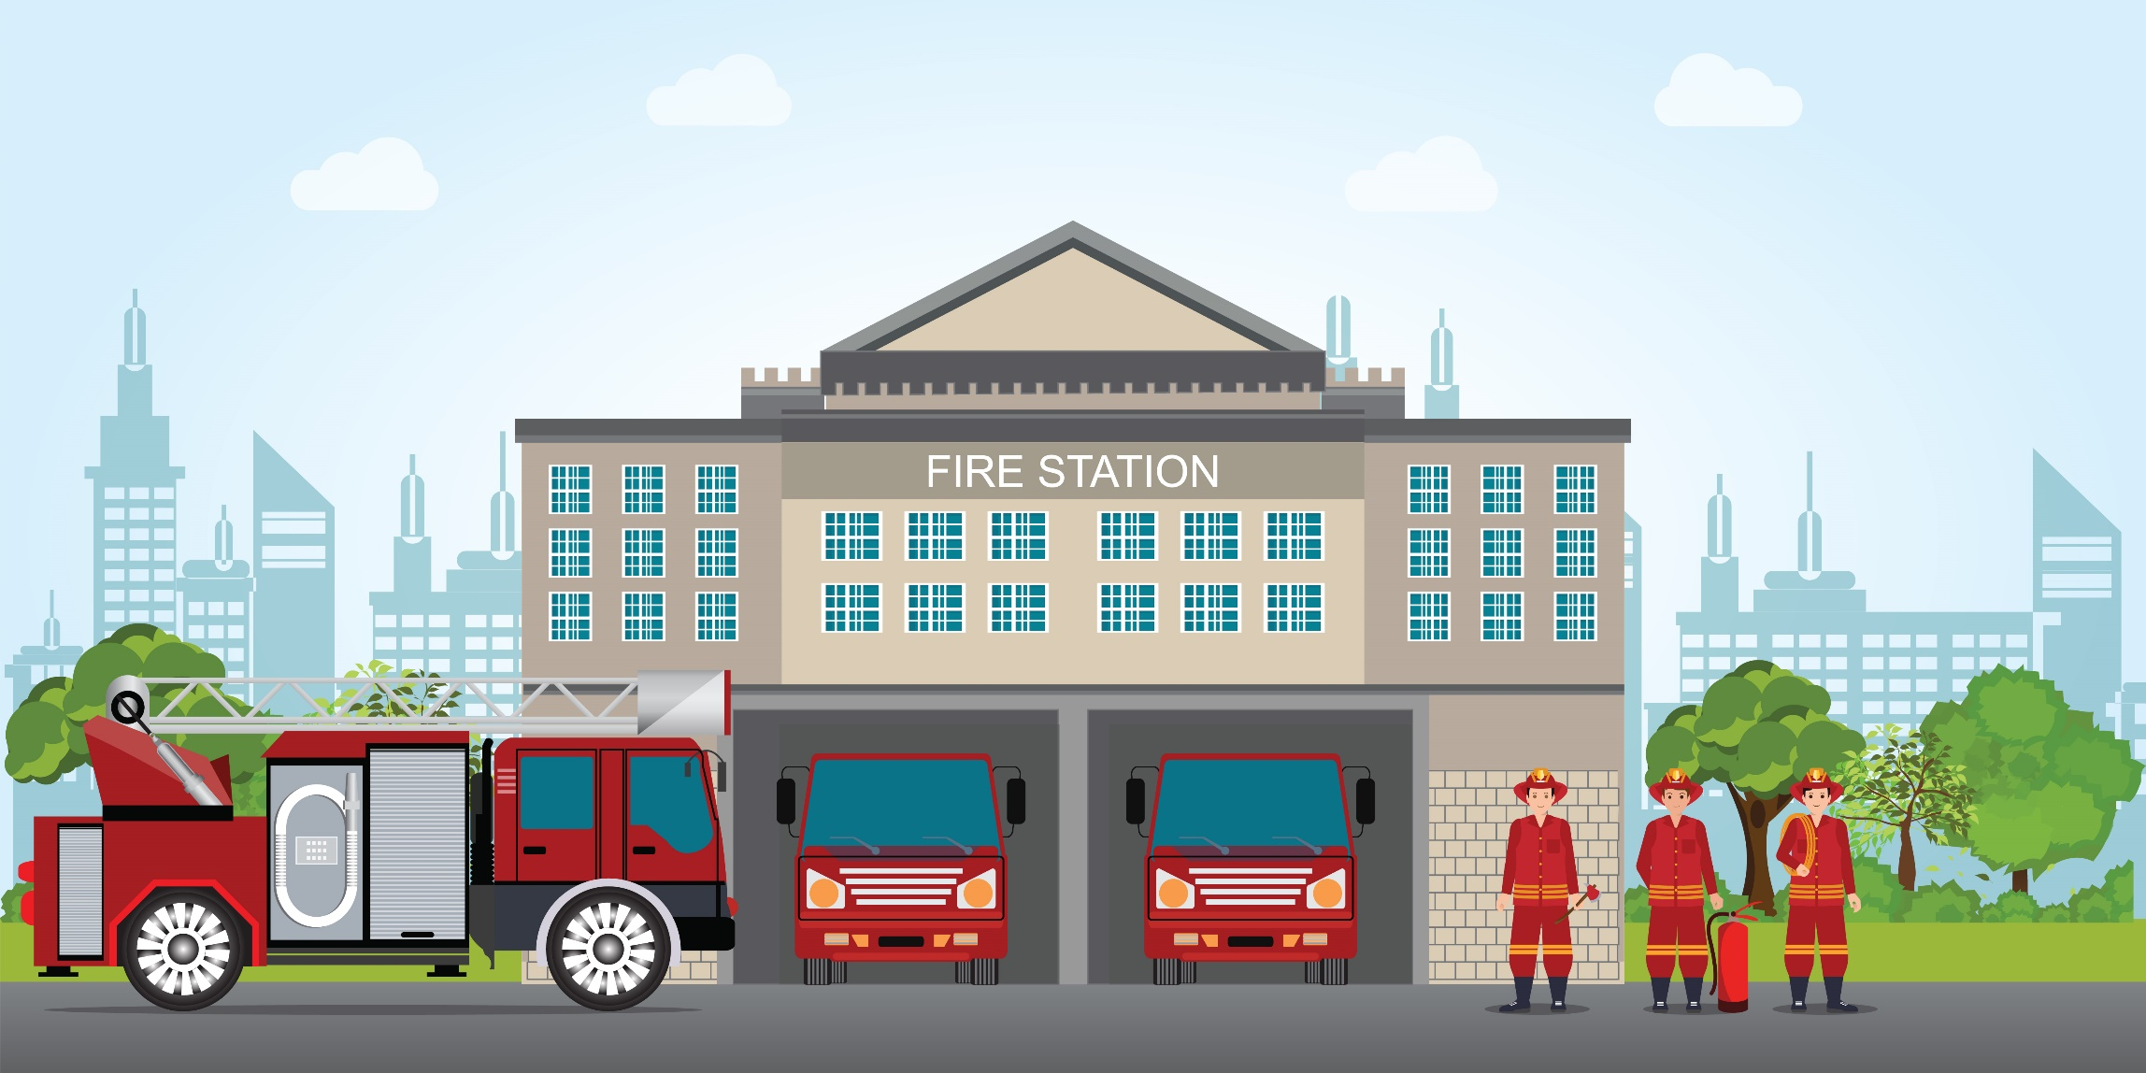
Look and Listen
fire station

Slide 16
Look and Listen
store

Slide 17
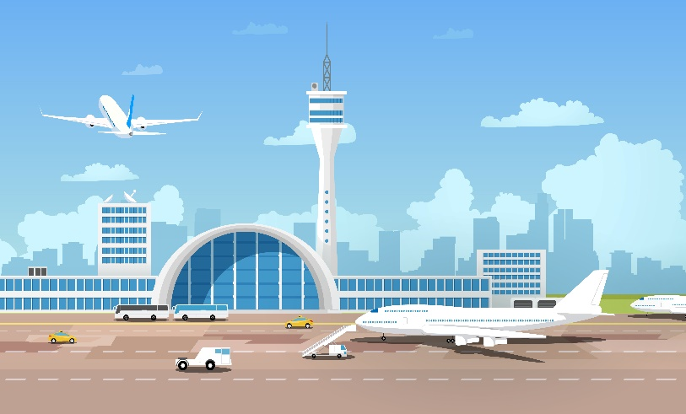
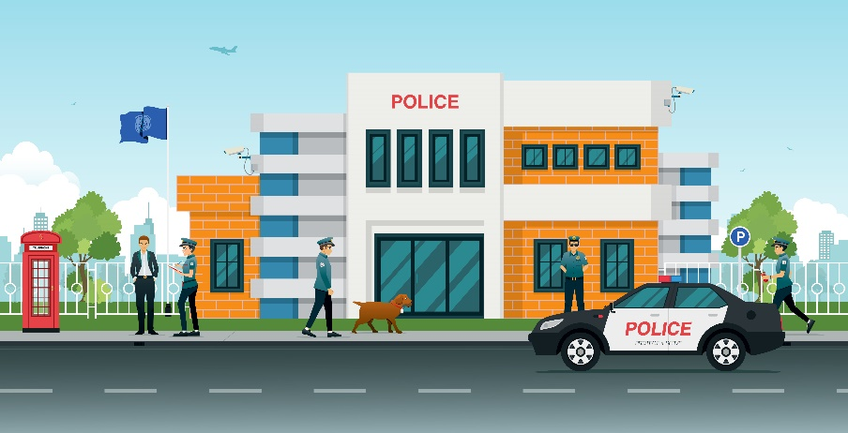
Listen and Point
hospital
airport
police station
fire station
store

Slide 18
Listen and Repeat
hospital
airport
police station
fire station
store

Slide 19
Good job!
Notes:
Point and Say

Slide 20
Listen and Chant
hospital
airport
police station
fire station
store

Slide 21
Good job!
Notes:
Point and Say

Slide 22
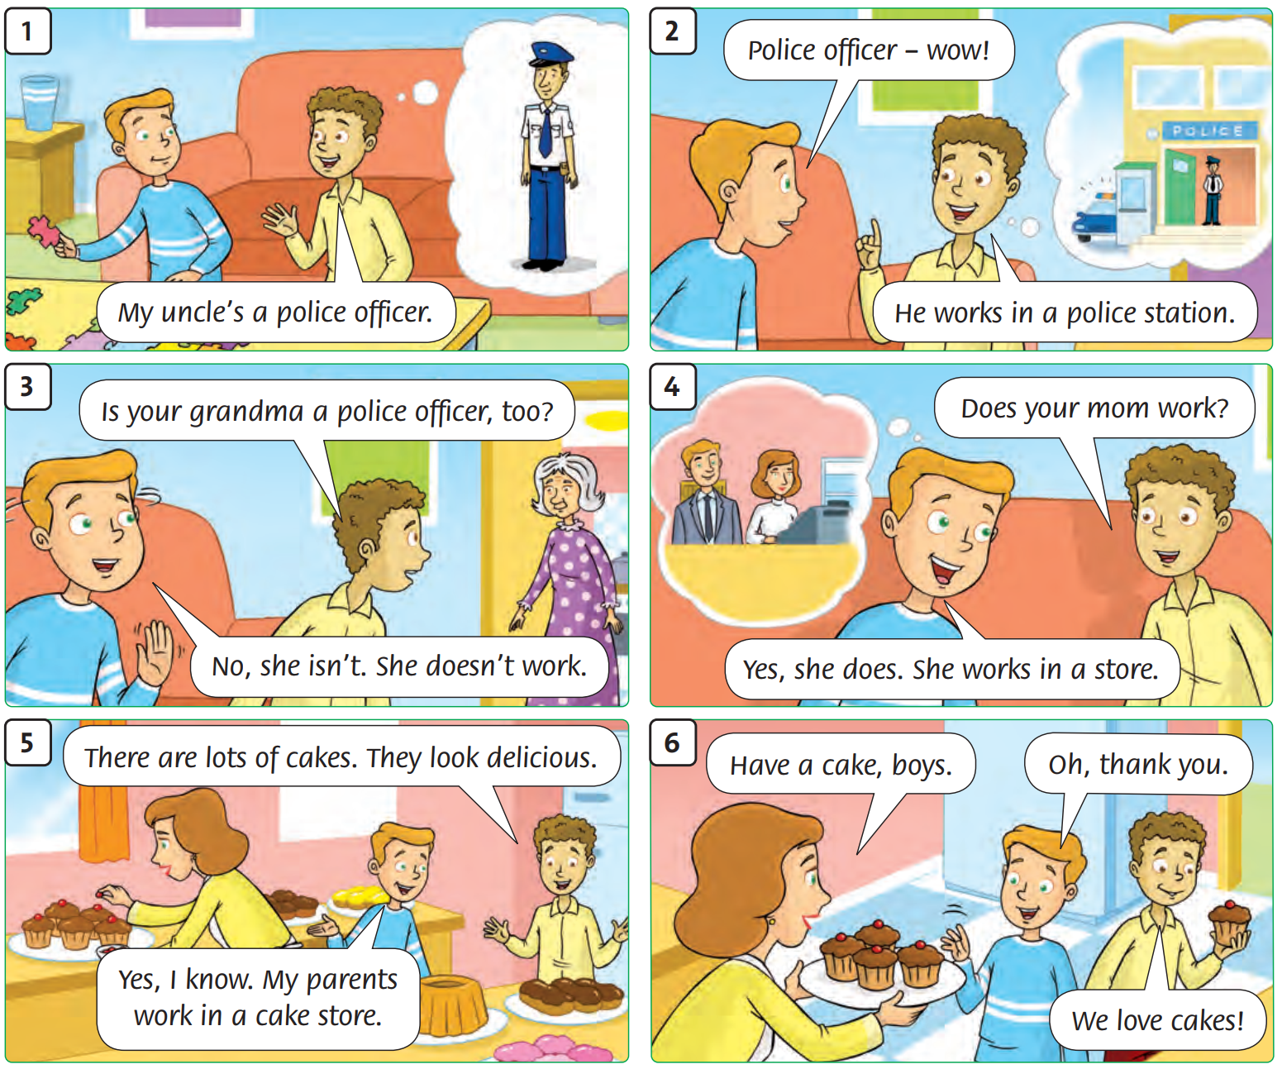
Look and
Answer
Notes:
Ask students to open their books. Look at the pictures in their books and answer the teacher’s questions.
e.g., Who is a police officer? Who works in a cake store?

Slide 23
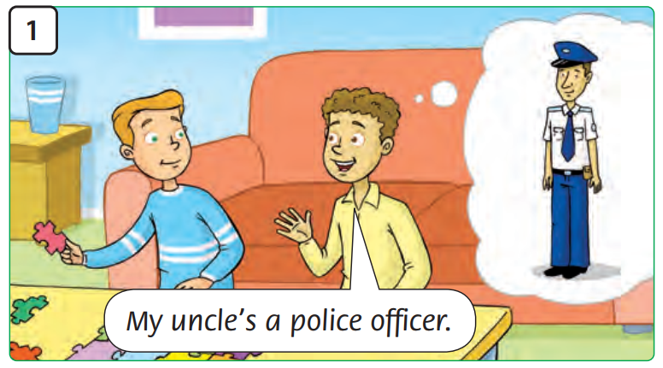
Look and
Say
Notes:
Ask students to open their books. Look at the pictures in their books and guess what people are talking about.
Actions:
Tim and his friend are talking. Tim’s friend stands up tall and straight like a police officer.

Slide 24
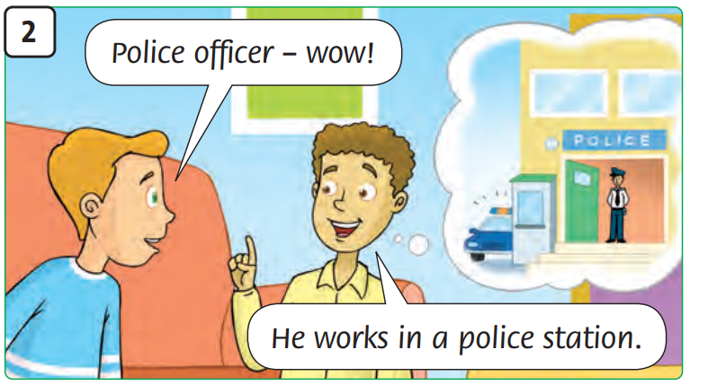
Look and
Say
Notes:
Ask students to open their books. Look at the pictures in their books and guess what people are talking about.
Actions:
Tim’s friend points into the distance (in the direction of the police station).

Slide 25
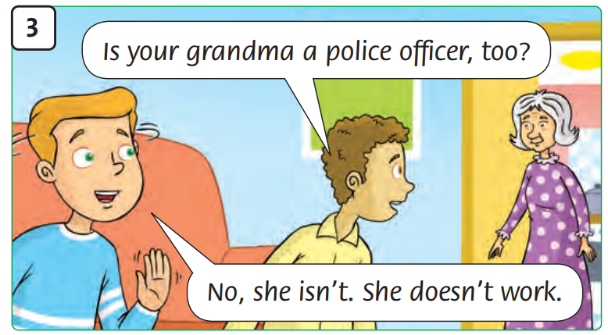
Look and
Say
Notes:
Ask students to open their books. Look at the pictures in their books and guess what people are talking about.
Actions:
Tim’s friend points to Grandma. Tim shakes his head.

Slide 26
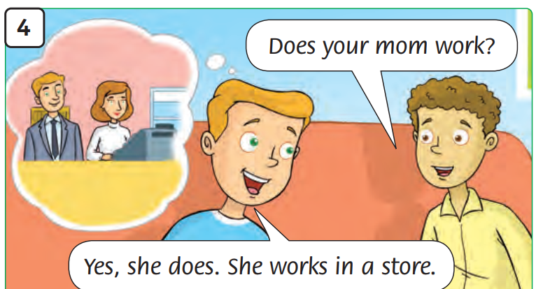
Look and
Say
Notes:
Ask students to open their books. Look at the pictures in their books and guess what people are talking about.
Actions:
Tim’s mom mimes using a cash register.

Slide 27
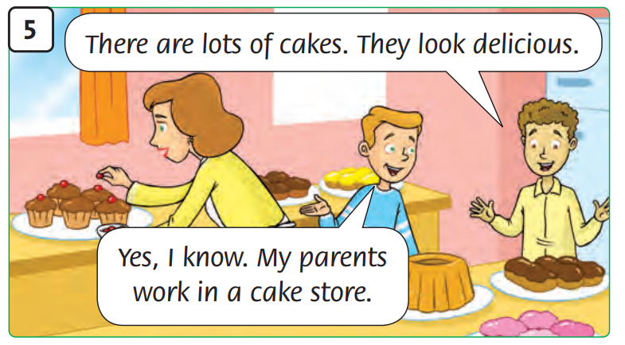
Look and
Say
Notes:
Ask students to open their books. Look at the pictures in their books and guess what people are talking about.
Actions:
Tim’s mom puts small cakes on a plate.

Slide 28
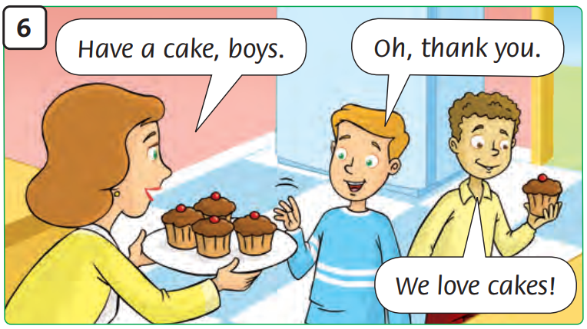
Look and
Say
Notes:
Ask students to open their books. Look at the pictures in their books and guess what people are talking about.
Actions:
Tim’ mom offers small cakes to the boys.

Slide 29
Listen and
Point
Notes:
Ask students to open their books. Listen and point to the pictures. .

Slide 30
Listen and
Repeat
Notes:
Ask students to open their books. Listen and repeat.

Slide 31
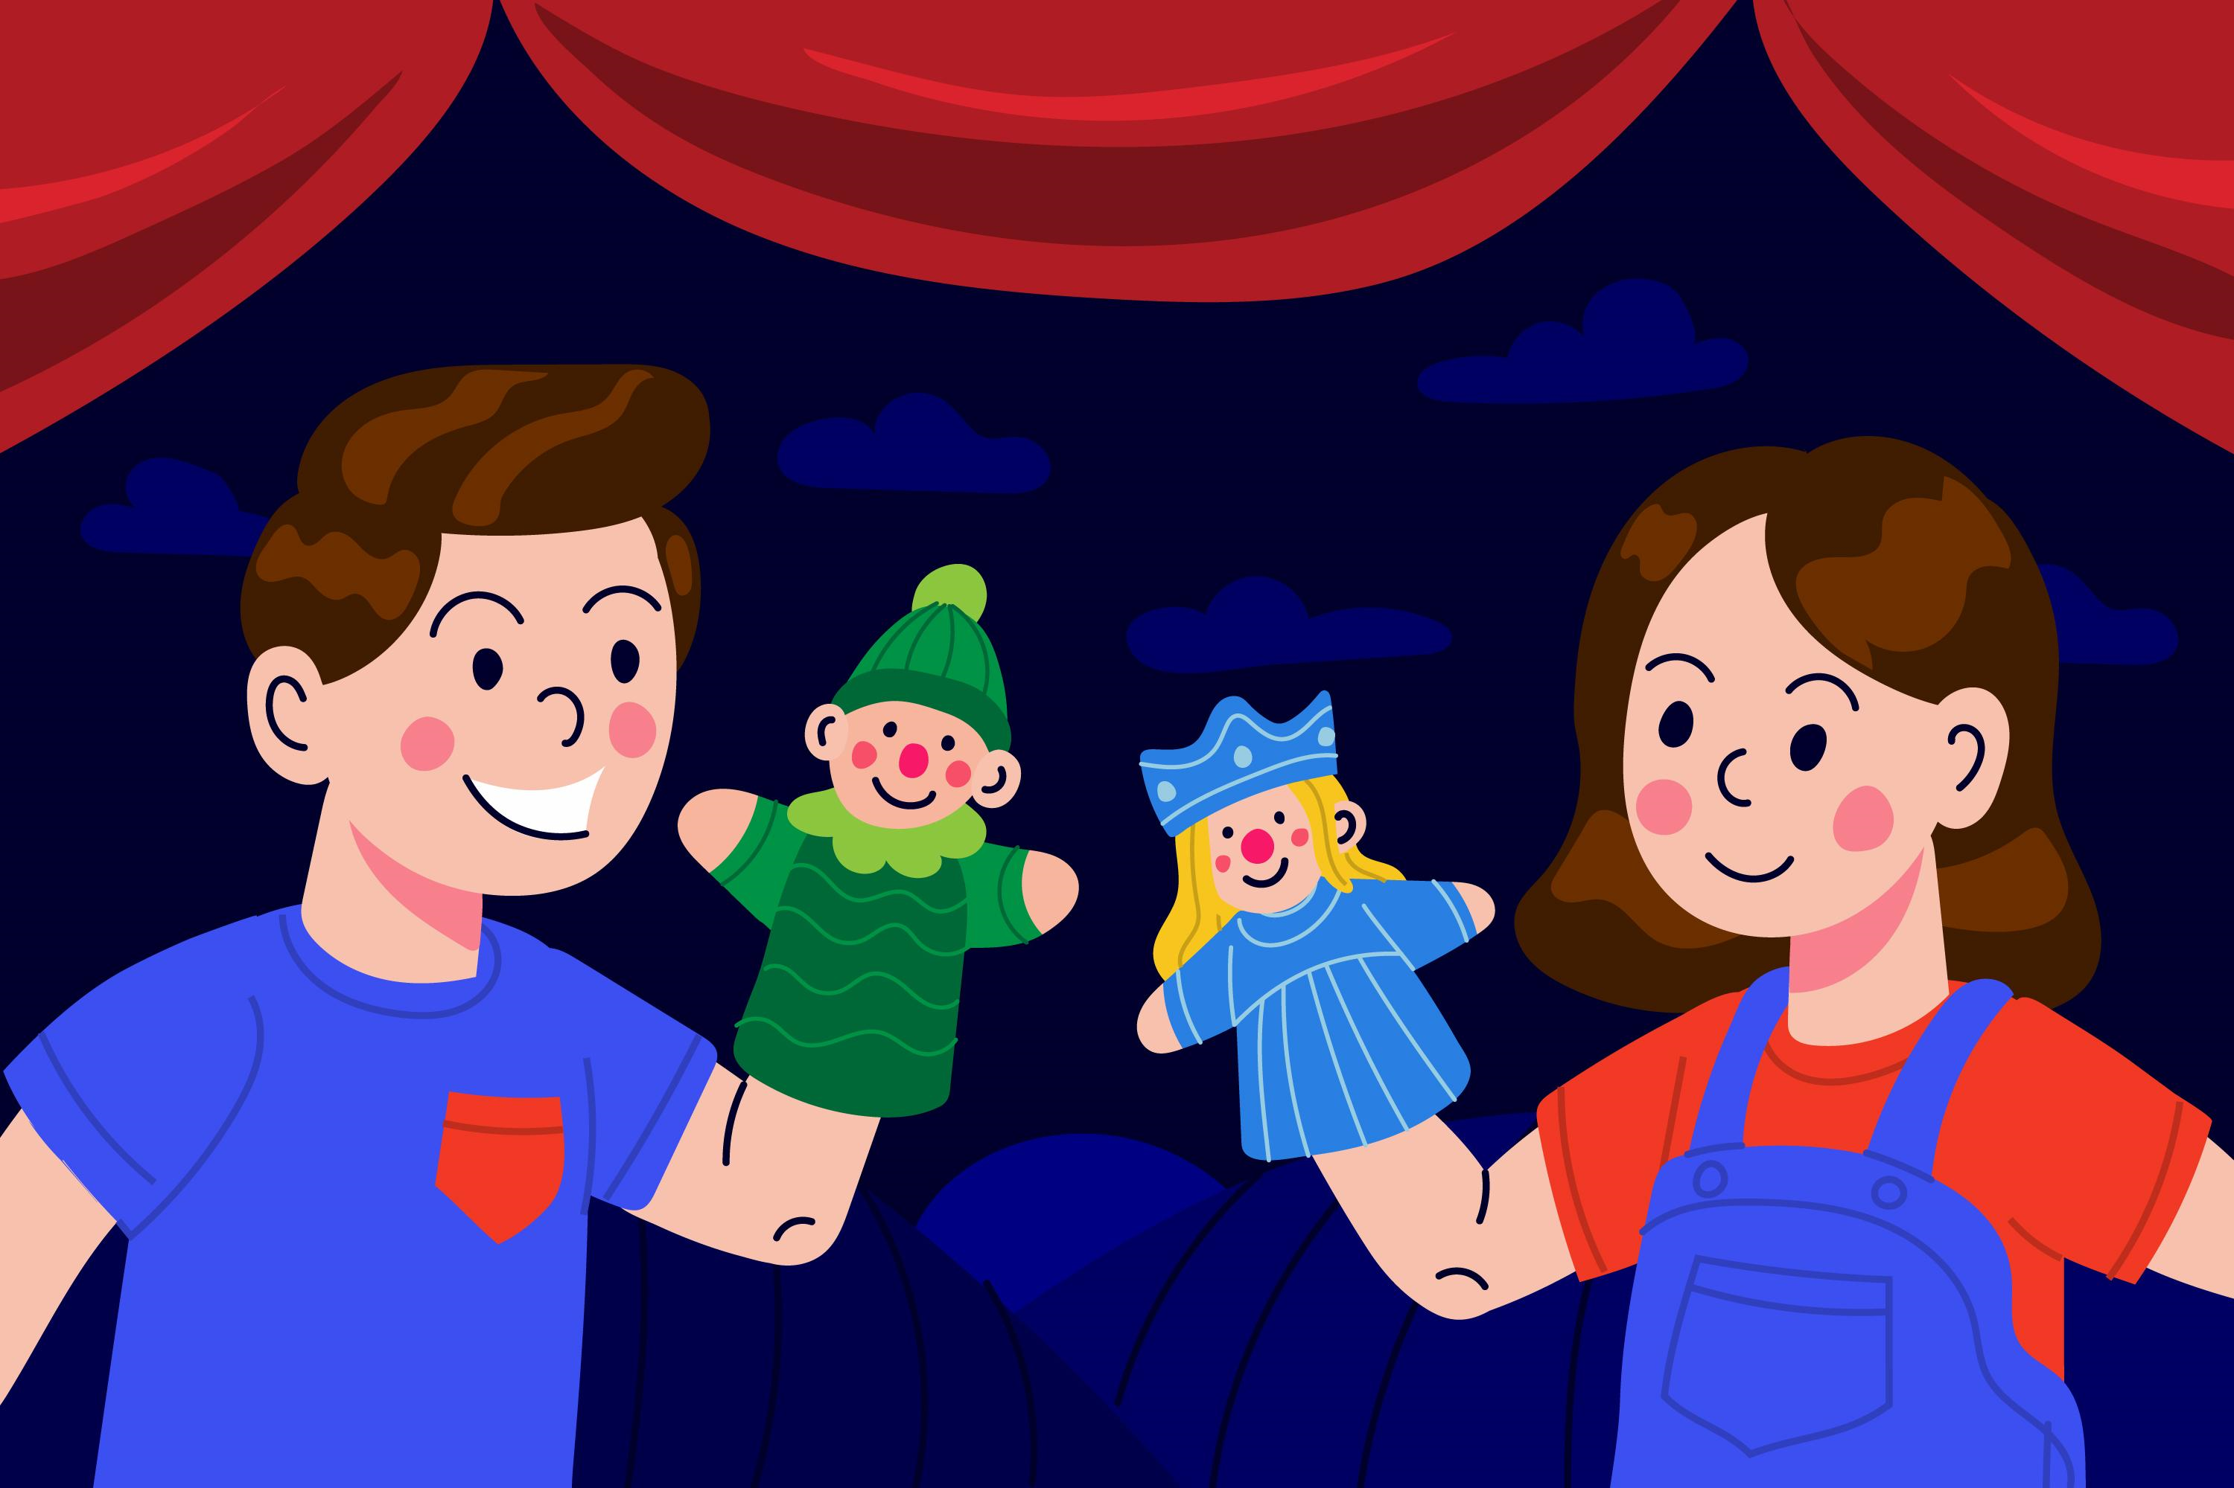
Story Actions
Notes:
Ask students to work in groups of three (Tim, Tim’s friend and Tim’s mom). They do role-play in 5 minutes.

Slide 32
Homework
Learn new words by heart.
Do the exercises in Workbook p.16.
Prepare for the next lesson
(Unit 2 - Lesson 2/Part 1).

Slide 33
Our Winners!
Peter
Eric
Julie
Notes:
Replace photos and names with your students’ information.

Slide 34
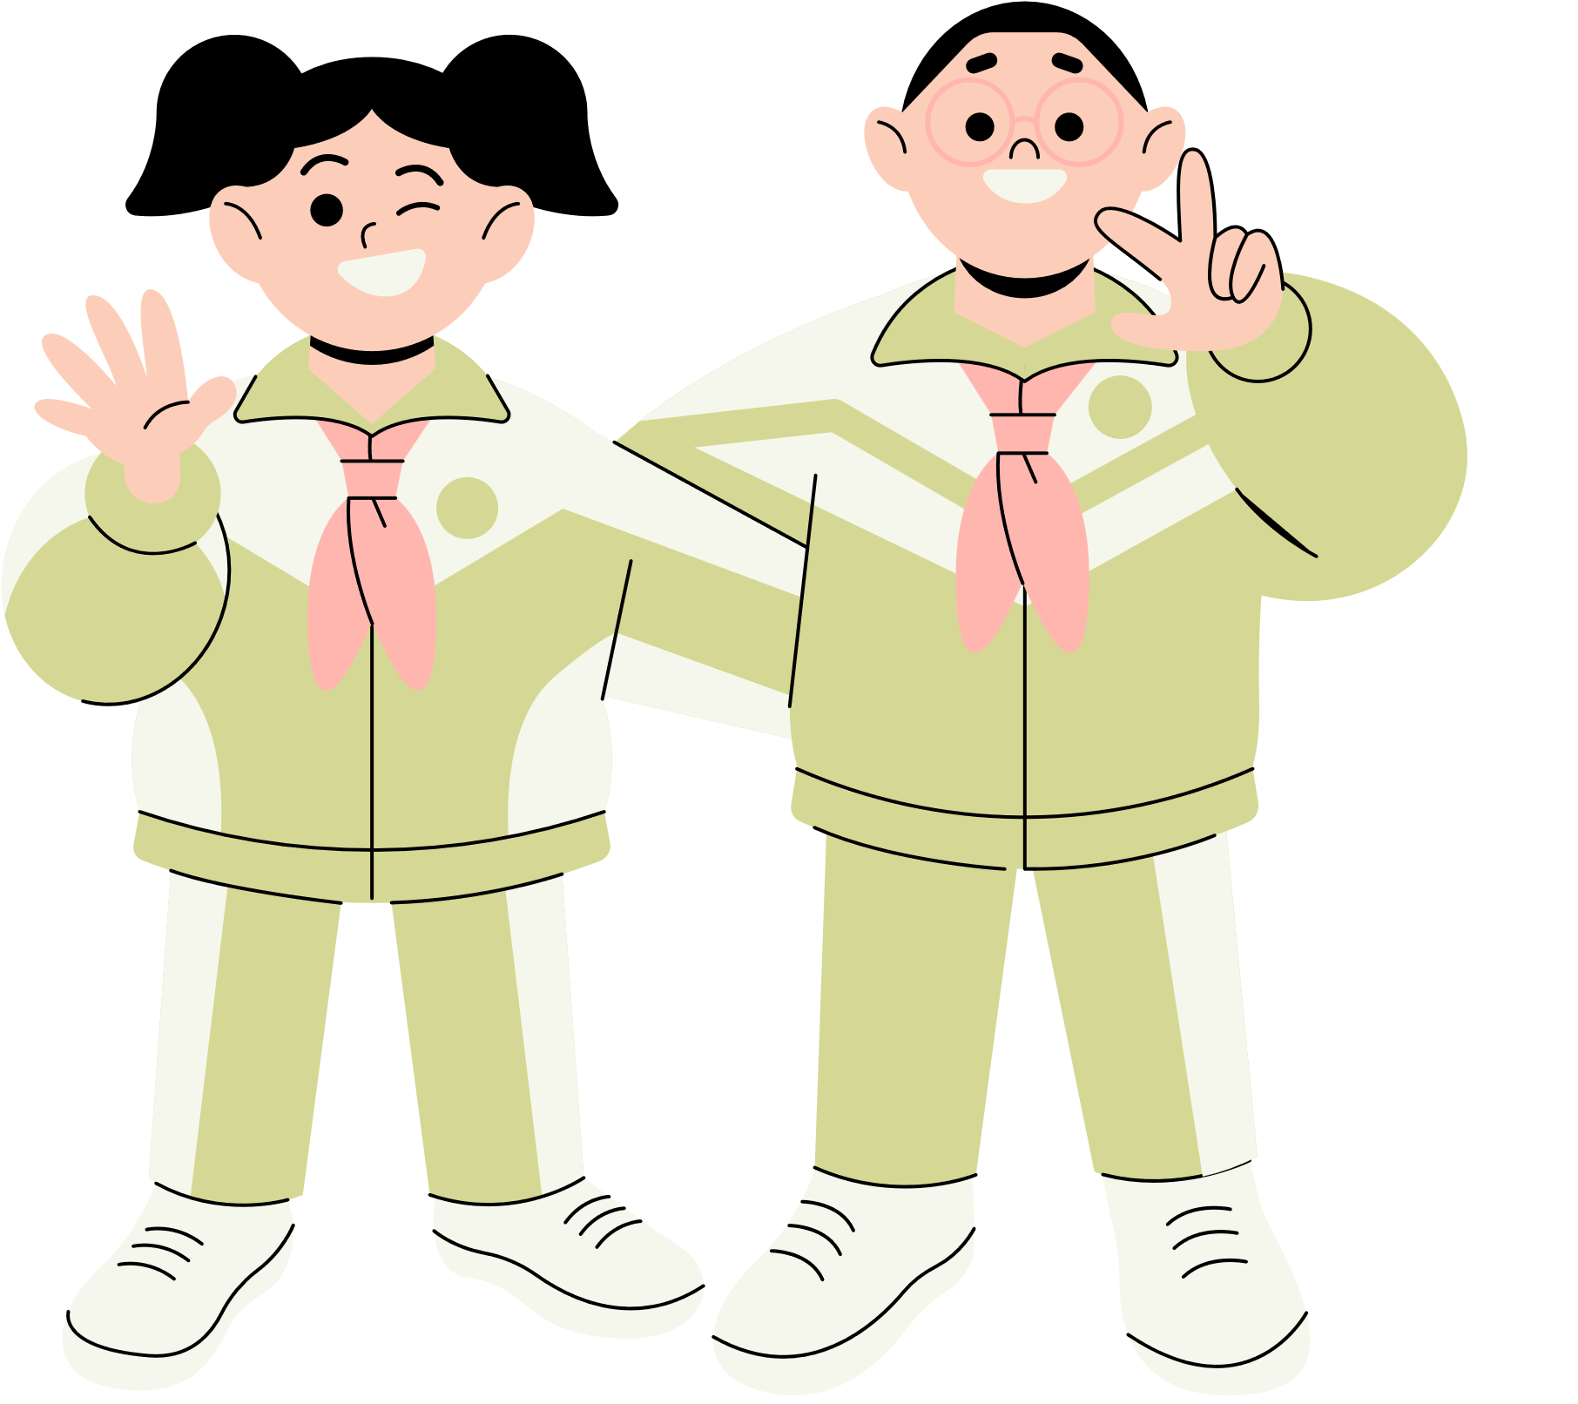
Thank You!
See You Next Time.
Notes:
https://www.youtube.com/watch?v=SRyFiVeNjWs

