Slide 2

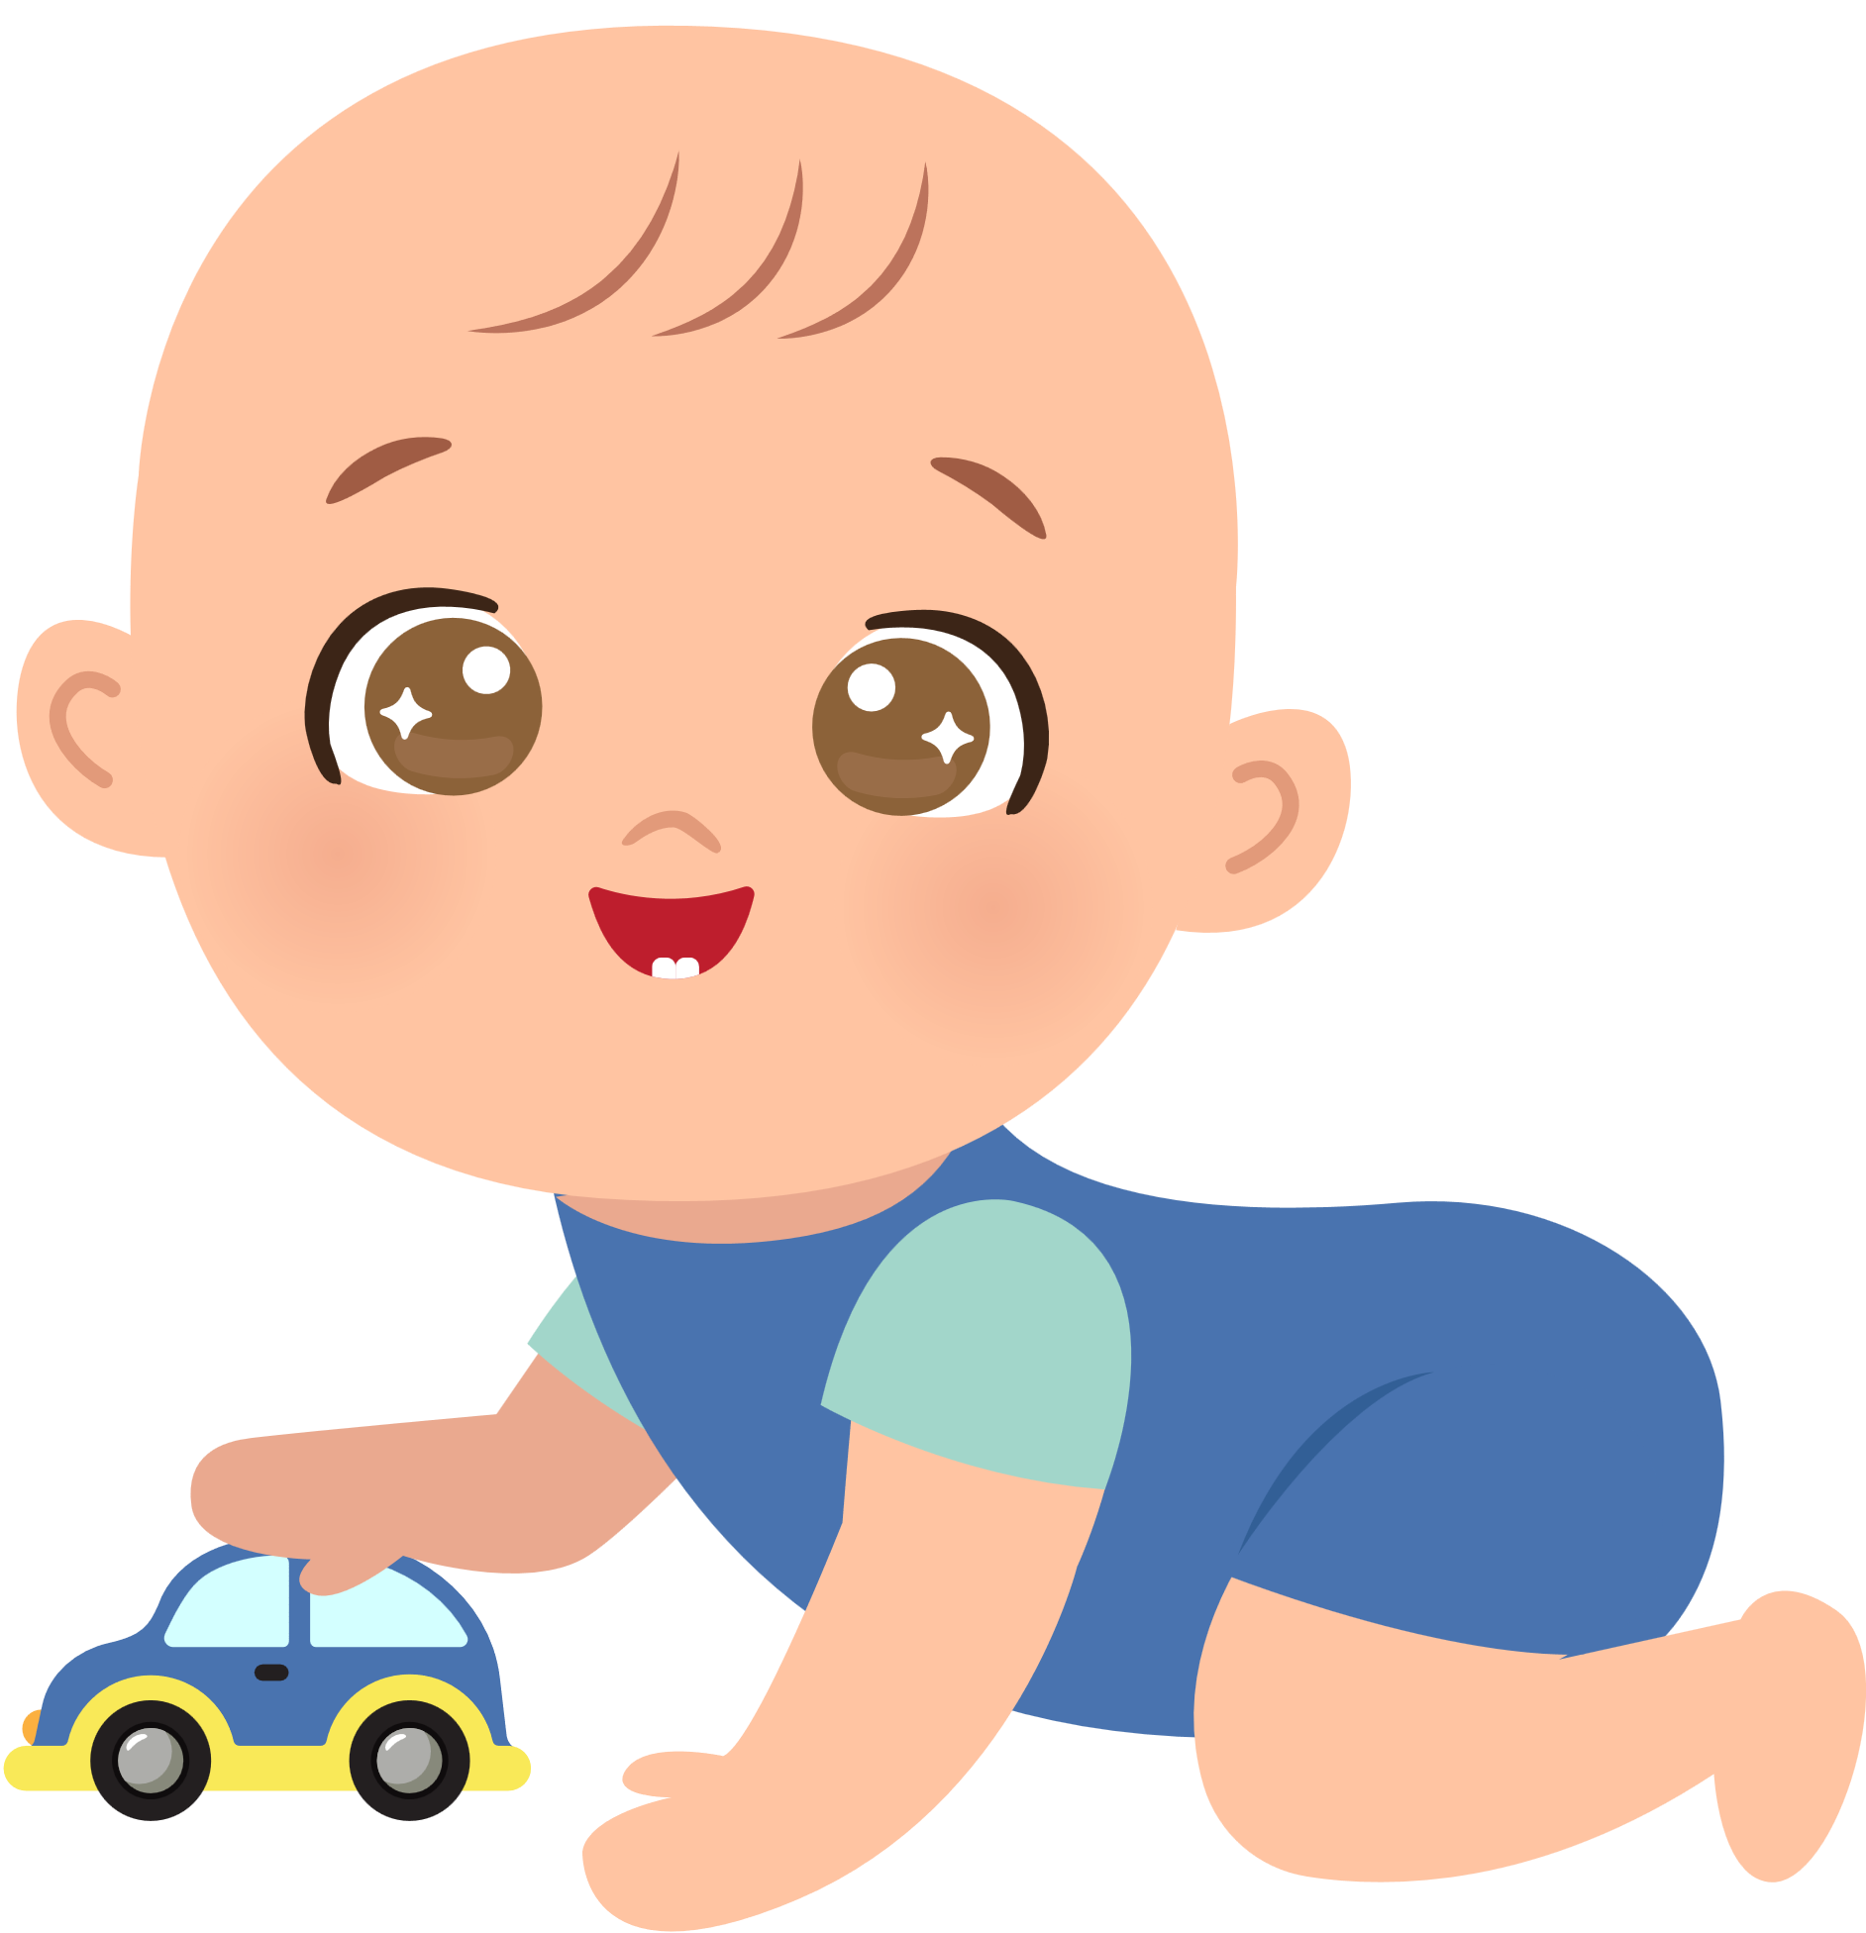
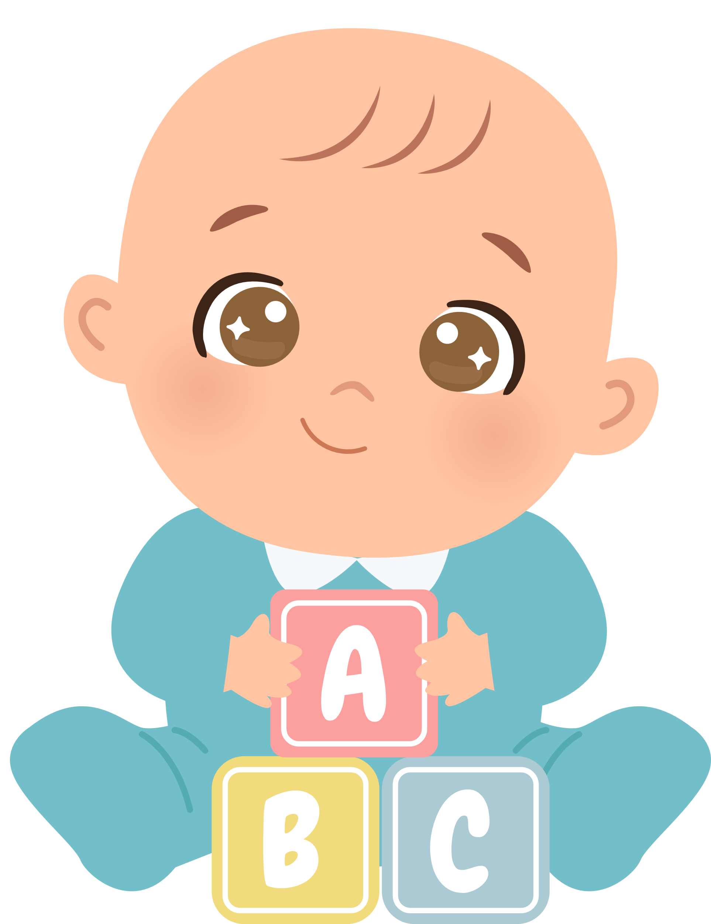

Unit 12
A SMART BABY!
Lesson 6 – Skills Time! – Period 2

Slide 3





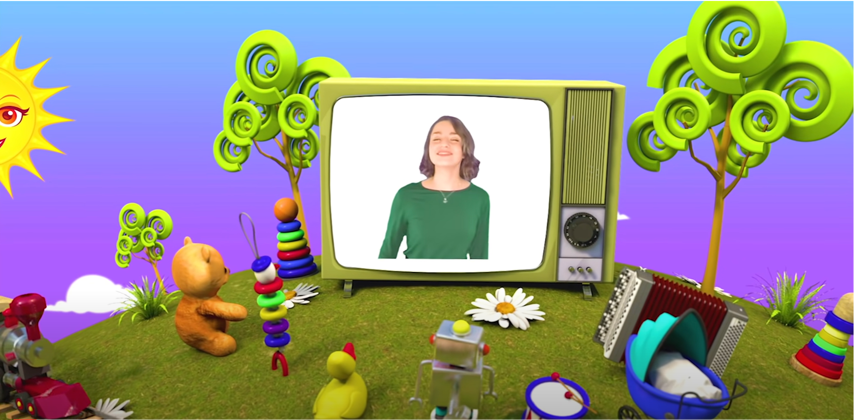
HELLO SONG
Notes:
https://www.youtube.com/watch?v=pqDEwPi7vxg

Slide 4







Slide 5

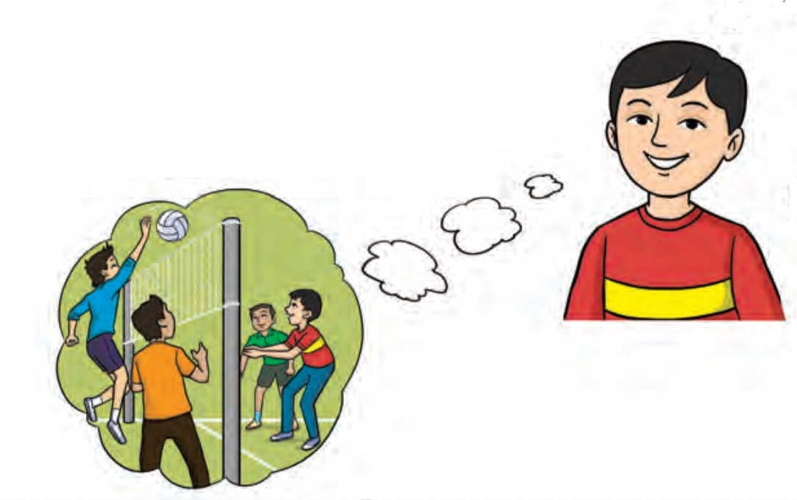

Game:
TALK ABOUT WHERE YOU WERE YESTERDAY!
Yesterday I was at school with my friends.
Notes:
* Mingle: Talk about where you were yesterday.
Play music, children move around to tell each other where they were yesterday, following the pattern in the speech bubble.

Slide 6
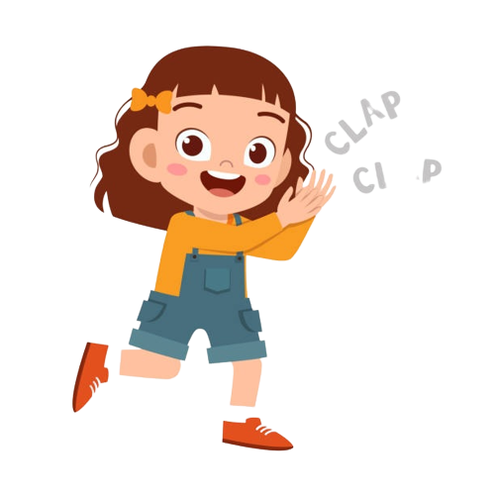
Good job!

Slide 7

Let’s write!
AN ARTICLE for YOUR ENGLISH CORNER
Notes:
* Write a party invite to a friend. Give directions. Look at page 86 to help you.
Tell the children that they are going to write a party invite to a friend.

Slide 8

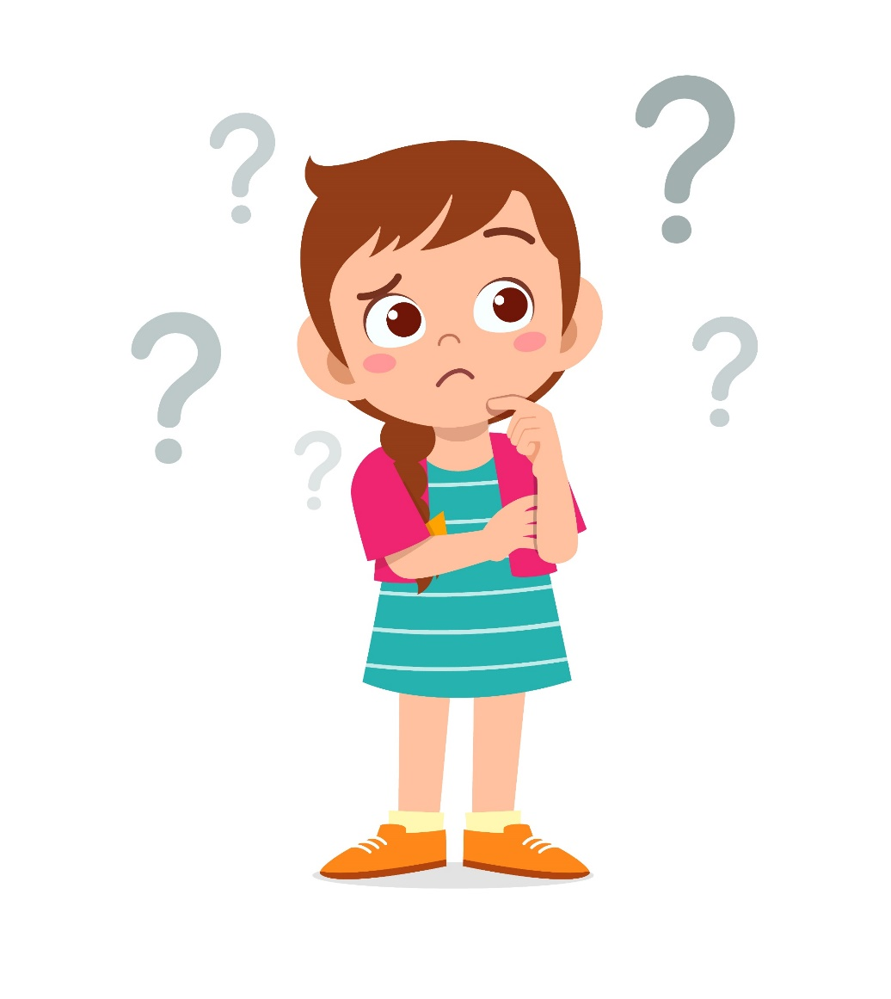
Let’s think!
Where were you last weekend?
1-minute THINKING time
Notes:
* Write an article about where you were last weekend. You can start with the example.
Children think about where they were last weekend in 1 minute.
In pairs, talk about it.

Slide 9
Let’s write!
Last Saturday, I was at soccer class with my friends. It was fun.
Last Sunday, ...............................
Notes:
Write the first sentence on the board.
Ask who also was at soccer class last Saturday. If any child says they were, ask them if it was fun.
Identify children who didn’t play soccer last Saturday and ask Where were you? Who was with you? What was the weather like? Was it fun?

Slide 10
Let’s write!
AN ARTICLE for YOUR ENGLISH CORNER
Last Saturday, I was at soccer class with my friends. It was fun.
Last Sunday, ...............................
Notes:
Encourage the children to write true, complete sentences in their notebooks.

Slide 11
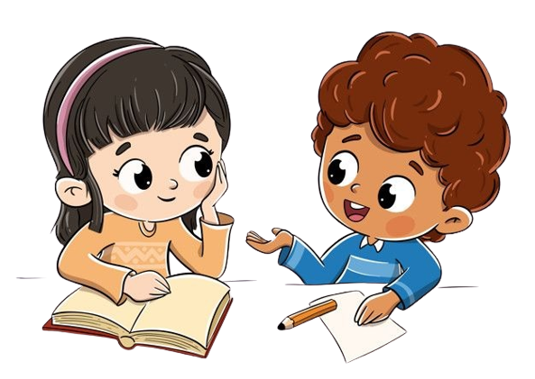

Work in Pairs.
Notes:
When they have finished, the children read their sentences to a partner and compare what they have written.

Slide 12
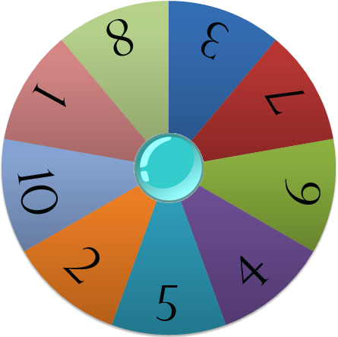
Let’s talk!
Start
Notes:
Number children from number 1 to 10.
Click START to spin the wheel.
The children with that number will talk about their writing.

Slide 13




Quiz Bee
?
?

Slide 14


Round 1
Round 2
Round 3
True
or False
Multiple Choice
Problem Solving

Slide 15


Round 1

Slide 16


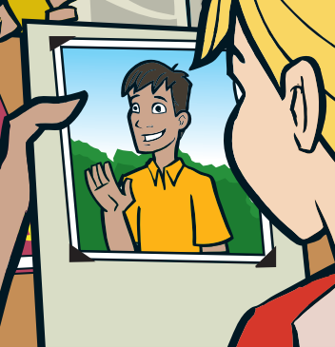

Question No. 1
Dad was old.
TRUE
FALSE

Slide 17
Answer
Dad was old.
TRUE
FALSE

Slide 18

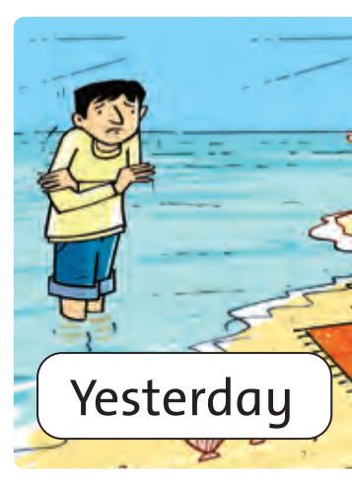
Question No. 2
Yesterday he was at the beach.
He was very cold.
TRUE
FALSE

Slide 19
Answer
Yesterday he was at the beach.
He was very cold.
TRUE
FALSE

Slide 20


Question No. 3
They were young.
TRUE
FALSE

Slide 21
Answer
They were young.
TRUE
FALSE

Slide 22
Round 2

Slide 23

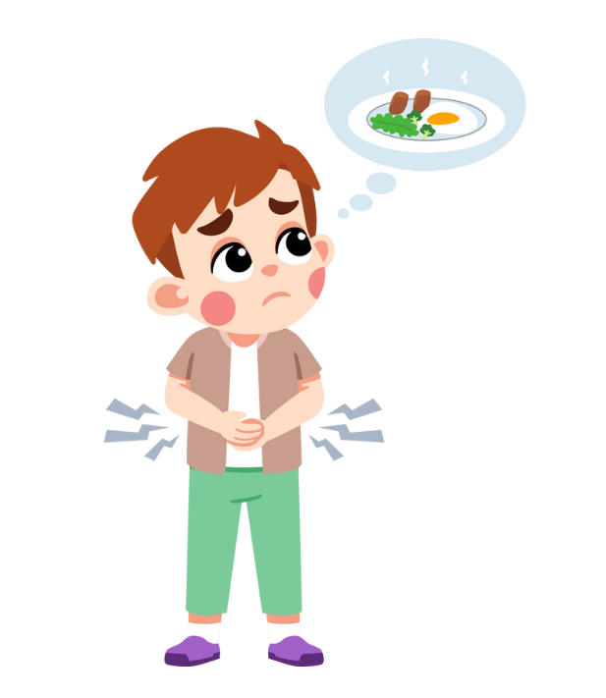
Question No. 1
A. He was hungry.
B. He was thirsty.
C. He was full.
D. He was happy.

Slide 24
Answer
A. He was hungry.
B. He was thirsty.
C. He was full.
D. He was happy.

Slide 25



Question No. 2
A. was
B. were
C. weren’t
D. wasn’t

Slide 26
Answer
A. was
B. were
C. weren’t
D. wasn’t

Slide 27

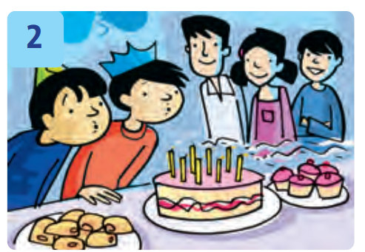
Question No. 3
A. was
B. were
They ..... at a party.
C. weren’t
D. wasn’t

Slide 28
Answer
A. was
B. were
They ..... at a party.
C. weren’t
D. wasn’t

Slide 29
Round 3

Slide 30


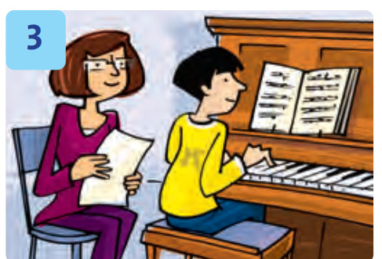
Question No. 1
Where was the boy yesterday?

Slide 31
Answer
He was at piano class.
Where was the boy yesterday?

Slide 32


Question No. 2
Where was the vet last night?

Slide 33
Answer
He was at the clinic.
Where was the vet last night?

Slide 34


Congratulations!

Slide 35


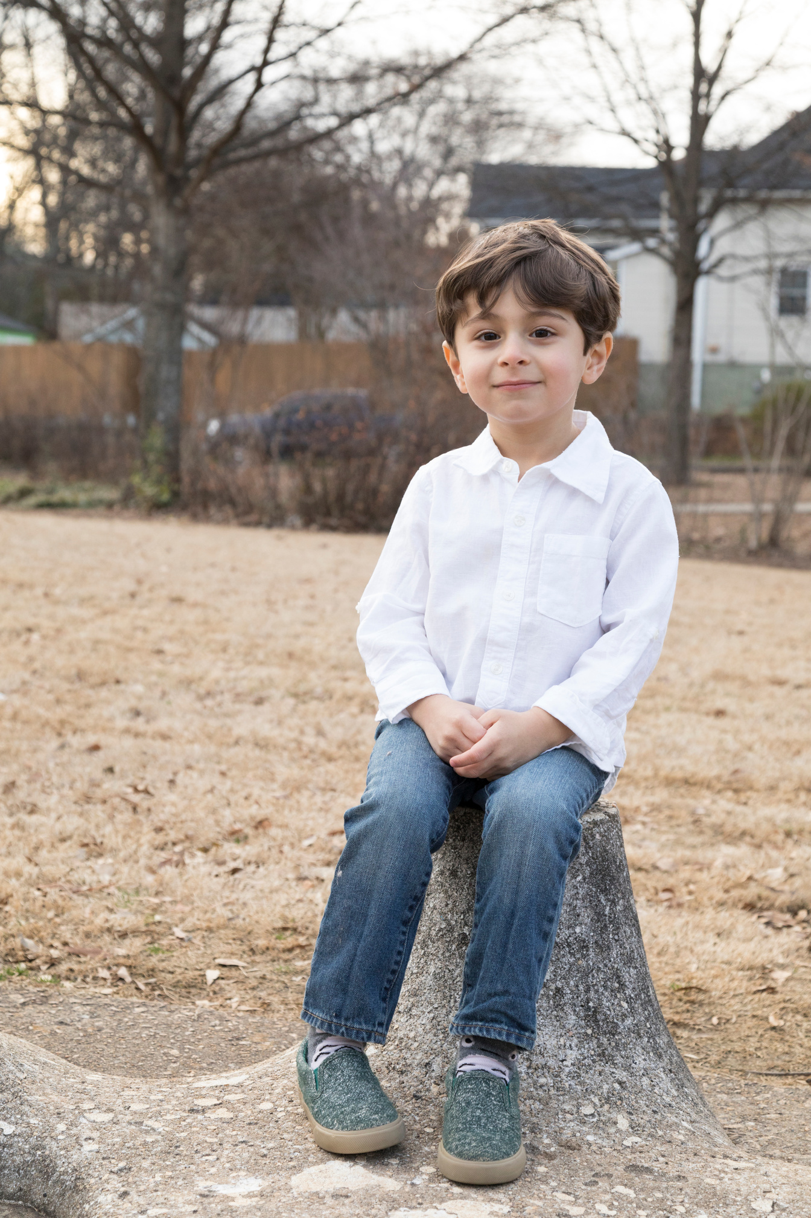
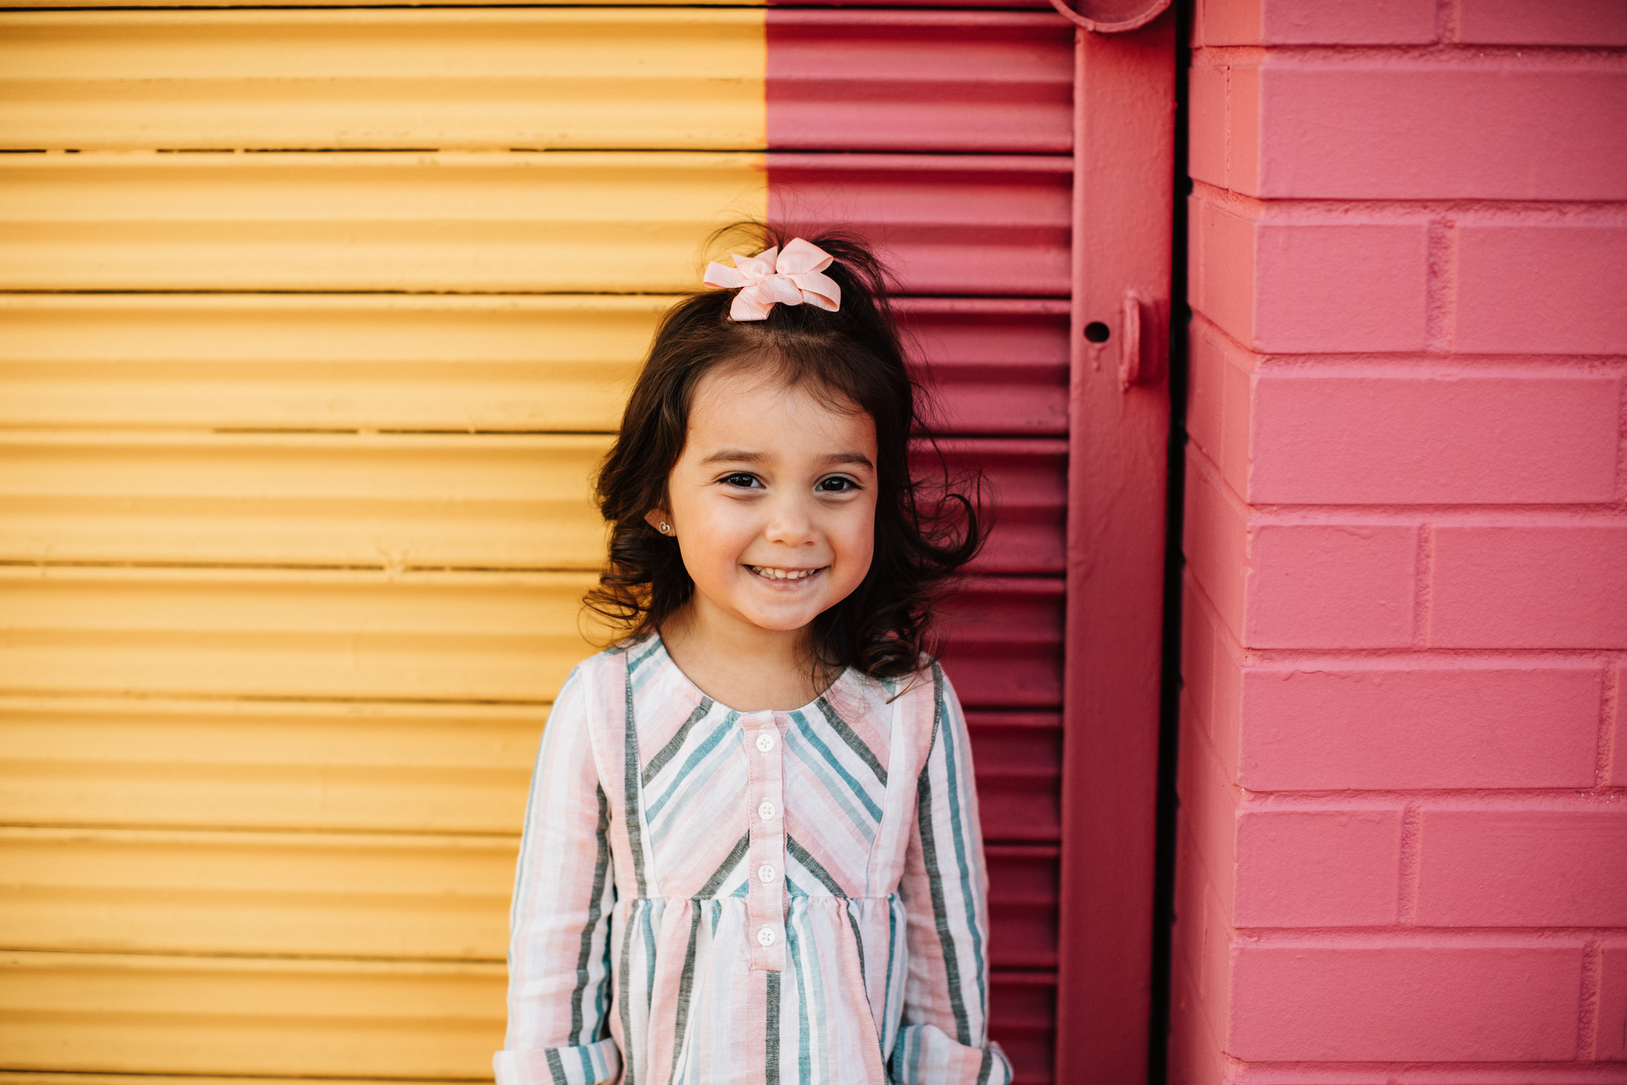

Our Winners!
Peter
Eric
Julie
Notes:
Replace photos and names with your students’ information.

Slide 36



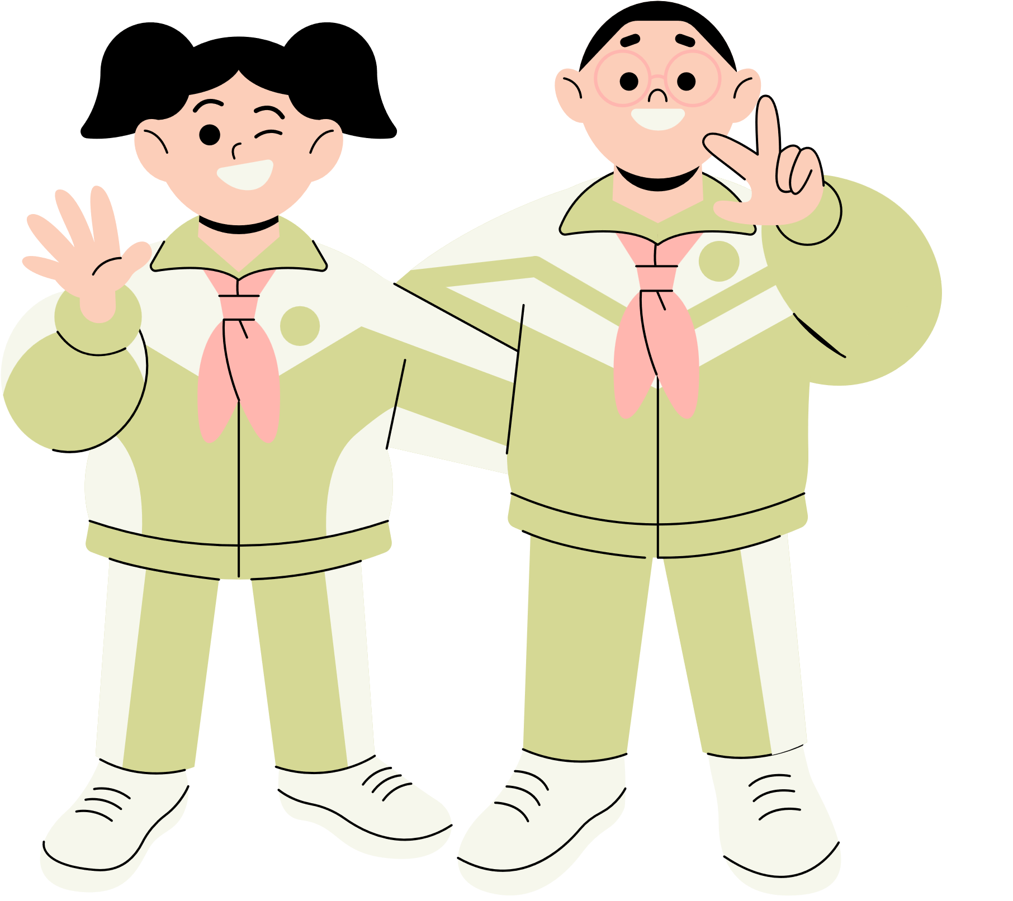







Thank You!
See You Next Time!
Notes:
https://www.youtube.com/watch?v=SRyFiVeNjWs

