Slide 2

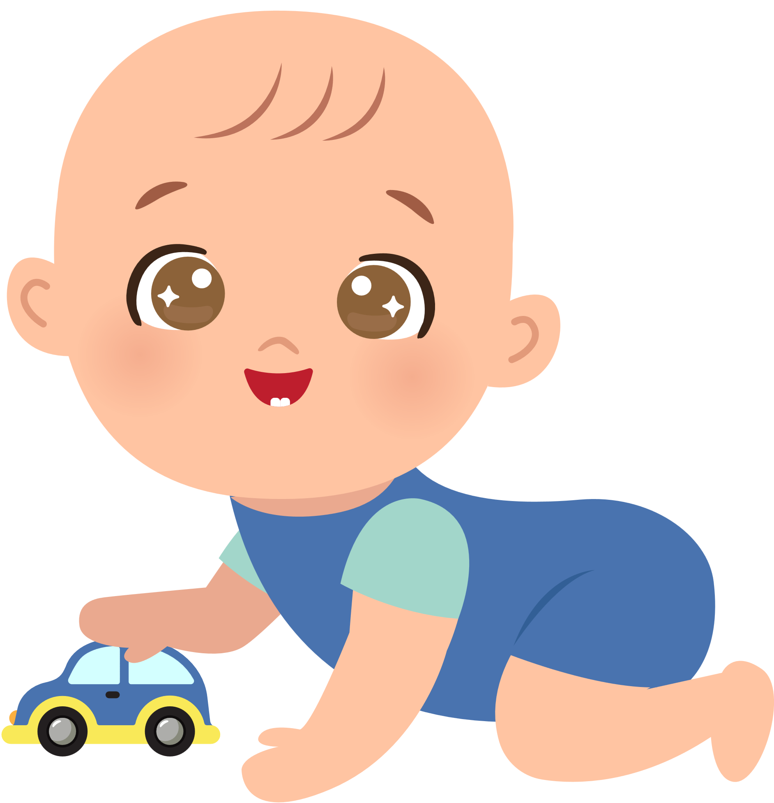


Unit 12
A SMART BABY!
Lesson 5 – Skills Time!

Slide 3





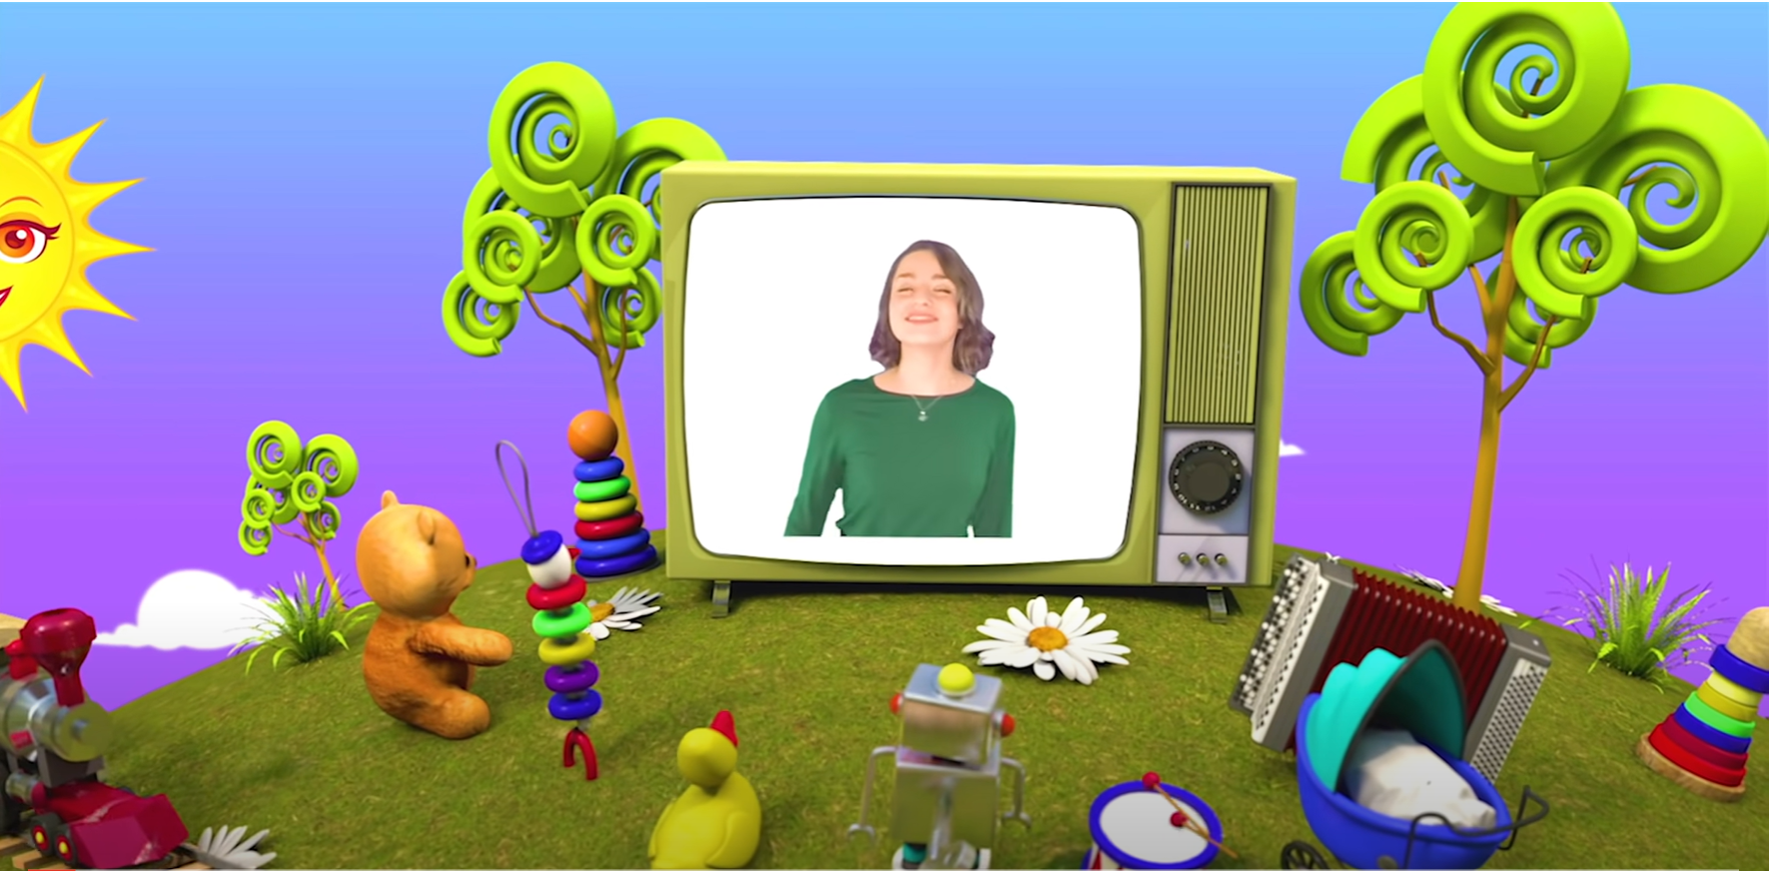
HELLO SONG
Notes:
https://www.youtube.com/watch?v=pqDEwPi7vxg

Slide 4







Slide 5


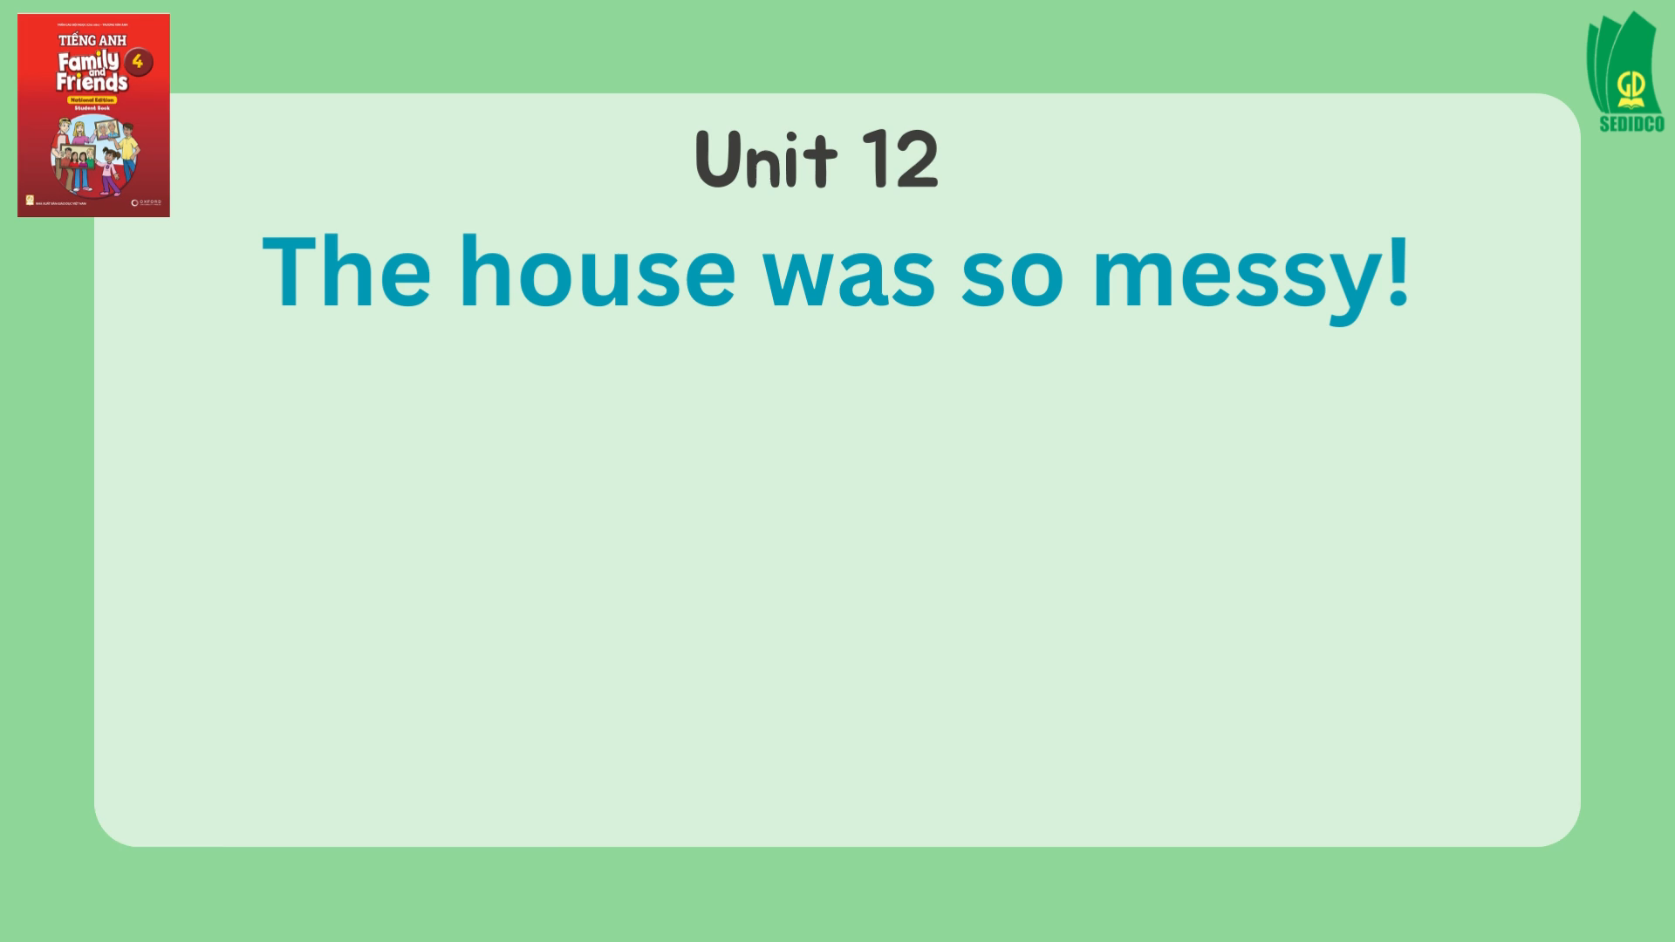
Sing and Do.
Notes:
* Warmer – Track 146
Sing The house was so messy! from page 90.

Slide 6
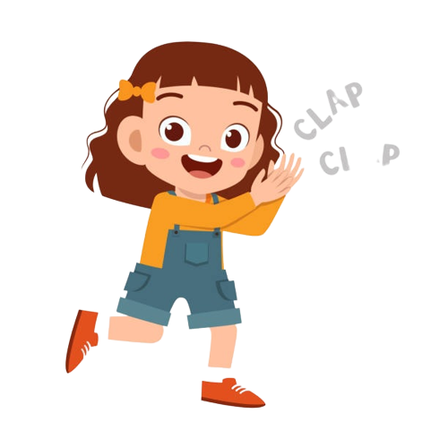
Good job!

Slide 7
Let’s Discuss!
Our school play
Notes:
* Lead-in
Write on the board Our school play and elicit the meaning.
If your school puts up school plays, ask the children if they have ever performed in one or seen one.

Slide 8
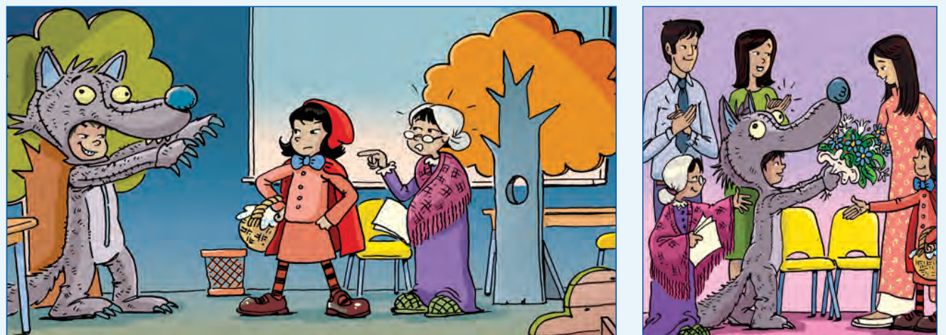
Look and Say.
92
Notes:
Ask children to open their books to page 92 and look at the pictures in the article.

Slide 9
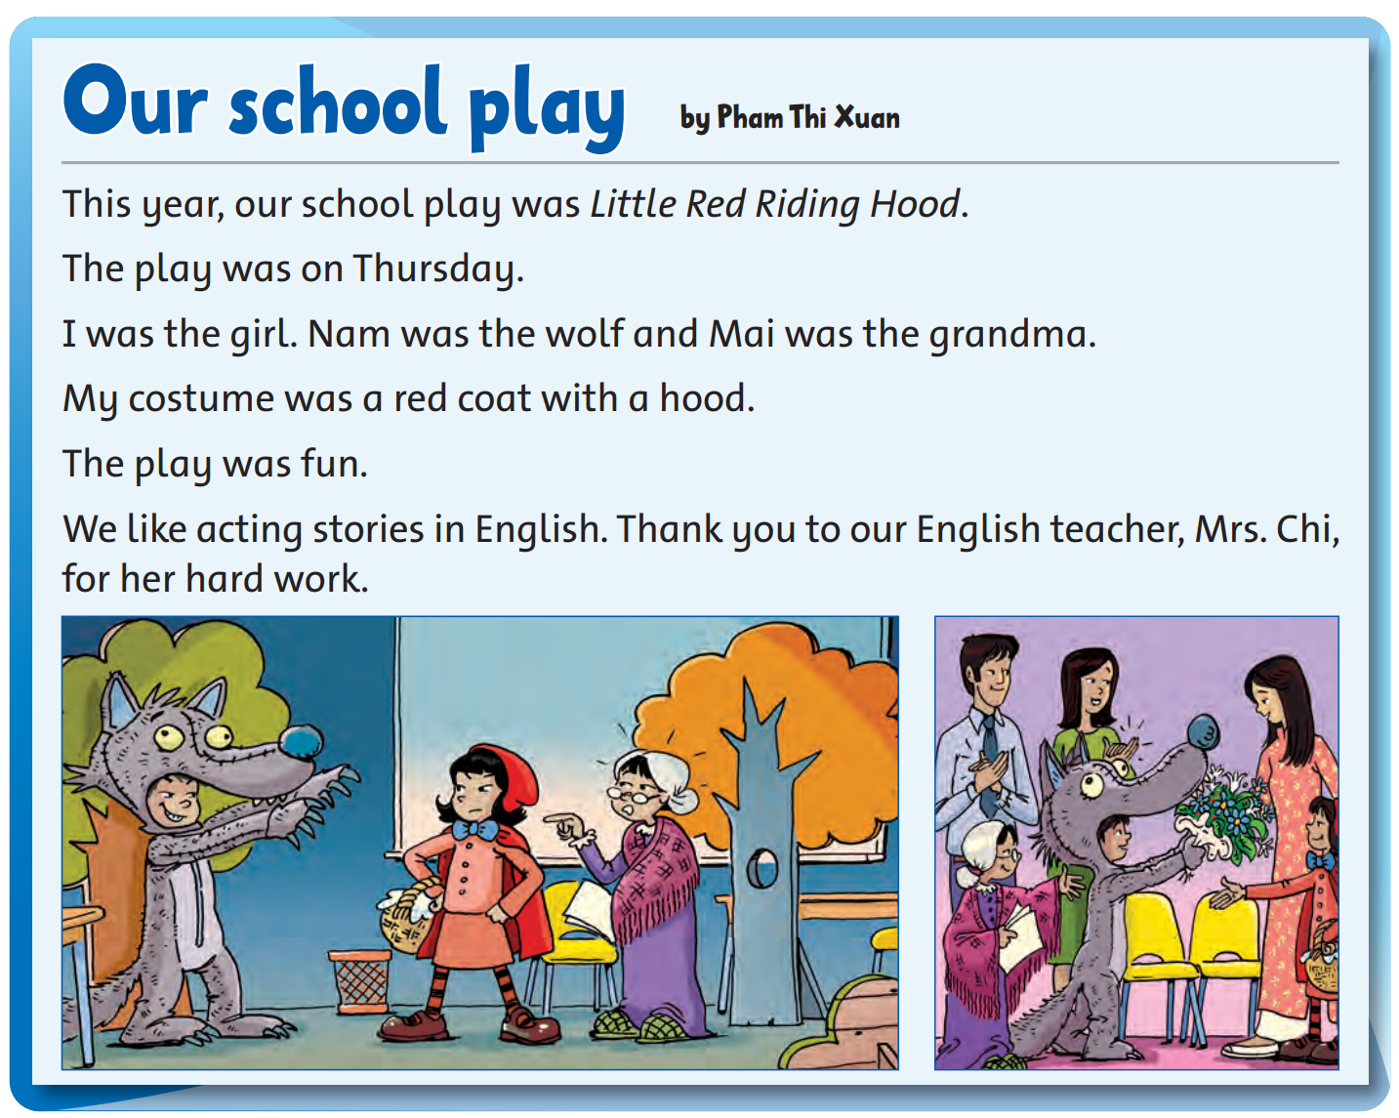
Look and Answer.
92
Notes:
Ask What kind of text is this? (a blog post or a school paper article). Do you know the characters in the story? What story is it? (Little Red Riding Hood). What happens in the story?
If children know the story of Little Red Riding Hood, encourage them to tell you what happens. If not, briefly tell them the story.

Slide 10
Listen and Answer.
92
Notes:
* Look at the pictures. What are the children wearing?
Ask children to look at the pictures again. Point to the different children and ask What’s he / she wearing? Ask the children what character they think each child is playing.
Answers
One girl is wearing a red sweater, a skirt, socks, shoes, and a coat.
Another girl is wearing a purple dress and green slippers.
A boy is wearing a wolf’s costume.

Slide 11

Listen and Point.
92
Notes:
* Listen and read. Track 149
Tell the children they are going to listen to the story.
Play Track 149. Children listen and follow along.
Play the recording again and answer any questions.

Slide 12
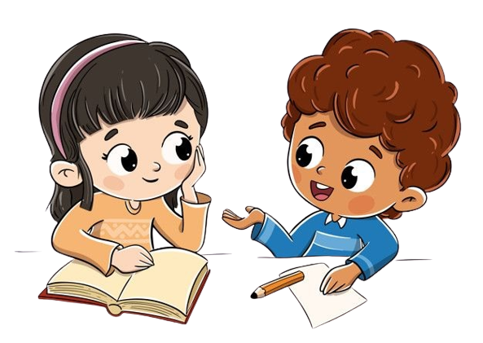
Read and Answer.
92
1. Who was Xuan in the school play?
2. What was her costume?
3. Does he like English class?
4. Who were Nam and Mai in the school play?
5. How was the play?
Notes:
Ask comprehension questions, e.g. Who was Xuan in the school play? What was her costume? Does she like her English class?
Children work in pairs to ask and answer the questions.

Slide 13
Ask and and Answer.
92
1. Who was Xuan in the school play?
She was the girl.
2. What was her costume?
It was a red coat with a hood.
3. Does he like English class?
Yes, he does.
Notes:
Check the answers to the questions you asked before the children read the texts. Then answer any questions they have.

Slide 14
Ask and and Answer.
92
4. Who were Nam and Mai in the school play?
Nam was the wolf and Mai was the Grandma.
5. How was the play?
It was fun.
Notes:
Check the answers to the questions you asked before the children read the texts. Then answer any questions they have.

Slide 15
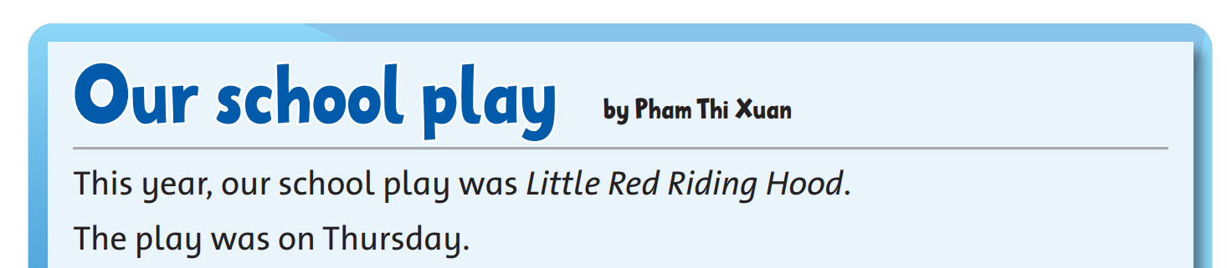

Read again and Write T (true) or F (false).
1. The play was on Tuesday.
T
F
Notes:
* Read again and write T (true) or F (false).
Ask children to close their books. Write the example sentence onto the board.

Slide 16
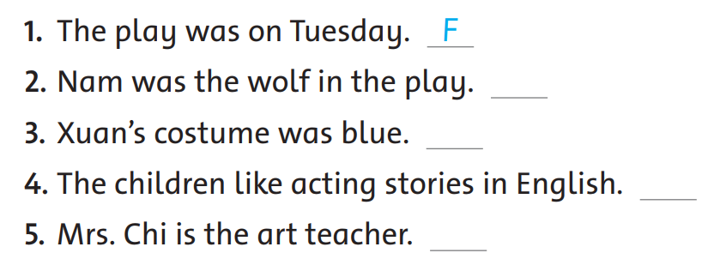
Read again and Write T (true) or F (false).
Notes:
Ask children to read the sentences silently.
Children do the exercise individually.

Slide 17
Work in Pairs
Notes:
Children work in pairs to peer-check their answers.

Slide 18
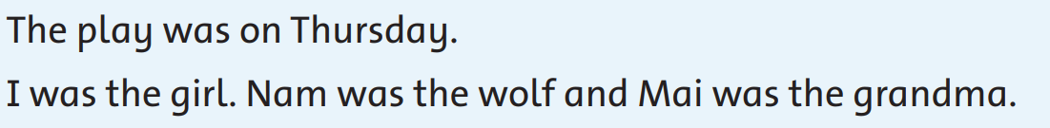



Let’s check!
2. Nam was the wolf in the play.
T
F
Notes:
Answers
1 F 2 T 3 F 4 T 5 F

Slide 19
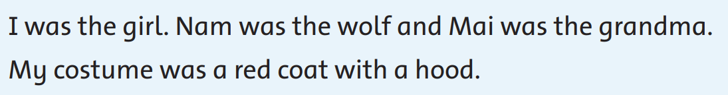

Let’s check!
3. Xuan’s costume was blue.
T
F
Notes:
Answers
1 F 2 T 3 F 4 T 5 F

Slide 20
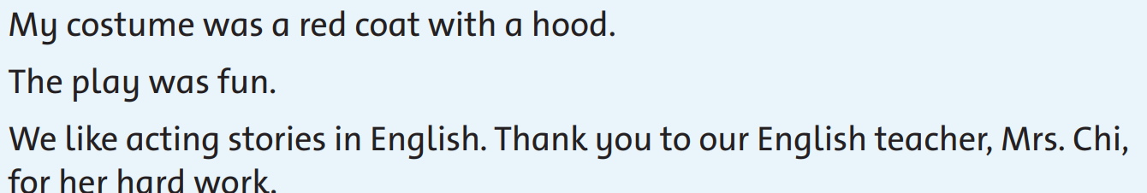

Let’s check!
4. The children like acting stories in English.
T
F
Notes:
Answers
1 F 2 T 3 F 4 T 5 F

Slide 21

Read again and Write T (true) or F (false).
5. Mrs. Chi is the art teacher.
T
F
Notes:
Answers
1 F 2 T 3 F 4 T 5 F

Slide 22
Good job!

Slide 23

Game: MINGLE!
What play do you know?
What is the story about?
Notes:
* What plays do you know?
Ask individuals what plays they know and what the story is about.
Encourage them to ask other children the question.

Slide 24


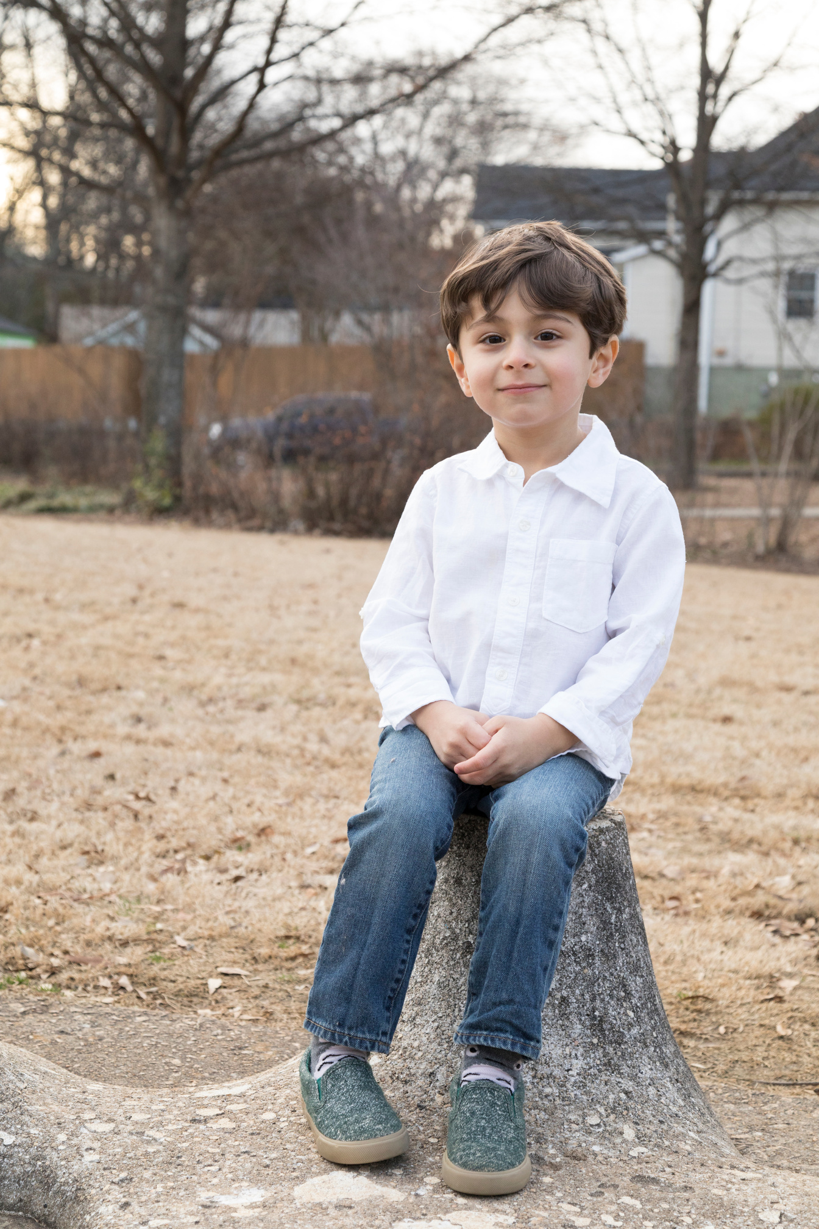
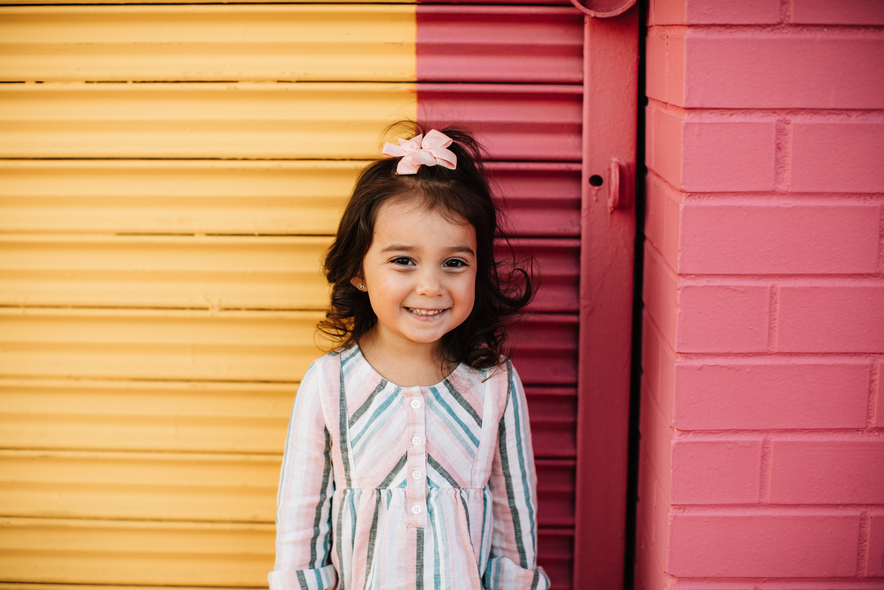
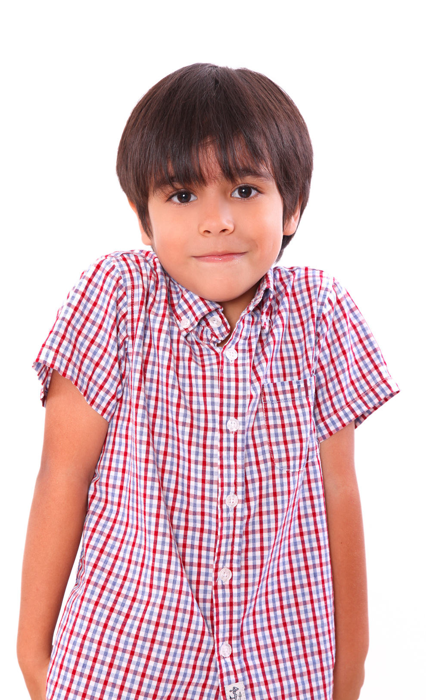
Our Winners!
Peter
Eric
Julie
Notes:
Replace photos and names with your students’ information.

Slide 25



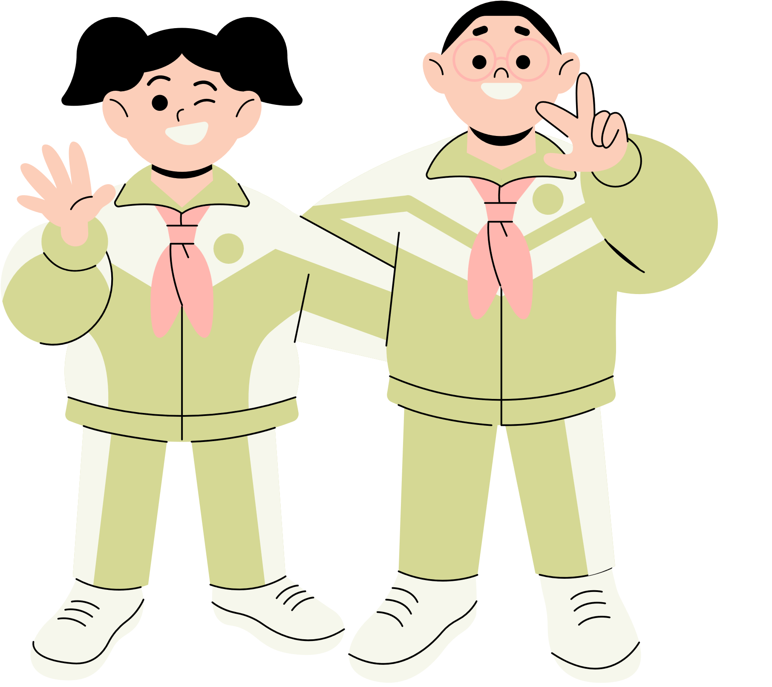







Thank You!
See You Next Time!
Notes:
https://www.youtube.com/watch?v=SRyFiVeNjWs

