Slide 2


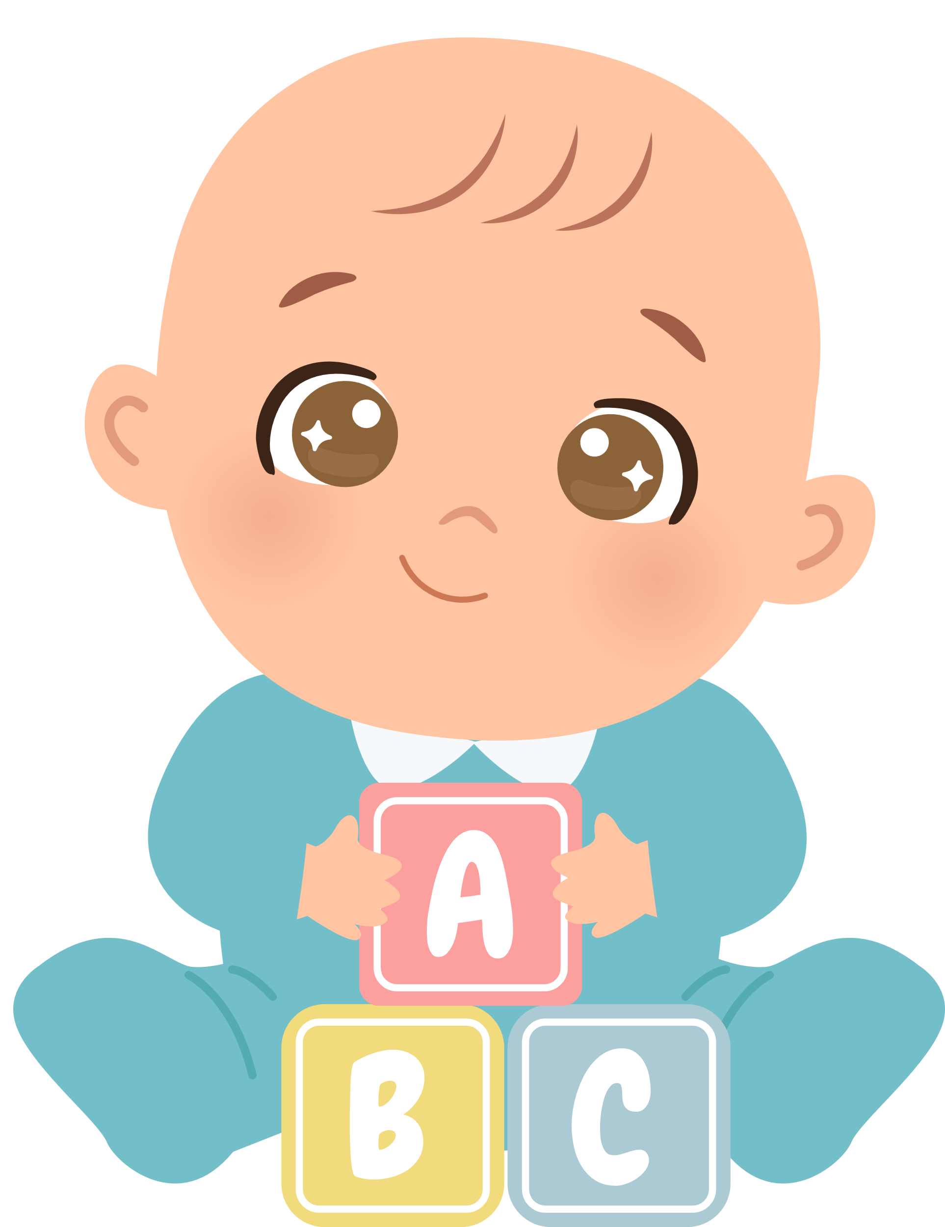

Unit 12
A SMART BABY!
Lesson 4 – Phonics

Slide 3





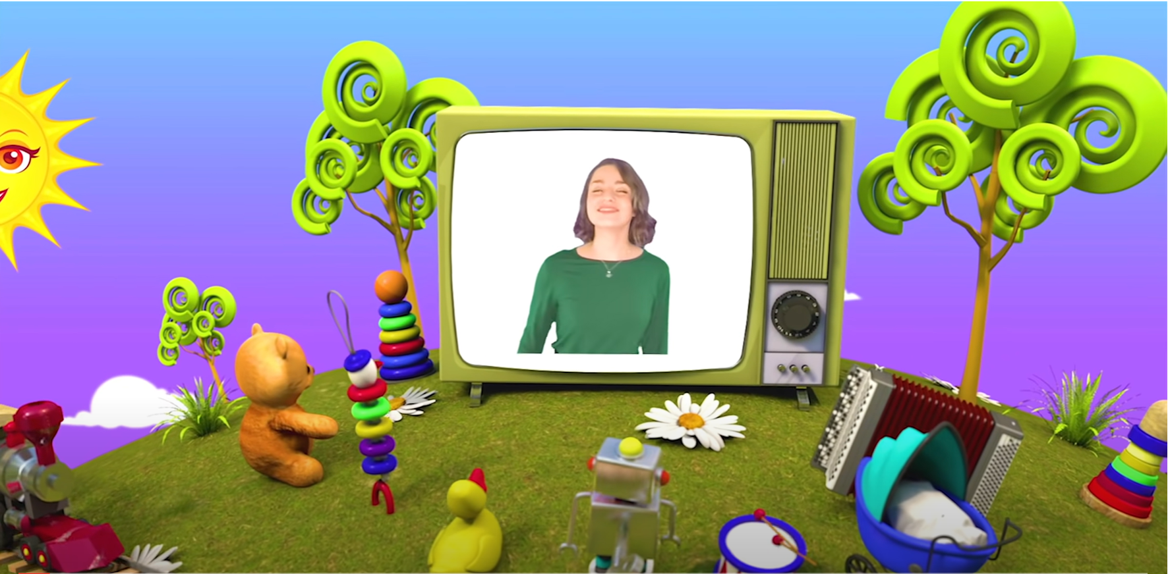
HELLO SONG
Notes:
https://www.youtube.com/watch?v=pqDEwPi7vxg

Slide 4




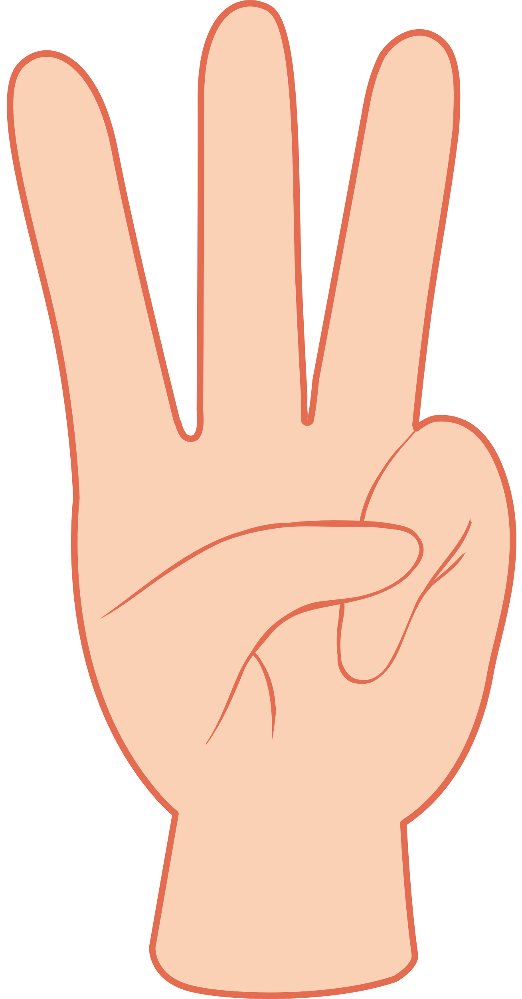


Slide 5


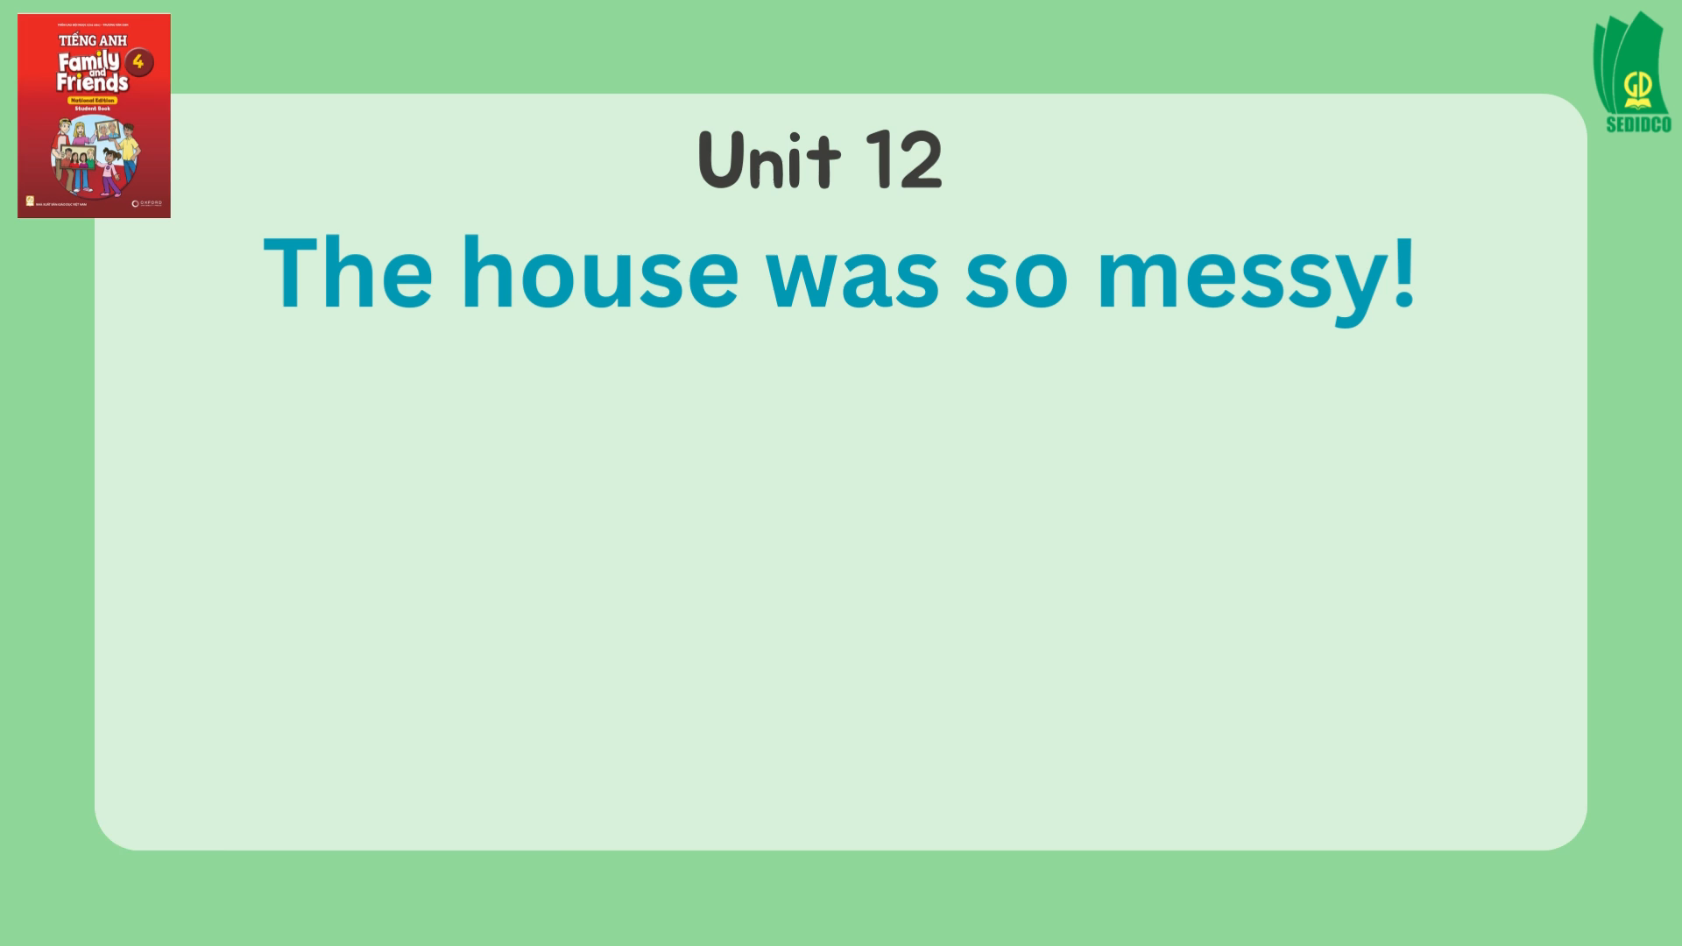
Watch a video
Notes:
* Warmer – Track 146
Sing The house was so messy! from page 90.

Slide 6
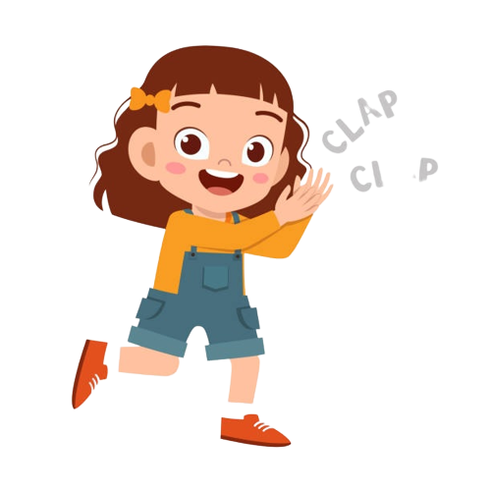
Good job!

Slide 7
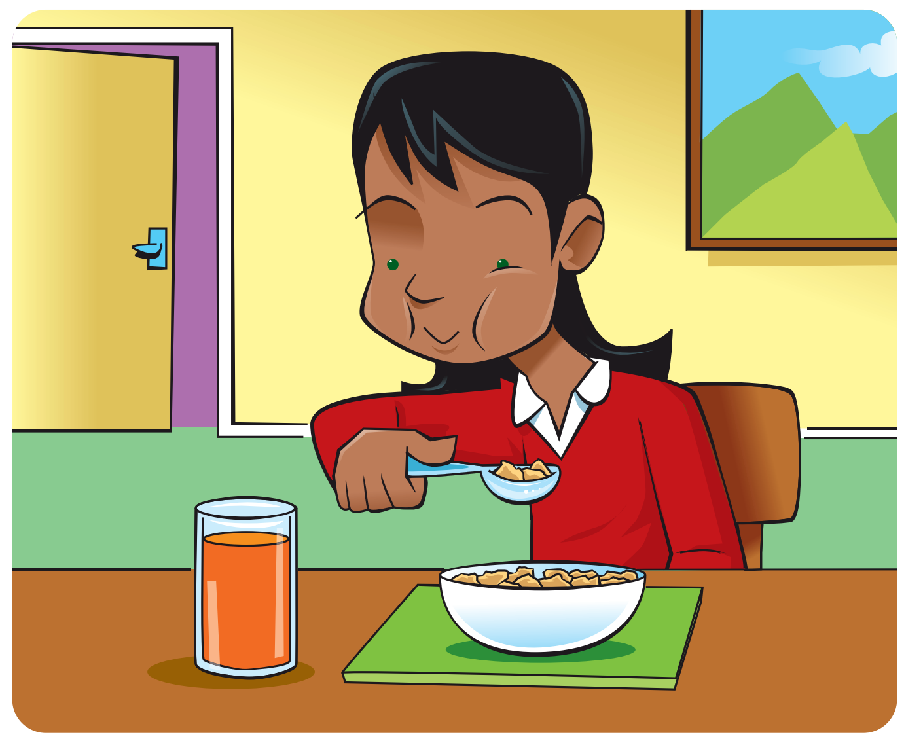
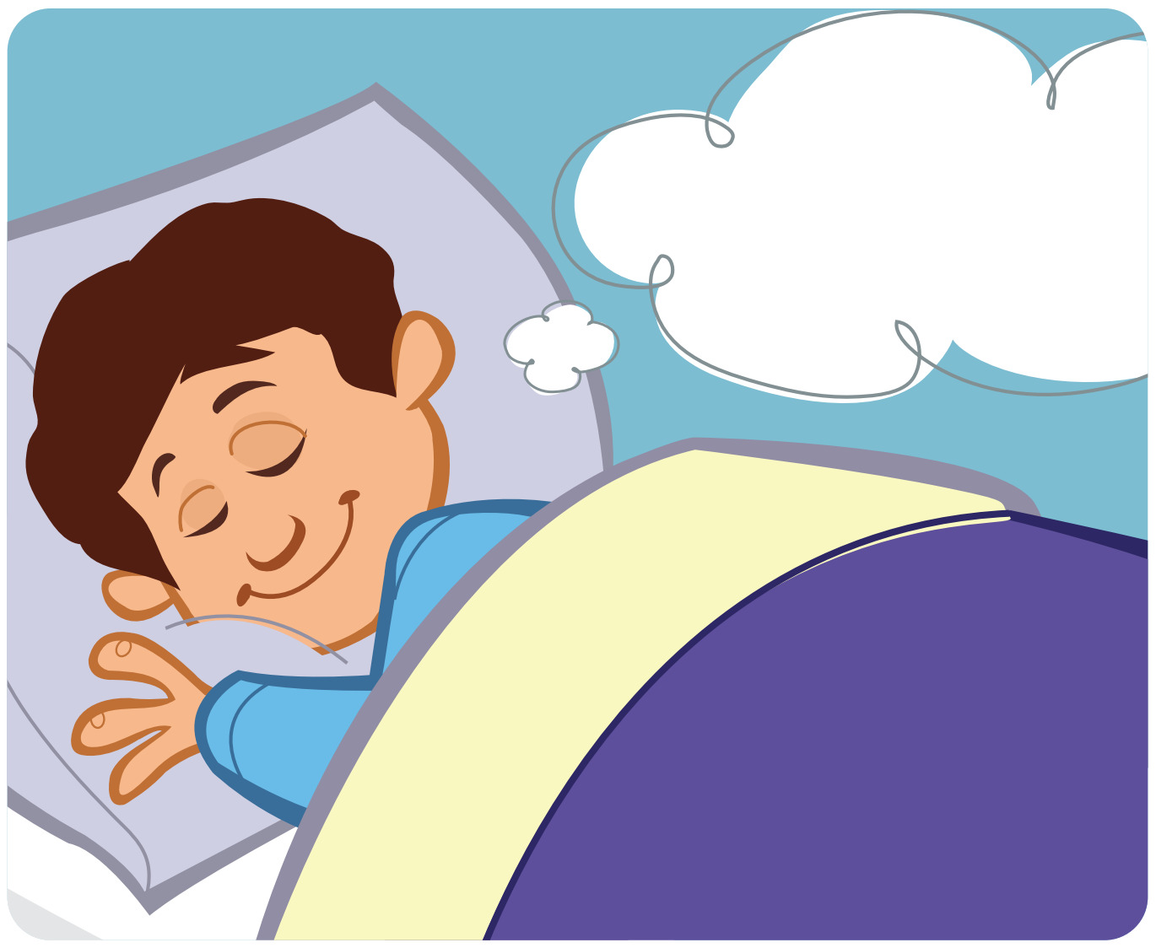
Listen and Repeat.
ea
eat
dream
Notes:
* Lead-in:
Hold up the phonics cards for eat, dream, queen, and green one at a time and elicit the words.

Slide 8


Listen and Repeat.
ee
queen
green
Notes:
* Lead-in:
Teach the sound and letters for this lesson using phonics cards. Hold up the germs card and say the word for the children to repeat.
Repeat with the other phonics cards.
Explain that sometimes the letters ea and ee have the same sound.

Slide 9

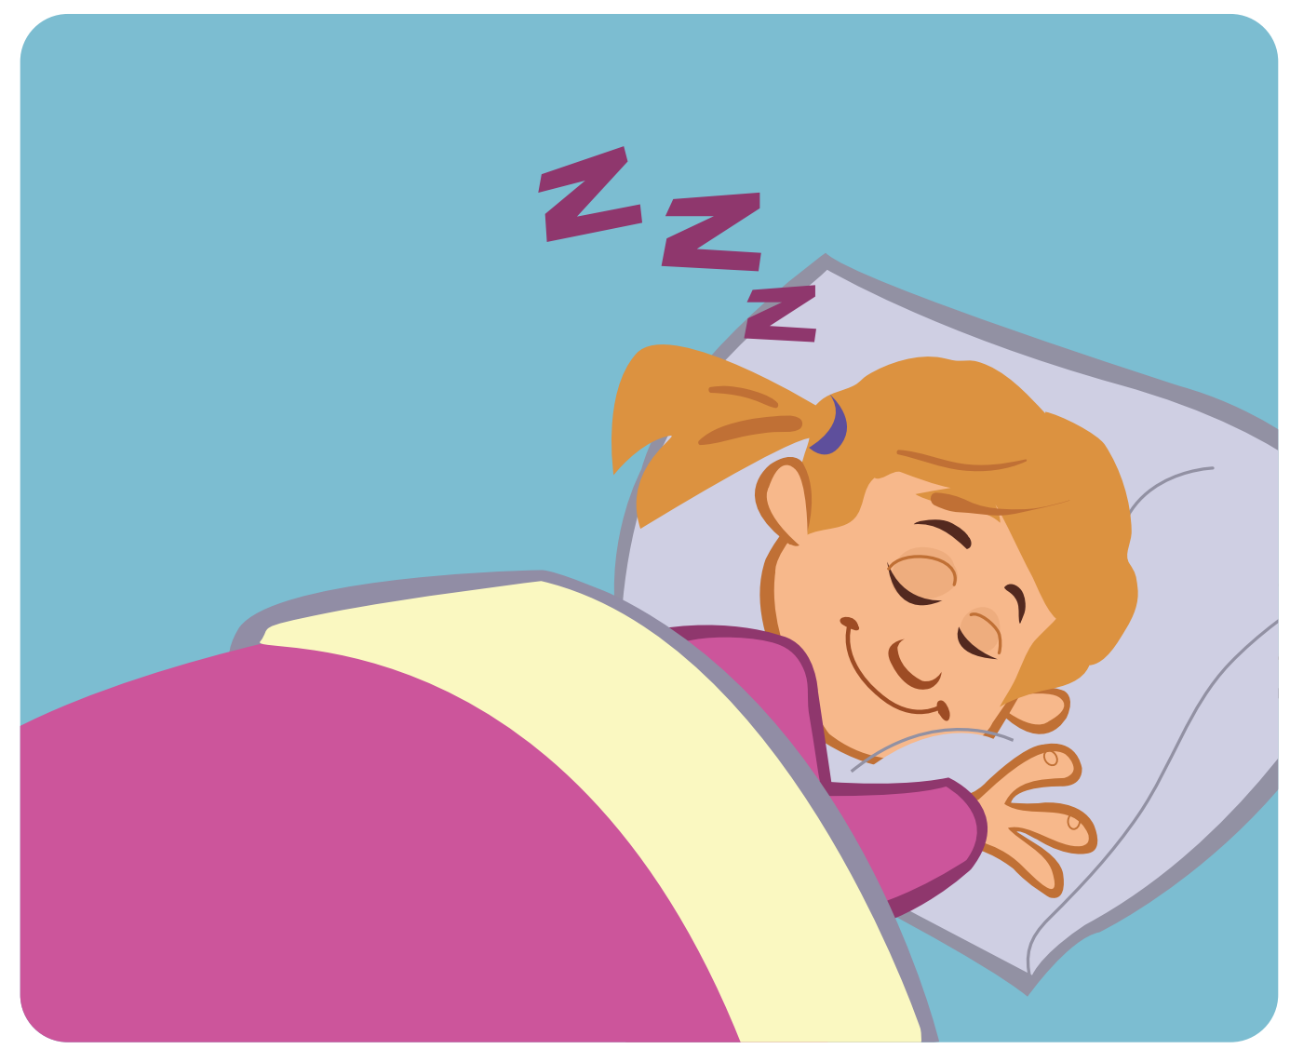
Listen and Repeat.
sl
sleep
Notes:
* Lead-in:
Teach the sound and letters for this lesson using phonics cards. Hold up the germs card and say the word for the children to repeat.
Repeat with the other phonics cards.

Slide 10

Listen and Repeat.
sp
spoon
Notes:
* Lead-in:
Teach the sound and letters for this lesson using phonics cards. Hold up the germs card and say the word for the children to repeat.
Repeat with the other phonics cards.
Put the flashcards on different sides of the room and say the words aloud randomly. Children point to the correct card.

Slide 11
Listen and Repeat.
s
l
sl
sleep
Notes:
Hold up the sleep card and say Letters s and l make the sound /sl/. Say the sound again for children to repeat.

Slide 12
Listen and Repeat.
s
p
sp
spoon
Notes:
Repeat the procedure with the spoon card.
Show each card and say the words for children to repeat.

Slide 13

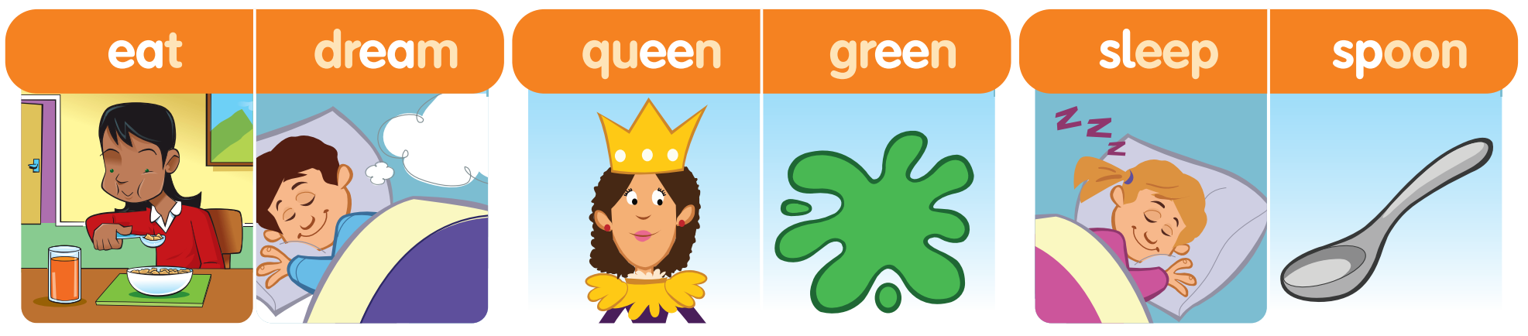
Listen and Point.
91
Notes:
* Listen, point, and repeat. Track 147
Ask children to look at the words and pictures. Tell them that they are going to hear a recording of the different sounds and words.
Play the first part of Track 147 for children to listen and point to the pictures.

Slide 14
Listen and Repeat.
91
Notes:
Play the second part of the recording, for children to repeat the sounds and words in chorus.

Slide 15

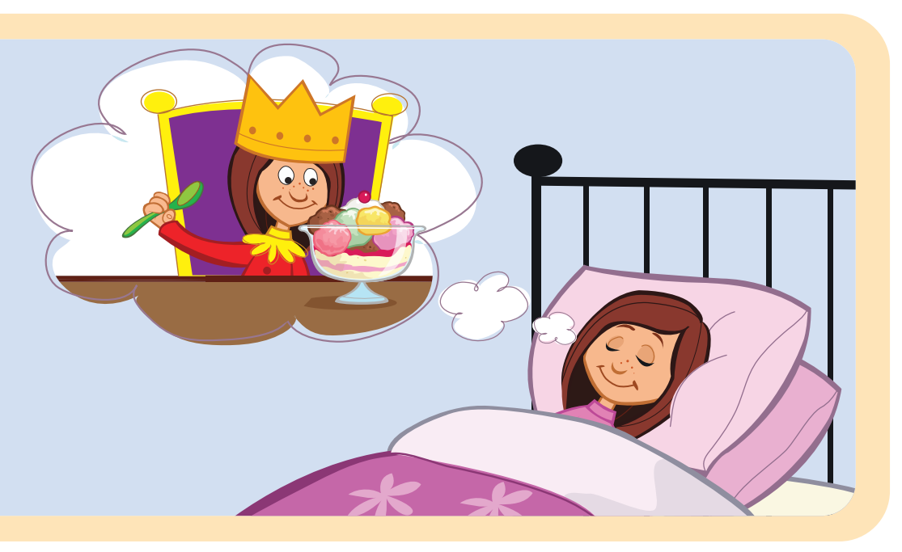
Look and Answer.
What can you see?
91
Notes:
* Listen and chant. Track 148
Ask children to look at the picture. Ask Where is the girl? What is she doing? What can you see in her dream?

Slide 16
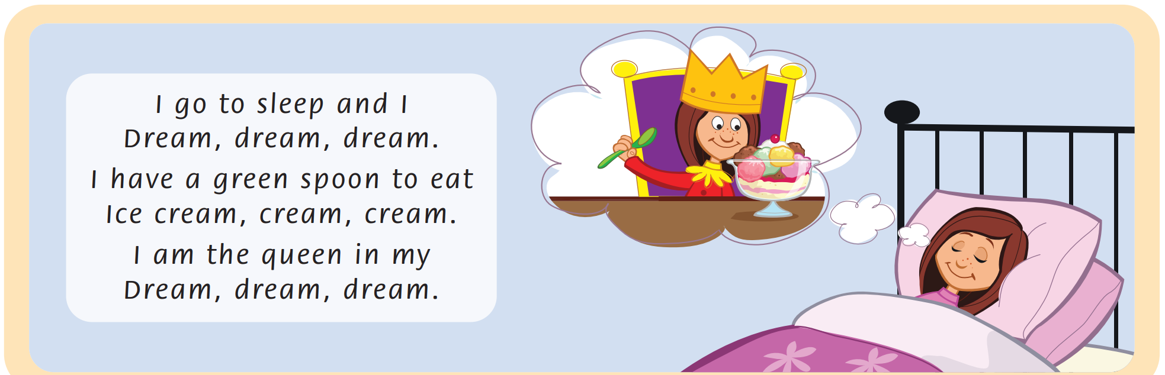
Listen and Point.
91
Notes:
Play Track 148 once all the way through.

Slide 17
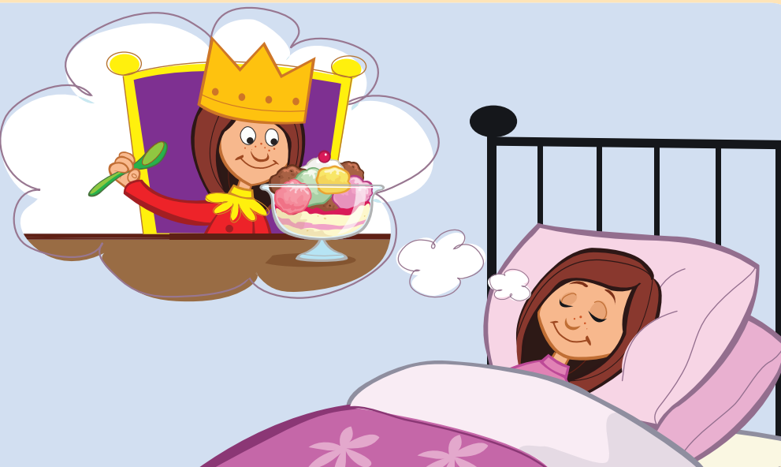
Listen and Repeat.
I go to sleep and I
Dream, dream, dream.
I have a green spoon to eat
Ice cream, cream, cream.
I am the queen in my
Dream, dream, dream
Notes:
Play the recording again, stopping after each line for children to read and repeat.

Slide 18
Read and Say the words. Write.
ea
sl
sp
ee
I go to sleep and I
Notes:
* Read the chant again. Say the words with ea, ee, sl, and sp. Write.
Ask children to read the chant and find all the words with ea, ee, sl, and sp, say them and write them in their notebooks.

Slide 19
Read and Say.
91
Notes:
Children read the chant and find all the words with ea, ee, sl, and sp, say them and write them in their notebooks.

Slide 20
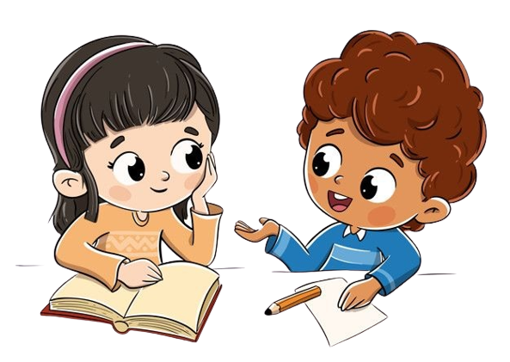
Work in Pairs
Notes:
Children work in pairs to peer-check their answers.

Slide 21
Let’s check!
ea
sl
sp
ee
Dream, dream, dream.
Notes:
Answers
sleep dream green spoon eat ice cream queen

Slide 22
Let’s check!
ea
sl
sp
ee
I have a green spoon to eat.
Notes:
Answers
sleep dream green spoon eat ice cream queen

Slide 23
Let’s check!
ea
sl
sp
ee
Ice cream, cream, cream.
Notes:
Answers
sleep dream green spoon eat ice cream queen

Slide 24
Let’s check!
ea
sl
sp
ee
Dream, dream, dream.
Notes:
Answers
sleep dream green spoon eat ice cream queen

Slide 25
Let’s check!
ea
sl
sp
ee
I am the queen in my.
Notes:
Answers
sleep dream green spoon eat ice cream queen

Slide 26
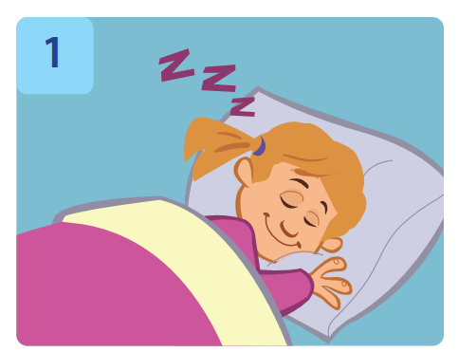
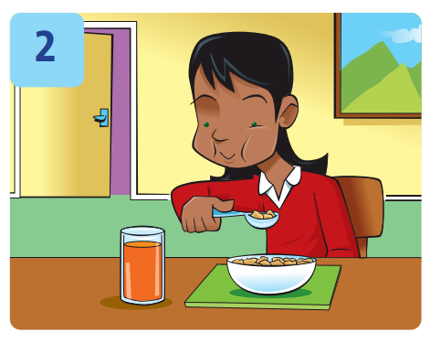

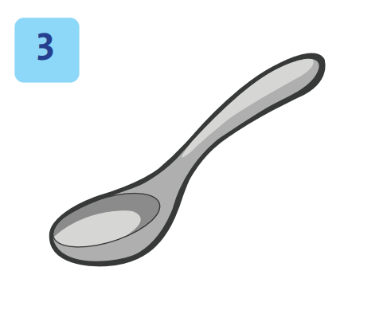
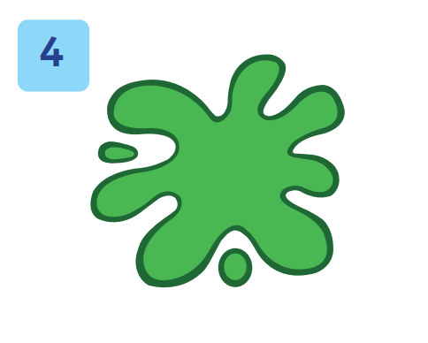
Look and Say.
Notes:
* Circle the missing letters. Write.
Focus on the four spellings under each picture and the example.

Slide 27
Circle and Write.
sl
___eep
Notes:
Tell them they are going to hear a recording of the words. They listen and write the missing letters.

Slide 28
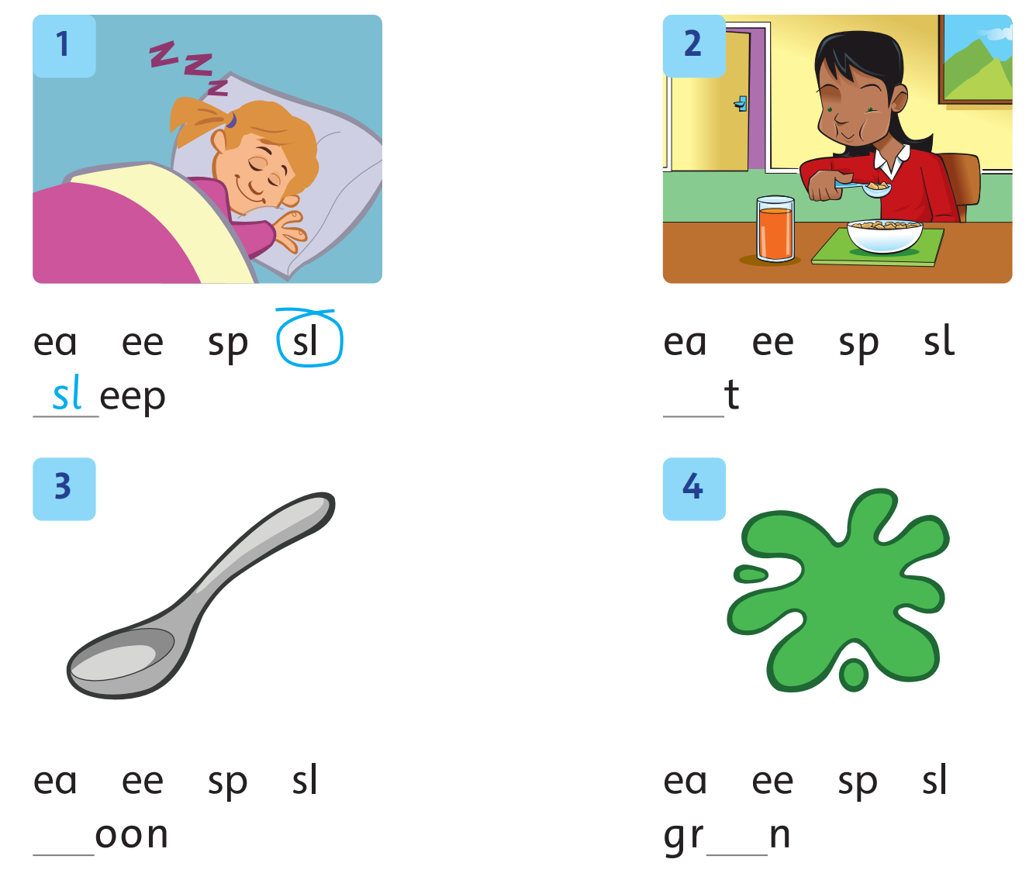
Circle and Write.
91
Notes:
Ask the children to circle the missing letters and then complete the words.

Slide 29
Let’s check!
ea
___t
Notes:
Answers
1 sleep 2 eat 3 spoon 4 green

Slide 30
Let’s check!
sp
___oon
Notes:
Answers
1 sleep 2 eat 3 spoon 4 green

Slide 31
Let’s check!
ee
gr___n
Notes:
Answers
1 sleep 2 eat 3 spoon 4 green

Slide 32
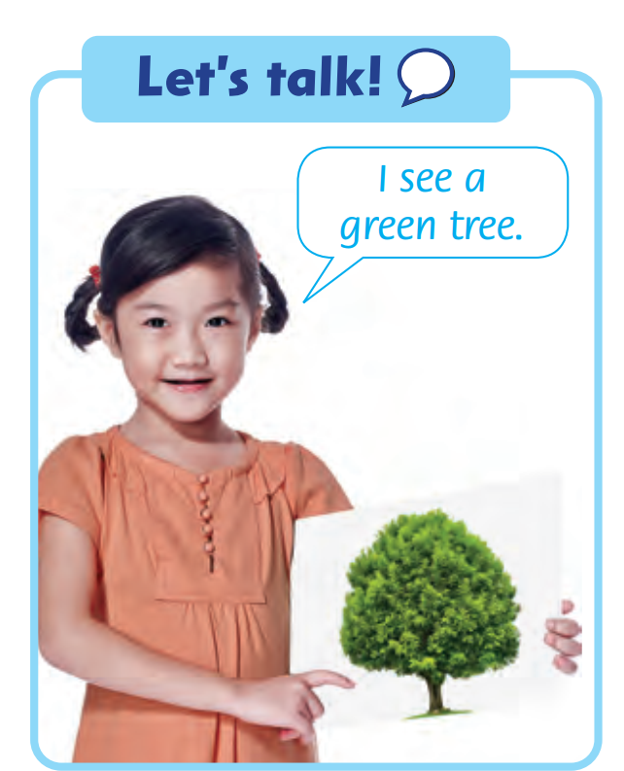
Let’s talk!
I see
a green tree.
Notes:
* Let’s talk!
Ask children to look at the picture and speech bubble.
Say I see a green tree. Ask children to repeat after you.
Ask children to work in pairs to take turns saying the sentence, using other vocabulary words on the page.

Slide 33




Sentence
Building

Slide 34



Choose a number,
say and write.

Slide 35
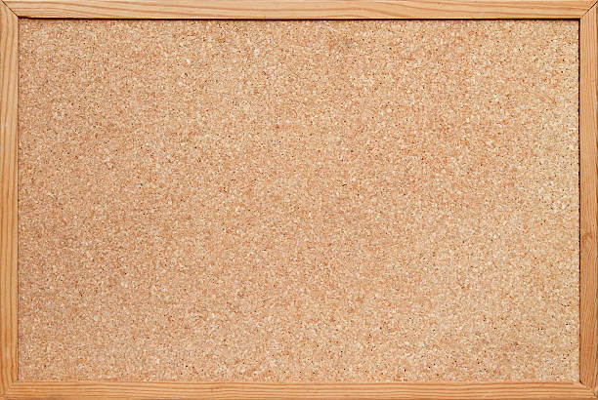
1
6
7
2
3
8
4
9
5
10

Slide 36
eat

Slide 37
green

Slide 38
dream

Slide 39
sleep

Slide 40
spoon

Slide 41
queen

Slide 42
read

Slide 43
sports

Slide 44


Slide 45

double scores!

Slide 46


Slide 47


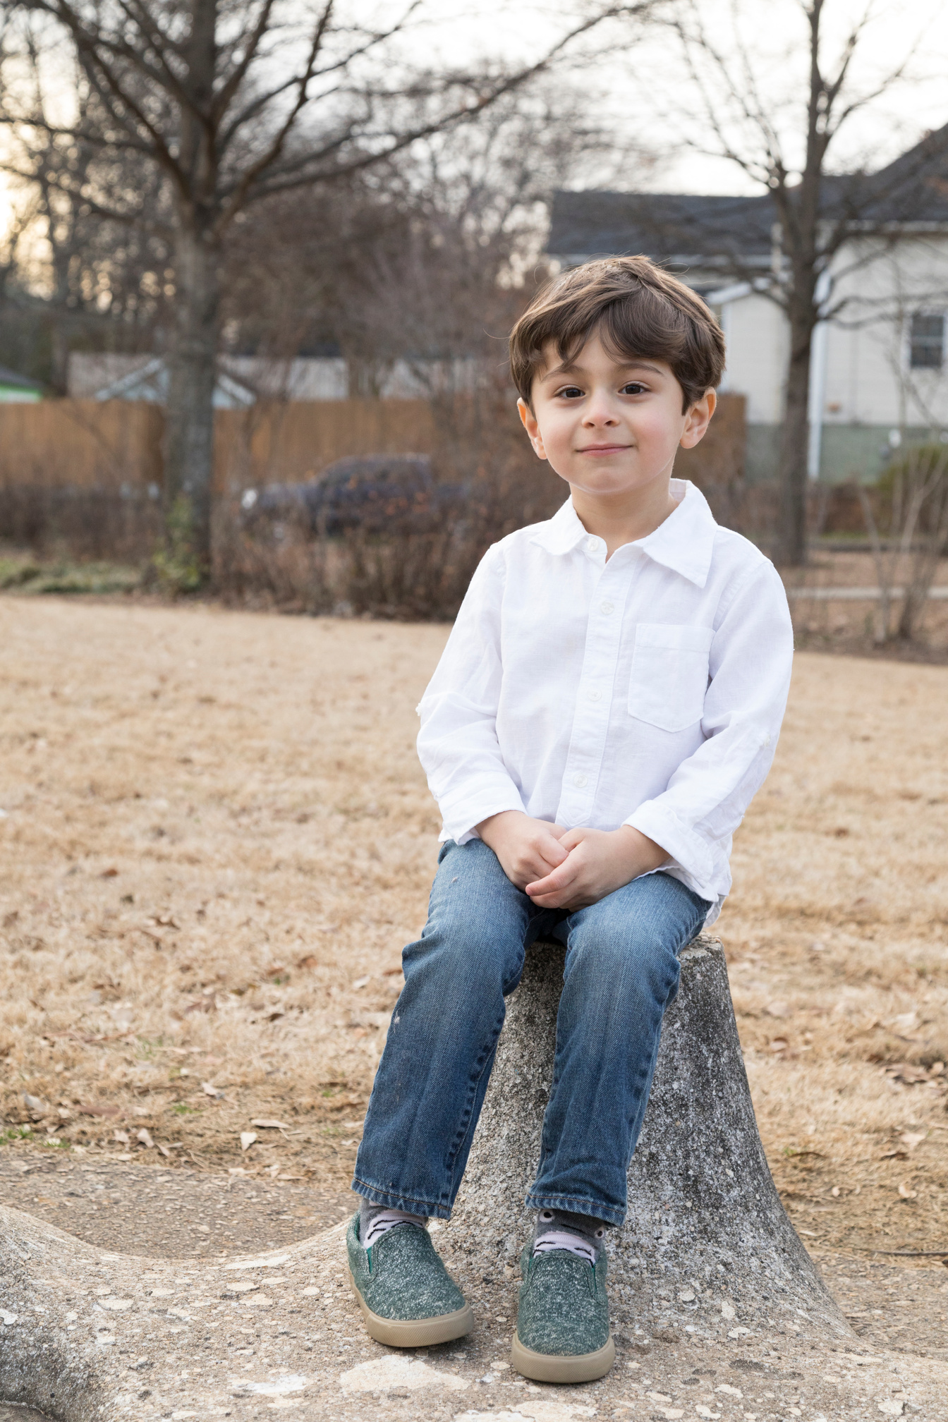
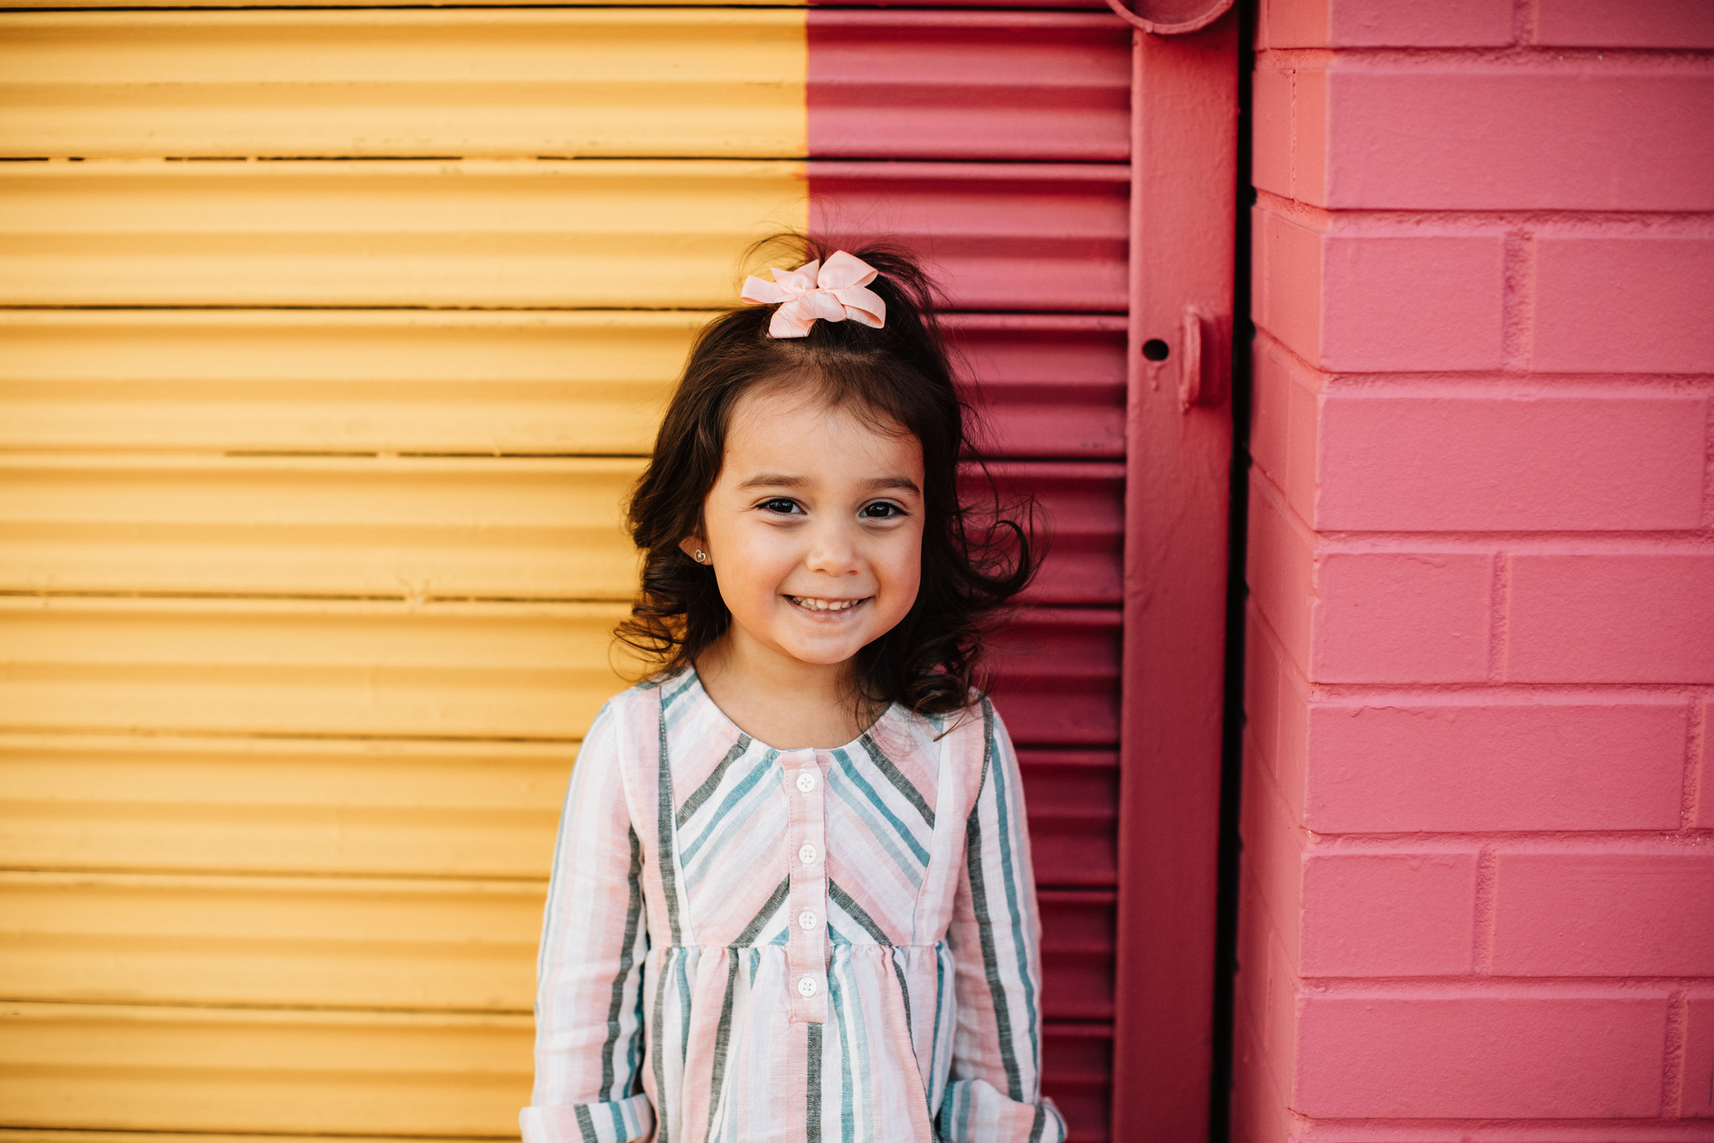

Our Winners!
Peter
Eric
Julie
Notes:
Replace photos and names with your students’ information.

Slide 48



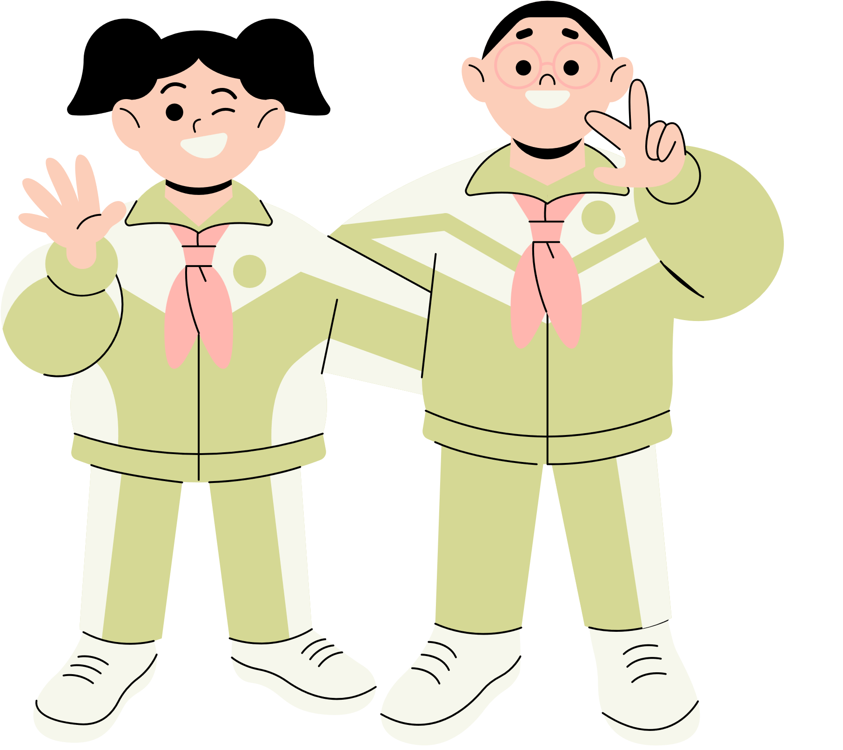







Thank You!
See You Next Time!
Notes:
https://www.youtube.com/watch?v=SRyFiVeNjWs

