Slide 2

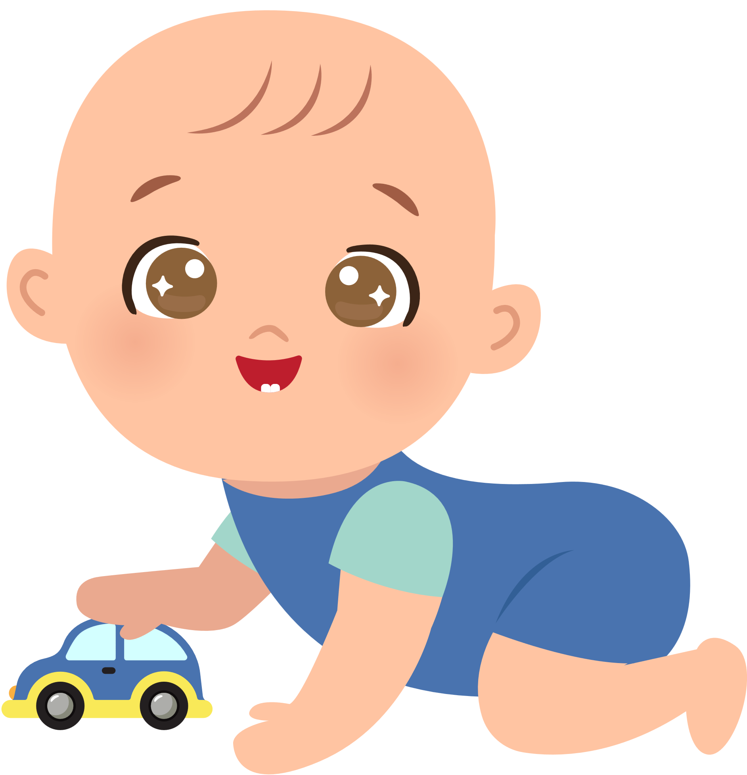


Unit 12
A SMART BABY!
Lesson 2 – Grammar – Period 2

Slide 3





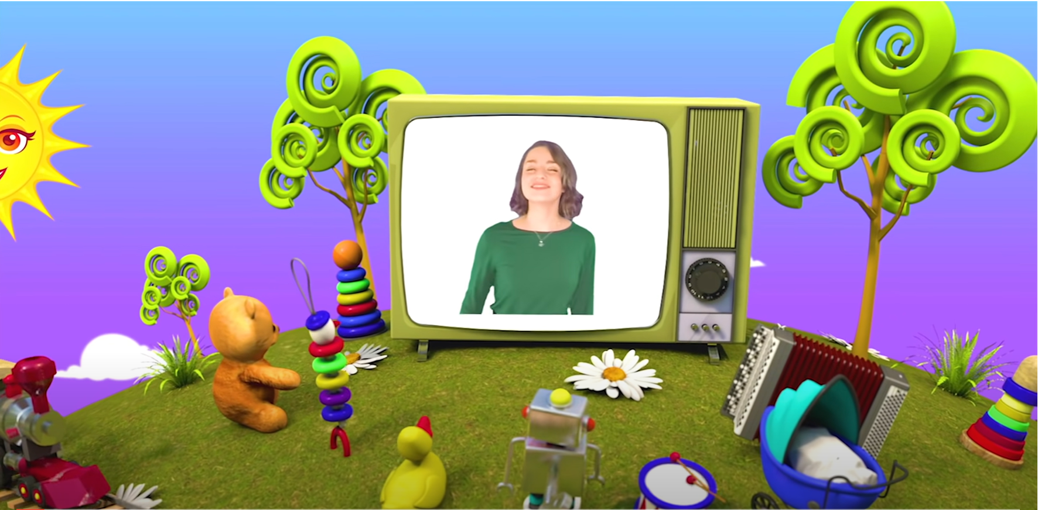
HELLO SONG
Notes:
https://www.youtube.com/watch?v=pqDEwPi7vxg

Slide 4







Slide 5

Game: TIC – TAC - TOE
Notes:
* Tic-Tac-Toe
Ask children to look at the colors, choose a color and make a sentence using affirmative and negative past simple form to describe people in the picture.
Children get scores if they have appropriate description.
Click the baby to the Congratulation slide!

Slide 6

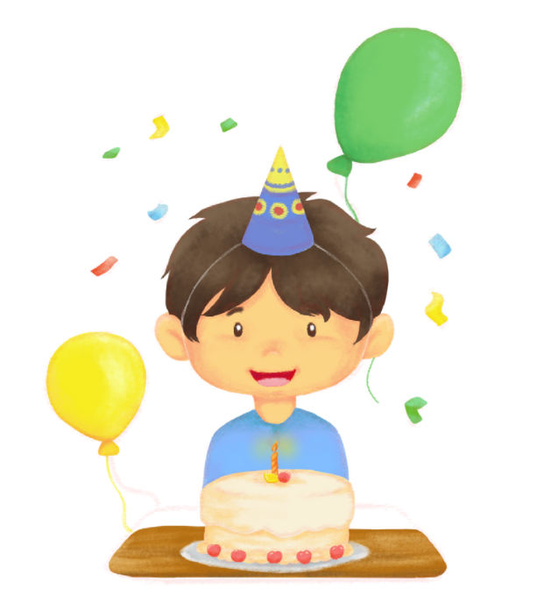

Look and Say
today
Yesterday it was Minh’s birthday.
Notes:
Click the baby to back to the Color slide.

Slide 7
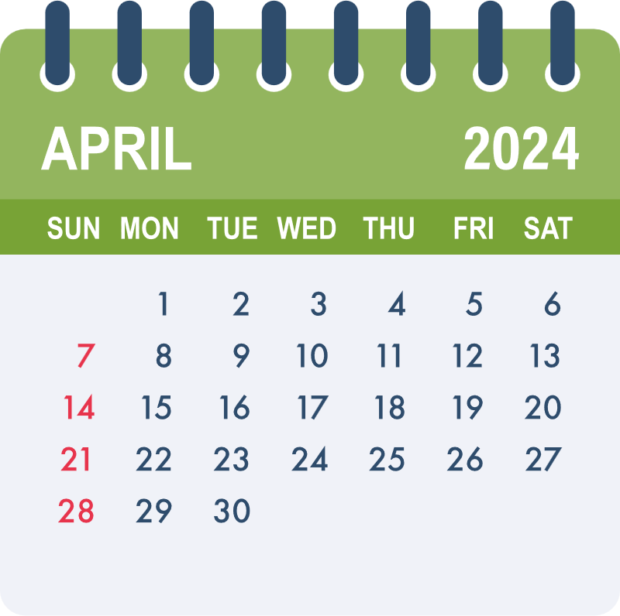
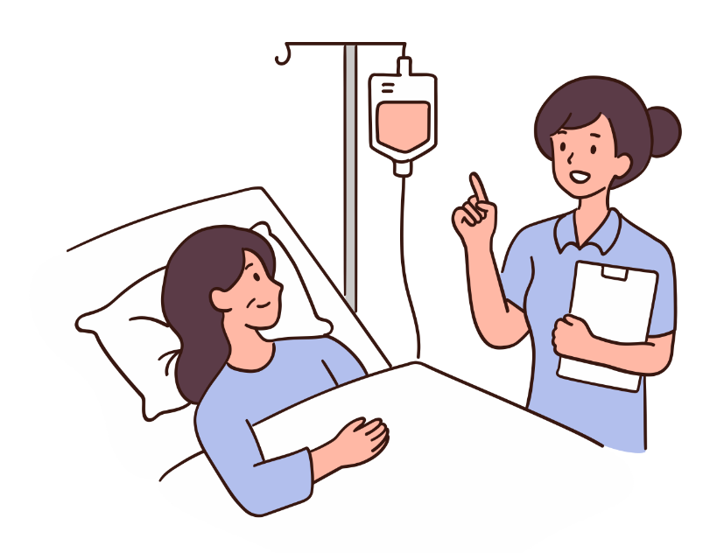
Look and Say
this week
Last week, she was in the hospital.
Notes:
Click the baby to back to the Color slide.

Slide 8

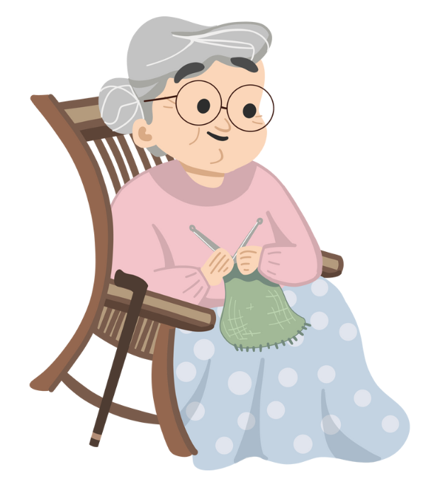
Look and Say
40 years ago
Grandma was young and pretty then.
Notes:
Click the baby to back to the Color slide.

Slide 9


Look and Say
20 years ago
My sister was young and cute then.
Notes:
Click the baby to back to the Color slide.

Slide 10
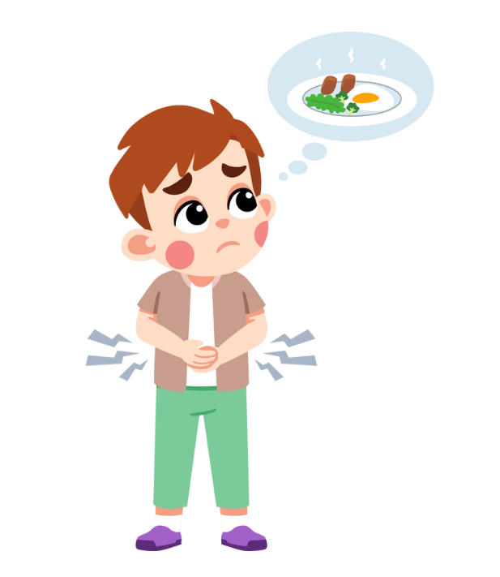
Look and Say
today
The boy was hungry yesterday.
Notes:
Click the baby to back to the Color slide.

Slide 11


Look and Say
today
He wasn’t at school yesterday.
Notes:
Click the baby to back to the Color slide.

Slide 12

Look and Say
this week
The vet wasn’t at the clinic last week.
Notes:
Click the baby to back to the Color slide.

Slide 13
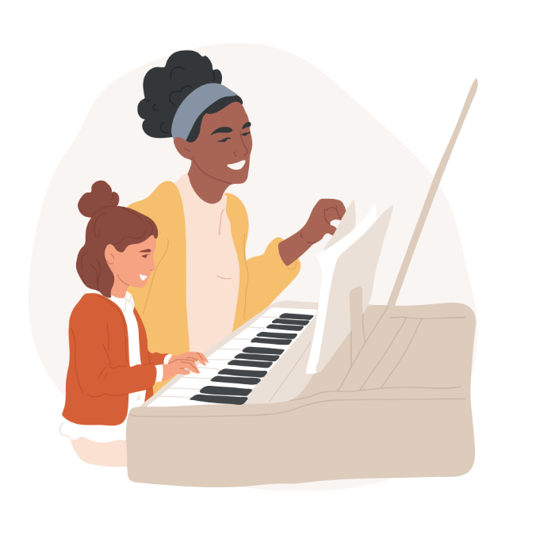

Look and Say
Last night
today
Last night, she was at piano class.
Notes:
Click the baby to back to the Color slide.

Slide 14

Good job!

Slide 15


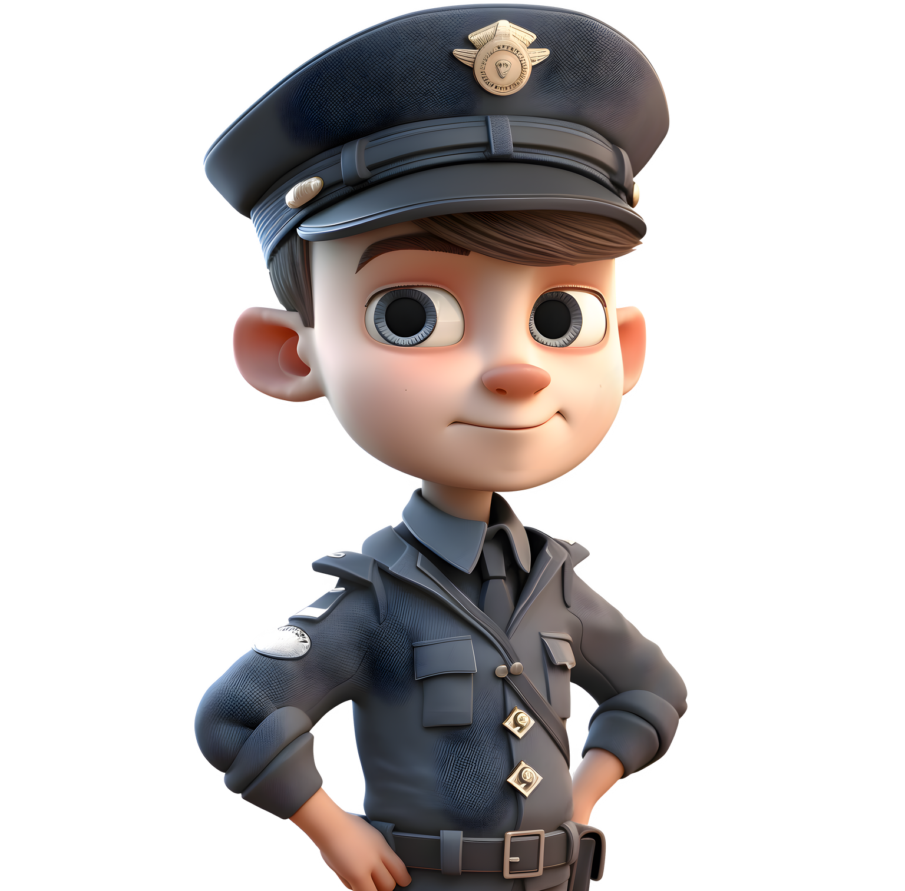
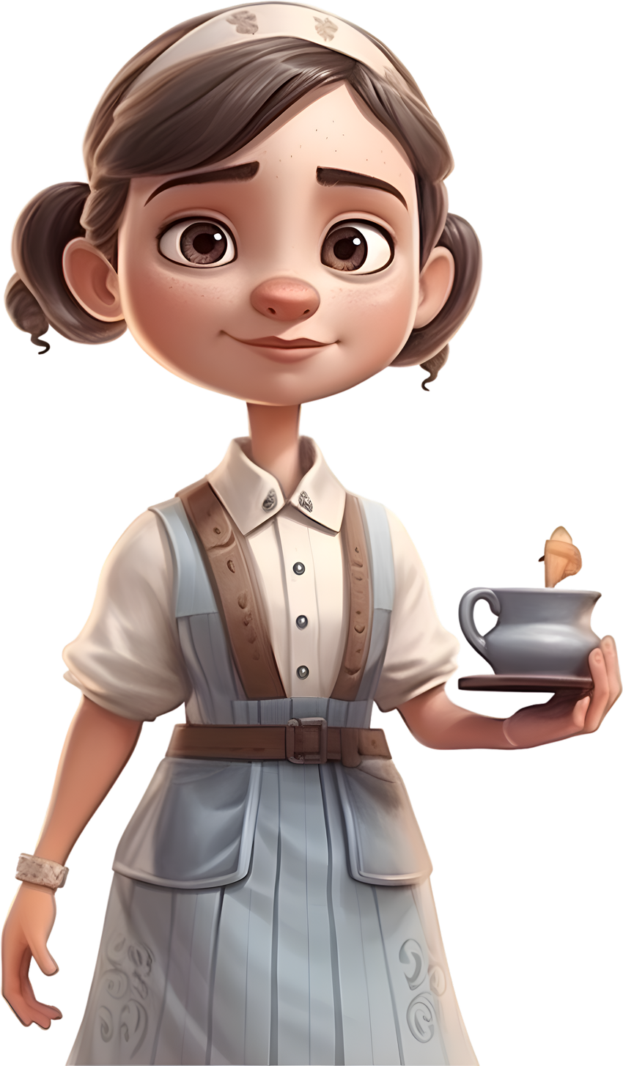
Look and Say
We weren’t all different.
20 years ago
She was young.
They were young.
He was young, too.
Notes:
* Lead-in:
Show a picture and say “He was young. She was young, too.”
Elicit They were young.

Slide 16
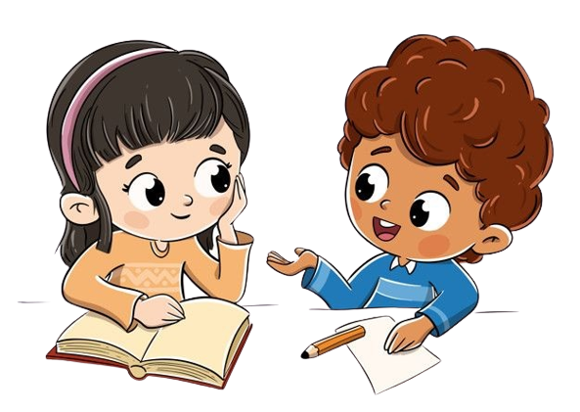
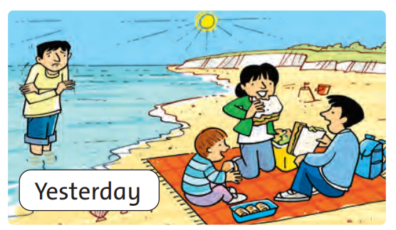
Rock – Scissors - Paper
They were at the beach yesterday.
Notes:
Children practice making sentences using simple past of be.

Slide 17
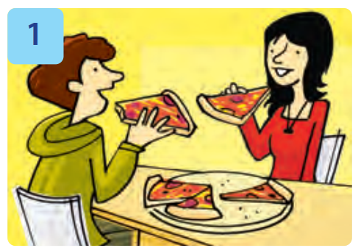
Rock – Scissors - Paper
They were at the café yesterday.
Notes:
Children practice making sentences using simple past of be.

Slide 18
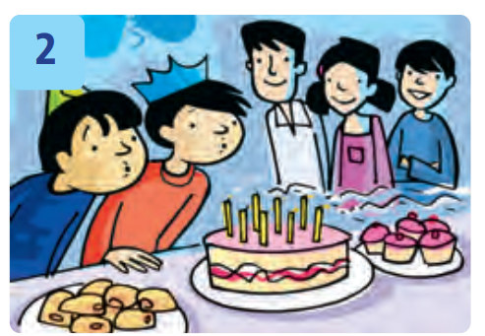
Rock – Scissors - Paper
They were at a party last weekend.
Notes:
Children practice making sentences using simple past of be.

Slide 19
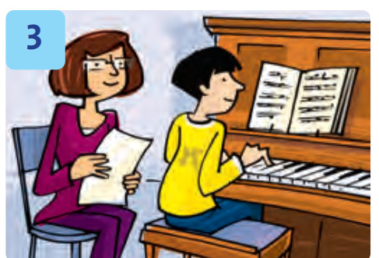
Rock – Scissors - Paper
Nam was at piano class last night.
Notes:
Children practice making sentences using simple past of be.

Slide 20
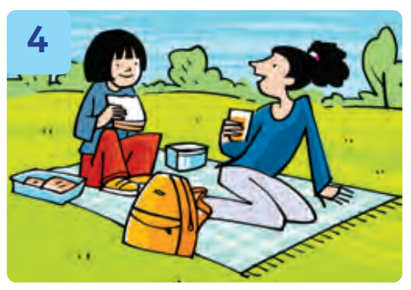
Rock – Scissors - Paper
We were at the park yesterday.
Notes:
Children practice making sentences using simple past of be.

Slide 21
Good job!

Slide 22

Read these sentences aloud.
…………..
1. They were/ weren’t at the park yesterday.
2. It was/ wasn’t rainy.
3. The sea was/ wasn’t cold.
4. The children were/ weren’t hungry.
5. The sandwiches were/ weren’t small.
Notes:
* Read and circle.
- Ask children to read the sentences aloud.

Slide 23
Read and Circle.
…………..
1. They were/ weren’t at the park yesterday.
Notes:
Focus on the picture. Ask Where are they? Is the water warm? How many children are there? What are they eating?
Show the example and do it with the whole class.

Slide 24

Read and Circle.
89
…………..
1. They were/ weren’t at the park yesterday.
2. It was/ wasn’t rainy.
3. The sea was/ wasn’t cold.
4. The children were/ weren’t hungry.
5. The sandwiches were/ weren’t small.
Notes:
Children do the exercise individually.

Slide 25
Work in Pairs.
Notes:
Children work in pairs to peer-check their answers.

Slide 26
Let’s check!
89
…………..
1. They were/ weren’t at the park yesterday.
2. It was/ wasn’t rainy.
3. The sea was/ wasn’t cold.
4. The children were/ weren’t hungry.
5. The sandwiches were/ weren’t small.
Notes:
Answer keys
1 weren’t 2 wasn’t 3 was 4 were 5 weren’t

Slide 27
Look and Write.
89
…………..
1. They _______ at a café yesterday. They ________ at school.
were
weren’t
Notes:
* Look and write.
Look at the example with the whole class, then ask children to do the exercise individually.

Slide 28
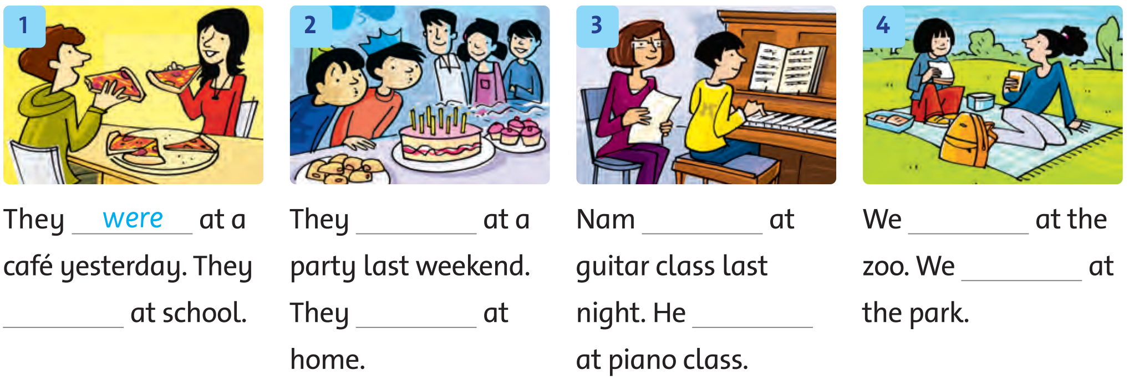
Look and Write.
89
Notes:
- Children do the exercise individually.

Slide 29
Let’s check!
89
…………..
2. They _______ at a café yesterday. They ________ at school.
were
weren’t
Notes:
Answers
1 were, weren’t
2 were, weren’t
3 wasn’t, was
4 weren’t, were

Slide 30
Let’s check!
89
…………..
2. They ______ at a party last weekend. They ___________ at home.
were
weren’t
Notes:
Answers
1 were, weren’t
2 were, weren’t
3 wasn’t, was
4 weren’t, were

Slide 31
Let’s check!
89
…………..
3. Nam _____ at guitar class last night. He _____ at piano class.
wasn’t
was
Notes:
Answers
1 were, weren’t
2 were, weren’t
3 wasn’t, was
4 weren’t, were

Slide 32
Let’s check!
89
…………..
4. We _____ at the zoo. We _____ at the park.
weren’t
were
Notes:
Answers
1 were, weren’t
2 were, weren’t
3 wasn’t, was
4 weren’t, were

Slide 33









6
5
4
3
2
1
NEXT

Slide 34


end

Slide 35
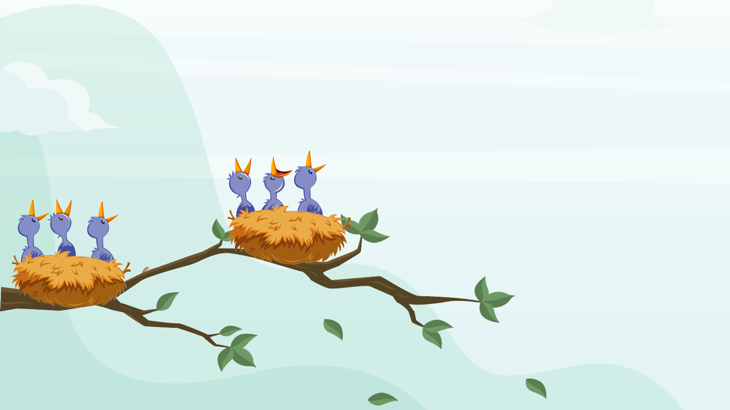




Question 1
The girls were at the …… yesterday.
A. park
B. beach
C. zoo
D. school

Slide 36
Question 2
The weather _____ sunny.
A. were
B. was
A. weren’t
A. wasn’t

Slide 37
Question 3
The sandwiches weren’t _________.
A. big
B. clean
C. dirty
D. small

Slide 38
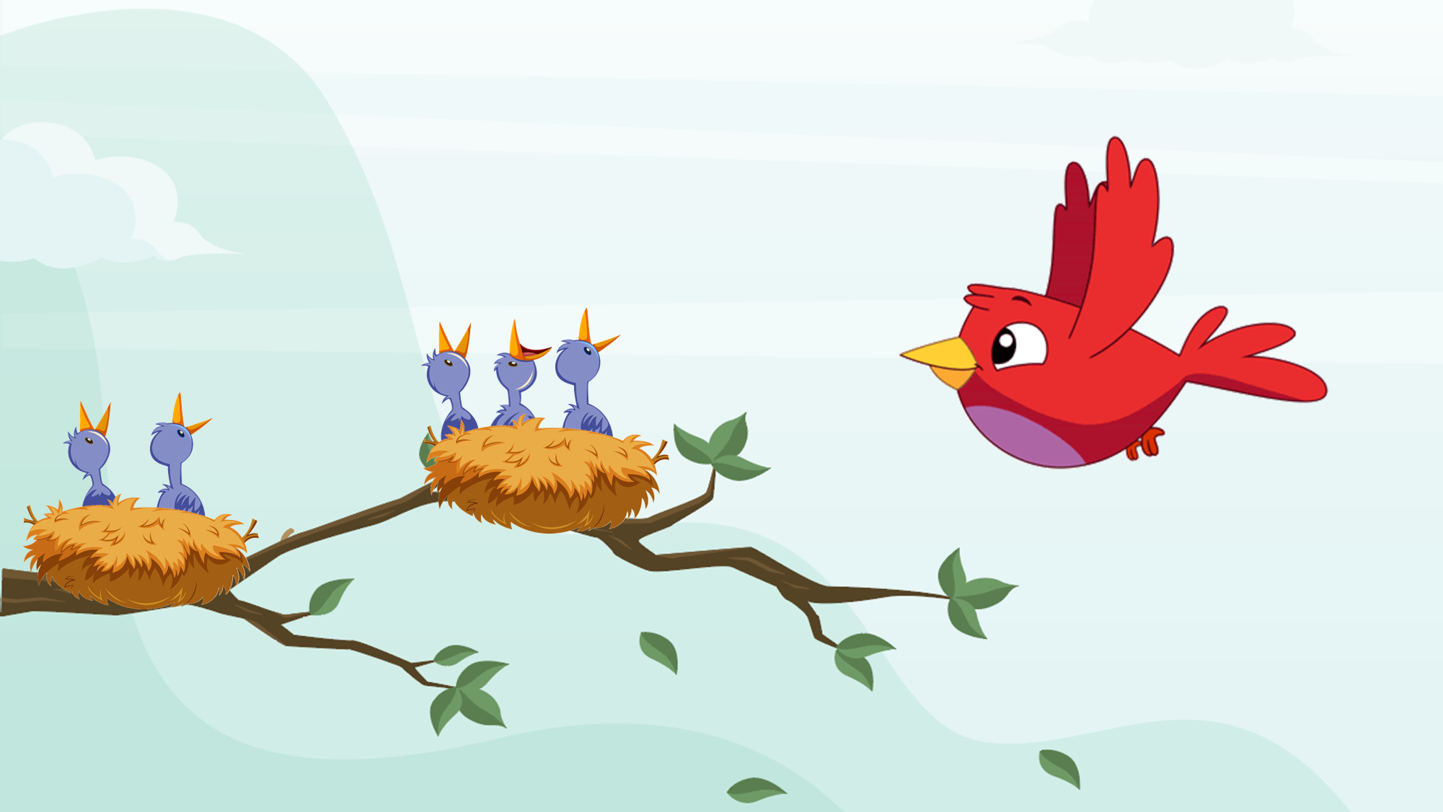
Question 4
The ______ were at a party last weekend.
A. men
B. girls
A. children
A. boys

Slide 39
Question 4
The teacher _____ at guitar class last night.
A. wasn’t
B. weren’t
C. was
D. were

Slide 40
Question 4
The vet _____ at the clinic last week.
A. was
A. were
A. wasn’t
A. weren’t

Slide 41


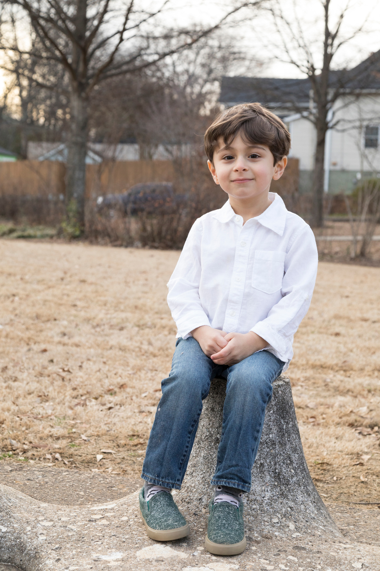
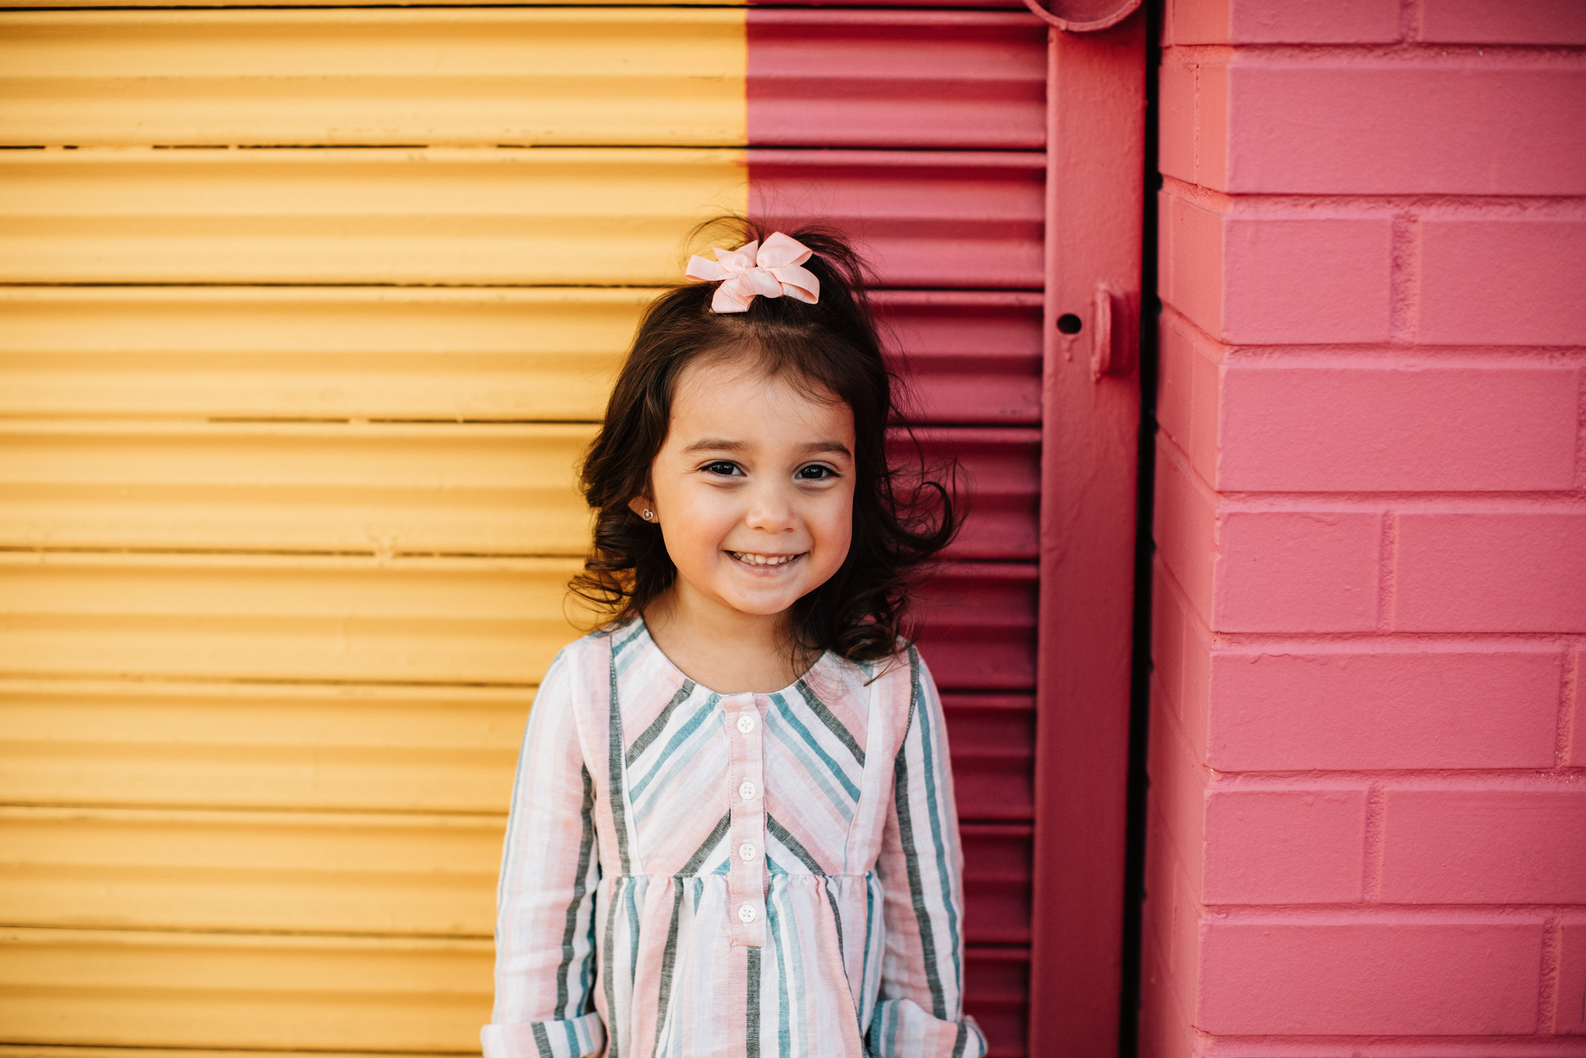
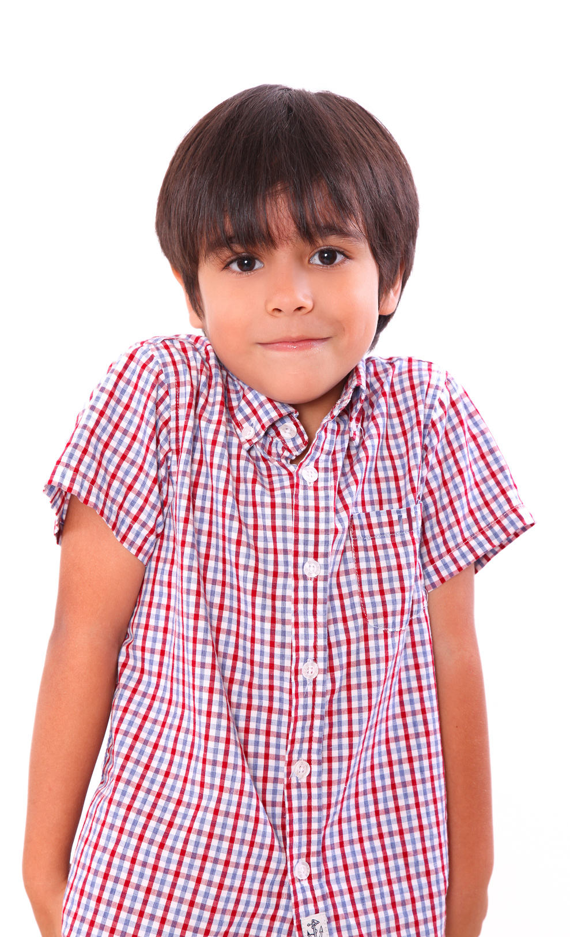
Our Winners!
Peter
Eric
Julie
Notes:
Replace photos and names with your students’ information.

Slide 42



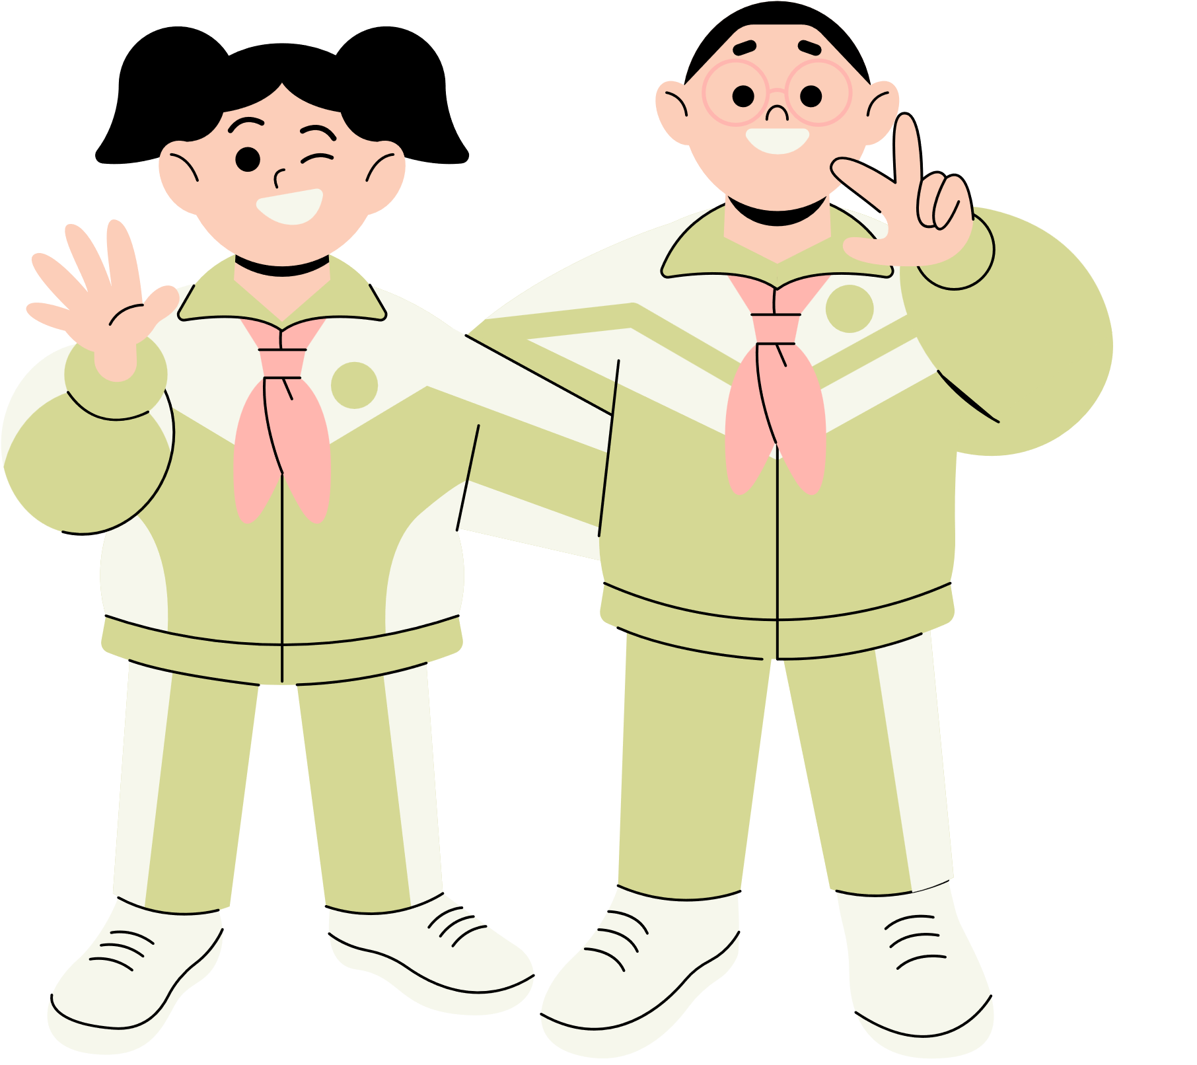







Thank You!
See You Next Time!
Notes:
https://www.youtube.com/watch?v=SRyFiVeNjWs

