Slide 2




Unit 12
A SMART BABY!
Lesson 2 – Grammar – Period 1

Slide 3





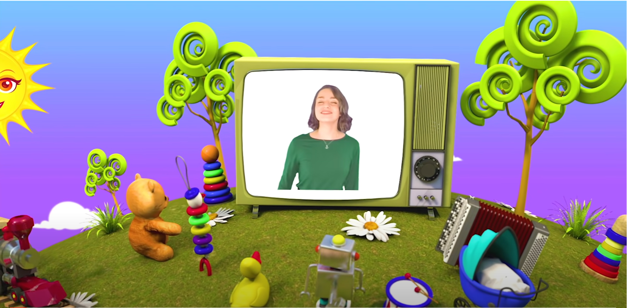
HELLO SONG
Notes:
https://www.youtube.com/watch?v=pqDEwPi7vxg

Slide 4







Slide 5

84
Sing and Do
Notes:
* Warmer - Track 134
Play How do we get to the station? from page 84 to energize the children.

Slide 6

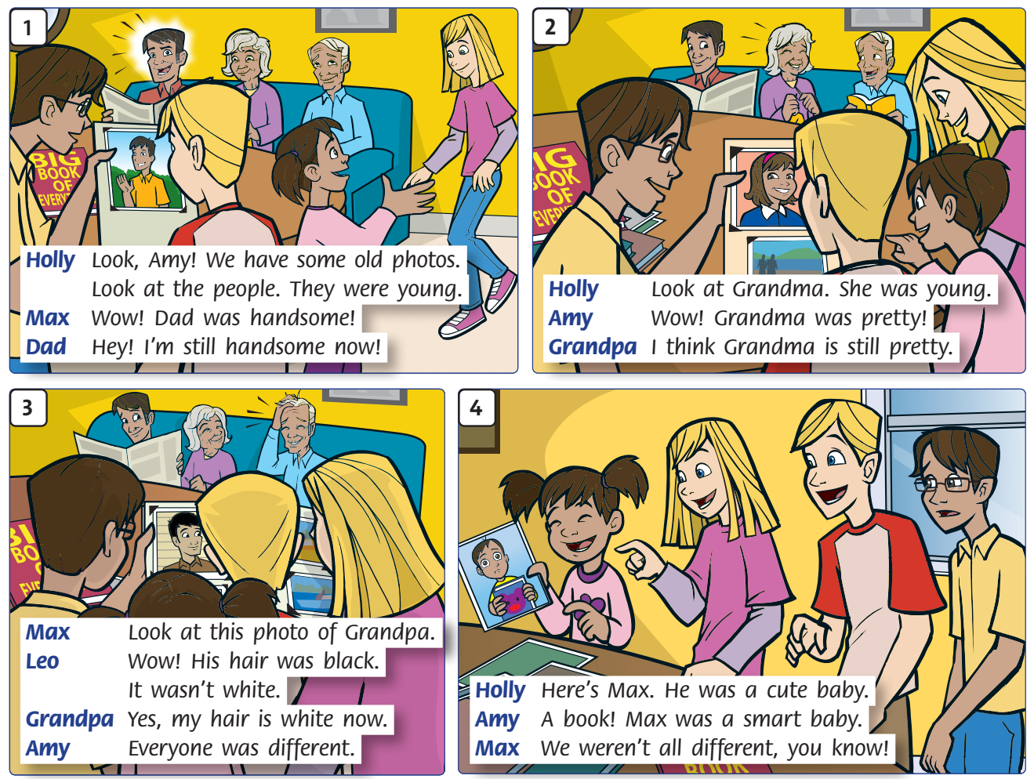

Listen and Point
88
Notes:
* Lead-in:
Use Story poster 12 to retell the story on page 88. Ask What are the children looking at? Who do they see in the photos? (Dad, Grandma, Grandpa, and Max). What color was Grandpa’s hair? What color is it now? Was Max different then?

Slide 7
Listen and Answer
88
old
young
handsome
pretty
cute
smart
Notes:
Cover the poster and ask children which words to describe people were used in the story (old, young, handsome, pretty, cute, smart).

Slide 8






Let’s check!
88
Notes:
* Lead-in:
Use Story poster 12 to retell the story on page 88. Ask What are the children looking at? Who do they see in the photos? (Dad, Grandma, Grandpa, and Max). What color was Grandpa’s hair? What color is it now? Was Max different then?

Slide 9
Listen and Repeat
88
Notes:
Play Track 143, pausing for children to repeat.

Slide 10

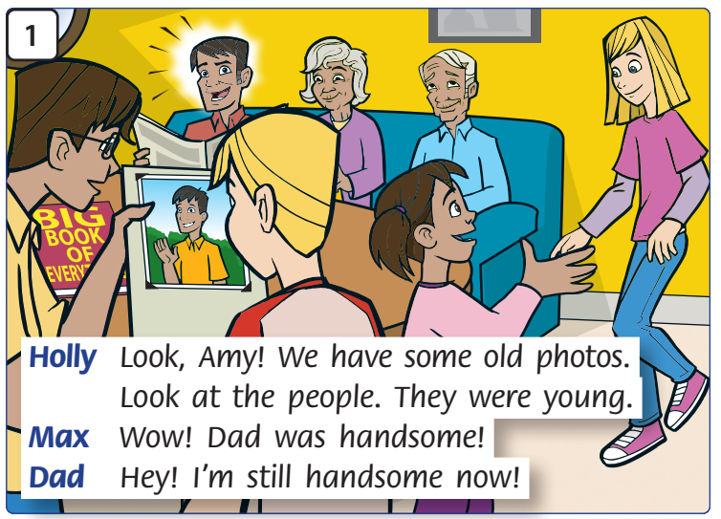
Look and Say
Notes:
As a class, decide on the story actions (see below).
Divide the class into groups of six to play the parts of Holly, Max, Dad, Amy, Grandpa, and Leo.
Story actions
Picture 1: Dad reads the paper. Grandpa reads a book. (Grandma knits). Max holds the photos. Amy comes in. Holly beckons her over and points at the photo. Dad looks up and responds to comments.

Slide 11
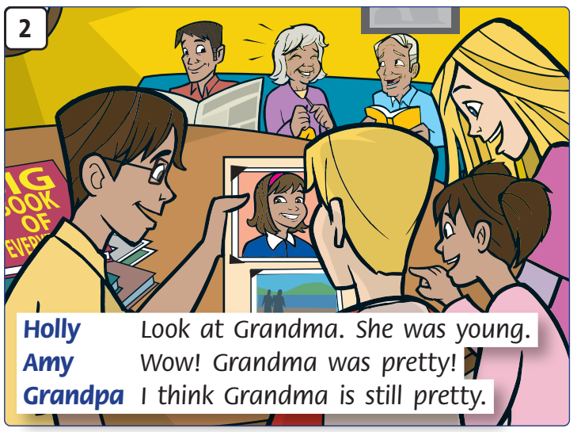
Look and Say
Notes:
As a class, decide on the story actions (see below).
Divide the class into groups of six to play the parts of Holly, Max, Dad, Amy, Grandpa, and Leo.
Story actions
Picture 2: Max turns the page in the photo album. Holly points at another photo. The kids look at Grandma.

Slide 12
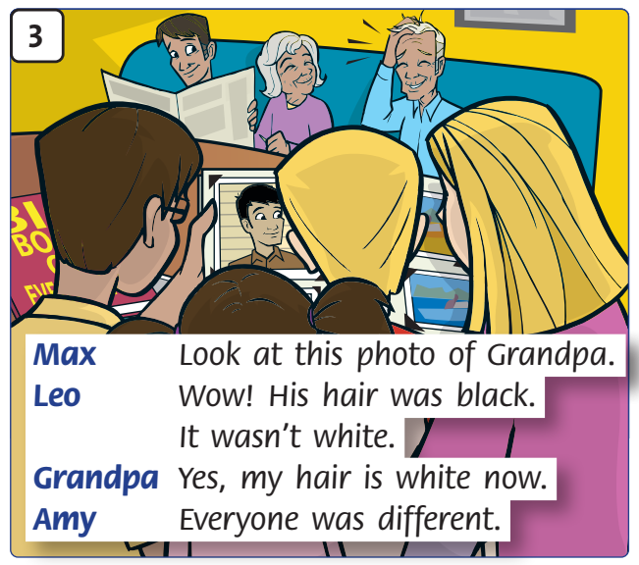
Look and Say
Notes:
As a class, decide on the story actions (see below).
Divide the class into groups of six to play the parts of Holly, Max, Dad, Amy, Grandpa, and Leo.
Story actions
Picture 3: Max and Leo point to the photo. Grandpa touches his hair.

Slide 13
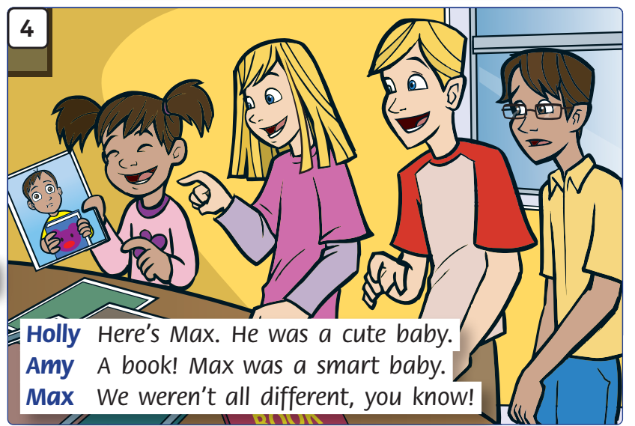
Look and Say
Notes:
As a class, decide on the story actions (see below).
Divide the class into groups of six to play the parts of Holly, Max, Dad, Amy, Grandpa, and Leo.
Story actions
Picture 4: Holly holds up a photo and points. Amy and Leo laugh. Max is embarrassed.

Slide 14
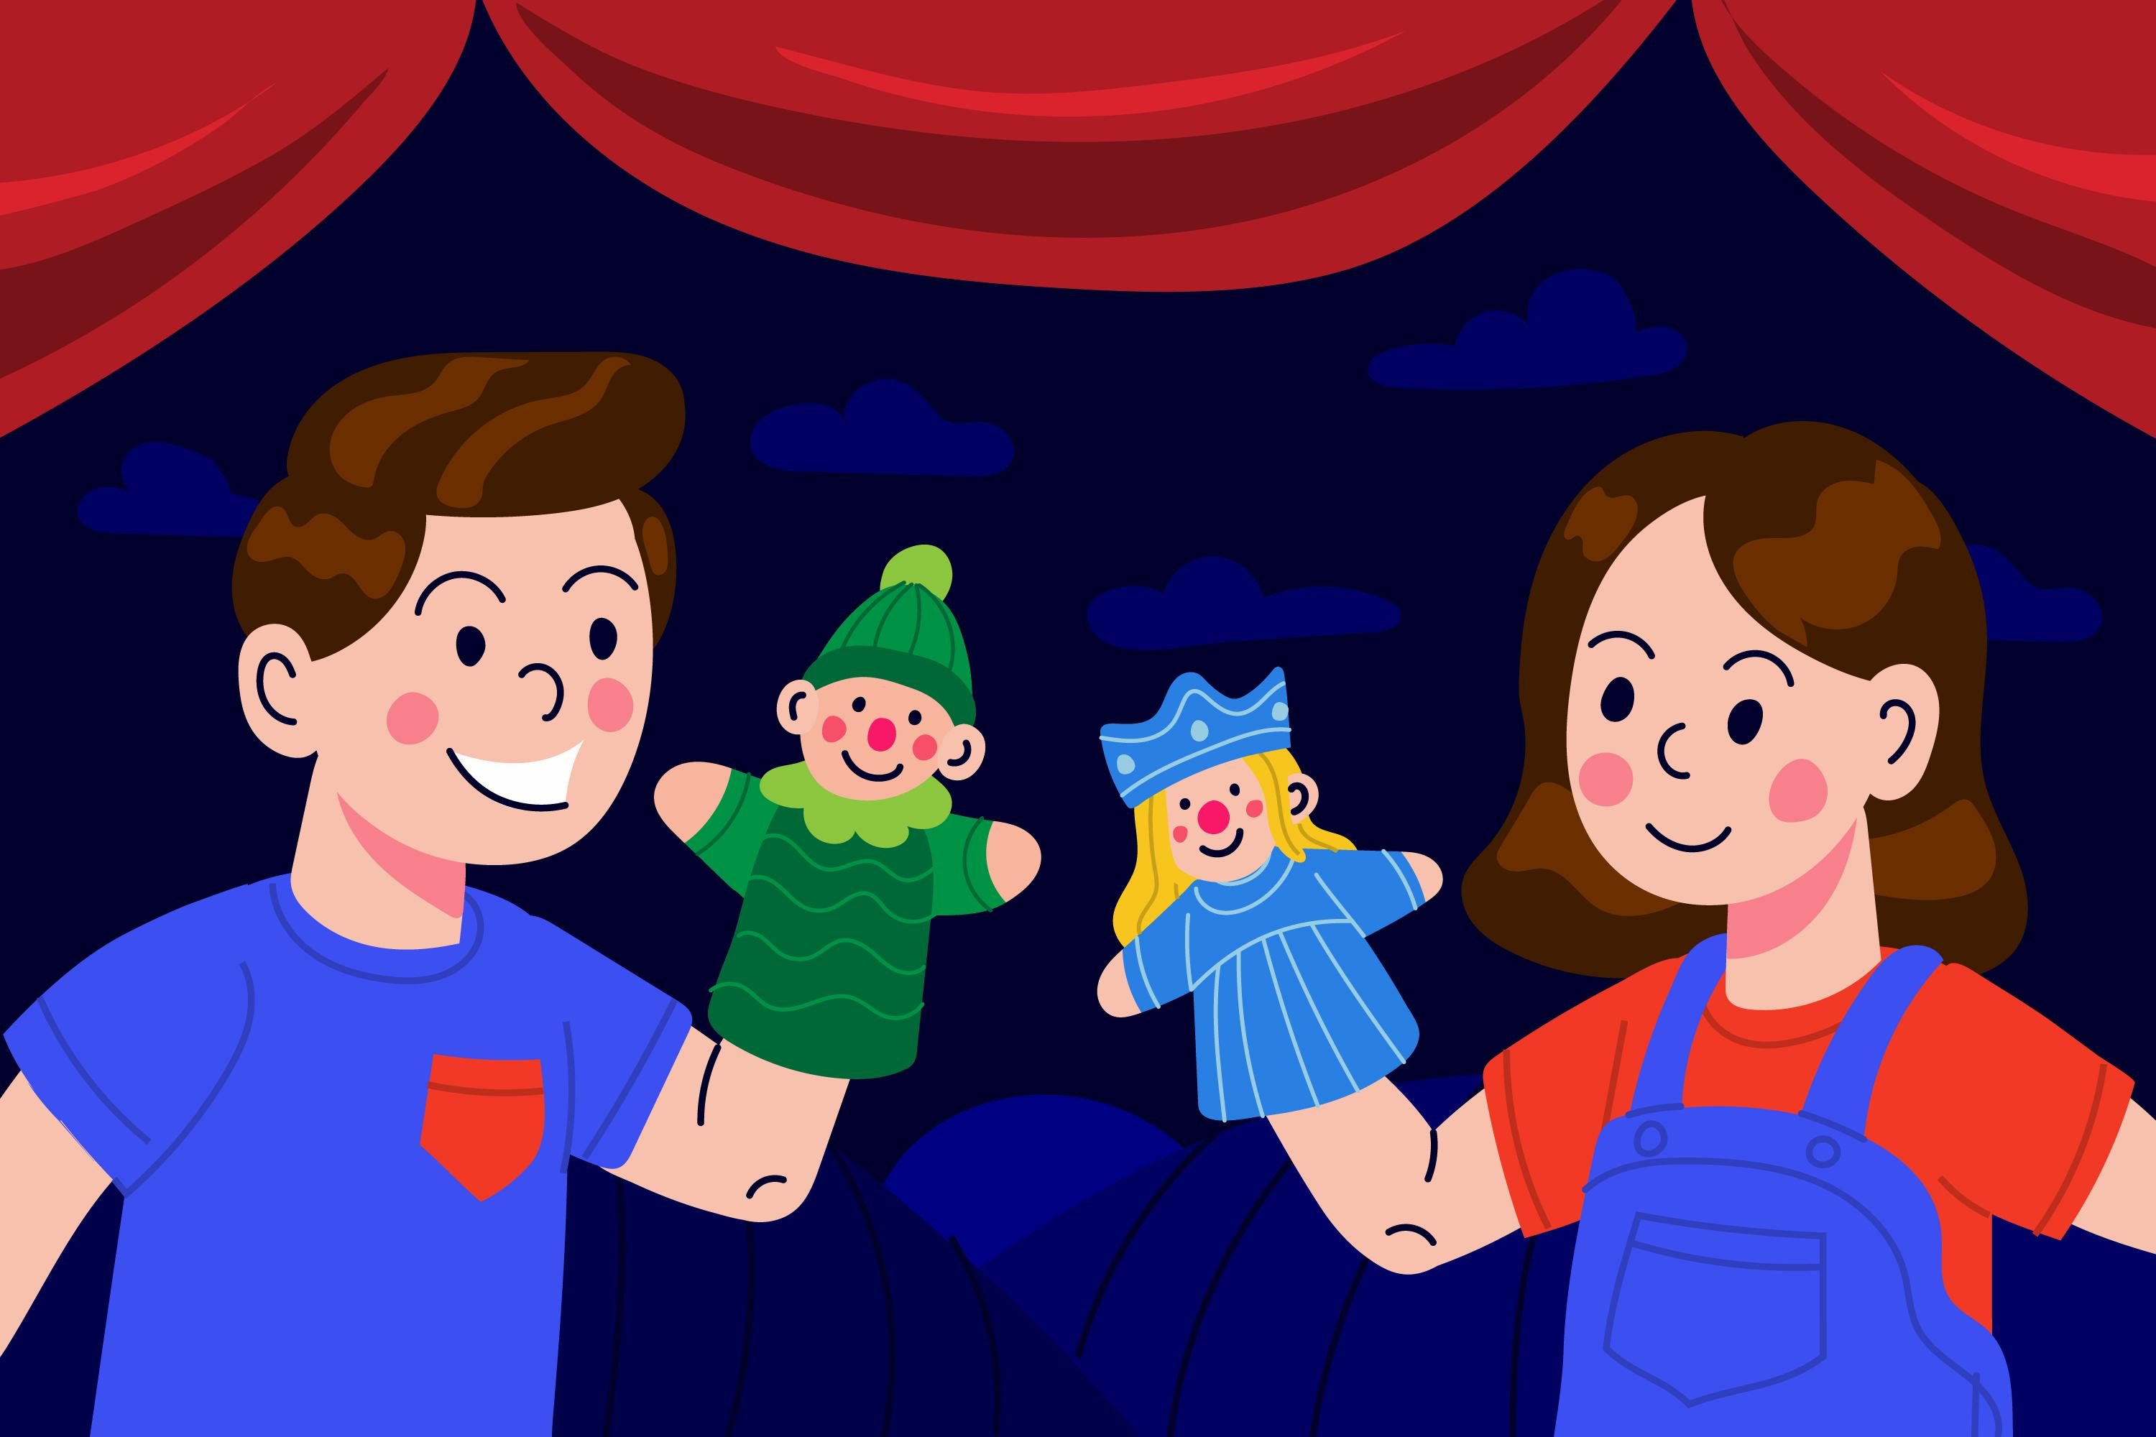
Story Actions
Notes:
Children practice acting out the story in their groups.
Ask a few groups to the front to act out the story.

Slide 15

Good job!
Notes:
Play the song How do we get to the station? from page 84, or your own music, as children pass the cards around the room.

Slide 16

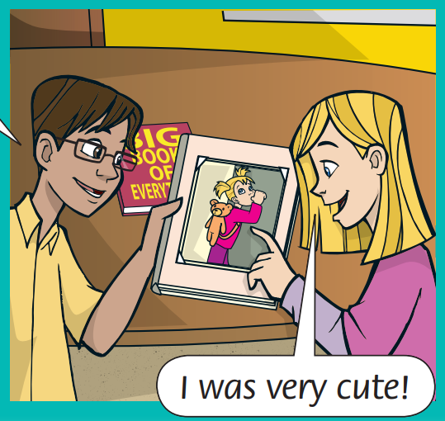
Look and Say
I was very cute!
Notes:
* Listen and say. Track 144
Focus on the picture in Let’s learn box and ask children to read out the speech bubbles.

Slide 17
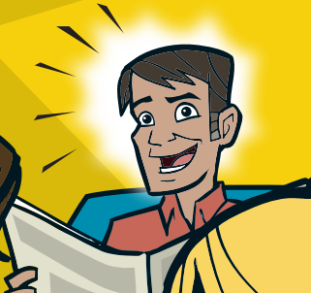
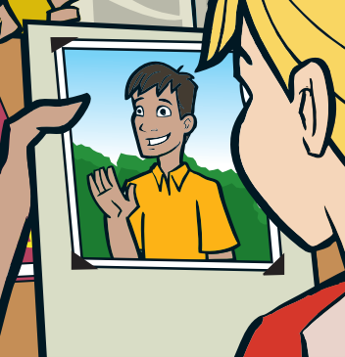
Dad – in the past
Dad – now
He was handsome!
Notes:
* Listen and say. Track 144
Focus on the picture in Let’s learn box and ask children to read out the speech bubbles.

Slide 18
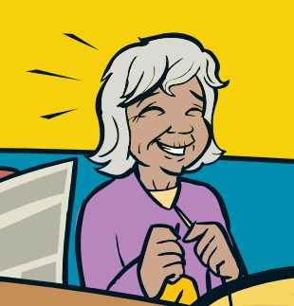
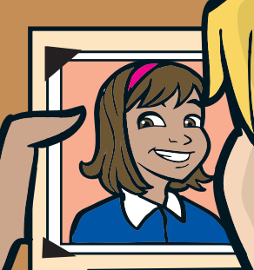
Grandma – in the past
Grandma – now
wasn’t = was not
Her hair wasn’t white!
She was pretty!
Notes:
* Listen and say. Track 144
Focus on the picture in Let’s learn box and ask children to read out the speech bubbles.

Slide 19
Look and Say
I _______ very cute!
was
Notes:
Copy the sentences onto the board; then rub out the red words. Ask children to tell you what the missing words are.

Slide 20
Dad – in the past
Dad – now
He ________ handsome!
was
Notes:
Copy the sentences onto the board; then rub out the red words. Ask children to tell you what the missing words are.

Slide 21
Grandma – in the past
Grandma – now
She ____ pretty!
Her hair ________ white!
was
wasn’t
Notes:
Copy the sentences onto the board; then rub out the red words. Ask children to tell you what the missing words are.

Slide 22
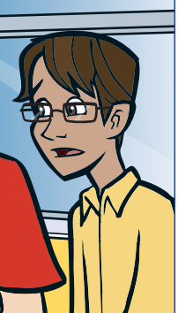
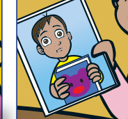
Max – in the past
Max – now
Look and Say
Max was smart.
Notes:
Rub out handsome and place suitable Adjectives to describe people flashcards next to each gap to elicit new sentences, e.g. He was cute then.

Slide 23

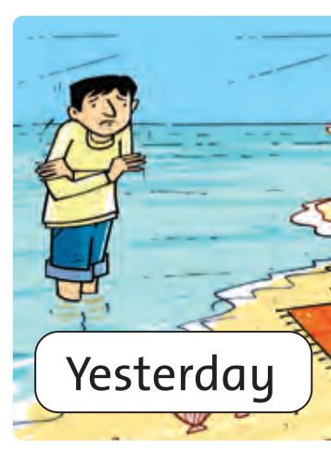

Yesterday
today
Yesterday, Nam was at the beach.
Notes:
Rub out handsome and place suitable Adjectives to describe people flashcards next to each gap to elicit new sentences, e.g. He was cute then.

Slide 24
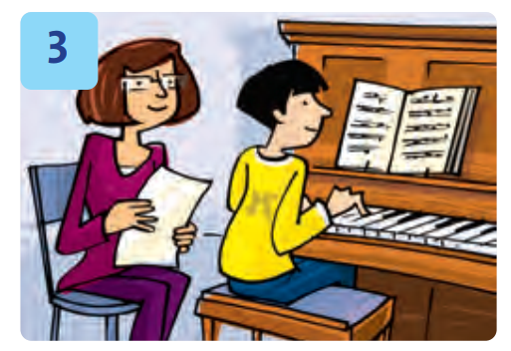

last week
this week
Last week, Nam wasn’t at guitar class.
Notes:
Rub out handsome and place suitable Adjectives to describe people flashcards next to each gap to elicit new sentences, e.g. He was cute then.

Slide 25
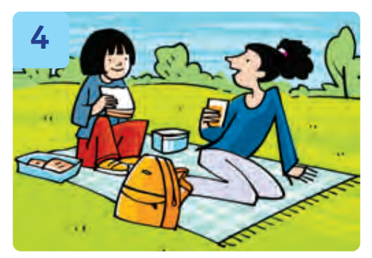
Yesterday
today
Yesterday, she was at the park.
She wasn’t at the beach.
Notes:
Rub out handsome and place suitable Adjectives to describe people flashcards next to each gap to elicit new sentences, e.g. He was cute then.

Slide 26
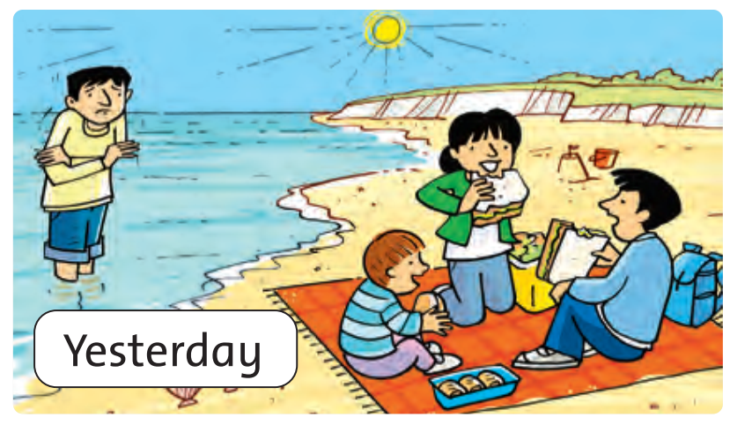
Look and Answer
Notes:
Focus on the picture. Ask Where are they? Is the water warm? How many children are there? What are they eating?

Slide 27
Game: TIC – TAC - TOE
Notes:
* Tic-Tac-Toe
Ask children to look at the colors, choose a color and make a sentence using affirmative and negative past simple form to describe people in the picture.
Children get scores if they have appropriate description.
Click the baby to the Congratulation slide!

Slide 28
Look and Say
The man was ………………………
at the beach yesterday.
Notes:
Click the baby to back to the Color slide.

Slide 29
Look and Say
The family wasn’t …………………………..
at the park yesterday.
Notes:
Click the baby to back to the Color slide.

Slide 30
Look and Say
sunny yesterday.
The weather was ……………………
Notes:
Click the baby to back to the Color slide.

Slide 31
Look and Say
The weather wasn’t ………………………….
rainy yesterday.
Notes:
Click the baby to back to the Color slide.

Slide 32
Look and Say
The man was ………………………...
cold yesterday.
Notes:
Click the baby to back to the Color slide.

Slide 33
Look and Say
The man wasn’t ………………………...
hot yesterday.
Notes:
Click the baby to back to the Color slide.

Slide 34
Look and Say
The sandwich was …………………….
big yesterday.
Notes:
Click the baby to back to the Color slide.

Slide 35
Look and Say
The sandwich wasn’t …………………….
small yesterday.
Notes:
Click the baby to back to the Color slide.

Slide 36
Look and Say
The boy was ……………………………
hungry yesterday.
Notes:
Click the baby to back to the Color slide.

Slide 37
Good job!

Slide 38


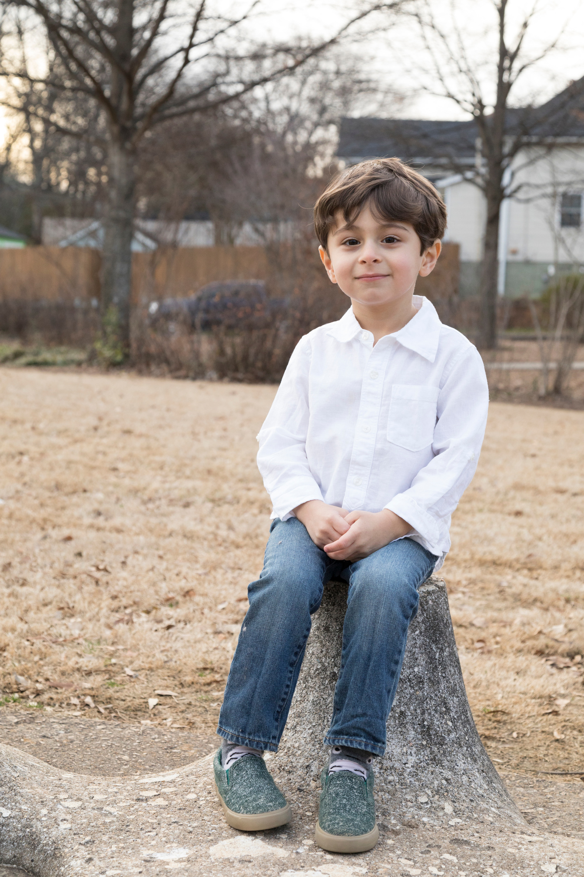
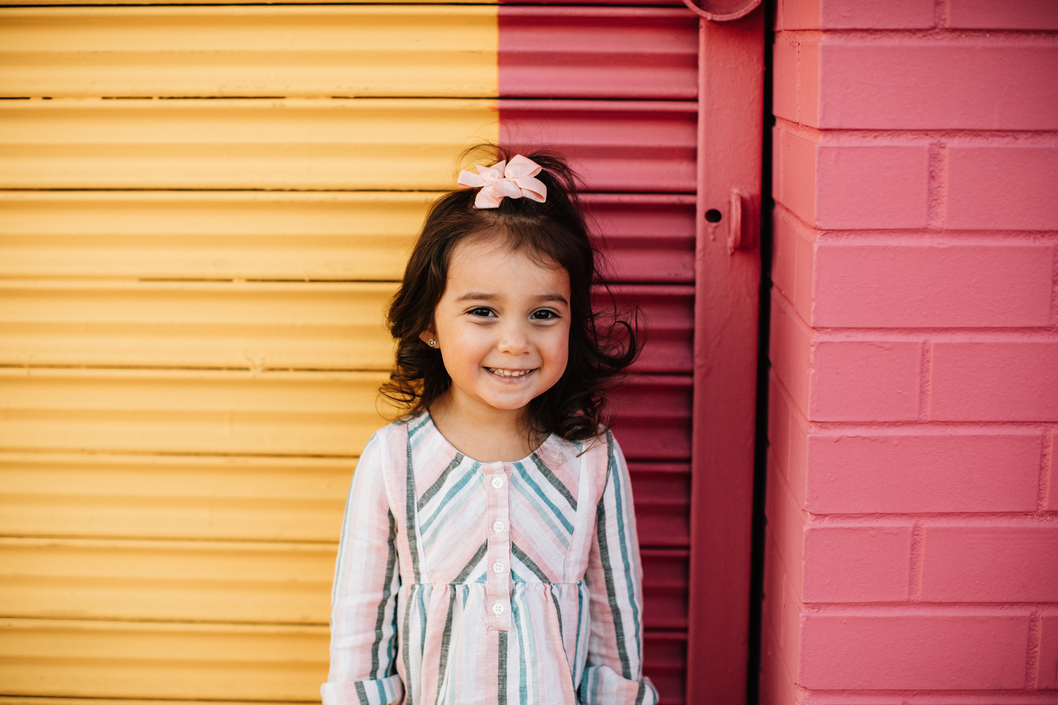
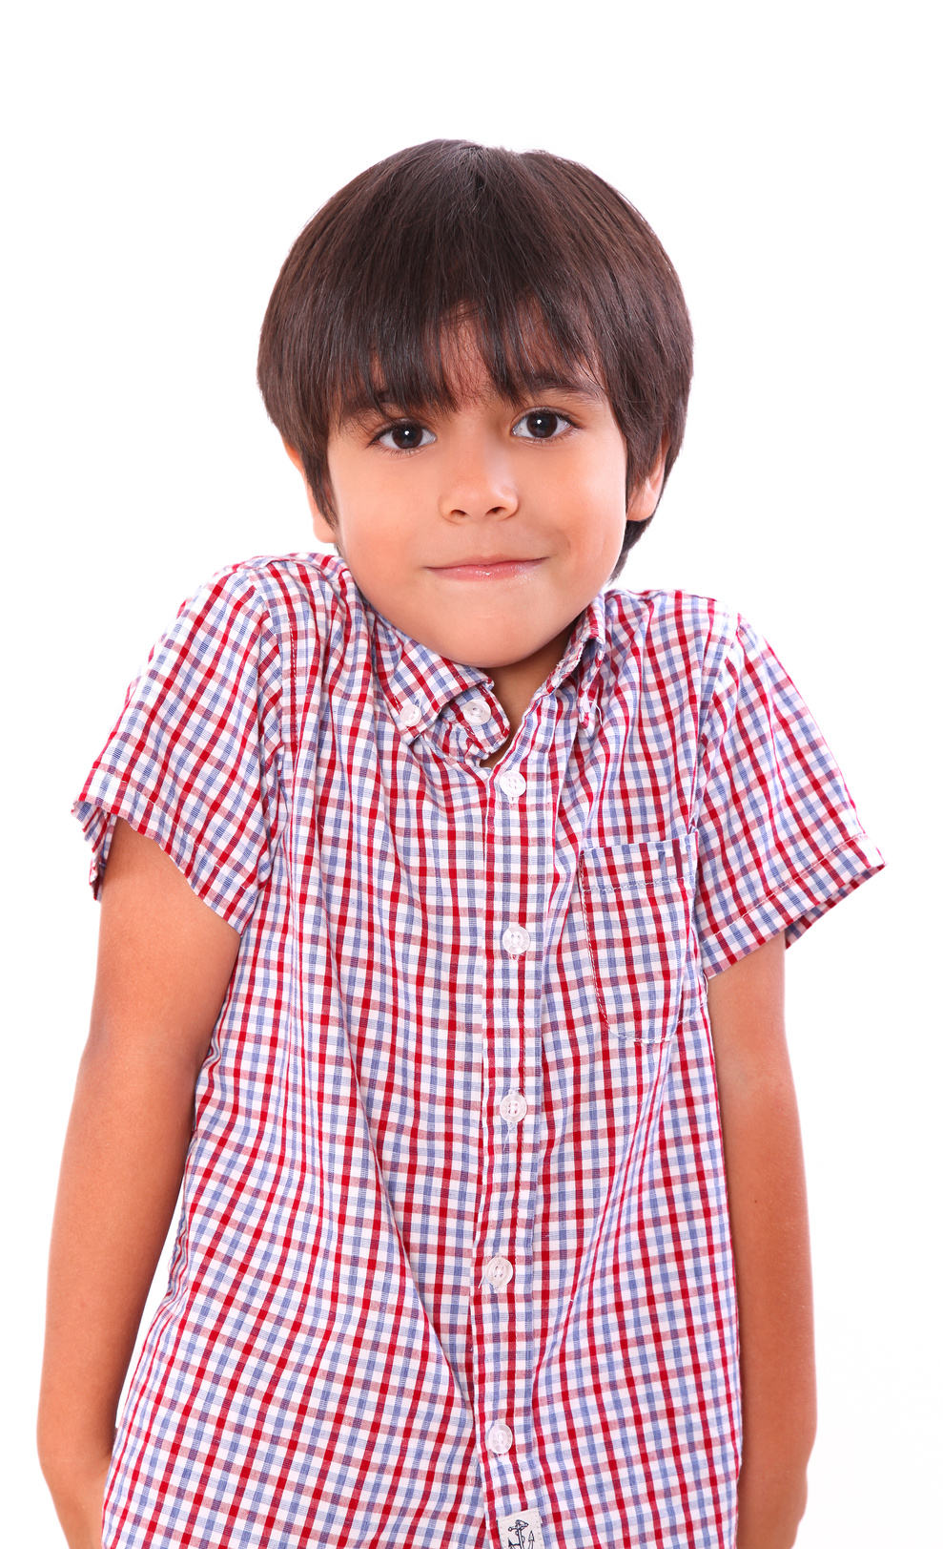
Our Winners!
Peter
Eric
Julie
Notes:
Replace photos and names with your students’ information.

Slide 39



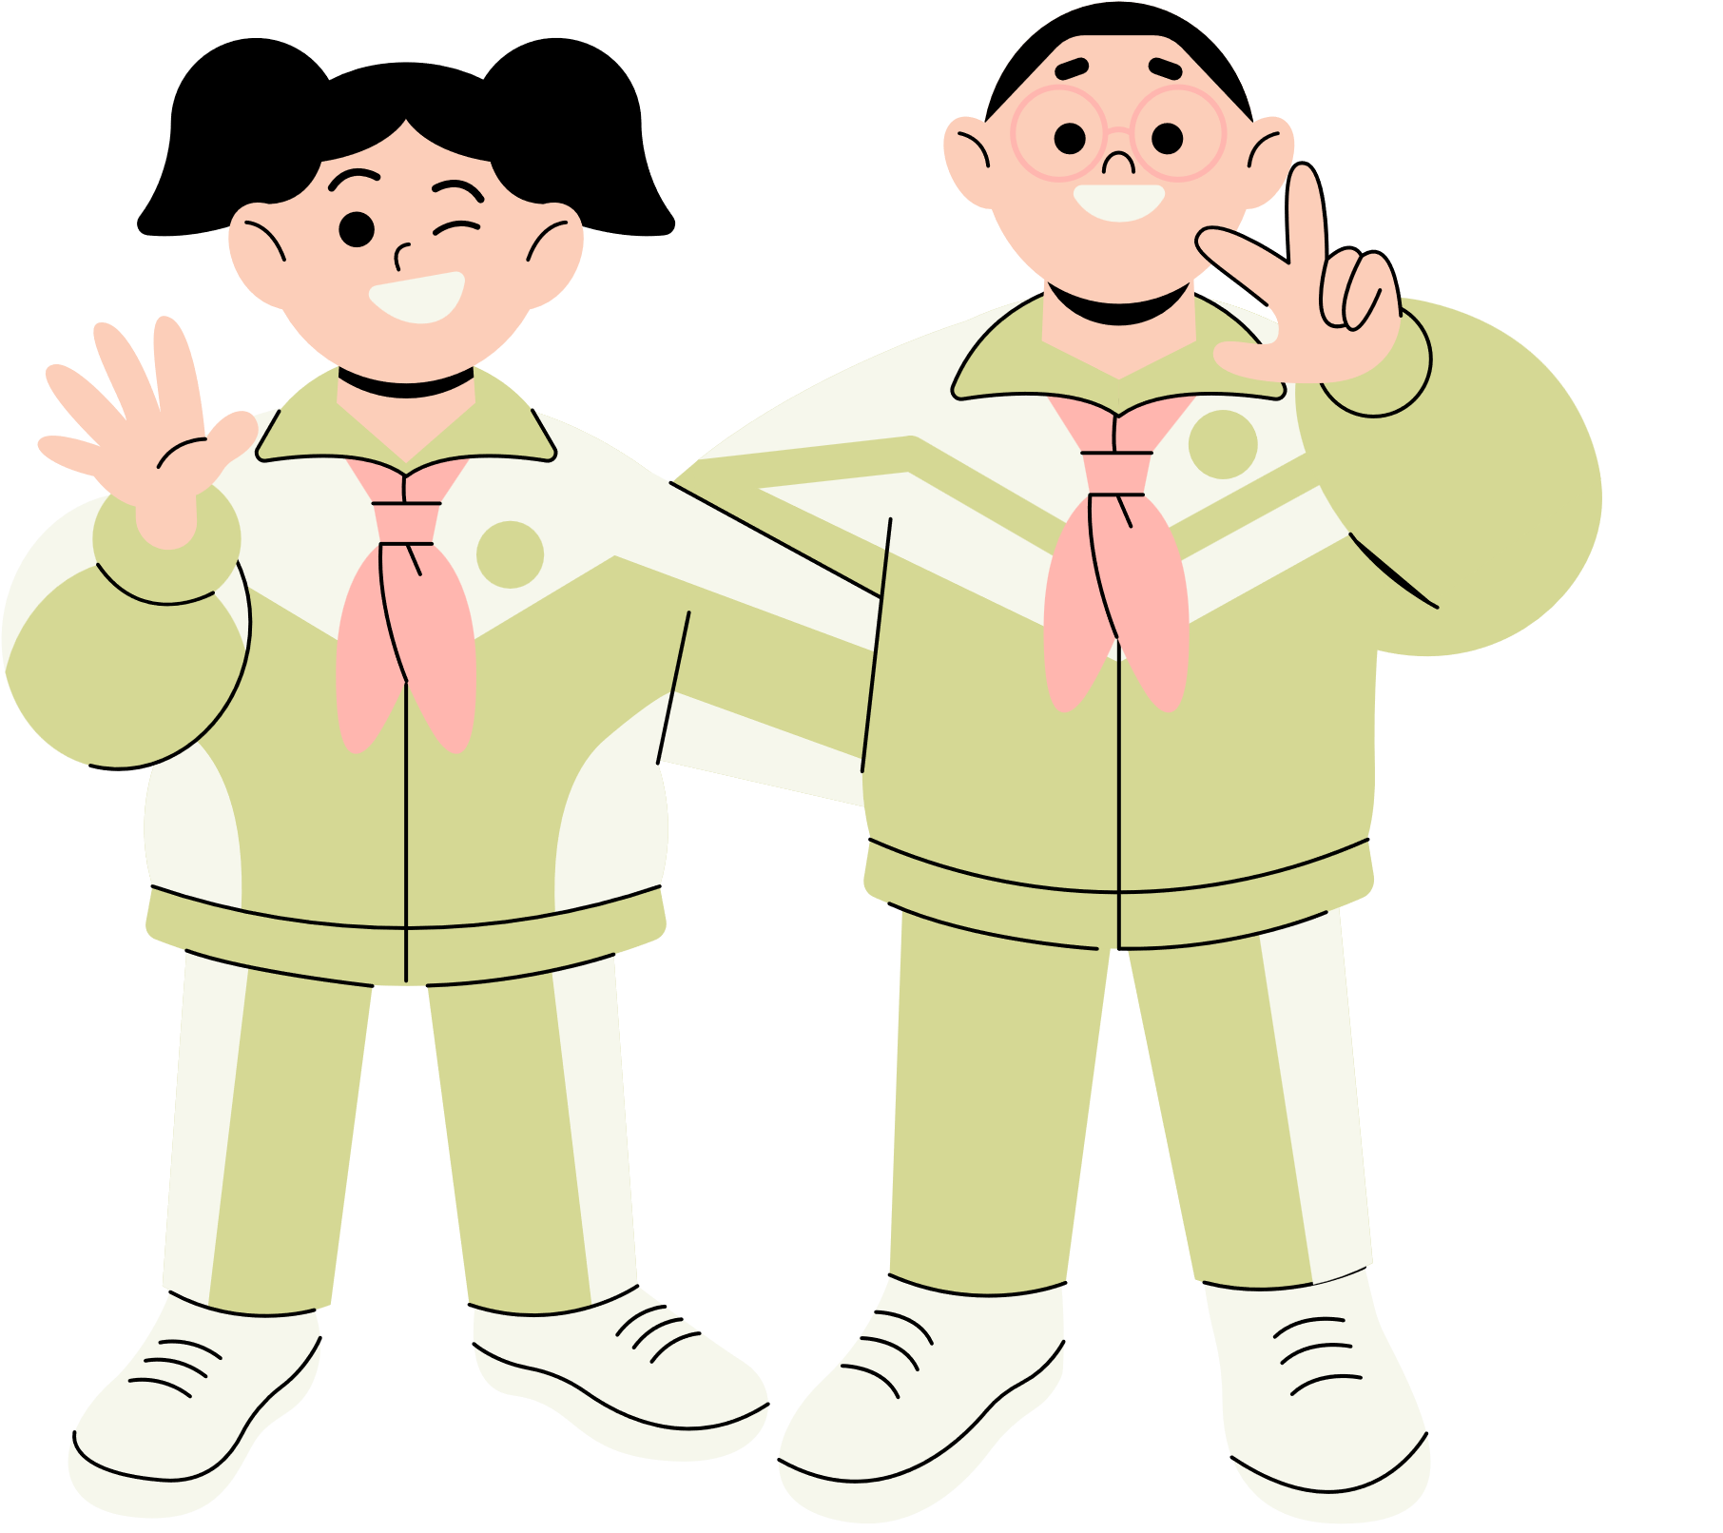







Thank You!
See You Next Time!
Notes:
https://www.youtube.com/watch?v=SRyFiVeNjWs

