Slide 2








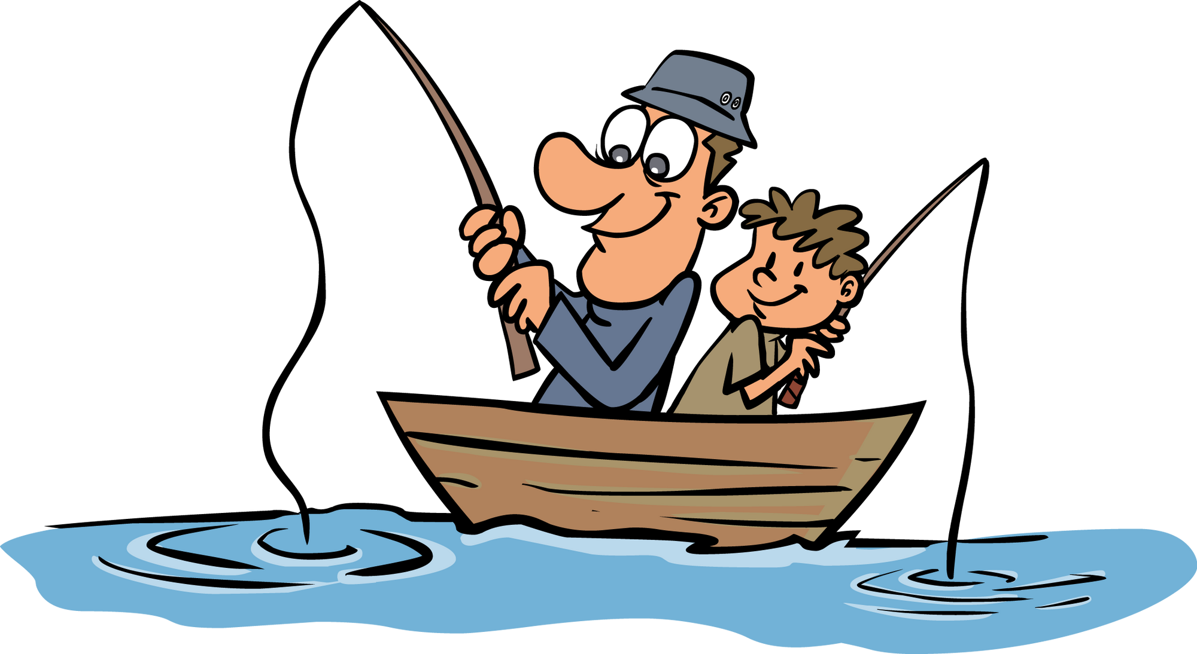

Unit 10
Do they like fishing?
Lesson 6 – Skills Time! – Period 1

Slide 3
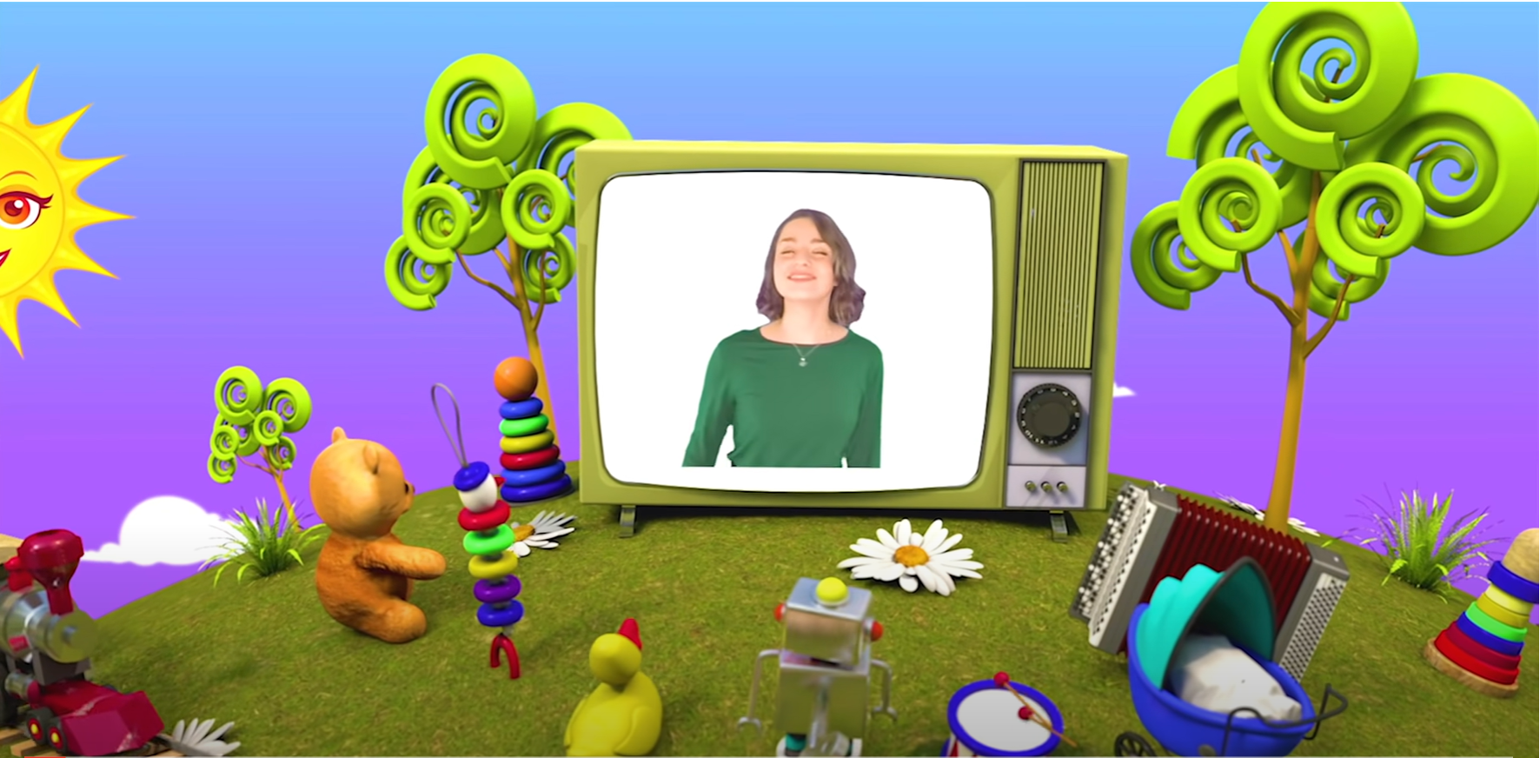
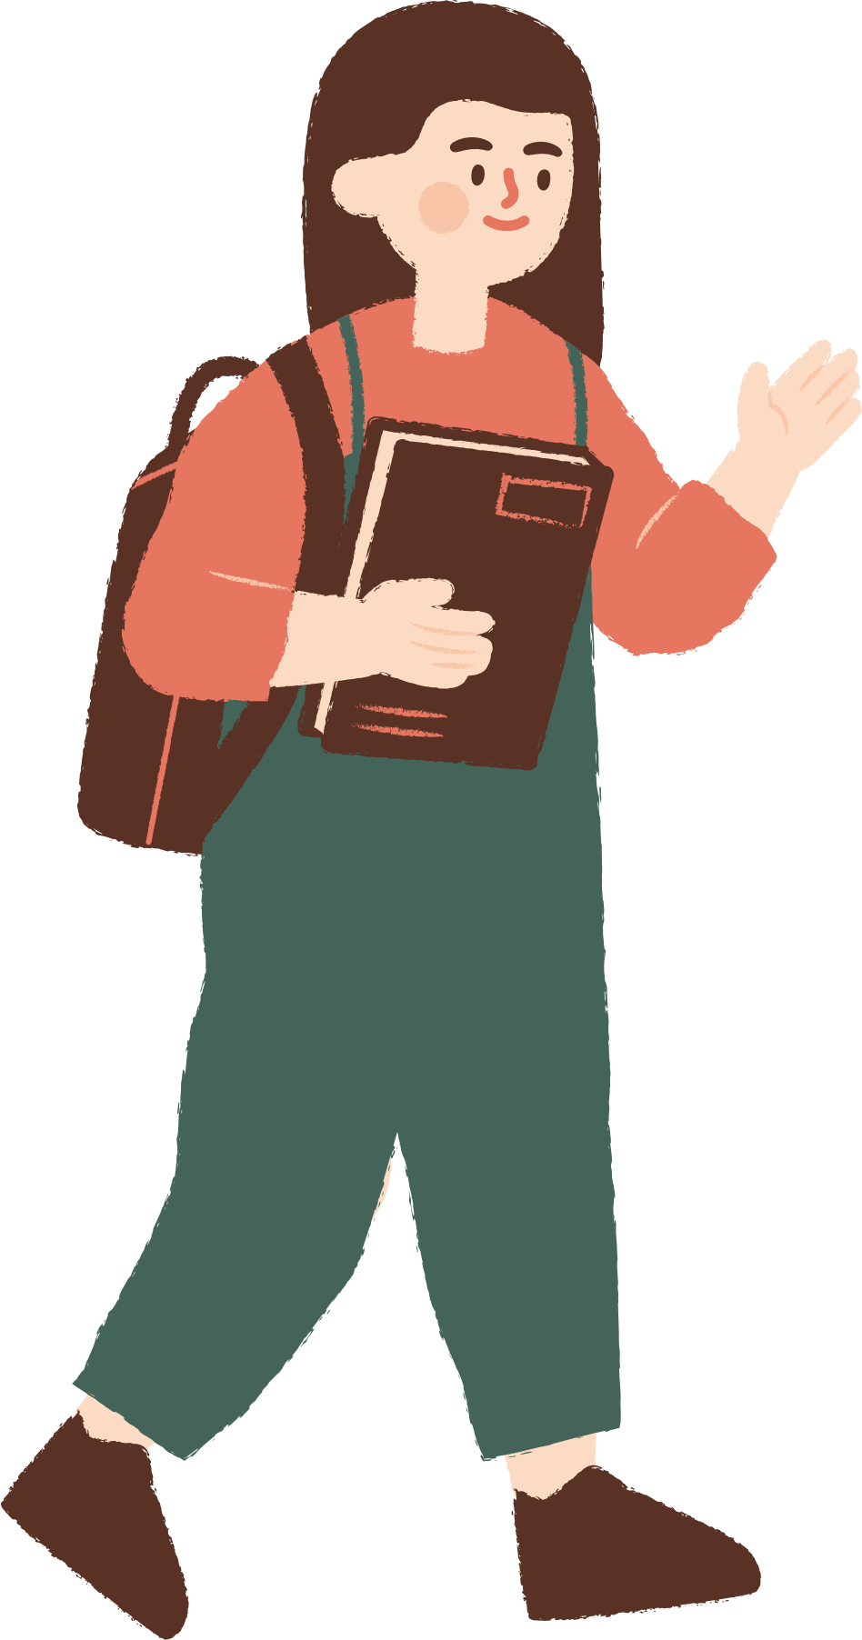

HELLO SONG

Slide 4



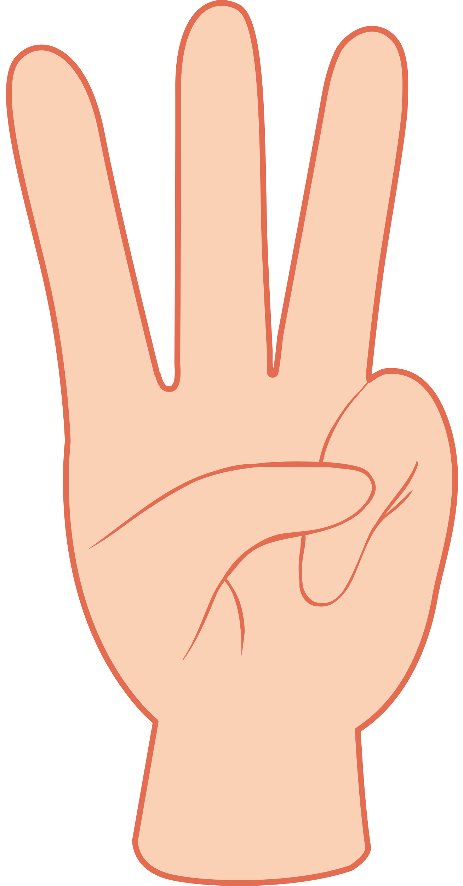



Slide 5


Watch a video
Notes:
* Warmer – Track 124
Sing I’m happy it’s the weekend! from page 78.

Slide 6

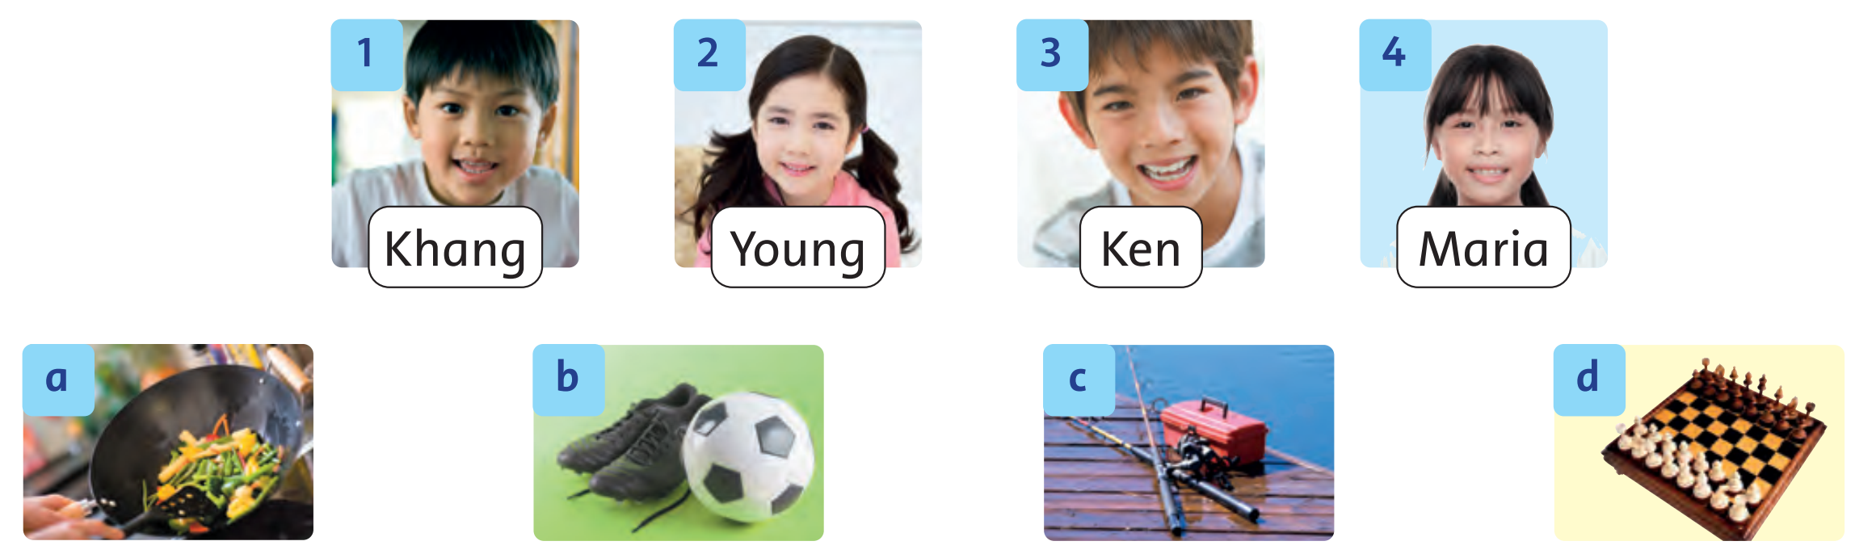
Listen and Answer.
81
Notes:
* Lead-in:
Focus on the photos in Exercise 1.
Ask children to tell you the hobbies they can see (cooking, playing soccer, fishing, and playing chess). Ask children about their hobbies, e.g. Do you like cooking, Giang?
Ask children to predict which hobbies Khang, Young, Ken, and Maria like doing.

Slide 7
Listen and Write.
1. Khang: …………………………………………….
2. Young: …………………………………………….
3. Ken: ……………………………………………….
4. Maria: ……………………………………………..
Notes:
* Listen and match. What do they like? – Track 129
Tell children they are going to hear a recording about what the four children like doing. They must listen and match the children with the hobbies.
Ask the children to write 1–4 in their notebooks.

Slide 8

Listen and Point.
81
Notes:
Play Track 129. Children point to the pictures.

Slide 9
Listen and Write.
81
b
1. Khang:
a
2. Young:
c
3. Ken:
d
4. Maria:
Notes:
Play the recording again, pausing after each dialogue for children to write the correct letter next to the numbers..
Answers
1 b 2 a 3 c 4 d

Slide 10

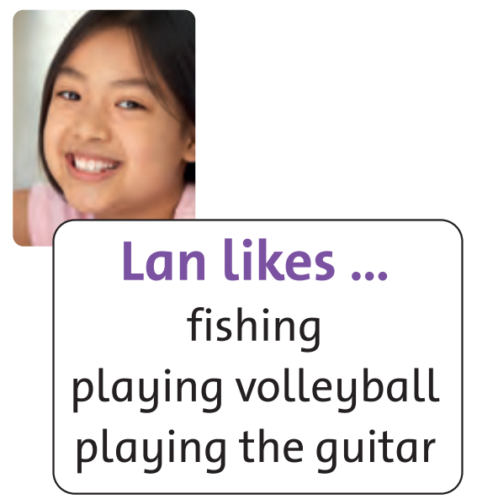
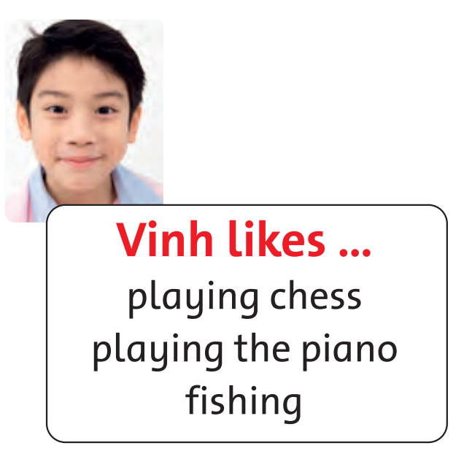
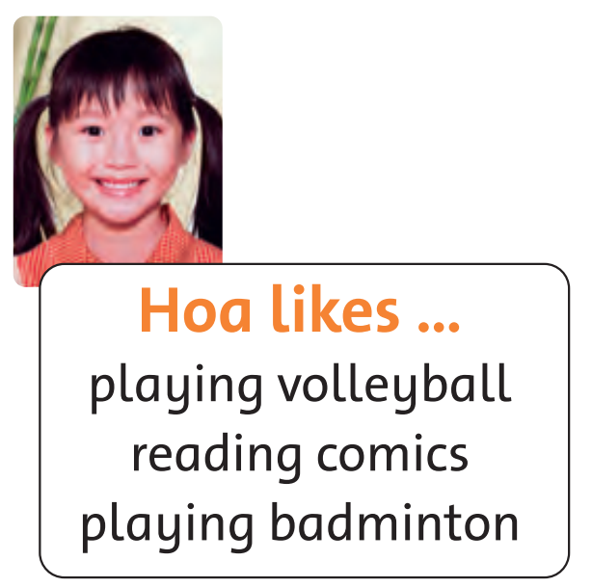
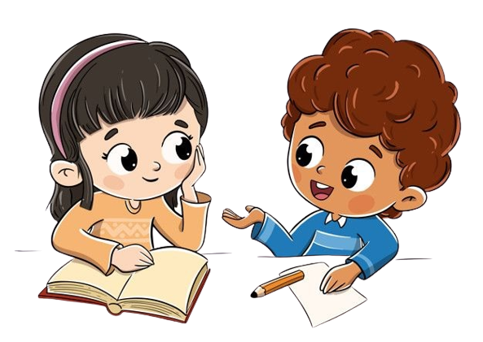
Ask and Answer!
81
I want a pen pal.
What do you like doing?
Write an email to Lan or Vinh.
They like fishing.
I like fishing.
Notes:
* Ask and answer.
Focus on the photos and texts. Ask a few questions, e.g. What does Quang like doing?
Ask two children to read the speech bubbles for the class.

Slide 11
Work in Pairs.
81
I want a pen pal.
What do you like doing?
I like fishing.
Write an email to Lan or Vinh.
They like fishing.
Notes:
Tell children that they are going to ask and answer questions about what they like doing, and choose pen pals for their partners.
Tell children they must choose from the hobbies that the children in Exercise 2 have.
In pairs, children ask and answer, using the speech bubbles as a model.

Slide 12
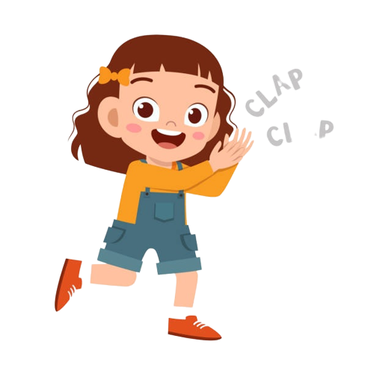
Good job!

Slide 13
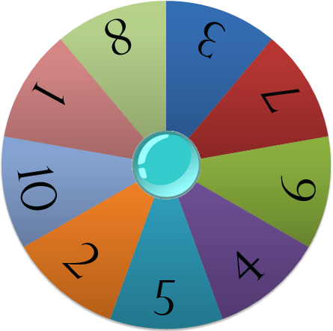









Game: TALK ABOUT YOUR FAMILY!
Let’s spin the wheel and talk about your family!
mom
friend
My sister
likes cooking.
dad
aunt
sister
uncle
brother
grandpa
grandma
Start
Notes:
* Talk about your family’s day.
Read aloud the example speech bubble and elicit sentences from the children.

Slide 14
Game: TALK ABOUT YOUR FAMILY!
mom
friend
dad
aunt
uncle
sister
Start
brother
grandpa
grandma
Notes:
Click START to spin the wheel.
The children talk about what their family do at different times of a day.

Slide 15
Game: TALK ABOUT YOUR FAMILY!
mom
friend
sister
aunt
dad
uncle
Start
brother
grandpa
grandma
Notes:
Click START to spin the wheel.
The children talk about what their family do at different times of a day.

Slide 16
Game: TALK ABOUT YOUR FAMILY!
mom
friend
dad
aunt
grandpa
uncle
Start
brother
sister
grandma
Notes:
Click START to spin the wheel.
The children talk about what their family do at different times of a day.

Slide 17
Game: TALK ABOUT YOUR FAMILY!
mom
friend
dad
aunt
brother
uncle
Start
sister
grandpa
grandma
Notes:
Click START to spin the wheel.
The children talk about what their family do at different times of a day.

Slide 18
Game: TALK ABOUT YOUR FAMILY!
sister
friend
dad
aunt
mom
uncle
brother
grandpa
Start
grandma
Notes:
Click START to spin the wheel.
The children talk about what their family do at different times of a day.

Slide 19
Game: TALK ABOUT YOUR FAMILY!
mom
friend
dad
sister
aunt
uncle
brother
grandpa
Start
grandma
Notes:
Click START to spin the wheel.
The children talk about what their family do at different times of a day.

Slide 20
Good job!

Slide 21


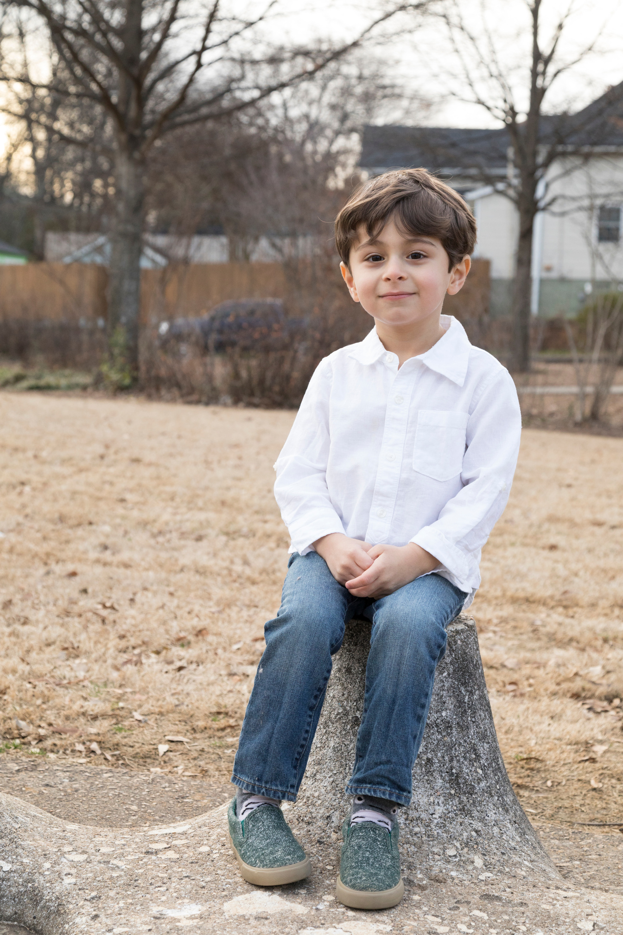
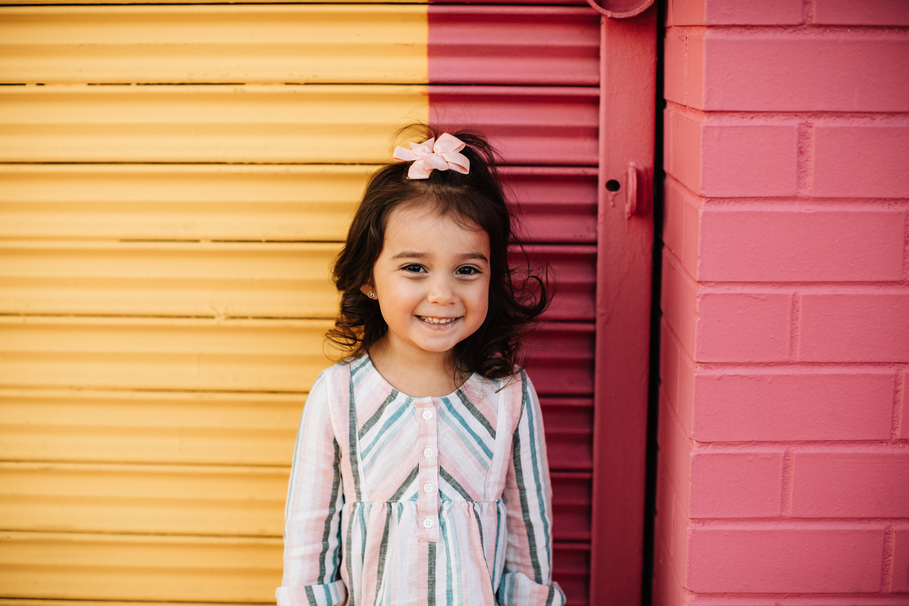
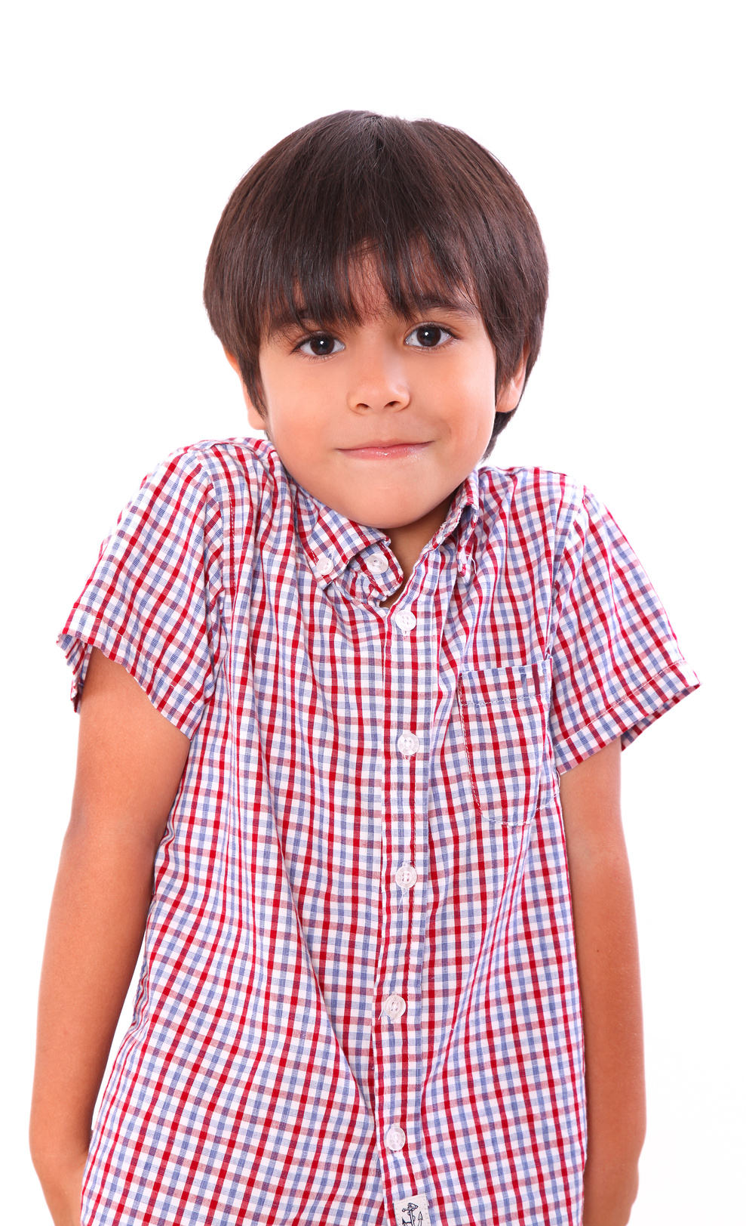
Our Winners!
Peter
Eric
Julie
Notes:
Replace photos and names with your students’ information.

Slide 22


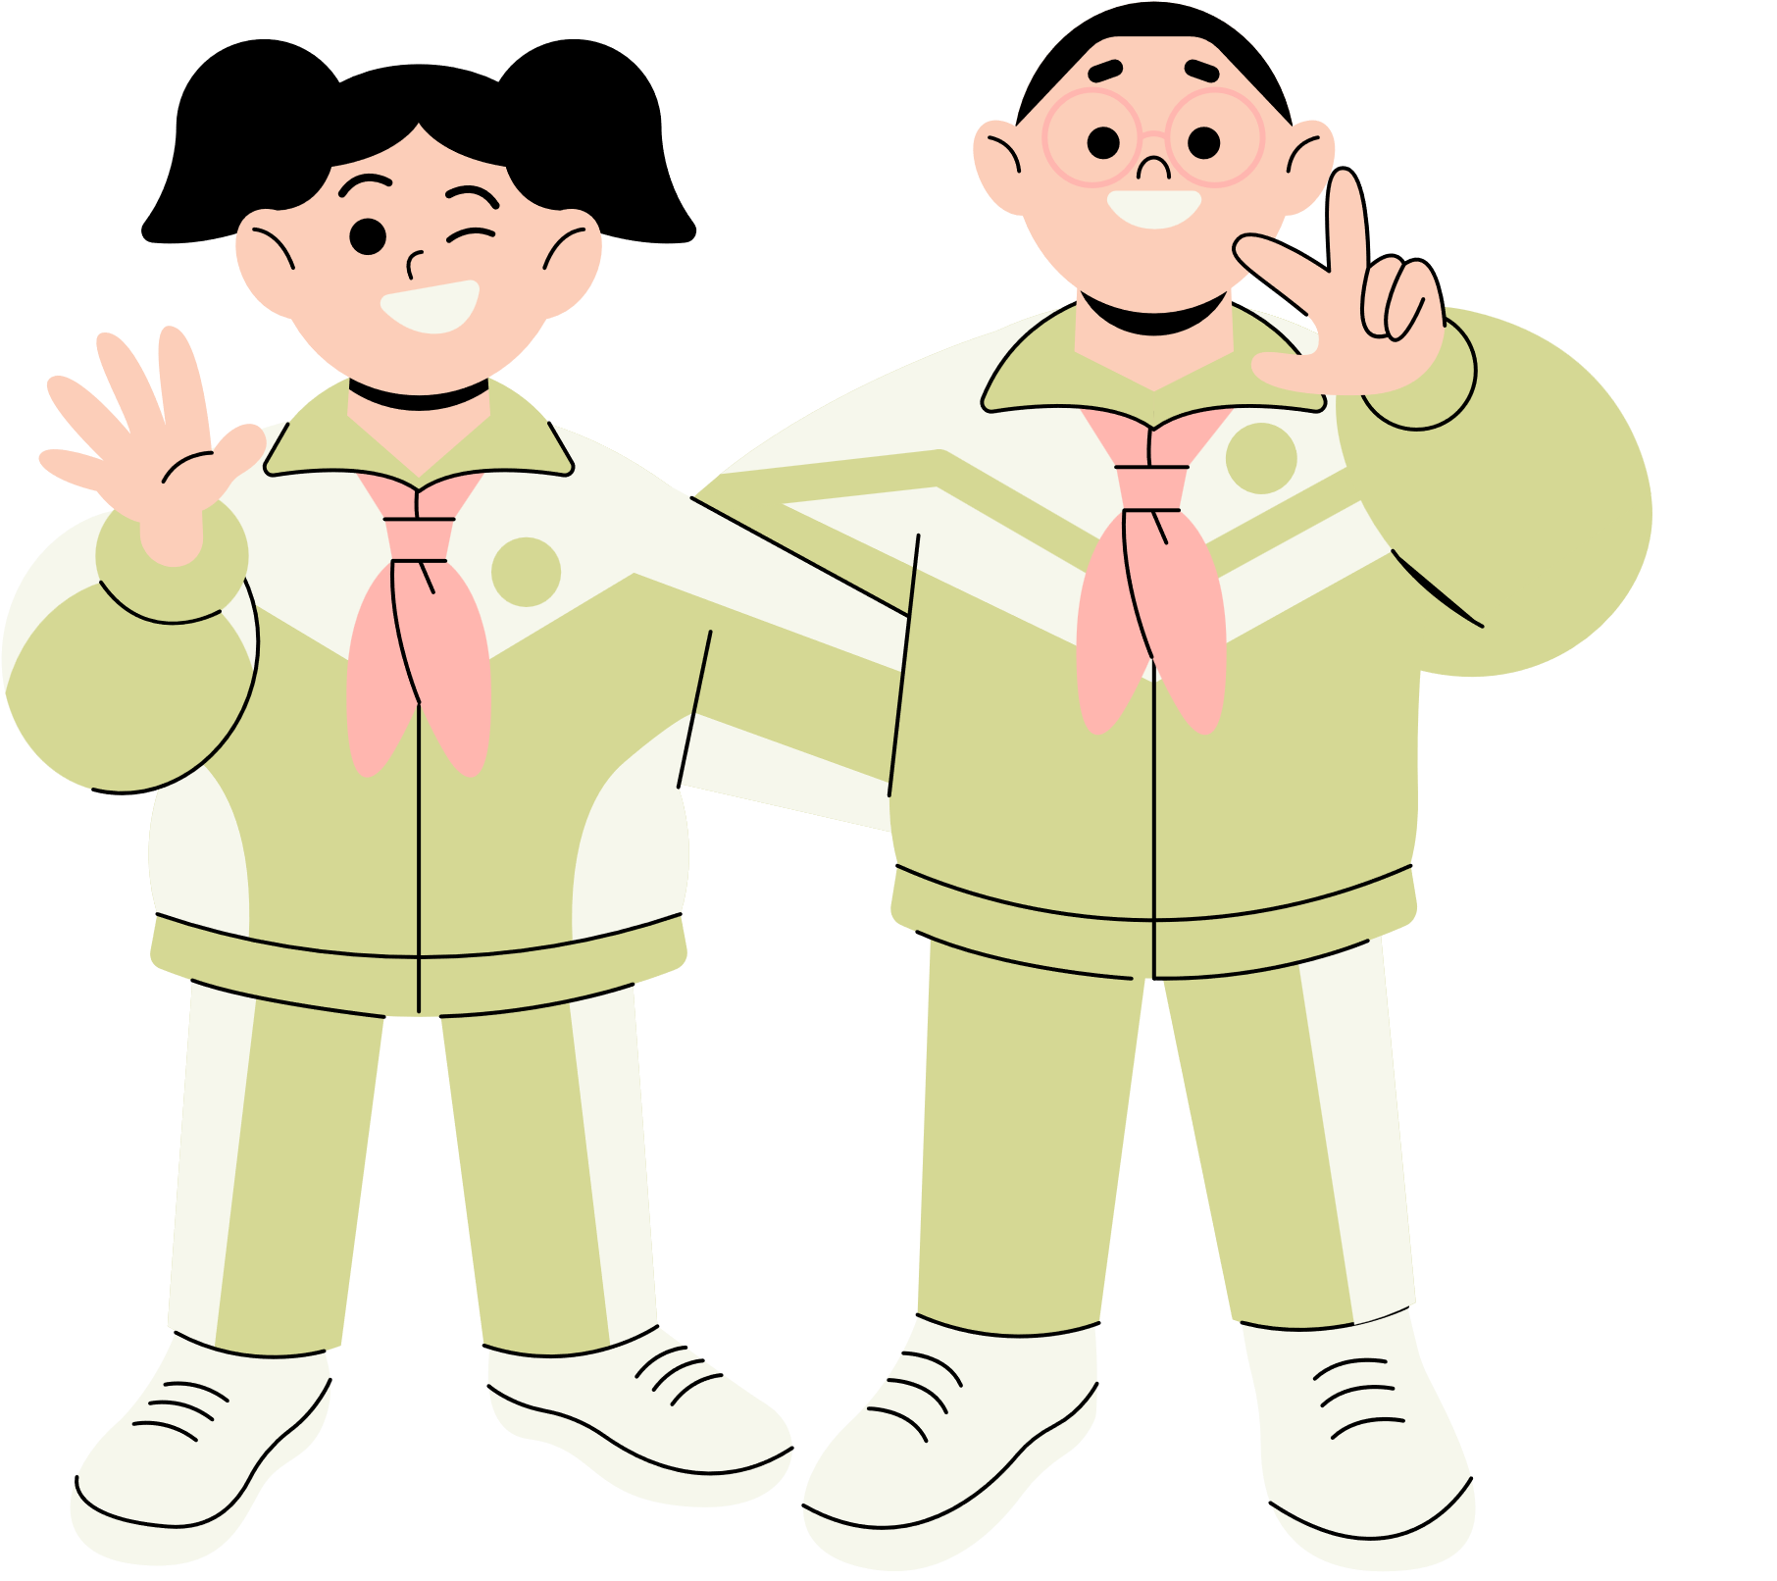





Thank You!
See You Next Time!
Notes:
https://www.youtube.com/watch?v=SRyFiVeNjWs

