Slide 2









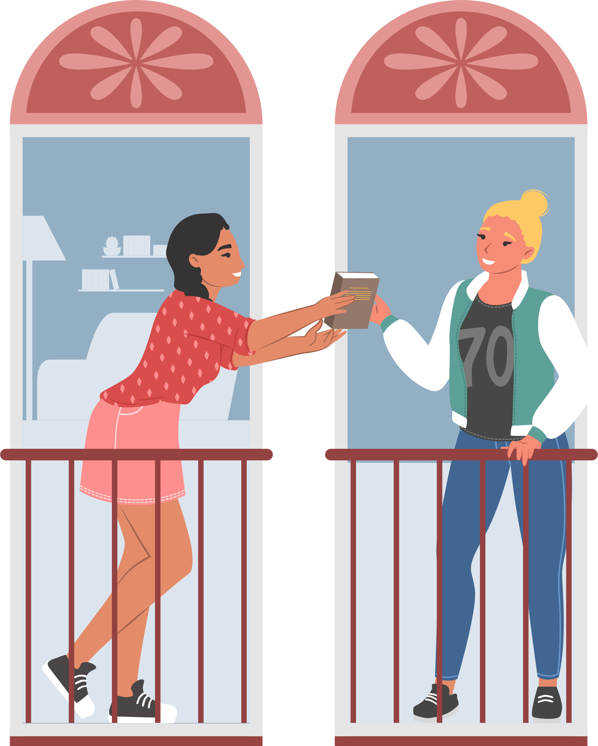

Unit 8
Let’s buy presents!
Lesson 6 – Skills Time! – Period 2

Slide 3
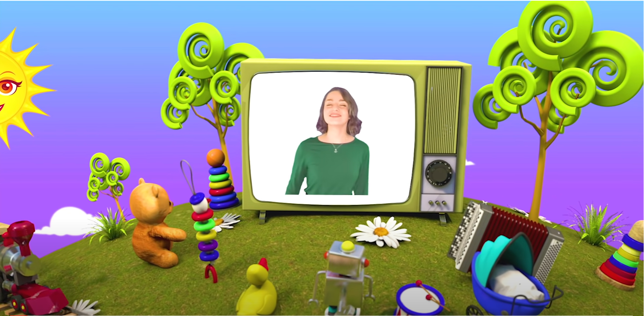
HELLO SONG
Notes:
https://www.youtube.com/watch?v=pqDEwPi7vxg

Slide 4






Slide 5


Game:
RING THE BELL!
Notes:
Game: Look and say. = Ring the bell!
Show pictures on the board.
Ask children to give commands and reasons for each picture. Then write sentences as fast as possible in the limited time.
Give scores to the children who are the fastest ones with the correct answers.

Slide 6






Look and Say, then Write.
6
1
2
3
4
5
7
8
9
10
START
Answer:
He likes candy because it’s delicious.

Slide 7

6
1
2
3
4
5
7
8
9
Look and Say, then Write.
10
START
Answer:
He doesn’t like balloons because they pop.

Slide 8


6
1
2
3
4
5
7
8
9
10
Look and Say, then Write.
START
Answer:
She likes the present because it’s a new toy.
Notes:
Possible answers:
- Go outside because it’s sunny today.

Slide 9


6
1
2
3
4
5
7
8
9
10
Look and Say, then Write.
START
Answer:
She doesn’t like cake because there’s jelly inside.

Slide 10
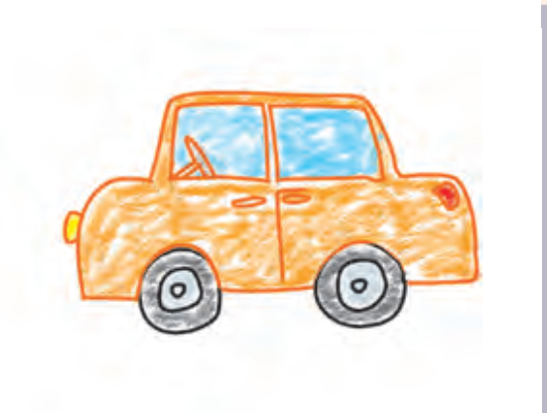
6
1
2
3
4
5
7
8
9
10
Look and Say, then Write.
START
Answer:
Here’s a picture of a car.

Slide 11
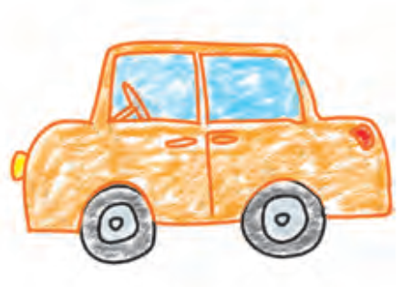
6
1
2
3
4
5
7
8
9
10
Look and Say, then Write.
START
Answer:
She likes cars because they’re fast.

Slide 12

Good job!

Slide 13
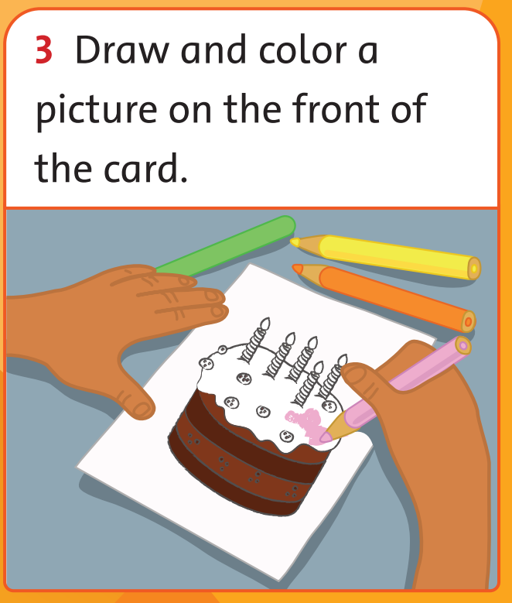
Let’s draw!
A THANK-YOU CARD
65
Notes:
* Draw and write a thank-you card for a family member. Look at the example to help you.
Focus on the example text. Ask the children to read it, and elicit what type of things you can say in a thank-you card.
Ask them to choose a family member they want to thank, and to think about what they want to thank them for, and what they can add to the card.
Ask the children to write the text of the card in their notebooks.

Slide 14
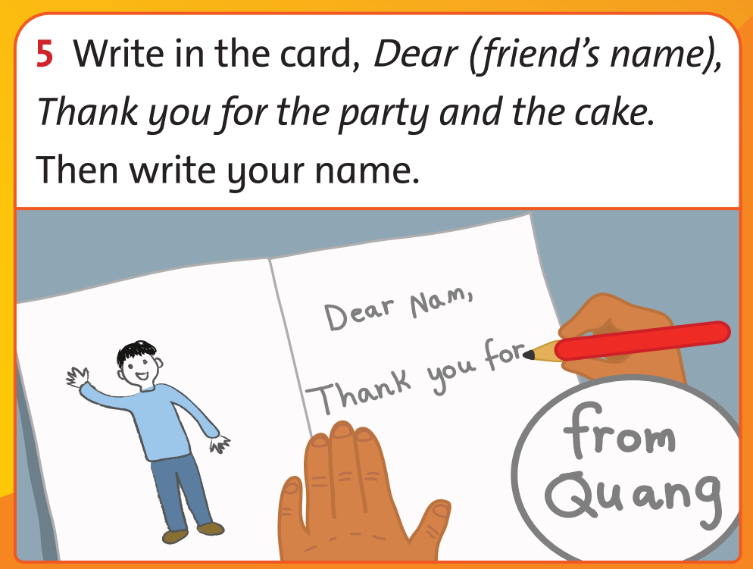
Let’s write!
A THANK-YOU CARD
65
Notes:
* Draw and write a thank-you card for a family member. Look at the example to help you.
Focus on the example text. Ask the children to read it, and elicit what type of things you can say in a thank-you card.
Ask them to choose a family member they want to thank, and to think about what they want to thank them for, and what they can add to the card.
Ask the children to write the text of the card in their notebooks.

Slide 15
Let’s write!
A THANK-YOU CARD
Dear Dad,
Thank you for everything you do.
Here’s a picture of a car.
I know you like cars because they’re fast.
Love,
Quang
Notes:
Show the example.
Ask children to think about what the weather is like today and the best clothes for it.

Slide 16

Let’s write!
A THANK-YOU CARD
Notes:
In 5 minutes, ask children to write their weather report in their notebooks.

Slide 17

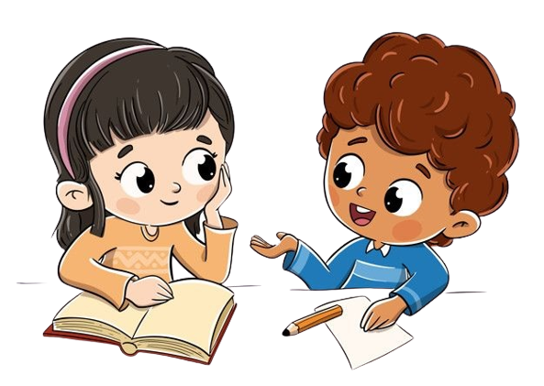
Work in Pairs.
Notes:
Children work in pairs to read their report to each other.
Invite some volunteer to rea aloud their report in the front.

Slide 18
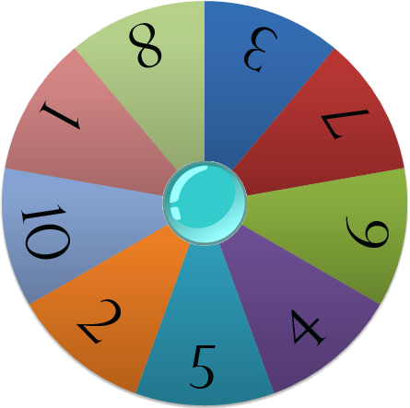
Let’s talk!
Start
Notes:
Number children from number 1 to 10.
Click START to spin the wheel.
The children with that number will talk about their thank-you card in the front.

Slide 19
Good job!

Slide 20



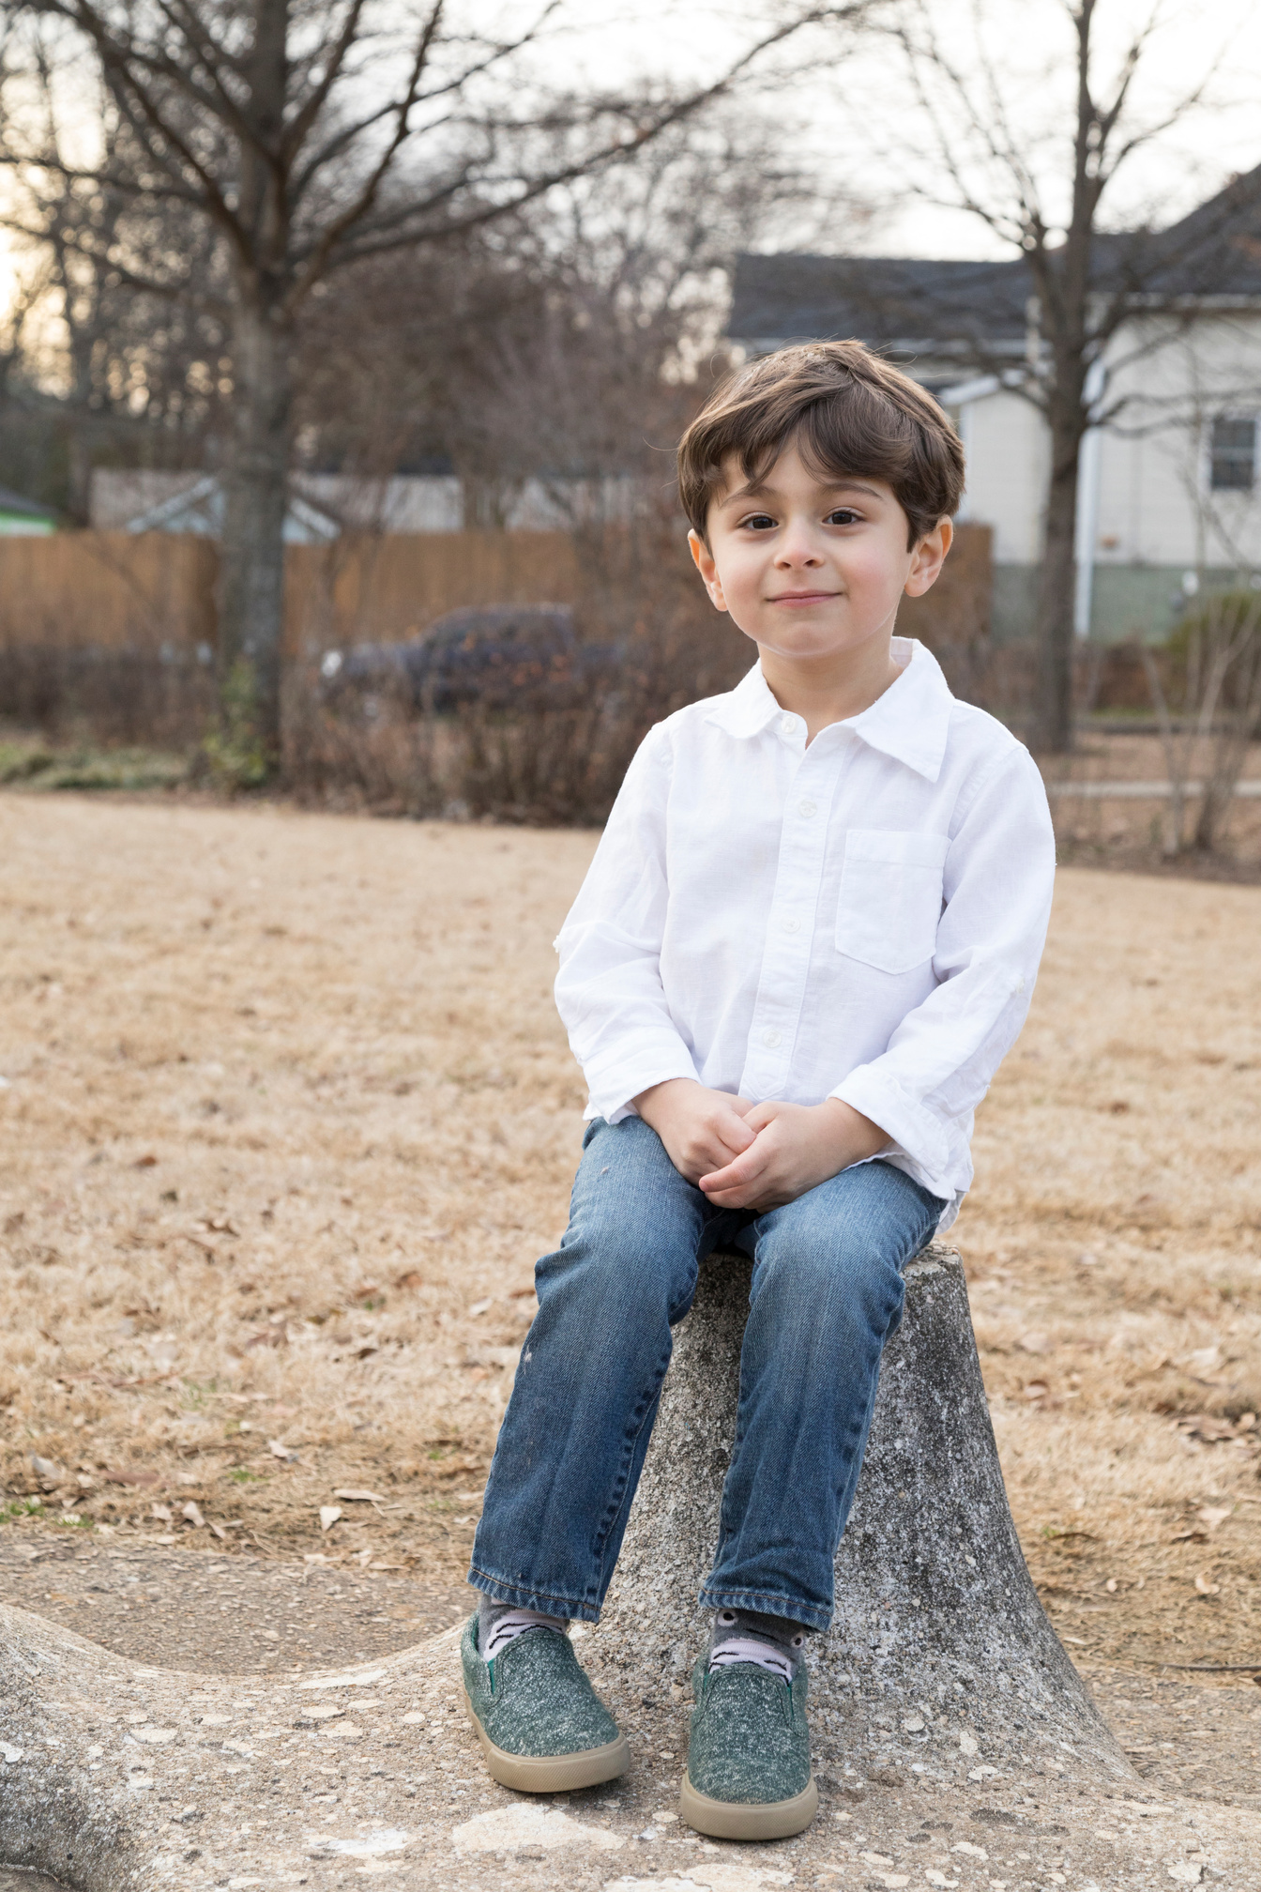
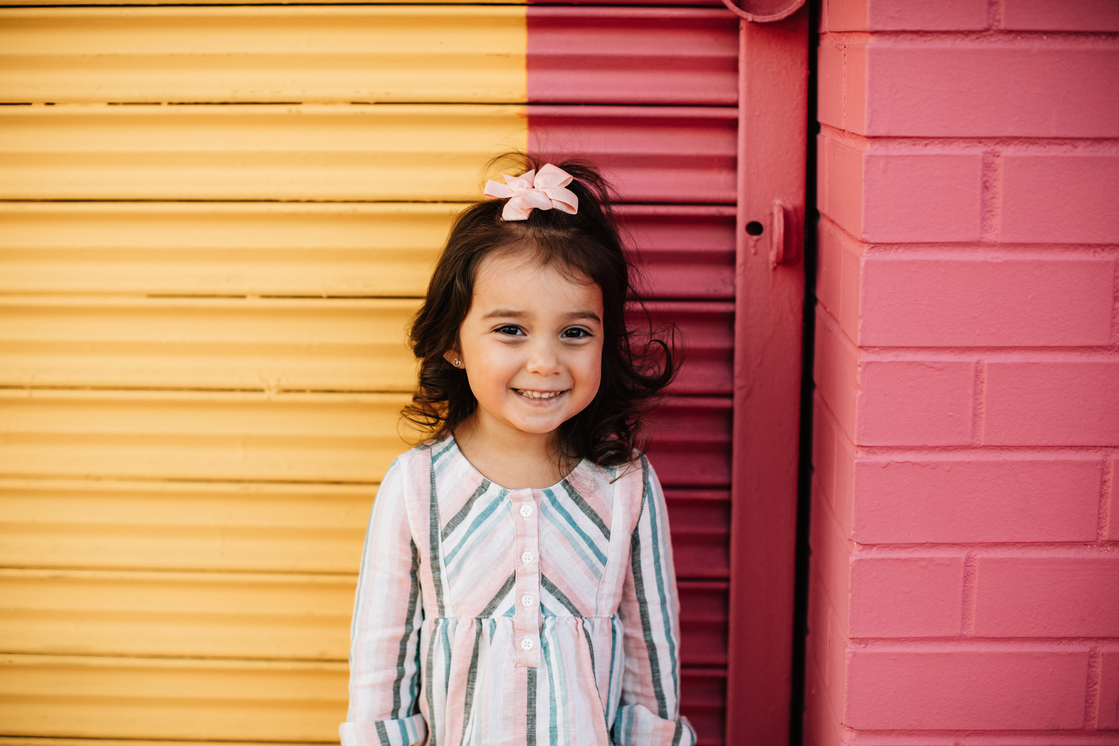
Our Winners!
Peter
Eric
Julie
Notes:
Replace photos and names with your students’ information.

Slide 21


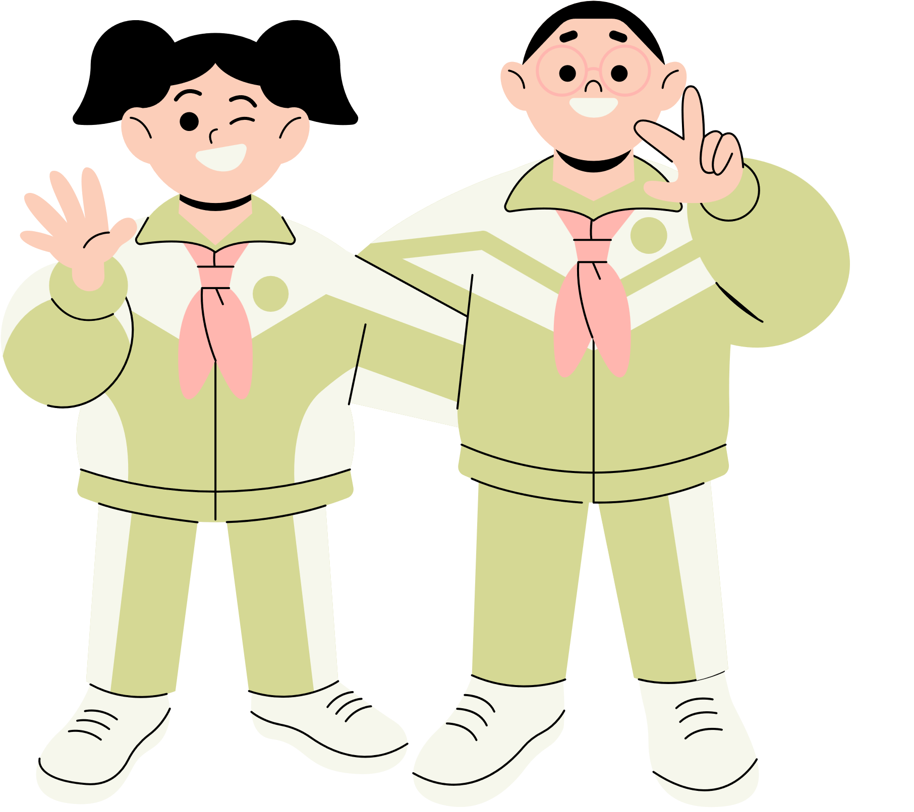





Thank You!
See You Next Time!
Notes:
https://www.youtube.com/watch?v=SRyFiVeNjWs

