Slide 2









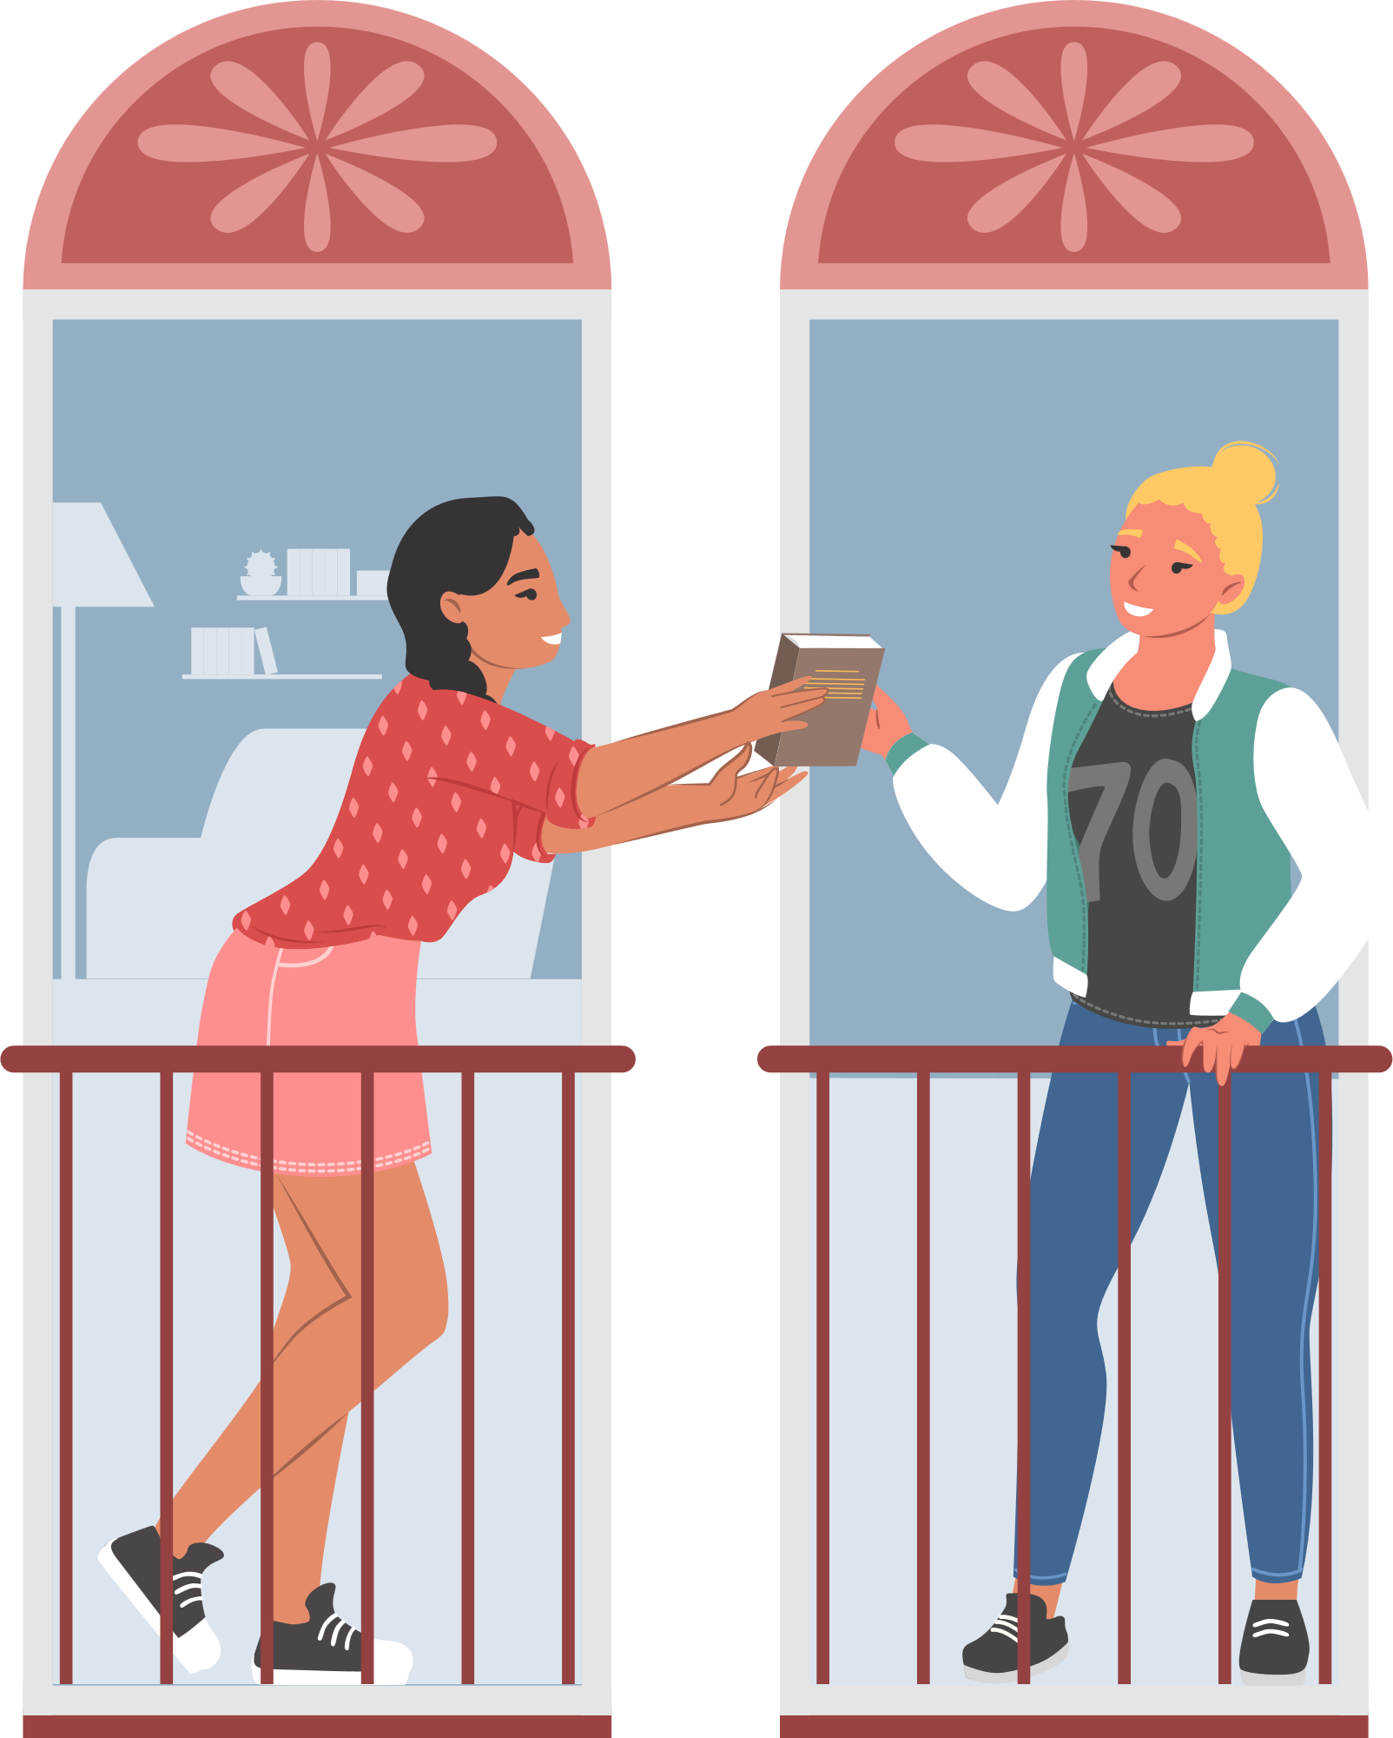

Unit 8
Let’s buy presents!
Lesson 6 – Skills Time! – Period 1

Slide 3
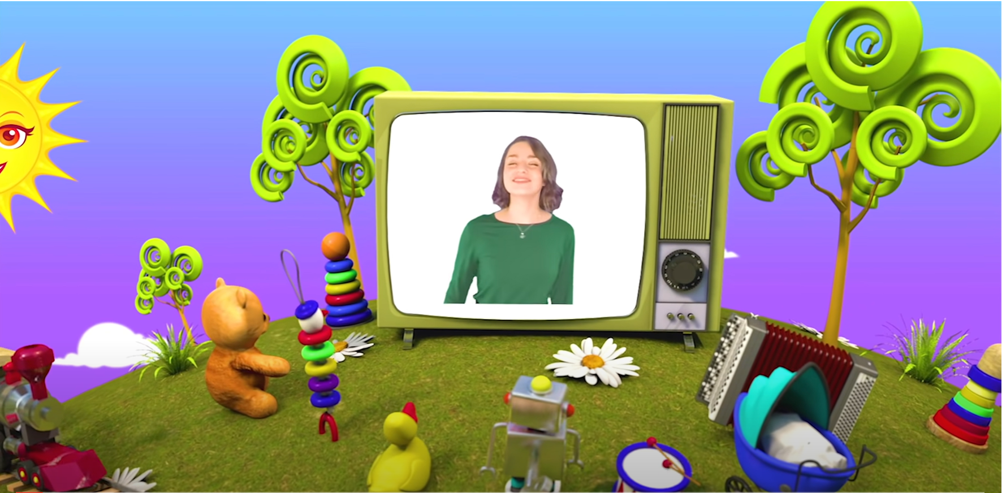
HELLO SONG
Notes:
https://www.youtube.com/watch?v=pqDEwPi7vxg

Slide 4






Slide 5










Let’s celebrate our birthday next week!
Notes:
* Warmer
Put the Special days flashcards on the board. Tell children that it’s their birthday next week. In small groups, the children choose a present the group would like and write its name.
Ask a child from one group to stand up. Choose a present for them from the board. Say, e.g. Your present from me is candy. If the present is the same as the one the group wanted, put a check on the board.
Repeat the activity with different groups.

Slide 6
Game: WHAT’S THE MEANING?
rainbow
A rainbow is a multicolored arc, or curved line, in the sky.
Notes:
* Game: What’s the meaning?
Choose a word that is unknown to children, using a dictionary as needed. Children in groups of three, without using a dictionary, guess the meaning of the word and write down a definition.
Allow children a few minutes to think and write.
Encourage them to use their imaginations and emphasize that it doesn’t have to be the correct meaning.
Collect the definitions and read them out loud. Children vote on what they think is the best definition. At the end, you can tell them the real meaning.
The idea of this game is to let the children be creative and practice their writing skills.

Slide 7
Game: WHAT’S THE MEANING?
sports
Sports are types of physical activity that people do to keep healthy.
Notes:
* Game: What’s the meaning?
Choose a word that is unknown to children, using a dictionary as needed. Children in groups of three, without using a dictionary, guess the meaning of the word and write down a definition.
Allow children a few minutes to think and write.
Encourage them to use their imaginations and emphasize that it doesn’t have to be the correct meaning.
Collect the definitions and read them out loud. Children vote on what they think is the best definition. At the end, you can tell them the real meaning.
The idea of this game is to let the children be creative and practice their writing skills.

Slide 8
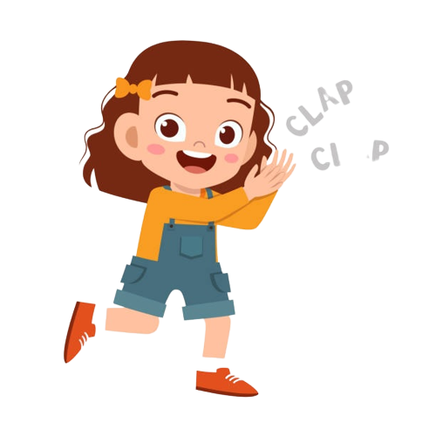
Good job!

Slide 9
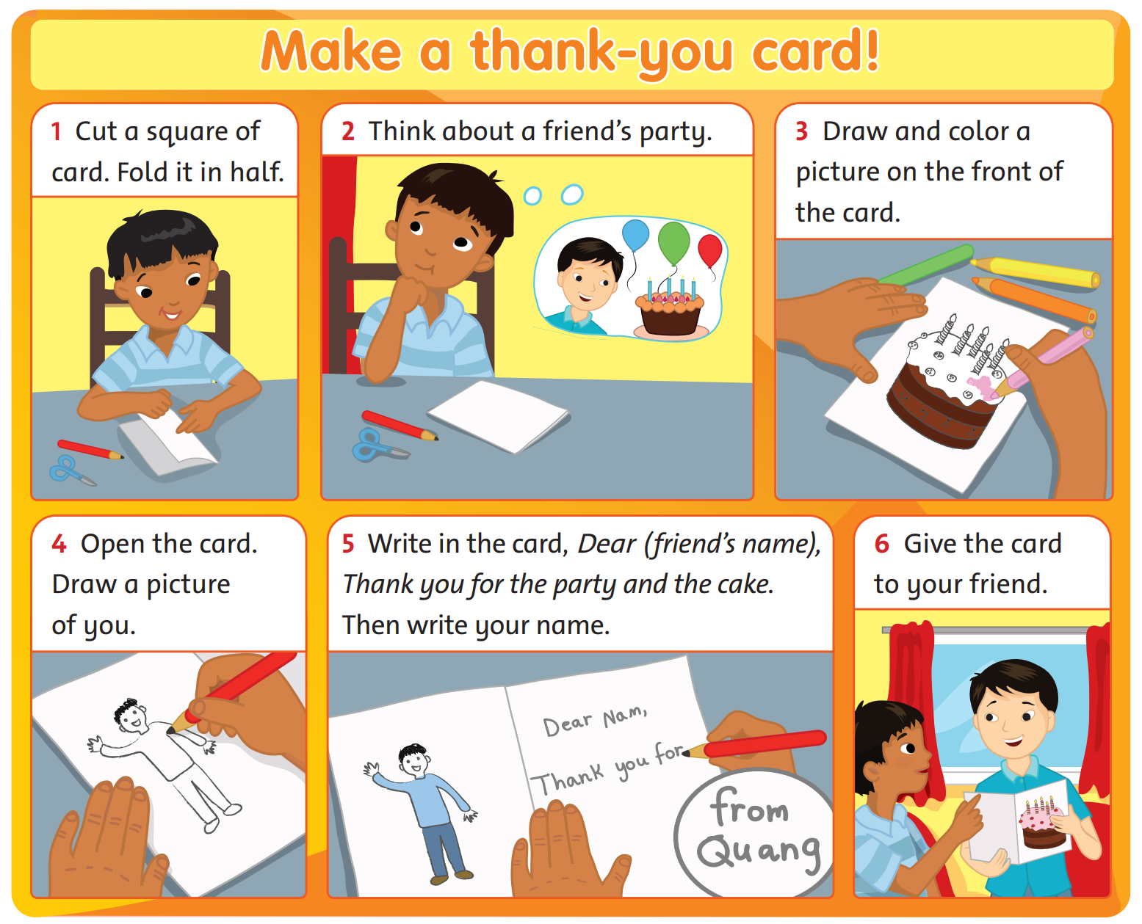
Listen
and
Answer.
1. What does the boy make?
2. How does he make it?
64
Notes:
* Lead-in:
Ask children what they can remember about the reading text from the previous lesson. Ask What does the boy make? How does he make it?
Allow children to check the text on page 64 of their books to see how much they remembered.

Slide 10
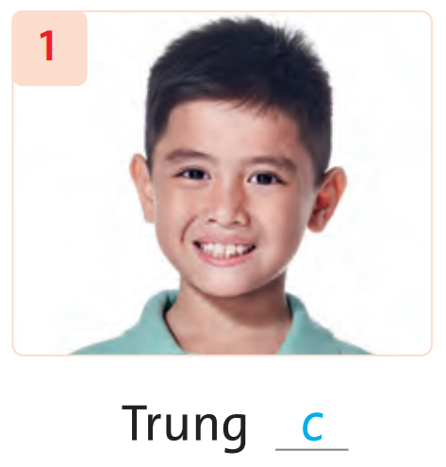
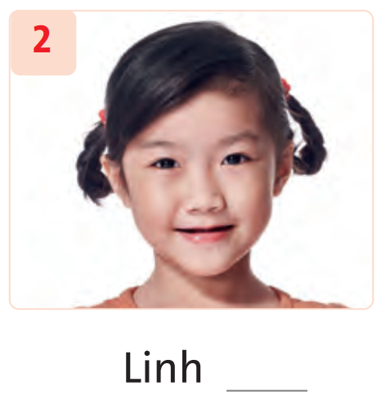
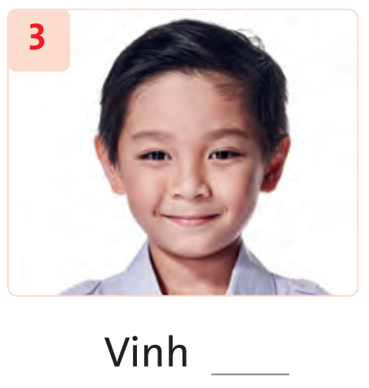
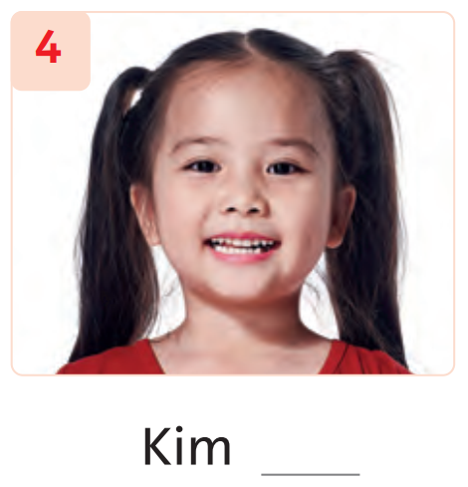
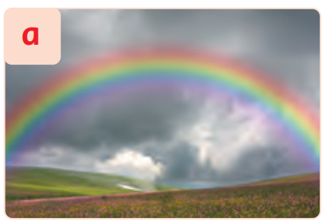
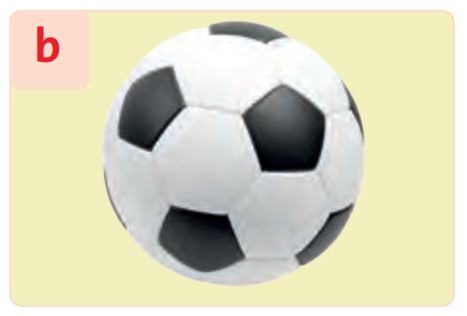
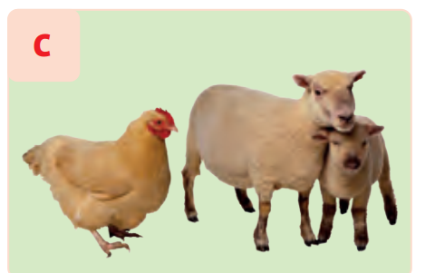
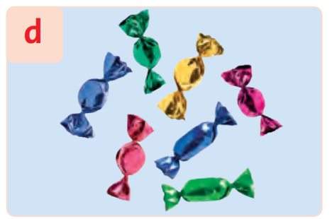
Look and Say.
Notes:
* Listen and match. Track 104
Ask children to look at the objects on page 65 of their books. Ask them to predict what they are going to hear.
Tell children that they are going to hear a recording of children talking about things they like or don’t like.

Slide 11

Listen and Point.
Notes:
Play Track 104. Children listen and point to the items as they hear them mentioned.

Slide 12
Listen and Point.
c
Notes:
- Play the recording again, stopping after the first item for children to match the person (Trung) to the item he mentioned (animals) and write c next to 1 in their books.
- Play the recording for children to complete the activity.

Slide 13
Listen and Point.
c
Notes:
- Play the recording for children to complete the activity.

Slide 14
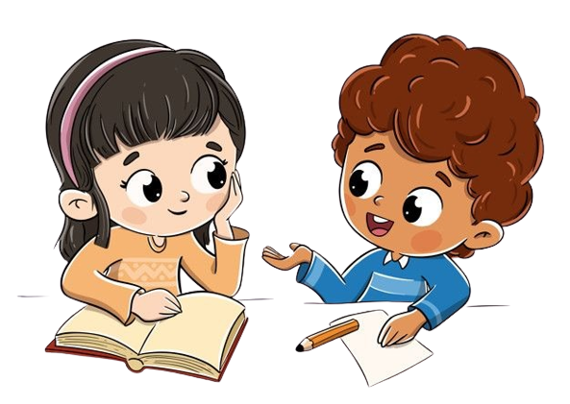
Work in Pairs.
65
Notes:
Children work in pairs to peer-check their answers.

Slide 15
Let’s check!
c
a
d
b
Notes:
Answers 1 c 2 a 3 d 4 b

Slide 16
Good job!

Slide 17

Ask and Answer.
65
What does Trung like?
c
a
d
b
He likes animals because they’re fun.
Notes:
* Point, ask, and answer.
Ask children to look at the pictures in Exercise 1 and read the words in the box.
Focus attention on the example in the speech bubbles.
Explain to the class that they need to ask and answer questions about the children in Exercise 1, using the words in the box.

Slide 18
Game: MINGLE!
Ask and answer about your hobbies.
What do you like?
I like rainbows because
I like many colors.
Notes:
* Ask and answer with a friend.
Read aloud the example speech bubbles.
In pairs, children take turns asking and answering questions about what they like giving reasons.
Click to play music for children to move around and exchange the questions and answers. When the music stops, invite two children to talk in the front loudly. Then click to continue playing the music and children play the game again.

Slide 19
Good job!

Slide 20



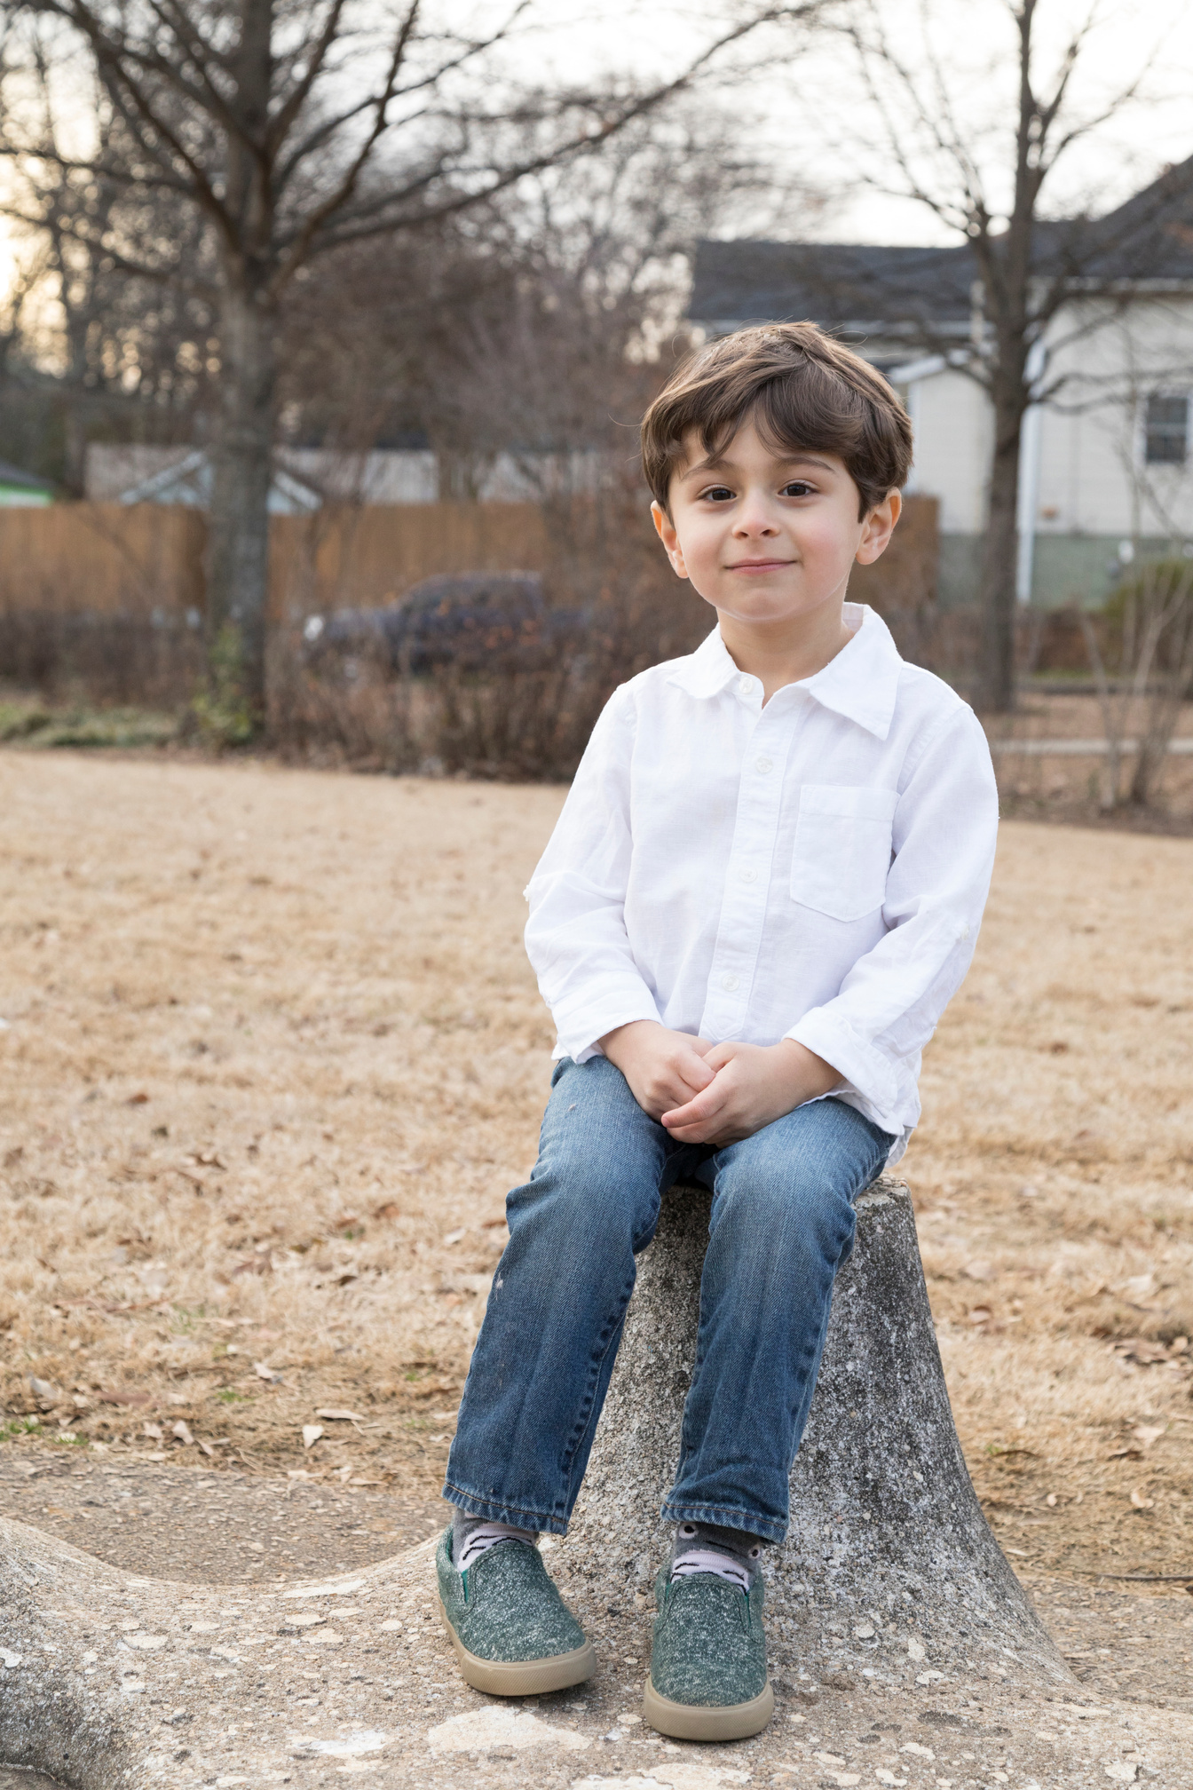
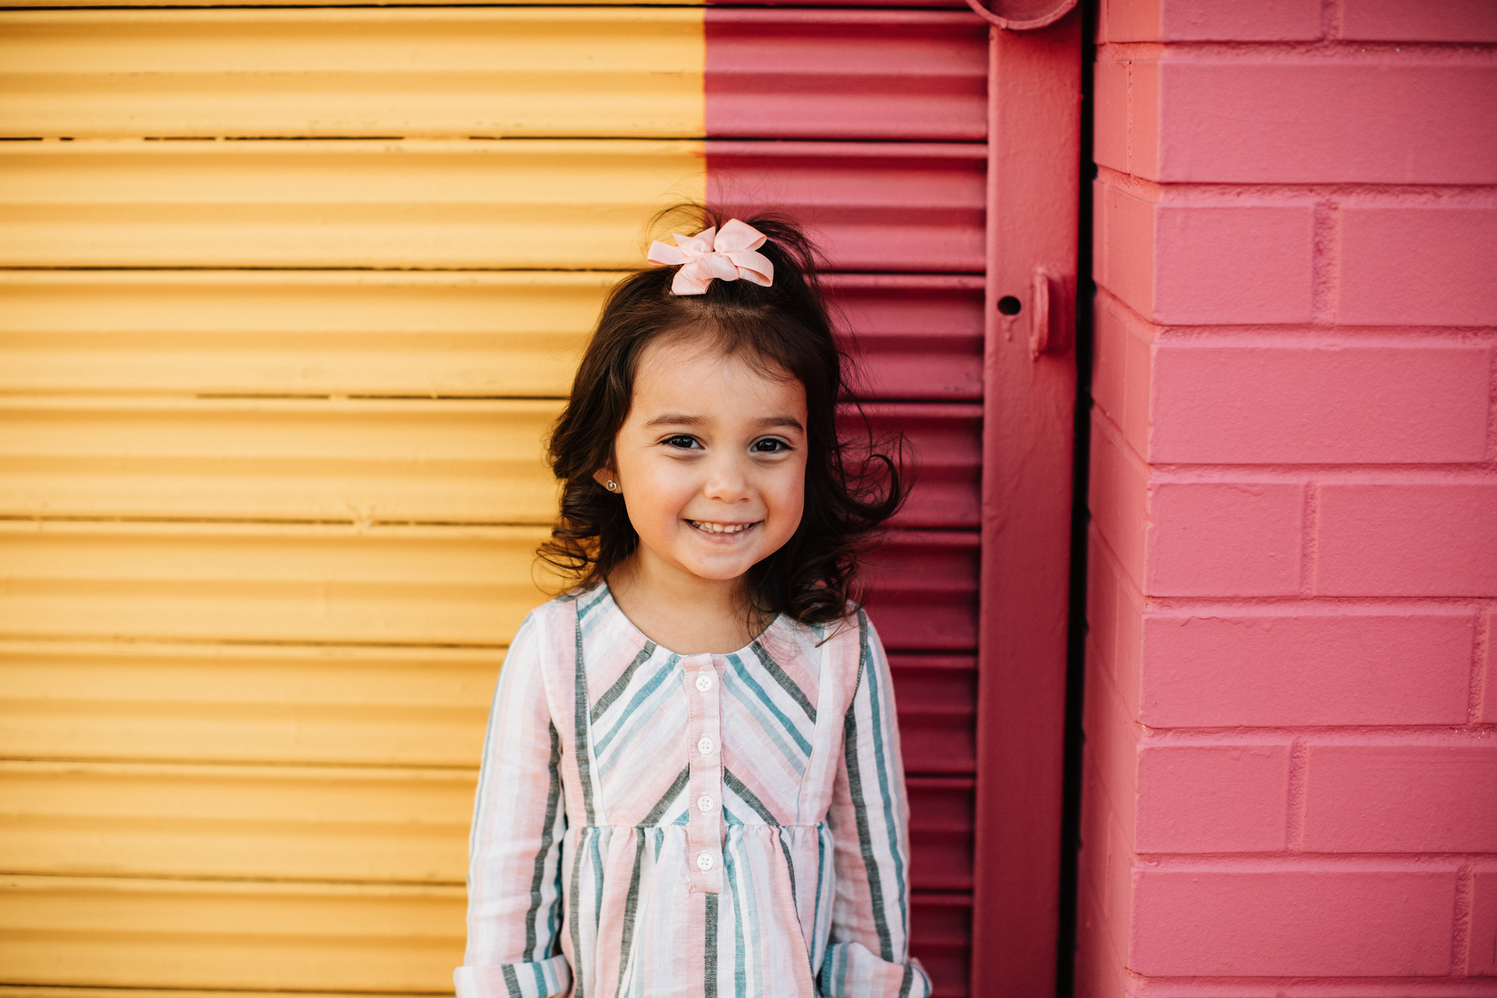
Our Winners!
Peter
Eric
Julie
Notes:
Replace photos and names with your students’ information.

Slide 21


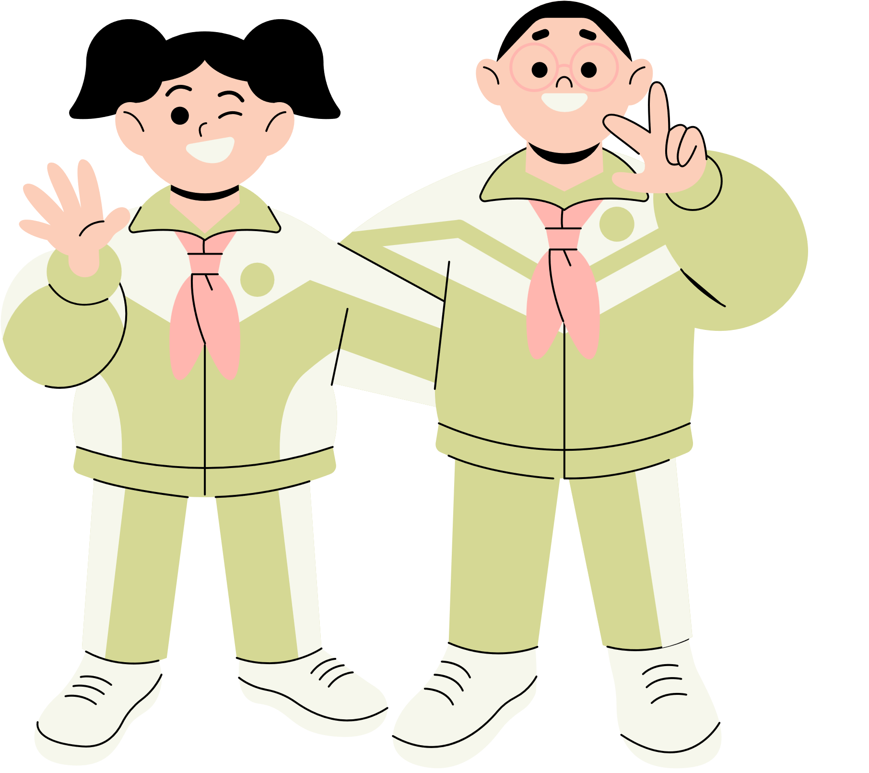





Thank You!
See You Next Time!
Notes:
https://www.youtube.com/watch?v=SRyFiVeNjWs

