Slide 2









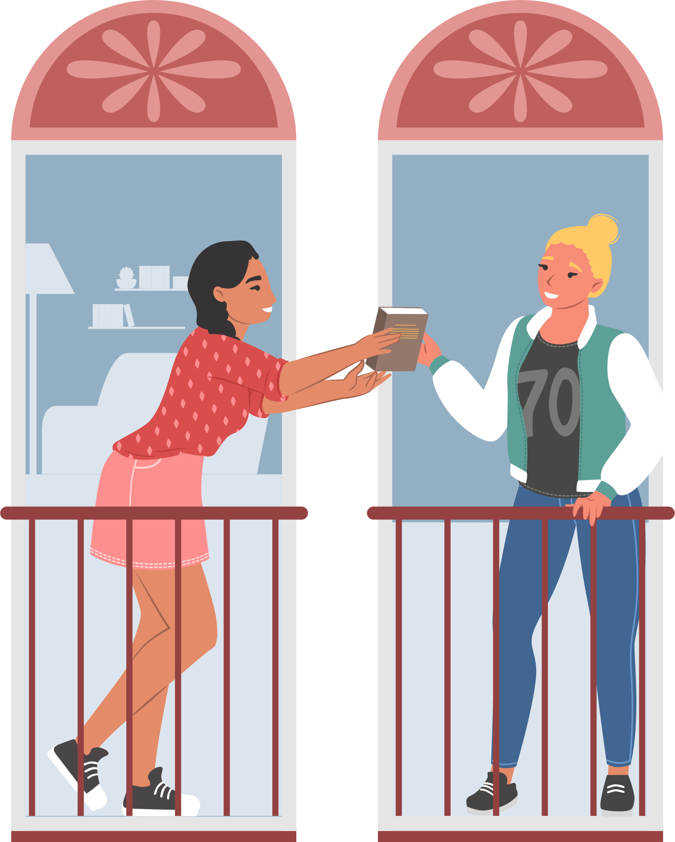

Unit 8
Let’s buy presents!
Lesson 5 – Skills Time!

Slide 3
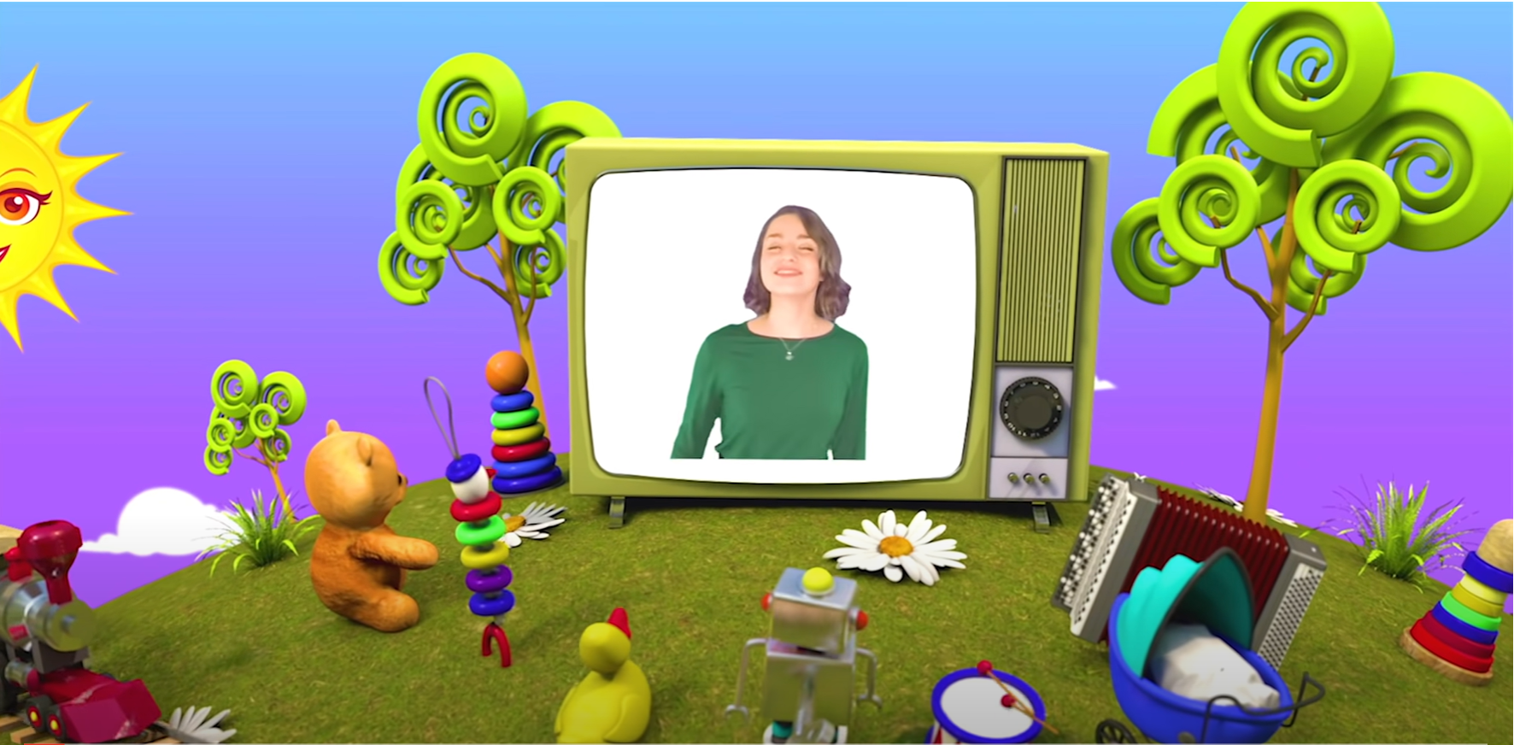
HELLO SONG
Notes:
https://www.youtube.com/watch?v=pqDEwPi7vxg

Slide 4






Slide 5

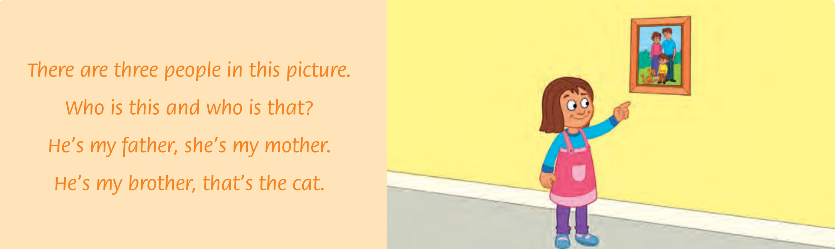

Let’s sing and do the actions!
63
Notes:
* Warmer
Sing the chant from page 63.

Slide 6



Game: CONCENTRATION!
1
2
A
B
neighbor
chocolate
3
4
C
D
balloons
presents
5
6
E
F
gift card
invite
Notes:
* Game: Concentration
Put children in groups of three or four.
Give each group a set of concentration cards and ask them to spread them out face down in random order.
Ask children to take turns flipping over two cards and saying the sound and the word.
If the flashcards are a match, the child keeps the cards. If they are different, they put them back, face down. The child with the most cards at the end is the winner.
.

Slide 7
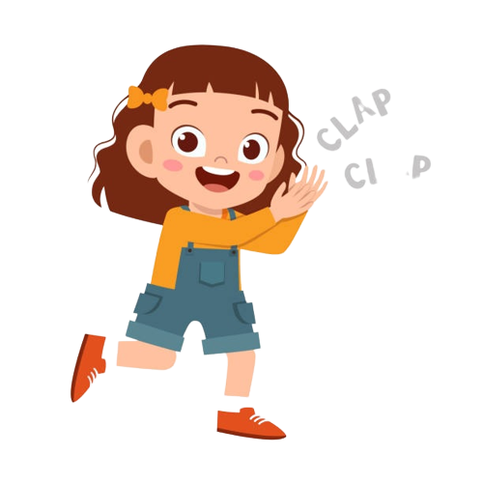
Good job!

Slide 8

Listen and Answer.
Notes:
* Lead-in
Talk about cards with the class. Ask Who do you send cards to? When do you send cards? Do you make cards or do you buy them?

Slide 9
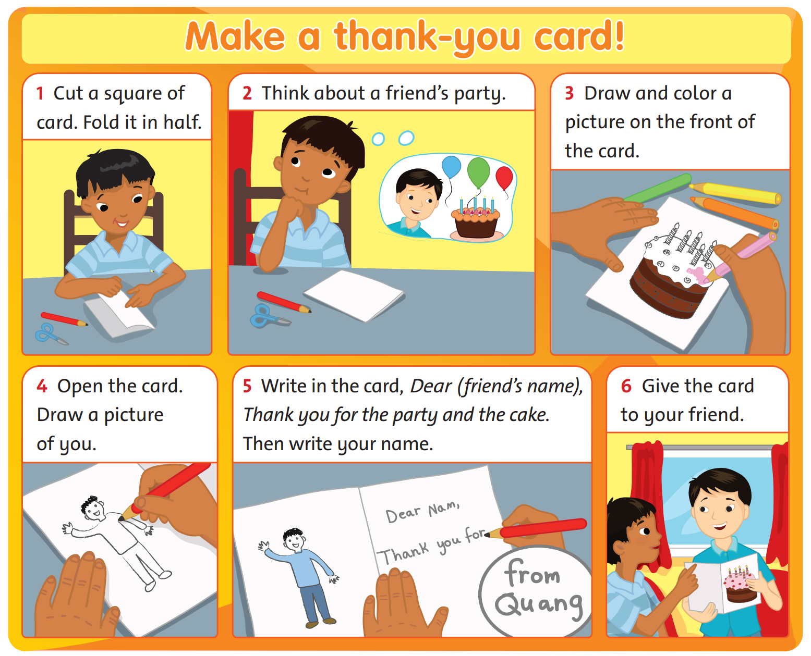
Look and Answer.
64
Notes:
* Look at the pictures. What is the card for?
Ask children to look at the pictures. Ask What is the boy making?

Slide 10
Look and Answer.
What does he do?
64
Notes:
Point to the pictures for children to tell you what the boy does at each stage, e.g. He folds the card. He draws a picture.

Slide 11
Look and Answer.
What does he do?
64
Notes:
Point to the pictures for children to tell you what the boy does at each stage, e.g. He folds the card. He draws a picture.

Slide 12
Look and Answer.
What does he do?
64
Notes:
Point to the pictures for children to tell you what the boy does at each stage, e.g. He folds the card. He draws a picture.

Slide 13
Look and Answer.
What does he do?
64
Notes:
Point to the pictures for children to tell you what the boy does at each stage, e.g. He folds the card. He draws a picture.

Slide 14
Look and Answer.
What does he do?
64
Notes:
Point to the pictures for children to tell you what the boy does at each stage, e.g. He folds the card. He draws a picture.

Slide 15
Look and Answer.
What does he do?
64
Notes:
Point to the pictures for children to tell you what the boy does at each stage, e.g. He folds the card. He draws a picture.
Ask What is the card for? (to thank a friend for inviting him to a party).

Slide 16
Listen, Point and Read in silent.
64
Notes:
* Listen and read. Track 103
Play the recording. Children listen and follow along.

Slide 17
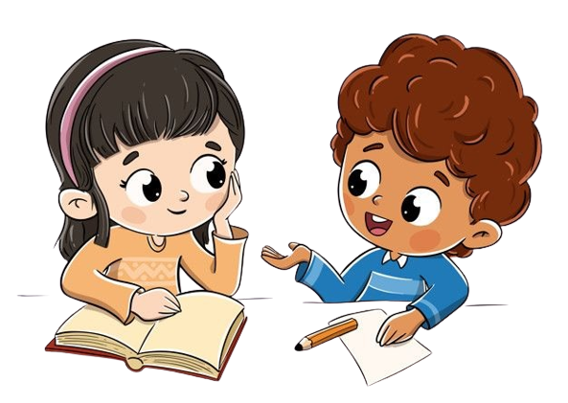
Listen and Answer.
64
1. What’s the first thing the boy does?
2. What does the boy draw in the card?
3. What does he write?
4. Who does the boy give the card to?
5. Does his friend like the card?
Notes:
Ask comprehension questions, e.g. What does the boy draw in the card? What does he write? Does his friend like the card?
Play the recording a second time.
Students work in pairs to ask and answer the questions.
Invite some volunteers to answer the questions in the front.

Slide 18


Let’s check!
64
1. What’s the first thing the boy does?
Cut a square of card.
Notes:
Invite some volunteers to answer the questions in the front.

Slide 19


Let’s check!
64
2. What does the boy
draw in the card?
He draws a picture.
Notes:
Invite some volunteers to answer the questions in the front.

Slide 20



Let’s check!
64
3. What does he write?
Dear Nam,
Thank you for the party
and the cake.
His name, Quang.
Notes:
Invite some volunteers to answer the questions in the front.

Slide 21

Let’s check!
64
4. Who does the boy give
the card to?
He gives to his friend.
Notes:
Invite some volunteers to answer the questions in the front.

Slide 22
Let’s check!
64
5. Does his friend like the card?
Yes, he does.
Notes:
Invite some volunteers to answer the questions in the front.

Slide 23
Good job!

Slide 24
Read and Put the sentences in the correct order.
Open the card. _____
Draw a picture on the front of the card. ______
Give the card to your friend. _______
Write in the card. _______
Draw a picture of you. ______
1
Notes:
* Read again and put the sentences in the correct order.
Ask children to look at the exercise in their books. Explain that the sentences are in the wrong order. Ask What’s the first thing you do? Elicit the correct answer and show the example answer.

Slide 25
Read and Put the sentences in the correct order.
Open the card. _____
Draw a picture on the front of the card. ______
Give the card to your friend. _______
Write in the card. _______
Draw a picture of you. ______
1
Notes:
Ask children to number in the order in which the actions are done.
Go over the answers with the class. Children say the sentences chorally, in the correct order.
Children work in pairs for peer-checking their answers.

Slide 26
Let’s check!
Open the card. _____
Draw a picture on the front of the card. ______
Give the card to your friend. _______
Write in the card. _______
Draw a picture of you. ______
2
1
5
4
3
Notes:
Answers
a 2 b 1 c 5 d 4 e 3

Slide 27

Game: MUSICAL CHAIRS!
Do you like cards?
Why?
Notes:
* Do you like cards and presents? Why?
Ask the questions around the class.
Encourage individuals to ask other children the question.

Slide 28
Game: MUSICAL CHAIRS!
Do you like presents?
Why?
Notes:
- Play again with another question.

Slide 29
Game: MUSICAL CHAIRS!
Do you like birthday cake?
Why?
Notes:
- Play again with another question.

Slide 30
Game: MUSICAL CHAIRS!
What do you like best?
Notes:
- Play again with another question.

Slide 31


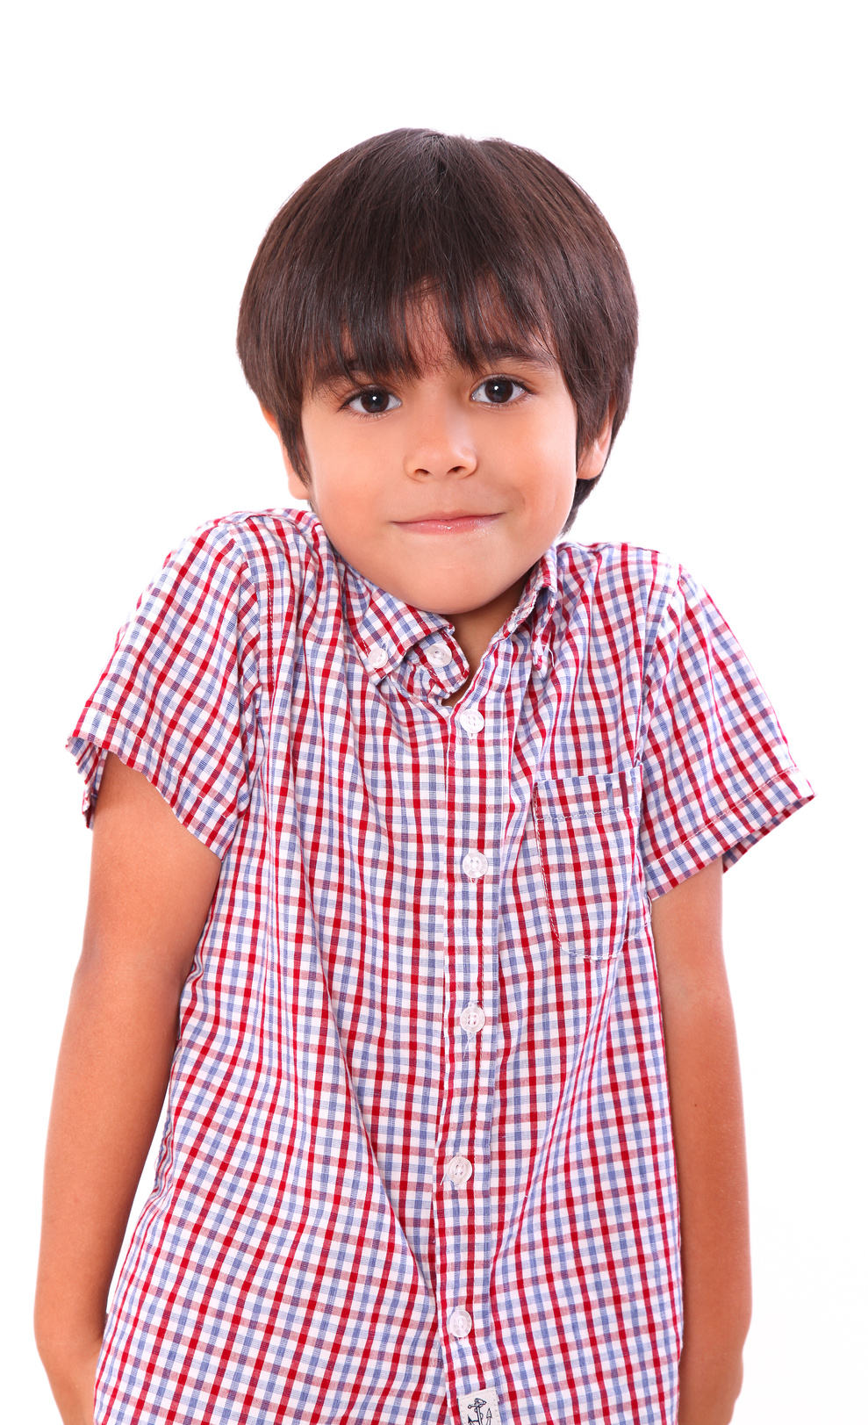
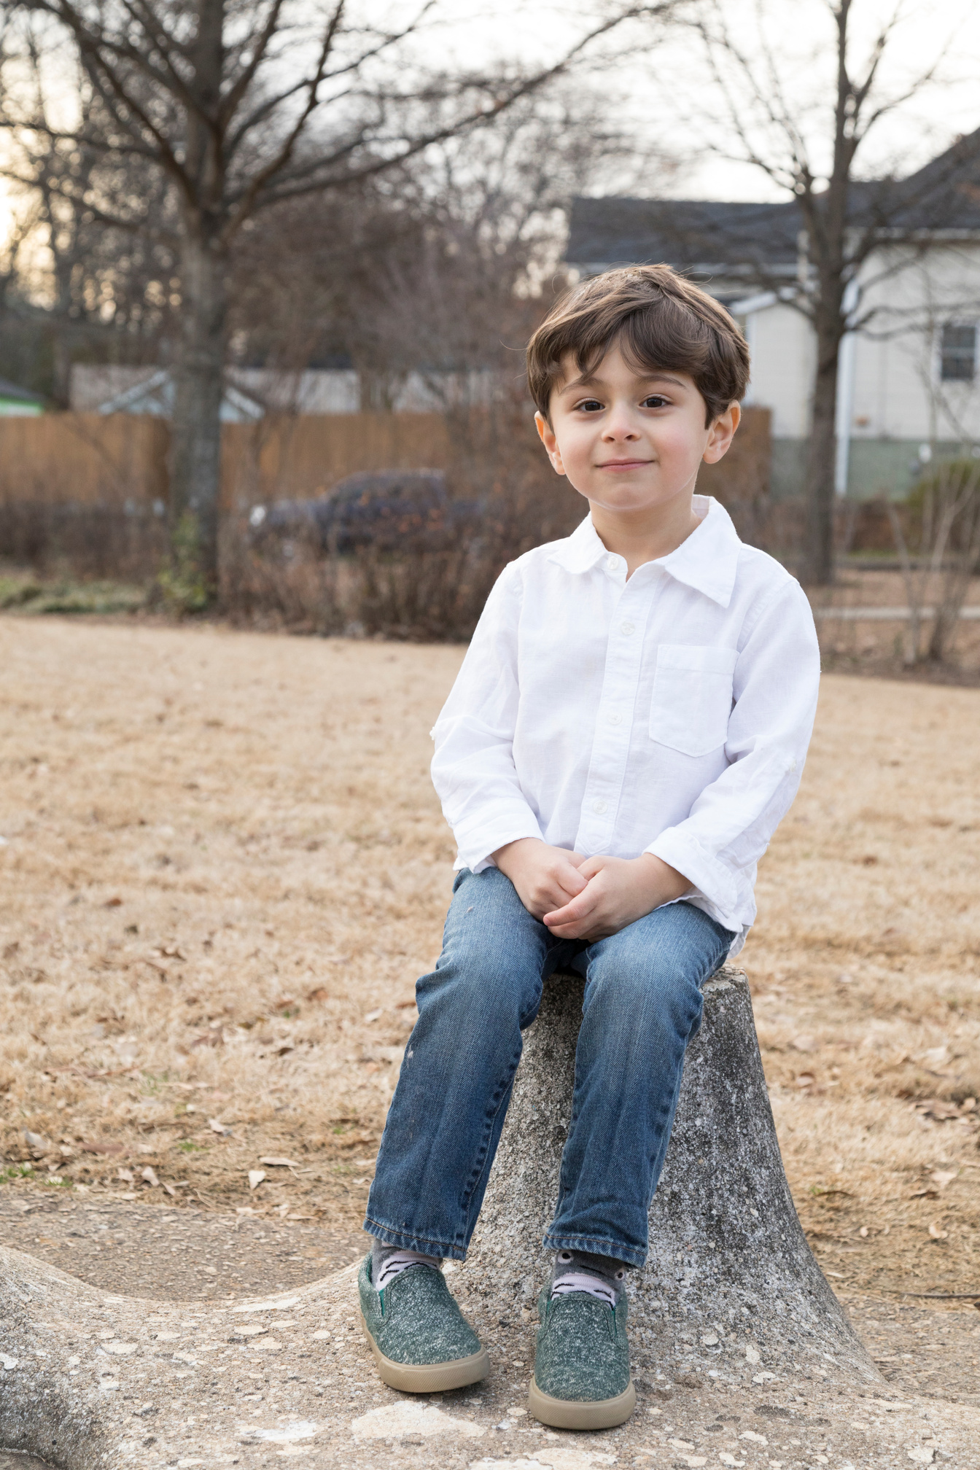
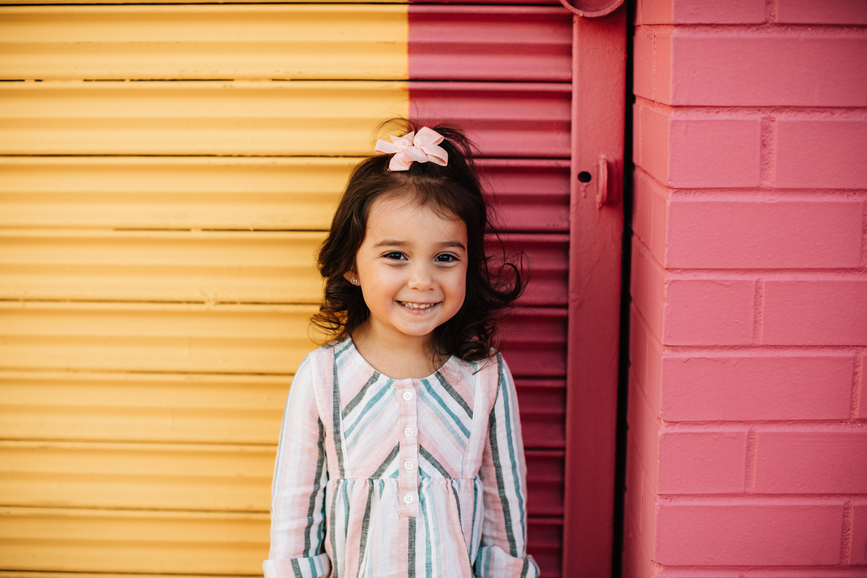
Our Winners!
Peter
Eric
Julie
Notes:
Replace photos and names with your students’ information.

Slide 32


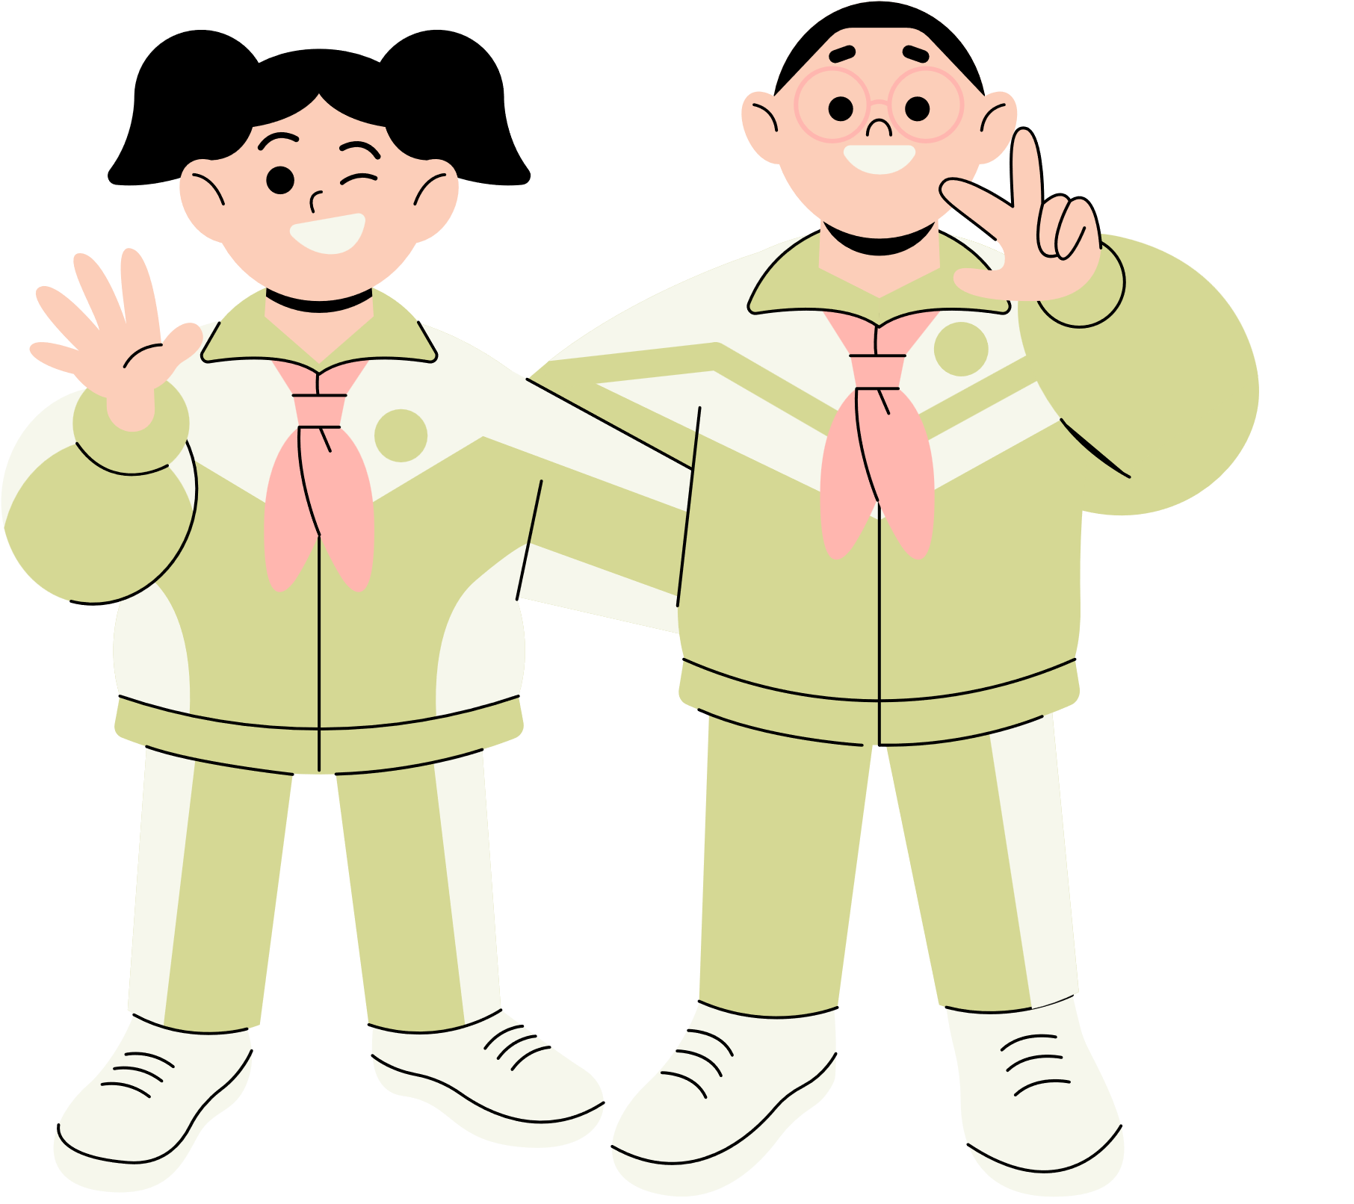





Thank You!
See You Next Time!
Notes:
https://www.youtube.com/watch?v=SRyFiVeNjWs

