Slide 2











Unit 8
Let’s buy presents!
Lesson 3 – Song

Slide 3
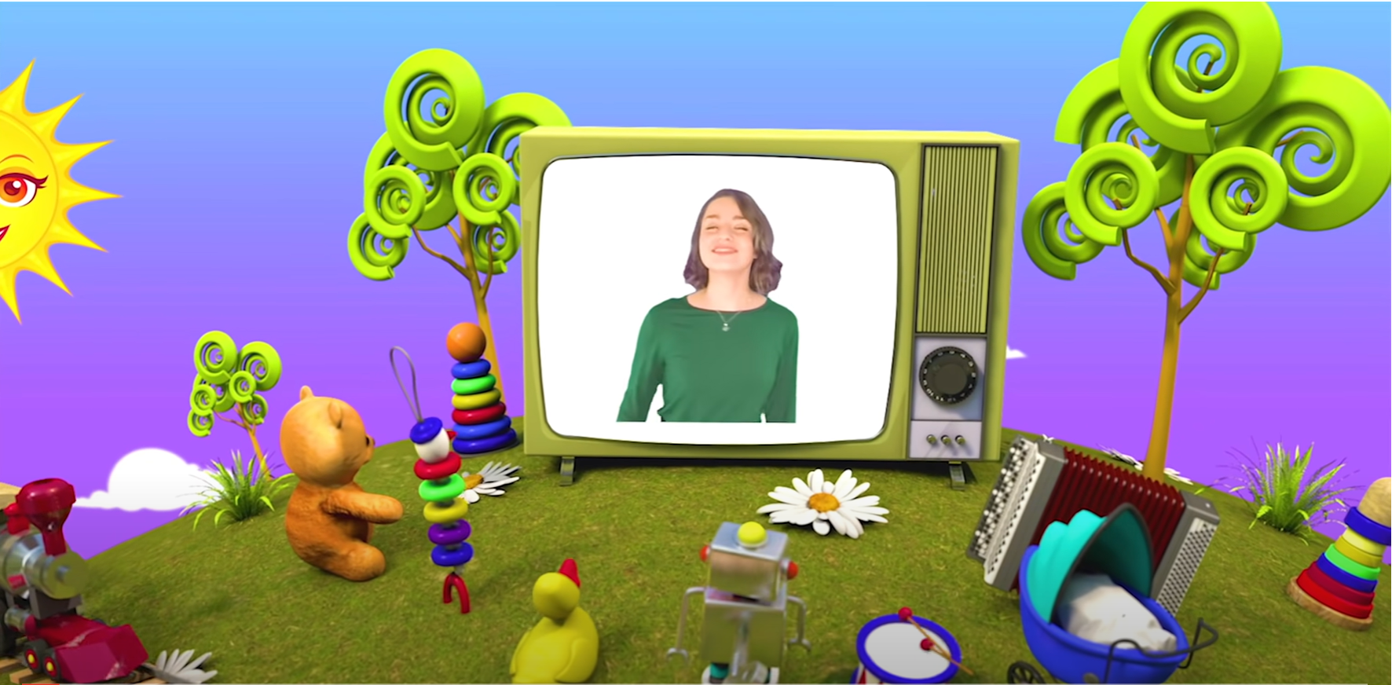
HELLO SONG
Notes:
https://www.youtube.com/watch?v=pqDEwPi7vxg

Slide 4






Slide 5








Game: QUICK FLASH!
Notes:
* Quick Flash
Use the flashcards from the unit so far and any other vocabulary cards that you want to review.
Show each card very quickly and then hide it again, ask the class to call out the words.

Slide 6
Game: QUICK FLASH!
Notes:
* Quick Flash
Use the flashcards from the unit so far and any other vocabulary cards that you want to review.
Show each card very quickly and then hide it again, ask the class to call out the words.

Slide 7

Good job!

Slide 8

Look and Answer.
Notes:
* Lead-in:
Ask children about their neighbors. Ask whether they ever visit each other or give presents to each other.

Slide 9



Look
and
Say.
Notes:
* Listen, point, and repeat. Track 99
Ask children to look at the pictures in their books. Establish that a neighbor is anyone who lives near you, not just the person who lives next door.

Slide 10

Listen and Repeat.
neighbor

Slide 11
Listen and Repeat.
invite

Slide 12
Listen and Repeat.
gift card

Slide 13
Listen and Repeat.
chocolate

Slide 14
Listen and Point.
62
neighbor
invite
gift card
chocolate
Notes:
Play the first part of the recording for children to point to the pictures and say the words.

Slide 15
Listen and Repeat.
62
neighbor
invite
gift card
chocolate
Notes:
Play the second part for children to repeat the words.

Slide 16
Look and Say.
neighbor
invite
gift card
chocolate
Notes:
Show the Special days flashcards for individuals to say the words.

Slide 17

Game: WHISPER!
Notes:
Invite a child to come to the front of the class and whisper the name of an object for them to draw. The child draws the picture on the board for the rest of the class to guess.
The children play in small groups using the special days vocabulary.

Slide 18
Good job!

Slide 19
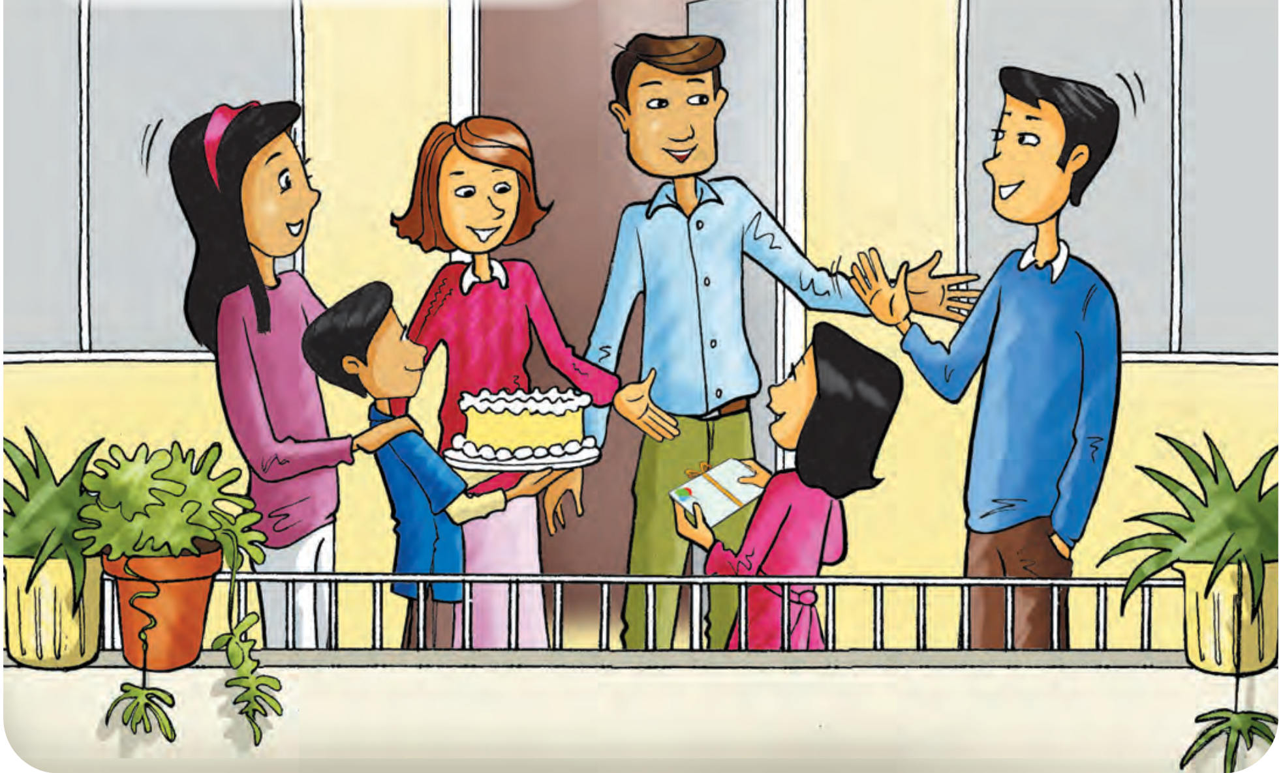
Look and Answer.
Notes:
* Listen and sing. Track 100
Ask children to look at the picture. Ask What can you see?
Ask them to predict what the song is about (a family going to their neighbors’ party).

Slide 20

Let’s watch!
Notes:
Play the song video for children to listen.

Slide 21
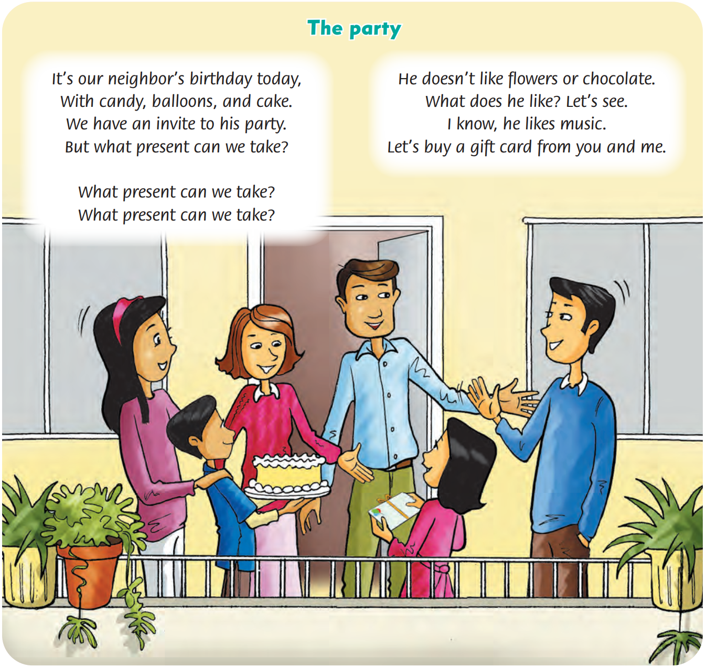
Listen and Point.
62
Notes:
Then play it again as they follow the words in their books.
Play the recording for children to sing along.

Slide 22
Listen and Repeat.
The party
It’s our neighbor’s birthday party,
With candy, balloons, and cake.
We have an invite to his party.
But what present can we take?
Notes:
Read each line of the song out loud for children to repeat.

Slide 23
Listen and Repeat.
The party
What present can we take?
What present can we take?
Notes:
Read each line of the song out loud for children to repeat.

Slide 24
Listen and Repeat.
The party
He doesn’t like flowers or chocolate.
What does he like? Let’s see.
I know, he likes music.
Let’s buy a gift card from you and me.
Notes:
Read each line of the song out loud for children to repeat.

Slide 25
Listen and Sing.
62
Notes:
Play the recording for children to sing along.

Slide 26
Practice the actions.
62
Notes:
Song actions
With candy, balloons, and cake. – mime eating the foods.
What present can we take? – mime thinking.
He doesn’t like flowers or chocolate. – wag your finger and shake your head to mean “no”.
I know, he likes music. – mime playing an instrument.
Let’s buy a gift card from you and me. – mime putting something in an envelope and giving it to someone.

Slide 27
Sing and Do.
62
Notes:
Play the recording. Children sing and do the actions.

Slide 28
Good job!

Slide 29
Game: NEW VERSION for THE SONG!
The party
It’s our neighbor’s birthday party,
With ……………., ……………, and ………….
We have an invite to his party.
But what present can we take?
Notes:
* Game: “New version for the song”
Show the song with blanks.
Ask the students to think of new words and use them to fill in the blanks.
Put the students into small groups of four or five and ask them to do the task.
Ask students to practice singing and doing the actions in groups.
Praise students if they have done well.

Slide 30
Game: NEW VERSION for THE SONG!
The party
What present can we take?
What present can we take?

Slide 31
Game: NEW VERSION for THE SONG!
The party
……… doesn’t like …………… or ……………..
What does …….. like? Let’s see.
I know, ……………. likes …………………..
Let’s buy… …………….from you and me.

Slide 32

LIVE ON THE STAGE
Notes:
Invite some groups to come to the front and perform their new version of the song with actions.

Slide 33
Good job!

Slide 34



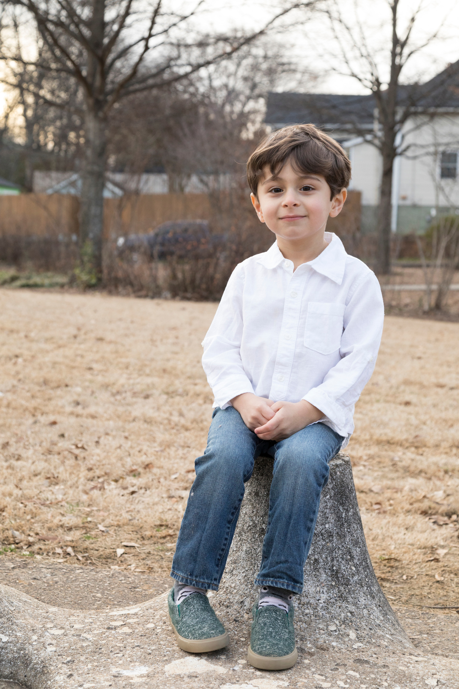
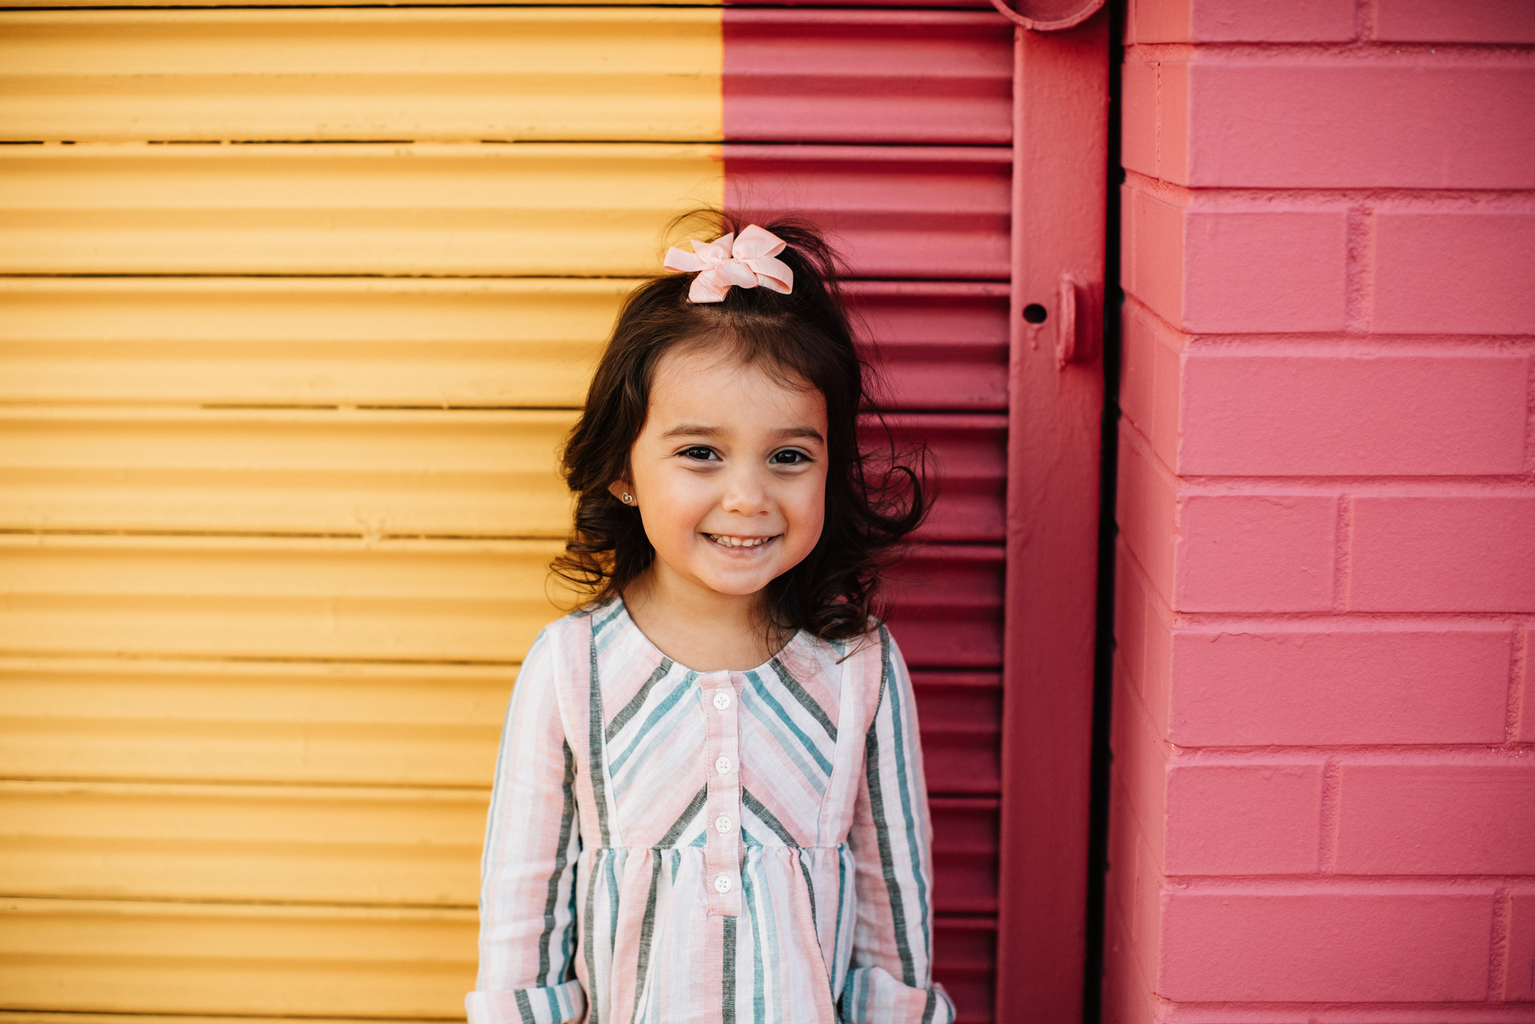
Our Winners!
Peter
Eric
Julie
Notes:
Replace photos and names with your students’ information.

Slide 35








Thank You!
See You Next Time!
Notes:
https://www.youtube.com/watch?v=SRyFiVeNjWs

