Slide 2










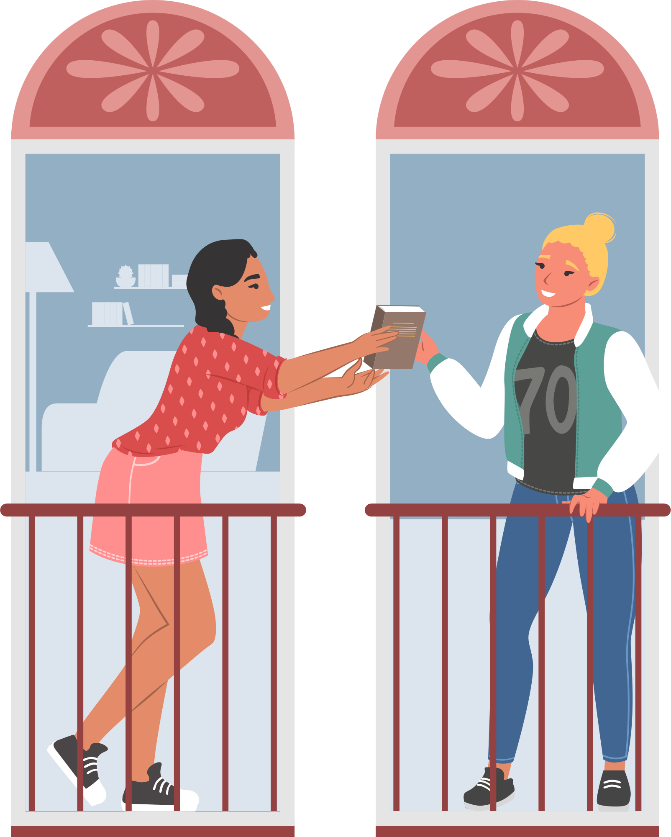
Unit 8
Let’s buy presents!
Lesson 2 – Grammar – Period 2

Slide 3
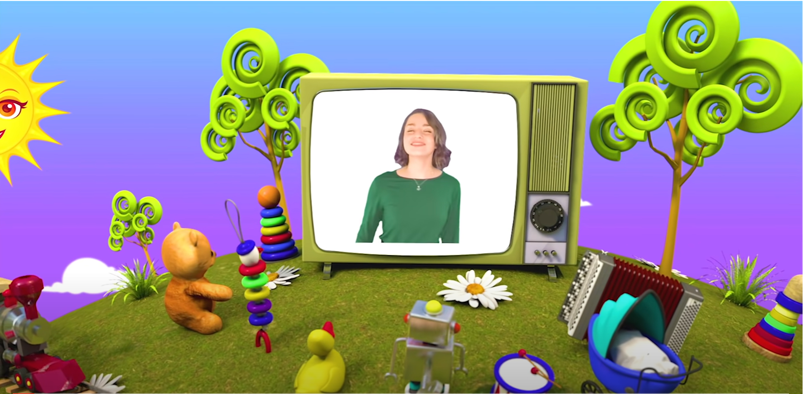
HELLO SONG
Notes:
https://www.youtube.com/watch?v=pqDEwPi7vxg

Slide 4






Slide 5

In the Racing Game of Knowledge
Who will finish first?
Click Here to Start
Notes:
Chia lớp thành các nhóm. Mỗi nhóm là 1 màu xe.
Các HS trong nhóm luân phiên đặt 1 câu về bản than mình. Nếu đúng, click vào xe để di chuyển (tính điểm).
5 câu miêu tả đúng sẽ cán đích.

Slide 6
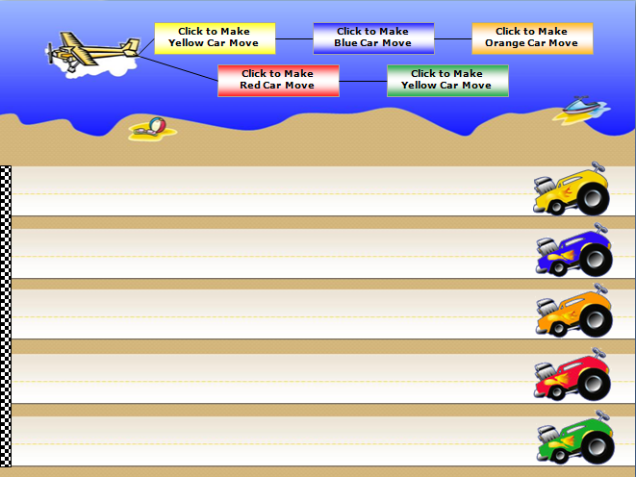
2
The Beach Rally
3
PLAY
Notes:
Chia lớp thành các nhóm. Mỗi nhóm là 1 màu xe.
Các HS trong nhóm luân phiên đặt 1 câu về bản than mình. Nếu đúng, click vào xe để di chuyển (tính điểm).
5 câu miêu tả đúng sẽ cán đích.
Có thể kết hợp hyperlink sang các slide sau để làm câu hỏi trên slide luôn.

Slide 7
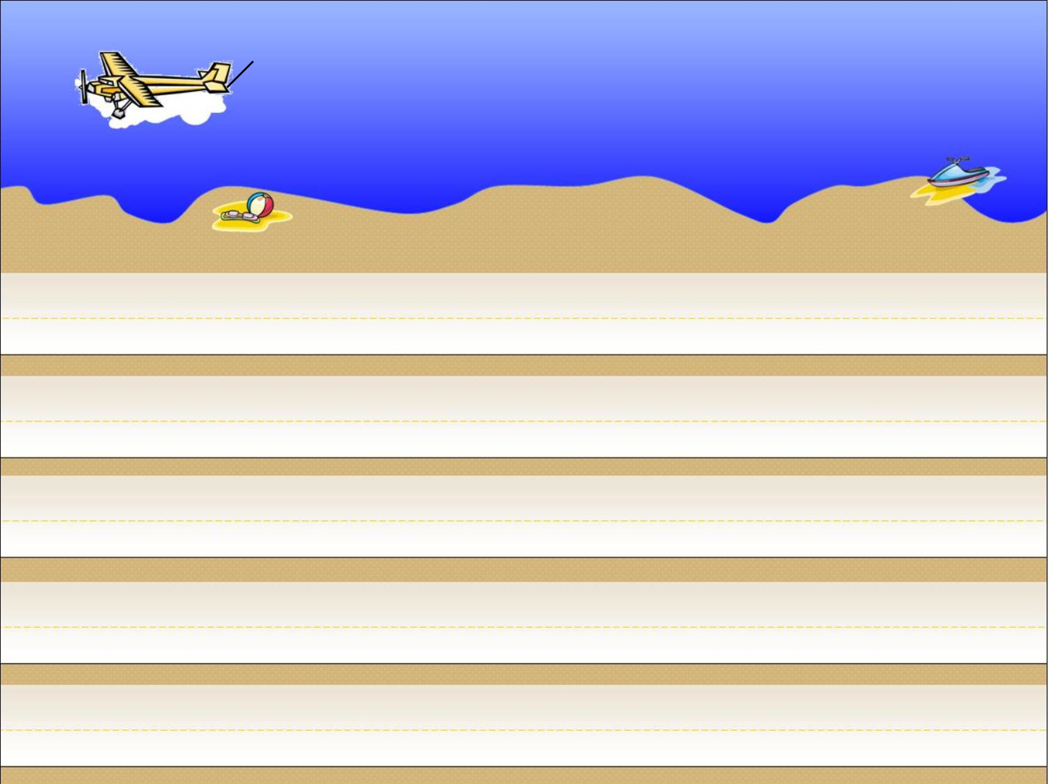





Click to Make
Yellow Car Move
Click to Make
Blue Car Move
Click to Make
Orange Car Move
Click to Make
Red Car Move
Click to Make
Green Car Move
1
2
3
4
5
Notes:
Choose the number to link to the Question slide.
Make the car move to score their team’s correct sentences.

Slide 8

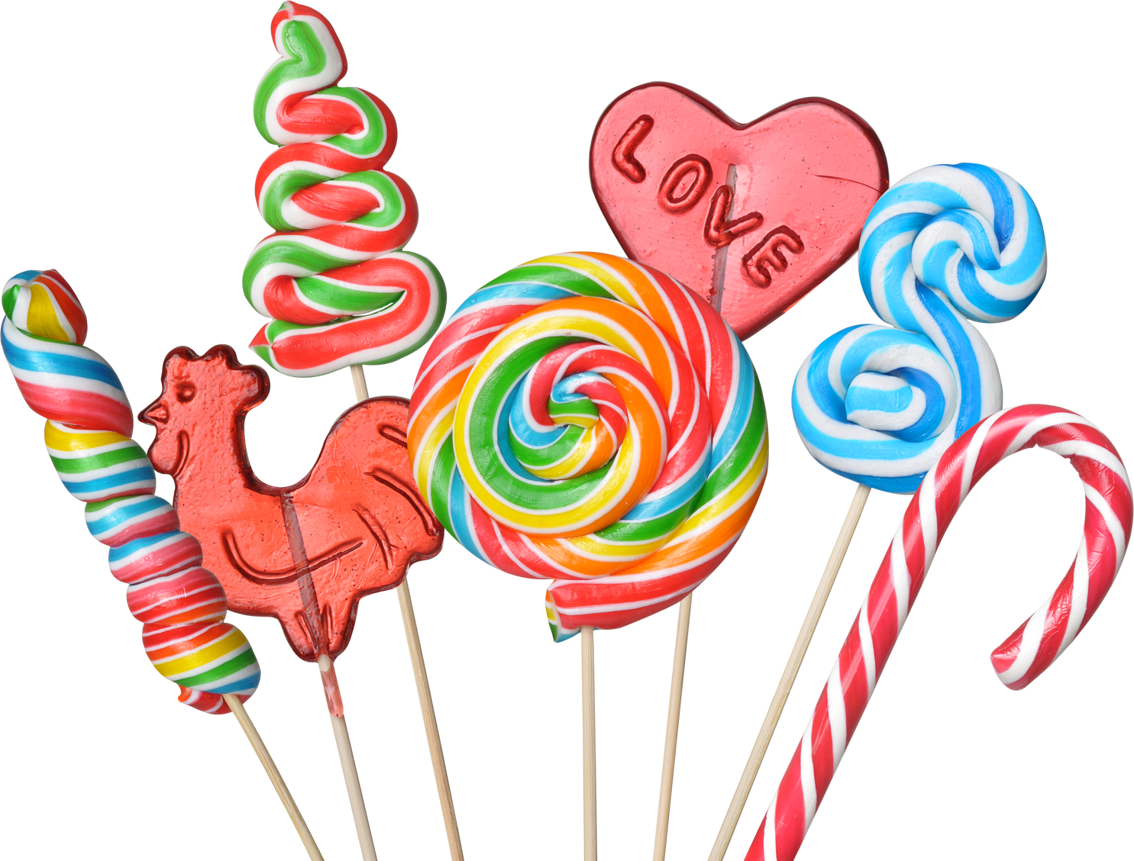

Look and Say.
He likes candy because it’s delicious.
Notes:
Click the answer sentence to back to the Score slide.

Slide 9


Look and Say.
She doesn’t like the cake because there is jelly inside.
Notes:
Click the answer sentence to back to the Score slide.

Slide 10

Look and Say.
He doesn’t like balloons because they pop.
Notes:
Click the answer sentence to back to the Score slide.

Slide 11
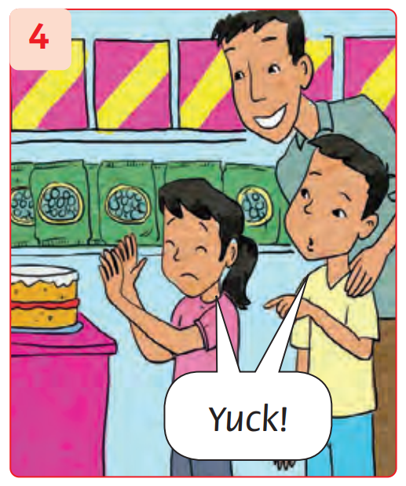
Look and Say.
They don’t like the cake
because there is jelly inside.
Notes:
Click the answer sentence to back to the Score slide.

Slide 12
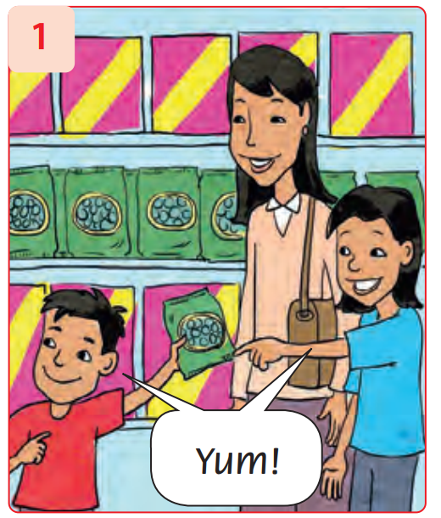
Look and Say.
They like candy because they are sweet.
Notes:
Click the answer sentence to back to the Score slide.

Slide 13
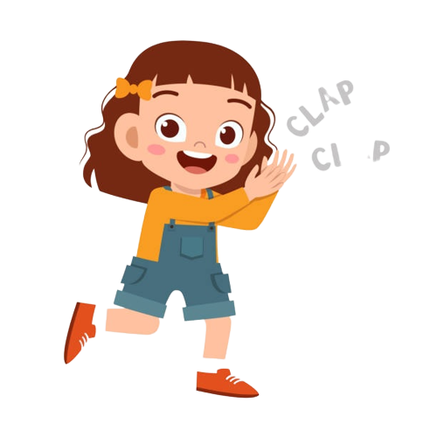

Good job!

Slide 14

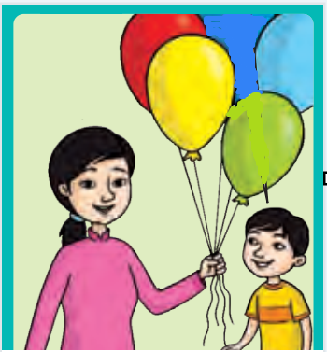
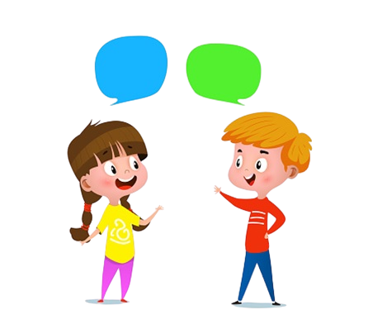
Listen and Repeat.
Do they like balloons?
Yes, they do.
Notes:
Focus on Let’s learn! box. Ask What can you see?
Do a click to play the audio.
Write the question and sentence on the board.

Slide 15
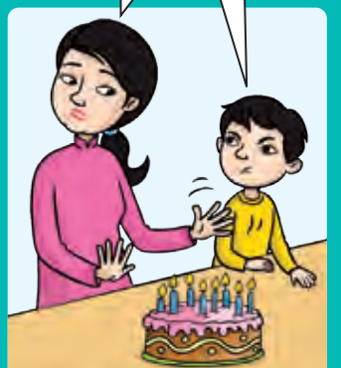
Listen and Repeat.
Do they like birthday cake?
No, they don’t.
Notes:
Focus on Let’s learn! box. Ask What can you see?
Do a click to play the audio.
Write the question and sentence on the board.

Slide 16
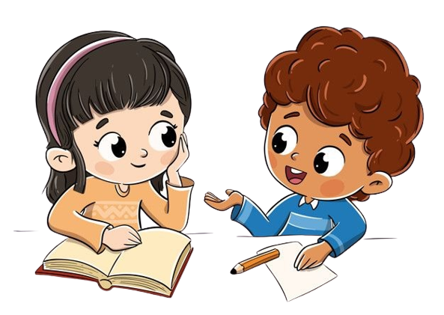
Ask and Answer.
Do they like candy?
Yes, they do.
Notes:
* Look, ask, and answer.
Show the pattern in the speech bubbles and the first item. Explain that Yum! shows that we like something very much, and Yuck! shows that we really dislike something.
In pairs, children ask and answer about the other pictures.

Slide 17
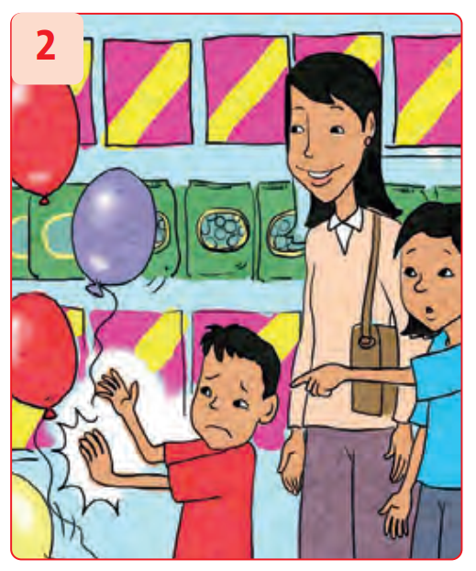
Ask and Answer.
Do they like balloons?
No, they don’t.
Notes:
* Look, ask, and answer.
Show the pattern in the speech bubbles and the first item. Explain that Yum! shows that we like something very much, and Yuck! shows that we really dislike something.
In pairs, children ask and answer about the other pictures.

Slide 18
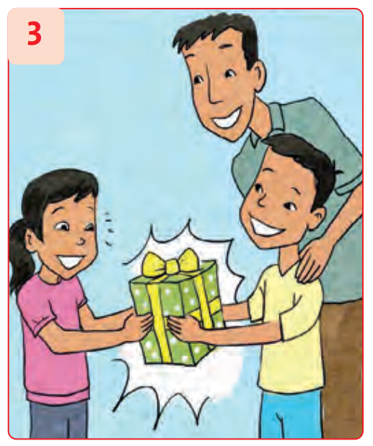
Ask and Answer.
Do they like the present?
Yes, they do.
Notes:
* Look, ask, and answer.
Show the pattern in the speech bubbles and the first item. Explain that Yum! shows that we like something very much, and Yuck! shows that we really dislike something.
In pairs, children ask and answer about the other pictures.

Slide 19
Ask and Answer.
Do they like the birthday cake?
No, they don’t.
Notes:
* Look, ask, and answer.
Show the pattern in the speech bubbles and the first item. Explain that Yum! shows that we like something very much, and Yuck! shows that we really dislike something.
In pairs, children ask and answer about the other pictures.

Slide 20
Listen and Repeat.
What do they like?
They like balloons.
Notes:
Focus on Let’s learn! box. Ask What can you see?
Do a click to play the audio.
Write the question and sentence on the board.

Slide 21
Ask and Answer.
What do they like?
They like candy.
Notes:
* Look, ask, and answer.
Show the pattern in the speech bubbles and the first item. Explain that Yum! shows that we like something very much, and Yuck! shows that we really dislike something.
In pairs, children ask and answer about the other pictures.

Slide 22
Ask and Answer.
What do they like?
They like the present.
Notes:
* Look, ask, and answer.
Show the pattern in the speech bubbles and the first item. Explain that Yum! shows that we like something very much, and Yuck! shows that we really dislike something.
In pairs, children ask and answer about the other pictures.

Slide 23
Good job!

Slide 24

Goin’
Fishin’

Slide 25

Do they like birthday cake?
A. Yes, they do.
B. No, they don’t.

Slide 26


Scoring

Slide 27

Does he like candy?
A. No, he doesn’t.
B. Yes, he does.

Slide 28
Scoring

Slide 29
Does she like balloons?
A. Yes, she does.
B. No, she doesn’t.

Slide 30

Scoring

Slide 31
Do they like presents?
A. No, they don’t.
B. Yes, they do.

Slide 32
Scoring

Slide 33
Congratulations!

Slide 34
Good job!

Slide 35


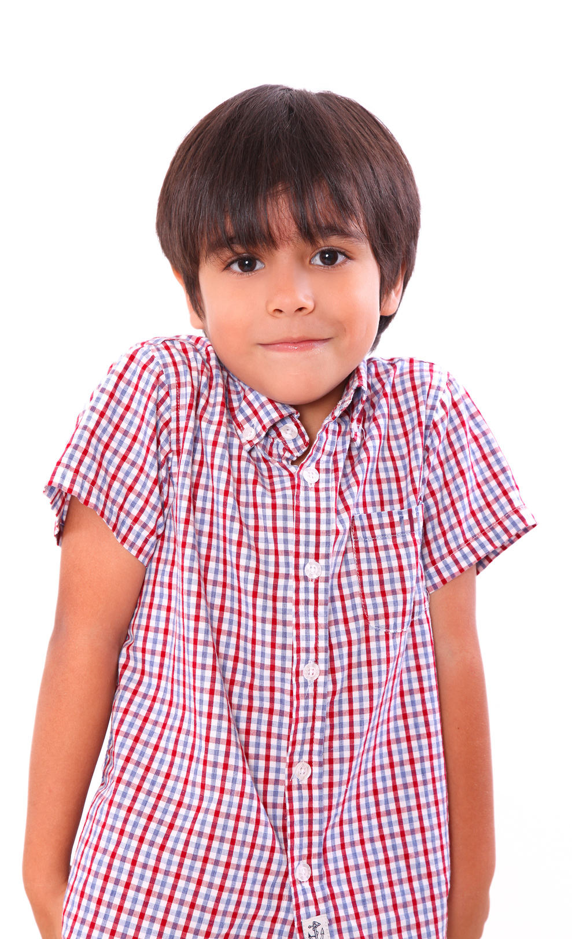
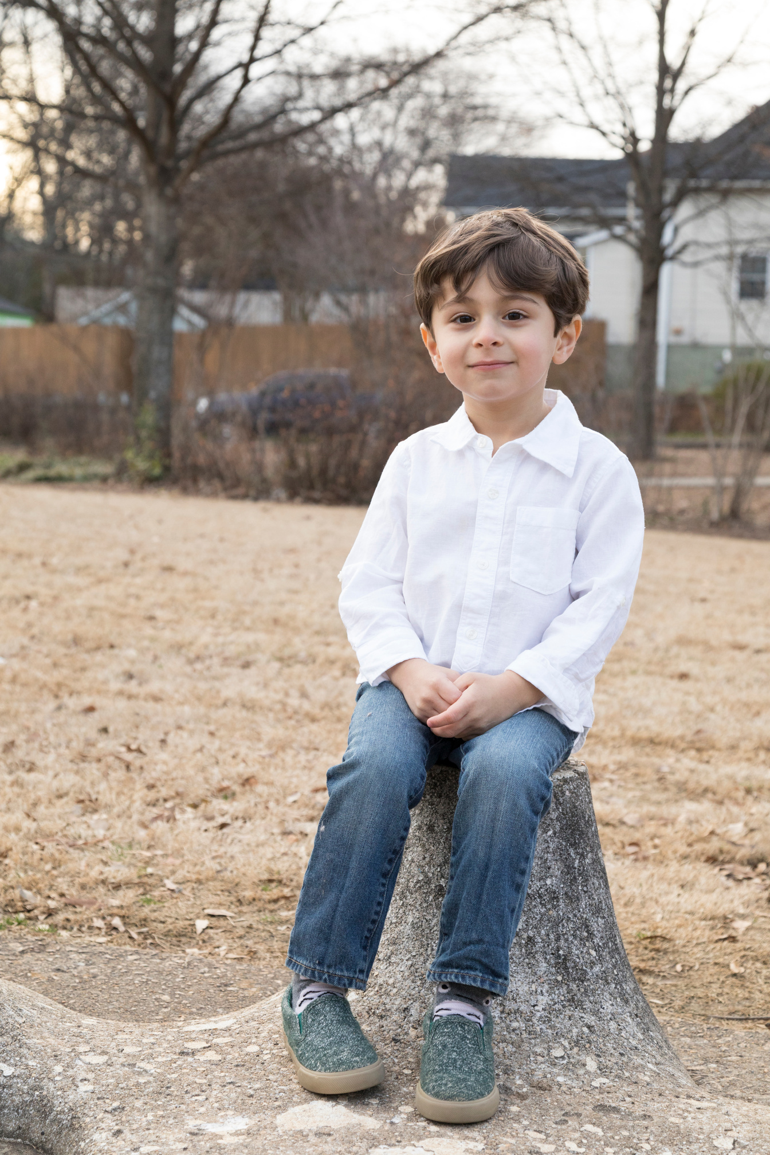
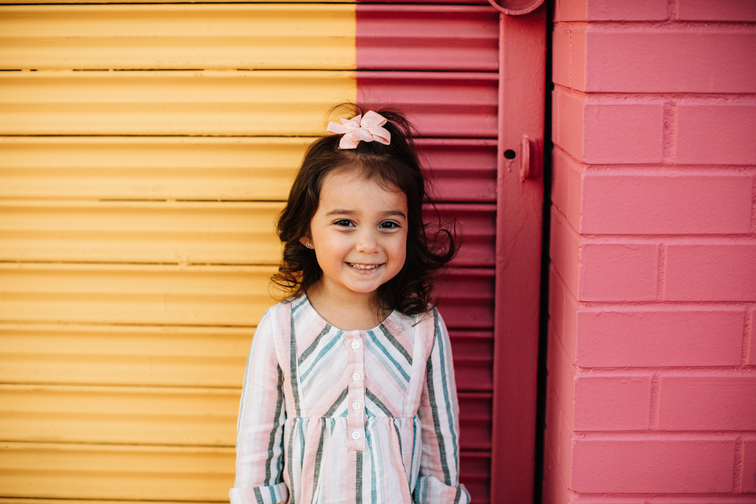
Our Winners!
Peter
Eric
Julie
Notes:
Replace photos and names with your students’ information.

Slide 36


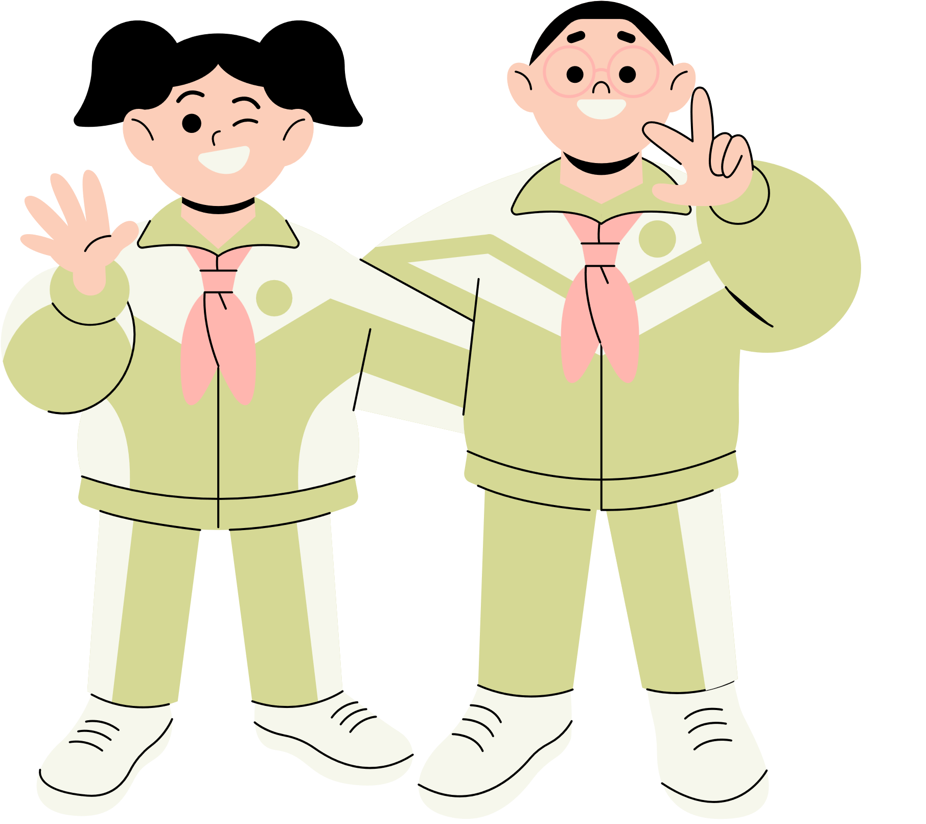





Thank You!
See You Next Time!
Notes:
https://www.youtube.com/watch?v=SRyFiVeNjWs

